Slide 1


Master-Thesis Presentation by Özcan Karaca Testbed-Development for lectureStudio
Testbed-Entwicklung für lectureStudio
Fachgebiet Echtzeitsysteme
Fachbereich Elektrotechnik und
Informationstechnik
Technische Universität Darmstadt
25.03.2024
Testbed-Development for lectureStudio

Slide 2

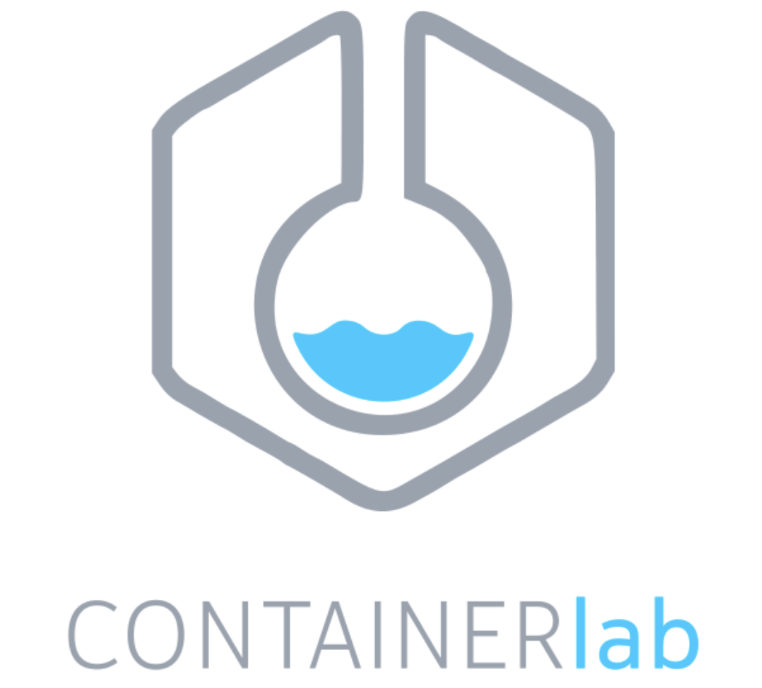



Motivation
Server
Server
P2P Algorithm for lectureStudio
Direct Distribution Among Clients
Reducing the Central Server's Load
Optimizing Bandwidth
Relay-Client
Client
Client
Client
Client
Client
Developing A Container-Based Testbed Environment for P2P Algorithm
Simulation of Real Network Data
Configuration and Validation of the Network Characteristics
Communication and Data Transfer between Nodes
Client
Client
Performance Evaluation of the P2P Algorithm
Analysis of Resource Consumption
Analysis of Total Duration
25.03.2024
Motivation

Slide 3
Task Description
Finding Real Network Data
Maximum Upload Speed, Maximum Download Speed, Latency, and Packet Loss
Simulating Real Network Data Using Normal Distribution
Generating Network Topology
Integrating the P2P Algorithm
Configuring the Components of the P2P Algorithm in the Testbed
Creating a Containerlab File and Configuring Network Management, Nodes and Links
Implementing the Network Characteristics of the Connections
Bandwidth, Latency, and Packet Loss
Validating the Network Characteristics of the Connections
Managing Communication and Data Transfer
Tracking , Validating and Analyzing the Data Transfer Process
Analyzing of Resource Efficiency of the P2P Algorithm Components (lectureStudio server and peers)
Evaluating of the Testbed and the P2P Algorithm Performance
25.03.2024
TASK DESCRiption

Slide 4

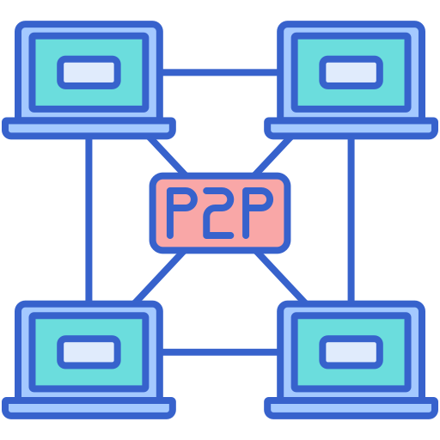
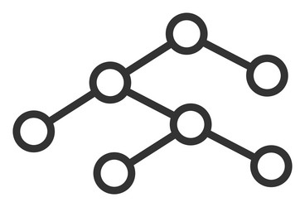



Initial Steps (Not Repeated) of the Testbed
Simulating Real Network Data Using Normal Distribution
Generating Mesh Network Topology
Integrating the P2P Algorithm
Implementing Traditional Server-Client Based Method
Calculating Optimized Network Topology with the P2P Algorithm
Simulating Real Network Data
Mesh Network Topology
4
Optimized Network Topology
1
2
5
3
Network Topology Generator
Integrating the P2P Algorithm
Data Flow between Steps
25.03.2024
INITAL steps (not repeated) of the testbed

Slide 5
Simulating Real Network Data
Analyzing Real Network Dataset
Max Download Speed, Max Upload Speed
Latency
Packet Loss
Reading Real Network Data from CSV File
Generating Network Data Using Normal Distribution
Having Mean and Standard Deviation from UK and Germany Based Data
Name of Configuration | Mean (μ) | Standard Deviation (σ)
First Configuration | From UK-Based Data | From UK-Based Data
Second Configuration | From Ger-Based Data | From UK-Based Data
25.03.2024
Simulating real network data

Slide 6
Network Topology
Generating Network Topology with the Testbed
Listing Nodes with Network Characteristics
Detailing Connections between LectureStudio Server and All Peers
Optimizing Network Topology with the P2P Algorithm
Identifying Super Peers
Optimizing Connections between LectureStudio Server and Peers
Network Topology Generated by the Testbed
Network Topology Optimized by the P2P Algorithm
{
"filename": "test.pdf",
"filesize": 5000,
"peers": [
{
"name": "lectureStudioServer",
"maxDownload": 29150,
"maxUpload": 9209
},
{
"name": "1",
"maxDownload": 1080,
"maxUpload": 373
}
]
}
"connections": [
{
"sourceName": "lectureStudioServer",
"targetName": "1",
"bandwidth": 1080,
"latency": 57,
"loss": 0.0035
},
{
"sourceName": "1",
"targetName": "lectureStudioServer",
"bandwidth": 373,
"latency": 57.15,
"loss": 0.0035
}
]
}
{
"superpeers": [
{
"name": "1"
}
],
"peer2peer": [
{
"sourceName": "lectureStudioServer",
"targetName": "1"
},
{
"sourceName": "1",
"targetName": "2"
}
]
}
25.03.2024
Network Topology

Slide 7
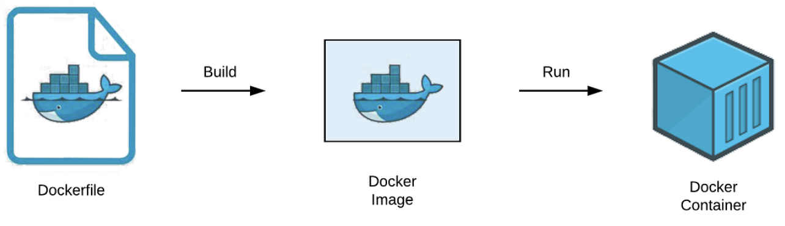
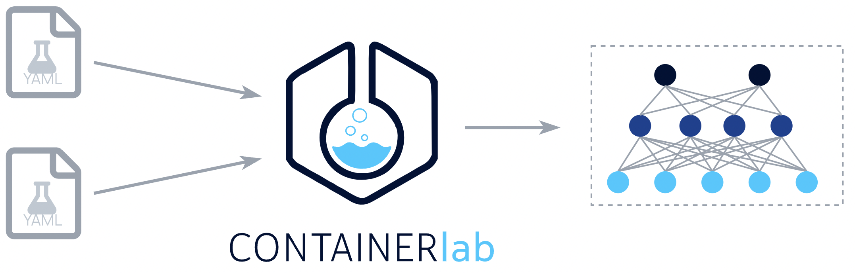

Container—Based Testbed Environment
Docker and Containerlab: Efficient, Isolated Simulation Environment
Creation and Management of User-Defined Network Topologies
Advantages of Using Containerlab for the Testbed
Properties of Containerlab (name, image, kind, env, binds, etc.)
Speed, Ease of Use, Repeatability
Creation of Complex Network Topologies
Configuration of Containerlab File (YAML)
name: testbed
topology:
nodes:
peer1:
kind: linux
Image: image-testbed
peer2:
kind: linux
image: image-testbed
links:
- endpoints: [peer1:eth1, peer2:eth1]
[2]
25.03.2024
Management of Container-Testbed Environment

Slide 8








Execution Steps (Repeated) of the Testbed
Communication and Data Transfer
2
4
3
Verifying the Connection Characteristics
Configurating the Connection Characteristics
1
5
Definition of the Containerlab
1
lectureStudio-server
Checking the PDF File
super-peer
peer
tracker-peer
7
Cleanup and Finalization
6
Tracking the Data Transfer
Data Flow between Steps
Data Flow to Testbed
25.03.2024
Execution Steps (Repeated) of the Testbed

Slide 9
Configuring the Components of the P2P Algorithm
Configuration of Containerlab File (Network Management, Nodes and Links)
Configuration of Nodes
name: testbed
mgmt:
network: fixedips
ipv4-subnet: 172.100.100.0/24
topology:
nodes: …
links:
- endpoints: [lectureStudioserver:eth1, 1:eth1] - endpoints: [lectureStudioserver:eth2, 2:eth1] - endpoints: [lectureStudioserver:eth3, 3:eth1] - endpoints: [lectureStudioserver:eth4, 4:eth1] - endpoints: [lectureStudioserver:eth5, 5:eth1] - endpoints: [lectureStudioserver:eth6, 6:eth1] - endpoints: [5:eth2, 7:eth1] - endpoints: [6:eth2, 8:eth1] - endpoints: [6:eth3, 9:eth1] - endpoints: [6:eth4, 10:eth1]
lectureStudio server
super peer
peer
tracker peer
25.03.2024
Configuring the Testbed Environment

Slide 10
Configuring and Verifying the Network Characteristics
Configurating the Connection Characteristics Using Traffic Control Commands
Bandwidth Limitation
Latency Addition
Packet Loss Simulation
Configuring these Characteristics with Scripts
Properties of Containerlab (exec, binds or cmd)
Verifying the Connection Characteristics
Using Tools like ping, iperf3
Network Emulator
latency
bandwidth
packet loss
eth0
netem
Testbed
Network Interface
25.03.2024
NeTwork topology configuration & verifying

Slide 11
Communication and Data Transfer Processes
Initial Notification by lectureStudio Server
Notification to Tracker Peer
Start of Data Transfer Process
Role of Super Peers
Reception and Forwarding of PDF File
Transition from Receiver to Sender
Confirmation Messages
From Peers and Super Peers
Connection and Communication Strategy
25.03.2024
Communication and Data transfer Processes

Slide 12
Connection Strategy Among Peers
Add Node Info in Testbed Setup
Port Number
IP Address
Use Netty Framework for Server
Handshaking
Authenticating Peers
Establishing Connections
Preparing the Network for Data Transfer
Transfer in Segments
Monitor Process and Performance
Communication via IP Address and Port
lectureStudio server
Port:7070
IP:172.20.21.2
IP:172.20.22.2
eth2
eth1
super peer
Port:9090
IP:172.20.23.2
IP:172.20.24.2
eth1
eth1
IP:172.20.22.3
eth2
eth3
peer
eth1
eth1
IP:172.20.23.3
IP:172.20.24.3
peer
peer
25.03.2024
Connection and data distribution among peers

Slide 13
Validating and Tracking of the Data Transfer
Integrity Checks of PDFs with Hash Value Calculation
Comparison of Hash Values in all Docker Containers
Methods to Inspect Data in Containers
Direct Container Access or Docker Command Feature for Data Movement and Control
Role of the Tracker Peer in Monitoring Data Transfer
Confirmation Message System
Initial Confirmation from the LectureStudio Server
Peer or Super Peer Confirmation Upon Data Receipt
Calculation of Data Transfer Duration
Counting Received Confirmations
Total Duration Calculation from First to Last Acknowledgment
25.03.2024
Validating and Tracking of the Data Transfer

Slide 14
Evaluation Research Questions
Testbed
RQ1.1 How Accurately Does the Testbed Measure the Configured Bandwidth, Latency and Packet Loss?
RQ1.2 How Well Does the Testbed Scale with More Nodes and Complex Topologies Affects The Host in Terms of Resource Utilization?
P2P Algorithm
RQ2.1 How Do CPU and Memory Usage Change of the Participants in Tests with and without the P2P Algorithm?
RQ2.2 How Does the P2P Algorithm React to Changing Network Characteristics (Bandwidth, Latency, Packet Loss)?
RQ2.3 Overall, is the P2P Algorithm Efficient for Data Transfer? How Does the Total Duration Obtained with the P2P Algorithm Respond to the Changing Number of Peers and Data Size?
25.03.2024
Evaluation Research Questions

Slide 15
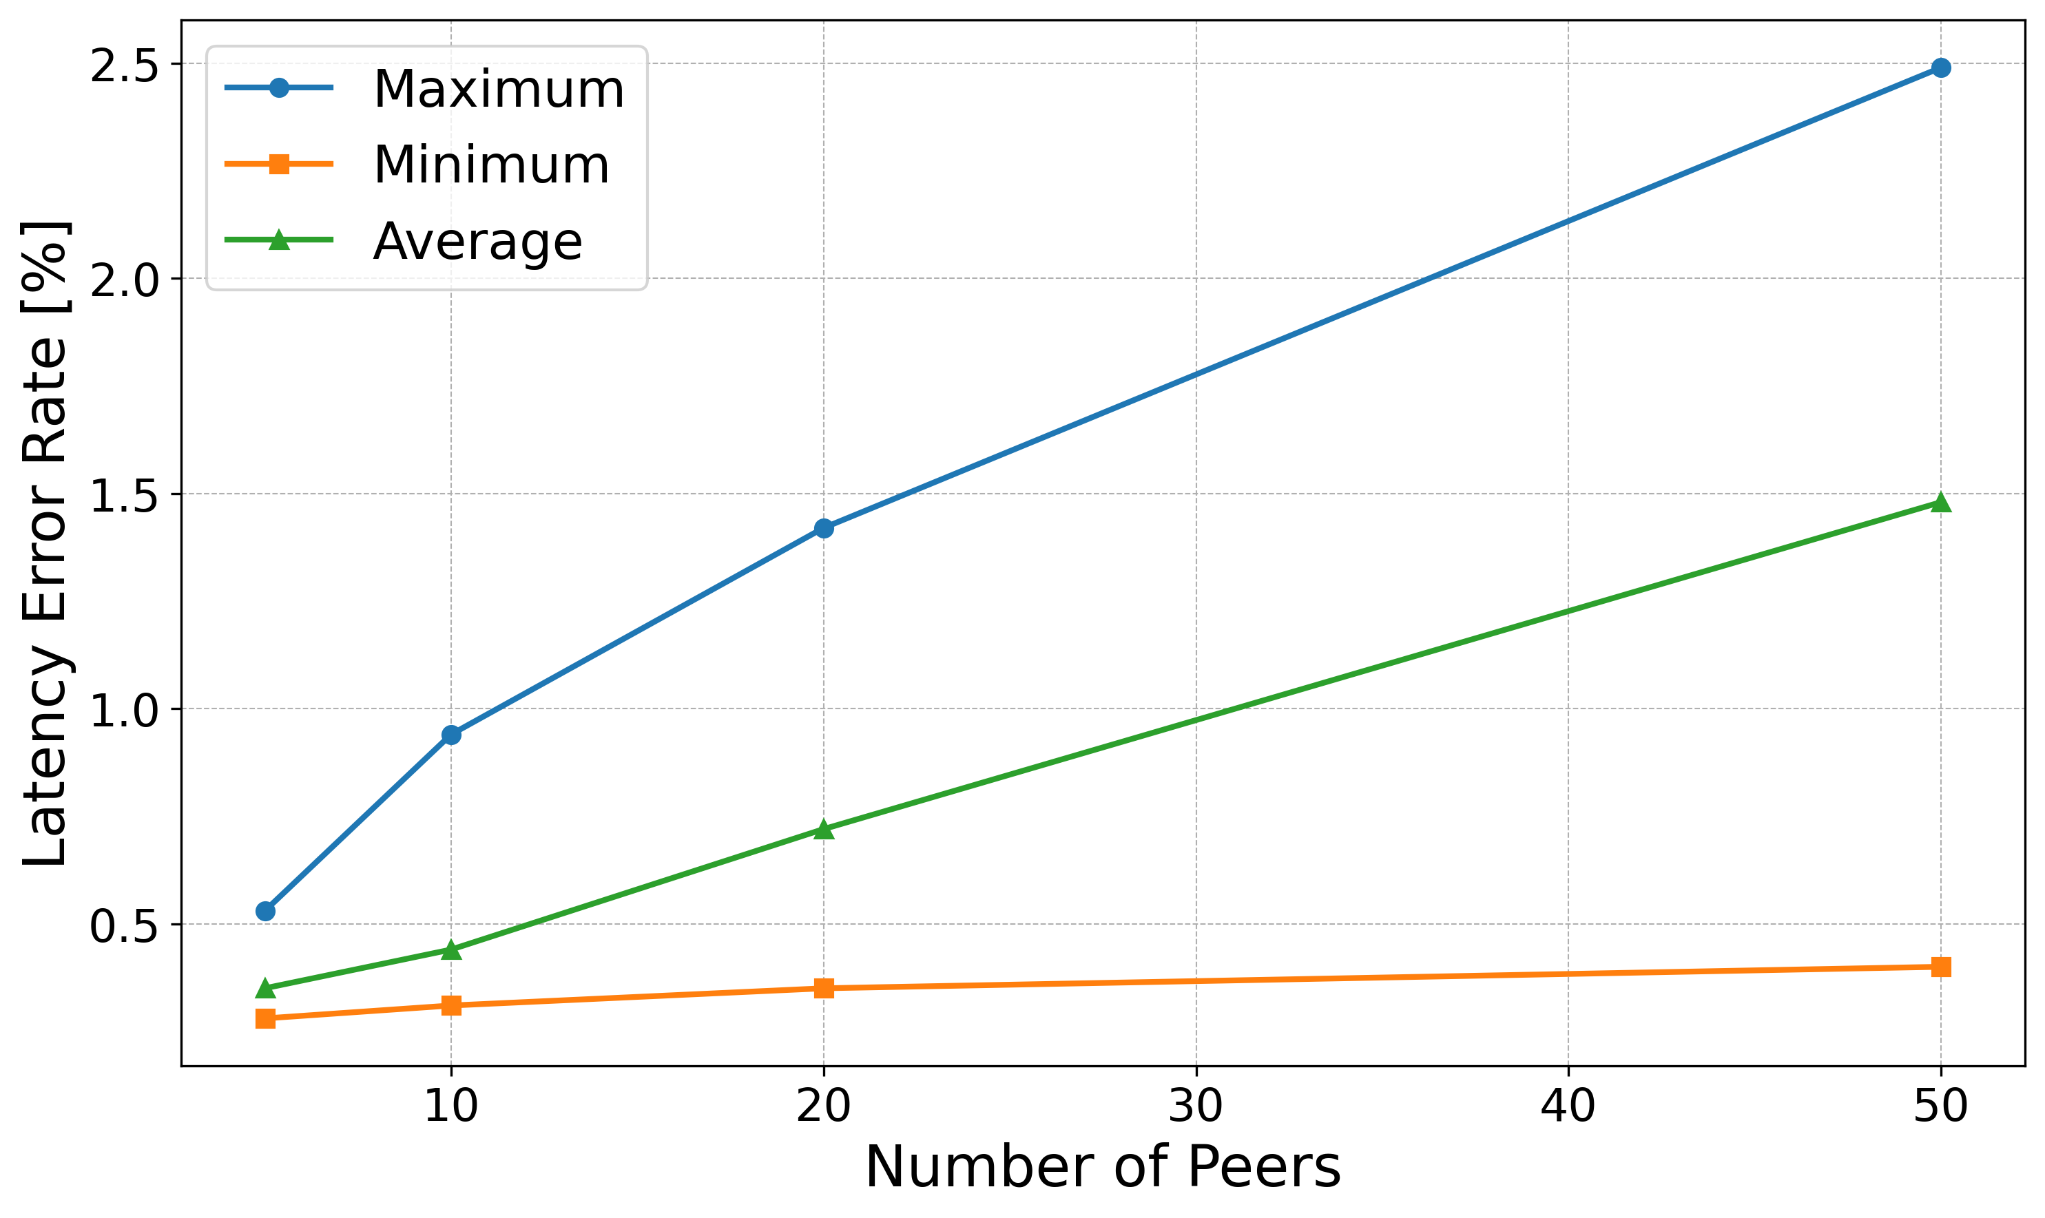
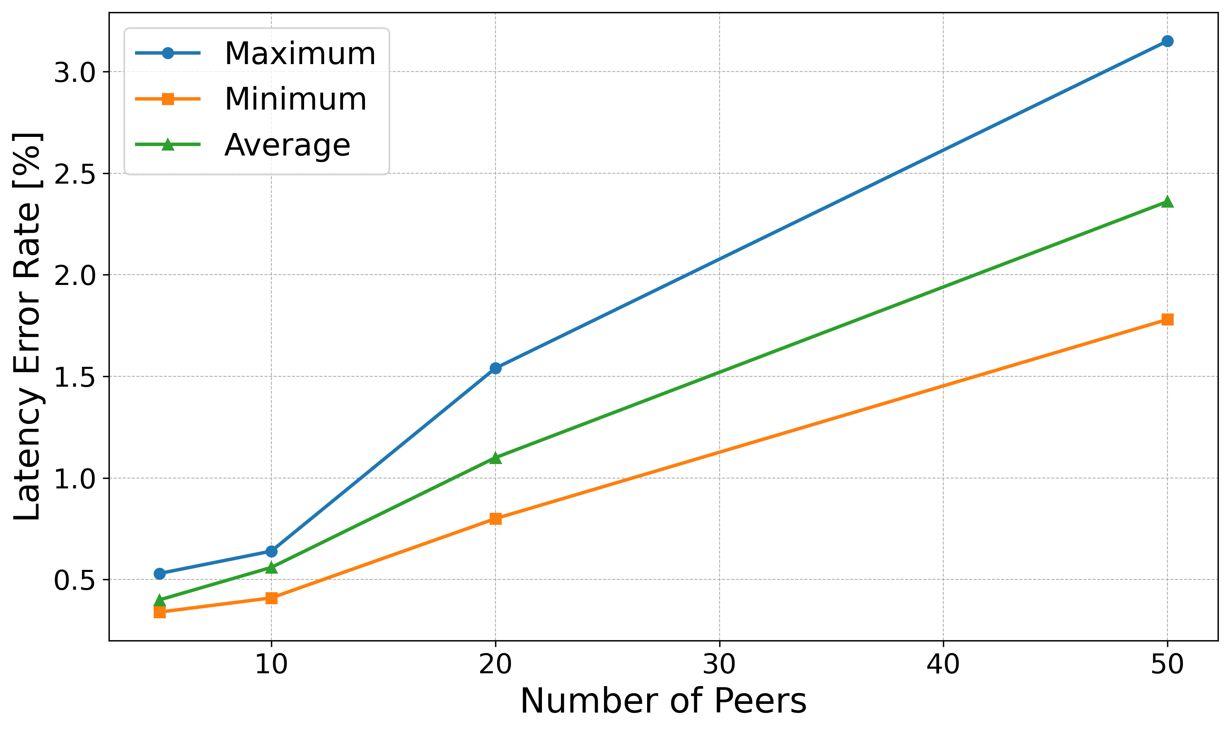
Accuracy of the Testbed, RQ1.1 (1)
Discrepancy between Desired and Measured Values
More Nodes Decrease Bandwidth Allocation Per Connection
A Reduction in Bandwidth Corresponds to a Rise in Latency.
High CPU and memory usage impacting network performance and Latency
Error Rate for Latency with P2P Algorithm
Error Rate for Latency without P2P Algorithm
25.03.2024
ACCUracy of the testbed, rq1.2

Slide 16
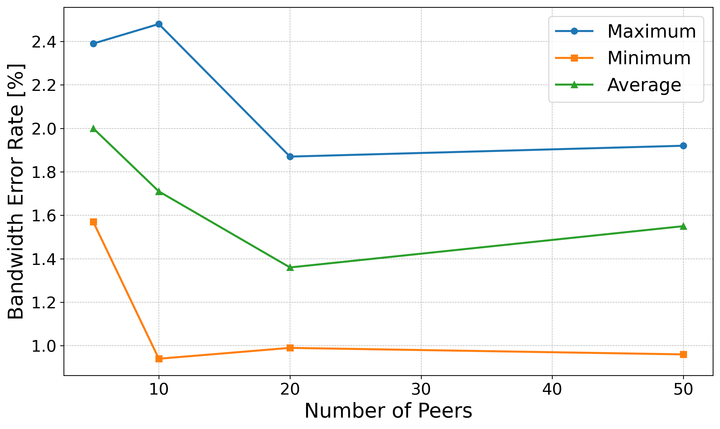
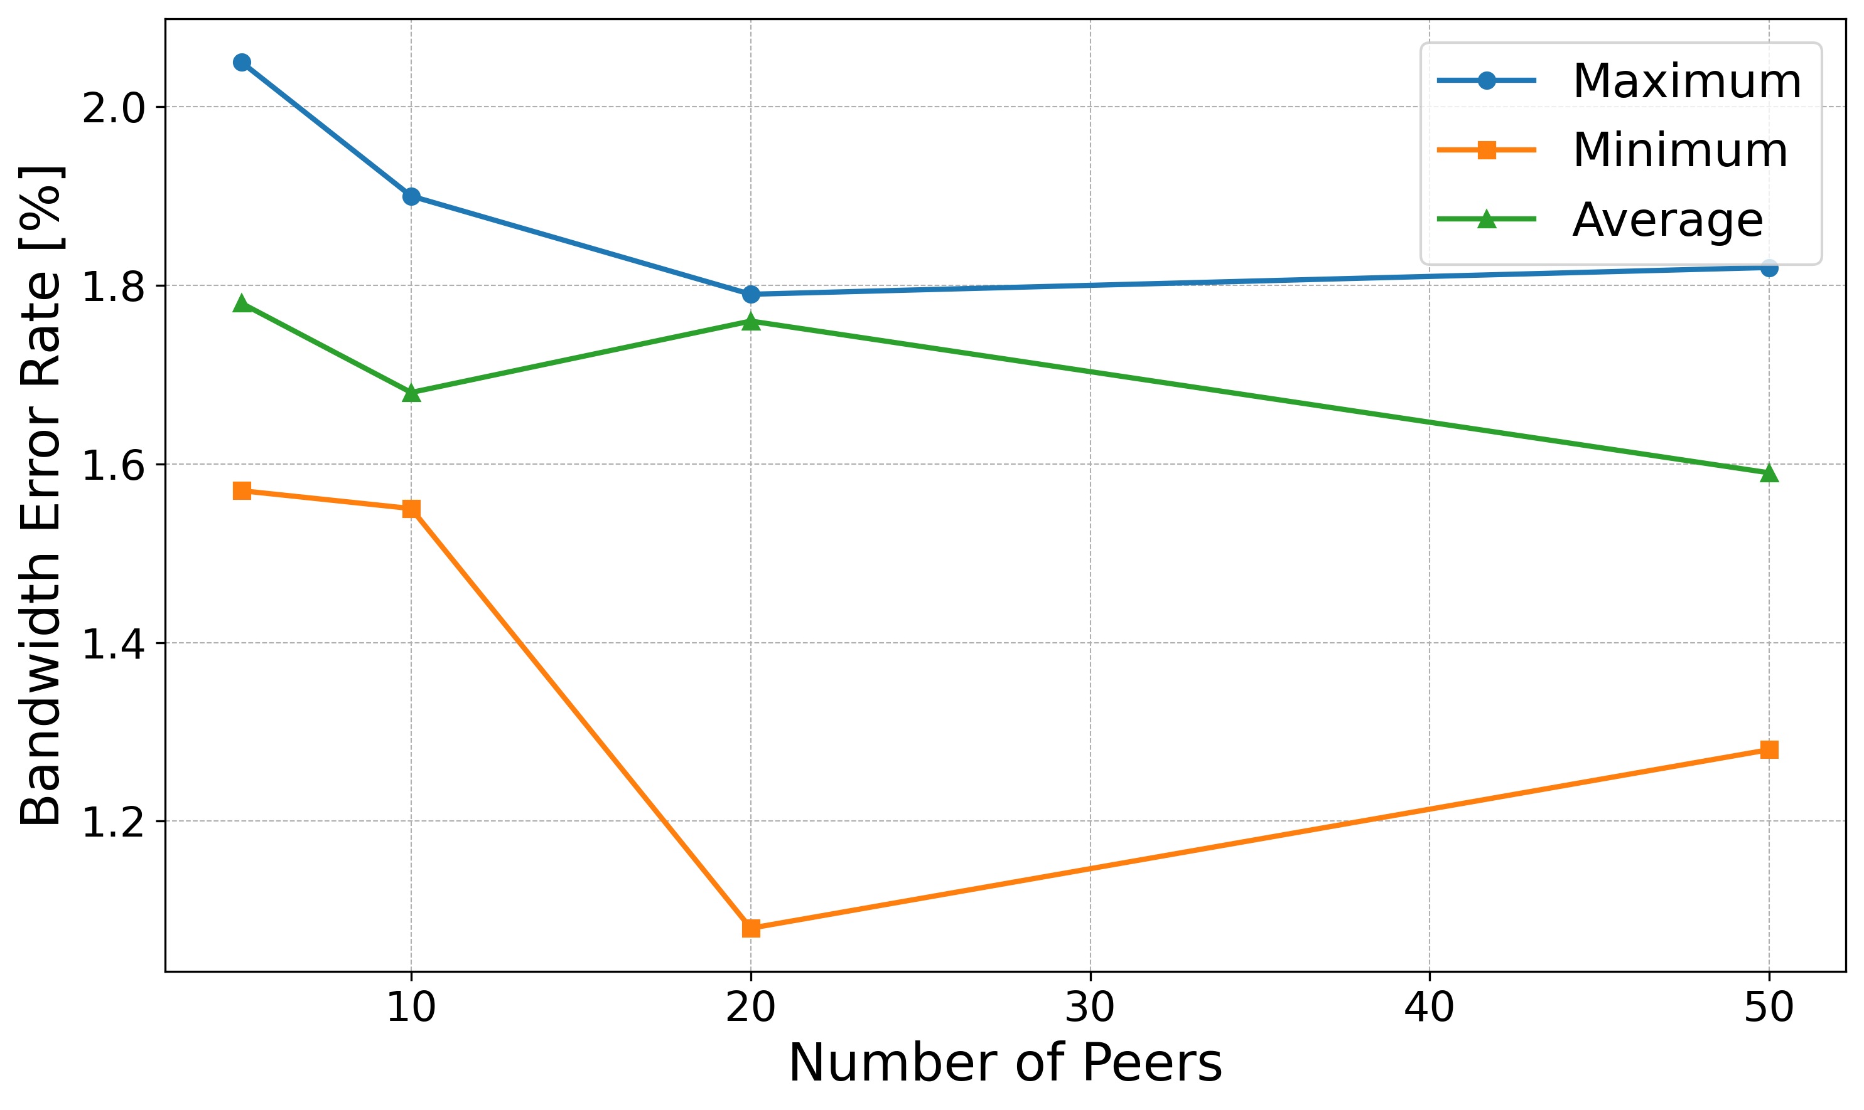
Accuracy of the Testbed, RQ1.1 (2)
Accuracy of Measuring Tools
Iperf Accuracy Results Variation from Actual Performance
Variables Like Network Conditions, Configuration, System overhead
Error Rate for Bandwidth with P2P Algorithm
Error Rate for Bandwidth without P2P Algorithm
25.03.2024
ACCUracy of the testbed, rq1.1

Slide 17
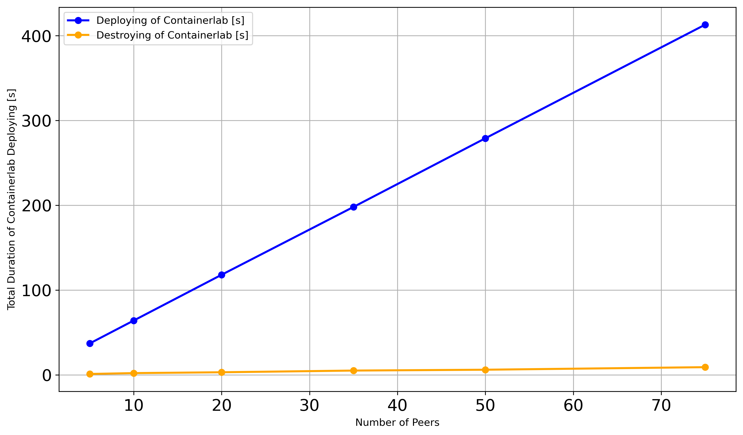
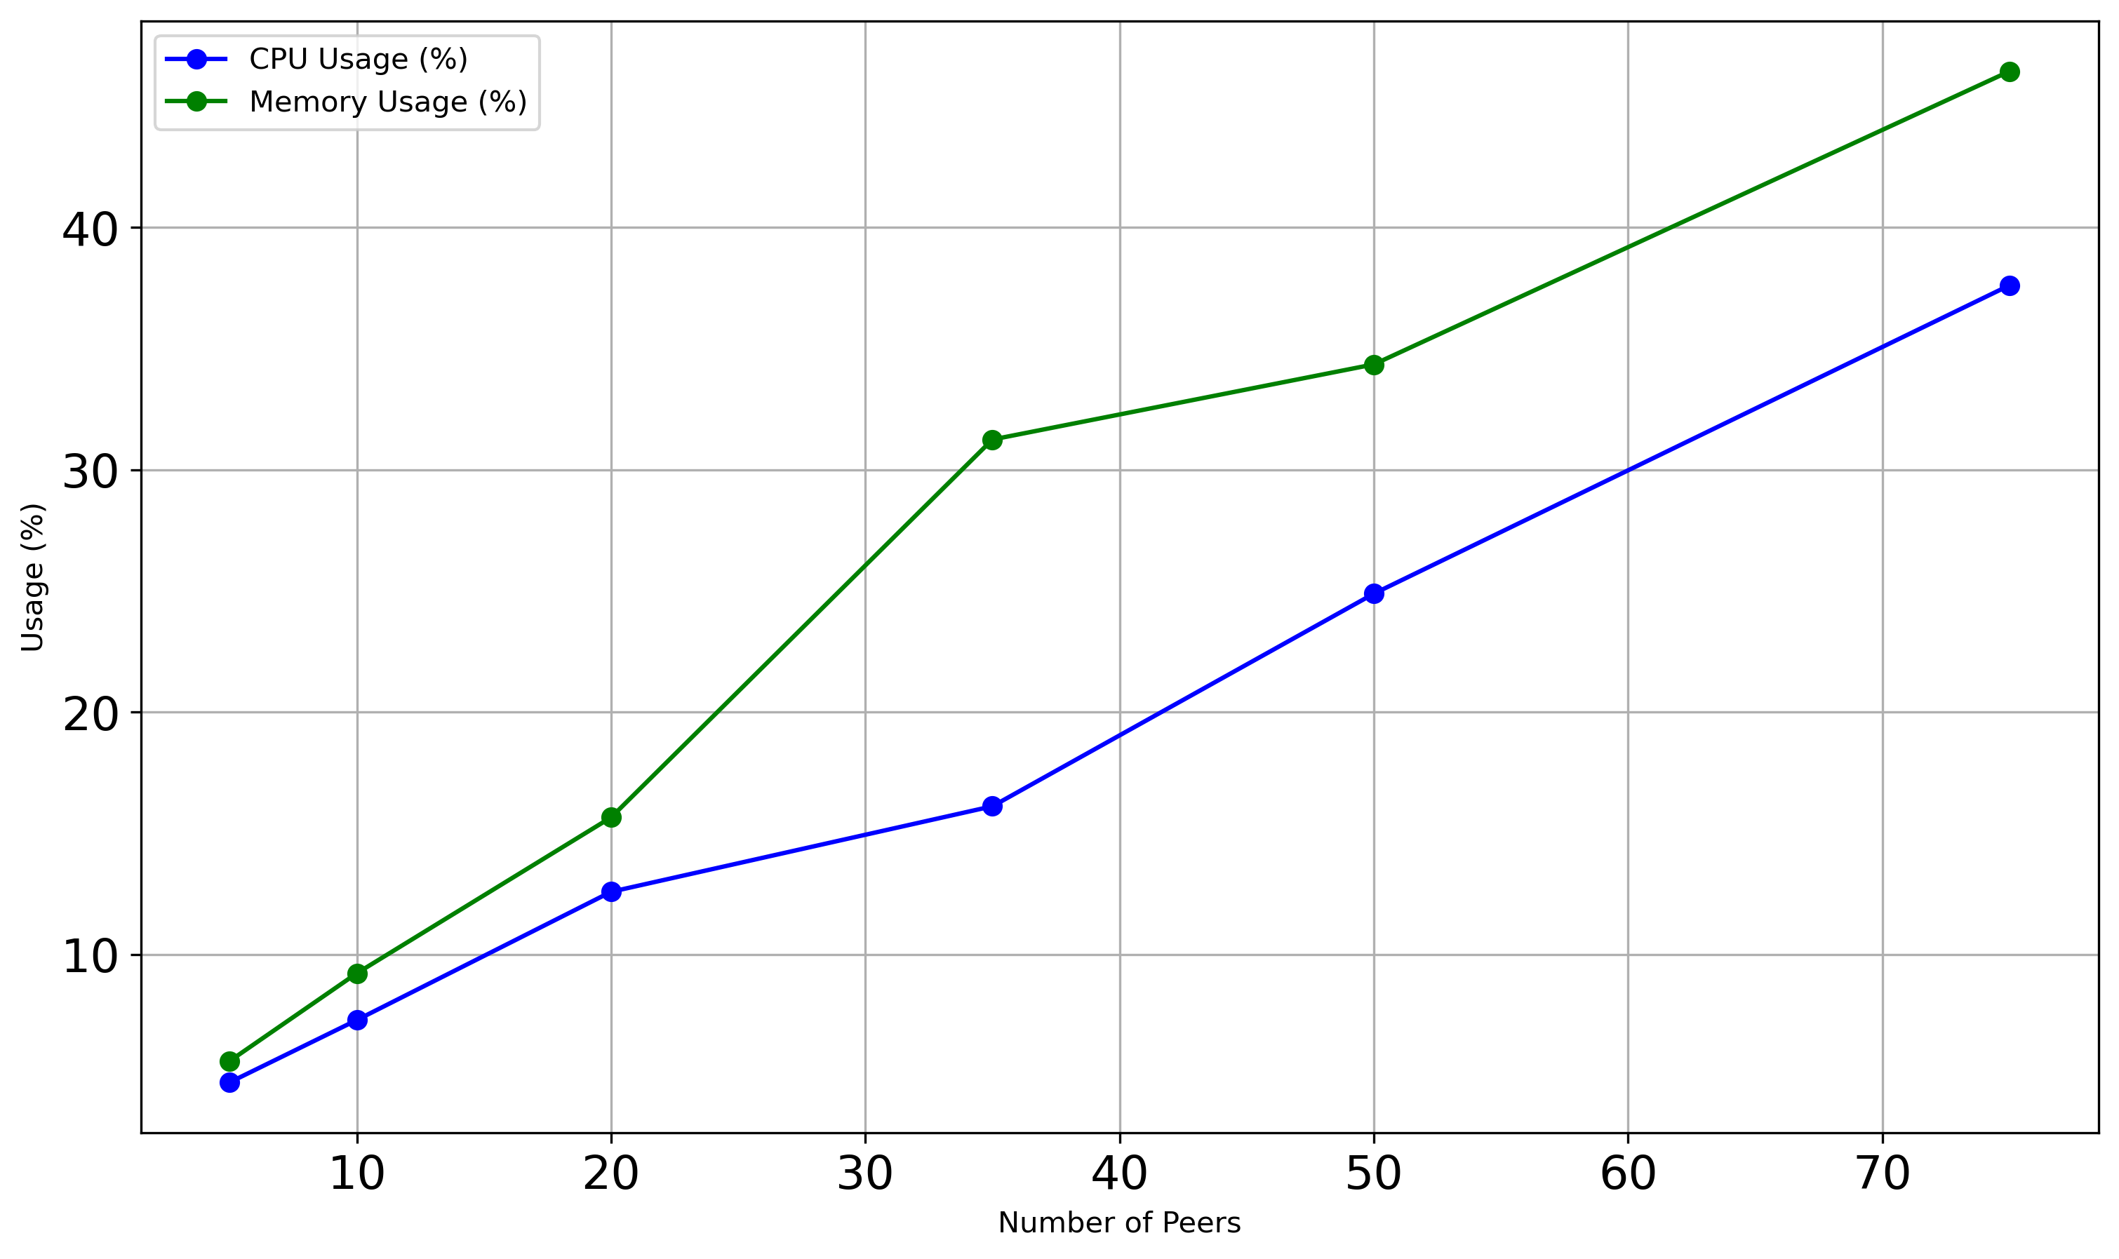
Testbed Scaling and Resource Utilization, RQ1.2
Scaling Peers with Containerlab for Simplified Topology Deployment
Deployment Time Increase of 5.37s per Additional Node
Destroying Process Time Low, Approximately 9 Seconds for 75 Nodes
Duration of Deploying and Destroying of Containerlab
CPU and Memory Usage of the Host
CPU and Memory Usage Rise with More Peers Indicating Increased Host Load
CPU Utilization Increase Linearly Showing Scalable Performance
Memory Usage Growth Suggests Potential Bottleneck with More Peers
25.03.2024
Testbed scaling and resource utilization, rq1.2

Slide 18
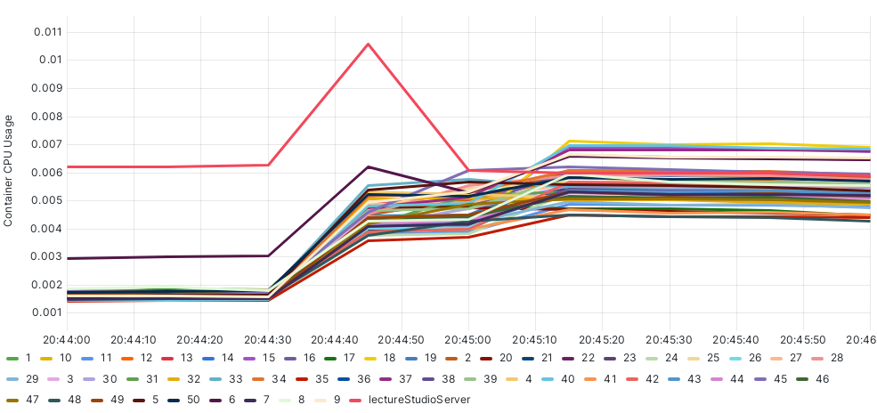
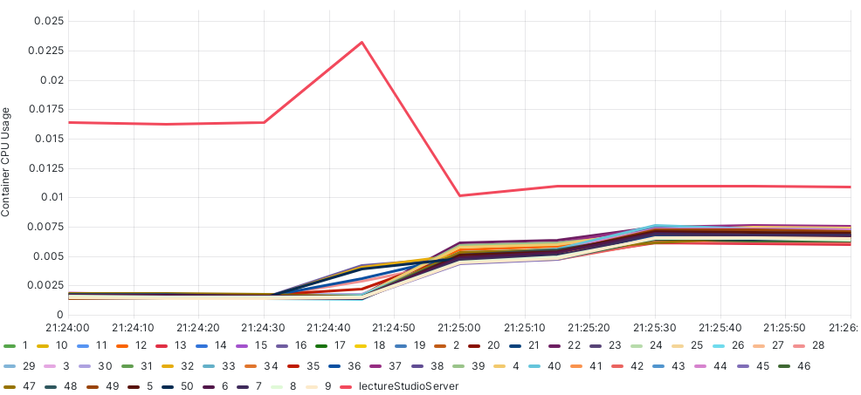
CPU and Memory Usage Analysis of Nodes, RQ2.1 (1)
Analysis of Resource Consumption of P2P Algorithm Components Including CPU, Memory for LectureStudio Server and Peers
High Initial CPU Usage on LectureStudio Server at Data Transfer Start
Peak CPU Usage Reduction of 52% by P2P Algorithm
Load Distribution Leading to Decreased CPU Usage
CPU Usage with P2P Algorithm
CPU Usage without P2P Algorithm
25.03.2024
Evaluation Setup

Slide 19
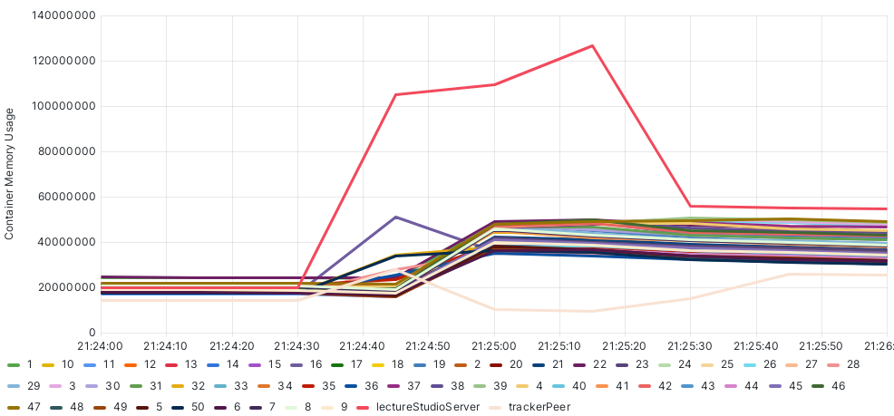
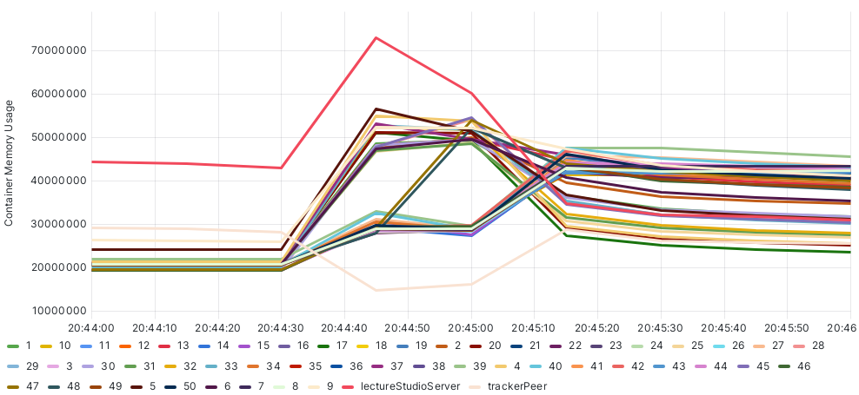
CPU and Memory Usage Analysis of Nodes, RQ2.1 (2)
Memory Usage Reduction of 41% by P2P Algorithm
Significant Resource Savings Due to P2P Utilization
Task Distribution to Super Peers Lowers Server's Memory Requirement
Memory Usage with P2P Algorithm
Memory Usage without P2P Algorithm
25.03.2024
Evaluation Setup

Slide 20
Performance Evaluation of P2P Algorithm, RQ2.2 and RQ2.3 (1)
Test Duration Measured from First to Last Acknowledgment Message
Over 1000 Tests Conducted
Varying Data Size or Number of Peers
First Configuration Simulates Real Network Data for Performance Analysis
Minimal Performance Difference between P2P and Server-Client Models Observed
Second Configuration Employs Varied Mean Values for Data Simulation
P2P Algorithm Improved Efficiency with Increased Peers and Data Size
Small File Sizes Not Significantly Benefited by P2P Optimization
Larger File Transfers Show P2P Algorithm Efficiency
Different Average Speeds for Upload and Download in Configurations Affect Performance
Higher Average Speeds in Second Configuration Enhance Network Efficiency, Reduce Bottlenecks
P2P Algorithm Effectively Identifies and Utilizes Super Peers with Higher Capacity
25.03.2024
CHALLENGES

Slide 21
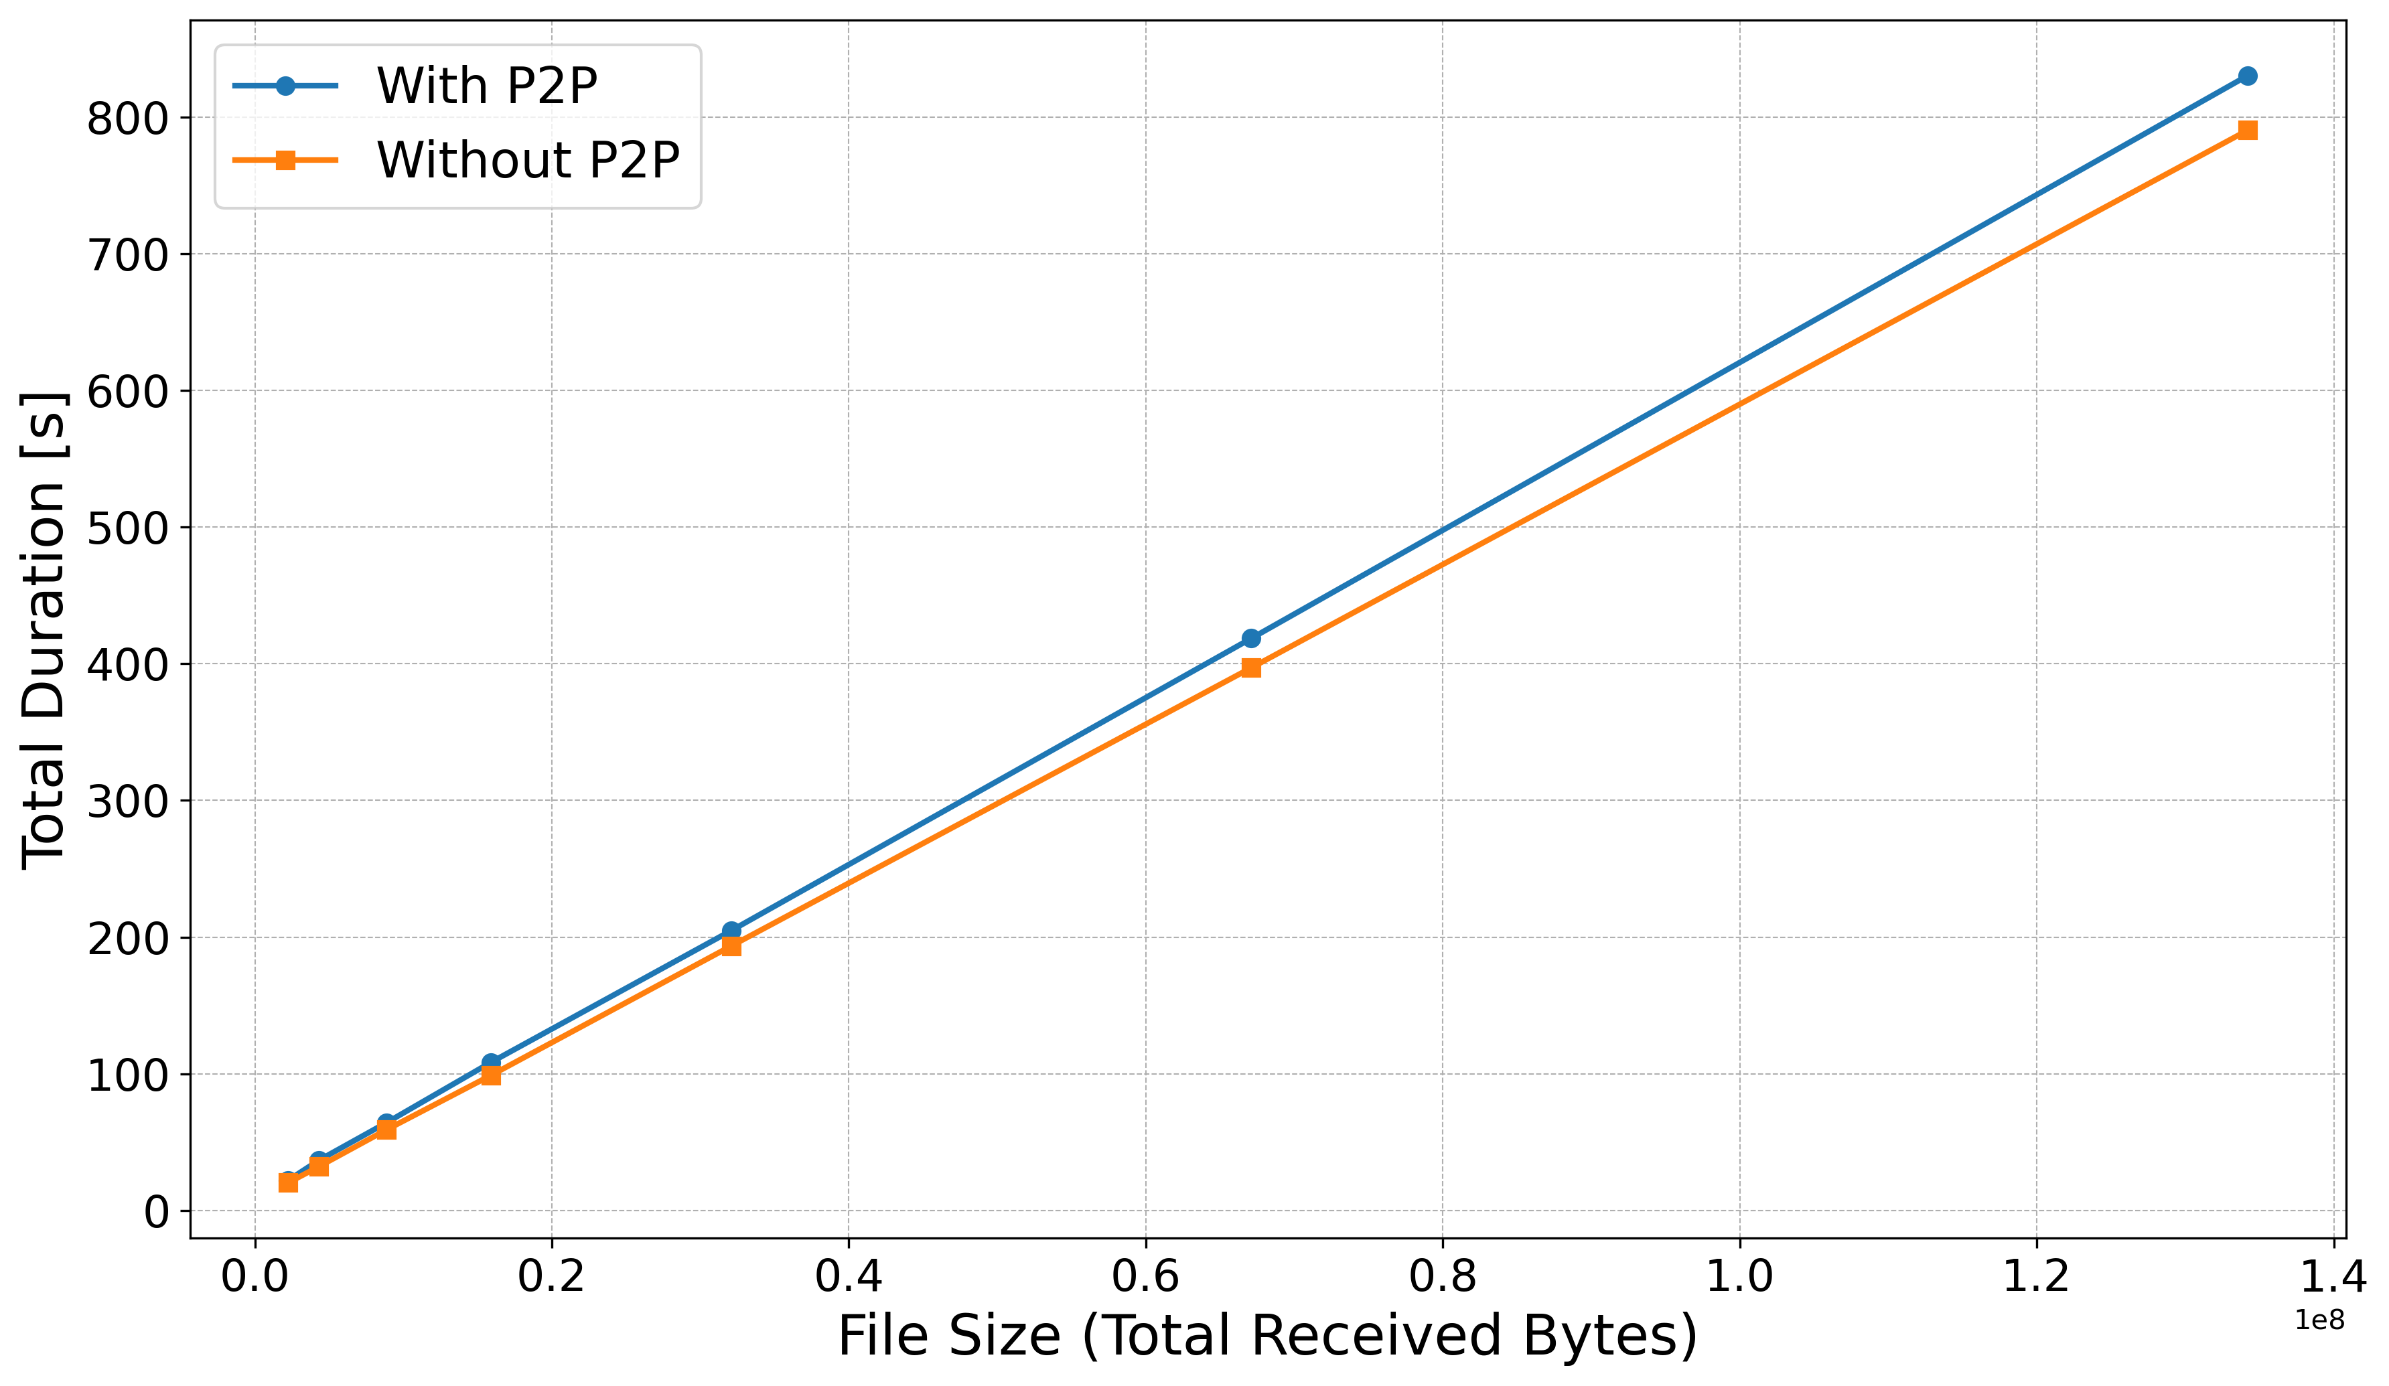
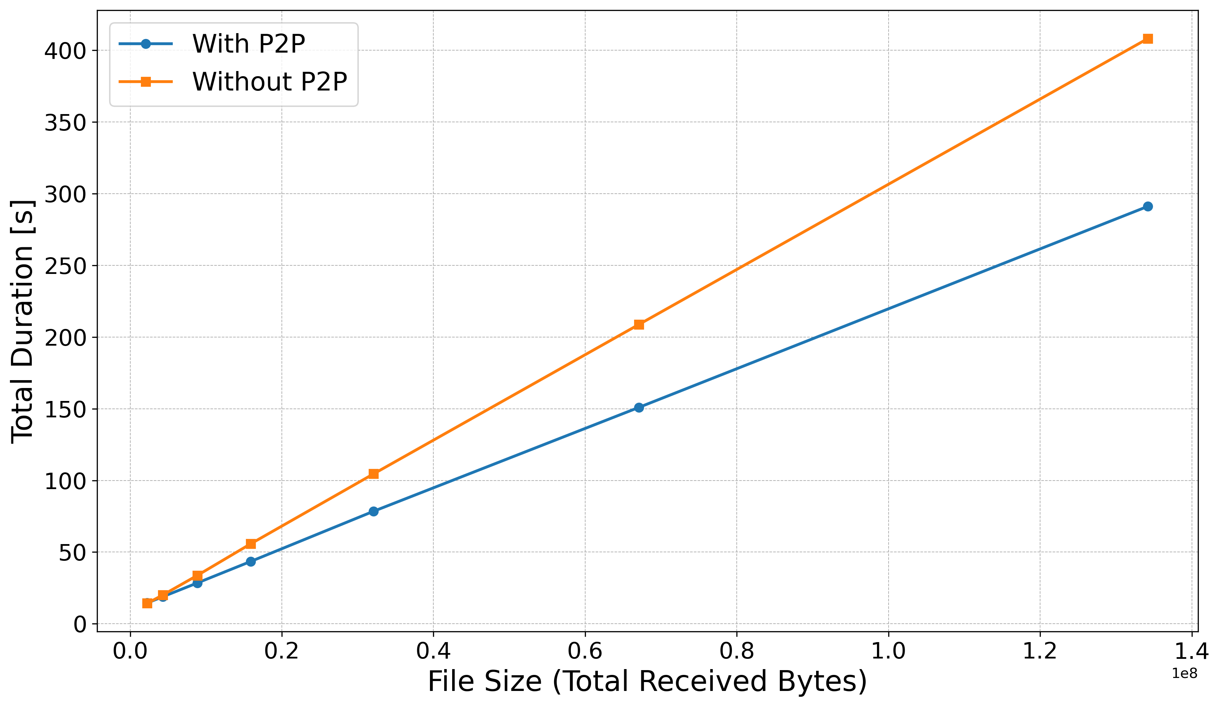
Performance Evaluation of P2P Algorithm, RQ2.2 and RQ2.3 (2)
First Configuration with lectureStudio Server and 20 Peers
P2P Algorithm Performance Little Worse to Traditional Approach
Second Configuration with lectureStudio Server and 20 Peers
Transferring 2MB Data Size, P2P Algorithm Performance Nearly Identical to Traditional Approach
Transferring 128MB Data Size, P2P Algorithm Performance 27% Faster than Traditional Approach
Time of Whole Data Transfer with the First Configuration
Time of Whole Data Transfer with the Second Configuration
25.03.2024
CHALLENGES

Slide 22
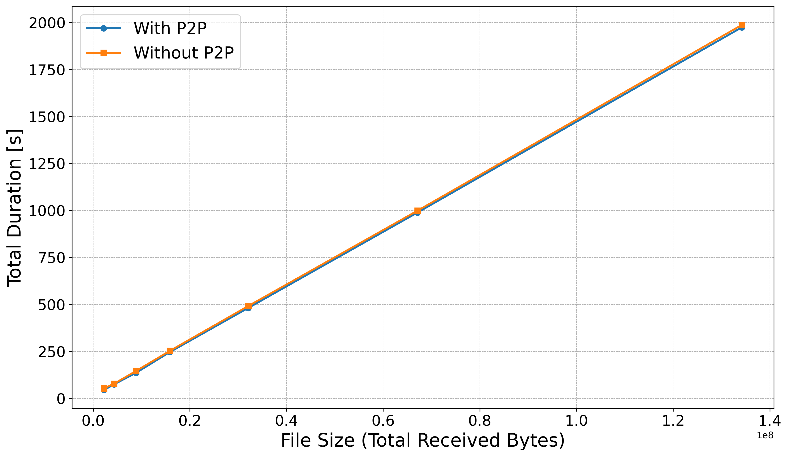
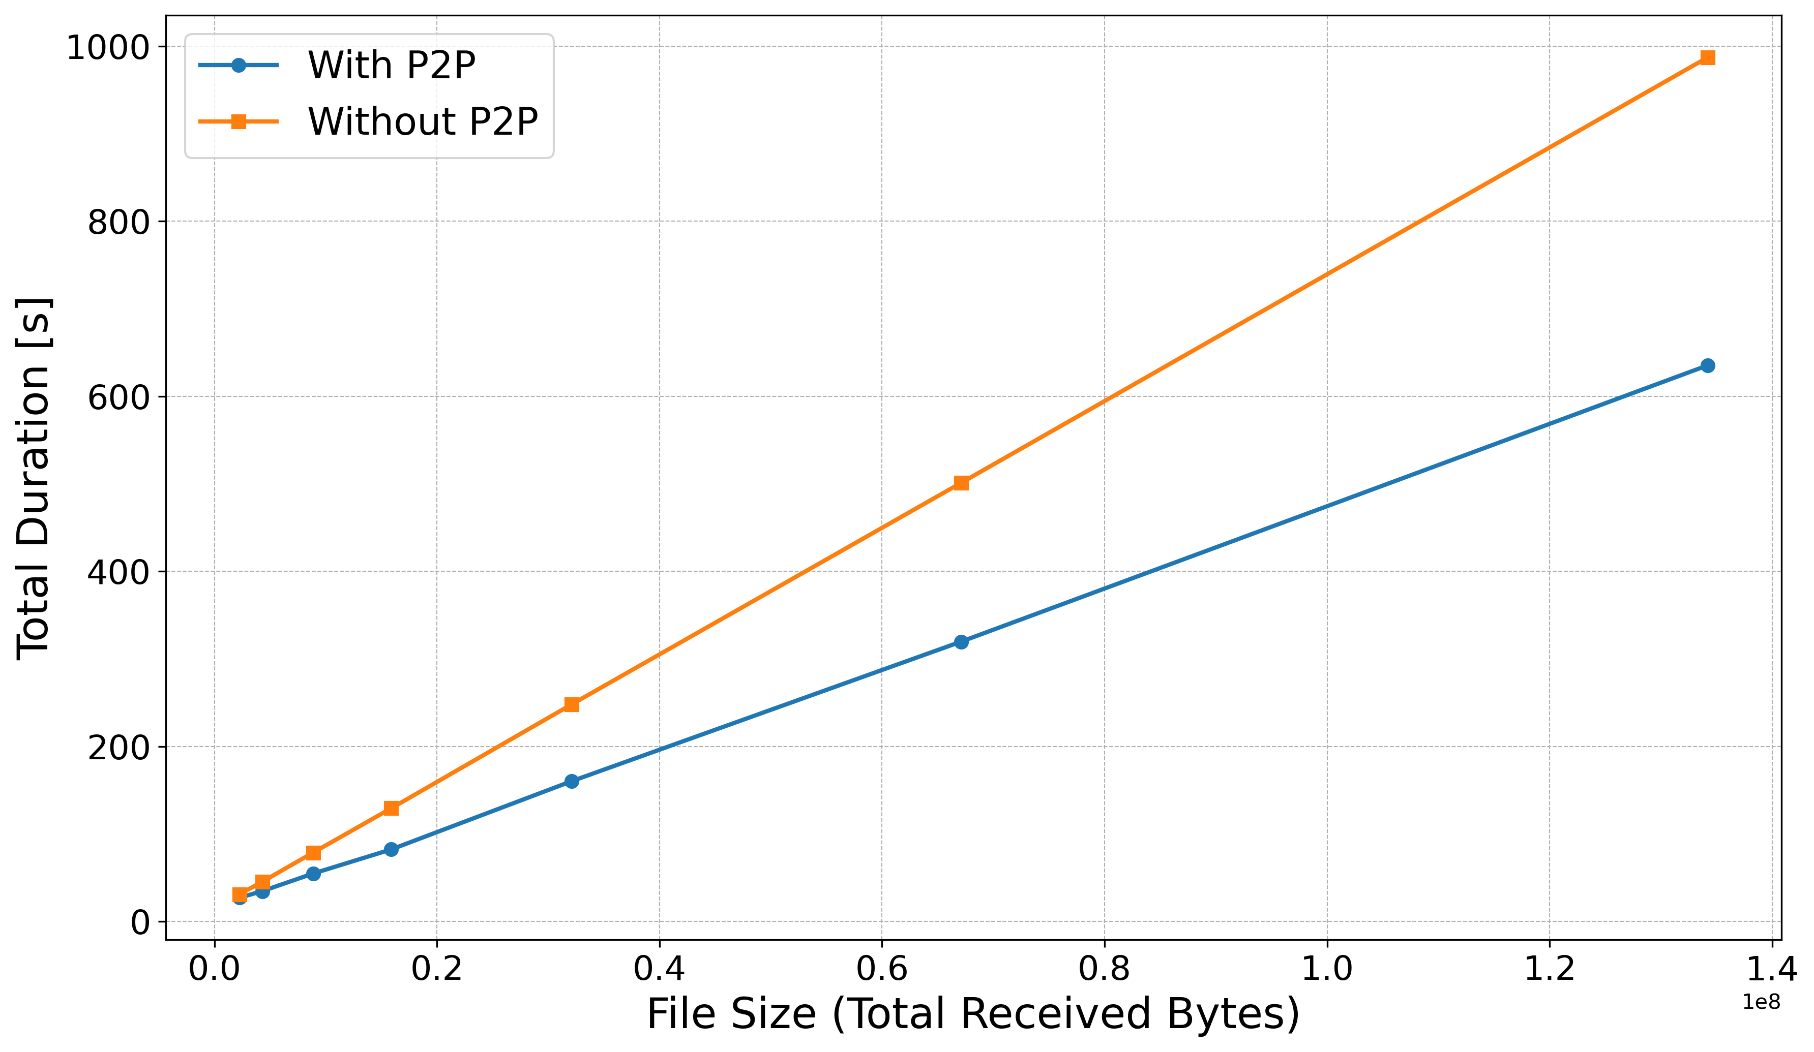
Performance Evaluation of P2P Algorithm, RQ2.2 and RQ2.3 (3)
First Configuration with lectureStudio Server and 50 Peers
Transferring 2MB Data Size, P2P Algorithm Performance Nearly Identical to Traditional Approach
Transferring 128MB Data Size, P2P Algorithm Performance 5% Faster than Traditional Approach
Second Configuration with lectureStudio Server and 50 Peers
Transferring 2MB Data Size, P2P Algorithm Performance 12% Faster than Traditional Approach
Transferring 128MB Data Size, P2P Algorithm Performance 35% Faster than Traditional Approach
Time of Whole Data Transfer with the First Configuration
Time of Whole Data Transfer with the Second Configuration
25.03.2024
CHALLENGES

Slide 23
Challenges
Finding real network dataset
Configuration of the Network Characteristics for Connections
Bandwidth Limitation
Latency Addition
Packet Loss Simulation
Synchronisation Problem of Total Time
Allocation of Bandwidth for the Connections between LectureStudio Server and Peers
Measurement of the Network Characteristics for Connections
Data Transmission between LectureStudio Server and Peers
Monitoring by Grafana, Prometheus and cAdvisor
25.03.2024
CHALLENGES

Slide 24
Conclusion and Future Work
Goal: Develop a Testbed for P2P Data Distribution Algorithm
Utilization of Docker and Containerlab for An Efficient, Isolated Testing Environment.
Simulation of Real Network Environments and Complex Network Topologies
High Replication Accuracy of Bandwidth and Latency
Effective Scalability with Increasing Nodes
High resource demand without P2P Algorithm; significant reduction with P2P Algorithm
Effective Data Distribution and Reduced Server Load through P2P Algorithm
Limited P2P Benefits for Small Files and Efficiency Improvements in Different Configurations
Robustness of P2P Algorithm with Increased Peers and Data Size
Enhancement of Packet Loss Simulation for Accurate Network Behavior
Automation Between Testbed and P2P Algorithm Optimization
Development of A Graphical Testbed interface for Easier Configuration and Real-Time Analysis
25.03.2024
CHALLENGES

Slide 25
Thank you for your attention!
Any questions?
25.03.2024
questions

Slide 26
References
[1] https://www.data.gov.uk/dataset/dfe843da-06ca-4680-9ba0-fbb27319e402/uk-fixed-line-broadband-performance
[2] https://containerlab.dev/manual/topo-def-file/
25.03.2024
References

