Slide 1


Master-Thesis Presentation by Özcan Karaca Testbed-Development for lectureStudio
Testbed-Entwicklung für lectureStudio
Fachgebiet Echtzeitsysteme
Fachbereich Elektrotechnik und
Informationstechnik
Technische Universität Darmstadt
25.03.2024
Testbed-Development for lectureStudio

Slide 2







Motivation
The lectureStudio tool
Reduced bandwidth requirements
Transmitting essential information only during lecture
Server
Server
A P2P algorithm for lectureStudio
Direct distribution among clients
Reducing the central server's load
Optimizing bandwidth
Relay-Client
Client
Client
Client
Client
Client
Client
Client
Developing a container-based testbed environment for the P2P algorithm
Performance evaluation of the P2P algorithm
25.03.2024
MOTIVATION

Slide 3



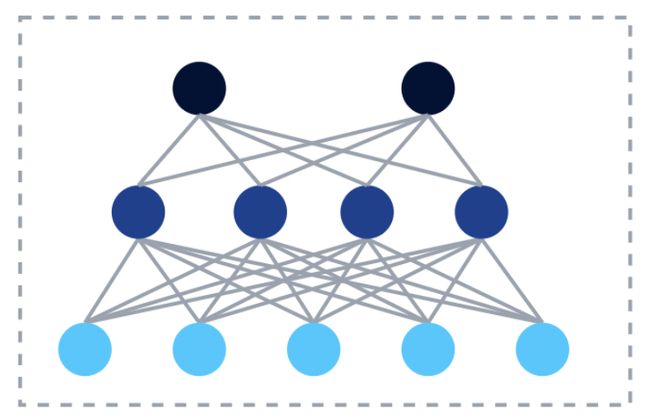




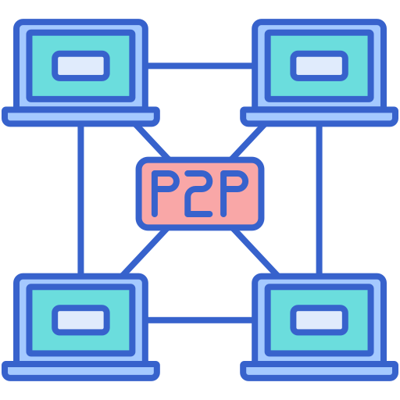

Overall Idea of the Testbed
Preparing Network Data and Topology for the Participants (lectureStudio server and peers)
Calculating the Result Topology by the P2P Algorithm
Deploying and Simulating the Network Topology for Data Transfer in the Testbed
A
C
B
25.03.2024
OVERALL IDEA OF THE TESTBED

Slide 4

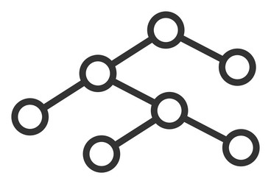

Initial Steps (Not Repeated) of the Testbed
Generating real network data using normal distribution
Creating mesh network topology by the testbed
Integrating the P2P algorithm
Calculating optimized network topology by the P2P algorithm
Implementing the traditional server-client based approach
Generating Real Network Data
Mesh Network Topology
Optimized Network Topology
Network Topology Generator
Integrating the P2P Algorithm
Data Flow between Steps
25.03.2024
INITIAL STEPS (NOT REPEATED) OF THE TESTBED

Slide 5
Generating Real Network Data
Analyzing real network dataset
Max download speed, max upload speed
Latency
Packet loss
Reading real network data from CSV file
Generating network data using normal distribution
Having mean and standard deviation from UK and DE-based data
Name of Configuration | Mean (μ) | Standard Deviation (σ)
First Configuration | From UK-Based Data | From UK-Based Data
Second Configuration | From DE-Based Data | From UK-Based Data
[1], [2]
25.03.2024
GENERATING REAL NETWORK DATA

Slide 6



Execution Steps (Repeated) of the Testbed
Communication and Data Transfer
2
4
3
Verifying the Connection Characteristics
Configurating the Connection Characteristics
1
5
Definition of the Containerlab
1
lectureStudio-server
Checking the PDF File
super-peer
peer
tracker-peer
6
Tracking the Data Transfer
Data Flow between Steps
Data Flow to Testbed
25.03.2024
EXECUTION STEPS (REPEATED) OF THE TESTBED

Slide 7
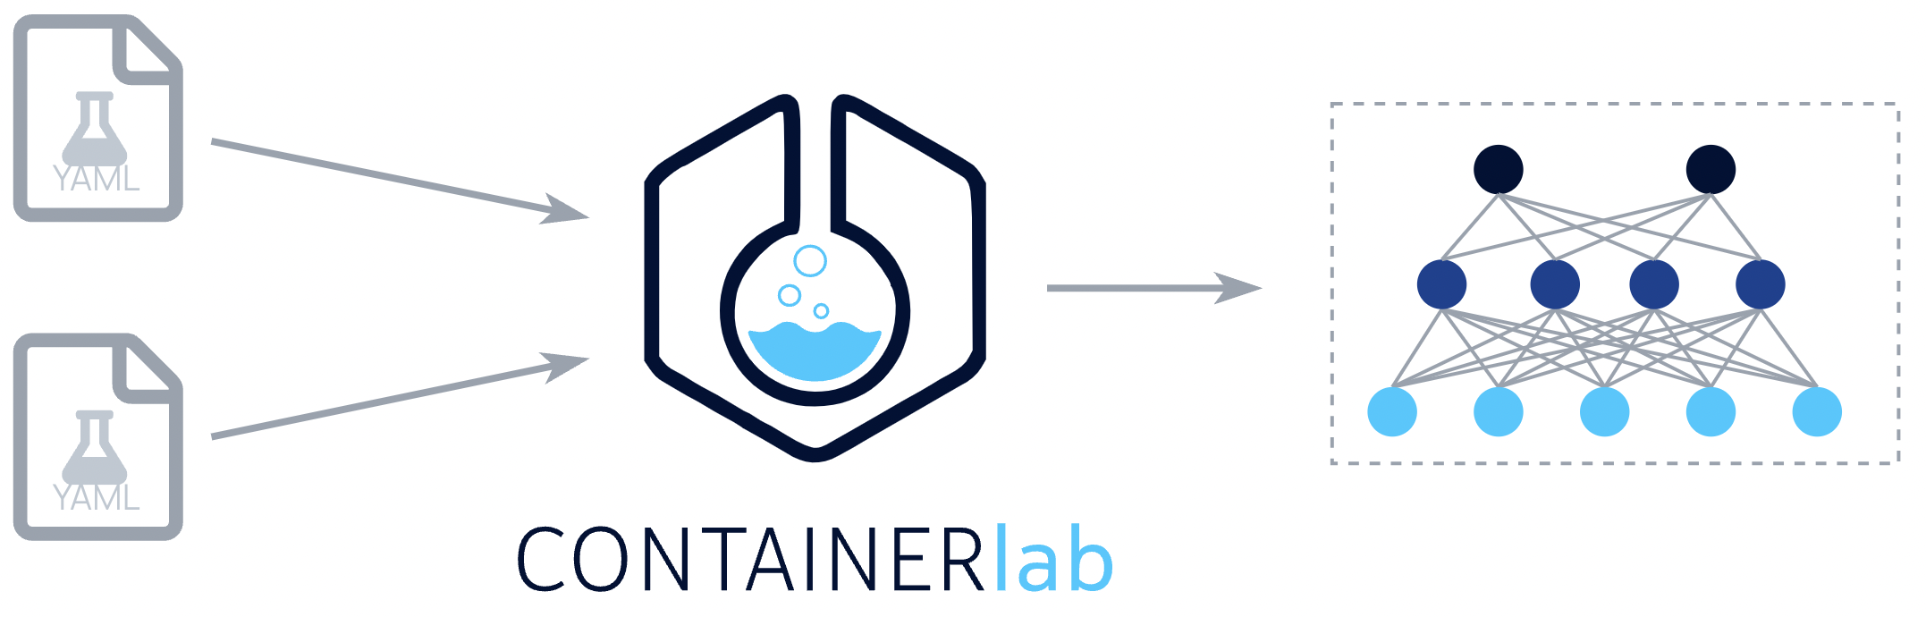
Container-Based Testbed Environment
Docker and Containerlab: efficient, isolated simulation environment
Creation and management of user-defined network topologies
Advantages of using Containerlab for the testbed
Properties of Containerlab
name, image, kind, env, binds, etc.
Speed, ease of use, repeatability
Creation of complex network topologies
Configuration of Containerlab File (YAML)
name: testbed
topology:
nodes:
peer1:
kind: linux
image: image-testbed
peer2:
kind: linux
image: image-testbed
links:
- endpoints: [peer1:eth1, peer2:eth1]
[3]
25.03.2024
CONTAINER-BASED TESTBED ENVIRONMENT

Slide 8
Configuring the Components of the P2P Algorithm
1
In each test, Containerlab file and all other processes automatically in the testbed
Configuration of Containerlab File
(Network Management, Nodes and Links)
name: testbed
mgmt:
network: fixedips
ipv4-subnet: 172.100.100.0/24
topology:
nodes: …
links:
- endpoints: [lectureStudioserver:eth1, 1:eth1] - endpoints: [lectureStudioserver:eth2, 2:eth1] - endpoints: [lectureStudioserver:eth3, 3:eth1] - endpoints: [lectureStudioserver:eth4, 4:eth1] - endpoints: [lectureStudioserver:eth5, 5:eth1] - endpoints: [lectureStudioserver:eth6, 6:eth1] - endpoints: [5:eth2, 7:eth1] - endpoints: [6:eth2, 8:eth1] - endpoints: [6:eth3, 9:eth1] - endpoints: [6:eth4, 10:eth1]
Configuration of Nodes
lectureStudio server
super peer
peer
tracker peer
25.03.2024
CONFIGURING THE COMPONENTS OF THE P2P ALGORITHM

Slide 9
Configuring and Verifying the Network Characteristics
2
3
Configuring the connection characteristics using traffic control commands
Bandwidth limitation
Latency addition
Packet loss simulation
Configuring these characteristics with scripts
Properties of Containerlab (exec, binds, or cmd)
Verifying the connection characteristics
Using tools like ping, iperf3
Network Emulator
latency
bandwidth
packet loss
eth0
netem
Testbed
Network Interface
25.03.2024
CONFIGURING AND VERIFYING THE NETWORK CHARACTERISTICS

Slide 10
Communication and Data Transfer Processes
4
5
6
Initial notification by the lectureStudio server
Notification to tracker peer
Start of data transfer process
Role of super peers
Reception and forwarding of PDF file
Transition from receiver to sender
Confirmation messages
From peers and super peers
Calculation of data transfer duration by tracker peer
Counting received confirmations
Total duration calculation
Integrity checks of PDFs with hash value calculation
Connection and Communication Strategy
25.03.2024
COMMUNICATION AND DATA TRANSFER PROCESSES

Slide 11
Establishing P2P Connections
Addition node infos in the testbed setup
Port number
IP address
Using Netty framework for server
Handshaking
Authenticating peers
Establishing connections
Preparing the network for data transfer
Monitoring process and performance
Communication via IP Address and Port
lectureStudio server
Port:7070
IP:172.20.21.2
IP:172.20.22.2
eth2
eth1
super peer
Port:9090
IP:172.20.23.2
IP:172.20.24.2
eth1
eth1
IP:172.20.22.3
eth2
eth3
peer
eth1
eth1
IP:172.20.23.3
IP:172.20.24.3
peer
peer
25.03.2024
ESTABLISHING P2P CONNECTIONS

Slide 12
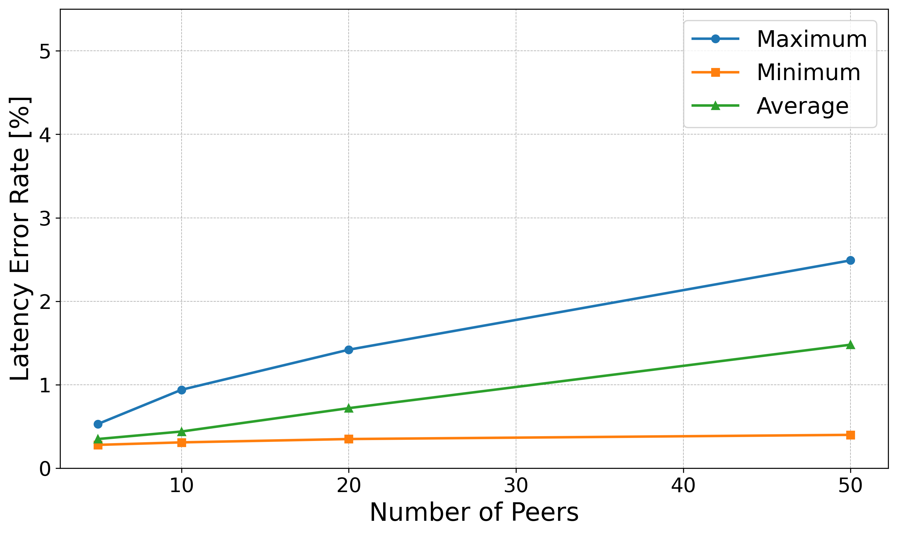
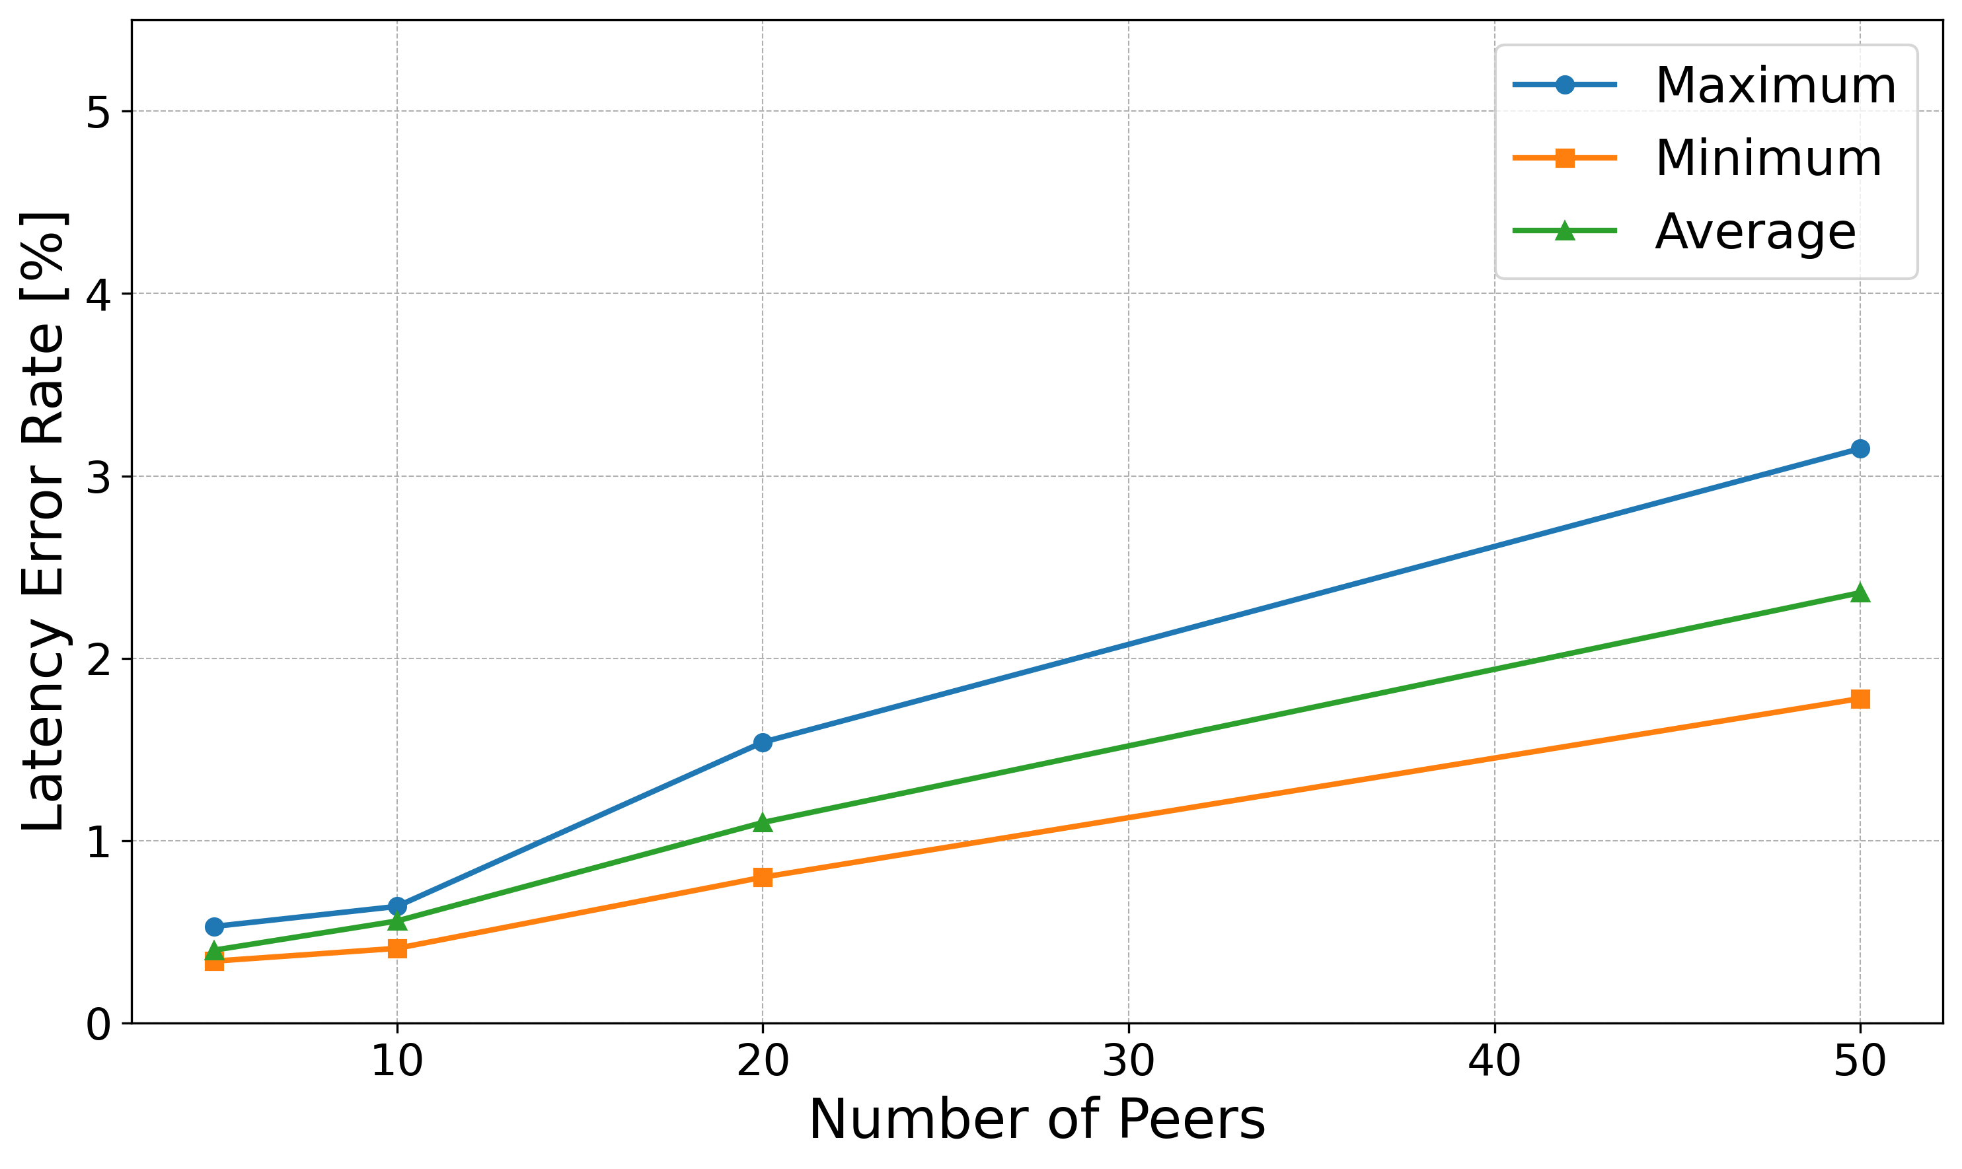
Accuracy of the Testbed, RQ1.1 (1)
RQ1.1 How well does the testbed simulate the configured bandwidth, latency, and packet loss?
Discrepancy between configured and measured values
More nodes result in reduced bandwidth allocation, leading to increased latency
High CPU and memory usage, affecting network performance and latency
Error Rate for Latency with the P2P Algorithm
Error Rate for Latency without the P2P Algorithm
25.03.2024
ACCURACY OF THE TESTBED, RQ1.1 (1)

Slide 13
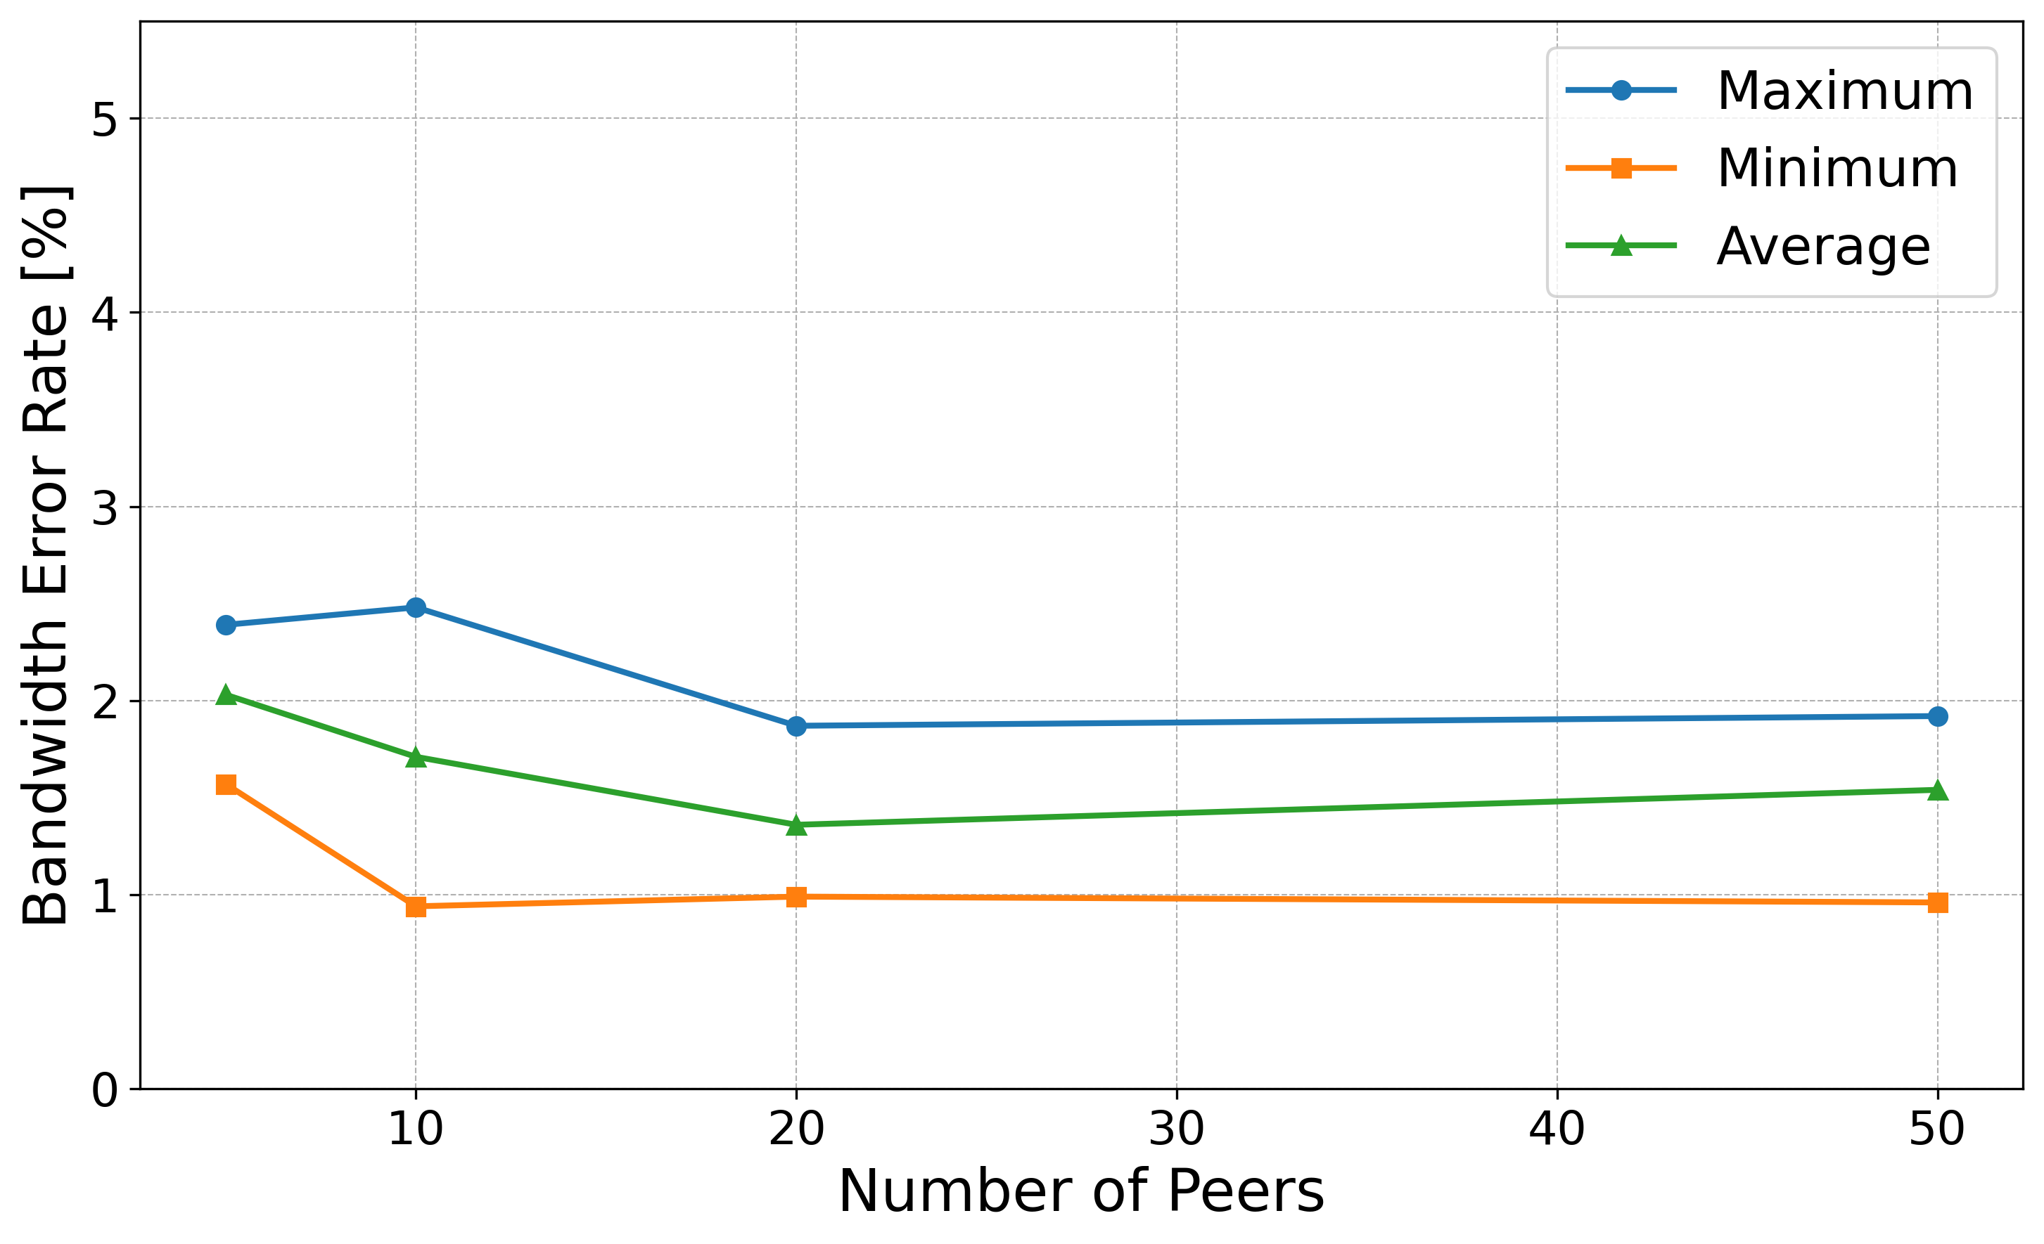
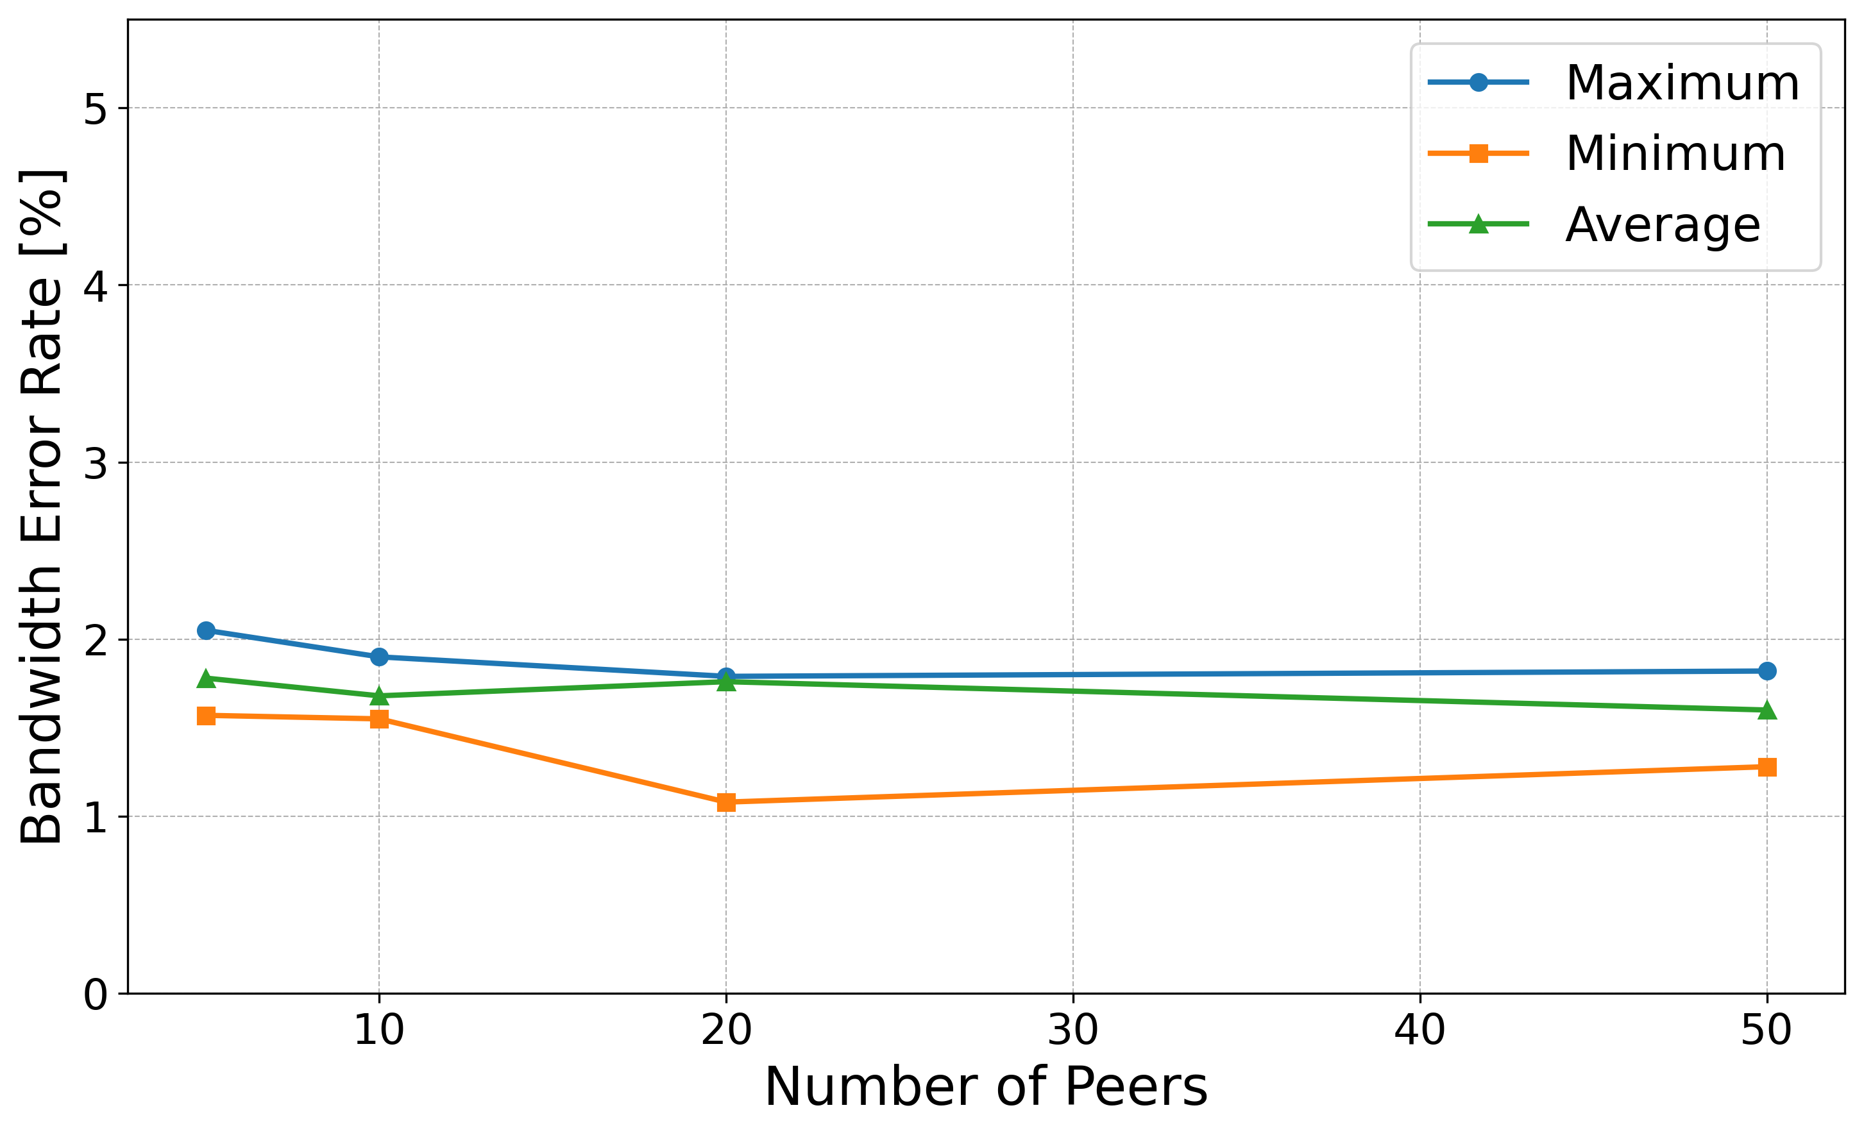
Accuracy of the Testbed, RQ1.1 (2)
Accuracy of measuring tools
Iperf accuracy results variation from actual performance
Variables like network conditions, configuration, system overhead
Error Rate for Bandwidth with the P2P Algorithm
Error Rate for Bandwidth without the P2P Algorithm
Testbed configured with packet loss values from real network data (%0.001)
Noted limitation in accurately measuring packet loss
Increase of latency with observed packet loss
25.03.2024
ACCURACY OF THE TESTBED, RQ1.1 (2)

Slide 14
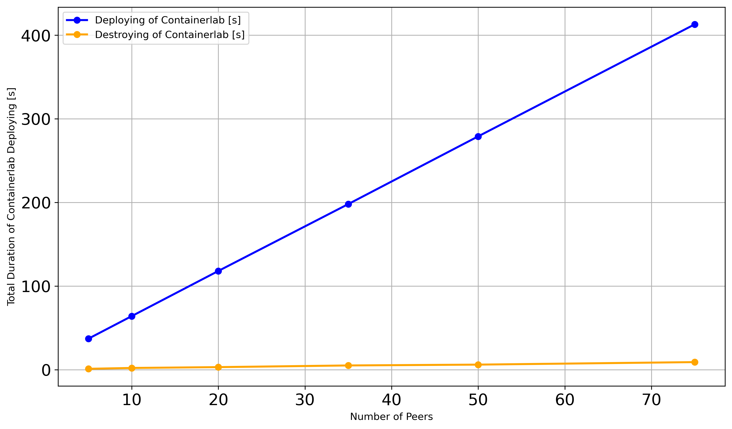
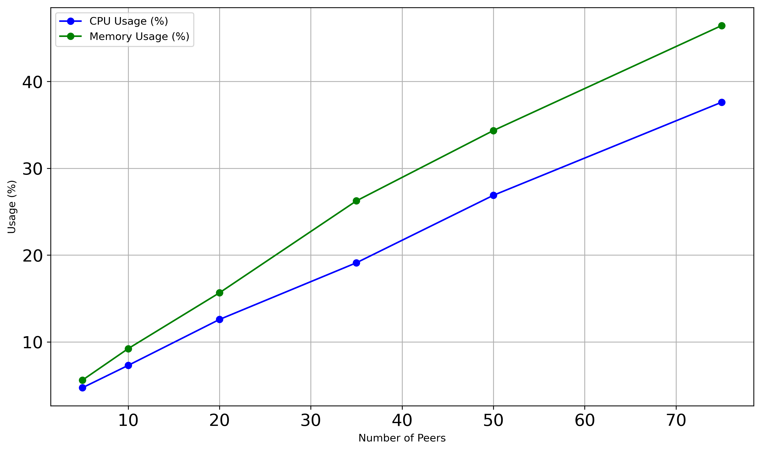
Testbed Scaling and Resource Utilization, RQ1.2
RQ1.2 How well does the testbed scale with more nodes and complex topologies affect the host in terms of resource utilization?
Time of Deploying and Destroying of Containerlab
Scaling peers with Containerlab
Deployment time increase of 5.37s per additional node
Destroying time low, approximately 9s for 75 nodes
CPU and Memory Usage of the Host
Utilization of CPU and memory usage with more peers
CPU and memory usage increase linearly, showing scalable performance
Memory usage growth suggests potential bottleneck with more peers
25.03.2024
TESTBED SCALING AND RESOURCE UTILIZATION, RQ1.2

Slide 15
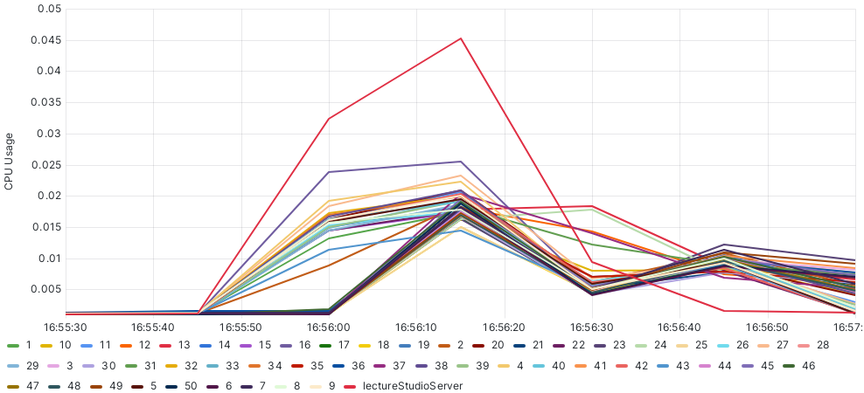
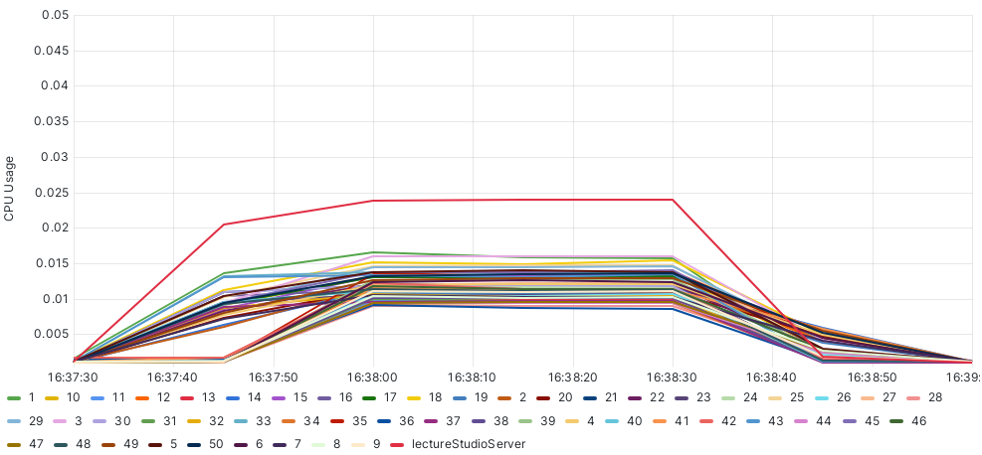
CPU and Memory Usage Analysis of Nodes, RQ2.1 (1)
RQ2.1 How do CPU and memory usage change of the participants (the lectureStudio server and peers) in tests with and without the P2P algorithm?
CPU Usage evaluation with and without the P2P algorithm in the testbed
Direct data transfer, increased CPU usage on the lectureStudio server
P2P algorithm, data distribution leading to decreased CPU usage on the lectureStudio server
Peak CPU usage reduction of 47% by the P2P algorithm
CPU Usage without the P2P Algorithm
CPU Usage with the P2P Algorithm
25.03.2024
CPU AND MEMORY USAGE ANALYSIS OF NODES, RQ2.1 (1)

Slide 16
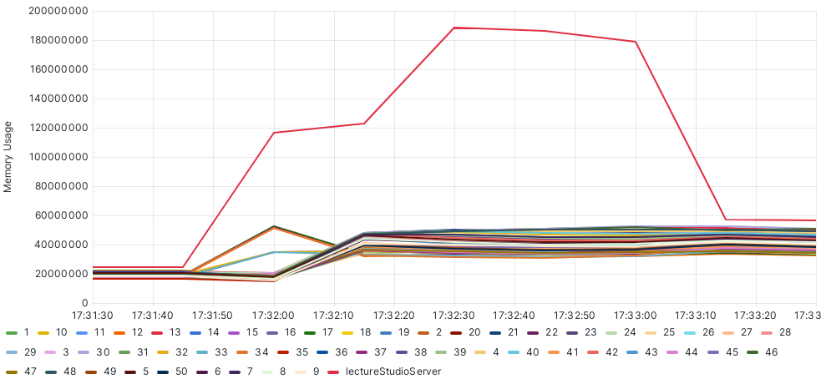
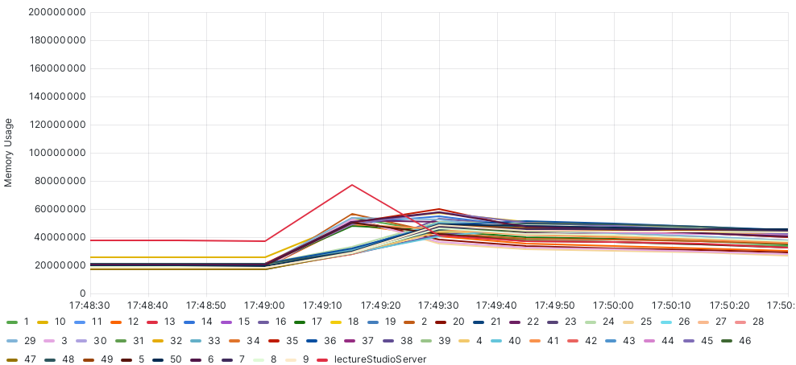
CPU and Memory Usage Analysis of Nodes, RQ2.1 (2)
Memory usage evaluation with and without the P2P algorithm in the testbed
Direct data transfer, increased memory usage on the lectureStudio server
P2P algorithm, data distribution leading to decreased memory usage on the lectureStudio server
Peak memory usage reduction of 58% by the P2P algorithm
Memory Usage without the P2P Algorithm
Memory Usage with the P2P Algorithm
Manageable increase in CPU and memory usage of super peers handling data flow
25.03.2024
CPU AND MEMORY USAGE ANALYSIS OF NODES, RQ2.1 (2)

Slide 17
Performance Evaluation of the P2P Algorithm, RQ2.2 and RQ2.3 (1)
RQ2.2 How does the P2P algorithm react to changing network characteristics (bandwidth, latency, packet loss)?
RQ2.3 Overall, is the P2P algorithm efficient for data transfer? How does the total duration obtained by the P2P algorithm respond to the changing number of peers and data size?
Test duration measurement from first to last acknowledgment message
Over 1000 tests performed with two configurations
Variation in data size or number of peers
1.Configuration:
Normal distribution with UK-based mean and standard deviation
Minimal difference between the P2P algorithm and server-client approach
2.Configuration:
Normal distribution with DE-based mean and UK-based standard deviation
P2P algorithm effective with increasing peers numbers/data size
From | Download Speed | Upload Speed
UK-Based | 53 Mbps | 5 Mbps
DE-Based | 90 Mbps | 30 Mbps
25.03.2024
PERFORMANCE EVALUATION OF THE P2P ALGORITHM, RQ2.2 AND RQ2.3 (1)

Slide 18
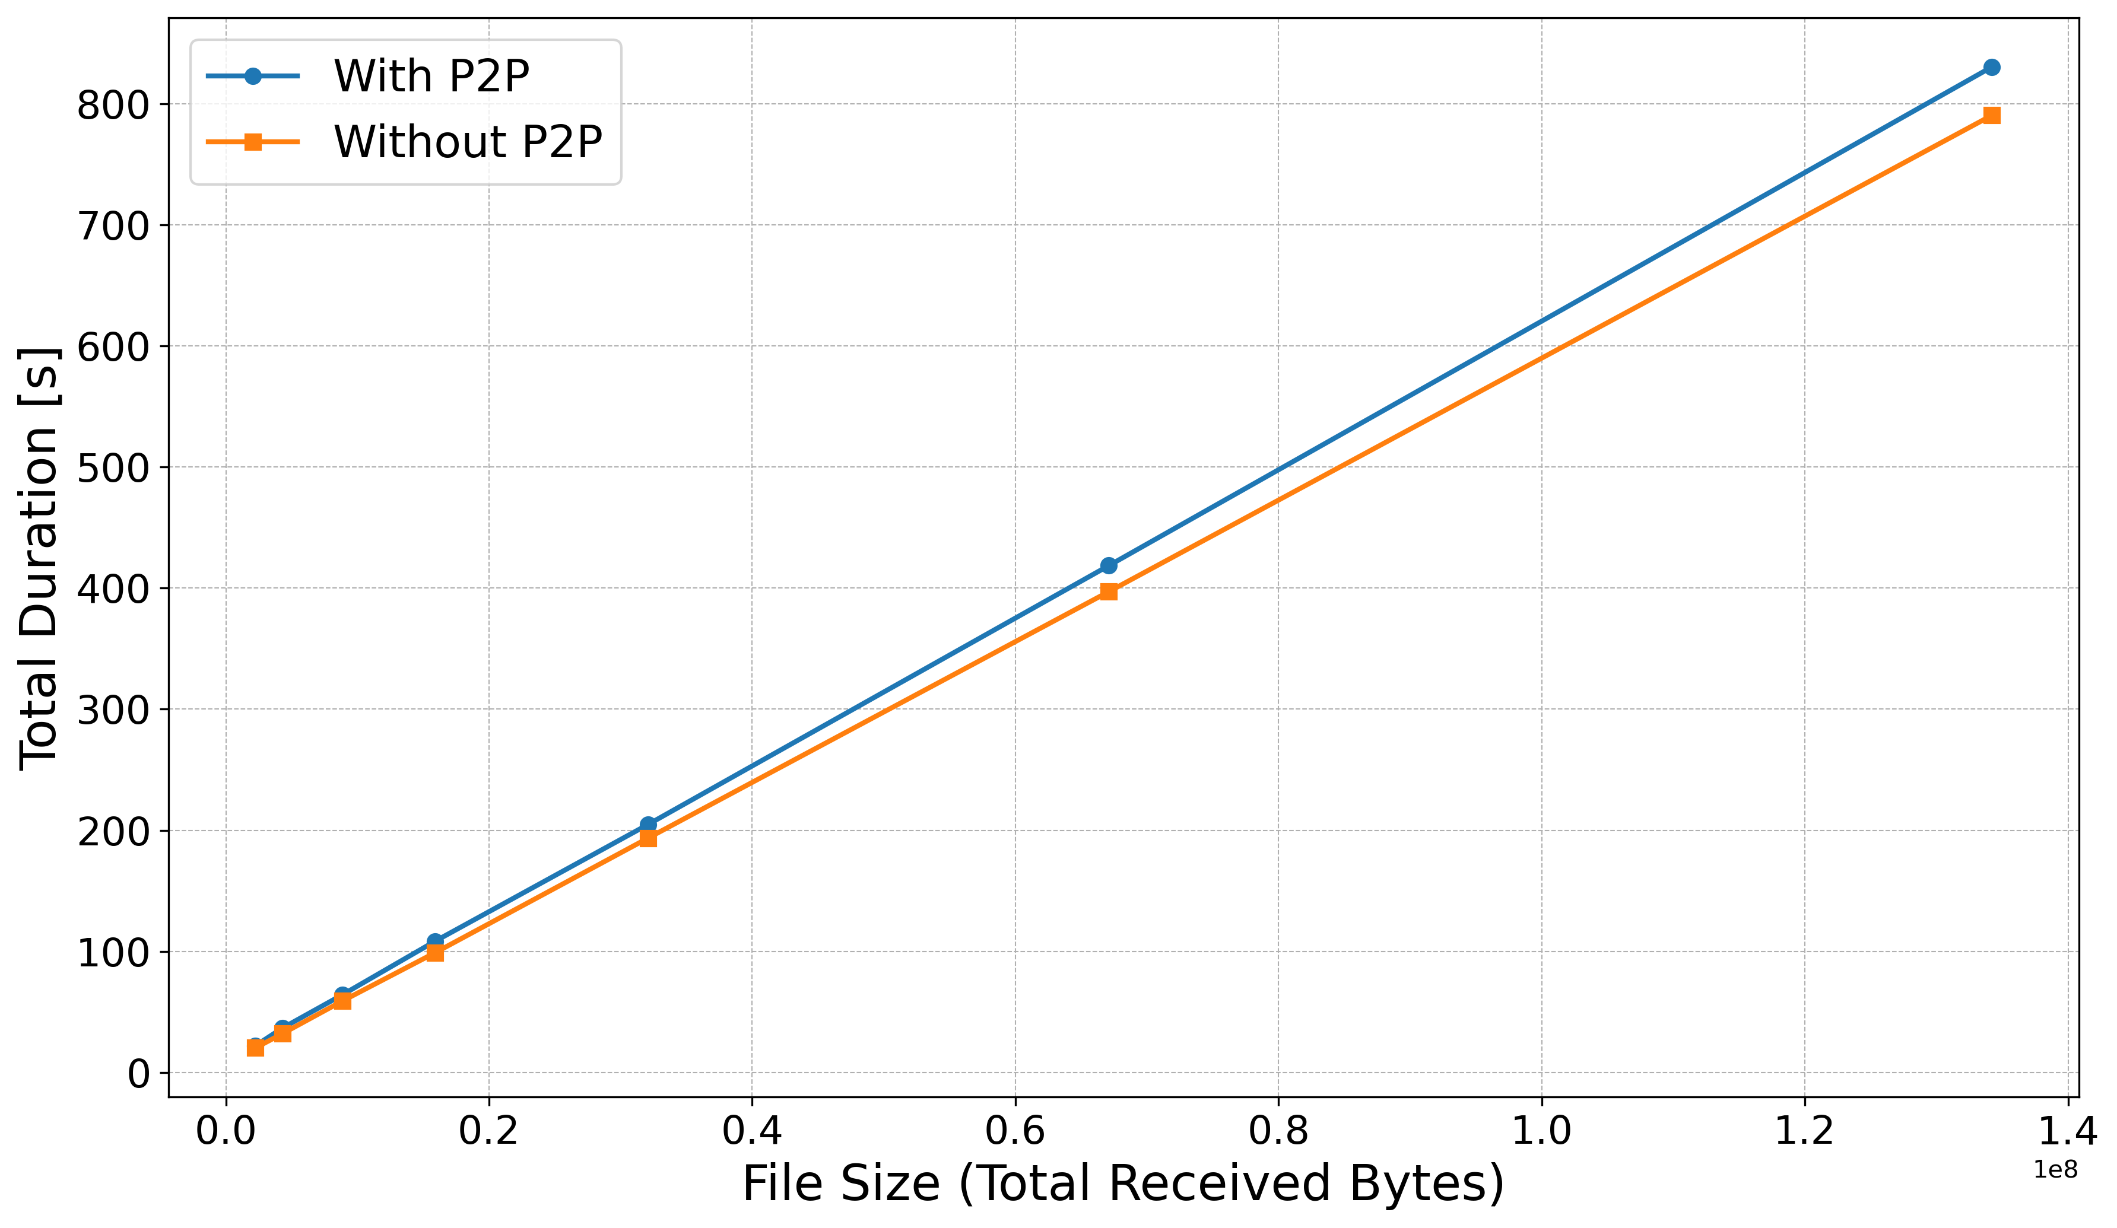
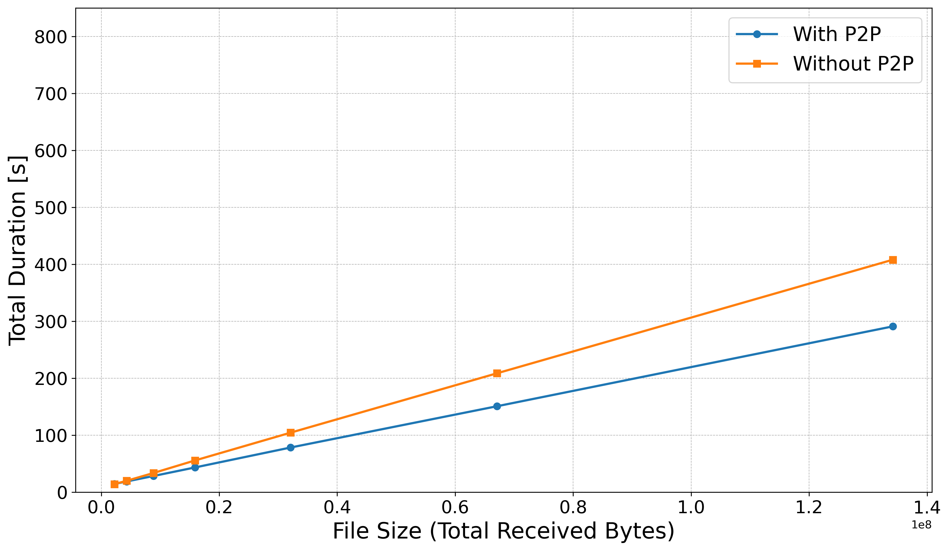
Performance Evaluation of the P2P Algorithm, RQ2.2 and RQ2.3 (2)
First configuration with the lectureStudio server and 20 peers
The P2P algorithm performance little worse to the traditional approach
Second configuration with the lectureStudio server and 20 peers
Transferring 2MB data size, the P2P algorithm performance nearly identical to the traditional approach
Transferring 128MB data size, the P2P algorithm performance 27% faster than the traditional approach
Time of Whole Data Transfer with the First Configuration
Time of Whole Data Transfer with the Second Configuration
25.03.2024
PERFORMANCE EVALUATION OF THE P2P ALGORITHM, RQ2.2 AND RQ2.3 (2)

Slide 19
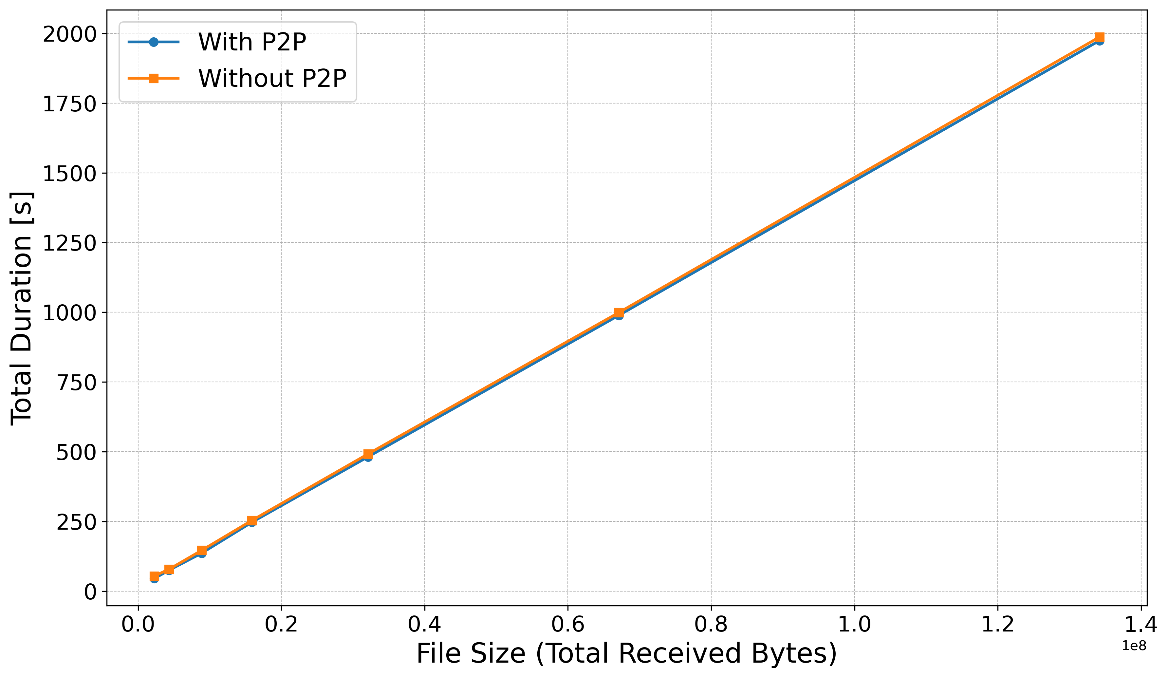
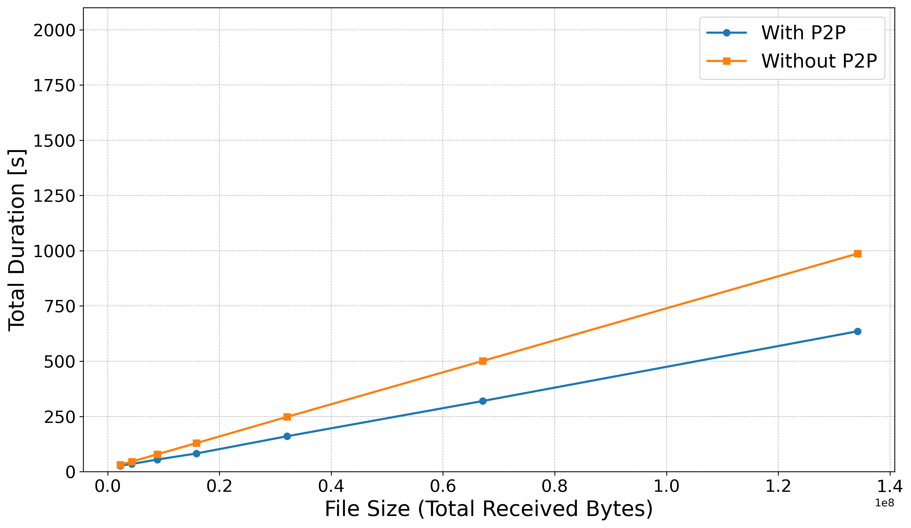
Performance Evaluation of the P2P Algorithm, RQ2.2 and RQ2.3 (3)
First configuration with the lectureStudio server and 50 peers
Transferring 2MB data size, the P2P algorithm performance nearly identical to the traditional approach
Transferring 128MB data size, the P2P algorithm performance 5% faster than the traditional approach
Second configuration with the lectureStudio server and 50 peers
Transferring 2MB data size, the P2P algorithm performance 12% faster than the traditional approach
Transferring 128MB data size, the P2P algorithm performance 35% faster than the traditional approach
Time of Whole Data Transfer with the First Configuration
Time of Whole Data Transfer with the Second Configuration
25.03.2024
PERFORMANCE EVALUATION OF THE P2P ALGORITHM, RQ2.2 AND RQ2.3 (3)

Slide 20
Conclusion and Future Work
Goal: Developing a testbed for the P2P data distribution algorithm
Results
Generating network topology: Normal distribution with data from the UK and DE
Creating the testbed: Docker and Containerlab
Deploying network topology: Data transfer between lectureStudio server and peers
Evaluating the testbed: Accuracy and scalability performance
Evaluating the P2P algorithm: Resource utilization and total time performance
Future Works
Enhancement of packet loss simulation for accurate network behavior
Automatic integration between the testbed and the P2P algorithm(s) optimization
Development of a graphical testbed interface for easier configuration and real-time analysis
25.03.2024
CONCLUSION AND FUTURE WORK

Slide 21
Thank you for your attention!
Any questions?
25.03.2024
QUESTIONS

Slide 22
References
[1] https://www.data.gov.uk/dataset/dfe843da-06ca-4680-9ba0-fbb27319e402/uk-fixed-line-broadband-performance
[2] https://www.speedtest.net/
[3] https://containerlab.dev/manual/topo-def-file/
25.03.2024
REFERENCES

Slide 23
Additional Slides (1) - Network Topology
Generating network topology by the testbed
Listing nodes with network characteristics
Detailing connections between the lectureStudio server and all peers
Optimizing network topology by the P2P algorithm
Identifying super peers
Optimizing connections between the lectureStudio server and peers
Network Topology Generated by the Testbed
Network Topology Optimized by the P2P Algorithm
{
"filename": "test.pdf",
"filesize": 5000,
"peers": [
{
"name": "lectureStudioServer",
"maxDownload": 29150,
"maxUpload": 9209
},
{
"name": "1",
"maxDownload": 1080,
"maxUpload": 373
}
]
}
"connections": [
{
"sourceName": "lectureStudioServer",
"targetName": "1",
"bandwidth": 1080,
"latency": 57,
"loss": 0.0035
},
{
"sourceName": "1",
"targetName": "lectureStudioServer",
"bandwidth": 373,
"latency": 57.15,
"loss": 0.0035
}
]
}
{
"superpeers": [
{
"name": "1"
}
],
"peer2peer": [
{
"sourceName": "lectureStudioServer",
"targetName": "1"
},
{
"sourceName": "1",
"targetName": "2"
}
]
}
25.03.2024
ADDITIONAL SLIDES (1) - NETWORK TOPOLOGY

Slide 24
Additional Slides (2) - Challenges
Finding real network dataset
Configuration and validation of the network characteristics for connections
Bandwidth limitation
Latency addition
Packet loss simulation
Data transmission between the lectureStudio server and peers (or super peers)
Synchronisation problem of total time
Monitoring by Grafana, Prometheus, and cAdvisor
25.03.2024
ADDITIONAL SLIDES (2) - CHALLENGES

Slide 25
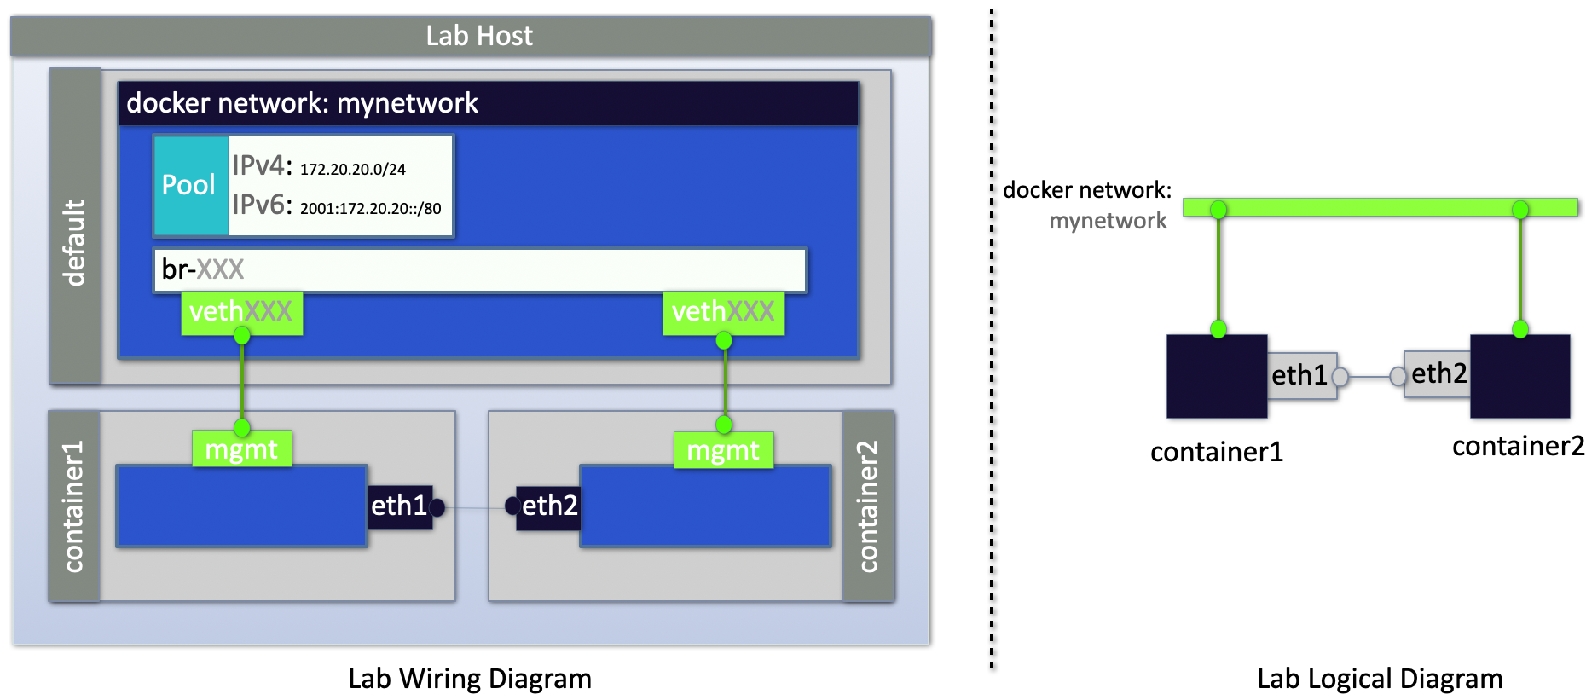
Additional Slides (3) - Network Wiring Concepts in Containerlab
25.03.2024
ADDITIONAL SLIDES (3) - NETWORK WIRING CONCEPTS IN CONTAINERLAB

