Slide 1


Berliner Food Recommender System
By: Özge Celenk
October 2019

Slide 2
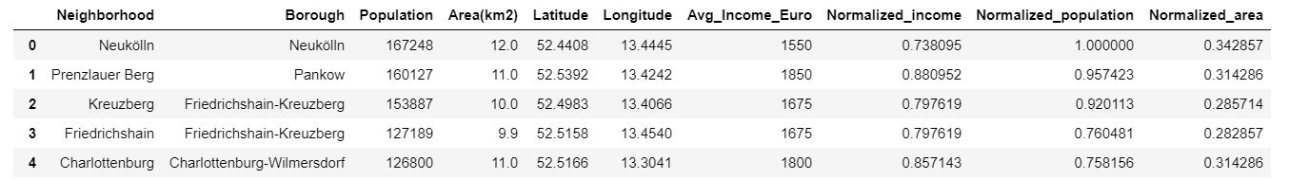
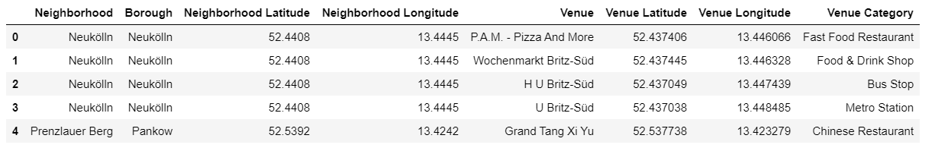
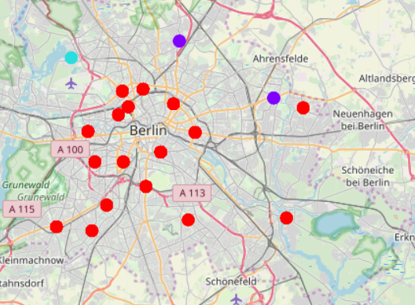
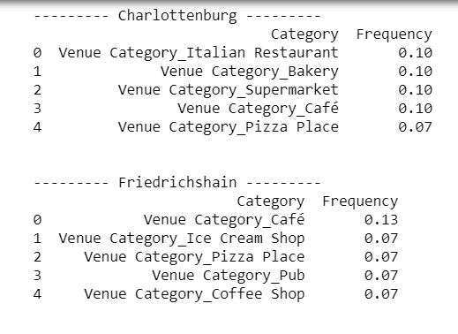
Methodology
Data Collection
Data preprocessing
K-Means Clustering
Model Testing

Slide 3
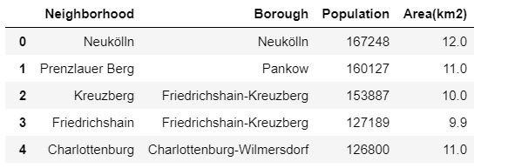
Datasets
Step 1: Finding the neighborhoods
Step 2: Adding geographical coordinates and average income per neighborhood
Step 3: Finding the venues per neighborhood using the Foursquare API

Slide 4
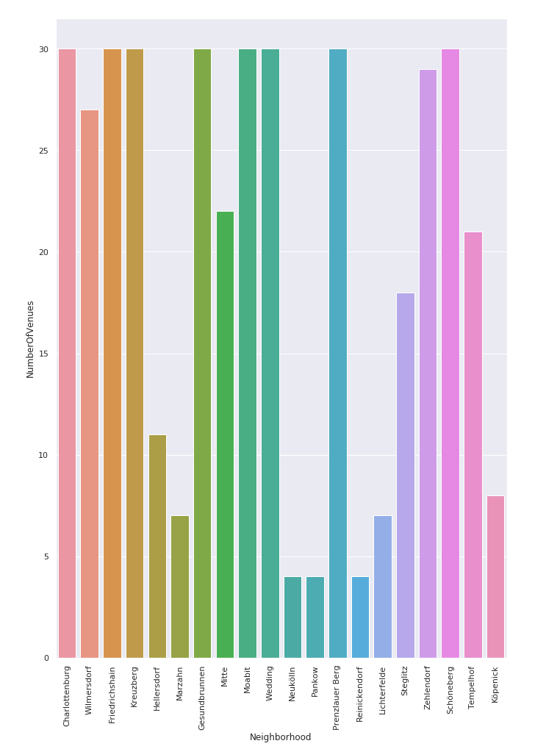
Data Preprocessing
Analyzing each neighborhood for venue categories
Visualizing the number of venues per neighbourhood

Slide 5
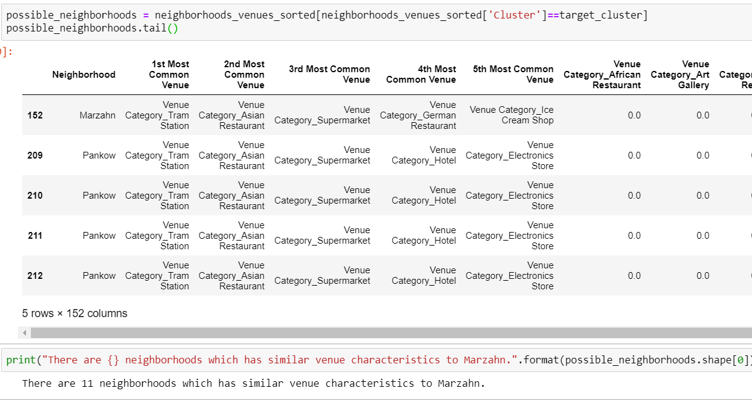
Results
K-Means Clustering
Recommender System Output

Slide 6
Discussion
Model works accurately, but still needs improvement
Future Work: Adding more neighborhoods to the recommender system

