Slide 1
Balls & bins
Itamar Cohen
Notes:
I will present the paper “Distributed Asynchronous Protocol for Service
Provisioning in the Edge-Cloud Continuum”.
This is a joint work with Paolo Giaccone, and Carla F. Chiasserini.

Slide 2
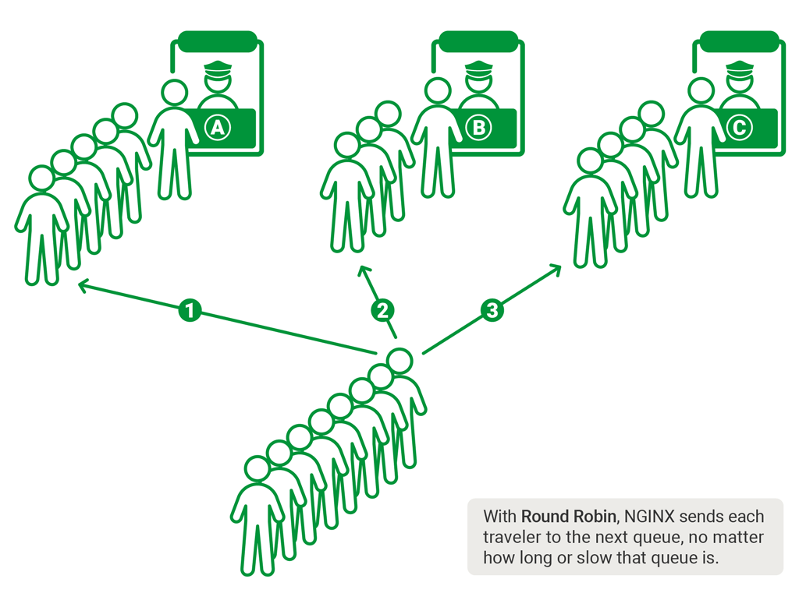
Motivation
Balls & bins
Motivation
Model
Algorithms
Results
Summary
Notes:
In the edge-cloud continuum, datacenters provide services to mobile users with hetero’ demands. For instance, a car safety service is time-critical, and therefore must be placed in an edge datacenter, close to the users. On the other hand, an infotainment service requires larger computational resources but looser timing constraint and therefore may be placed in the cloud. Furthermore, as users are mobile, services may have to be migrated to follow the user’s trajectory.

Slide 3
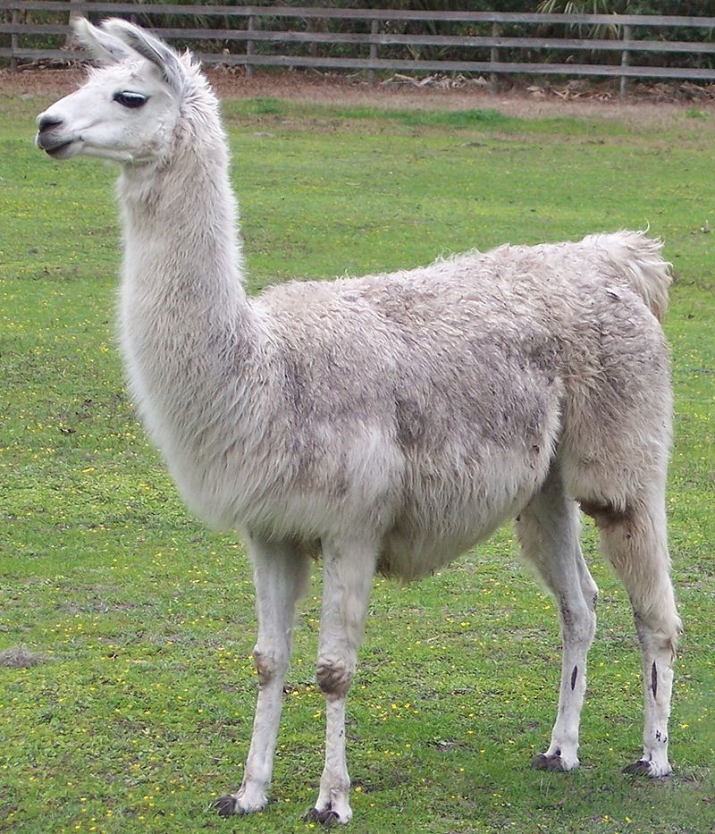
Motivation
Balls & bins
Motivation
Model
Algorithms
Results
Summary
Notes:
In the edge-cloud continuum, datacenters provide services to mobile users with hetero’ demands. For instance, a car safety service is time-critical, and therefore must be placed in an edge datacenter, close to the users. On the other hand, an infotainment service requires larger computational resources but looser timing constraint and therefore may be placed in the cloud. Furthermore, as users are mobile, services may have to be migrated to follow the user’s trajectory.

Slide 4
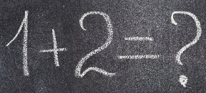
Motivation
Balls & bins
Load balancing
Servers & tasks
Motivation
Model
Algorithms
Results
Summary
Notes:
In the edge-cloud continuum, datacenters provide services to mobile users with hetero’ demands. For instance, a car safety service is time-critical, and therefore must be placed in an edge datacenter, close to the users. On the other hand, an infotainment service requires larger computational resources but looser timing constraint and therefore may be placed in the cloud. Furthermore, as users are mobile, services may have to be migrated to follow the user’s trajectory.

Slide 5
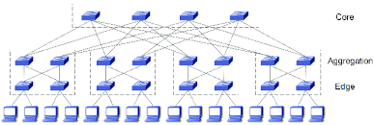
Motivation
Balls & bins
Load balancing
Servers & tasks
Paths & flows
…
Motivation
Model
Algorithms
Results
Summary
Notes:
In the edge-cloud continuum, datacenters provide services to mobile users with hetero’ demands. For instance, a car safety service is time-critical, and therefore must be placed in an edge datacenter, close to the users. On the other hand, an infotainment service requires larger computational resources but looser timing constraint and therefore may be placed in the cloud. Furthermore, as users are mobile, services may have to be migrated to follow the user’s trajectory.

Slide 6
Problem statement
Balls & bins
1 2 3 … m-1 m
Motivation
Model
Algorithms
Results
Summary
1 2 3 … i … n
Notes:
In the edge-cloud continuum, datacenters provide services to mobile users with hetero’ demands. For instance, a car safety service is time-critical, and therefore must be placed in an edge datacenter, close to the users. On the other hand, an infotainment service requires larger computational resources but looser timing constraint and therefore may be placed in the cloud. Furthermore, as users are mobile, services may have to be migrated to follow the user’s trajectory.

Slide 7
Problem statement
Balls & bins
(Simplifying) assumptions
One ball at a time
Uniform balls
Uniform bins
Motivation
Model
Algorithms
Results
Summary
Notes:
In the edge-cloud continuum, datacenters provide services to mobile users with hetero’ demands. For instance, a car safety service is time-critical, and therefore must be placed in an edge datacenter, close to the users. On the other hand, an infotainment service requires larger computational resources but looser timing constraint and therefore may be placed in the cloud. Furthermore, as users are mobile, services may have to be migrated to follow the user’s trajectory.

Slide 8
Picking the absolute minimum
Balls & bins
Motivation
Model
Algorithms
Results
Summary
1 2 3 … i … n
Notes:
In the edge-cloud continuum, datacenters provide services to mobile users with hetero’ demands. For instance, a car safety service is time-critical, and therefore must be placed in an edge datacenter, close to the users. On the other hand, an infotainment service requires larger computational resources but looser timing constraint and therefore may be placed in the cloud. Furthermore, as users are mobile, services may have to be migrated to follow the user’s trajectory.

Slide 9
Picking the absolute minimum
Balls & bins
Motivation
Model
Algorithms
Results
Summary
1 2 3 … i … n
Notes:
In the edge-cloud continuum, datacenters provide services to mobile users with hetero’ demands. For instance, a car safety service is time-critical, and therefore must be placed in an edge datacenter, close to the users. On the other hand, an infotainment service requires larger computational resources but looser timing constraint and therefore may be placed in the cloud. Furthermore, as users are mobile, services may have to be migrated to follow the user’s trajectory.

Slide 10
Picking the absolute minimum
Balls & bins
☺ Optimal performance
☹ High communication overhead
☹ Incast problem
Motivation
Model
Algorithms
Results
Summary
1 2 3 … i … n
Notes:
In the edge-cloud continuum, datacenters provide services to mobile users with hetero’ demands. For instance, a car safety service is time-critical, and therefore must be placed in an edge datacenter, close to the users. On the other hand, an infotainment service requires larger computational resources but looser timing constraint and therefore may be placed in the cloud. Furthermore, as users are mobile, services may have to be migrated to follow the user’s trajectory.

Slide 11


Picking a bin u.a.r
Balls & bins
Motivation
Model
Algorithms
Results
Summary
1 2 3 … i … n
Notes:
In the edge-cloud continuum, datacenters provide services to mobile users with hetero’ demands. For instance, a car safety service is time-critical, and therefore must be placed in an edge datacenter, close to the users. On the other hand, an infotainment service requires larger computational resources but looser timing constraint and therefore may be placed in the cloud. Furthermore, as users are mobile, services may have to be migrated to follow the user’s trajectory.

Slide 12
Picking a bin u.a.r
Balls & bins
Motivation
Model
Algorithms
Results
Summary
1 2 3 … i … n
Notes:
In the edge-cloud continuum, datacenters provide services to mobile users with hetero’ demands. For instance, a car safety service is time-critical, and therefore must be placed in an edge datacenter, close to the users. On the other hand, an infotainment service requires larger computational resources but looser timing constraint and therefore may be placed in the cloud. Furthermore, as users are mobile, services may have to be migrated to follow the user’s trajectory.

Slide 13
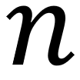
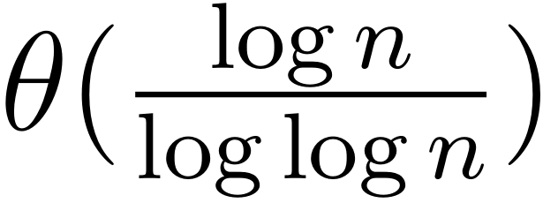
Picking a bin u.a.r
Balls & bins
☺ No communication overhead
Performance: maximal load for balls
and bins is w.h.p.
Motivation
Model
Algorithms
Results
Summary
1 2 3 … i … n
Notes:
In the edge-cloud continuum, datacenters provide services to mobile users with hetero’ demands. For instance, a car safety service is time-critical, and therefore must be placed in an edge datacenter, close to the users. On the other hand, an infotainment service requires larger computational resources but looser timing constraint and therefore may be placed in the cloud. Furthermore, as users are mobile, services may have to be migrated to follow the user’s trajectory.

Slide 14
The power of 2 choices
Balls & bins
Motivation
Model
Algorithms
Results
Summary
1 2 3 … i … n
Notes:
In the edge-cloud continuum, datacenters provide services to mobile users with hetero’ demands. For instance, a car safety service is time-critical, and therefore must be placed in an edge datacenter, close to the users. On the other hand, an infotainment service requires larger computational resources but looser timing constraint and therefore may be placed in the cloud. Furthermore, as users are mobile, services may have to be migrated to follow the user’s trajectory.

Slide 15
The power of 2 choices
Balls & bins
Motivation
Model
Algorithms
Results
Summary
1 2 3 … i … n
Notes:
In the edge-cloud continuum, datacenters provide services to mobile users with hetero’ demands. For instance, a car safety service is time-critical, and therefore must be placed in an edge datacenter, close to the users. On the other hand, an infotainment service requires larger computational resources but looser timing constraint and therefore may be placed in the cloud. Furthermore, as users are mobile, services may have to be migrated to follow the user’s trajectory.

Slide 16
The power of 2 choices
Balls & bins
Motivation
Model
Algorithms
Results
Summary
1 2 3 … i … n
Notes:
In the edge-cloud continuum, datacenters provide services to mobile users with hetero’ demands. For instance, a car safety service is time-critical, and therefore must be placed in an edge datacenter, close to the users. On the other hand, an infotainment service requires larger computational resources but looser timing constraint and therefore may be placed in the cloud. Furthermore, as users are mobile, services may have to be migrated to follow the user’s trajectory.

Slide 17
The power of 2 choices
Balls & bins
Motivation
Model
Algorithms
Results
Summary
1 2 3 … i … n
Notes:
In the edge-cloud continuum, datacenters provide services to mobile users with hetero’ demands. For instance, a car safety service is time-critical, and therefore must be placed in an edge datacenter, close to the users. On the other hand, an infotainment service requires larger computational resources but looser timing constraint and therefore may be placed in the cloud. Furthermore, as users are mobile, services may have to be migrated to follow the user’s trajectory.

Slide 18
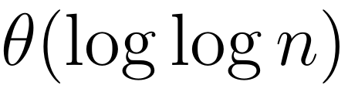
The power of two choices
Balls & bins
☺ Low communication overhead
☺ Performance: maximal load for balls
and bins is w.h.p. [1]
Motivation
Model
Algorithms
Results
Summary
1 2 3 … i … n
[1] Mitzenmacher, M. "The power of two choices in randomized load balancing."
IEEE Transactions on Parallel and Distributed Systems 12.10 (2001): 1094-1104.
Notes:
In the edge-cloud continuum, datacenters provide services to mobile users with hetero’ demands. For instance, a car safety service is time-critical, and therefore must be placed in an edge datacenter, close to the users. On the other hand, an infotainment service requires larger computational resources but looser timing constraint and therefore may be placed in the cloud. Furthermore, as users are mobile, services may have to be migrated to follow the user’s trajectory.

Slide 19
The power of two choices
Balls & bins
☺ Low communication overhead
☺ Performance: maximal load for balls
and bins is w.h.p.
E.g., =1M:
Picking u.a.r:
max. load=5.26
Power of 2 choices
max. load=2.63
Motivation
Model
Algorithms
Results
Summary
Notes:
In the edge-cloud continuum, datacenters provide services to mobile users with hetero’ demands. For instance, a car safety service is time-critical, and therefore must be placed in an edge datacenter, close to the users. On the other hand, an infotainment service requires larger computational resources but looser timing constraint and therefore may be placed in the cloud. Furthermore, as users are mobile, services may have to be migrated to follow the user’s trajectory.

Slide 20
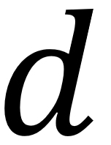
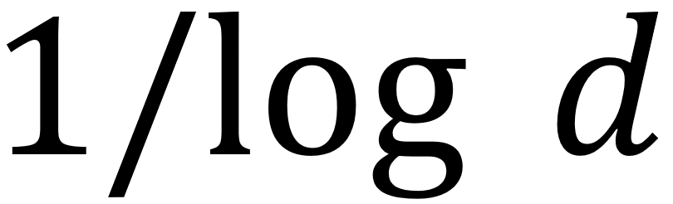
The power of d choices
Balls & bins
☺ Sampling bins reduces the load by
multiplicative factor [1]
Motivation
Model
Algorithms
Results
Summary

Slide 21
Implementation dilemma
Balls & bins
Sampling d bins may be harder if we disallow repetitions
Is that important?
Motivation
Model
Algorithms
Results
Summary
Notes:
In the edge-cloud continuum, datacenters provide services to mobile users with hetero’ demands. For instance, a car safety service is time-critical, and therefore must be placed in an edge datacenter, close to the users. On the other hand, an infotainment service requires larger computational resources but looser timing constraint and therefore may be placed in the cloud. Furthermore, as users are mobile, services may have to be migrated to follow the user’s trajectory.

Slide 22
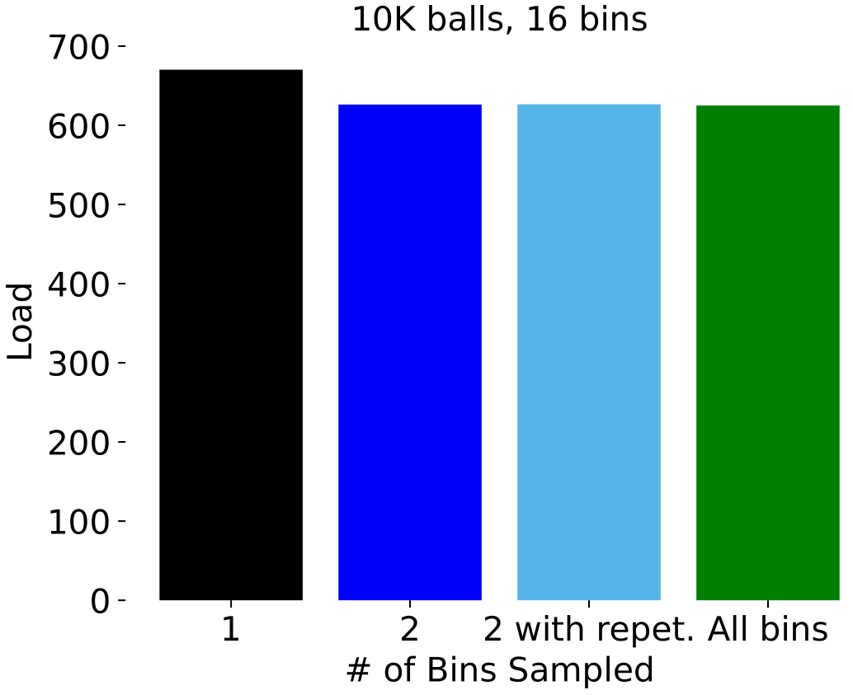
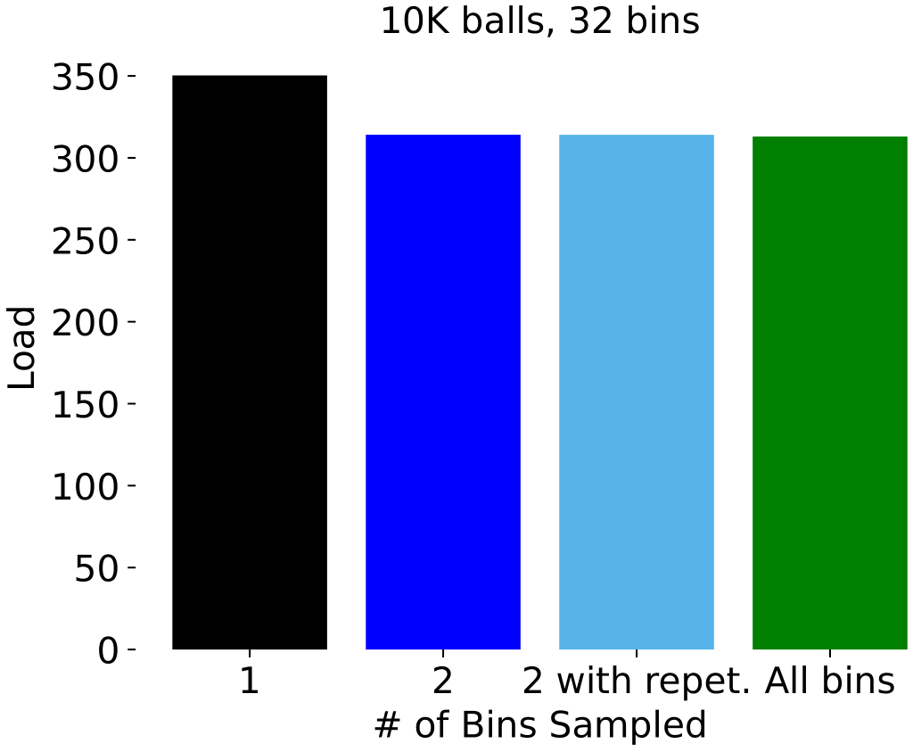
Results (absolute values)
Balls & bins
Motivation
Model
Algorithms
Results
Summary
Notes:
In the edge-cloud continuum, datacenters provide services to mobile users with hetero’ demands. For instance, a car safety service is time-critical, and therefore must be placed in an edge datacenter, close to the users. On the other hand, an infotainment service requires larger computational resources but looser timing constraint and therefore may be placed in the cloud. Furthermore, as users are mobile, services may have to be migrated to follow the user’s trajectory.

Slide 23
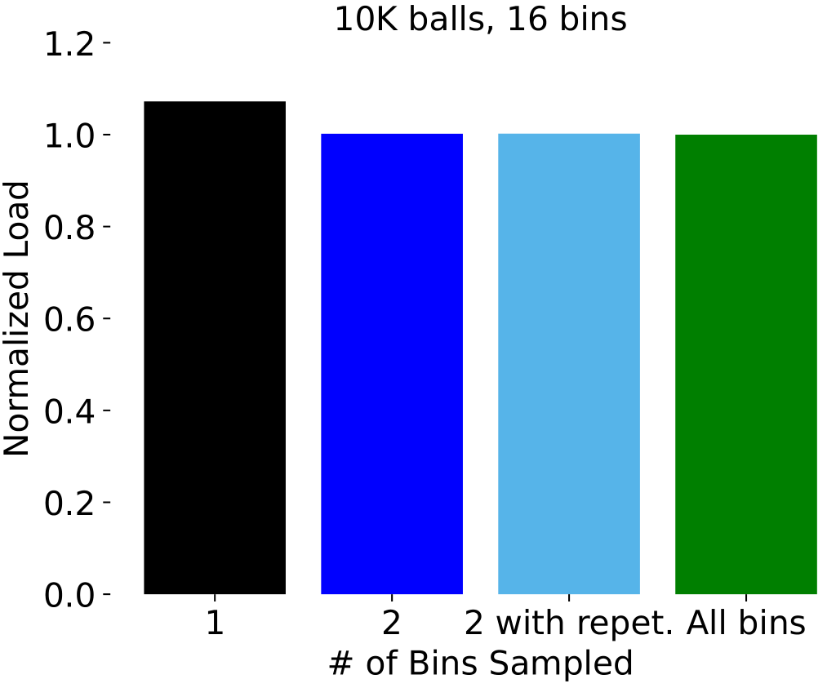
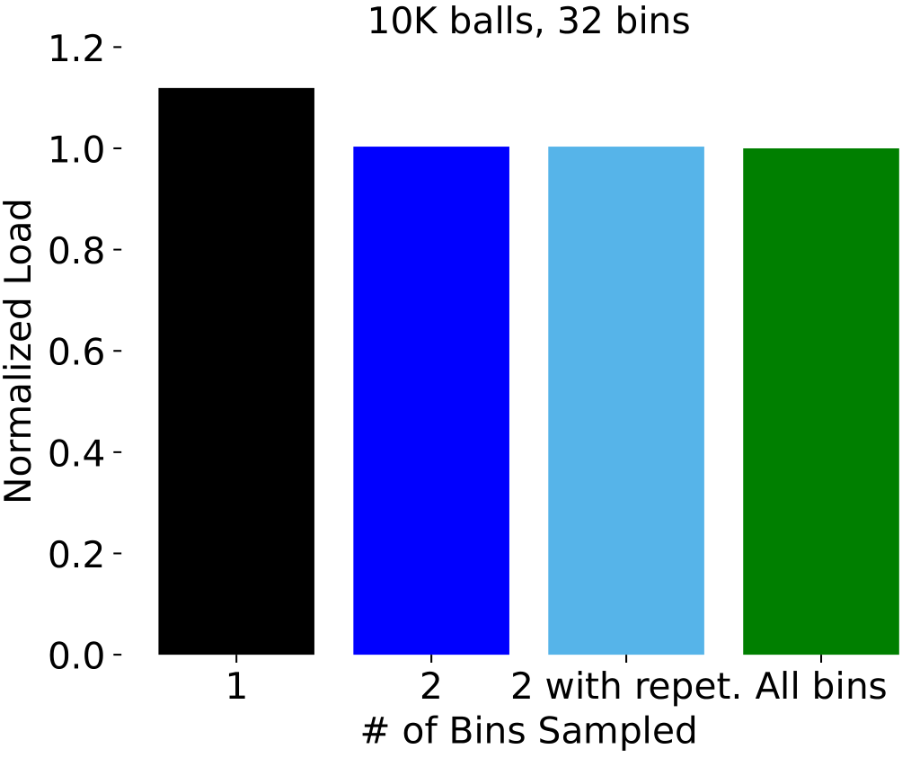
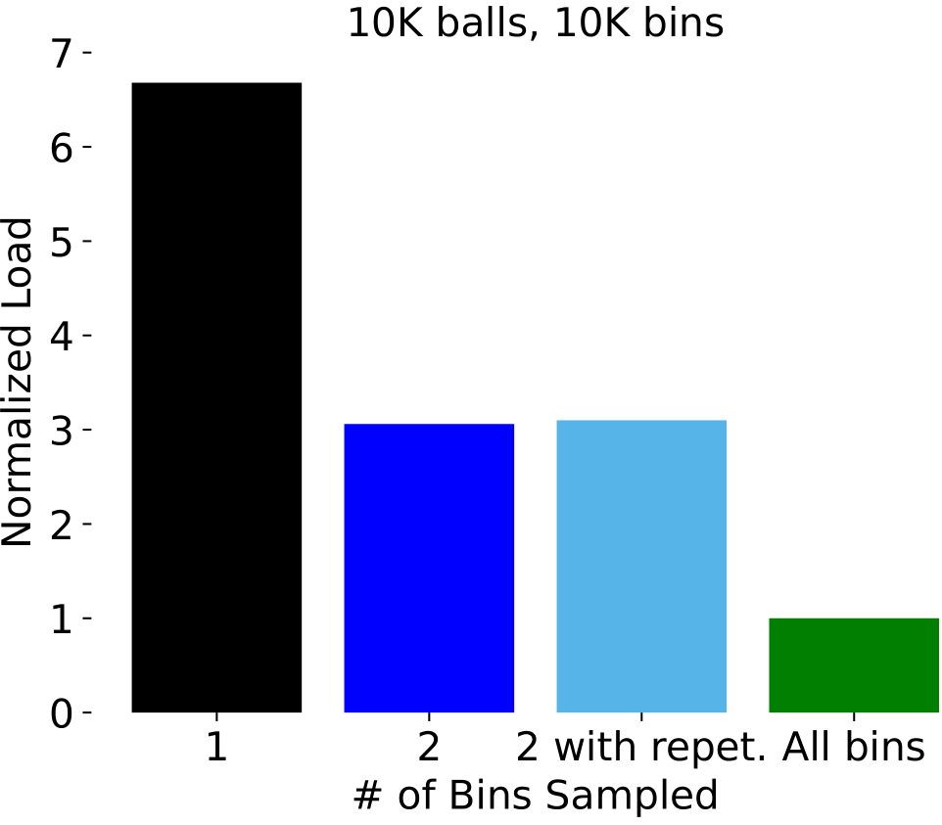
Results (normalized w.r.t Opt)
Balls & bins
Motivation
Model
Algorithms
Results
Summary
Notes:
In the edge-cloud continuum, datacenters provide services to mobile users with hetero’ demands. For instance, a car safety service is time-critical, and therefore must be placed in an edge datacenter, close to the users. On the other hand, an infotainment service requires larger computational resources but looser timing constraint and therefore may be placed in the cloud. Furthermore, as users are mobile, services may have to be migrated to follow the user’s trajectory.

Slide 24
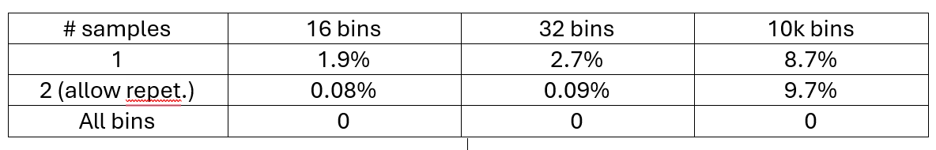
Std. dev. / average of the max. load
Balls & bins
Motivation
Model
Algorithms
Results
Summary
Notes:
In the edge-cloud continuum, datacenters provide services to mobile users with hetero’ demands. For instance, a car safety service is time-critical, and therefore must be placed in an edge datacenter, close to the users. On the other hand, an infotainment service requires larger computational resources but looser timing constraint and therefore may be placed in the cloud. Furthermore, as users are mobile, services may have to be migrated to follow the user’s trajectory.

Slide 25
Conclusions
Balls & bins
Allowing repetitions hardly changes the results
But this may change when varying m, n, d.
The power of 2 choices
especially effective when m~n
the relative std. dev. remains high
Motivation
Model
Algorithms
Results
Summary
Notes:
In the edge-cloud continuum, datacenters provide services to mobile users with hetero’ demands. For instance, a car safety service is time-critical, and therefore must be placed in an edge datacenter, close to the users. On the other hand, an infotainment service requires larger computational resources but looser timing constraint and therefore may be placed in the cloud. Furthermore, as users are mobile, services may have to be migrated to follow the user’s trajectory.

Slide 26
Generalization
Balls & bins
Heterogeneous balls, bins
Multiple dimensions
Cpu
Memory
BW
Decaying load (finished tasks)
“Rounds” of sample → pick → deploy
Motivation
Model
Algorithms
Results
Summary
Notes:
In the edge-cloud continuum, datacenters provide services to mobile users with hetero’ demands. For instance, a car safety service is time-critical, and therefore must be placed in an edge datacenter, close to the users. On the other hand, an infotainment service requires larger computational resources but looser timing constraint and therefore may be placed in the cloud. Furthermore, as users are mobile, services may have to be migrated to follow the user’s trajectory.

Slide 27
Parallelization
Balls & bins
Independent schedulers may collide
Possible solutions
Static partition
☹ Fragmentation problem
Dynamic partition
☹ Complex implementation
Our contribution: adjustable # of sched’s.
☺ Balance between TP and collision ratio
Motivation
Model
Algorithms
Results
Summary
Notes:
In the edge-cloud continuum, datacenters provide services to mobile users with hetero’ demands. For instance, a car safety service is time-critical, and therefore must be placed in an edge datacenter, close to the users. On the other hand, an infotainment service requires larger computational resources but looser timing constraint and therefore may be placed in the cloud. Furthermore, as users are mobile, services may have to be migrated to follow the user’s trajectory.

