Slide 1
Balls & bins
Itamar Cohen

Slide 2
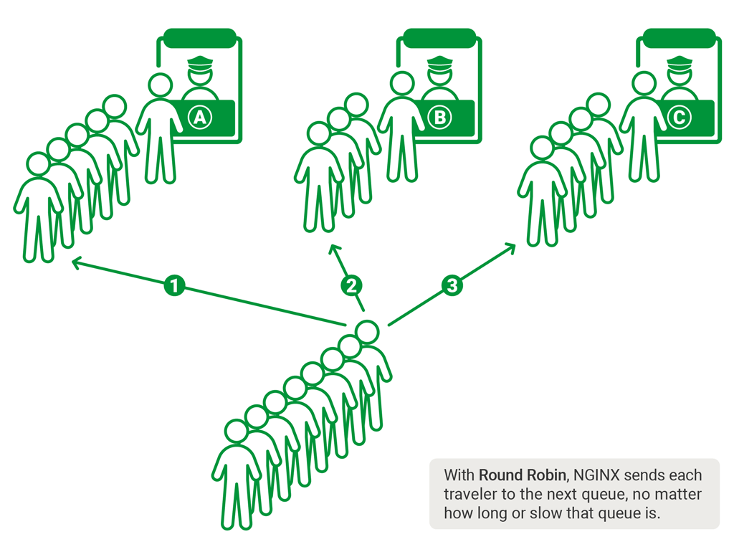
Motivation
Balls & bins
Motivation
Model
Algorithms
Results
Summary

Slide 3
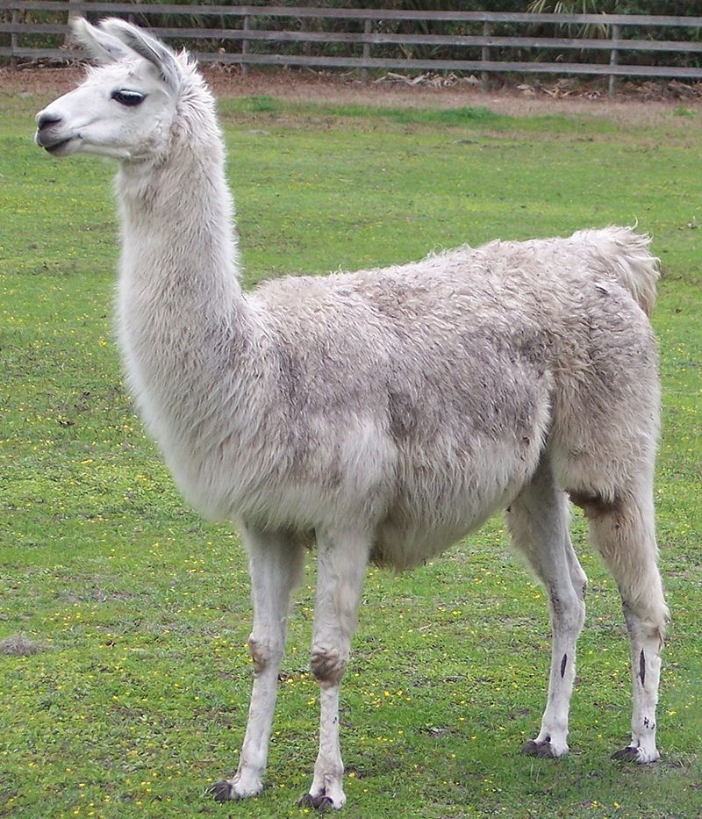
Motivation
Balls & bins
Motivation
Model
Algorithms
Results
Summary

Slide 4
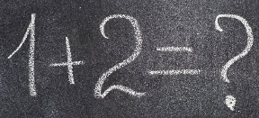
Motivation
Balls & bins
Load balancing
Servers & tasks
Motivation
Model
Algorithms
Results
Summary

Slide 5
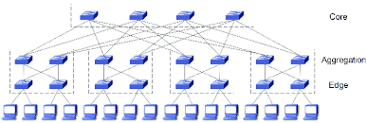
Motivation
Balls & bins
Load balancing
Servers & tasks
Paths & flows
…
Motivation
Model
Algorithms
Results
Summary

Slide 6
Problem statement
Balls & bins
1 2 3 … m-1 m
Motivation
Model
Algorithms
Results
Summary
1 2 3 … i … n

Slide 7
Problem statement
Balls & bins
(Simplifying) assumptions
One ball at a time
Uniform balls
Uniform bins
Motivation
Model
Algorithms
Results
Summary

Slide 8
Picking the absolute minimum
Balls & bins
Motivation
Model
Algorithms
Results
Summary
1 2 3 … i … n

Slide 9
Picking the absolute minimum
Balls & bins
Motivation
Model
Algorithms
Results
Summary
1 2 3 … i … n

Slide 10
Picking the absolute minimum
Balls & bins
☺ Optimal performance
☹ High communication overhead
☹ Incast problem [Cohen’23]
Motivation
Model
Algorithms
Results
Summary
1 2 3 … i … n

Slide 11


Picking a bin u.a.r
Balls & bins
Motivation
Model
Algorithms
Results
Summary
1 2 3 … i … n

Slide 12
Picking a bin u.a.r
Balls & bins
Motivation
Model
Algorithms
Results
Summary
1 2 3 … i … n

Slide 13
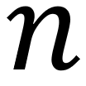
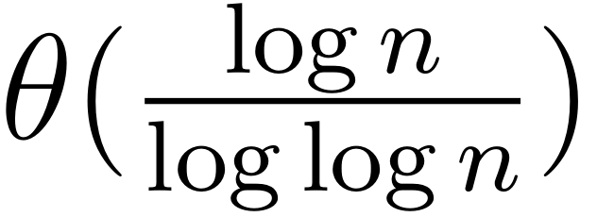
Picking a bin u.a.r
Balls & bins
☺ No communication overhead
Performance: maximal load for balls
and bins is w.h.p.
Motivation
Model
Algorithms
Results
Summary
1 2 3 … i … n

Slide 14
The power of 2 choices
Balls & bins
Motivation
Model
Algorithms
Results
Summary
1 2 3 … i … n

Slide 15
The power of 2 choices
Balls & bins
Motivation
Model
Algorithms
Results
Summary
1 2 3 … i … n

Slide 16
The power of 2 choices
Balls & bins
Motivation
Model
Algorithms
Results
Summary
1 2 3 … i … n

Slide 17
The power of 2 choices
Balls & bins
Motivation
Model
Algorithms
Results
Summary
1 2 3 … i … n

Slide 18
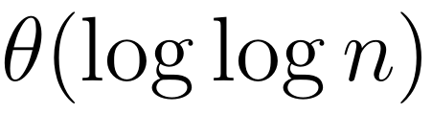
The power of two choices
Balls & bins
☺ Low communication overhead
☺ Performance: maximal load for balls
and bins is w.h.p. [Mitzenmacher’01]
Motivation
Model
Algorithms
Results
Summary
1 2 3 … i … n

Slide 19
The power of two choices
Balls & bins
☺ Low communication overhead
☺ Performance: maximal load for balls
and bins is w.h.p.
E.g., =1M:
Picking u.a.r:
max. load=5.26 + o(1)
Power of 2 choices
max. load=3.78 + o(1)
Motivation
Model
Algorithms
Results
Summary

Slide 20
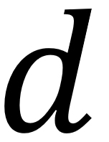
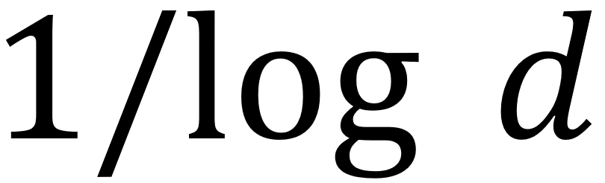
The power of d choices
Balls & bins
☺ Sampling bins reduces the load by
multiplicative factor
[Mitzenmacher’01]
Motivation
Model
Algorithms
Results
Summary

Slide 21
Implementation dilemma
Balls & bins
Sampling d bins may be harder if we disallow repetitions
Is that important?
Motivation
Model
Algorithms
Results
Summary

Slide 22
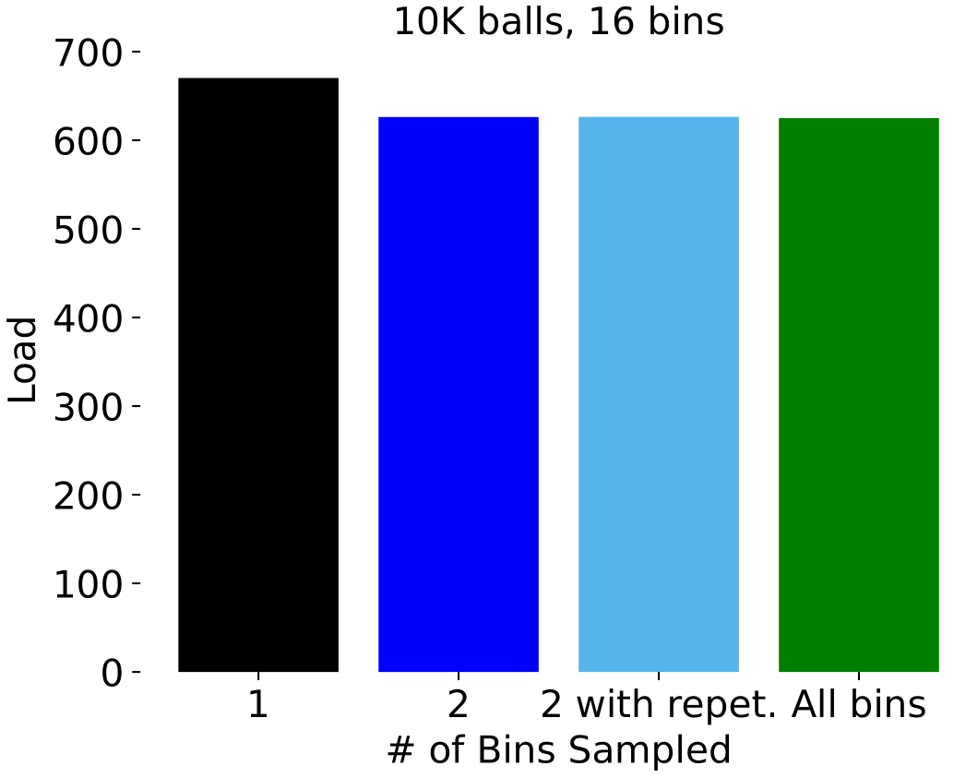
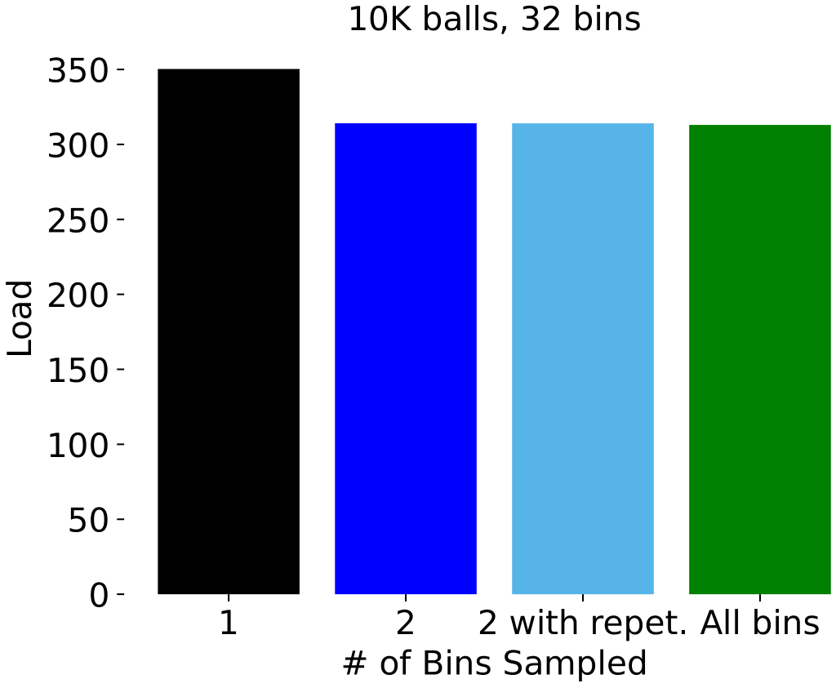
Results (absolute values)
Balls & bins
Motivation
Model
Algorithms
Results
Summary

Slide 23
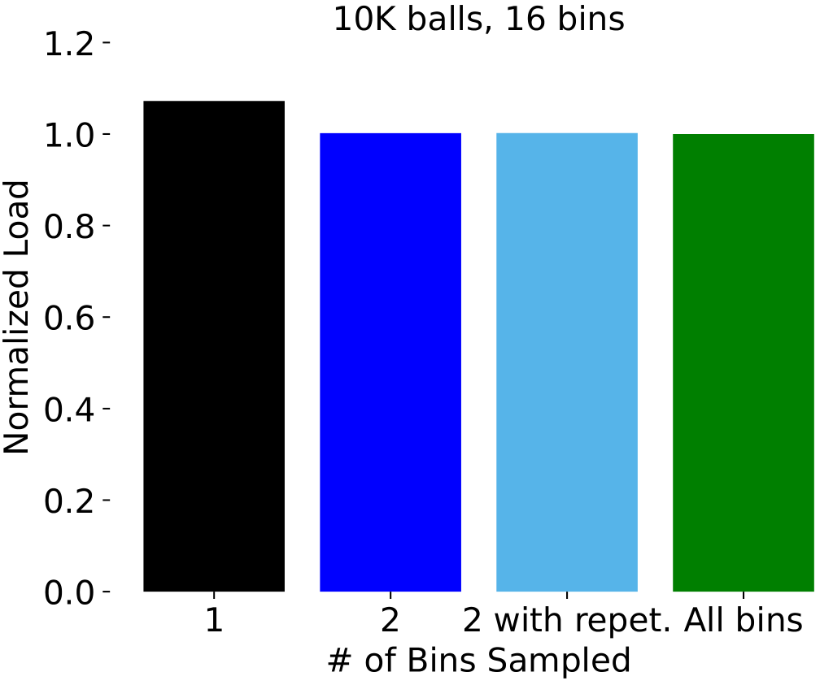
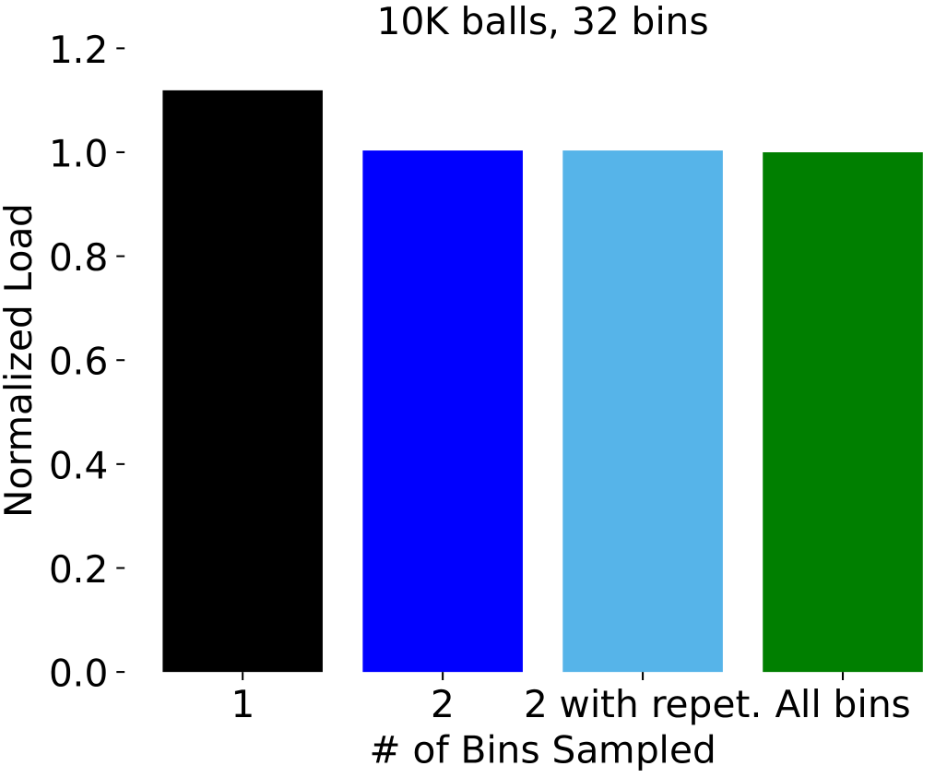
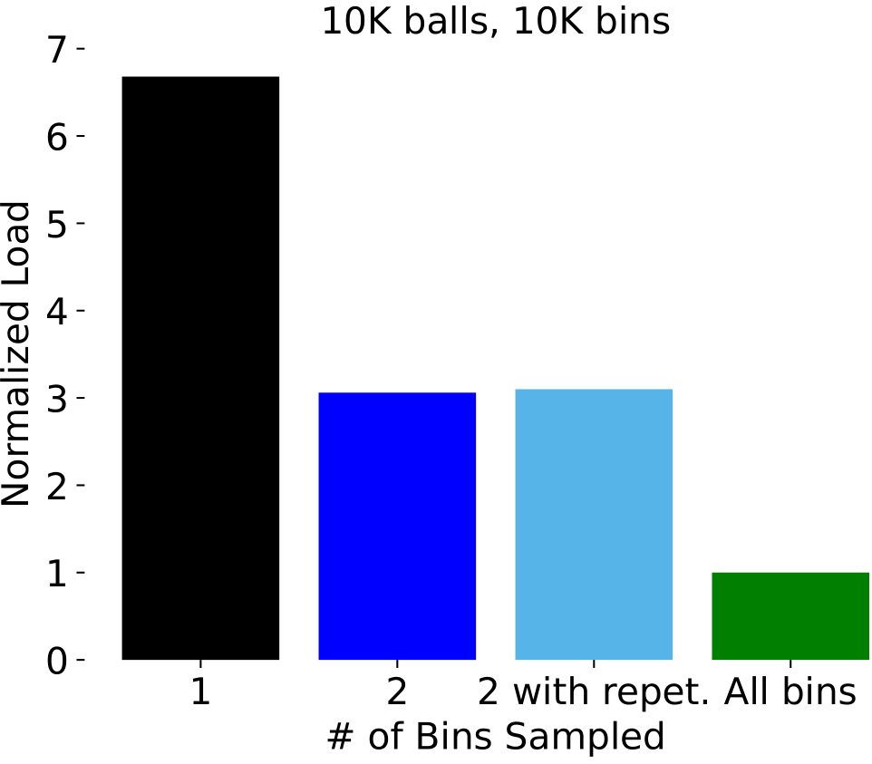
Results (normalized w.r.t Opt)
Balls & bins
Motivation
Model
Algorithms
Results
Summary
Theoretical bounds
(10K bins):
1 sample: 4.15 + O(1)
2 samples: 3.2 + O(1)

Slide 24
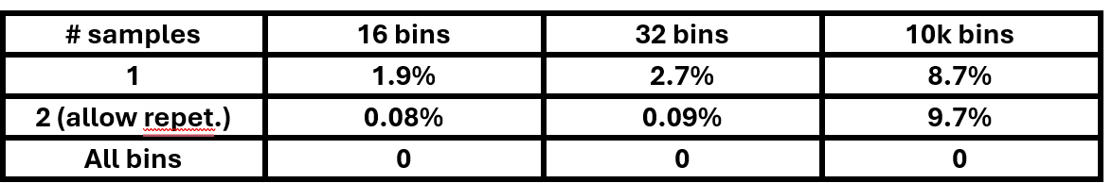
Std. dev. / average of the max. load
Balls & bins
Motivation
Model
Algorithms
Results
Summary

Slide 25
Conclusions
Balls & bins
Allowing repetitions hardly changes the results
But this may change when varying m, n, d.
The power of 2 choices
more relevant when m~n
the relative std. dev. remains high
Motivation
Model
Algorithms
Results
Summary

Slide 26
Relevance for Cisco Silicon One
Balls & bins
Telemetry-assisted Ethernet
Selecting path (ECMP)
Flood telemetry info in an async, lazy manner
Motivation
Model
Algorithms
Results
Summary

Slide 27
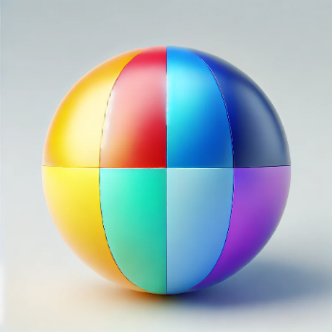
Generalization
Balls & bins
Heterogeneous balls, bins
Multiple dimensions [MD_P2_IBM]
Cpu
Memory
BW
Dynamic case (finished tasks)
E.g., as a Poisson process
“Rounds” of sample → pick → deploy
Motivation
Model
Algorithms
Results
Summary
Notes:
Multi-dim prob’:
MD_P2_IBM: out of the sampled bins, select the one minimizing the maximal load (in all dims). Or the “total” load (?).
Dist from diag.

Slide 28
Parallelization
Balls & bins
Independent schedulers may collide
Possible solutions
Static partition [Quincy]
☹ Fragmentation problem
Dynamic partition [Mesos]
☹ Complex implementation
Our contribution: adjustable # of sched’s.
Show that random. decreases collisions prob’
☺ Balance TP Vs. collision ratio [Cohen’23]
Motivation
Model
Algorithms
Results
Summary

Slide 29
Alternative approaches
Balls & bins
Use cached state snapshots [ASC]
Reversing the supermarket [Nahir’16]
Save energy by assuring load in [low_th, high_th]
Motivation
Model
Algorithms
Results
Summary
Notes:
Supermarket: balls → M/M/1 Qs

Slide 30
References
Balls & bins
[Cohen’23] Cohen, Itamar, et al. "High throughput vms placement with constrained communication overhead and provable guarantees." IEEE TNSM 20.3 (2023): 3148-3161.
[Mitzenmacher’01] Mitzenmacher, M. "The power of two choices in randomized load balancing." IEEE Transactions on Parallel and Distributed Systems 12.10 (2001): 1094-1104.
[MD_P2_IBM] Narang, A., Dutta, S., & Bhattacherjee, S. (2011). Multidimensional Balanced Allocation for Multiple Choice & (1+ Beta) Processes. arXiv preprint arXiv:1111.0762.
[Nahir’16] Nahir, A., Orda, A., & Raz, D. (2016, April). Reversing the supermarket: A distributed approach for handling elasticity in the cloud. In NOMS 2016-2016 IEEE/IFIP Network Operations and Management Symposium (pp. 87-95). IEEE.
[Quincy] M. Isard et al. “Quincy: Fair scheduling for distributed computing clusters,” in Proc. ACM SIGOPS, 2009, pp. 261–276.
[Mesos] B. Hindman et al., “Mesos: A platform for fine-grained resource sharing in the data center,” in Proc. NSDI, 2011, pp. 295–308.
Motivation
Model
Algorithms
Results
Summary

Slide 31
References (Cont’)
Balls & bins
[ASC] G. Einziger, M. Goldstein, and Y. Sa’ar, “Faster placement of virtual machines through adaptive caching,” in Proc. INFOCOM, 2019,
pp. 2458–2466.
Motivation
Model
Algorithms
Results
Summary

