Slide 1
Opnet Simulations of Handover Mechanisms for IEEE 802.16
Itamar Cohen,
Msc student,
Faculty of Electrical Engineering,
The Technion, Israel Institute of Technology
Email: ofanan@tx.technion.ac.il
Revision 3, Feb-06

Slide 2
Agenda
Overview of IEEE 802.16 standard
Motivation: the Handover problem and existing solutions
LPM Handover scheme
The Opnet model
Simulations results
Conclusions

Slide 3
Agenda
Overview of IEEE 802.16 standard
Motivation: the Handover problem and existing solutions
LPM Handover scheme
The Opnet model
Simulations results
Conclusions

Slide 4
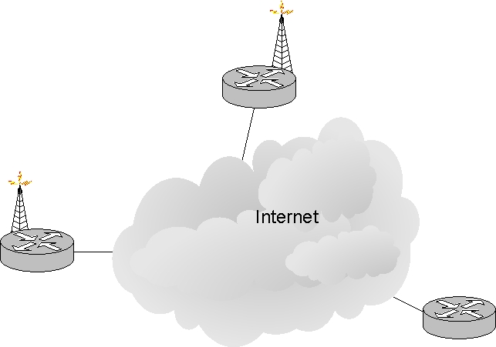


Motivation: the Handover problem
Mobile Subscriber Station (MSS) uses the serving Base Station (BS) for connecting to the network
Communication is established with Correspondent Node (CN)
MSS moves away, to the area covered by the target BS.
200.1.1.1
Target BS
Correspondent Node
192.2.3.1
MSS
Serving BS
CN
197.2.3.1

Slide 5
Motivation (Cont’)
We would like the Handover (HO) to be transparent to the higher layers (above IP).
For doing so, we must minimize the HO delay and eliminate packet losses during HO.
MSS
200.1.1.1
Target BS
Correspondent Node
192.2.3.1
Serving BS
CN
197.2.3.1

Slide 6
Existing solutions
802.16e is an extension of 802.16, which deals HO.
802.16e discusses mainly the lower layers’ HO mechanism
Note: the revision which was used at this project is D5, from 2004 (the newest revision which was available during the work on this project).
A newer revision was approved and published by IEEE on
7-Dec-05.
At the current HO mechanisms, the IP connectivity is broken during the lower layers’ HO.
LPM is a scheme, which was proposed in aim to let the L3 HO and L2 HO procedure to progress concurrently so as to minimize the HO affects on the higher layers’ performances.

Slide 7
Agenda
Overview of IEEE 802.16 standard
Motivation: the Handover problem and existing solutions
LPM Handover scheme
The Opnet model
Simulations results
Conclusions

Slide 8
Least Packet Marking (LPM)
Additional terminology:
PAR: Packet Access Router
HA : Home Agent
AAA: Authentication, Authorization & Accounting
ISP : Internet Service Provider
The ISP’s network is formed in a tree
structure.

Slide 9
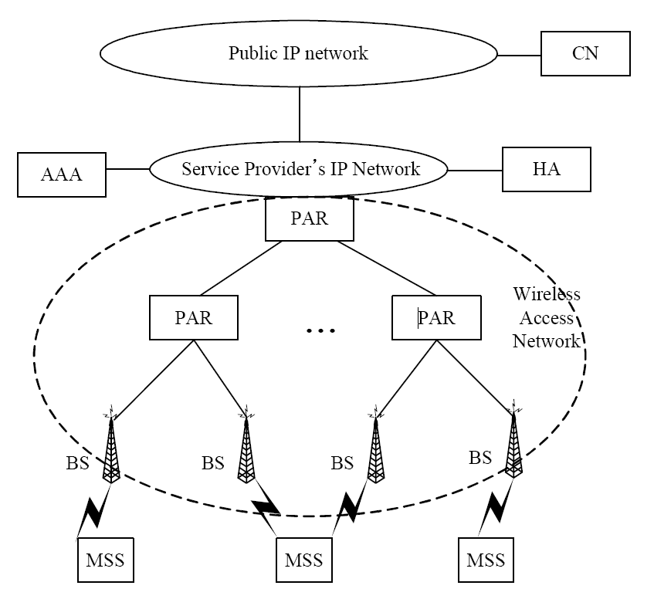
LPM: the ISP network model

Slide 10
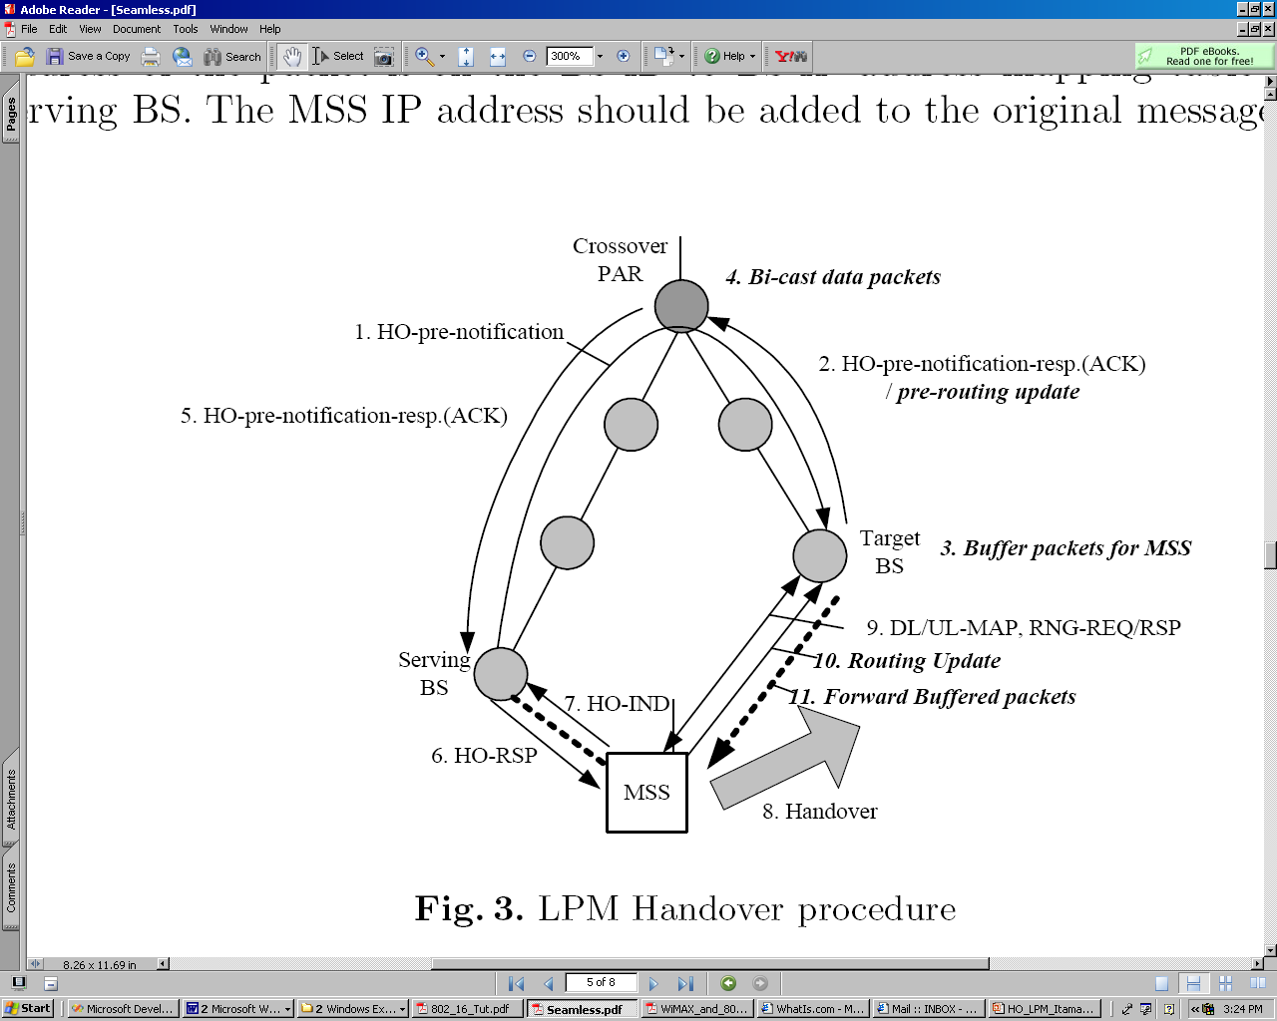
LPM HO Procedure
Route packets via the target BS
Start bi-casting packets
HO_PRE_NOT_RSP + pre-rtng_updt
HO_PRE_NOT
Routing update + LPM

Slide 11
LPM HO Procedure (Cont’)
The pace of forwarding the buffered packets from the target BS to MSS is not well defined in the paper [1].
In practice, the number of these packets is very low.
Thus, in the simulation these packets are simply sent back to back, without waiting for acks.
The procedure assumes a topology of tree.
Very reasonable assumption for standard routing.
Doesn’t comply dynamic routing changes or
multi-path routing in the wired network.
However, one should recall that dynamic routing changes or multi-path routing make the HO process more complex not only in the case of LPM, but also in every other HO scheme.

Slide 12
LPM HO - Overhead
The most significant overhead of deploying LPM stems from the bi-casting and the buffering of data packets.
How many different data packets would be duplicated?
We will use the simulations’ results for answering this question.
How many duplications may there exist for a single data packet sent from CN to MSS?

Slide 13
Overhead of the duplicated packets (Cont’)
In the worst case, each level in the tree contains one exclusive leaf, which is an optional BS, which agrees to accept MSS.
→Each level in the tree contains exactly one crossover PAR.
→The number of duplications is identical to the number of levels in the tree.
Very extreme, not realistic scenario.
We shall discuss ways to decrease this significant overhead in the conclusions sections.

Slide 14
Agenda
Overview of IEEE 802.16 standard
Motivation: the Handover problem and existing solutions
LPM Handover scheme
The Opnet model
Simulations results
Conclusions

Slide 15
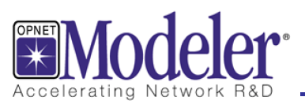
The Opnet Model
The authors of [1] used NS-2 simulations for testing their algorithm.
For enabling a meaningful comparison, wherever possible, the Opnet model uses the same simulation setup as in [1].

Slide 16
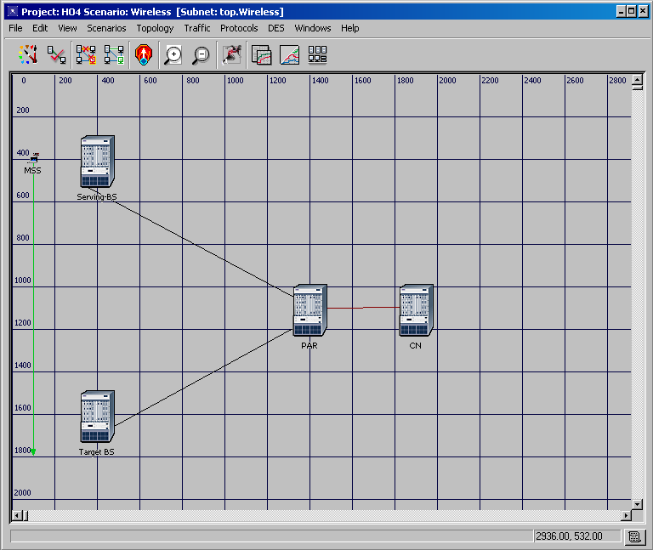
2Mbp/s wireless
(802.11) “link”
MSS’s trajectory
10BaseT, 50ms delay
10BaseT, 5ms delay

Slide 17
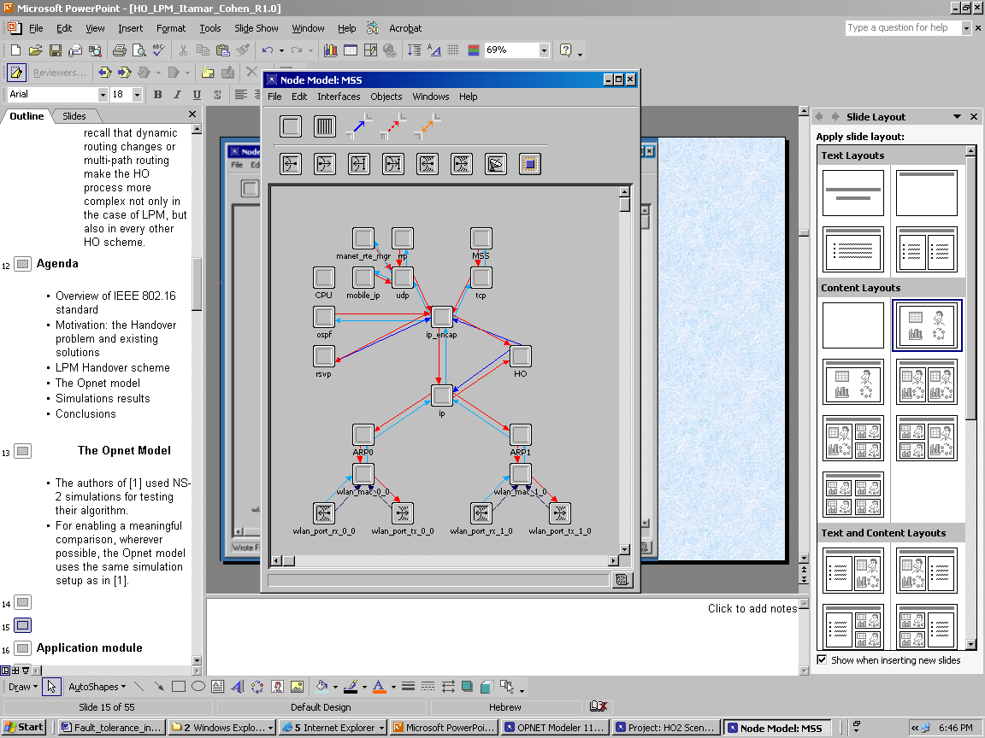
Application module
(MSS, CN) establish a (client, server)
TCP connection.
CN sends to MSS packets of 1024B.
The lower layers (and, in particular,
the HO mechanism) are totally
transparent to the application and the
TCP layers.
- In fact, only the end nodes (MSS and
CN) have TCP and application
modules.

Slide 18
HO module
Initiates, transmits and receives the
HO messages.
Injects to the network (bi-casted or
shifted) packets, by sending them to
ip_encap).
As all the packets are sent over IP,
only the final IP source & destination
can receive / transmit them.
But we need to have the ability to
intercept or dispatch packets also at
the midway nodes…

Slide 19
Brief on Opnet’s IP’s models
Ip_encap: encapsulates /
decapsulates the packets and
interfaces the higher layers.
Ip (ip_dispatch): handles the IP
connection and interfaces the lower
layers.
For manipulating the packets’
routing at the midway node, both
ip_dispatch and ip_encap were
slightly modified.

Slide 20
Manipulations on MSS’s IP modules
The modified Ip_dispatch module
intercepts the TCP segments’ packets
which are destined to CN, and sends
them to MSS HO’s module.
HO module re-injects the packets to
ip_encap, determining theirs destination to be
the target BS .
This loop enables us to use Opnet’s IP
model functionality (determining the
ports and streams, add / remove the IP
header and many Opnet’s specific
details) also for shifted, buffered and
duplicated packets.
Ip_encap was slightly modified, for
forcing it to identify the new
injected packets as TCP segments,
though they were not injected by a TCP
module.
Next slide: PAR’s HO animation
Link to the serving BS
Link to the target BS

Slide 21
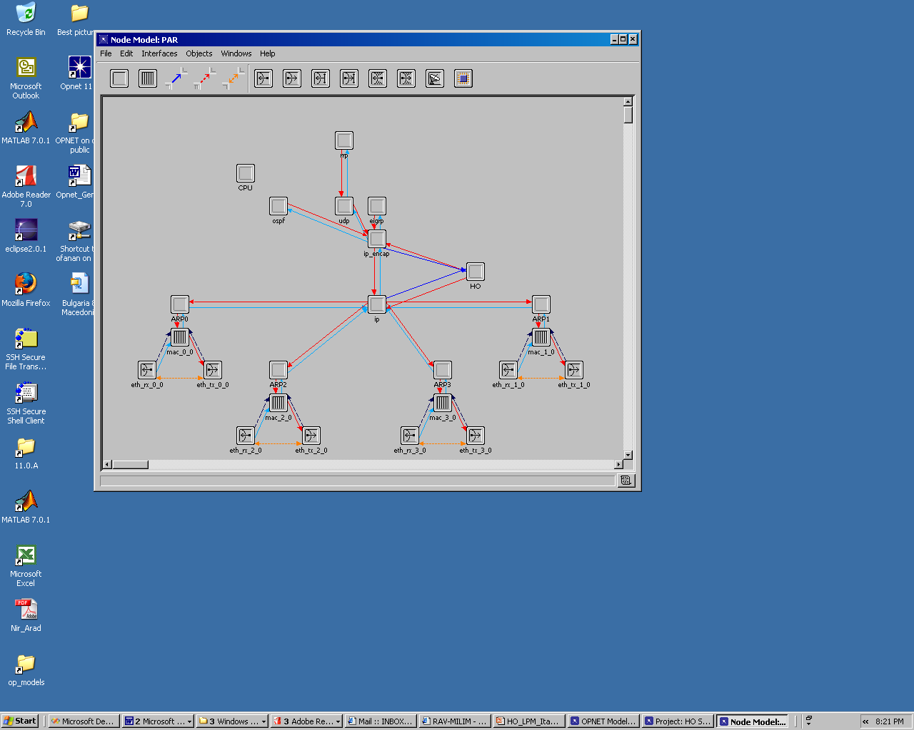
Link to CN
Link to serving BS
Link to target BS
Notes:
vcbvb

Slide 22
Agenda
Overview of IEEE 802.16 standard
Motivation: the Handover problem and existing solutions
LPM Handover scheme
The Opnet model
Simulations results
Conclusions

Slide 23
Simulation setup
The TCP connection
At t = 3sec, MSS starts the TCP connection with CN.
CN’s application layer forwards to the transport (TCP) layer 1KB packet every 8msec.
This fits to ideal throughput (TP) of 1Mbps.
TCP parameters
MSS’s receiver’s window size is 20KB, and the application’s response time is zero.
New Reno fast recovery algorithm is employed.
Read about Reno / New Reno here.
The affect of TCP parameters on the HO delay is widely discussed in the following slides.
The MAC layer
Modeled by 802.11, at data rate of 2Mbps.
Most Opnet’s WLAN attributes were set to their default.
Notes:
Additional Opnet’s TCP parameters:
Receive Buffer Usage Threshold = 0.
Delayed ack mechanism = Segment / Clock based.
Max ack delay = 0.2
Max ack segments = 2.
Slow Start Initial count = 1
Fast-re-transmit – Enable
Duplicate ack Threshold – 3.
Window scaling – disabled (see RFC 1323).
SACK – disabled.
ECN capability – disabled (see RFC-3168).
Segment Send Threshold = Byte boundary.
Nagle – Disabled.
Karn – enabled.
Init RTO (retransmission timeout) = 0.5
Min (max) RTO =0.25 (64) sec.
RTT (deviation) gain = 0.125 (0.25).
Timer granularity = 0.2
Persistence TO = 0.5.
Time stamp: status = disabled, Clock tick = 500ms

Slide 24
The simulation scenario
MSS’s trajectory
t=10: MSS starts move from near the serving BS towards the target BS.
T=20: MSS finishes its trajectory, and is located near the target BS.
See reminder of the configuration in the next slide.

Slide 25
2Mbp/s wireless
(802.11) “link”
MSS’s trajectory
10BaseT, 50ms delay
10BaseT, 5ms delay

Slide 26
Hard HO
Let us explore “hard HO”, where 802.16e schemes is deployed without LPM.

Slide 27
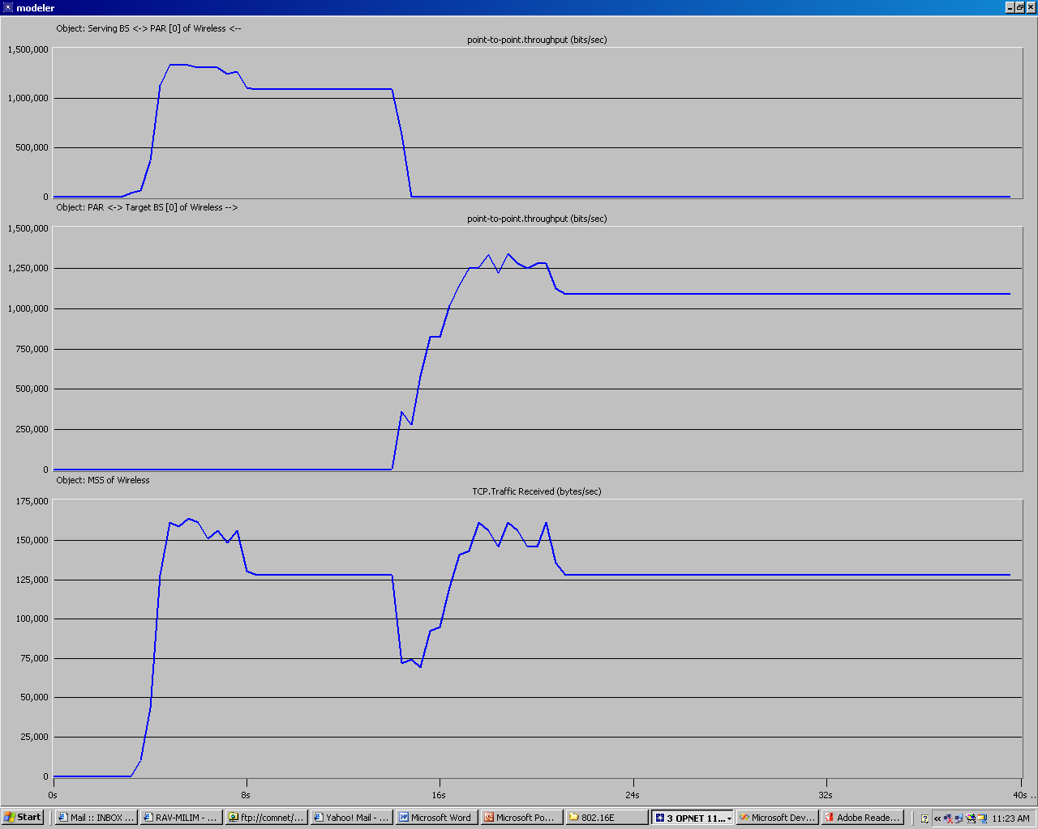
TP: PAR → Serving BS [bits/sec]
TP: PAR → target BS [bits/sec]
TCP: traffic received by MSS [bytes/sec]

Slide 28
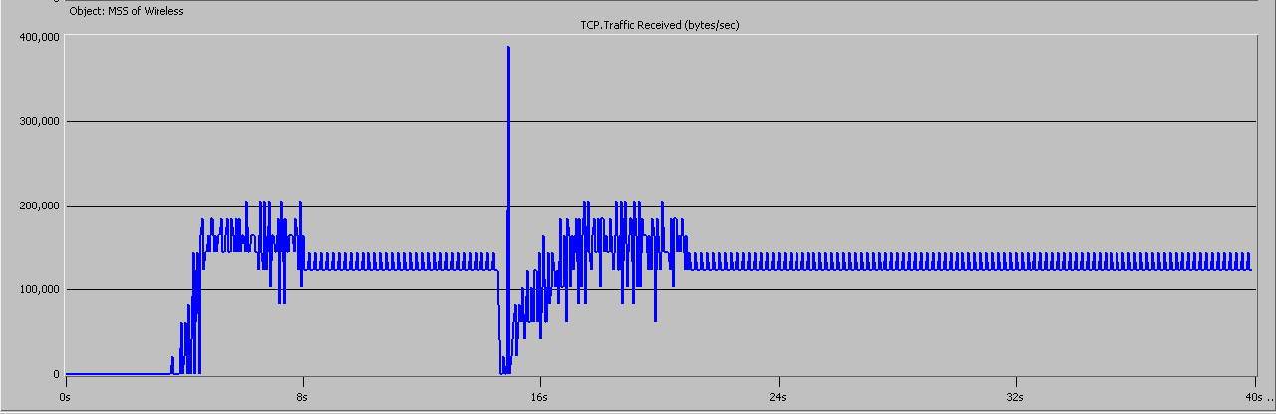
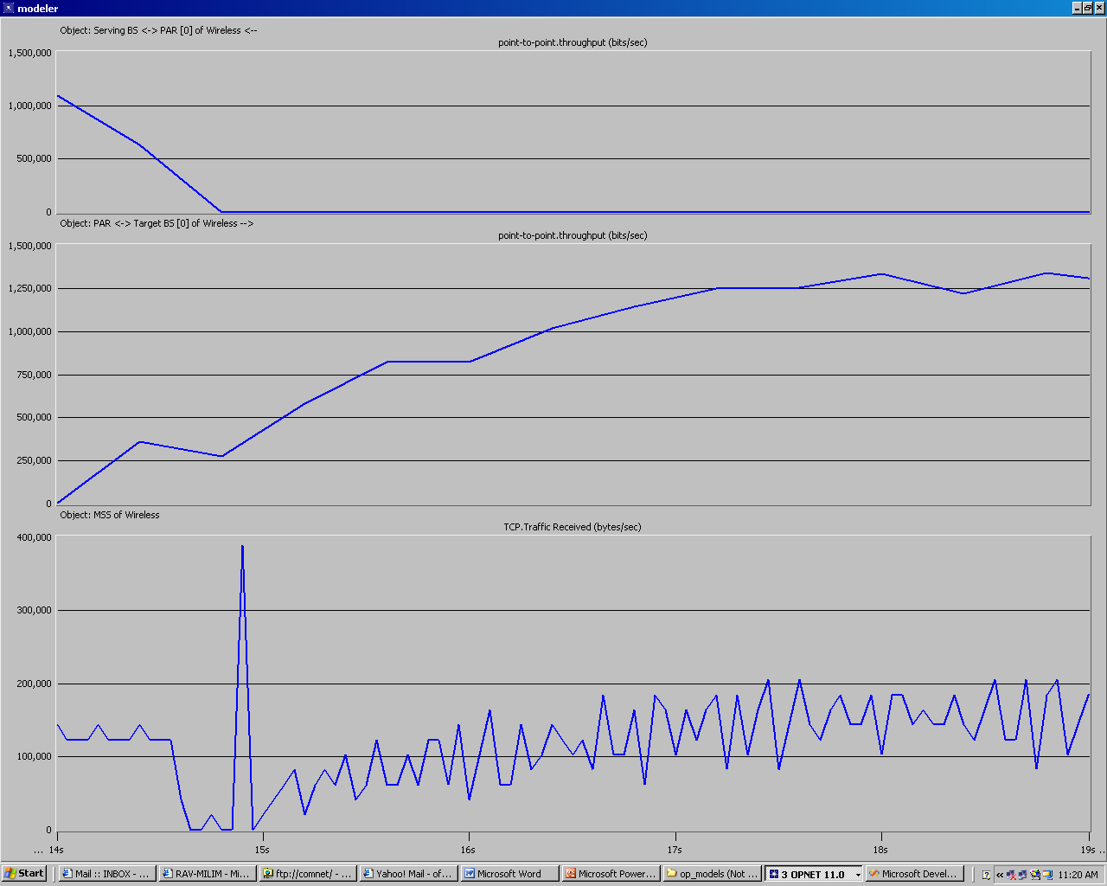
TCP: traffic received by MSS [bytes/sec]: sampling every 50ms
TCP: traffic received by MSS [bytes/sec]: sampling every 50ms. Zoom on the HO

Slide 29
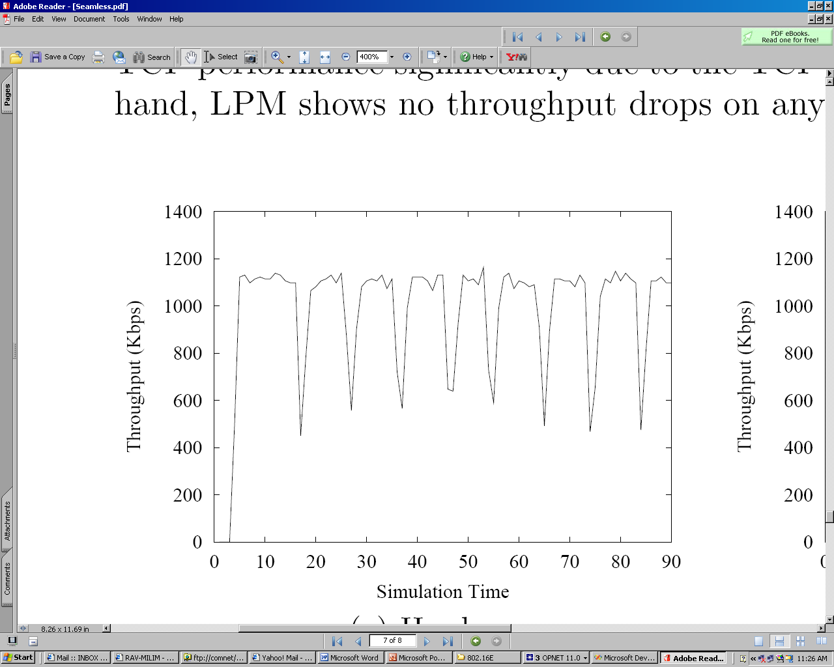
NS-2 simulations of HO every 10sec
Figure was taken from [1]
The figure was taken from [1]

Slide 30
LPM HO
Simulation of link layer HO delay
In the NS simulation in [1] the link layer’s HO delay was set to 15ms.
Accordingly, in the scenarios discussed from here and on LPM is employed, and the link layer’s HO is simulated by dropping all the TCP packets to / from MSS for a duration of 15ms during the HO (which begins when MSS sends RNG_REQ to the target BS).
LPM HO invocation
t=14: MSSHO_REQ (starting preparation for HO)
t=14.6: RMG_REQ (the real HO)

Slide 31
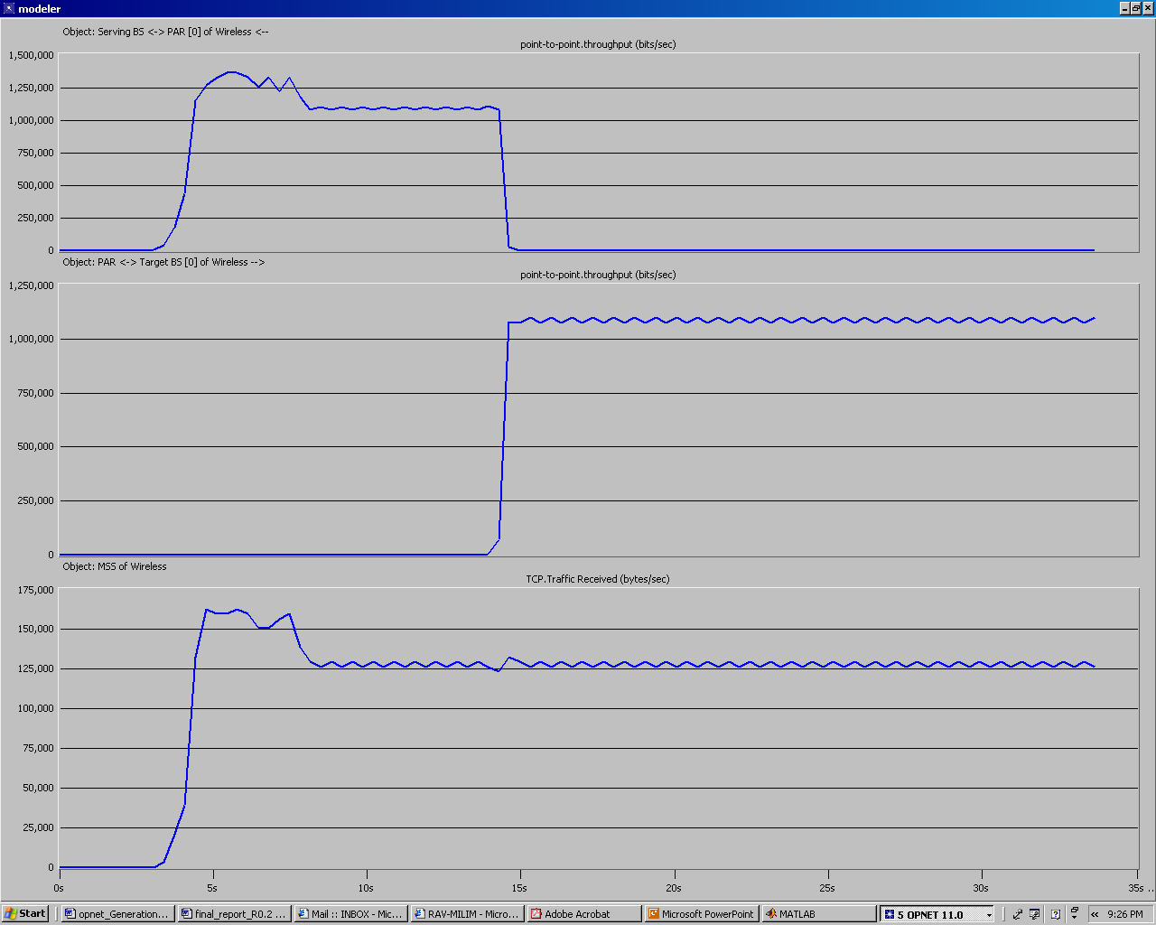
TP: PAR → Serving BS [bits/sec]
TP: PAR → target BS [bits/sec]
TCP: traffic received by MSS [bytes/sec]

Slide 32
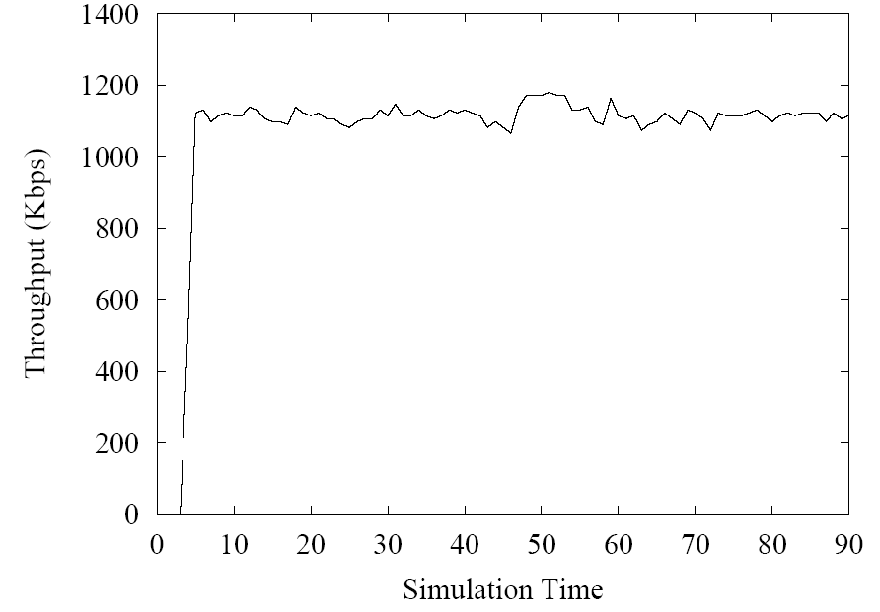
NS-2 LPM HO simulation: totally seamless
The figure was taken from [1]

Slide 33
LPM HO: IP packets’ sniffing
Sniffing of the packets at the IP modules well demonstrates how LPM HO scheme works.
Module (2246), (top.Wireless.MSS.MSS)
time: 3.482470, TCP connection with CN was successfully opened
Module (2615), (top.Wireless.MSS.HO)
time = 14.604364, starting DLL_HO_DELAY
-Module (2247), (top.Wireless.MSS.ip)
time = 14.608173, dropping TCP seg id 15798
Module (2247), (top.Wireless.MSS.ip)
time = 14.616173, dropping TCP seg id 15816

Slide 34
IP packets’ sniffing (Cont’)
Module (2615), (top.Wireless.MSS.HO)
time = 14.619364, finishing DLL_HO_DELAY
Module (2615), (top.Wireless.MSS.HO)
time = 14.619364: sending rtng_update. LPM is: 15785
Module (1580), (top.Wireless.Target BS.HO)
Time: 14.619773. Sending buffered TCP seg id 15798
Module (1580), (top.Wireless.Target BS.HO)
Time: 14.619773. Sending buffered TCP seg id 15816
Module (1580), (top.Wireless.Target BS.HO)
Time: 14.619773. Sending buffered TCP seg id 15829

Slide 35
LPM HO: simulation pitfall
One should well verify, that no new IP packet arrive to MSS from the serving BS between the time MSS’s link layer’s HO DELAY is over, and the time MSS sends routing update to the PAR (via the target BS).
Otherwise, the LPM which MSS publishes to the target BS, would be wrong.

Slide 36
The sampling rate
By default, Opnet collects most statistics once per second.
For a thorough examination of the performances, it is better to use a smaller averaging window.
However, small averaging window shows large fluctuations in the TP – not only during the HO, but also during standard TCP connection.
See example in the next slide.

Slide 37
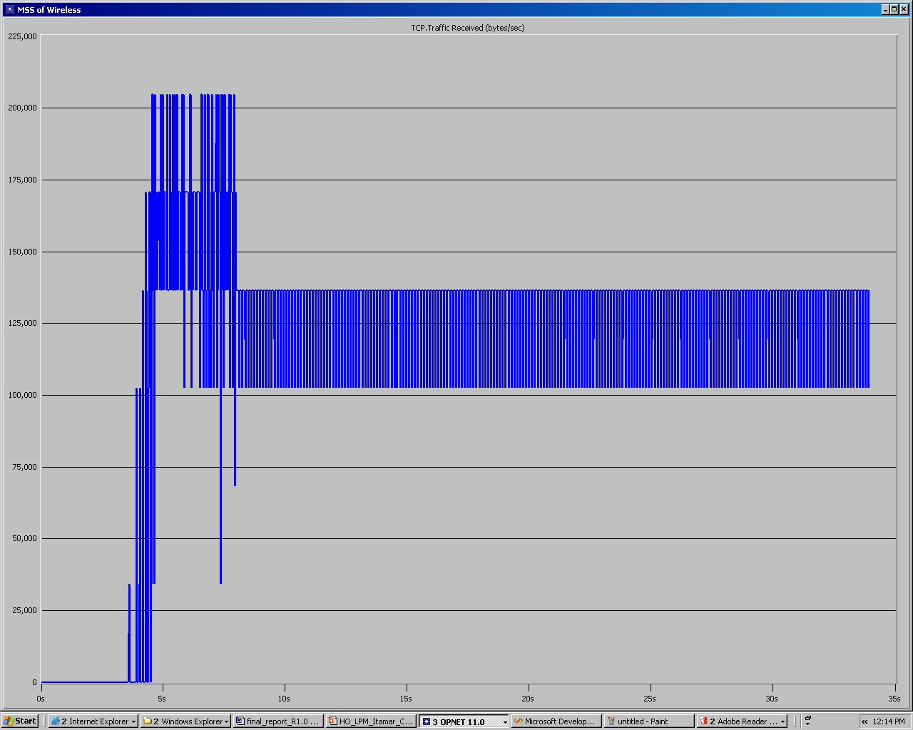
TCP: traffic received by MSS [bytes/sec]: sampling every 1sec
TCP: traffic received by MSS [bytes/sec]: sampling every 30msec

Slide 38
The impact of various parameters on LPM HO
In the following slides we shall observe the impact of various parameters on the HO.
Unless stated otherwise, only one parameter is scaled, while the other parameters remain as in the default configuration.

Slide 39
The link layer HO delay
When scaling the link layer’s HO delay from 15ms to 50ms, some performances’ degradation is inevitable.
However, LPM shows excellent resilience.

Slide 40
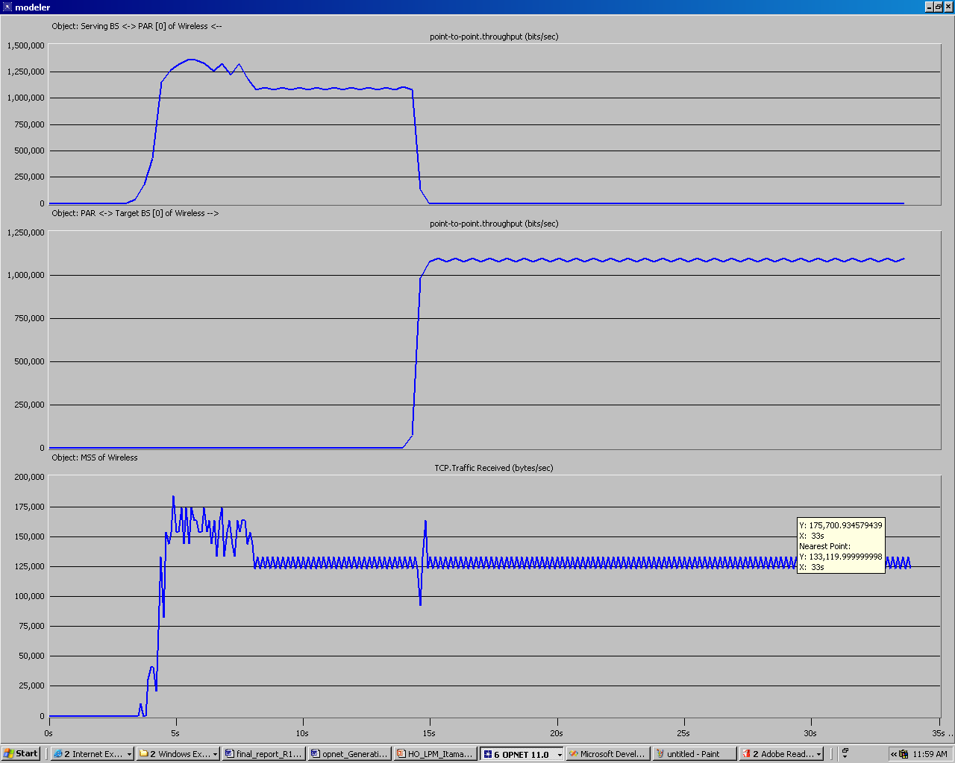
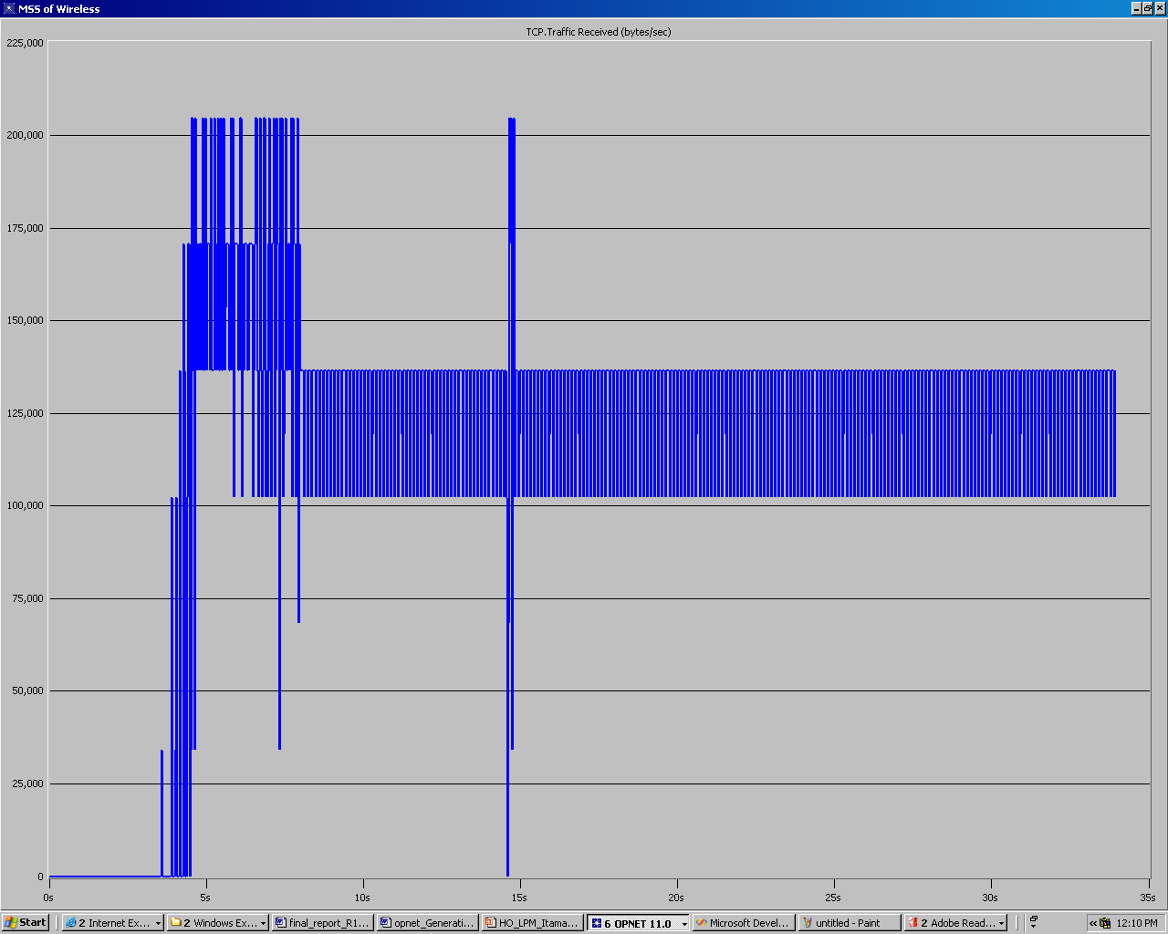
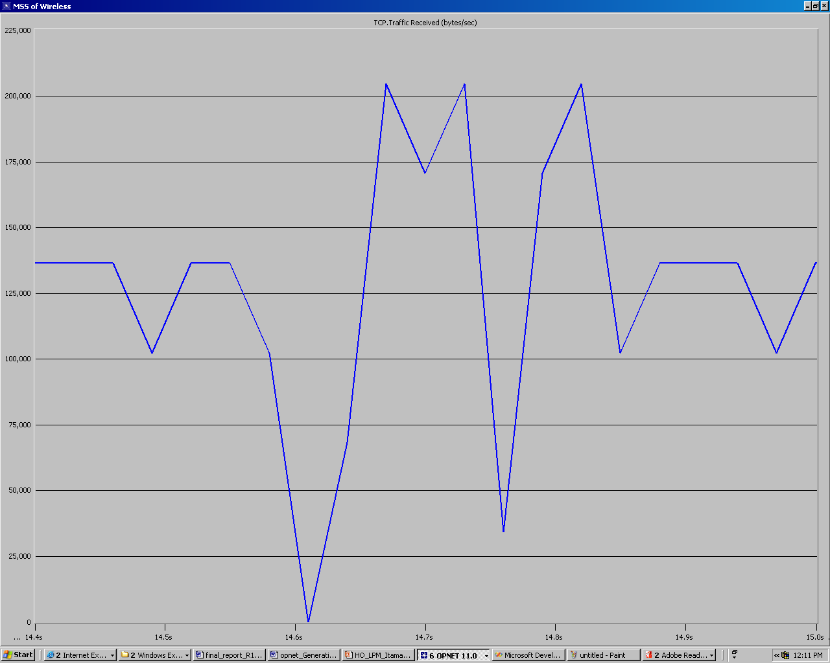
TCP: traffic received by MSS [bytes/sec]: sampling every 100msec
TCP: traffic received by MSS [bytes/sec]: sampling every 30msec
TCP: traffic received by MSS [bytes/sec]: sampling every 30msec: zoom on the HO

Slide 41
TCP receiver’s buffer
In [1], TCP window size was set to 20.
As we use fixed-size 1[KB] packets and a zero-delay application, this fits to a receiver buffer of 20[KB].
Let us explore what happens when scaling the receiver’s buffer.
Reminder: at our simulations, New Reno algorithm was employed for fast recovery.

Slide 42
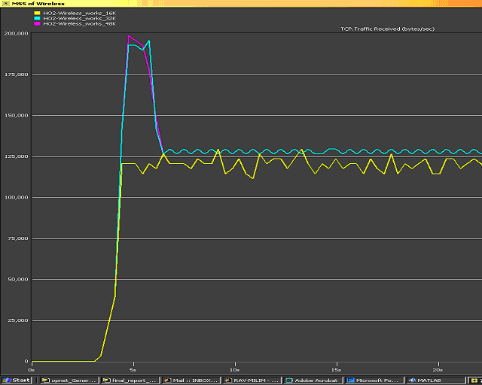
TCP: traffic received by MSS [bytes/sec]: sampling every sec

Slide 43
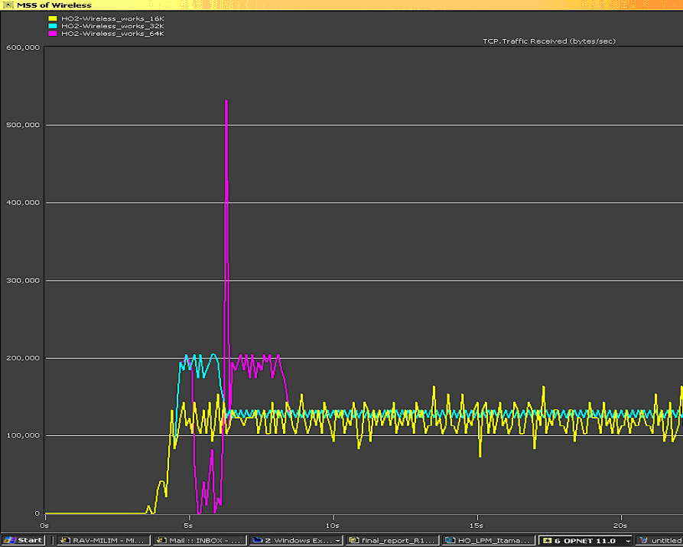
TCP: traffic received by MSS [bytes/sec]: sampling every 30ms

Slide 44
TCP receiver’s buffer: conclusions
Small receiver buffer decreases the maximum ideal TP, and causes significant fluctuations in the TP.
This problem is general, i.e. not special for the HO scenario, and indeed, no change in the fluctuations’ size is observed during the HO.

Slide 45
Application response time
In the graphs presented by now, a zero response-time application was assumed.
In real life applications may be slower, thus causing instability due to the frequent changes in the available space in the TCP receiver buffer (which may cause frequent scaling of the TCP window).
Relevant mainly for small buffers
The following slides present different application’s response times for a receiver buffer of 20KB.
The slides show very seamless HO even when the receiver’s buffer is quite small and the application is very slow.

Slide 46
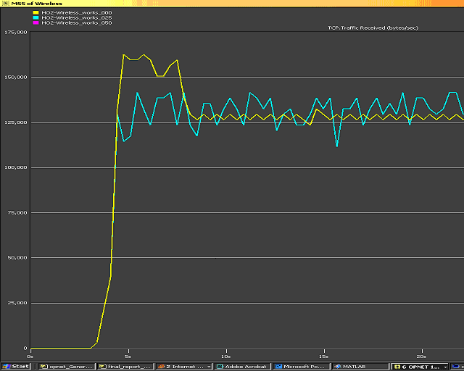
TCP: traffic received by MSS [bytes/sec].
TCP RCV SEG ratio = 0, 0.25, 0.5 (sampling every 0.5sec)

Slide 47
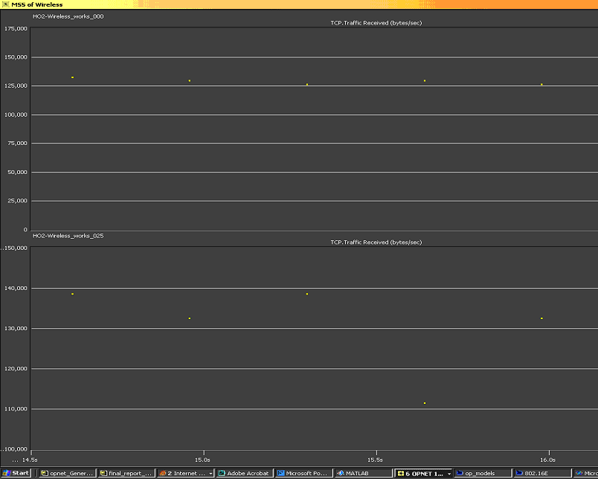
TCP: traffic received by MSS [bytes/sec]; RCV SEG ratio = 0.0 (sampling every 0.5sec)
TCP: traffic received by MSS [bytes/sec]; RCV SEG ratio = 0.25 (sampling every 0.5sec)

Slide 48
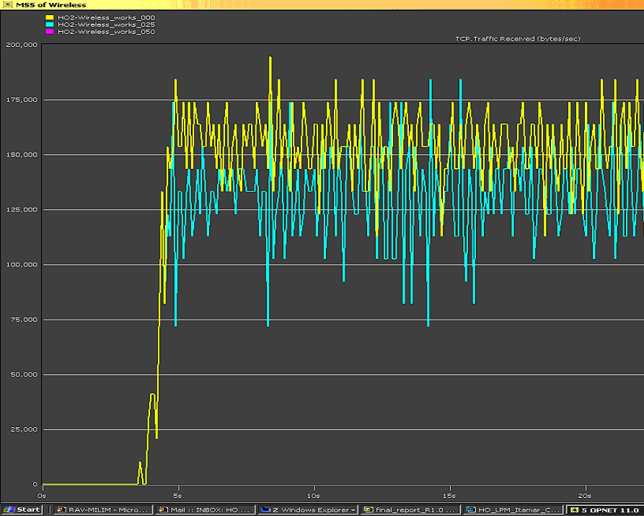
TCP: traffic received by MSS [bytes/sec]: sampling every 30ms
TCP RCV SEG ratio = 0, 0.25, 0.5

Slide 49
When should the preparation for the HO start?
If too early
Large overhead on the network due to the duplicated packets.
Not realistic, because the future trajectory of MSS is known in simulation, but not always in real life.
If too late
The many LPM HO control messages won’t have enough time for finish the preparation before the real HO starts.
The exact minimum necessary time interval between the preparation for the HO and the real HO may be found by simulations.

Slide 50
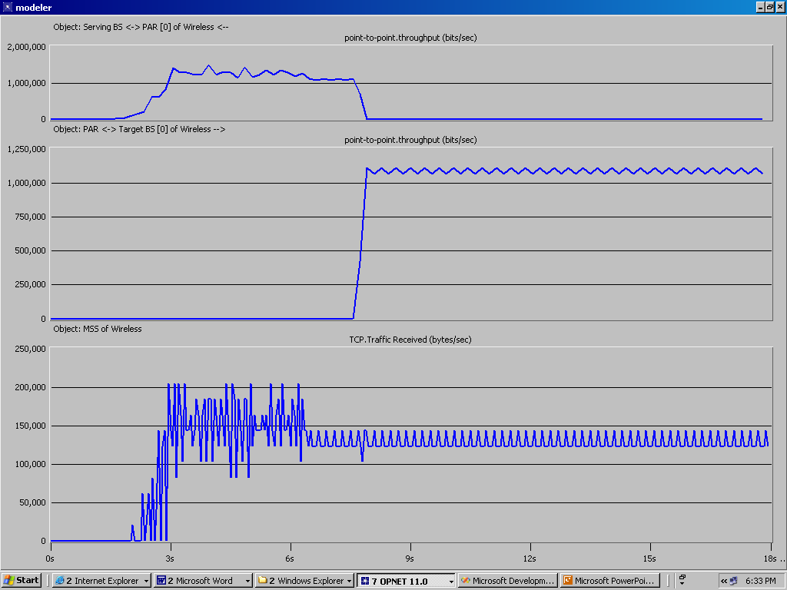
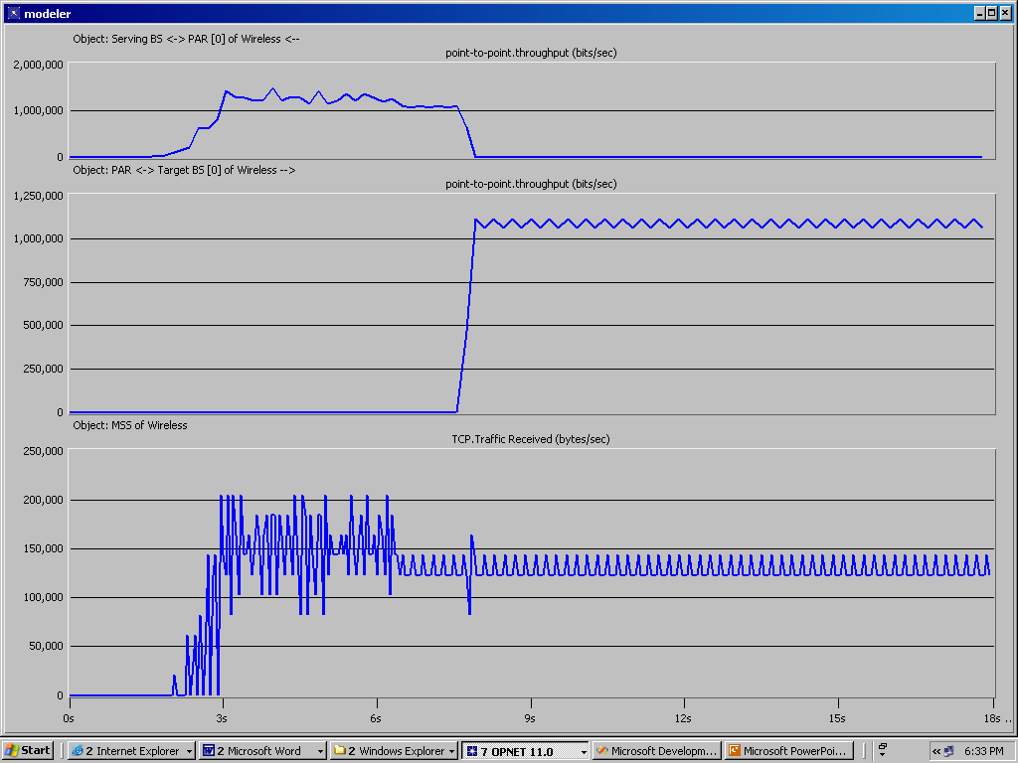
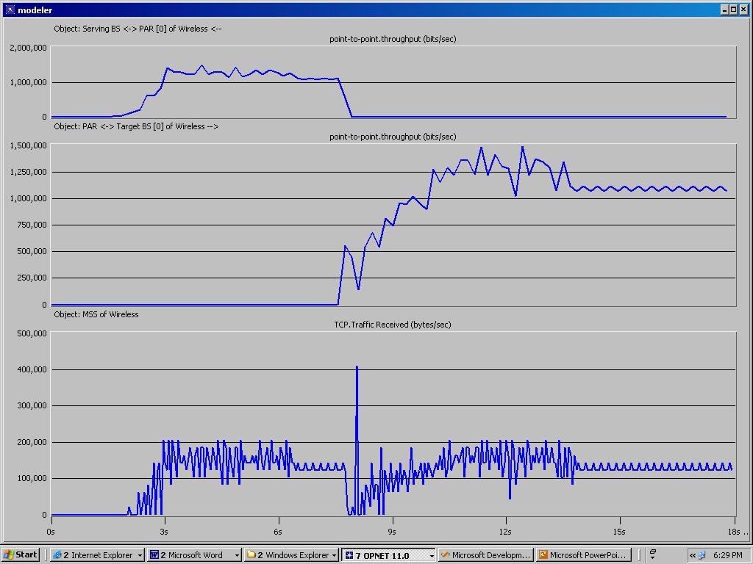
TCP: traffic received by MSS [bytes/sec]
1. The preparation starts 0.30sec before the real HO
2. The preparation starts 0.29sec before the real HO
3. The preparation starts 0.28sec before the real HO

Slide 51
When should the preparation for the HO start? (Cont’)
Repeated simulations show that for ensuring that the HO would be seamless, the preparation period should be at least 0.35sec.
A preparation period of 0.30 - 0.35sec may degrade the TP at some probability.
A preparation period shorter than 0.30sec will certainly cause a severe performance degradation.

Slide 52
Overhead of the duplicated packets
Now we can estimate the quantity of the duplicated data.
The duplication of packets starts slightly after the preparation for the HO starts, and ends slightly after the real HO is done.
The preparation for the HO takes at least 0.35sec.
The real HO delay is 0.15sec.
At a data rate of 1Mbps, this means overhead of about 0.5Mb of duplicated data.
In fact, the length of the time interval, during which packets are bi-casted, is bounded also by the routing update timeout.
Reminder: each data packet may be duplicated several times – once per each candidate target BS, which agrees to accept MSS.
→ The amount of ~0.5Mb should be multiplied by the number of such candidate target BSs.

Slide 53
MSS’s trajectory speed
We will now examine a much faster scenario, where MSS moves at an unrealistic speed of 1.4km/sec, and thus finishes its trajectory within ~1sec.
In fact, MSS moves so fast, that it has to start the preparation for the HO as soon as it starts to moves.
The exact values are:
t=1.50: MSS starts the TCP connection with CN.
t=8.00: MSS starts moving.
t=8.00: MSS_HO_REQ_TIME
t=8.35 → 8.50 The real HO.
t=9.00: MSS finishes its 1400m trajectory.
→ MSS’s speed = 1.4km/sec

Slide 54
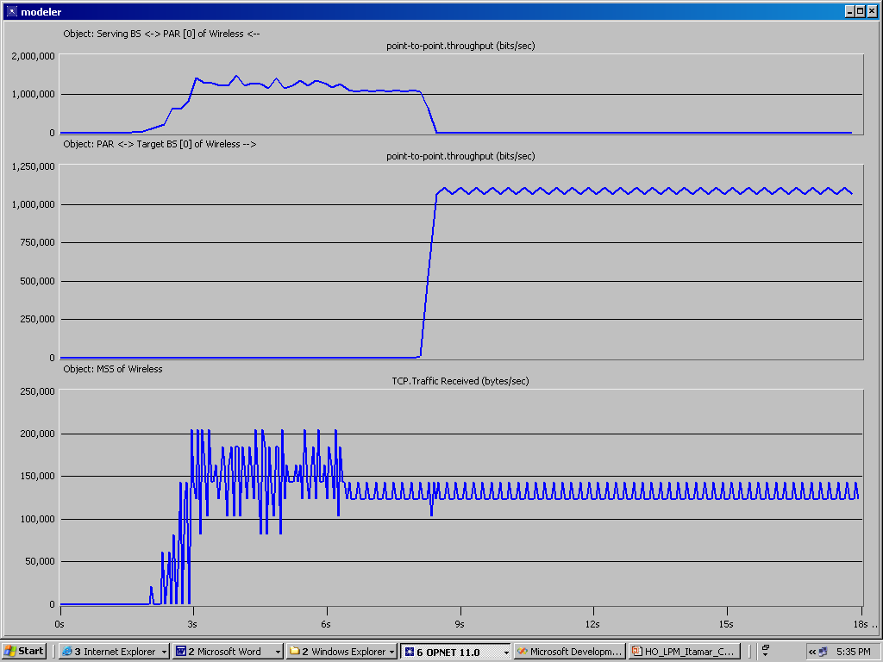
TP: PAR → Serving BS [bits/sec]
TP: PAR → target BS [bits/sec]
TCP: traffic received by MSS [bytes/sec]

Slide 55
But why not start the preparation for the HO even before start moving?
The exact values are:
t=1.50: MSS starts the TCP connection with CN.
t=7.99: MSS_HO_REQ_TIME
t=8.00: MSS starts moving.
t=8.34 → 8.49 The real HO.
t=9.00: MSS finishes its 1400m trajectory.

Slide 56

TP: PAR → Serving BS [bits/sec]
TP: PAR → target BS [bits/sec]
TCP: traffic received by MSS [bytes/sec]

Slide 57
Too good to be true?...
The perfect HO at such a tremendous speed seems like a magic – or like a trick…
We will widely discuss the possible pitfalls later.
As we saw, the time interval of the preparation for the HO + the real HO is at least 0.5sec.
Thus, we will not discuss scenarios, in which MSS finishes its trajectory within less than 2*0.5sec = 1sec.

Slide 58
HO at higher data rate
NS-2 simulations used a 2Mbps 802.11 connection for “approximating” 802.16.
For checking whether LPM HO is seamless either at higher data rates, a few parameters were changed as follows:
Data rate of the 802.11 Wireless connection: 11Mbps
The 10BaseT wires were upgraded to 100BaseT wires.
MSS’s TCP receiver buffer: 128KB
The rate of the data initiated by CN application: 8Mbps
The bottom line: the HO is still totally seamless.
Testing at higher data rate was impossible, as Opnet limits the maximal data rate of 802.11 to 11Mbps.

Slide 59
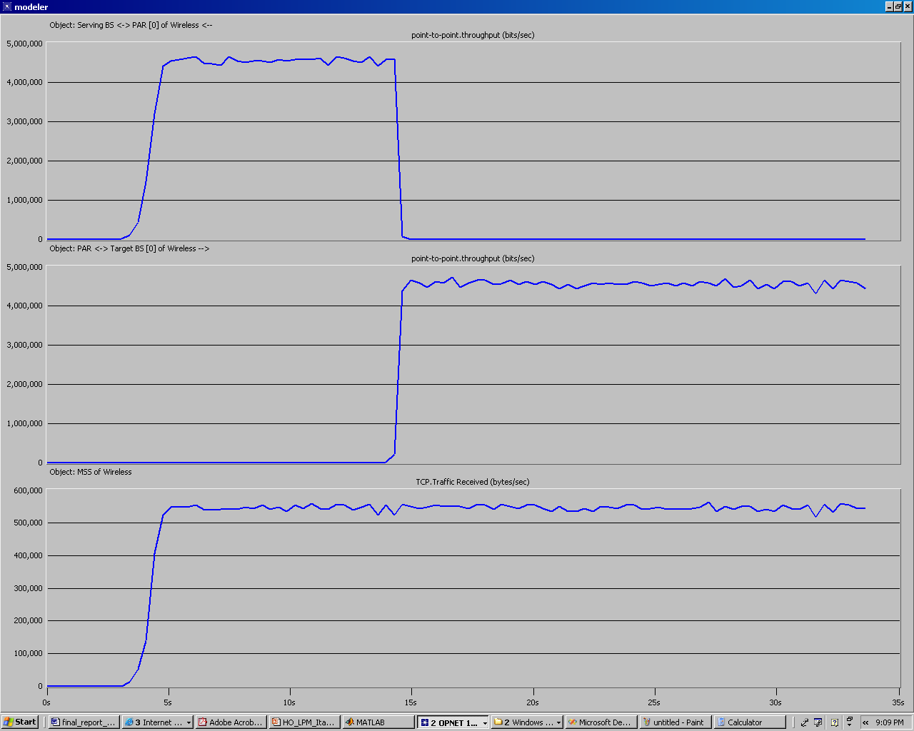
TP: PAR → Serving BS [bits/sec]
TP: PAR → target BS [bits/sec]
TCP: traffic received by MSS [bytes/sec]

Slide 60
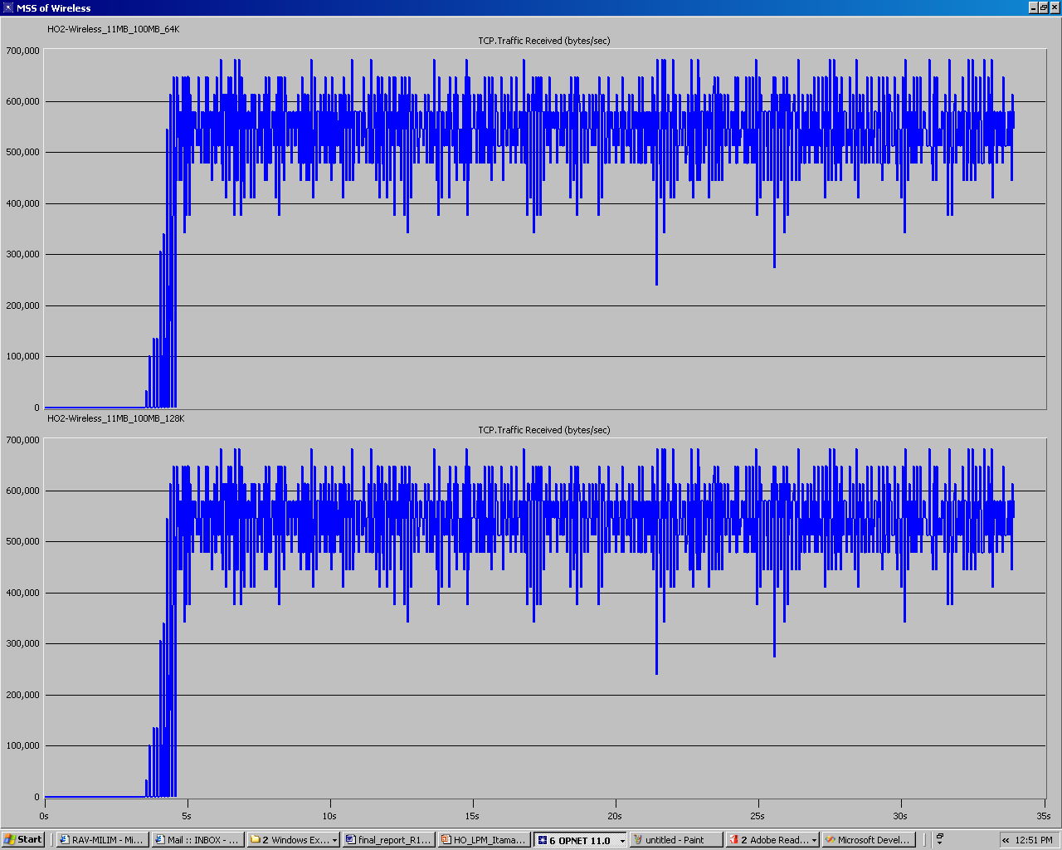
TCP: traffic received by MSS [bytes/sec]: sampling every 30ms; rcv_buff=64KB
TCP: traffic received by MSS [bytes/sec]: sampling every 30ms; rcv_buff=128KB

Slide 61
Scaling the timer granularity
The timer granularity is the shortest time duration used to handle all TCP’s timers, except the maximum ACK delay timer.
A higher (i.e. slower) timer granularity may hurt the stability of the connection.
However, scaling the timer granularity from 0.2sec to 0.5sec had no impact on LPM HO’s results.

Slide 62
Changing more parameters
Various scenarios (not presented here) in which a few parameters were changed together, were also tested.
LPM was found again very stable; no new interesting affects were found.

Slide 63
Agenda
Overview of IEEE 802.16 standard
Motivation: the Handover problem and existing solutions
LPM Handover scheme
The Opnet model
Simulations results
Conclusions

Slide 64
Conclusions
Implementing LPM consumes high overhead.
The additional control messages.
The routing updates.
The duplication of the packets by the PAR(s), and theirs buffering by the target BS(s).
The additional load on the network due to the duplicated packets.
One should recall that in the real world many MSSs may join / leave a BS simultaneously.
However, the excellent simulations results of LPM pose it as a very promising scheme for solving the complex problem of fast dynamic HO.
Only after the common-used network simulators (NS and Opnet) would enable simulations of 802.16 standard, will we have a closer-to-reality approximation of the performances of LPM HO.

Slide 65
Issues for future work
We discussed a simplified scenario, in which there is only one MSS and hard-coded Serving BS and Target BS.
Once 802.16 is modeled in Opnet, one should consider a more sophisticated model, in which
Many MSSs compete for the bandwidth.
Each BS is a target BS (serving BS) of many MSSs, which join (leave) it simultaneously.

Slide 66
References
[1] Kyung-ah Kim, Chong-Kwon Kim, Tongsok Kim, A Seamless Handover Mechanism for IEEE 802.16e Broadband Wireless Access. Lecture Notes in Computer Science, Volume 3515, Jan 2005, Pages 527 – 534
[2] The IEEE 802.16 WirelessMan Standard for Broadband Metropolitan Area Networks, Roger B. Marks, IEEE computer society distinguished visitors program, 9-Apr-03.
[3] The IEEE 802.16 Working Group on Broadband Wireless Access Standards
[4] The WiMAX Forum
[5] Opnet

