Slide 1
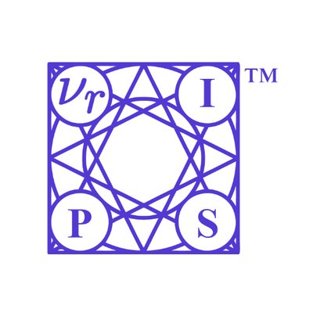

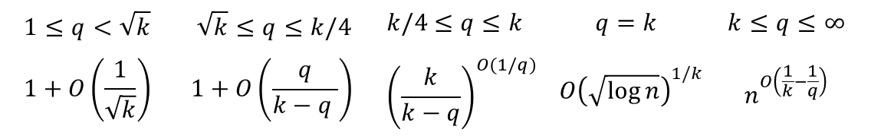
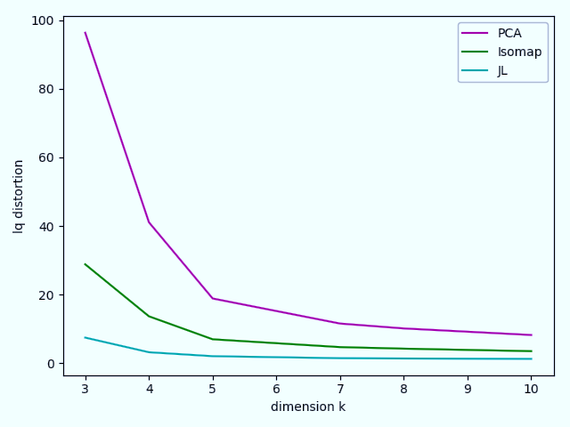
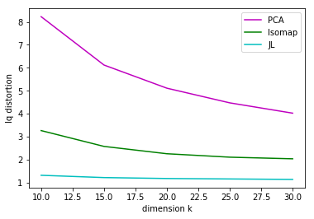
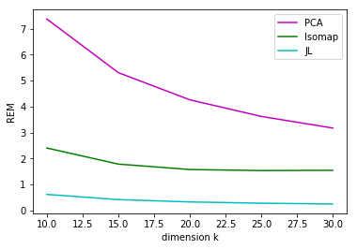
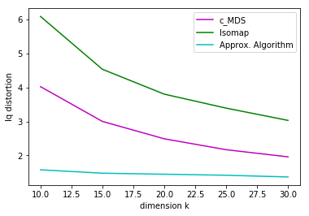


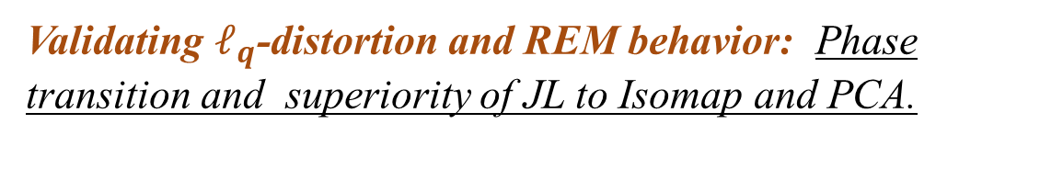
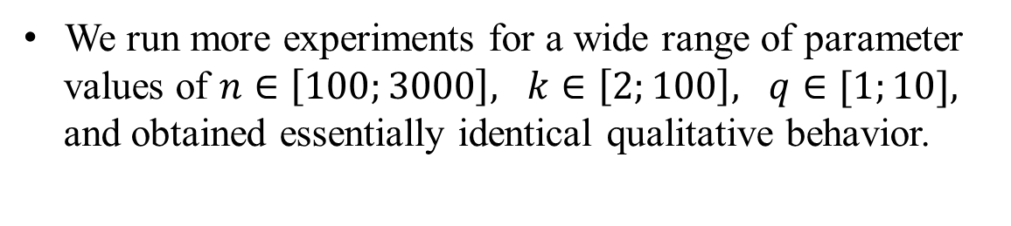



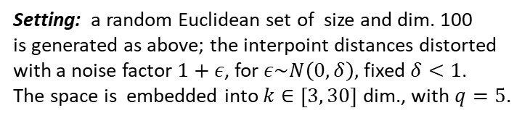

Dimensionality Reduction: Theoretical Perspective on Practical Measures
They say, in practice, // Few dimensions are enough. // But in theory?
Nova Fandina, joint work with Yair Bartal & Ofer Neiman @ Hebrew University, Ben Gurion University
Background and Motivation
Quality Measures: Practical Criteria
Our Results: Analysis and Approximation
Empirical Experiments
Metric dimensionality reduction is a fundamental tool in a vast range of application areas, where data from a general metric is embedded into low dimensional space. It is often used as the first step before applying data analysis algorithms.
In most practical applications, the quality of the method is measured by various average case criteria: average performance of the embedding over all pairs of the input data.
Most of theoretical research has been devoted to analyzing the worst-case behavior of the dimensionality reduction method, and hence has little relevance to practical settings.
The goal of this work is to bridge the gap between theory and practice outlook on dimensionality reduction. Among our results:
Nearly tight bounds on the absolute values of the most basic and commonly used average case distortion criteria.
First approximation algorithms with provable guarantees.
Empirical comparison of our techniques with the most popular dimensionality reduction tools: PCA, MDS, Isomap.
For a map $f:X→Y$, a distribution $Π$ over a set of pairs of $X$, and any $q≥1,$ some of the most popular in practice measurement criteria:
Moments of distortion. [ABN11] Multiplicative error of a pair:
$dist_{f}\left(u,v\right)=\max{\{ {\hat{d }(u,v)}/{d(u,v)}}, { d(u,v)}/{\hat{d }\left(u,v\right)}\}$.
$ℓ_{q}$-distortion(f) = ${\left(E_{Π}\left[(dist_{f}{\left(u,v\right))}^{q}\right]\right)}^{1/q}$
Additive distortion measures. Originated within the MDS community [~60s]. The most common are Stress, Energy and Relative Error Measure:
$${REM}_{q}(f)={\left(E_{Π}\left[{\left(\frac{|\hat{d }\left(u,v\right)−d\left(u,v\right)|}{max\{{\hat{d }\left(u,v\right),d\left(u,v\right)\}}}\right)}^{q}\right]\right)}^{1/q}$$
ML motivated measure: $σ$-distortion. Recently proposed in [VL18], designed to indicate the quality of ML applications.
$α(q,k)$-Dimension reduction. JL map with Gaussian entries.
Theorem 1: There is a map $f:X→ℓ_{2}^{k}$, such that for a given
$q≥1,$ $ℓ_{q}$-distortion(f) is bounded from above by:
Asymptotically tight for all $q≥\sqrt{k}$.
Tight for simultaneous guarantee on the $ℓ_{q}$-distortion.
Theorem 2: There is a map $f:X→ℓ_{2}^{k}$, for $k≥2$, such that for all $1≤q<k$ simultaneously:
$$Stress_{q}, Energy_{q}, σ−dist, REM_{q}=O\left(\sqrt{q/k}\right).$$
Asymptotically tight for $q≥2$.
Not all implementations of JL have bounded measures:
Any linear map with transform matrix having a finite number of values, has $ℓ_{q}$-distortion and $REM_{q}=∞$ (on certain spaces).
Phase transition. Guidance on choosing the target dimension $k$.
Theorem 3: Any dimensionality reduction method $f$ that maps $n$-point uniform metric into $k$ dimensions, must have
$ℓ_{k}$-distortion(f)$=Ω\left({\left(\sqrt{\log{n}}\right)}^{1/k}\right)$.
Choose k = Ω(q) in order to obtain bounded q moments.
Approximating the optimal embedding. Convex Optim. + JL map.
Theorem 4: For a given finite $X$, for $k≥3$ and $2≤q<k$, there is a randomized polynomial time algorithm that computes an embedding $F$ of $X$ into $k$-dimensions, s.t. with const. prob.
$l_{q}$-distortion$\left(F\right)=\left(1+O\left(\frac{1}{\sqrt{k}}+\frac{q}{k−q}\right)\right)⋅OPT .$
$Measure_{q}\left(F\right)$ = $O(OPT)+ O\left(\sqrt{q/k} \right)$.
Setting:
We use Normal distribution with random variance for sampling Euclidean input spaces.
Validating $ℓ_{q}$-distortion and REM behavior: Phase transition and superiority of JL to Isomap and PCA.
Setting: a random Euclidean set of size and dim. 800 is embedded into $k∈\left[3, 30\right]$ dim.,
with $q=5$. (The average of 10 independent repetitions).
Non-Euclidean input space: behavior of $ℓ_{q}$-distortion
Setting: a random Euclidean set of size and dim. 100
is generated as above; the interpoint distances distorted with a noise factor $1+ε$, for $ε\sim N\left(0,δ\right),$ fixed $δ<1$.
The space is embedded into $k∈\left[3, 30\right]$ dim., with $q=5$.
Statement of the Main Questions
We run more experiments for a wide range of parameter
values of $n∈\left[100;3000\right], k∈\left[2;100\right], q∈[1;10],$
and obtained essentially identical qualitative behavior.
Quality Measures: Theoretical Perspective
$α(q,k)$-Dimension reduction. Given a dimension bound $k≥1$ and $q≥1$, what is the least $α(q,k)$ s. t. every finite Euclidean subset embeds into $k$ dim. with $Measure_{q}≤α(q,k)$?
[For any $Measure_{q}$, commonly used in practical settings].
Approximating the optimal embedding. For a given finite metric space $X$ and for $k≥1$, compute an embedding of $X$ into k-dim. Euclidean space that approximates the best possible embedding, for a given $Measure_{q}$.
Our solution is based on the JL methods.
Comparison of the JL based methods to the existing heuristics.
How well do the JL based methods perform in practice in comparison with the most popular heuristics?
Study of the near optimality of the JL based methods. Our upper and lower bounds leave a gap in the case of small $q$. This leads to an open problem of whether a better algorithm than JL exists for these cases.
Theoretical research mainly deals with worst-case distortion: informally, the largest stretch factor of a pair under embedding.
Notations: For an embedding $f:X→Y$, for a pair $u,v∈X$,
$d(u,v)=d_{X}(u,v)$, $\hat{d }(u,v)=d_{Y}\left(f\left(u\right), f\left(v\right)\right)$.
For a non-contractive $f$ the worst-case distortion is
$dist\left(f\right)=\max_{u,v∈X} \{ {\hat{d }(u,v) }/{d(u,v)}\}$.
Johnson-Lindenstrauss map: $X$ is an $n$-point Euclidean set, $f$ is a random projection of $X$ into a k-dim. subspace.
$k∼(log{n)/ε^{2}}$, $dist(f)$=$1+ε$. The bound is tight [LN16].
Any fixed $k≥1, dist(f)=\tilde{O}(n^{2/k})$. The bound is almost tight: for $k≥1$ , any map has $dist\left(f\right)=n^{Ω\left(\frac{1}{k}\right)}.$(When applied on a particular 𝑛-point Euclidean set).
Conclusions
We show nearly tight bounds on the absolute values of all distortion criteria, essentially showing that the JL transform is near optimal for dimensionality reduction.
A phase transition, exhibited in our bounds, provides guidance on how to choose the target dimension k.
We give the first approximation algorithms for embedding any finite metric into $k$-dim Euclidean space, with provable approximation guarantees.
Experimental results validate theoretical analysis and show the advantage the JL based approach on existing heuristics.

