Slide 1
Covering Metric Spaces by Few Trees
Nova Ora Fandina
Hebrew University of Jerusalem
Co-authors:
Yair Bartal, Hebrew University of Jerusalem
Ofer Neiman, Ben Gurion University

Slide 2

Embedding into a tree metric introduction
Let $G=\left(V, E\right)$ be an underected graph, with edge weights $w:E→R^{+}$
$(V, d_{G})$ is the the shortest path metric
u
2
Tree metric – is a metric defined over a tree graph:
divide and conquer approach
compact representation
efficient algorithms
1
5
1
4
3
v
Notes:
Put weights on a tree metric

Slide 3
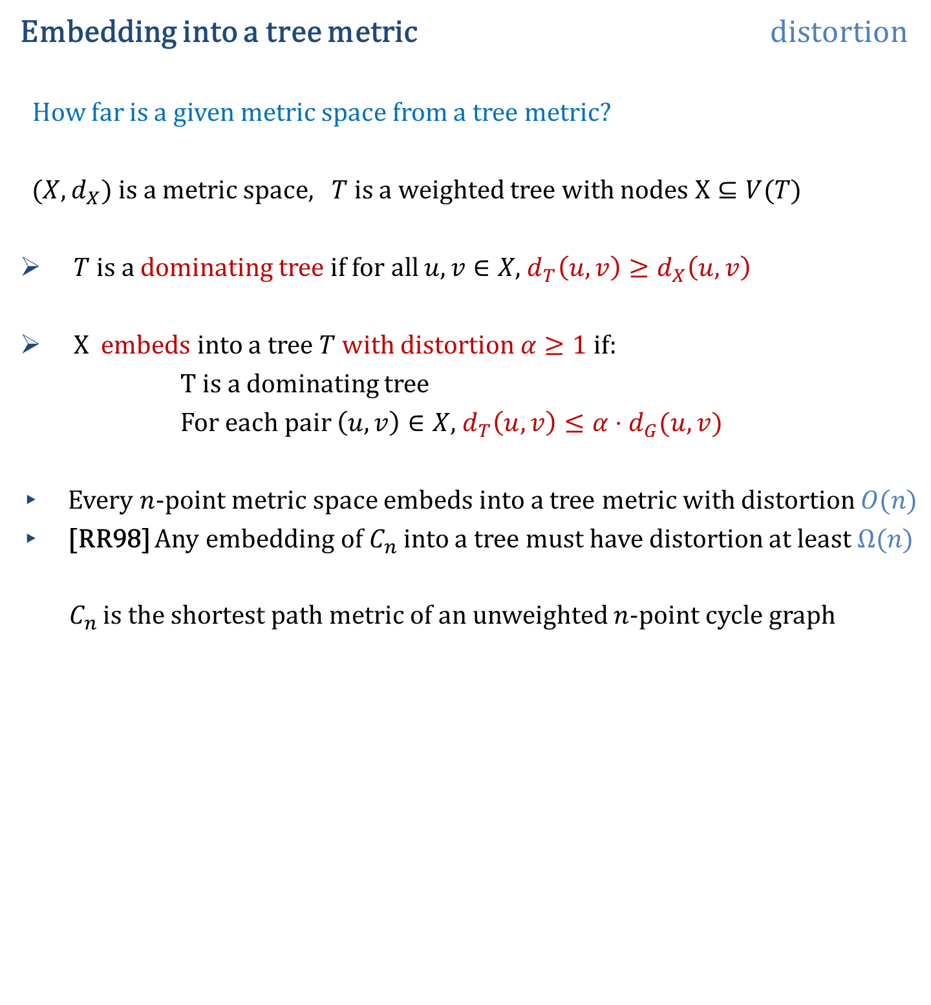
Embedding into a tree metric distortion
How far is a given metric space from a tree metric?
$(X,d_{X})$ is a metric space, $T$ is a weighted tree with nodes $X⊆V(T)$
$T$ is a dominating tree if for all $u,v∈X$, $d_{T}\left(u,v\right)≥d_{X}\left(u,v\right)$
X embeds into a tree $T$with distortion $α≥1$if:
T is a dominating tree
For each pair $\left(u,v\right)∈X$, $d_{T}\left(u,v\right)≤α⋅d_{G}(u,v)$
Every $n$-point metric space embeds into a tree metric with distortion $O(n)$
[RR98] Any embedding of $C_{n}$ into a tree must have distortion at least $Ω(n)$
$C_{n}$ is the shortest path metric of an unweighted $n$-point cycle graph
Notes:
Check RR ref, year?

Slide 4
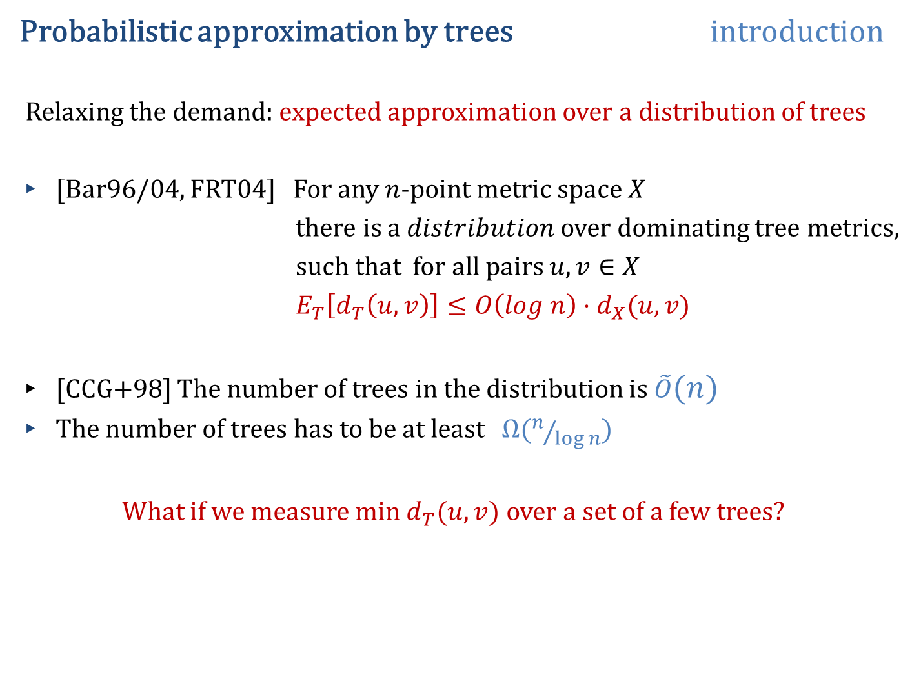
Probabilistic approximation by trees introduction
Relaxing the demand: expected approximation over a distribution of trees
[Bar96/04, FRT04] For any $n$-point metric space $X$
there is a $distribution$ over dominating tree metrics,
such that for all pairs $u,v∈X$
$E_{T}\left[d_{T}\left(u,v\right)\right]≤O\left(log n\right)⋅d_{X}(u,v)$
[CCG+98] The number of trees in the distribution is $\tilde{O}(n)$
The number of trees has to be at least $Ω(n/{\log{n}})$
What if we measure min $d_{T}(u,v)$ over a set of a few trees?
[This is tight]
Notes:
Bar04 Add

Slide 5
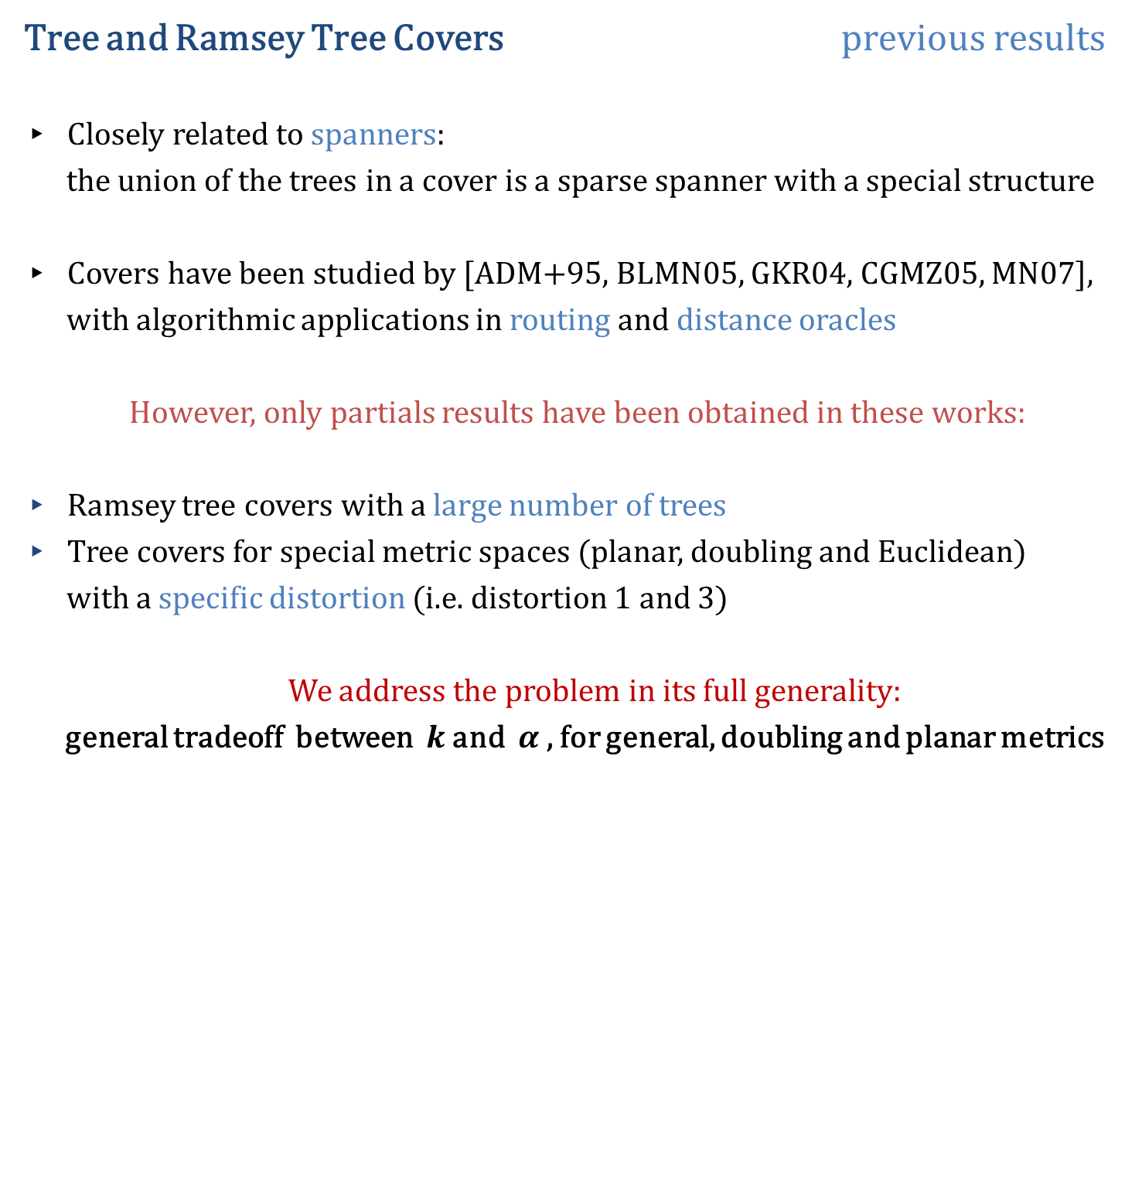
Tree and Ramsey Tree Covers previous results
Closely related to spanners:
the union of the trees in a cover is a sparse spanner with a special structure
Covers have been studied by [ADM+95, BLMN05, GKR04, CGMZ05, MN07],
with algorithmic applications in routing and distance oracles
However, only partials results have been obtained in these works:
Ramsey tree covers with a large number of trees
Tree covers for special metric spaces (planar, doubling and Euclidean)
with a specific distortion (i.e. distortion 1 and 3)
We address the problem in its full generality:
general tradeoff between $k$ and $α$ , for general, doubling and planar metrics
Notes:
Check RR ref, year?

Slide 6
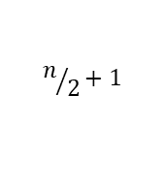


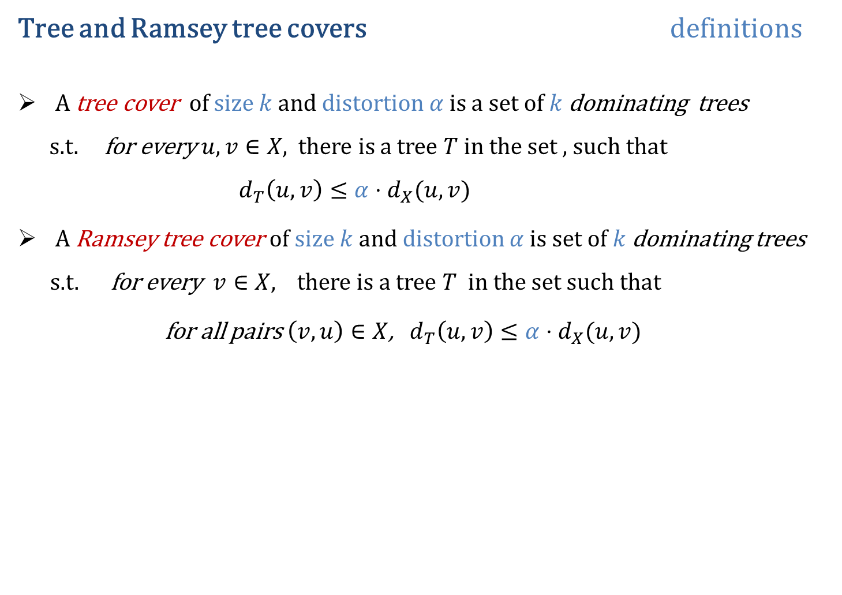




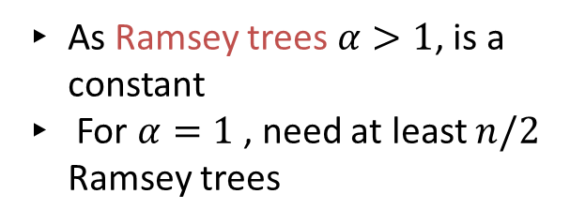







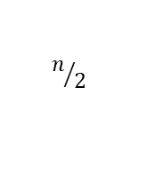

Tree and Ramsey tree covers definitions
A tree cover of size $k$ and distortion $α$ is a set of $k$ dominating trees
s.t. for every $u,v∈X$, there is a tree $T$in the set , such that
$d_{T}\left(u,v\right)≤α⋅d_{X}(u,v)$
A Ramsey tree cover of size $k$ and distortion $α$ is set of $k$dominating trees s.t. for every $v∈X$, there is a tree $T$ in the set such that
for all pairs $\left(v,u\right)∈X$, $d_{T}\left(u,v\right)≤α⋅d_{X}(u,v)$
$$n$$
$$1$$
$$2$$
$$3$$
$$n/2+1$$
$$n$$
$$1$$
$$2$$
$$n/2$$
Tree cover: $k=2, α=1$
As Ramsey trees $α>1$, is a constant
For $α=1$, need at least $n/2$ Ramsey trees
$\frac{n}{2}+1$
$$\frac{n}{2}$$
$$n$$
$\frac{n}{2}+1$
$$\frac{n}{2}$$
$\frac{n}{2}−1$
$$1$$
Notes:
The proof for Ramsey cover: each tree can isometrically host only two consecutive points on the cycle.
Say that the union of trees in the cover form a sparse spanner with a special structure

Slide 7
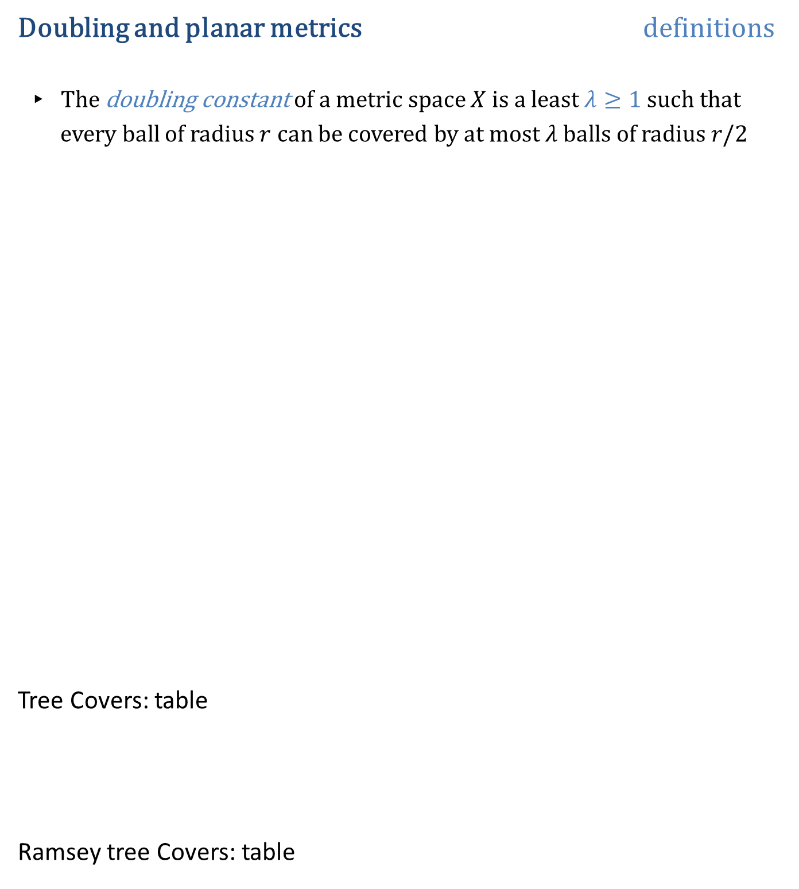
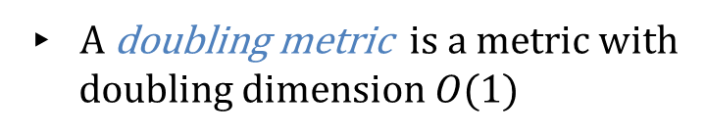

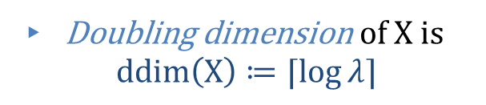
Doubling and planar metrics definitions
The doubling constant of a metric space $X$ is a least $λ≥1$ such that
every ball of radius $r$ can be covered by at most $λ$ balls of radius $r/2$
Tree Covers: table
Ramsey tree Covers: table
Doubling dimension of X is
$$ddim\left(X\right)≔⌈log{λ}⌉$$
Doubling dimension of $R^{d}$ is $Θ\left(d\right)$
A doubling metric is a metric with
doubling dimension $O(1)$
Planar metric is a shortest path metric of a planar graph
Notes:
This is a standard notion of dimension for arbitrary metrics

Slide 8











Ramsey tree covers old and new results
General metrics:
Distortion
# Ramsey trees
$$\#trees≲log n$$
$$\tilde{O}(n^{\frac{1}{k}})$$
$$k$$
[NEW]
$$Ω(n^{\frac{1}{k}})$$
$$k$$
[NEW]
$$\#trees ≳log n$$
$$α$$
$$O(α⋅ n^{1/α})$$
[MN07]
$$α$$
$$n^{ Ω\left(\frac{1}{α\log{α}}\right)}$$
[NEW]
Doubling and planar: the lower bound examples are doubling and planar
For general, planar and doubling the question is solved up to log factors
Notes:
Change the order. Also, put the disclaimer that the bad example is also aplanar and doubling. Also, our results are colored, the rest are black .
Say that all the upper bounds

Slide 9

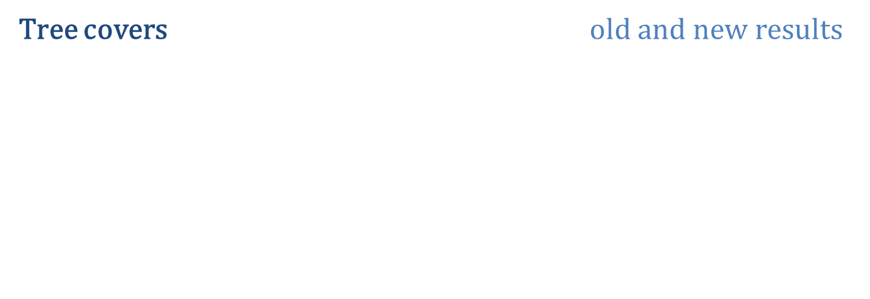


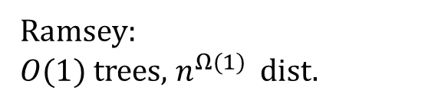

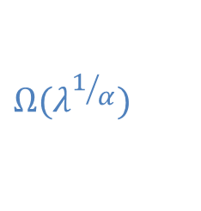






Tree covers old and new results
$λ$ – doubling metrics:
Distortion
# trees in cover
$$α$$
$$\tilde{O}(λ^{1/α})$$
[NEW]
Ramsey:
$O(1)$ trees, $n^{Ω(1)}$ dist.
$$α$$
$$Ω(λ^{1/α})$$
[NEW]
$$1+ε$$
$${\left(1/ε\right)}^{Θ(\log{λ})}$$
[NEW]
[tight]
Planar metrics:
$$1+ε$$
$$O({\left(\log{n}\right)}^{2}/ε^{2})$$
[NEW]
$$O(1)$$
$$O(1)$$
[KLMN04]
General metrics for k trees: $Ω\left(\log_{k}{n}\right)≤ α ≤\tilde{O}(n^{1/k})$

Slide 10

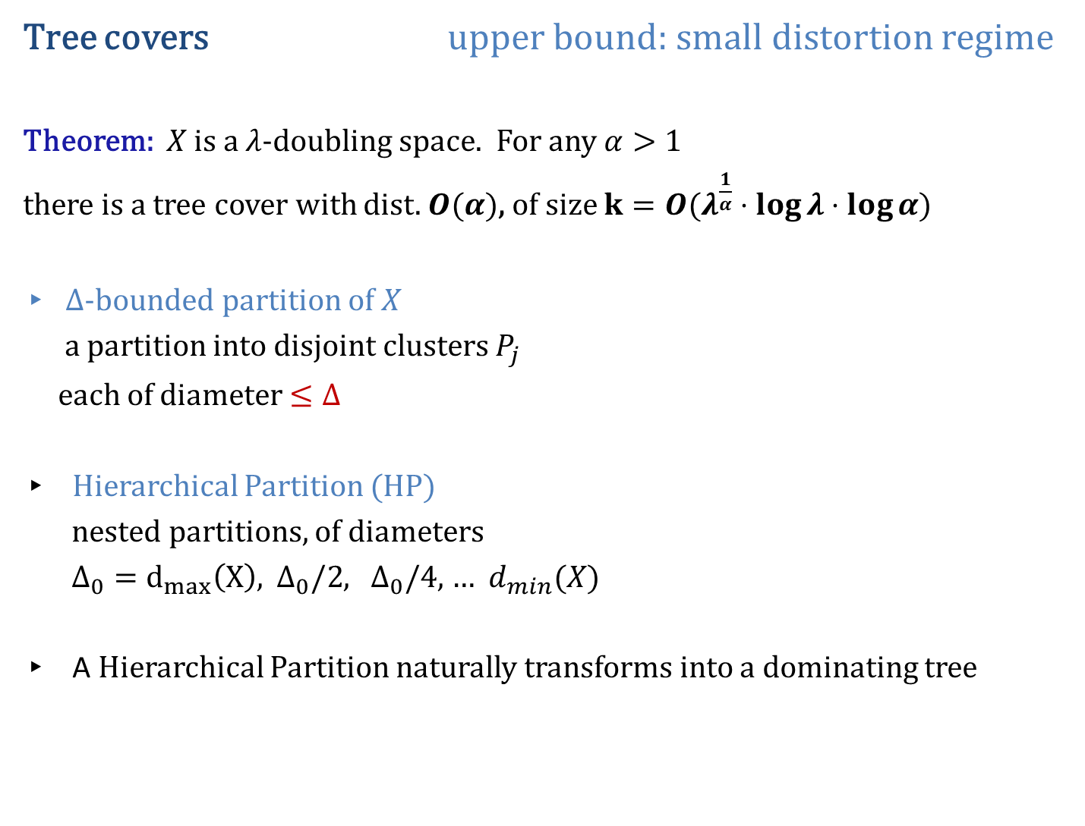






Tree covers upper bound: small distortion regime
Theorem: $X$ is a $λ$-doubling space. For any $α>1$
there is a tree cover with dist. $O(α)$, of size $k=O(λ^{\frac{1}{α}}⋅\log{λ}⋅\log{α})$
$Δ$-bounded partition of $X$
a partition into disjoint clusters $P_{j}$
each of diameter $≤Δ$
Hierarchical Partition (HP)
nested partitions, of diameters
$Δ_{0}=d_{max}\left(X\right),$ $Δ_{0}/2$, $Δ_{0}/4$, $…$ $d_{min}(X)$
A Hierarchical Partition naturally transforms into a dominating tree
$$Δ_{i}=Δ_{o}/2^{i}$$
Notes:
Slide 1: all the hierarchies and what we want eventually. A small family with padding property.
Slide: we show that there exist such a family with p.p. 1/\alpha and of small size. We use ABN which can construct one scale with padding property we want.
We use it to build a family that covers log alpha scales: it has the size we want.
Slide 3: we use locality of ABN Here to apply LLL:
Slide 4: from these we form the full range family

Slide 11

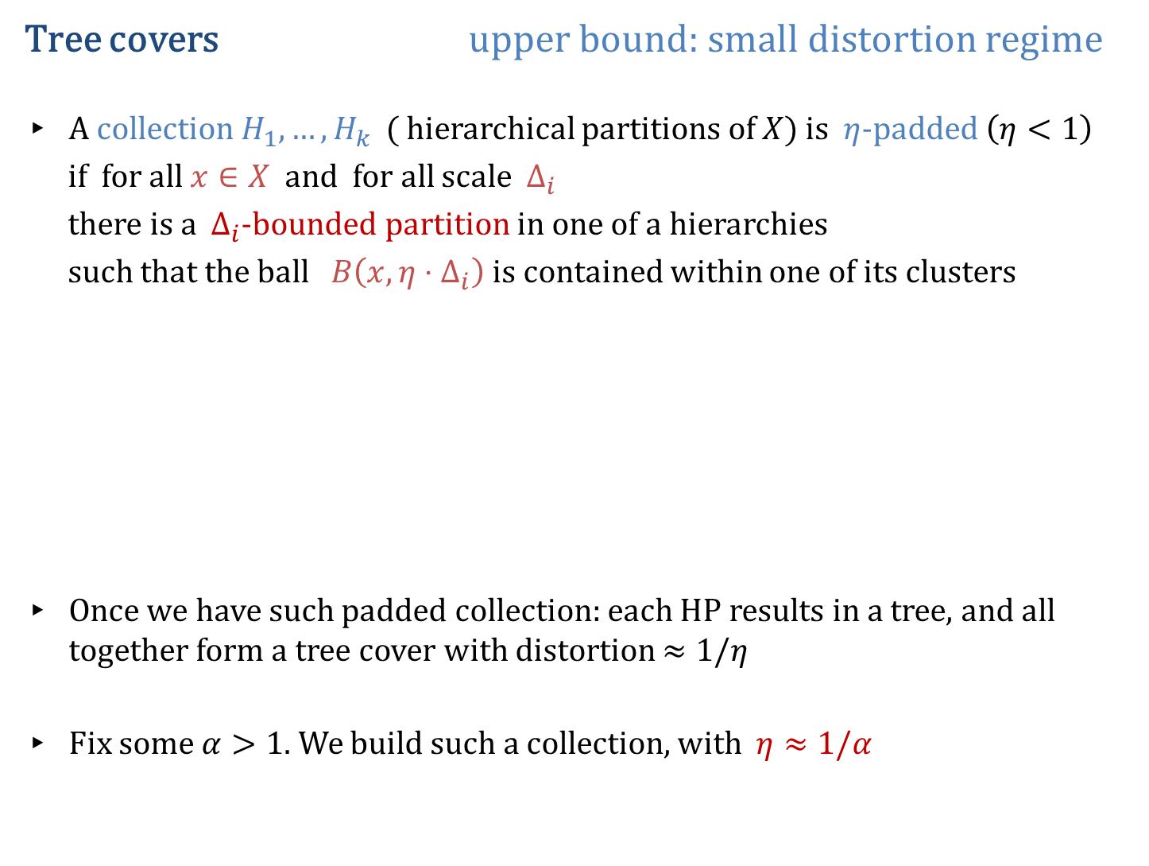









Tree covers upper bound: small distortion regime
A collection $H_{1}, …, H_{k}$ ( hierarchical partitions of $X)$ is $η$-padded $\left(η<1\right)$
if for all $x∈X$ and for all scale $Δ_{i}$
there is a $Δ_{i}$-bounded partition in one of a hierarchies
such that the ball $B\left(x, η⋅Δ_{i}\right)$ is contained within one of its clusters
Once we have such padded collection: each HP results in a tree, and all together form a tree cover with distortion $≈1/η$
Fix some $α>1.$We build such a collection, with $η≈1/α$
$$r=η⋅Δ_{i}$$
partitions of scale $Δ_{i}$

Slide 12
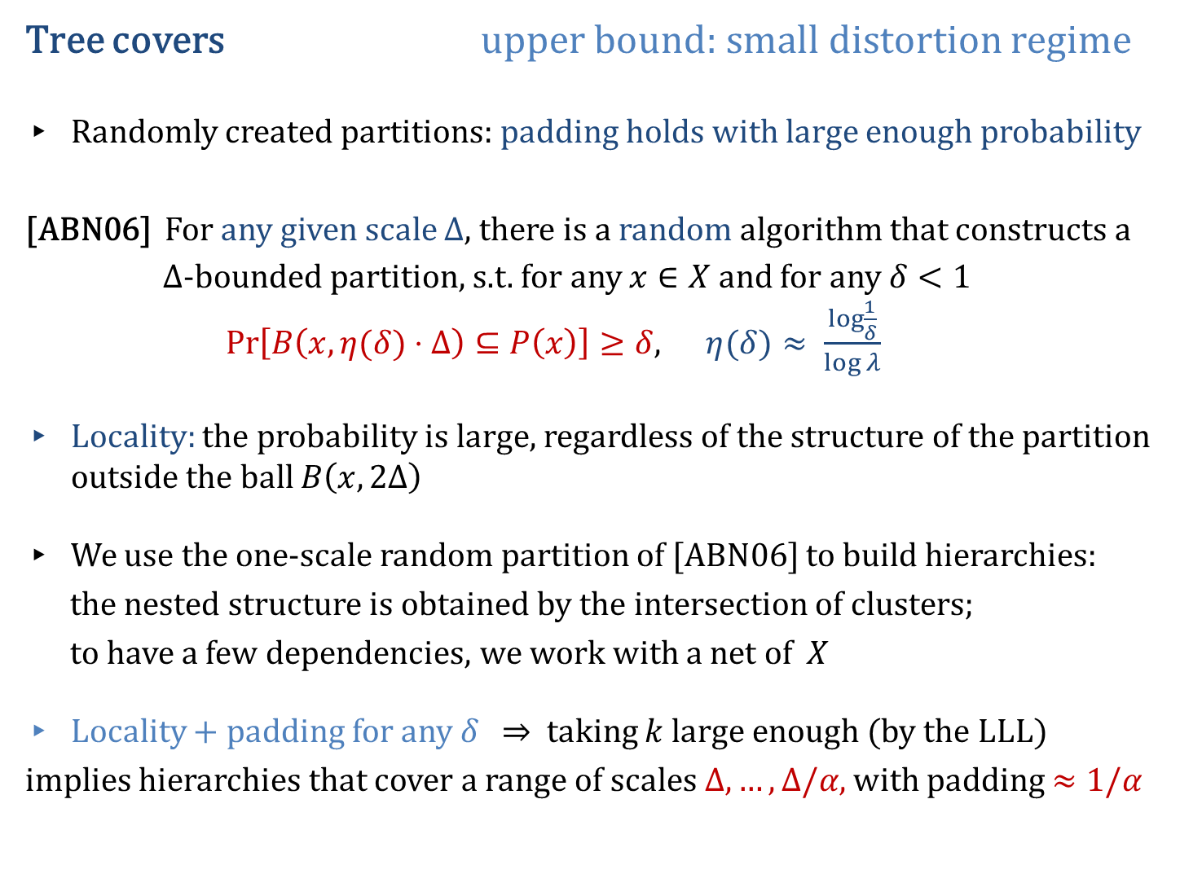
Tree covers upper bound: small distortion regime
Randomly created partitions: padding holds with large enough probability
[ABN06] For any given scale $Δ$, there is a random algorithm that constructs a
$Δ$-bounded partition, s.t. for any $x∈X$ and for any $δ<1$ $\operatorname{Pr}\left[B\left(x, η(δ)⋅Δ\right)⊆P\left(x\right)\right]≥δ$, $η(δ)≈ \frac{\log{\frac{1}{δ}}}{\log{λ}}$
Locality: the probability is large, regardless of the structure of the partition outside the ball $B\left(x, 2Δ\right)$
We use the one-scale random partition of [ABN06] to build hierarchies:
the nested structure is obtained by the intersection of clusters;
to have a few dependencies, we work with a net of $X$
Locality + padding for any $δ$ $⇒$ taking $k$ large enough (by the LLL)
implies hierarchies that cover a range of scales $Δ, …, Δ/α$, with padding $≈1/α$
Notes:
Using the locality property and the fact that the padding holds for any
parameter $δ$ , we construct random hierarchies by intersection of
clusters, and use the Lovász local lemma to obtain hierarchies of small
size that cover a range of scales

Slide 13
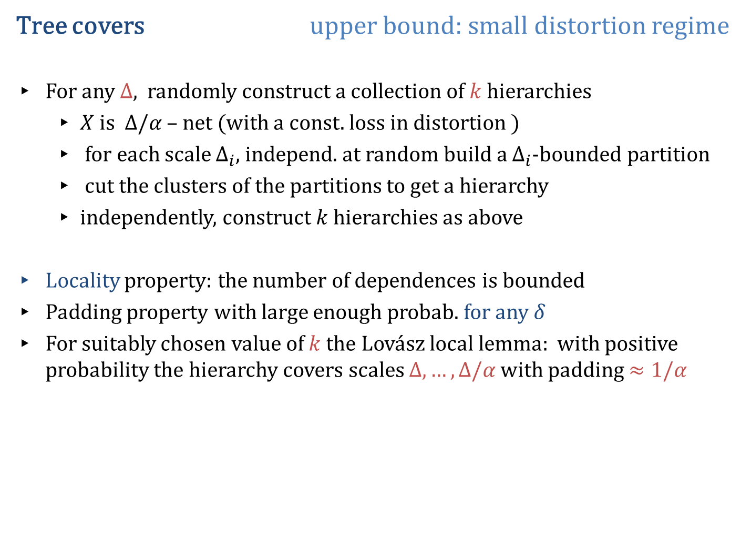
Tree covers upper bound: small distortion regime
For any $Δ$, randomly construct a collection of $k$ hierarchies
$X$ is $Δ/α$ – net (with a const. loss in distortion )
for each scale $Δ_{i}$, independ. at random build a $Δ_{i}$-bounded partition
cut the clusters of the partitions to get a hierarchy
independently, construct $k$ hierarchies as above
Locality property: the number of dependences is bounded
Padding property with large enough probab. for any $δ$
For suitably chosen value of $k$ the Lovász local lemma: with positive probability the hierarchy covers scales $Δ, …, Δ/α$ with padding $≈1/α$

Slide 14






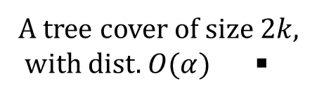





Tree covers upper bound: small distortion regime
From partial range hierarchies to full range collection of hierarchies
by union of clusters (with const. loss in distortion)
$$Δ_{0}$$
$H_{1}$ $H_{2}$ $H_{3}$ $…$ $H_{k}$
$Δ_{0}/α$
$S_{1}$ $S_{2}$ $S_{3}$ $…$ $S_{k}$
$Δ_{0}/α^{2}$
$H_{1}$ $H_{2}$ $H_{3}$ $…$ $H_{k}$
$Δ_{0}/α^{3}$
$S_{1}$ $S_{2}$ $S_{3}$ $…$ $S_{k}$
$H_{1}$ $H_{2}$ $H_{3}$ $…$ $H_{k}$
union of clusters
A tree cover of size $2k$,
with dist. $O(α)$ ◾
$d_{min}$

Slide 15


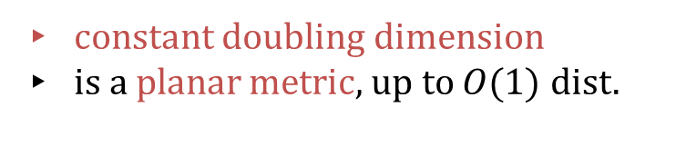
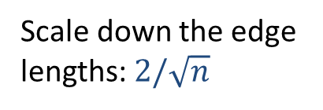

Ramsey Tree Covers few trees: lower bound
Theorem: $∀ k≥1,$there is an $n$-point $X$, s.t. any Ramsey tree cover of size $k$ must have distortion $Ω(n^{1/k})$. Moreover, $X$ is planar and doubling.
Proof. By induction on $k$
$k=1$ $X=C_{n}$ ( unweighted cycle on $n$ nodes) One tree has dist. $Ω\left(n\right)$
$k=2$ $X=C_{\sqrt{n}}∘C_{\sqrt{n}}$ (composition of $C_{\sqrt{n}}$ with itself)
$$C_{\sqrt{n}}∘C_{\sqrt{n}}$$
1
$$C_{\sqrt{n}}$$
Scale down the edge lengths: $2/\sqrt{n}$
constant doubling dimension
is a planar metric, up to $O(1)$ dist.

Slide 16
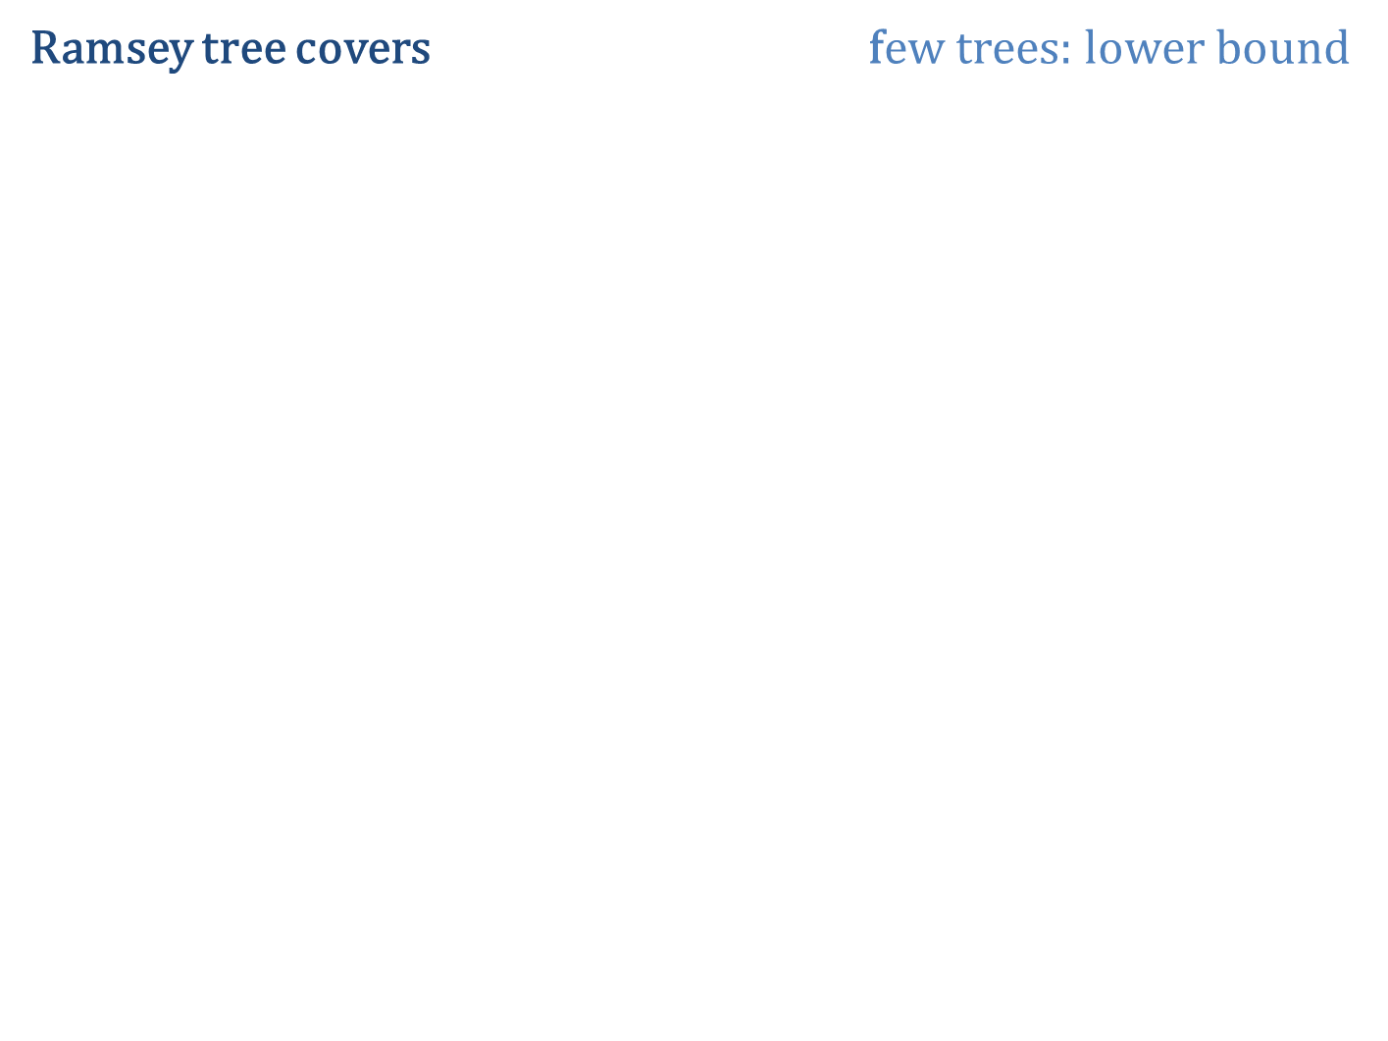



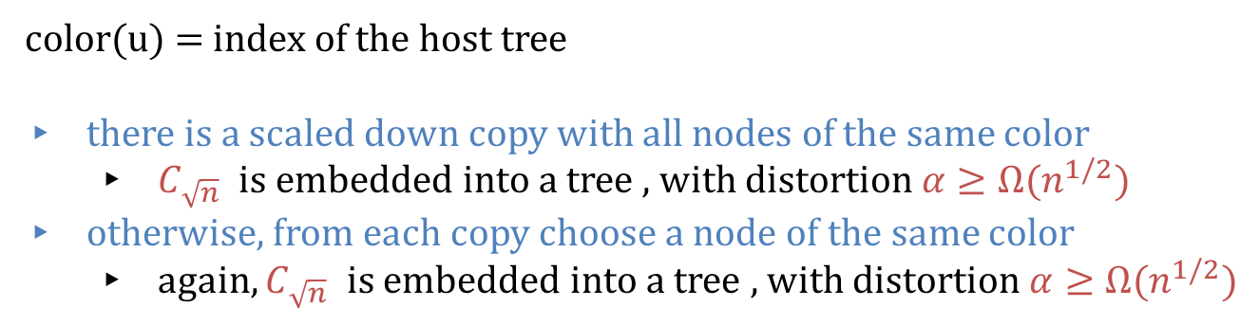
Ramsey tree covers few trees: lower bound
Ramsey tree $T_{1}$
Ramsey tree $T_{2}$
dist. $α$
color(u) = index of the host tree
there is a scaled down copy with all nodes of the same color
$C_{\sqrt{n}}$ is embedded into a tree , with distortion $α≥Ω(n^{1/2})$
otherwise, from each copy choose a node of the same color
again, $C_{\sqrt{n}}$ is embedded into a tree , with distortion $α≥Ω(n^{1/2})$

Slide 17
Ramsey tree covers few trees: lower bound
For $k≥3$ : $X=C_{n^{1/k} }∘{ C}_{n^{1/k} }∘ … ∘ C_{n^{1/k} }$

Slide 18
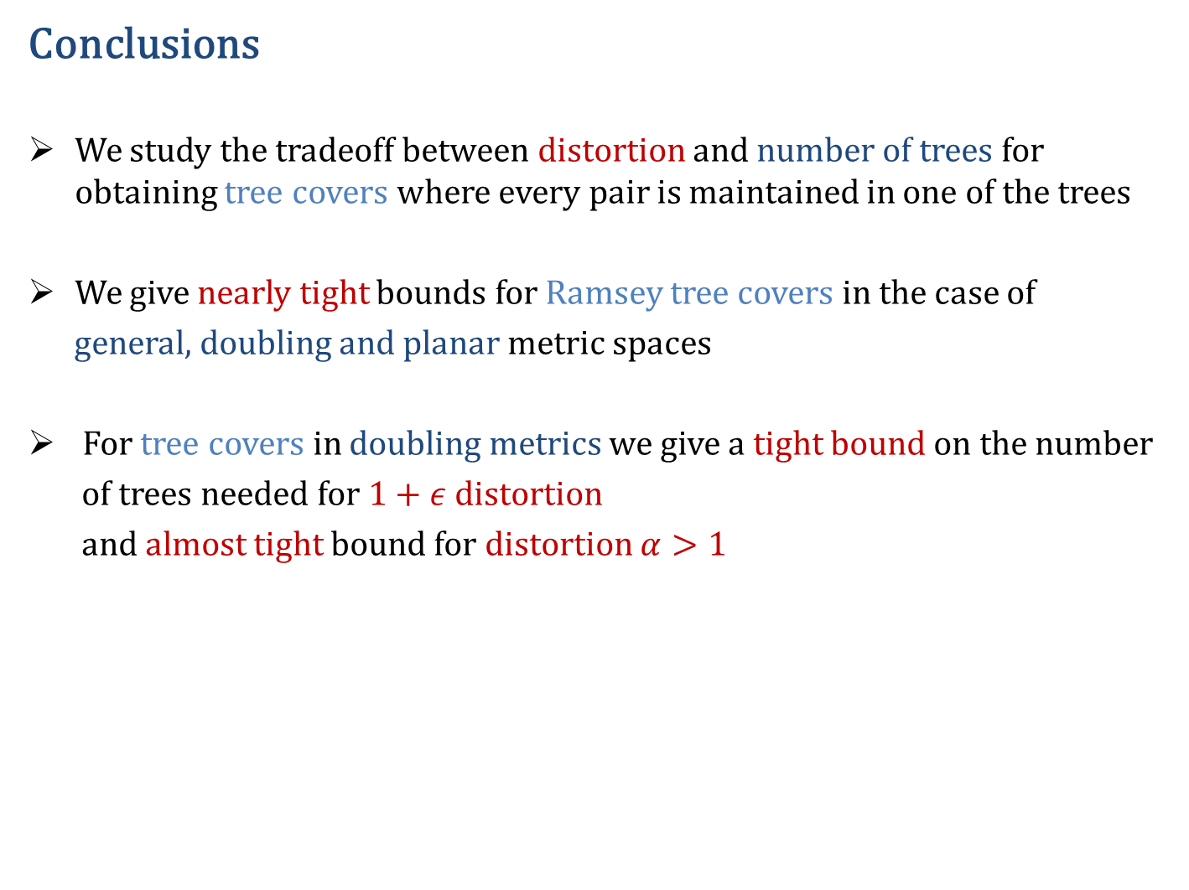
Conclusions
We study the tradeoff between distortion and number of trees for obtaining tree covers where every pair is maintained in one of the trees
We give nearly tight bounds for Ramsey tree covers in the case of
general, doubling and planar metric spaces
For tree covers in doubling metrics we give a tight bound on the number
of trees needed for $1+ε$ distortion
and almost tight bound for distortion $α>1$
A really short (Haiku) conclusion: In a doubling world,
You see this bunch of trees?
They are enough.

