Slide 1
A Smart Vehicle
Internet of Things

Slide 2
Case Study
The project idea came from my personal experience, when my car’s security system locked me out When trying to jump start The engine.
Windows were closed and The engine was running.
I Called 911 BUT They wouldn't come- reason: vehicle parked in front of owner’s home and not obstructing vehicular traffic.

Slide 3
Available Options
Call the insurance Company for help . But It was on a Sunday
Call An Auto Mechanic: This will surely cost me
Self help, BUT How?

Slide 4
solution
Self help- I Forced a thin rod through the side window rubber seal to wind the side window down, praying the action wouldn’t trigger the alarm system or even create some more serious damage
I was lucky!

Slide 5
A better solution (A smart vehicle)
Make the vehicle smart enough to open the doors or wind the side windows down for the owner to open the door in a situation like this.

Slide 6
IOT project deliverables
Owner can wind down side windows from any smart cellphone or connected computer from any part of the world with his username and password
Owner can off and start vehicle’s engine remotely from any connected pc or smart phone from any corner of the world
Vehicle knows when the battery is running low and recharges battery immediately by automatically starting the engine and offing it again Until battery is fully charged

Slide 7
Project Deliverables
Project website:
http://www.smartvehicles.somee.com/smart_car_real.asp
Project code link:
https://build.particle.io/build/5728d86b042355e1c20001dc
Project prototype:

Slide 8
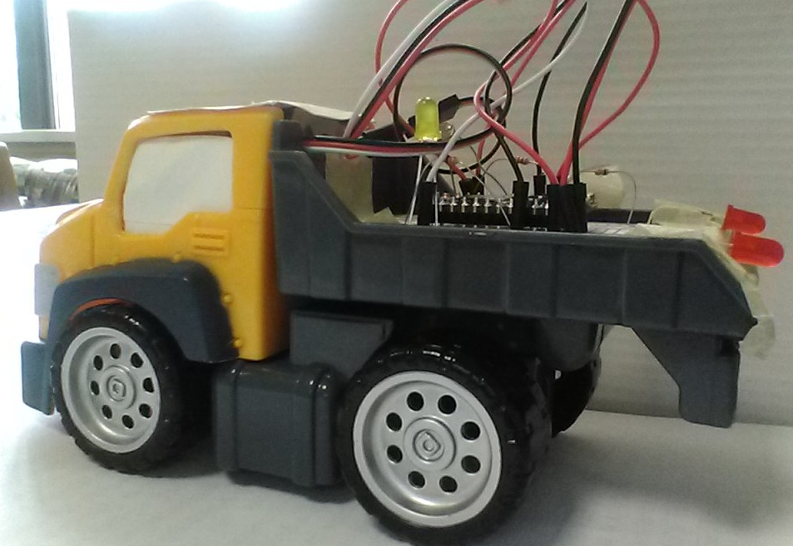
Project prototype

