Slide 1
NIGERIA CYBERSECURITY
INCIDENT ANALYSIS
2019 – 2024
SQL Data Analysis Capstone Project
TDI Emerald Cohort
Banking · Fintech · Government · Healthcare · Telecom · Oil & Gas · Education

Slide 2
PROBLEM STATEMENT
Between 2019 to 2024 cyberattacks incidents took place across 7 critical sectors, but decision-makers lack clear, data-driven visibility into where losses are greatest, which threats are accelerating, and whether response resources are deployed effectively. Without this insight, investments are being made blindly and vulnerabilities remain unaddressed.
Nigeria Cybersecurity Incident Analysis (2019–2024) | TDI Emerald Cohort | SQL Data Analysis Capstone

Slide 3
OBJECTIVES
1
Identify financial losses by incident status and sector to expose where the biggest financial risks lie.
2
Evaluate response team performance and identify resource gaps across cities.
3
Track year-over-year attack trends to spot the fastest-growing threats.
4
Flag persistently targeted organizations that require continuous monitoring.
Nigeria Cybersecurity Incident Analysis (2019–2024) | TDI Emerald Cohort | SQL Data Analysis Capstone

Slide 4
RESEARCH QUESTIONS
RQ1
What is the percentage of financial loss suffered per incident status?
RQ2
What are the top 3 teams with the highest number of resolved incidents?
RQ3
Which organization has the highest number of affected users?
RQ4
Which sectors have total financial loss above the national sector average, and by how much?
RQ5
What is the year-over-year change in total financial loss per attack type, and which are growing fastest?
RQ6
Which months consistently produce the highest cybersecurity incidents across all 6 years?
RQ7
Which organizations have been attacked in every single year from 2019 to 2024?
RQ8
What is the total financial exposure from unresolved and under-investigation incidents per sector?
RQ9
Which cities handle a disproportionately high number of incidents relative to their team count?
Nigeria Cybersecurity Incident Analysis (2019–2024) | TDI Emerald Cohort | SQL Data Analysis Capstone

Slide 5
KEY PERFORMANCE INDICATORS
5,000
₦3.3T+
60%
40%
Total Incidents
Total Financial Loss
Resolution Rate
Open Incident Rate
7
100
25
₦720.8M
Sectors Affected
Organizations
Response Teams
Average Loss Per Incident
Nigeria Cybersecurity Incident Analysis (2019–2024) | TDI Emerald Cohort | SQL Data Analysis Capstone

Slide 6
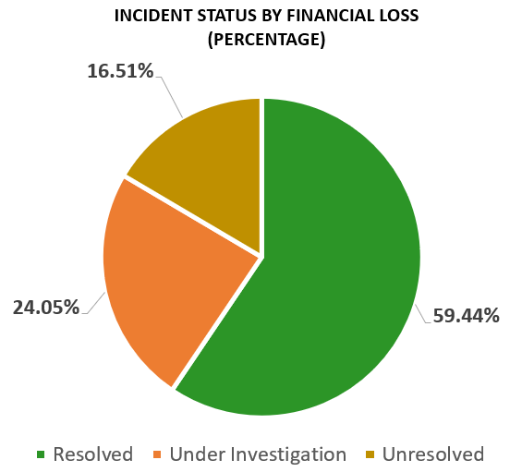
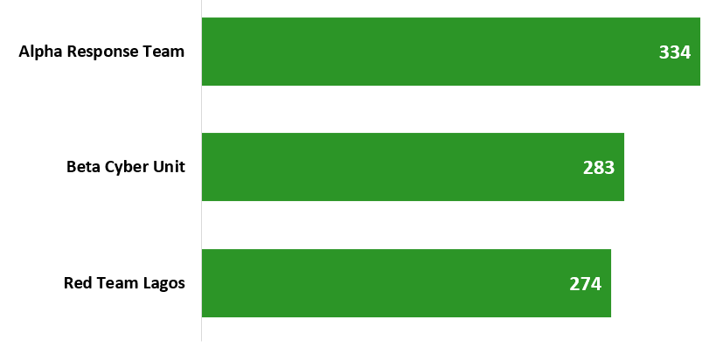
INCIDENT STATUS & UNRECOVERED FINANCIAL LOSS
Resolved Incidents have the highest financial loss by approximately 60% (RQ 1)
The Alpha Response team have handled a greater number of Incidents compared to other teams from 2019 to 2024 (RQ 2)
TEAMS WITH THE HIGHEST NO OF RESOLVED INCIDENTS
Nigeria Cybersecurity Incident Analysis (2019–2024) | TDI Emerald Cohort | SQL Data Analysis Capstone

Slide 7
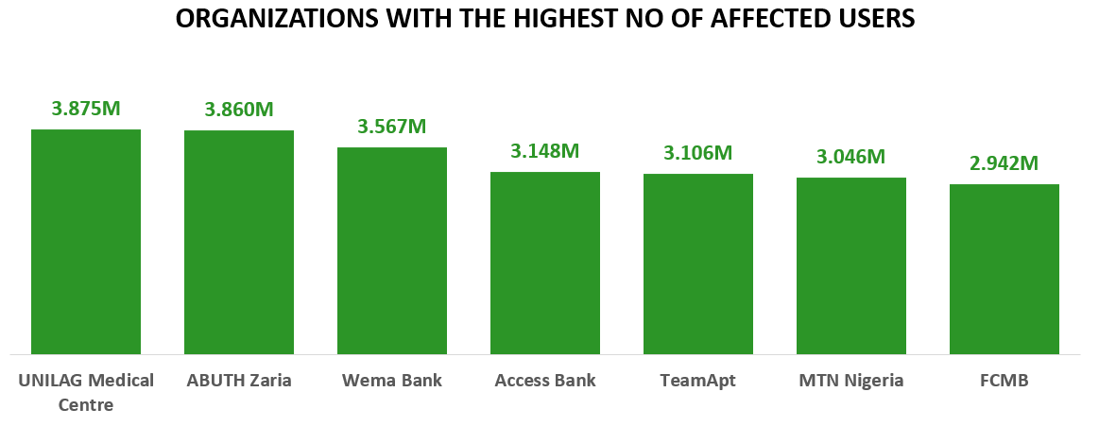
ORGANIZATIONS AND AFFECTED USERS
With 3.875 Miliion, UNILAG Medical Centre has the highest no. of Affected users. (RQ 3
Note: for the sake of clarity , only the top 7 organizations were shown
Nigeria Cybersecurity Incident Analysis (2019–2024) | TDI Emerald Cohort | SQL Data Analysis Capstone

Slide 8
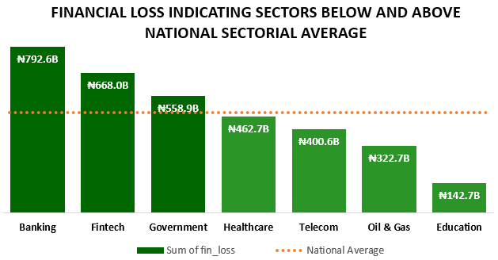
SECTORS ABOVE & BELOW NATIONAL SECTOR AVERAGE
With ₦478.3B being the national sector average, Banking, Government and Fintech exceed the national sector average — all other sectors fall below it, with Education the furthest below. (RQ 4)
▲ Above Average: Banking, Fintech
▼ Below Average: Healthcare, Telecom, Oil & Gas, Education
Nigeria Cybersecurity Incident Analysis (2019–2024) | TDI Emerald Cohort | SQL Data Analysis Capstone

Slide 9
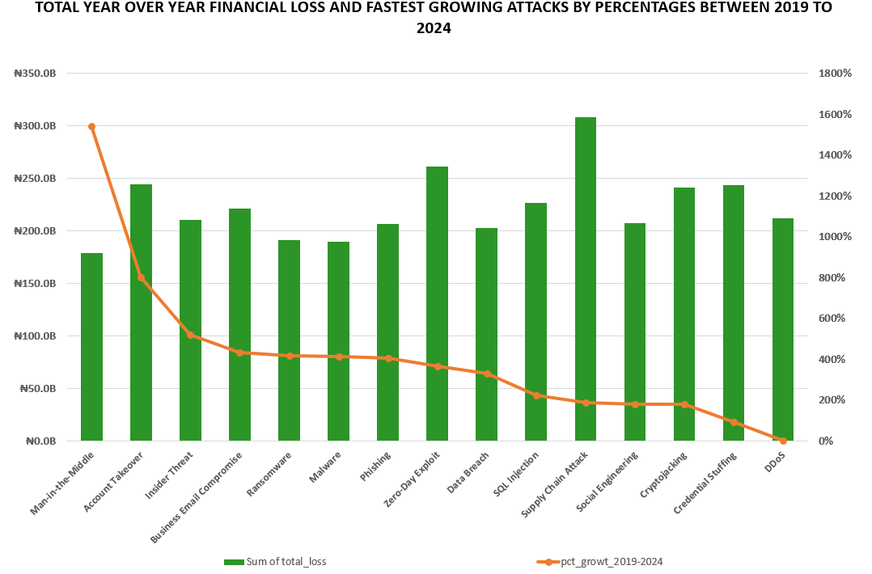
YEAR-OVER-YEAR ATTACK GROWTH (2019–2024)
Man-in-the-Middle attacks grew by 1,541% between 2019 and 2024 — the fastest growing attack type in the dataset. (RQ 5)
Fastest Growing
Man-in-the-Middle
1,541%
Account Takeover
~850%
Insider Threat
~500%
BEC
~400%
Ransomware
~400%
Source: RQ5 — pct_growth_2019_2024 via LAG() & FIRST_VALUE()
Nigeria Cybersecurity Incident Analysis (2019–2024) | TDI Emerald Cohort | SQL Data Analysis Capstone

Slide 10
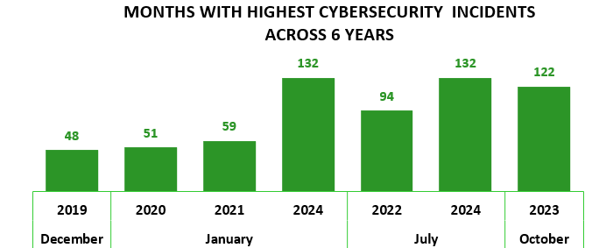
SEASONAL PATTERNS & CITY RESOURCE GAPS
January frequently saw a peak in cybersecurity incidents, accounting for half of the years observed. (RQ6).
January is Peak Month
Incidents consistently peak in January — annual security reviews should be completed before year-end
Nigeria Cybersecurity Incident Analysis (2019–2024) | TDI Emerald Cohort | SQL Data Analysis Capstone

Slide 11
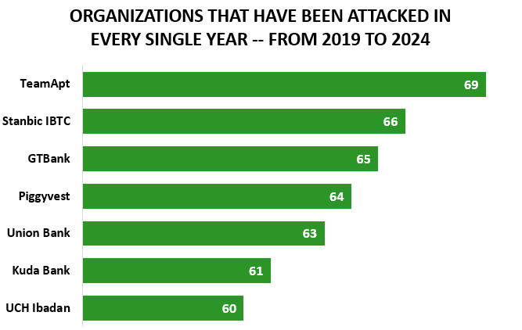
ORGANIZATIONS ATTACKED EVERY YEAR (2019–2024)
These organizations recorded incidents in all 6 consecutive years — indicating persistent targeting and inadequate remediation (RQ7).
TeamApt leads
69 total incidents — highest across all 6 years in the Fintech sector
Fintech Dominance
TeamApt, Piggyvest & Kuda Bank are all Fintech firms — a sector pattern
Banking Exposure
Stanbic IBTC, GTBank, Union Bank all appear — systemic bank vulnerability
Healthcare Presence
UCH Ibadan is the only healthcare org in the persistent attack list
Nigeria Cybersecurity Incident Analysis (2019–2024) | TDI Emerald Cohort | SQL Data Analysis Capstone

Slide 12
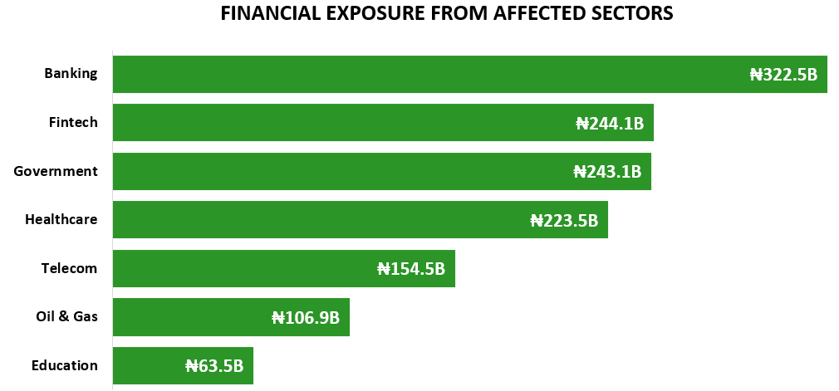
FINANCIAL EXPOSURE BY SECTOR
Banking sector leads with the highest total financial exposure from currently unresolved and under-investigation (RQ8)
Nigeria Cybersecurity Incident Analysis (2019–2024) | TDI Emerald Cohort | SQL Data Analysis Capstone

Slide 13
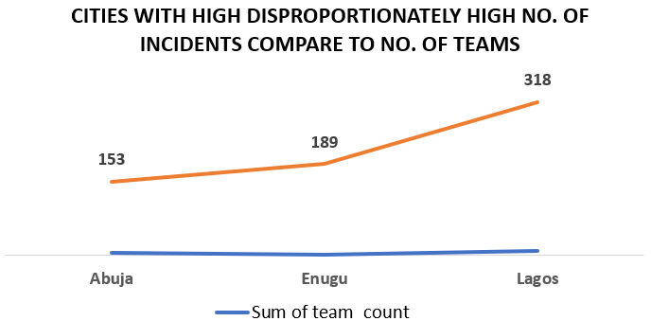
SEASONAL PATTERNS & CITY RESOURCE GAPS
Lagos faces the greatest resource pressure relative to team count (RQ9).
Lagos Resource Gap
Lagos: highest incidents with fewest teams — urgent need for additional response capacity
Enugu Rising
Enugu's incident count is growing — early investment in response teams recommended
Note: only Abuja, Enugu and Lagos had combination of teams that had above the average no. of incidents (125) across all teams.
Nigeria Cybersecurity Incident Analysis (2019–2024) | TDI Emerald Cohort | SQL Data Analysis Capstone

Slide 14
KEY FINDINGS
Banking Sector Highest Loss
January is Peak Attack Month
The banking sector recorded the highest financial losses across all sectors — making it the most financially exposed sector in the dataset.
January frequently saw a peak in cybersecurity incidents, accounting for half of the years observed
Lagos Under Resourced
Man-in-the-Middle Growing Fast
Lagos recorded the highest incidents relative to available response teams — a significant resource imbalance.
MitM attacks recorded 1,541% growth in financial loss impact between 2019 and 2024 — an emerging critical threat.
Persistent Repeat Targets
Several organizations were attacked every year from 2019 to 2024, signalling persistent targeting of critical institutions.
Nigeria Cybersecurity Incident Analysis (2019–2024) | TDI Emerald Cohort | SQL Data Analysis Capstone

Slide 15
RECOMMENDATIONS
Increase Sector Investments
Annual Pre-Year Security Audits
Banking, telecom, government, and critical infrastructure sectors should increase cybersecurity investments and strengthen monitoring capabilities.
Conduct security audits, employee awareness training, and vulnerability assessments before the start of each year to prepare for January peaks.
Reduce Resolution Times
Adopt Zero Trust for MitM
Reducing investigation and resolution times minimizes unrecovered financial losses and improves organizational resilience.
Implement MFA, encryption, secure communication protocols, and Zero Trust frameworks to counter the rapidly growing Man-in-the-Middle threat.
Deploy More Teams to Lagos
Continuous Monitoring for Repeat Targets
Additional response teams and cybersecurity professionals should be deployed to Lagos to address its disproportionately high incident-to-team ratio.
Organizations repeatedly attacked should adopt continuous threat monitoring, penetration testing, and proactive risk management strategies.
Nigeria Cybersecurity Incident Analysis (2019–2024) | TDI Emerald Cohort | SQL Data Analysis Capstone

Slide 16
THANK YOU
TDI Emerald Cohort · SQL Data Analysis Capstone · Nigeria Cybersecurity Incident Analysis (2019–2024)

Slide 17
CONCLUSION
This analysis of 5,000 cybersecurity incidents across Nigeria (2019–2024) reveals systemic vulnerabilities that demand urgent, data-driven action.
Banking sector recorded the highest financial losses — sector-specific defenses are critical
January is the peak attack month — annual readiness before year-end is essential
Man-in-the-Middle grew 1,541% — Zero Trust and encryption must be adopted nationally
Lagos faces the greatest resource-to-incident gap — urgent team deployment needed
TDI Emerald Cohort · SQL Data Analysis Capstone · Nigeria Cybersecurity Incident Analysis (2019–2024)

