Slide 1
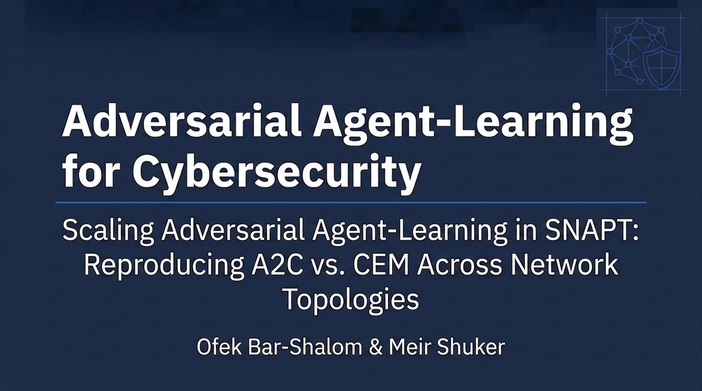
Adversarial Agent-Learning
for Cybersecurity
A Comparison of Algorithms
Paper Review & Experimental Reproduction
Student Name
Advanced Topics in Cyber Defense, 2025

Slide 2
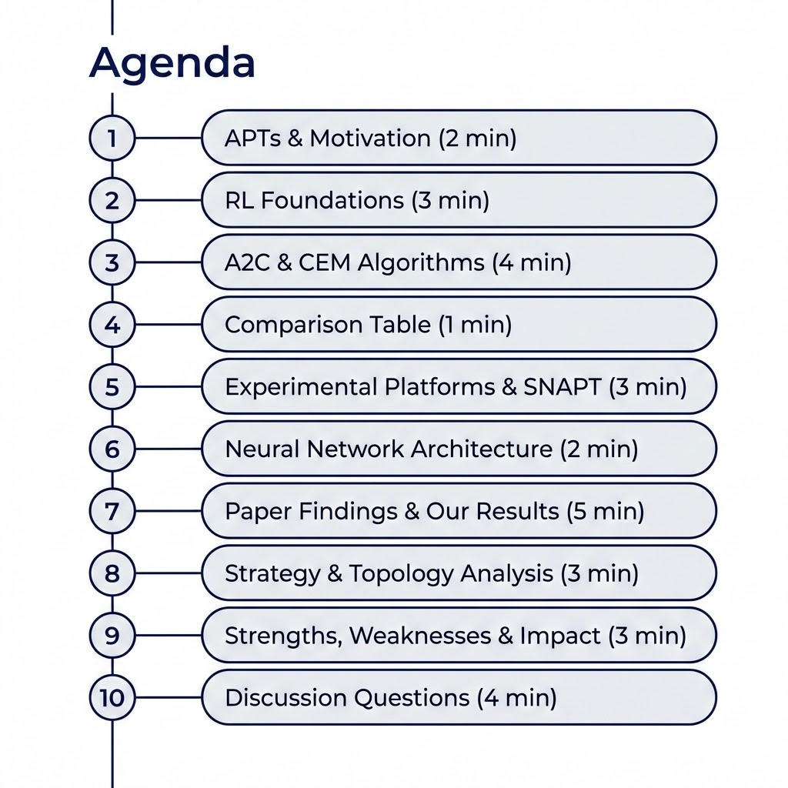

Slide 3
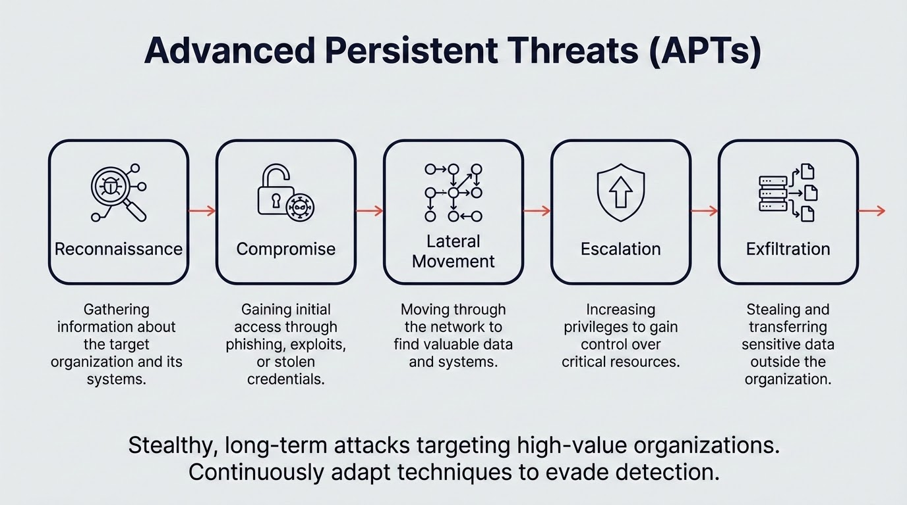

Slide 4
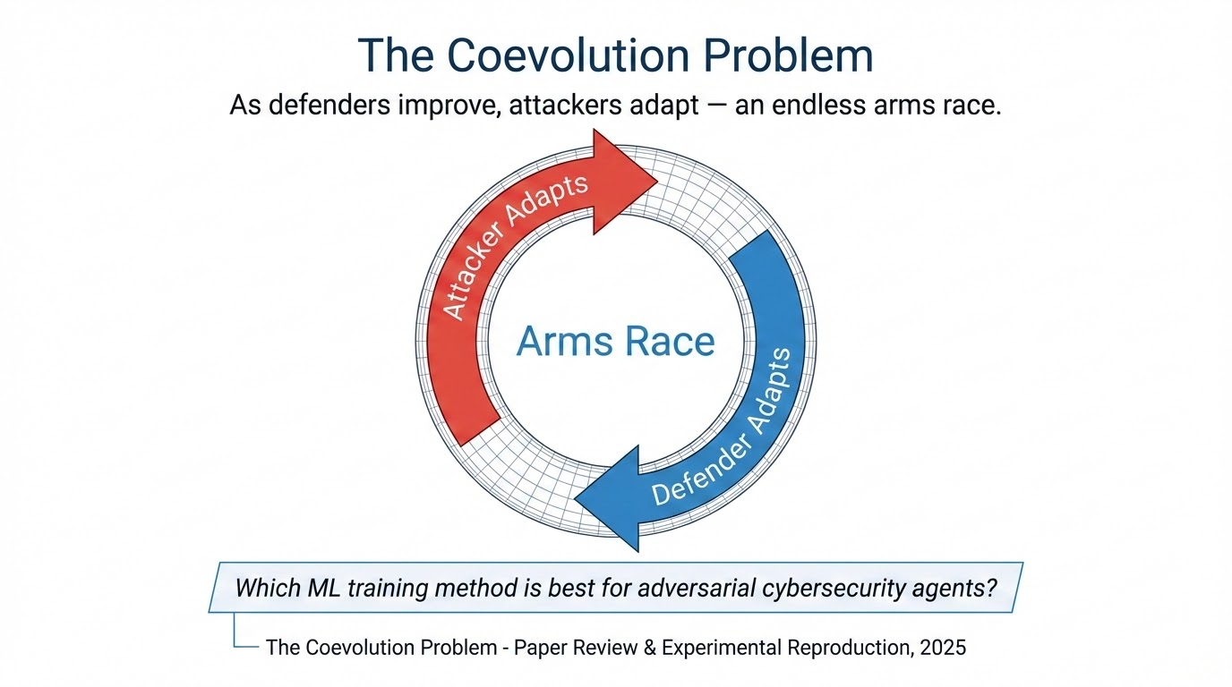

Slide 5
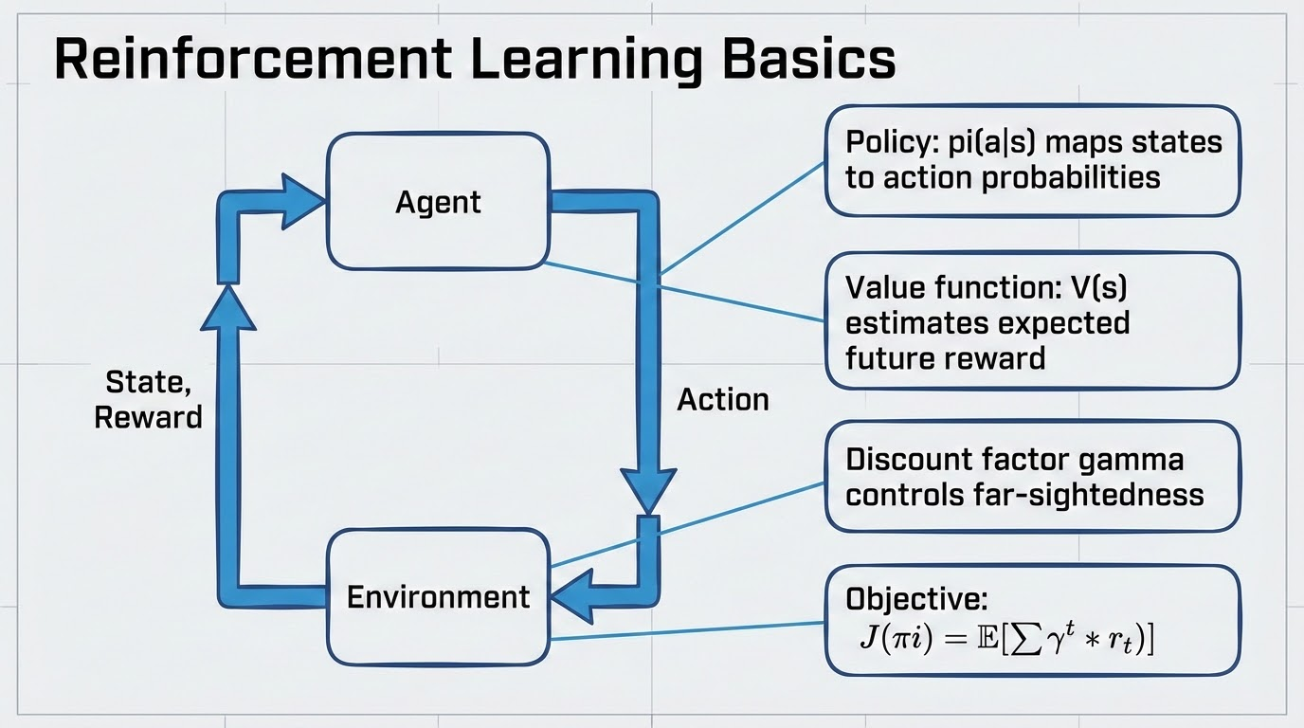

Slide 6
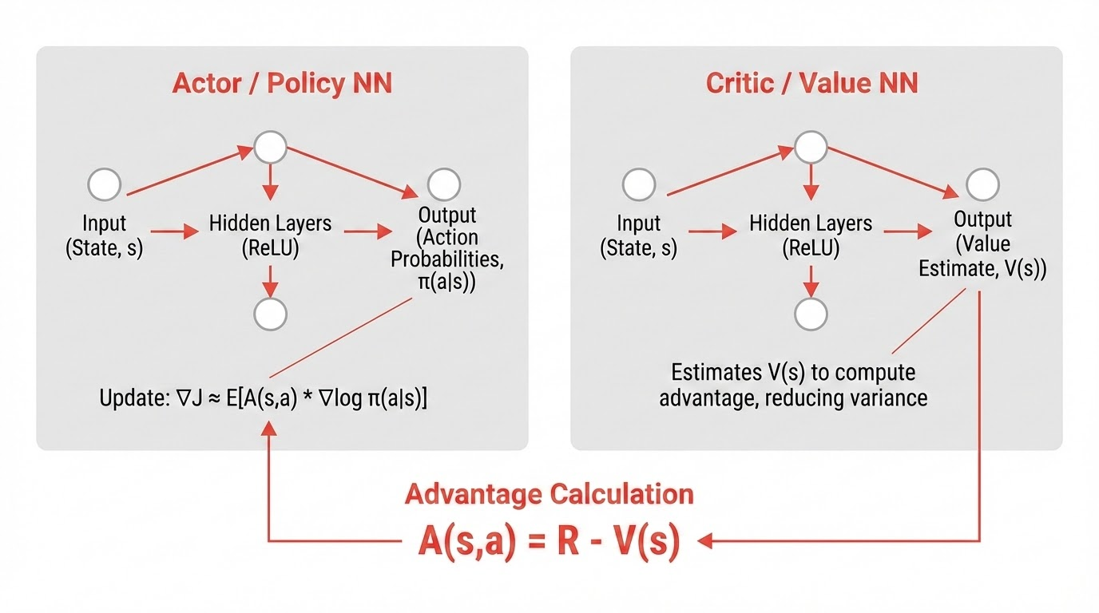

Slide 7
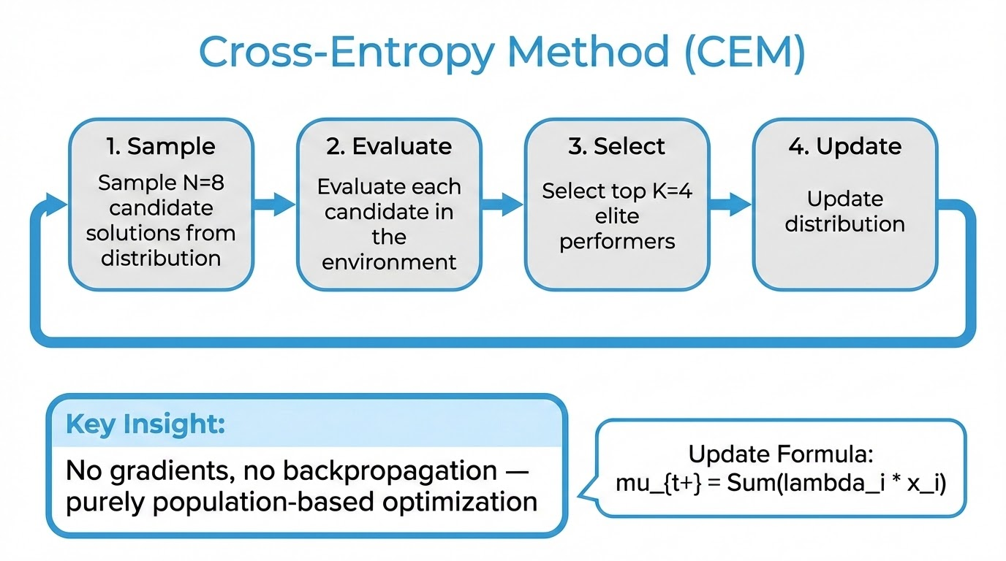

Slide 8
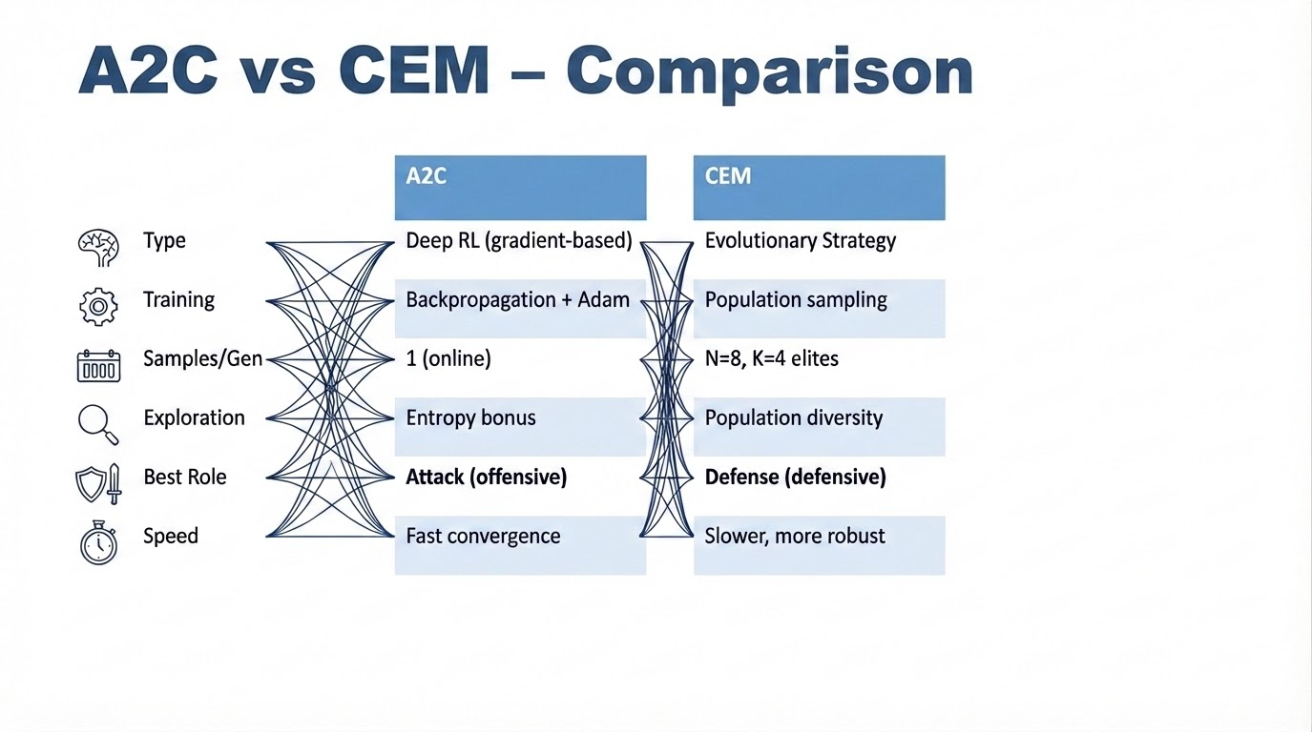

Slide 9
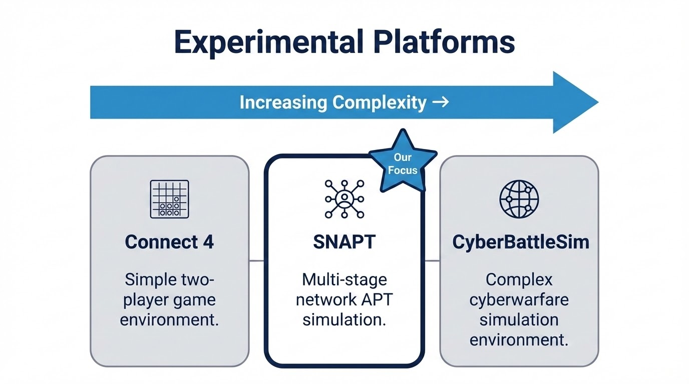

Slide 10
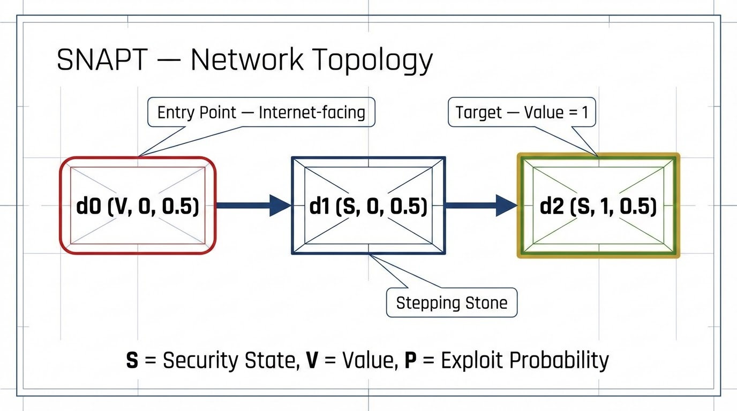

Slide 11
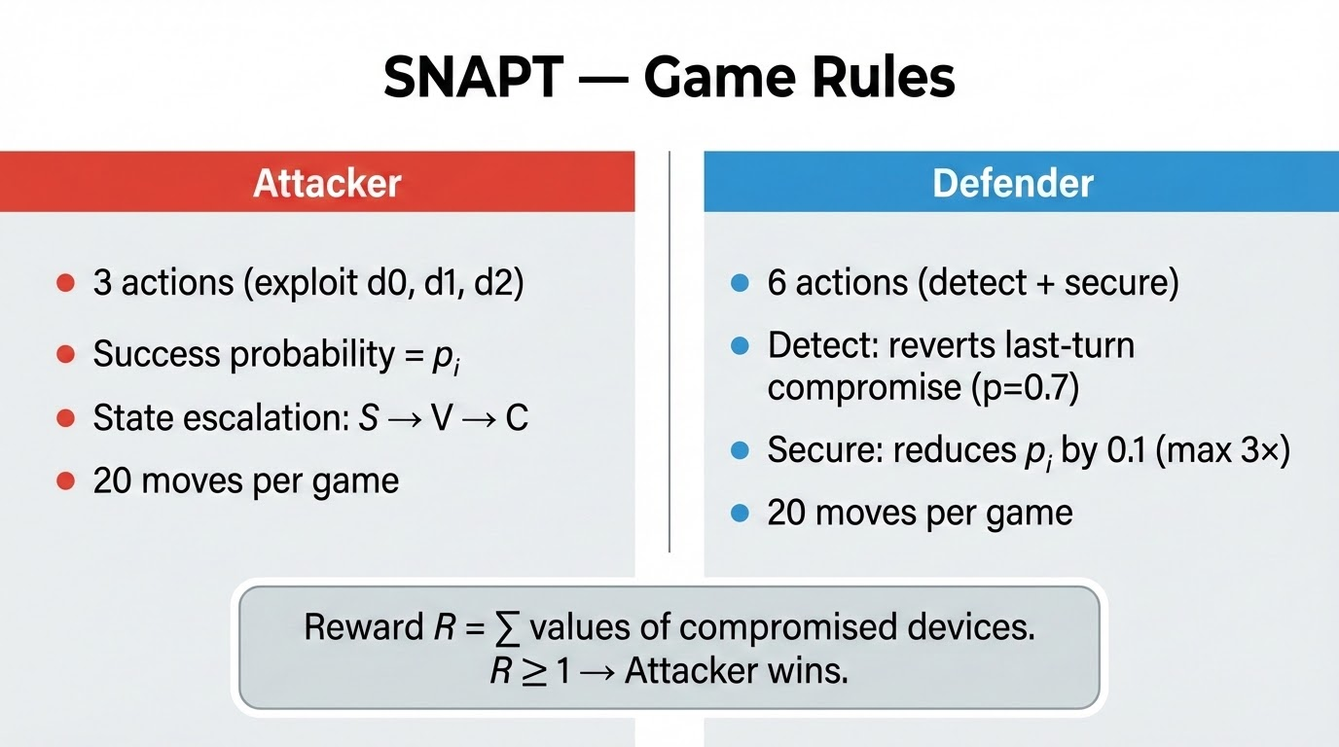

Slide 12
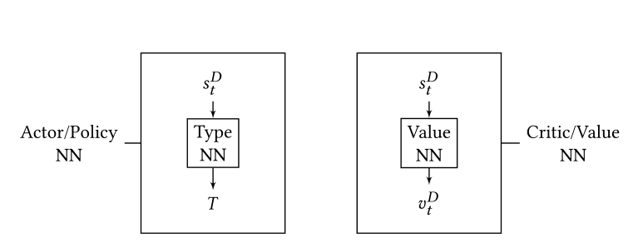
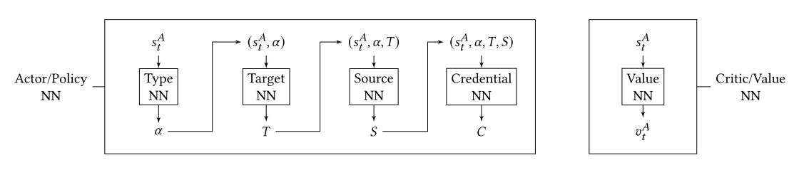
Neural Network Architecture
Defender
Attacker
Both networks: 2 hidden layers, 64 units each, ReLU activation

Slide 13
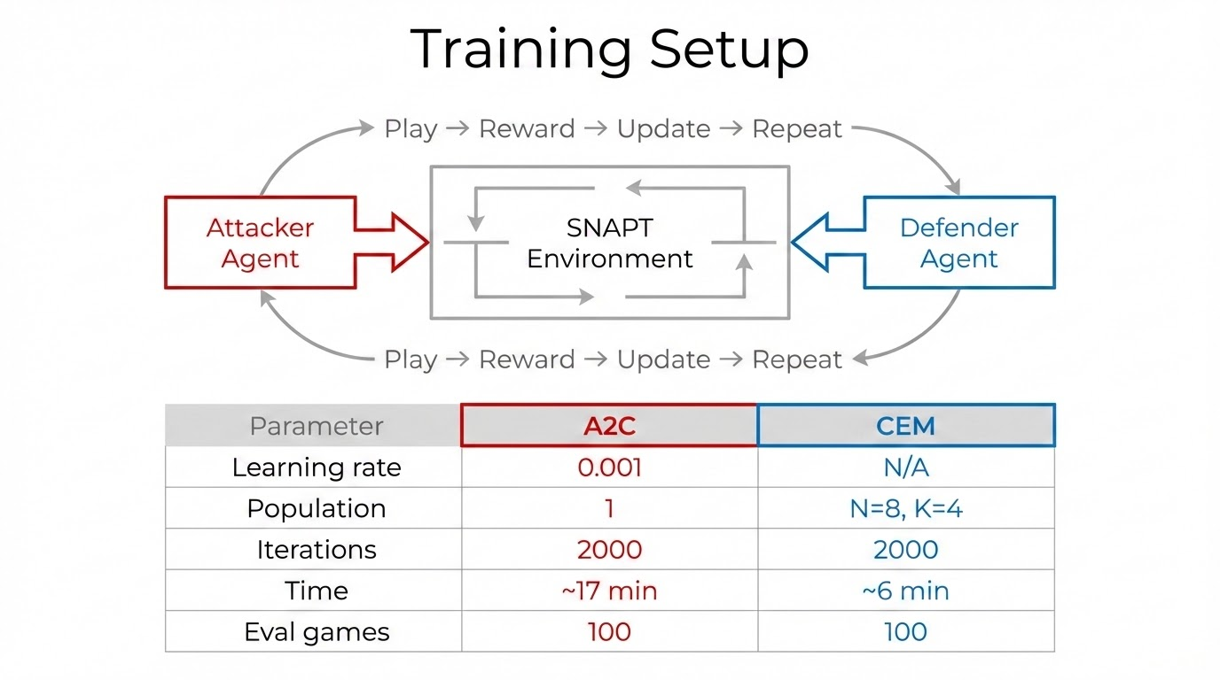

Slide 14
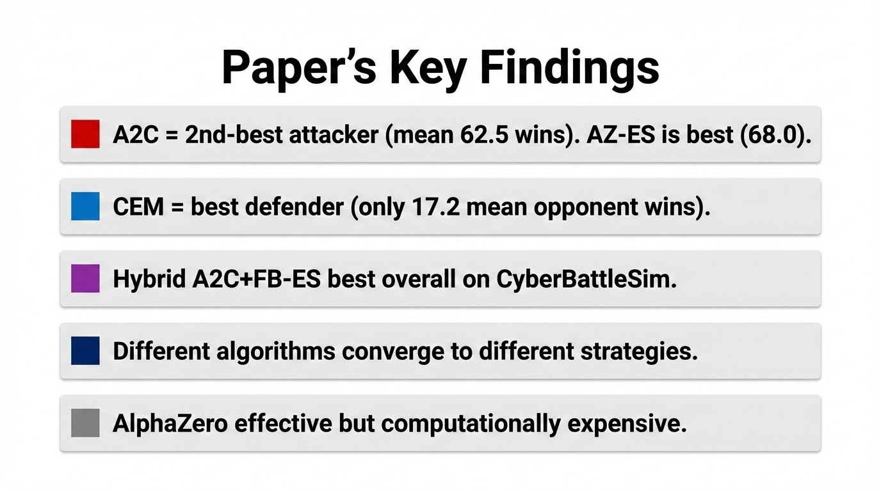

Slide 15
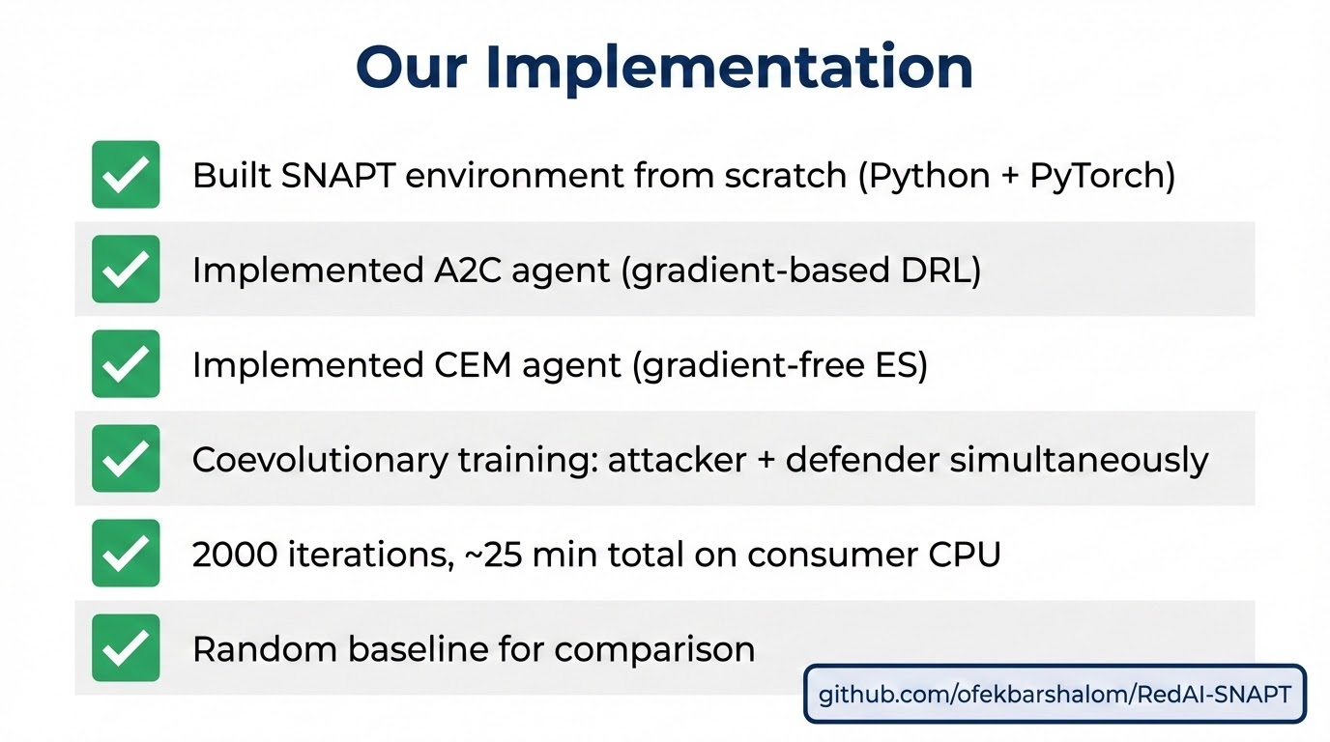

Slide 16
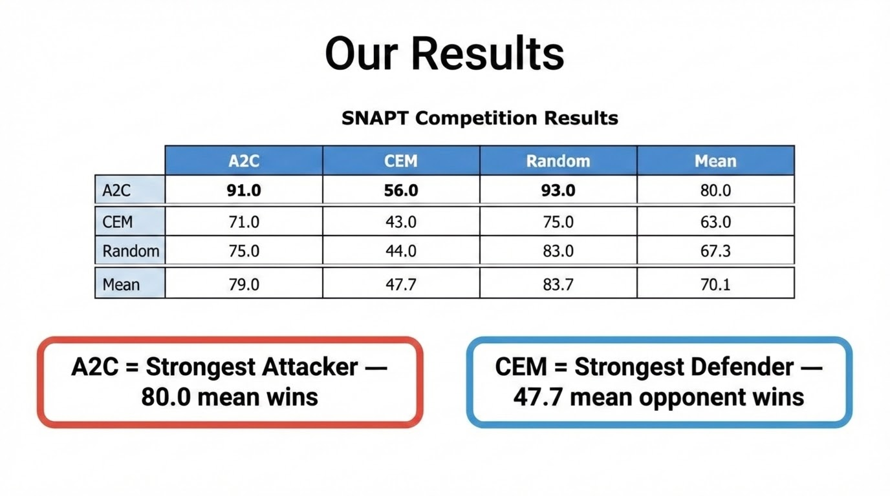

Slide 17
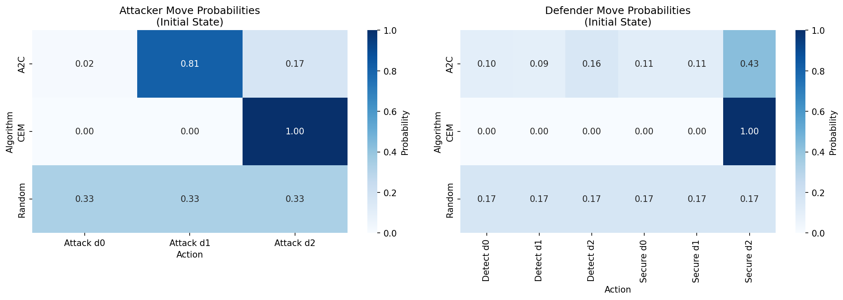
Strategy Analysis
A2C attackers focus exploits on vulnerable entry node (d0)
CEM defenders distribute actions more evenly across nodes

Slide 18
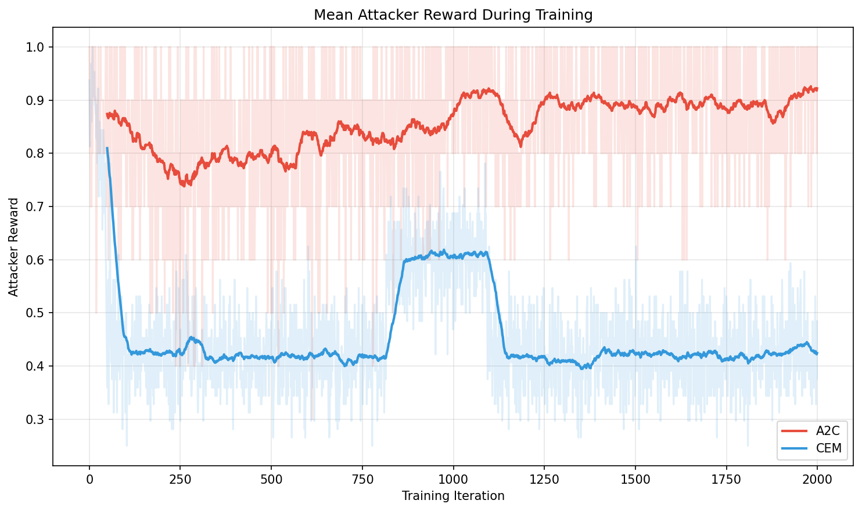
Training Dynamics
A2C converges faster but shows more variance
CEM is slower but produces more stable policies over time

Slide 19
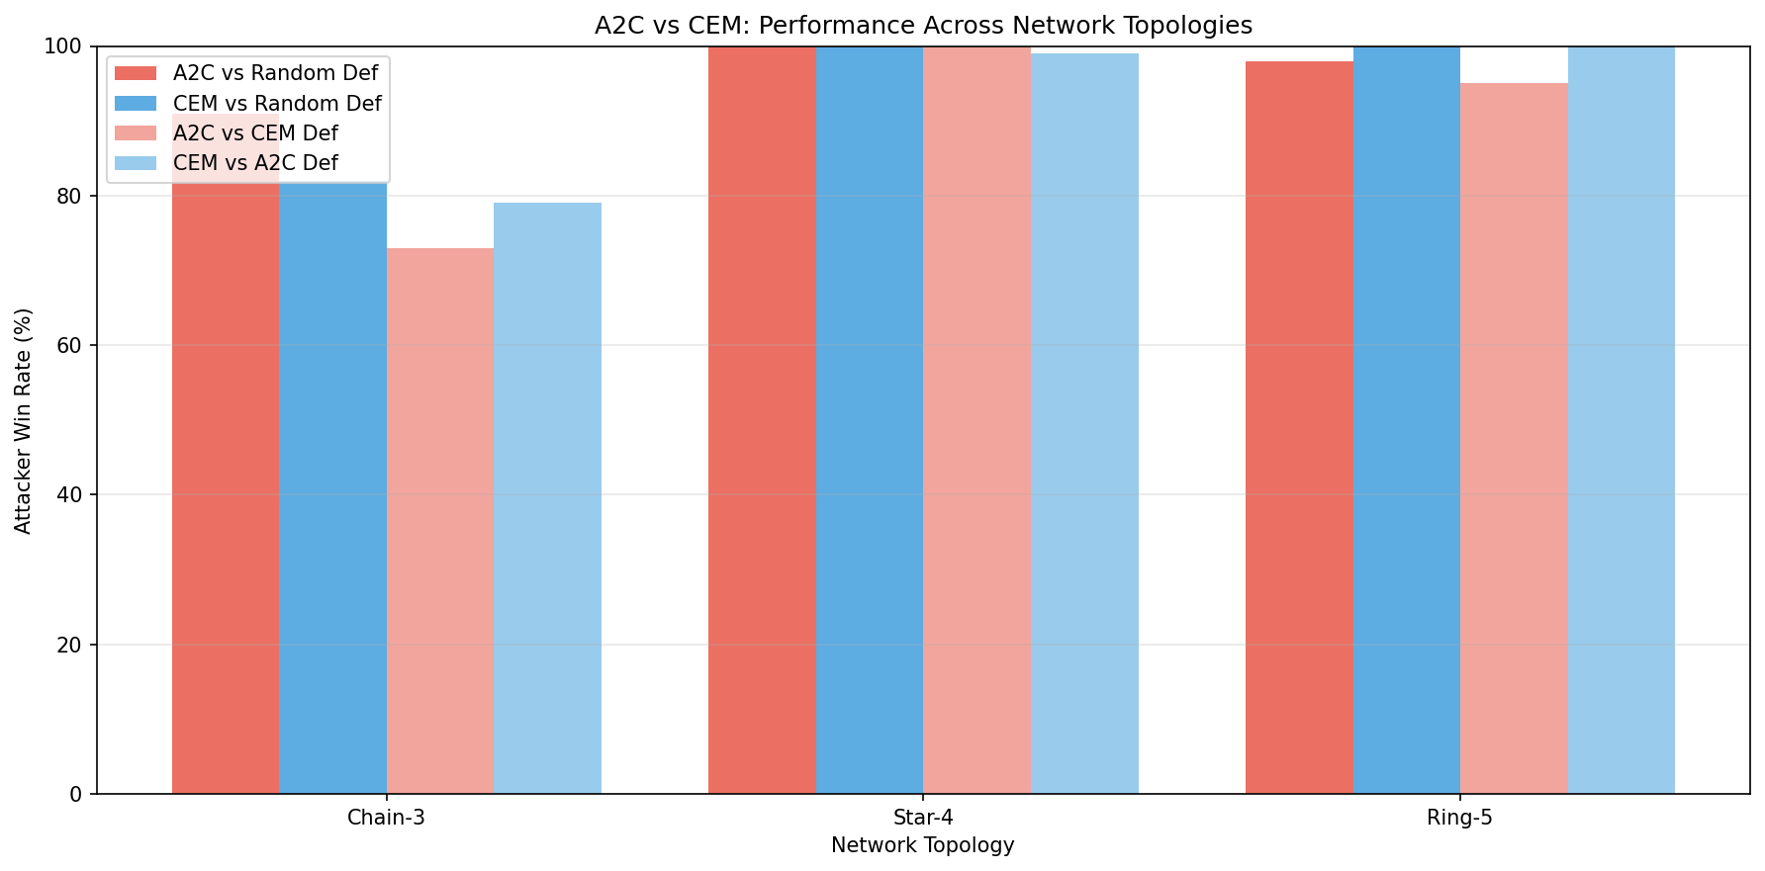
Extension: Network Topologies
Topology | Attacker Adv.
Linear (3) | Moderate
Star (5) | High
Mesh (5) | Very High
Larger, more connected networks favor attackers — more paths to exploit

Slide 20
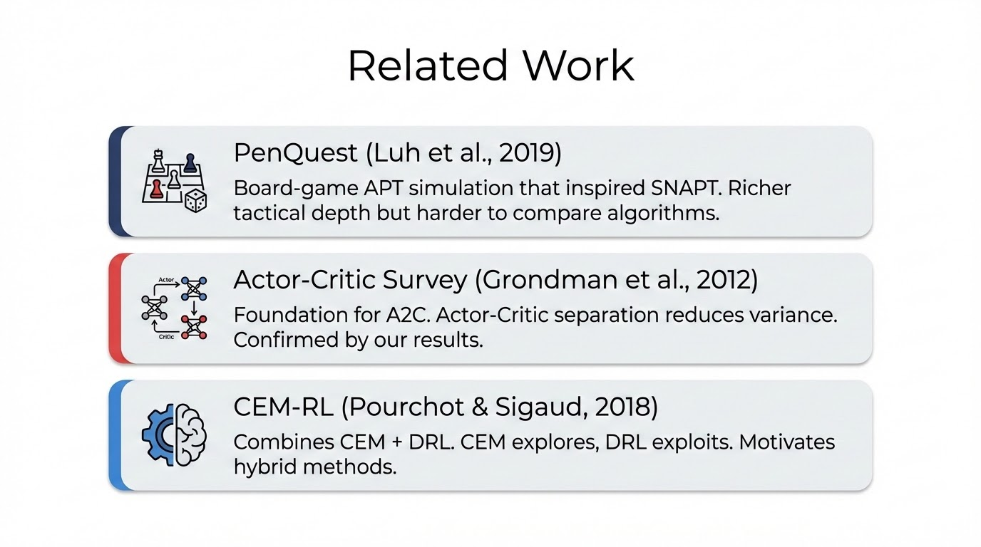

Slide 21
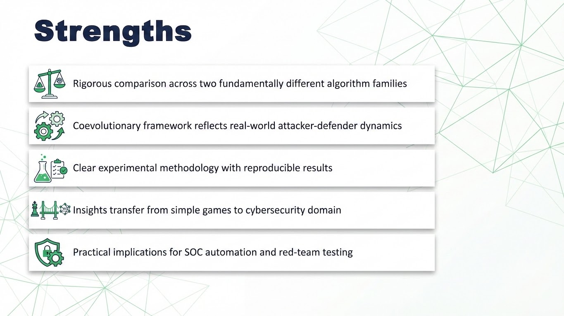

Slide 22
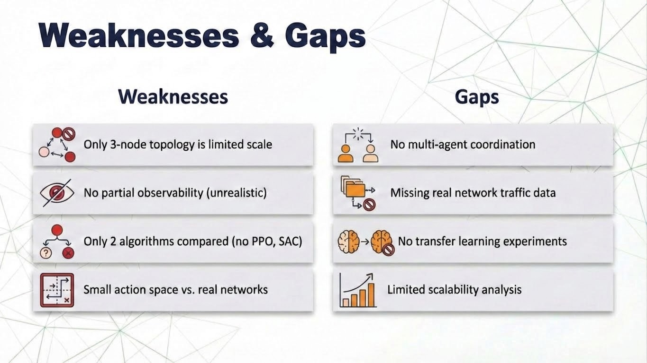

Slide 23
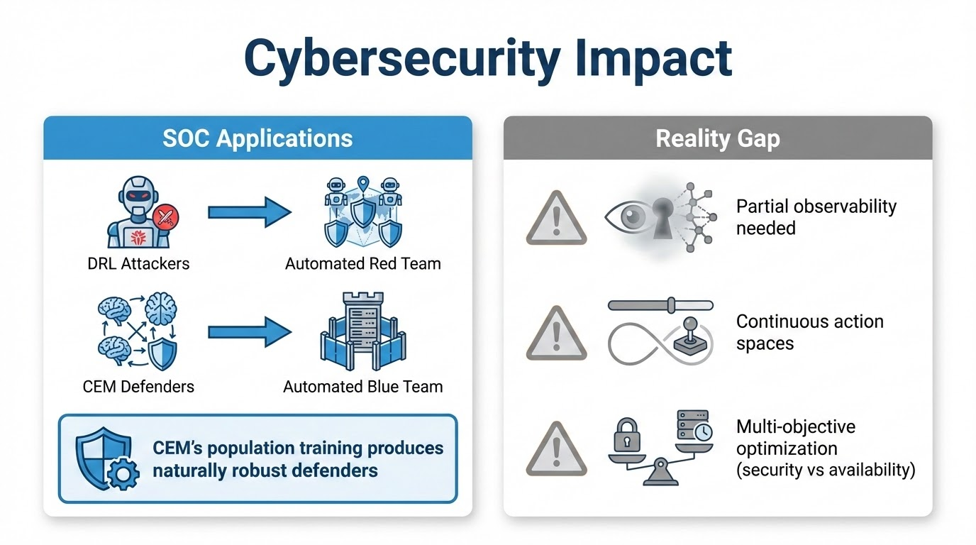

Slide 24
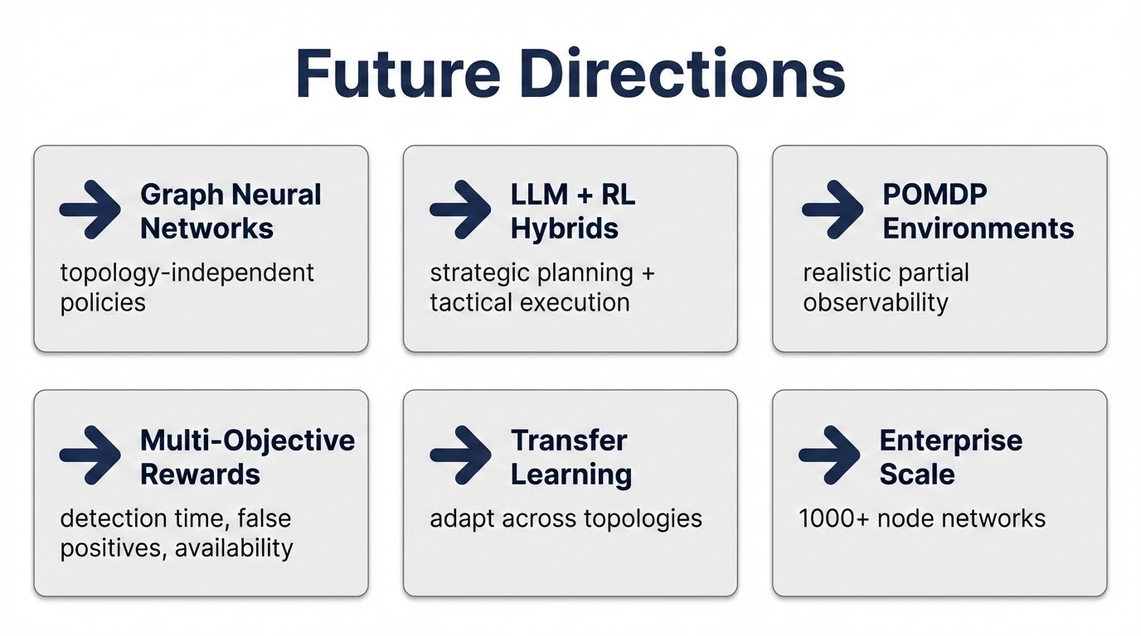

Slide 25
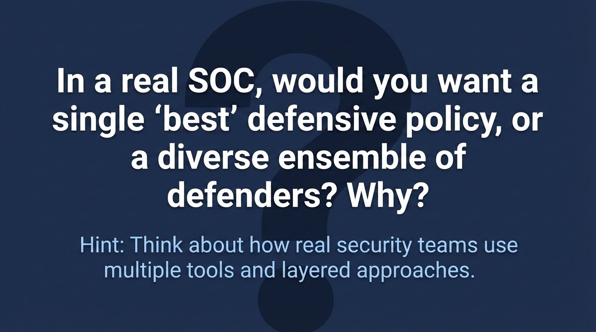

Slide 26
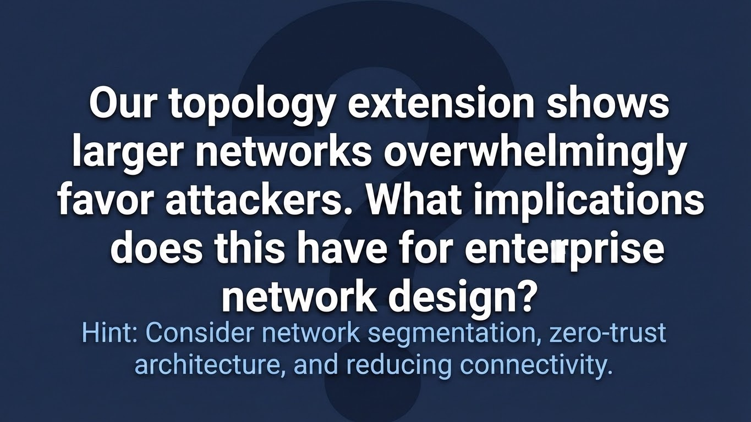

Slide 27
