Slide 1

SQL Detective Game
Learn Through Play
Ofek Cofman & Ariel Vaknin

Slide 2




Introduction
Educational 3D game teaching SQL through detective gameplay
Game Concept
Immersive Learning
Progressive Difficulty
3D environment where players solve crimes using SQL
Schema expands as players advance
Cross-Platform
PC for exploration, phone for queries

Slide 3






Why SQL Detective Game?
Fun learning experience
Games improve retention
Practical SQL skills
Hands-on query building
Accessible to beginners
Gradual introduction to concepts

Slide 4
Unique Approach
Other SQL Games
SQL Detective
Mostly 2D or text-based
Immersive 3D environment
Limited interactivity
Cross-platform gameplay
No progress saving
Saves progress in cloud

Slide 5




Technical Architecture
Unity Engine
C# Programming
3D environment and WebGL
Game logic and validation
Cloud Services
SupaBase
Progress saving via GCP
3
SQL backend integration

Slide 6
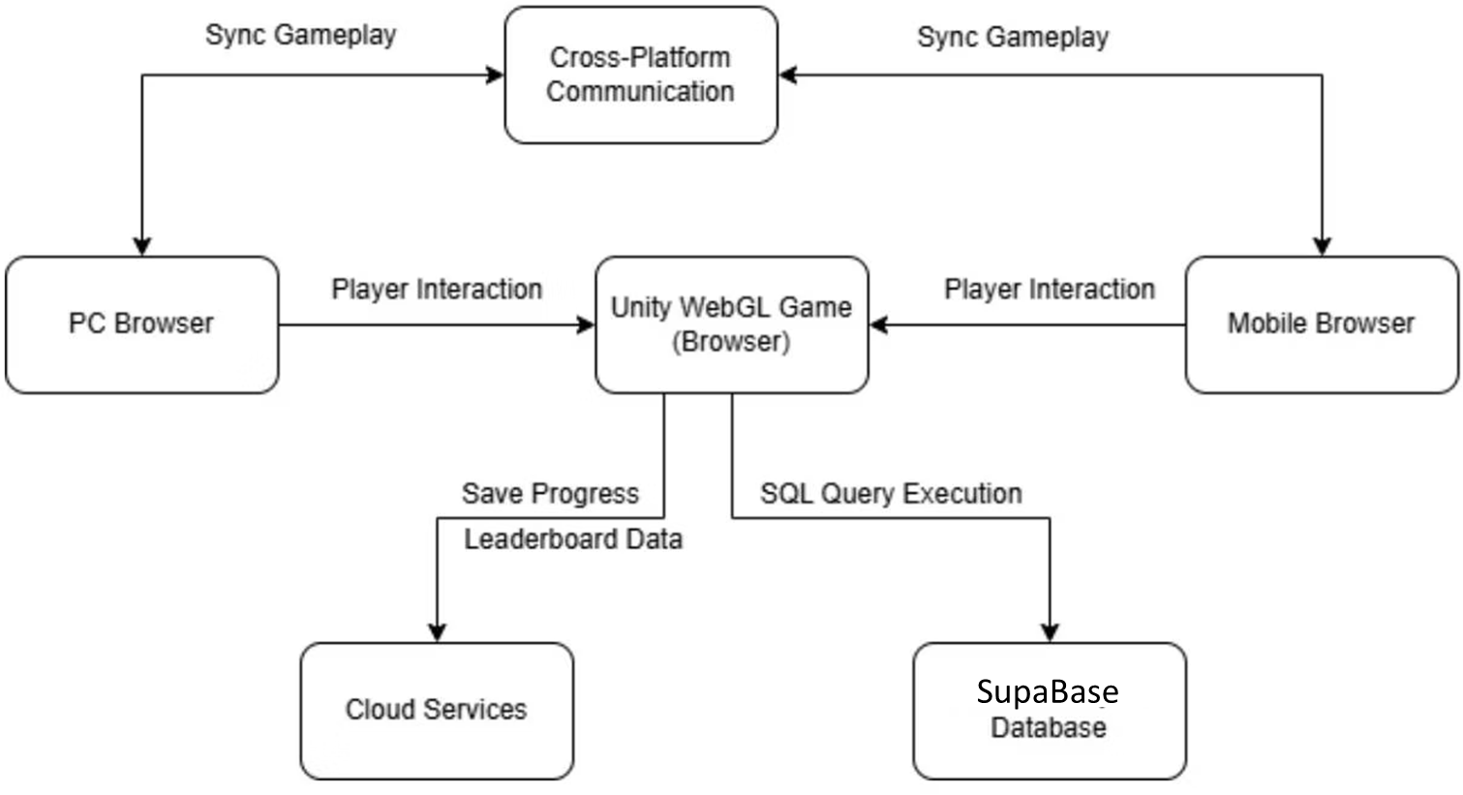

Slide 7




Gameplay Progression
Detective’s Office
Start the game and explore the world
Crime Mystery
Find clues that lead to the criminal
Query Building
Build SQL queries, unlock new tables
Advanced Levels
Complex queries across multiple tables

Slide 8
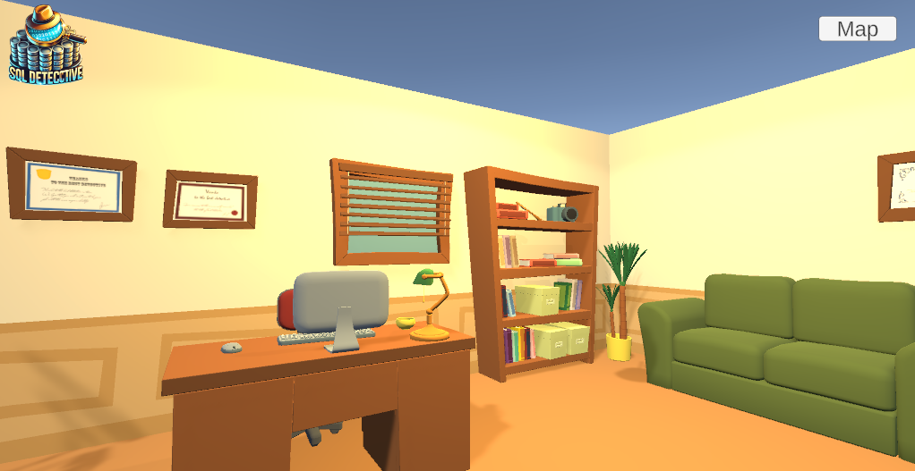
Query Interface
PC View
Shows schema and environment

Slide 9
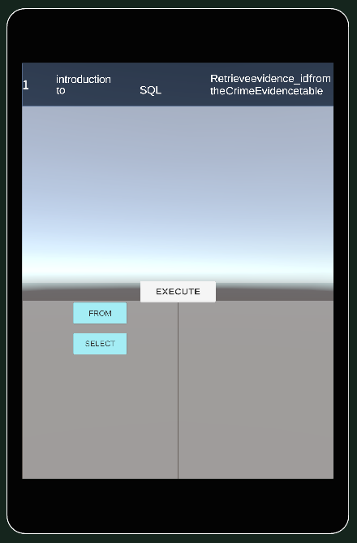
Query Interface
Mobile Interface
Drag-and-drop query building

Slide 10
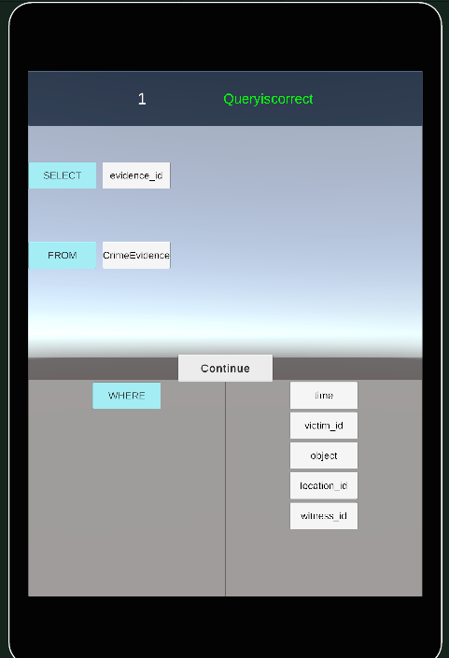
Query Interface
Results Display
Query results on PC screen

Slide 11

Get Started
Connect Mobile
Setup Unity
Connect your mobile to the game and play!
Clone Repository
Install Unity and WebGL modules
From GitHub: UnityFinalProject_Ofek_Ariel

Slide 12





Future Development
Our roadmap to expand the SQL Detective Game with new features and opportunities.
Mobile App Launch
Full mobile interface with touch optimization for SQL query building on the go.
New Places and Cases
New crime scenarios introducing complex database concepts like subqueries and views.
SQL Certification Path
Industry-recognized credentials earned through game completion and challenge mastery.

