Slide 1
Can a Routine CBC Predict Chronic Disease?
Student: Ofek Vilkerstone
Advisors: Prof. Noa Dagan, Dr. Seffi Cohen, Dr. Liat Friedman Antwarg
Notes:
שלום לכולם, אני אוֹפק ויִלקרסטוֹן, סטודנט בהנדסת מערכות מידע, ואני רוצה לספר לכם על פרויקט שניסה לענות על שאלה רפואית פשוטה — האם ספירת דם רגילה יכולה לגלות מחלות אוטואימוניות?

Slide 2

Can a Routine CBC Predict Chronic Disease?
Notes:
"אדם מגיע לרופא עם עייפות וכאבי מפרקים. ספירת הדם שלו נעשית בכל ביקור — אבל הרופא מסתכל רק על WBC ו-HGB. מה אם מהנתונים האלה — שכבר קיימים — אפשר לגלות דלקת מפרקים שגרונית שנים לפני האבחנה?"
"ספירת דם היא הבדיקה הנפוצה ביותר בעולם — מיליארדים בשנה. היא זולה, שגרתית, ולא מוסיפה עומס על המטופל. השאלה המחקרית שלנו: האם נוסחאות מתמטיות שנגזרות מ-14 ערכי CBC יכולות לנבא אבחנות של מחלות כרוניות?"
"המוטיבציה: לא צריך בדיקות גנטיות, לא ביופסיות — הנתונים כבר קיימים."

Slide 3
Why Rheumatoid Arthritis?
THE DISEASE
WHY A CBC BIOMARKER?
Rheumatoid Arthritis is a systemic autoimmune disease affecting ~1% of adults worldwide, causing progressive joint damage and systemic inflammation. Diagnosis is often delayed 1–2 years: early symptoms are non-specific, and confirmation requires specialist referral, anti-CCP serology, and imaging — resources not always available in primary care. Early treatment (within 3–6 months of onset) dramatically slows joint destruction. Each month of delay worsens long-term outcomes.
A Complete Blood Count is ordered in virtually every routine hospital visit — cheap (~$15), fast, and universally available. A CBC-based alert could flag patients for specialist referral before symptoms are clinically obvious, closing the diagnosis gap in primary care. Why does CBC carry RA signal? • Chronic inflammation ↑ monocyte % — monocytes are key mediators of RA synovial inflammation • Inflammation suppresses red cell production → anemia of chronic disease (↓ hematocrit, ↓ MCHC) • These signals appear directly in the winning formula: (mono_pct / neut_pct)² × log(hct − mchc)
Focus disease throughout this presentation. Results for all 6 diseases shown in the multi-disease summary slide.

Slide 4

Background:
Severe Class Imbalance
T2D
12.73%
RA prevalence ~1%. A naive model yields 99 false positives per 100 flagged patients.
T1D
1.08%
RA
1.07%
Why Not Just Use ML?
Crohn’s
0.80%
A black-box LR gives no interpretable biomarker. The goal is a formula, not a model.
Psoriasis
0.57%
Lupus
0.39%
0
2
4
6
8
10
12
14
Prevalence (%)
Primary metric: AUC-PR Lift (= AUC-PR / prevalence) — the only fair cross-disease comparison.
Notes:
"אחד האתגרים המרכזיים: חוסר איזון קיצוני בנתונים. ב-RA למשל, רק 1% מהמטופלים חולים. מדד כמו AUC-ROC לא מספיק — השתמשנו ב-AUC-PR Lift."
"המטרה שלנו אינה מודל חזאי בלבד, אלא נוסחה פשוטה שאפשר להסביר לרופא."

Slide 5
The Framework: Plug-and-Play Architecture
Dataset
Pre-processing
Evaluation
MIMIC-IV v3.1
M1 · Threshold
M2 · Rand. Search
AUC-PR Lift
~223,000 patients
Youden's Index
10,000 formulas
Primary metric
90-day LB
Literature cutoffs
± × ÷ √ log
1,950 cases (RA)
First 24h index
AUC-ROC
Last value agg.
Bootstrap CI
221,502 ctrl
Imputation
M3 · Genetic Prog.
M4 · LLM
Normalization
gplearn | pop=500
Med-Gemma 4B
vs. Baseline
~1% prevalence
Train / Test split
gen=100, pars=0.0001
(80 / 20)
Seeded prompts
90-day LB
External Validation
NHANES
EHRSHOT
24h index admit
Baseline: Logistic Regression (all 14 features)

Slide 6






Three Methods + Two Baselines
B1 · Threshold
Single CBC feature + optimal cutoff (Youden’s index). Simplest interpretable rule.
M2 · Random Search
Random formulas from operator set. 10,000 attempts.
M3 · Genetic Programming ★
Evolutionary symbolic regression (gplearn). pop=500, gen=100. Best performer.
M4 · LLM
Med-Gemma 4B generates formulas. 94 unique valid outputs. Best Formula complexity/performance
Two baselines: (B1) single-feature threshold · (B2) logistic regression using the same features as the winning formula. Methods M2–M4 compete against both.

Slide 7
Results: Method Comparison
GP Wins on RA — But Could It Do Better?
1.59×
3
GP discovered multiplicative interactions no other method found. The winning formula:
1.45×
2.5
1.32×
2
mono_pct × log(−(mono_pct−√rbc)) + log(hct−mchc)
1.76×
Matched LR (B2): 1.21×
AUC-PR Lift (×)
1.38×
1.5
1.21×
(mono_pct/neut_pct)² × log(hct−mchc)
1
• mono_pct / neut_pct → immune imbalance ratio (↑ in autoimmune disease) • hct − mchc → anemia severity signal (↓ in chronic inflammation)
0.5
Matched
B1
M2
M3
M3 GP
M4
0
LR (B2)
Threshold
Random
GP
Seeded
LLM
Method
M3 GP Seeded: best frozen-test run (gpt4o seeds, no bootstrap CI). Error bars = 95 % bootstrap CI on held-out test set.

Slide 8
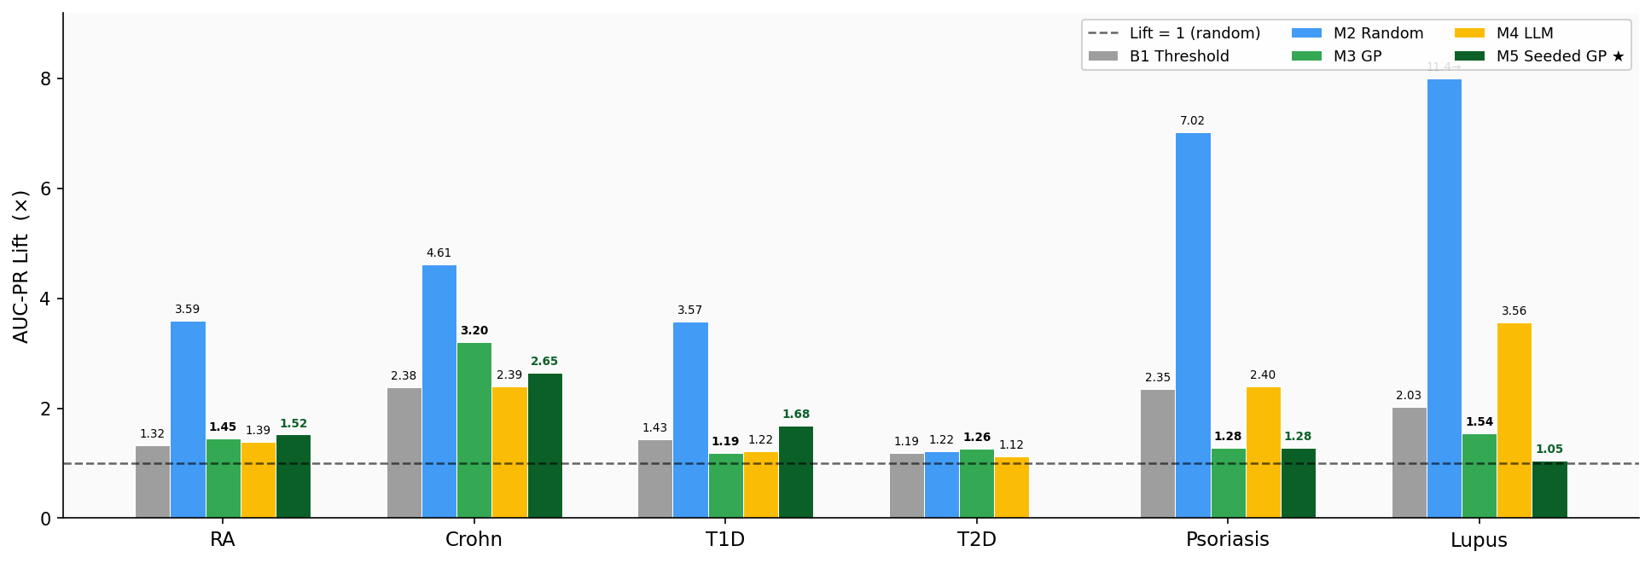
AUC-PR Lift Across All 6 Diseases — MIMIC Test Set
Lift = AUC-PR / prevalence. Values > 1 mean the formula outperforms random flagging. Y-axis capped at 8× (M2 Lupus = 11.36×, M2 Psoriasis = 7.02×).
B1 = single-feature threshold baseline. M5 (dark green) = Seeded GP using LLM-generated formula seeds. T2D has no M5 (seeding not applied). M2’s high MIMIC lift on lup/psr reflects feature count overfitting — see next slide.

Slide 9
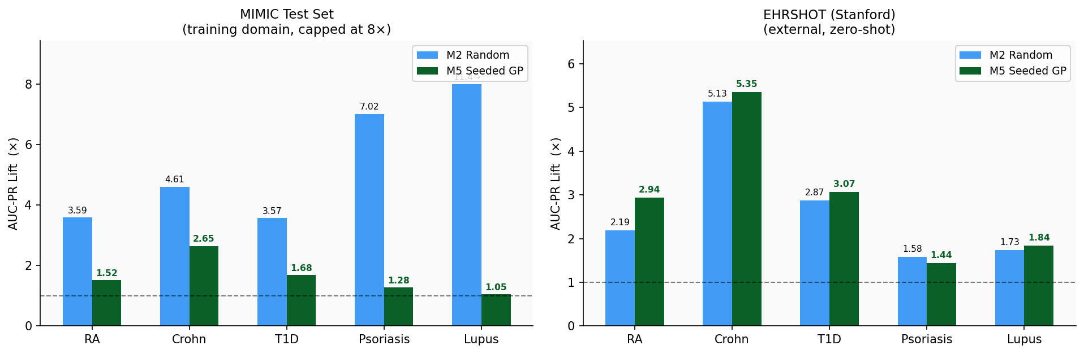
Why M5? M2 Overfits — M5 Generalises
M2 (Random Search) uses 4–13 features and achieves very high MIMIC test-set lift. On EHRSHOT (unseen Stanford data) that advantage nearly vanishes. M5 (Seeded GP, 3–6 features) is more consistent across both datasets.
Features used: RA: M2=9, M5=4 | Crohn: M2=13, M5=4 | T1D: M2=6, M5=9 | Psoriasis: M2=4, M5=3 | Lupus: M2=8, M5=6

Slide 10

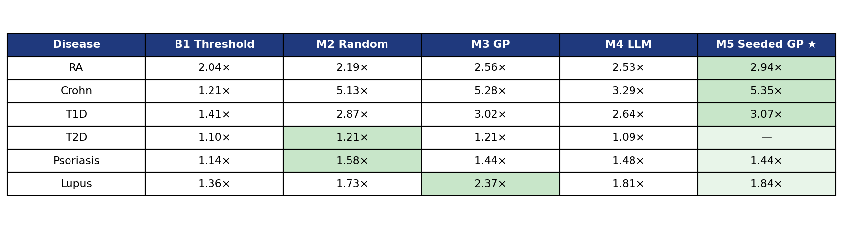
External Validation & Generalization
EHRSHOT (Stanford EHR) — AUC-PR Lift (lift = AUC-PR / cohort prevalence)
MIMIC-IV
NHANES
Train + internal test. ~223K patients, 6 diseases. Bootstrap CI (n=1,000).
US national population survey. External validation for RA and Psoriasis only — other diseases excluded after questionnaire variable audit.
EHRSHOT (Stanford)
External clinical validation. OMOP CDM format, different hospital system.
NHANES (US population survey, RA + Psoriasis only): RA AUC-PR — M1: 0.082, M2: 0.077, M3: 0.079, M4: 0.102. Psoriasis — M1: 0.022, M2: 0.033, M3: 0.038, M4: 0.035. (Lift not computed: NHANES prevalence unknown due to self-report inflation.)

Slide 11

Summary & Closing
1
2
Mathematical Structure > Feature Selection
Evolutionary Search Wins
GP beat all methods including a medical LLM. 50,000 structured evaluations over 100 generations found what random attempts and expert heuristics couldn't.
3
The Framework Is the Contribution
Notes:
אם ספירת דם פשוטה מכילה מספיק מידע לנבא דלקת מפרקים שגרונית — מה עוד מסתתר בבדיקות שכבר עושים לנו?

