Slide 1
Can a Routine CBC Predict Chronic Disease?
Interpretable formulas via LLM-seeded genetic programming
Ofek Vilkerstone
Advisors: Prof. Noa Dagan · Dr. Seffi Cohen · Dr. Liat Friedman Antwarg
BGU · 2026
Notes:
Welcome everyone. Today I'll present my undergraduate project on using routine blood tests to predict chronic diseases.

Slide 2
14 Features, 6 Diseases, One Blood Test
Complete Blood Count
Target Diseases
The most ordered lab test — cheap, universal, already collected at every clinical encounter.
Rheumatoid Arthritis
Crohn's Disease
9
standard counts
5
WBC differentials
Lupus
Psoriasis
Type 1 Diabetes
Type 2 Diabetes
MIMIC-IV · ~223,000 patients · ~1% prevalence
Goal: Interpretable CBC formulas that flag disease risk
Notes:
The CBC is the most commonly ordered blood test — 14 features from a single draw. We ask whether these can predict 6 chronic diseases. Our dataset is MIMIC-IV with about 223,000 patients and roughly 1% positive rate per disease.

Slide 3

Evaluation Framework
Dataset
Pre-processing
Formula Discovery
Evaluation
MIMIC-IV ~223,000 patients ~1% prevalence 90-day lookback 80 / 20 train-test
90-day lookback First 24 h index Last-value aggregation Imputation Normalization
AUC-PR Lift Primary metric AUC-ROC Bootstrap CI vs. Baseline External validation EHRSHOT · NHANES
M1 · Threshold
M2 · Random Search
Youden's Index cutoffs
10,000 random formulas
M3 · Genetic Prog.
M4 · LLM
gplearn · pop = 500
Med-Gemma 4B · seeded
Baseline: Logistic Regression (all 14 features)
Notes:
We built a plug-and-play pipeline where every method uses the same data processing and evaluation harness, making results directly comparable. Four formula discovery methods plus a logistic regression baseline.

Slide 4
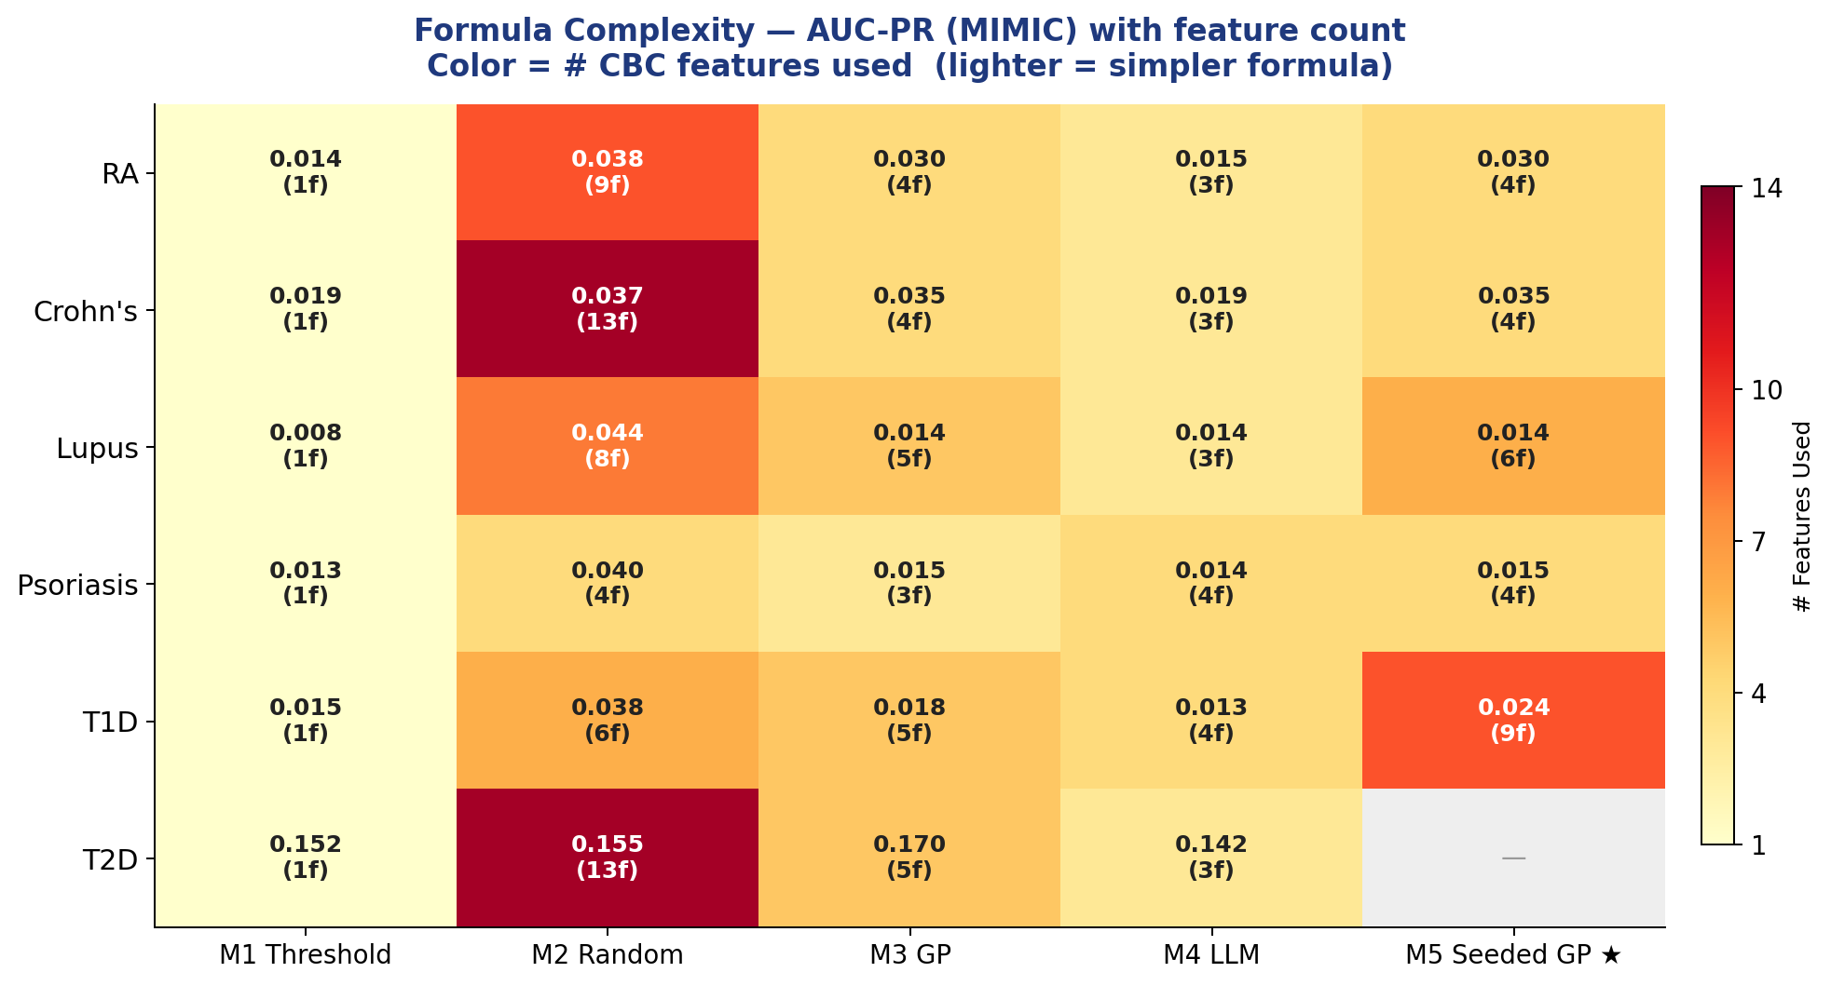
Performance and Complexity
Notes:
This heatmap shows all five methods across six diseases. Color indicates the number of CBC features each formula uses — lighter means simpler. M2 random search produces complex formulas with modest gains. M3 and M5 use similar feature counts, but M5's features are LLM-guided and biologically meaningful. That difference is the core of this project.

Slide 5
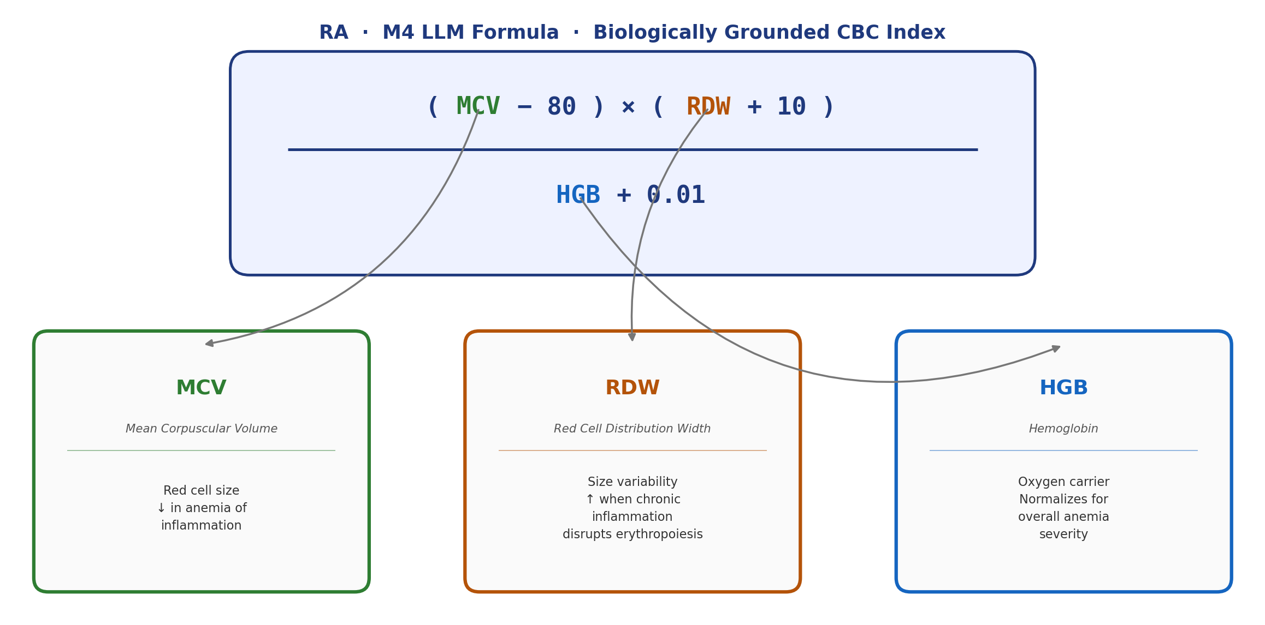
Case Study: Rheumatoid Arthritis
Chronic inflammation → anemia-of-inflammation markers detectable in a routine CBC. The LLM combines three biologically grounded features:
Notes:
Let me zoom in on rheumatoid arthritis. RA causes chronic inflammation, which leads to anemia-of-inflammation markers in the CBC. The M4 LLM identified MCV, RDW, and hemoglobin — three markers any clinician would recognize. It combined them into a formula that reads like a clinical index. By contrast, vanilla GP found a formula with arbitrary features like monocyte percentage over neutrophil percentage.

Slide 6
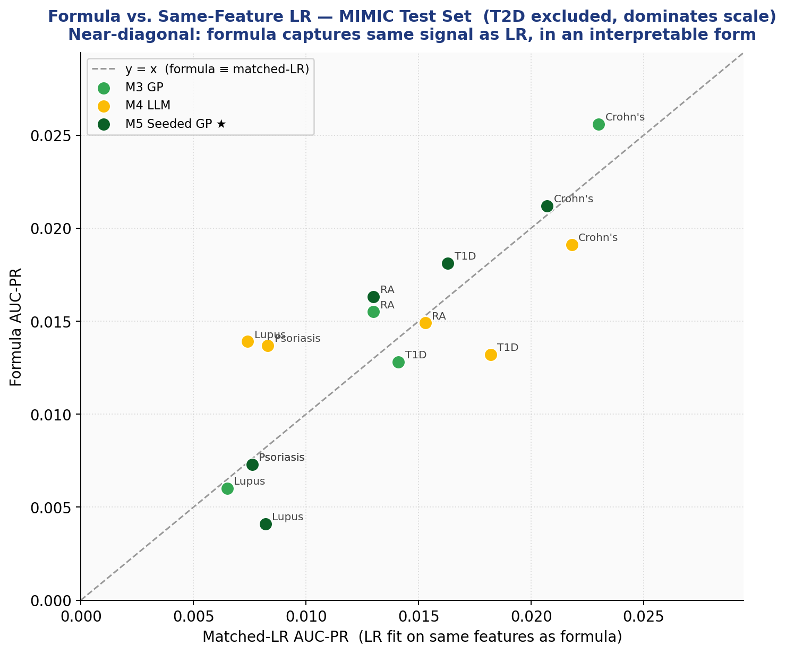
Seeded GP: Best of Both Worlds
M4 (LLM) selects biologically meaningful features
GP optimizes the mathematical expression
M5 ≥ M3 on every disease tested
+46%
+46%
+74%
T1D gain
RA gain
Lupus gain
Near-diagonal = formula captures same signal as matched LR
Notes:
M5 seeded GP takes the LLM's biological feature selection and feeds it to genetic programming for optimization. The result: M5 matches or beats vanilla GP on every disease. The scatter plot on the right compares each formula's AUC-PR to a logistic regression trained on the same features. Points near the diagonal mean the formula captures the same predictive signal — but in a compact, interpretable form.

Slide 7
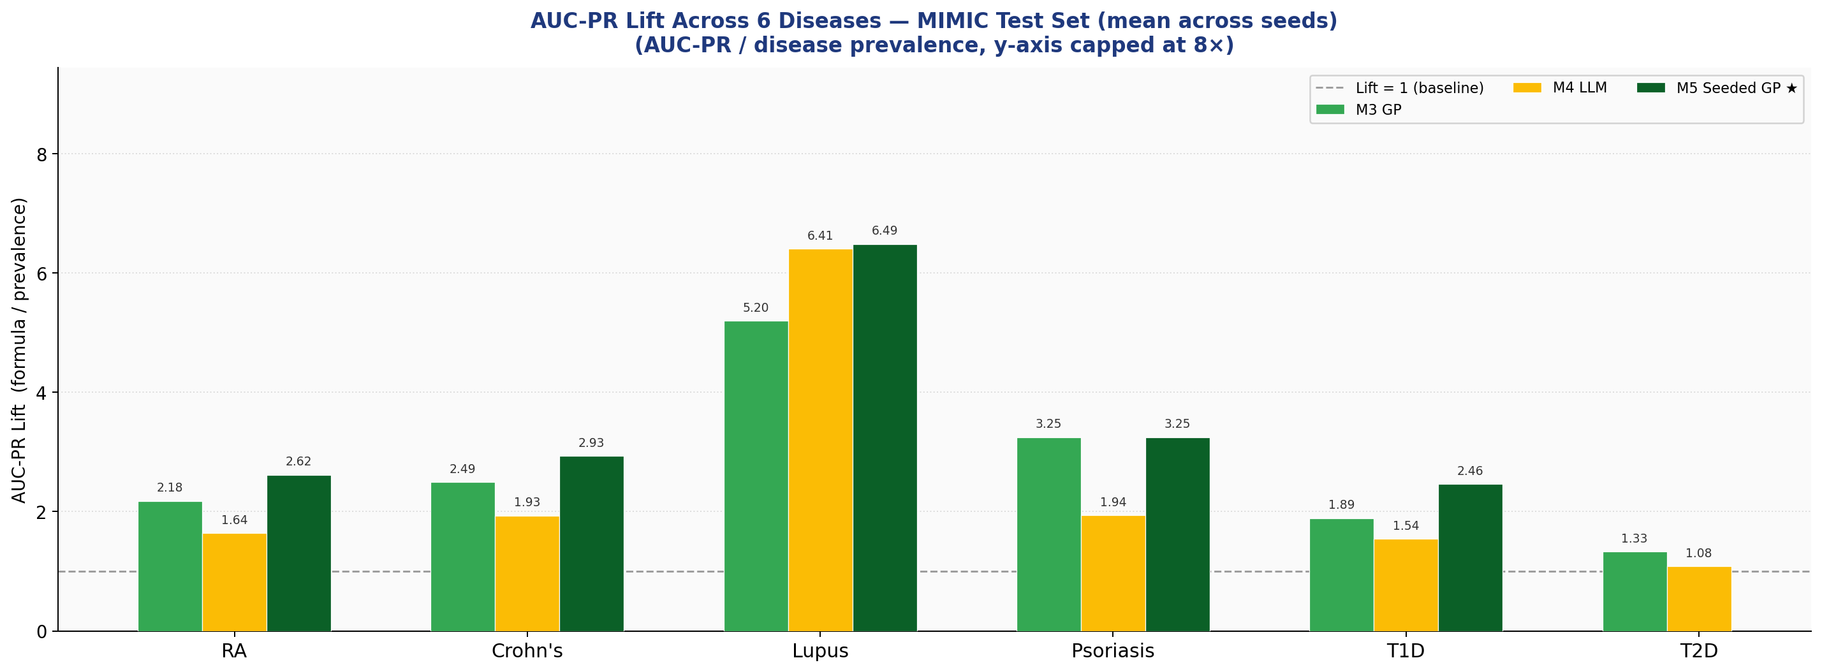
2–6× Lift Across 6 Diseases
Notes:
Lift measures how much better our formulas are than random chance. Lift of 1 means no better than guessing. Across all 6 diseases, formulas show 2 to 6 times lift. Lupus is the standout with over 5x. This is the within-distribution result — the interesting question is whether it holds externally.

Slide 8
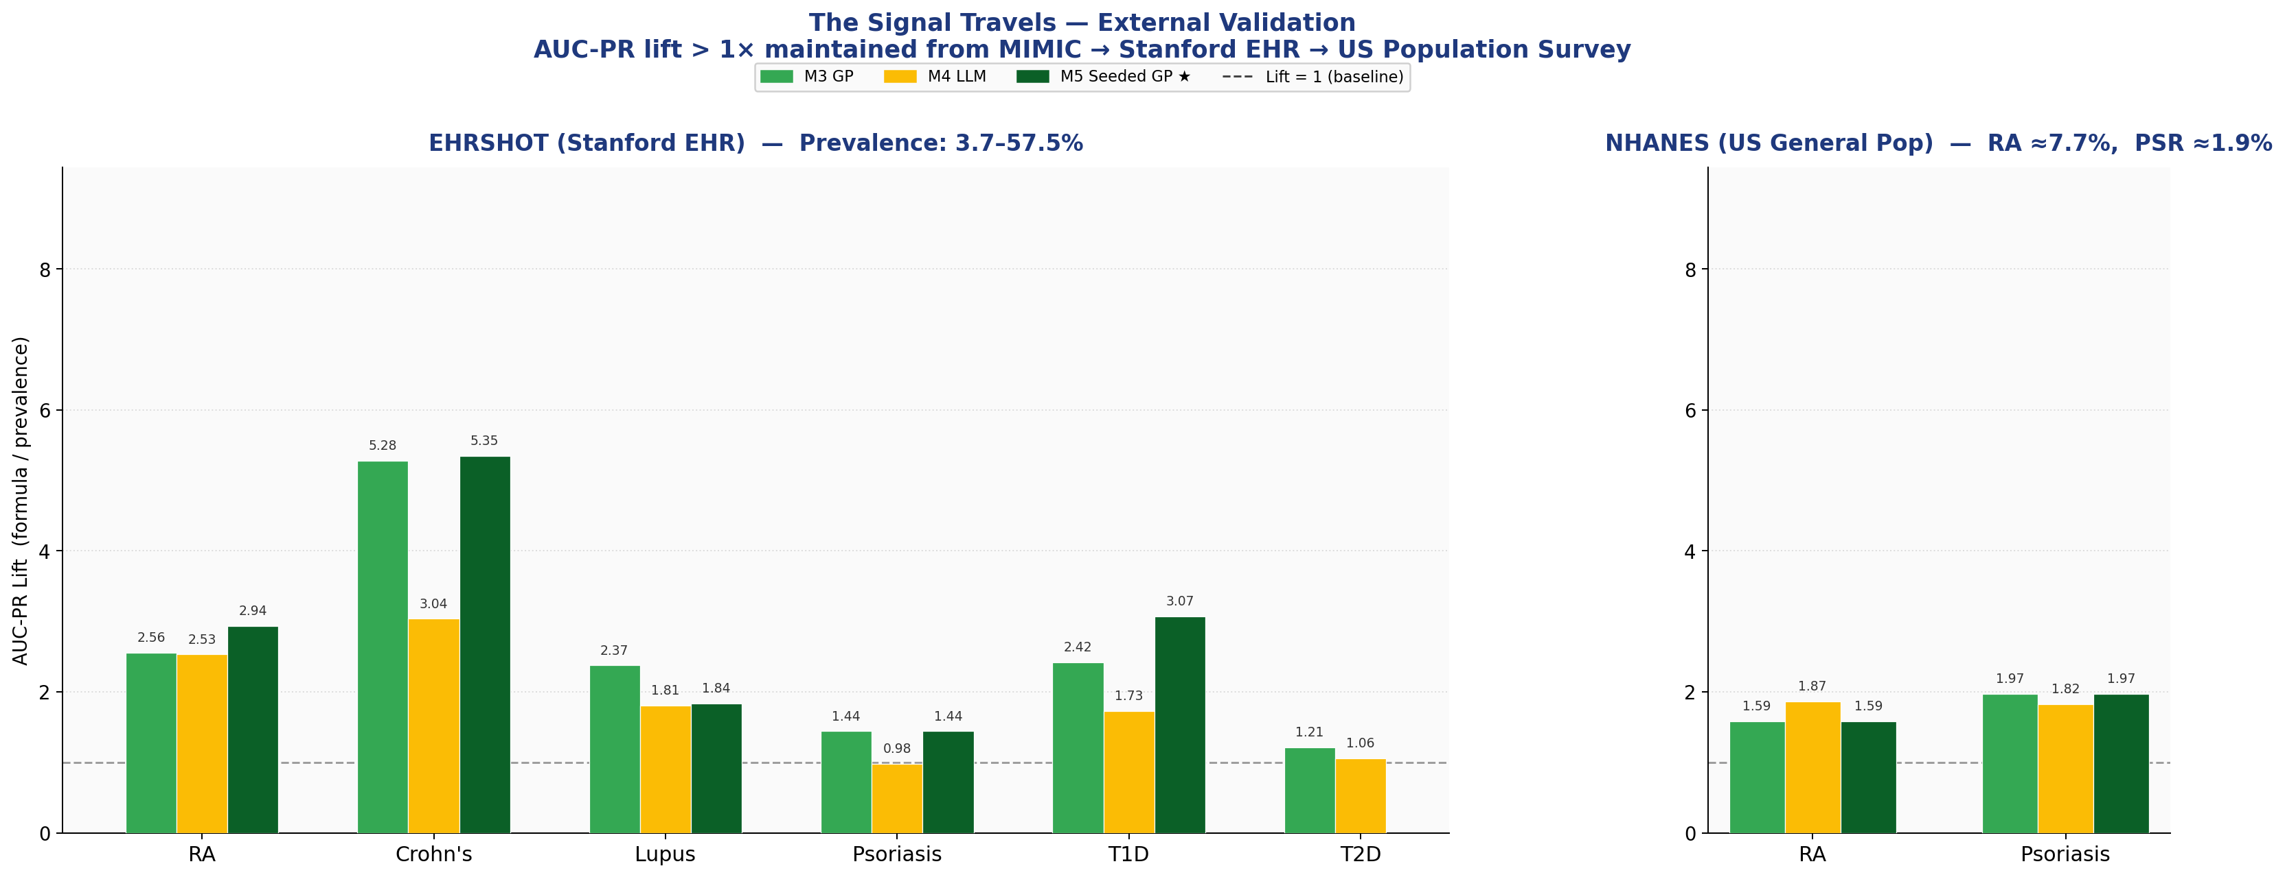
The Signal Travels
AUC-PR lift > 1× maintained from MIMIC → Stanford EHR → US population survey
Notes:
The critical question: does this hold outside MIMIC? On EHRSHOT, a Stanford hospital cohort with prevalences from 3% to 57%, lift stays above 1. On NHANES, a US population survey for RA and psoriasis, lift is still above 1. The CBC signal is not a MIMIC artifact — it generalizes across populations and settings.

Slide 9
Three Findings
01
LLM as Biological Compass
M4 generates compact, clinically interpretable formulas. GP alone finds valid expressions but with arbitrary, unrecognizable features.
02
Best of Both Worlds
Seeded GP matches or beats vanilla GP on every disease while using fewer, more meaningful features. The seed never hurts.
03
The Signal Travels
AUC-PR lift > 1× maintained across MIMIC → EHRSHOT → NHANES, despite prevalence varying from ~1% to ~57%.
Notes:
Three key findings. First, LLMs serve as a biological compass — they generate interpretable formulas with clinically meaningful features. Second, seeded GP combines the best of both worlds, matching or beating vanilla GP while keeping formulas interpretable. Third, the signal generalizes across very different datasets and populations.

Slide 10
Thank You
Questions?
Ofek Vilkerstone · [Institution]
Notes:
Thank you for your attention. I'm happy to take any questions.

