Slide 1
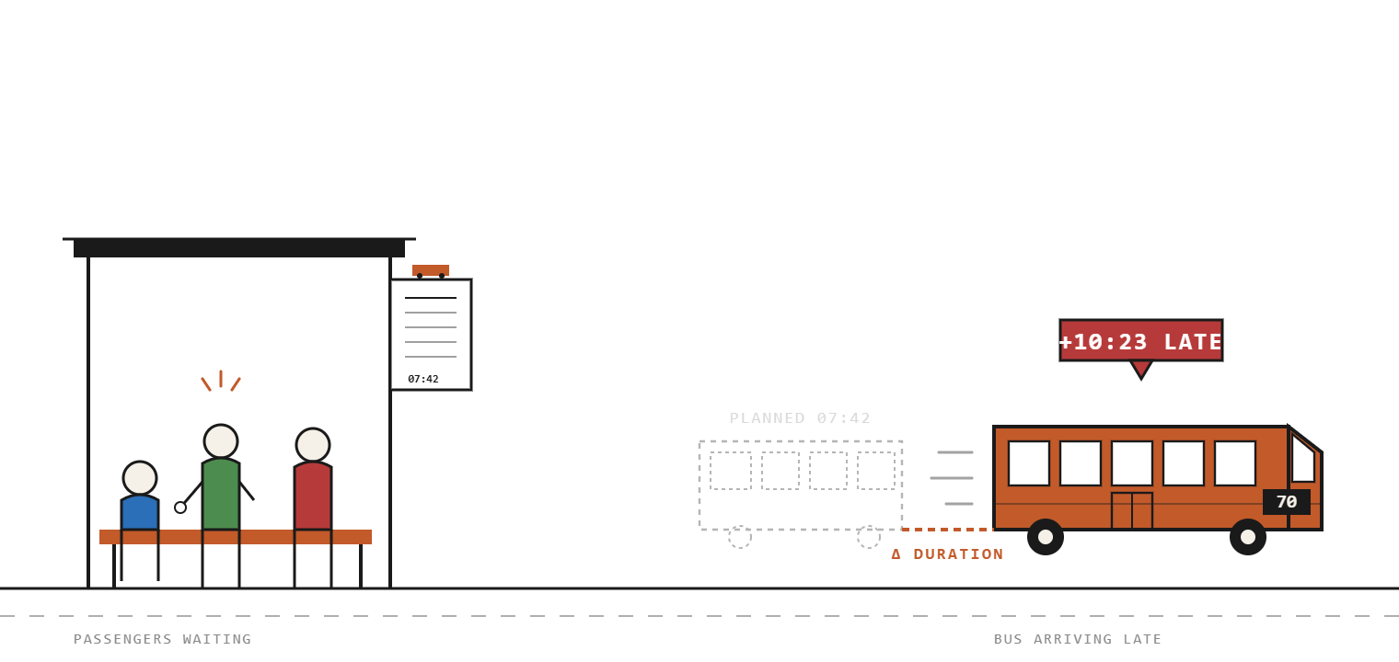

BAR-ILAN UNIVERSITY · DATA SCIENCE PROGRAM
DS22 / 1125 · ML PROJECT · MAY 2026
PUBLIC-TRANSIT RELIABILITY
Machine Learning Approach to Trip-Level Deviations
A trip-level multi-class model trained on GTFS schedules, SIRI live positions, smart-card validations, weather, and the bus-priority network.
Applied to bus routes in the Tel Aviv metropolitan area, April 2024.
INSTITUTION
AUTHORS
Bar-Ilan University
Ofer Shahal · Tamir Edelstein
Notes:
Hi everyone, we're Ofer and Tamir. Our project asks a simple question — when a bus leaves its origin in Tel Aviv, will it arrive on time? We trained a multi-class model on roughly 92,000 bus trips from April 2024, joined across schedules, live AVL pings, validations, weather and route geometry. The headline is that lateness is highly predictable, dominated by passenger load and time of day, and we'll spend the next 15 minutes showing you how we got there.

Slide 2
DS22 - Bar Ilan ML PROJECT
MAY 2026
AGENDA
What we'll cover today.
01
Agenda
A walkthrough of how we framed the problem, what the data revealed, the manipulation pipeline, and the modeling experiments that produced our final XGBoost classifier.
02
Data & target
03
EDA
04
Pipeline
05
Modeling
01
Data & target
Six sources, 92,548 trips × 35 columns, target defined as Δ-duration with three classes.
06
Conclusions
02
Exploratory analysis
Passenger-load t-test, Spearman correlations, the long-route night flip, and the hour × route-length heatmap.
03
Manipulation pipeline
Imputation per route, midnight-crossing & IQR outlier handling, target encoding, feature engineering, embedded selection.
04
Modeling experiments
Four model families, overfit checks, SMOTE, threshold tuning at 0.20, Optuna, and final XGBoost on the test set.
05
SHAP & conclusions
Per-class feature importance, baseline-vs-final comparison, three insights and three open questions.
02 / 34
Notes:
Here's the path. Part one is the data — sources, the raw scale, and the target. Part two is EDA. Part three is the manipulation pipeline — cleaning, encoding, feature engineering, and selection. Part four is modeling, with overfit checks, SMOTE experiments, threshold tuning, hyperparameter tuning and the final test results. Part five is conclusions.

Slide 3
DS22 - Bar Ilan ML PROJECT
MAY 2026
PART I · SECTION OPENER
01
Agenda
02
Data & target
03
EDA
04
Pipeline
05
Modeling
06
Conclusions
SECTION
Data & Target.
01
From GTFS plans and SIRI pings to weather, validations and route geometry - joined into 92,548 rows on a single trip-level key.
03 / 34
Notes:
Section one. Where the signals come from.

Slide 4
DS22 - Bar Ilan ML PROJECT
MAY 2026
DATA · SOURCES
Six independent feeds.
01
Agenda
Two primary anchors describe what should happen and what did. Four enrichments explain why the difference exists.
02
Data & target
03
EDA
04
Pipeline
05
Modeling
PRIMARY · STATIC
PRIMARY · LIVE
Validations
06
Conclusions
GTFS
SIRI
Published schedule. Stops, trips, planned durations. The should-be anchor.
30-second AVL pings . Reconstructed to actual trip duration. Retrieved via API from: https://open-bus-stride-api.hasadna.org.il/docs#/
Smart-card taps per trip - proxy for passenger load and dwell time at stops. Received from Ministry of Transportation.
IMS
Priority lanes
Route shape
Daily and hourly rainfall and temperature, joined by date and station. Downloaded from IMS website.
Geometry of the bus-priority lanes. We compute % of route on priority lane. Downloaded spatial data from the Ministry of Transport GIS platform (“Tiltan”)
GTFS shape coordinates – created geometry of each bus line
Joined based on:
Route id (GTFS route identifier) – matching trips with route geometry features
Date and hour – Rainfall
Date, hour, and line - Passengers
04 / 34
Notes:
Six independent feeds joined into one trip-level table. GTFS is the published schedule — the should-be anchor. SIRI is 30-second AVL pings — what actually happened. The other four are enrichments: smart-card validations as a crowding proxy, weather from IMS, the priority-lane network, and route geometry. Two anchors plus four enrichments, joined on trip_id, route_id and date.

Slide 5
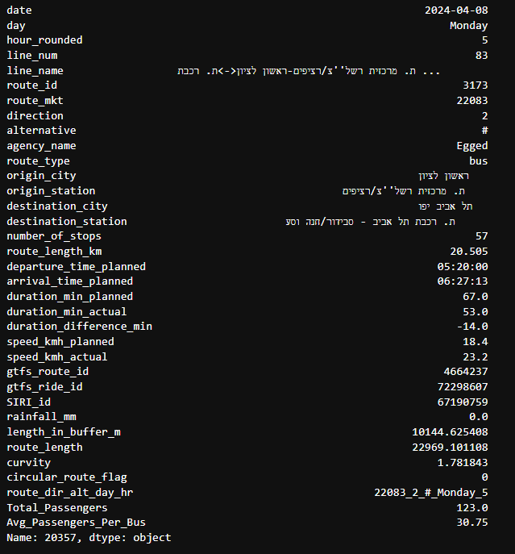
DS22 - Bar Ilan ML PROJECT
MAY 2026
DATA · RAW SCALE
The starting point.
01
Agenda
After joining all six sources on trip-level keys, our raw dataset before any cleaning, encoding or feature engineering.
02
Data & target
03
EDA
04
Pipeline
05
Modeling
COLUMNS
Sample record
06
Conclusions
ROWS
90,881
35
BUS TRIPS
RAW FEATURES
Each row is a single bus trip on a single date
Time: 7-13.2024 (7 days)
Location: Only trips starting and/or ending in Tel-Aviv
RAW COLUMNS · BY THEME
Schedule (GTFS)
Live position (SIRI)
Operational (validations)
Network & geometry
Weather (IMS)
Identifiers
05 / 34
Notes:
The raw dataset before any processing: 92,548 rows and 35 columns. That's our starting point. Each row is one bus trip on one date. The columns span schedule data, live position summaries, weather, network attributes and operational signals. Out of these 35 we'd ultimately keep 20 features for the final model.

Slide 6
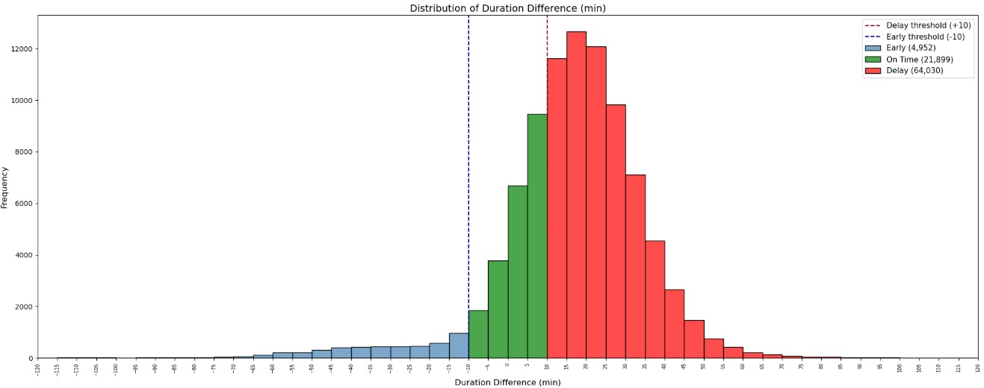
DS22 - Bar Ilan ML PROJECT
MAY 2026
DATA · TARGET
The target: Δ in minutes.
01
Agenda
A regression-style signed difference, bucketed into three operational classes.
02
Data & target
03
EDA
04
Pipeline
duration_{planned}
FIG · DISTRIBUTION OF Δ-DURATION
N = 90,881
05
Modeling
Δ
=
duration_{actual}
−
06
Conclusions
CLASS · EARLY
CLASS · ON-TIME
CLASS · DELAY
Δ < -10
Δ > 10 or Δ < -10
Δ > 10
5.4% · n=4,952
24.1% · n=21,899
70.5% · n=64,030
WHAT MATTERS TO US
We categorize the travel time deviation into a 3-class classification problem to focus on significant operational misses:
1. Early : Δ < -10 : The trip arrived at its destination 10 minutes or more ahead of the original GTFS schedule.
2. Late: Δ > 10 : The trip arrived at its destination 10 minutes or more behind the original GTFS schedule.
3. On-Time: Δ > 10 or Δ < -10 : All other trips that fall within the 20-minute "buffer" window.
We initially framed this as a regression problem, but model performance was poor — the continuous target had high variance and no strong linear structure. Reframing as a 3-class classification problem yielded substantially better results and cleaner operational thresholds.
06 / 34
Notes:
The target is the difference between actual trip duration and planned trip duration. Positive means the trip ran longer than scheduled — late. Negative means faster than scheduled — early. We classify into three buckets: early, on-time, delay. The chart on the right is the actual distribution of this difference; it's right-skewed, so the system runs late more than early.

Slide 7
DS22 - Bar Ilan ML PROJECT
MAY 2026
PART II · SECTION OPENER
01
Agenda
02
Data & target
03
EDA
04
Pipeline
05
Modeling
06
Conclusions
EXPLORATORY DATA ANALYSIS
SECTION
Decoding Transit Patterns.
02
A passenger-load t-test, a Spearman correlation ranking, and the long-route night flip - three findings that shaped feature engineering.
07 / 34
Notes:
Section two — exploratory data analysis. We spent serious time looking at the data before touching a model.

Slide 8
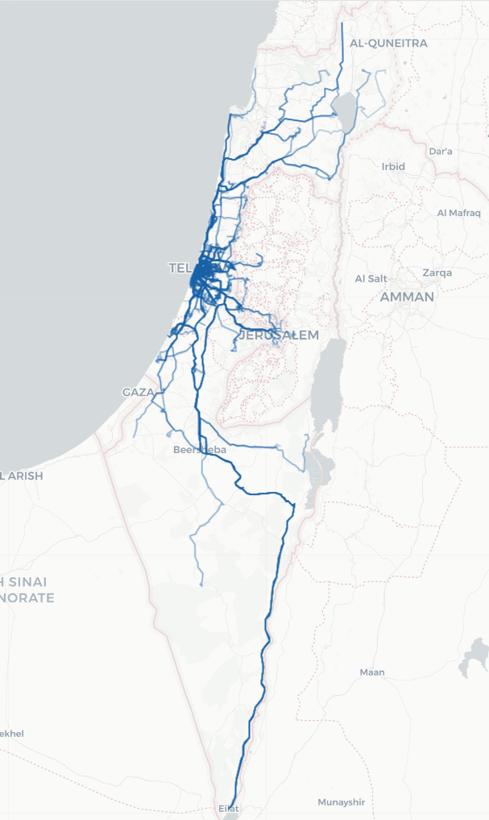
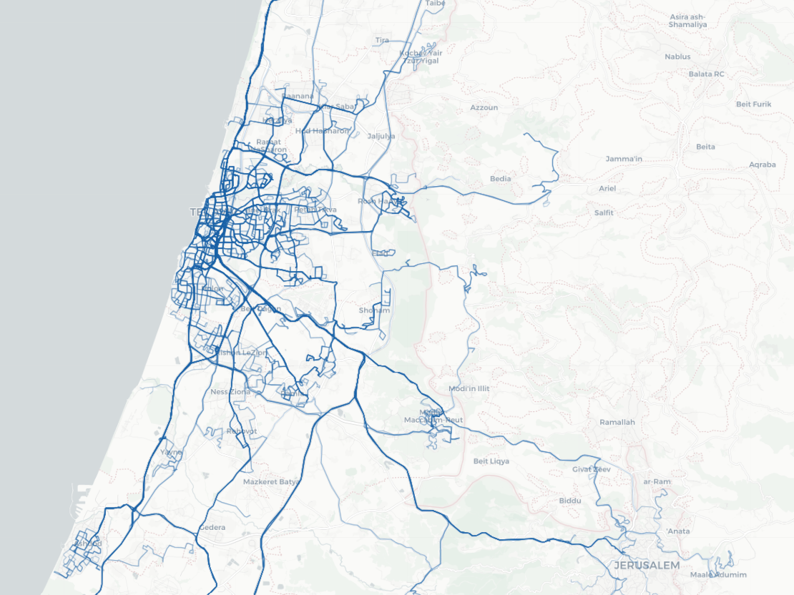
DS22 - Bar Ilan ML PROJECT
MAY 2026
EDA · OPERATING SCALE
A large, dense network.
01
Agenda
02
Data & target
UNIQUE LINES · APRIL 2024
FIG · NATIONAL COVERAGE
EILAT ↔ THE NORTH
03
EDA
297
04
Pipeline
05
Modeling
Distinct (agency, line, direction, alt.) combinations in our dataset covering bus routes in the Tel Aviv metropolitan area.
06
Conclusions
FIG · ROUTE GEOMETRIES · TEL AVIV METRO
DENSITY MAP
08 / 34
Notes:
Section three — the manipulation pipeline.

Slide 9
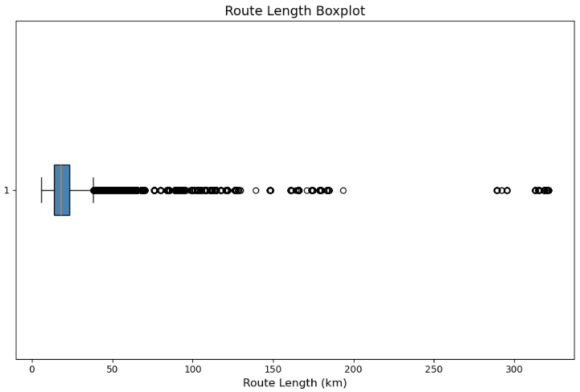
DS22 - Bar Ilan ML PROJECT
MAY 2026
EDA · ROUTE LENGTH DISTRIBUTION
A heavy long tail.
01
Agenda
SHAPE
02
Data & target
FIG · ROUTE LENGTH DISTRIBUTION
BOXPLOT · KM
Dense urban core. The IQR sits near 10–25 km — the bulk of TLV-metro lines.
03
EDA
Long tail to ~330 km. Intercity lines (Eilat, far north) extend the distribution dramatically.
04
Pipeline
05
Modeling
06
Conclusions
WHY IT MATTERS
A single global model has to handle a 30× length range. We did not cap long routes — instead we let the tree-based models partition on length, and we engineered the hour × length probability feature to exploit the night-time intercity lift.
09 / 34
Notes:
Outlier handling had two parts. First, midnight-crossing trips — when arrival time is earlier than departure time, the trip ended after midnight. We detected and corrected those. Second, IQR-based outlier detection on every numeric column, with box plots showing the percentage of outliers per column. We capped or removed extreme values per column based on the IQR bounds.

Slide 10
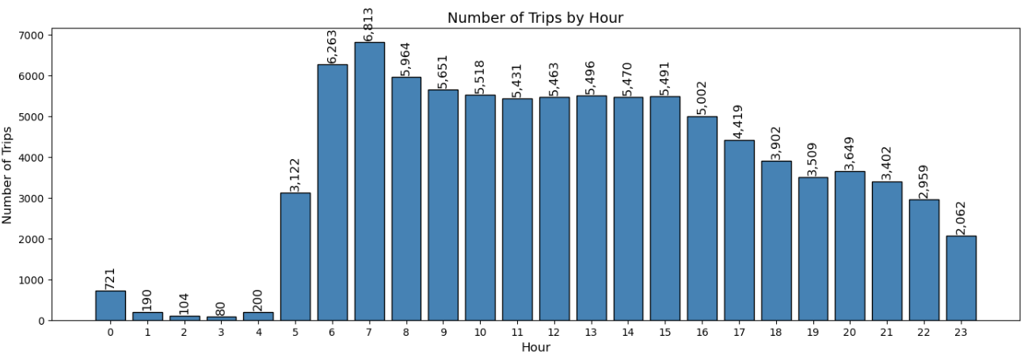
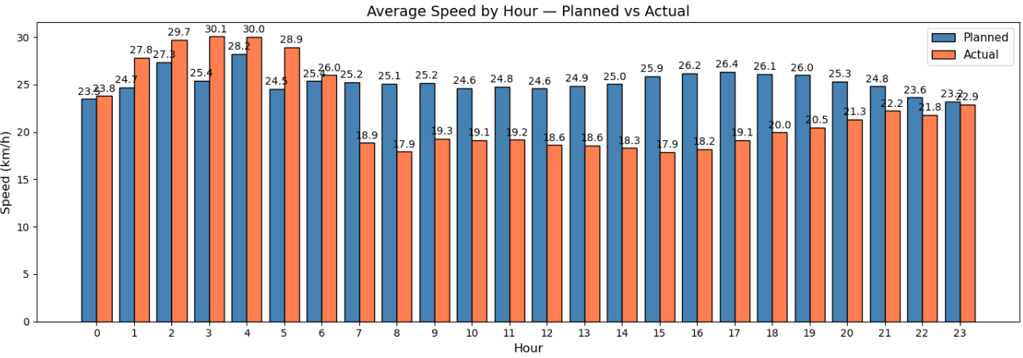
DS22 - Bar Ilan ML PROJECT
MAY 2026
EDA · VOLUME VS. SPEED
Volume up, speed down.
01
Agenda
Trip volume peaks at 06:00–08:00 (~6,800 trips/hr). At those same hours actual speed collapses 8–10 km/h below planned - exactly the gap the model learns.
02
Data & target
03
EDA
FIG · TRIPS BY HOUR
N = 90,881
FIG · AVG SPEED · PLANNED VS ACTUAL
KM/H
04
Pipeline
05
Modeling
06
Conclusions
10 / 34
Notes:
Nulls were filled per route. For speed, actual duration, and the duration difference, we used the median within each route_id and direction group. If still missing, fall back to the global median from a reference dataset. For average passengers per bus, same approach: median per route, then fall back. This keeps imputation route-aware — the median delay on Route 70 has nothing to do with the median on Route 5.

Slide 11
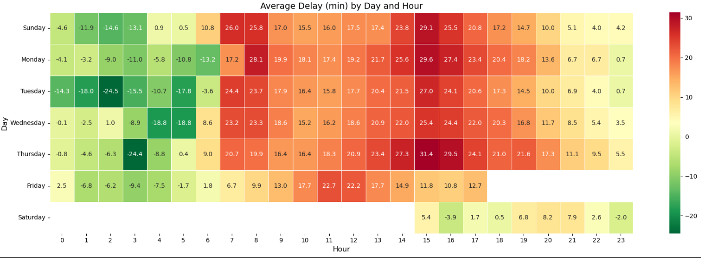
DS22 - Bar Ilan ML PROJECT
MAY 2026
EDA · TEMPORAL PATTERNS
Average delay by day & hour.
01
Agenda
02
Data & target
FIG · AVERAGE DELAY (MINUTES) · DAY × HOUR
RED = LATE · GREEN = EARLY
03
EDA
04
Pipeline
05
Modeling
06
Conclusions
PEAK LATE
PEAK EARLY
SHABBAT
Thursday 15:00 · +31.4 min
Tuesday 02:00 · −24.5 min
Saturday · partial service
Late afternoon Thursdays are the worst slot of the week.
Pre-dawn weekdays consistently run far ahead of schedule.
Service starts at 15:00 - limited fleet, near-zero average deviation.
11 / 34
Notes:
Five major stages. We start with type fixes, then null imputation, outlier handling, target creation, encoding categoricals, feature engineering, then selection. The selection stage is fitted on train only and replayed frozen on validation and test.

Slide 12
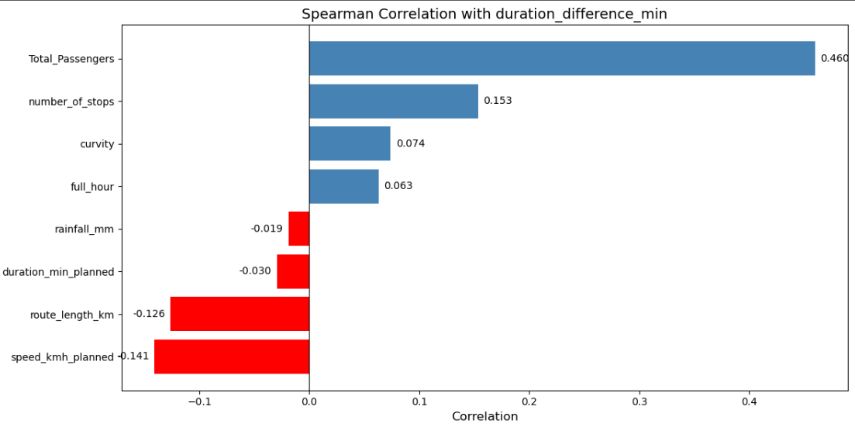
DS22 - Bar Ilan ML PROJECT
MAY 2026
EDA · SPEARMAN CORRELATION
Ranking signals against the target.
01
Agenda
02
Data & target
FIG · SPEARMAN CORRELATION WITH Δ-DURATION
NUMERIC FEATURES ONLY
POSITIVE · DRIVERS OF DELAY
03
EDA
Total_Passengers · +0.46— by far the strongest. Confirms the t-test.
04
Pipeline
05
Modeling
number_of_stops · +0.15 — more stops, more dwell.
06
Conclusions
curvity · +0.07 — winding routes, slightly slower.
full_hour · +0.06 — small late-day drift.
NEGATIVE · ANTI-DELAY
speed_kmh_planned · −0.14 — faster-scheduled routes have more slack.
route_length_km · −0.13 — long routes have generous timetables.
rainfall_mm · 0.02 — surprisingly weak.
11 / 34
Notes:
Spearman correlation between numeric features and the duration difference. Total passengers leads with a 0.46 correlation — by far the strongest. Number of stops, curvity and full hour have positive but small correlations. Speed and route length km are negatively correlated with delay — paradoxically, longer or faster-scheduled routes are slightly less likely to be late, because they have more slack baked in. These correlations gave us our first ranked list of candidates for feature selection.

Slide 13
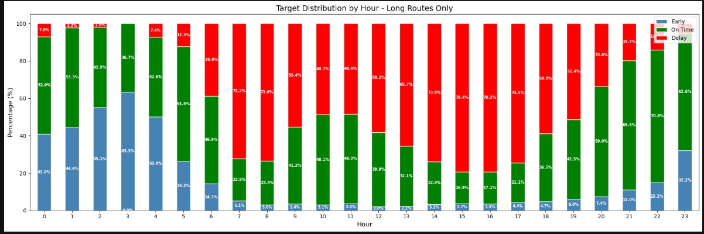
DS22 - Bar Ilan ML PROJECT
MAY 2026
EDA · TARGET × HOUR × ROUTE LENGTH
The long-route night flip.
01
Agenda
02
Data & target
FIG · TARGET DISTRIBUTION BY HOUR · LONG ROUTES
STACKED %
03
EDA
04
Pipeline
05
Modeling
06
Conclusions
3 AM
3–5 PM
INSIGHT
Empty roads, generous schedules.
Peak passenger load.
Lateness isn't a route property — it's route × hour
EARLY 63.3%
DELAY 79.4 / 79.3 / 74.5%
63% early to 79% late within 12 hours, on the same routes.
12 / 34
Notes:
On long routes, the share of delayed trips climbs above 70% during business hours and 79% mid-afternoon. Late nights flip the pattern entirely: at 3 AM, 63% of trips run early. So lateness is not a property of the route — it's a property of the route times the hour. This insight became one of our strongest engineered features.

Slide 14
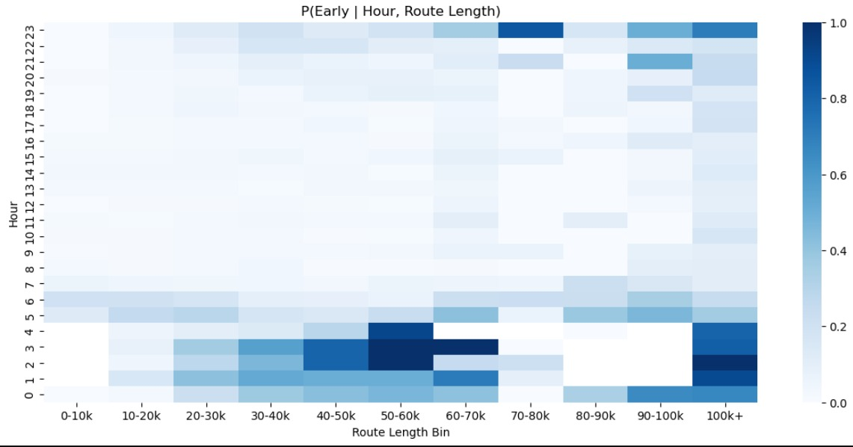
DS22 - Bar Ilan ML PROJECT
MAY 2026
EDA · INTERACTION EFFECTS
Hour × route length, conditional on early.
01
Agenda
02
Data & target
FIG · P(EARLY | HOUR, ROUTE LENGTH)
CONDITIONAL PROBABILITY
READING IT
03
EDA
Hot band: hours 1–4, routes ≥ 50km. Empty roads + long routes = consistently early.
04
Pipeline
05
Modeling
Cool ocean: hours 7–22. P(early) ≈ 0 for all route lengths during the active day.
06
Conclusions
Right-edge spike (100 km+). Intercity lines have generous schedules and high variance.
ENGINEERED FEATURE
early_by_hour_length_proba
Direct lift from this heatmap. Becomes the #1 SHAP driver for the early class , #2 for delay.
13 / 34
Notes:
The same finding rendered as a heatmap of P(early given hour, route length). The hot band at hours 1 to 4 across longer routes is the same nighttime pattern. We lifted this directly into a numeric feature called early_by_hour_length_proba, which becomes the second-most-important feature in the model.

Slide 15
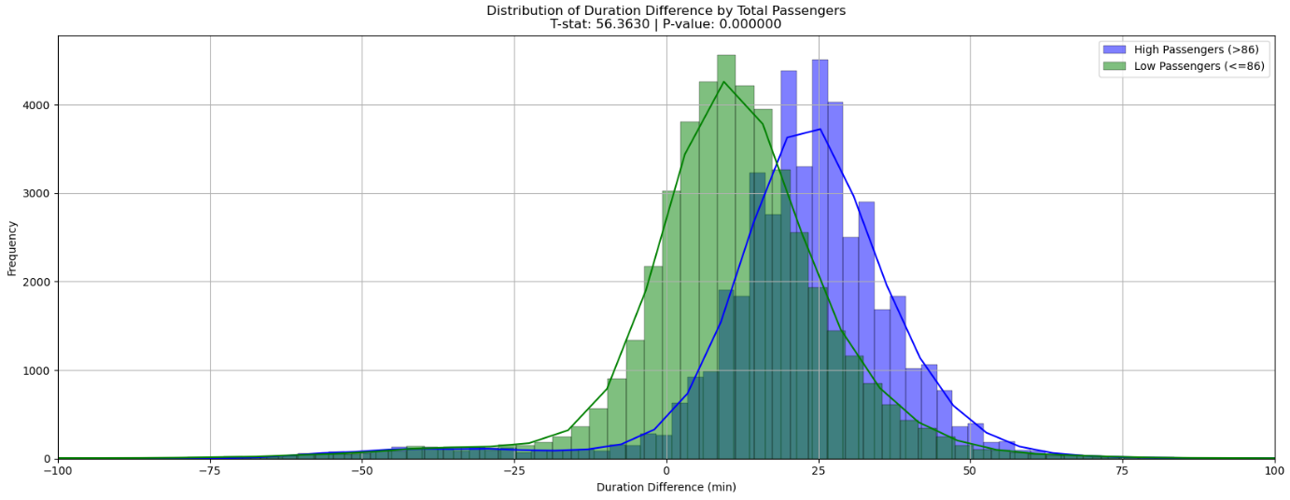
DS22 - Bar Ilan ML PROJECT
MAY 2026
EDA · PASSENGER LOAD × TARGET
Crowded buses run much later.
01
Agenda
02
Data & target
FIG · DISTRIBUTION OF Δ-DURATION BY PASSENGER LOAD
MEDIAN SPLIT @ 86
TWO-SAMPLE T-TEST
03
EDA
56.4
04
Pipeline
05
Modeling
06
Conclusions
T-STATISTIC
High vs. low passenger trips, split at the median (86).
P-VALUE
< 10⁻¹⁰⁰
Effectively zero. The difference between the two distributions is overwhelmingly significant.
READ THIS WAY
Crowding causes lateness — the high-load distribution is shifted ~15 min later than the low-load distribution.
14 / 34
Notes:
First look — the relationship between passenger load and delay. We split trips into high-load and low-load groups using the median number of passengers as the cutoff at 86. The two distributions are clearly different: high-load trips center around 25 minutes late, low-load trips center near 10 minutes. The t-statistic is 56.4 with a p-value essentially zero — the difference is overwhelmingly significant. Crowding causes lateness. This was our first quantitative confirmation of the operational hypothesis.

Slide 16
DS22 - Bar Ilan ML PROJECT
MAY 2026
PART III · SECTION OPENER
01
Agenda
02
Data & target
03
EDA
04
Pipeline
05
Modeling
06
Conclusions
MANIPULATION & CLEANING
SECTION
Manipulation & cleaning pipeline.
03
Selection runs on train only — the same operations are then frozen and replayed on validation and test.
15 / 34
Notes:
Categorical encoding. Day of week was ordinal encoded since it has natural order. The rest — agency, origin city, destination city, origin and destination station, and the route line direction code — went through target encoding using the category_encoders TargetEncoder. Target encoding gives each category its mean target value, which is much more efficient than one-hot for high-cardinality columns like route_line_direction.

Slide 17
DS22 - Bar Ilan ML PROJECT
MAY 2026
PIPELINE · OVERVIEW
Split Data
01
Agenda
02
Data & target
03
EDA
04
Pipeline
Before doing any manipulation to the dataset – it was split into 3
05
Modeling
06
Conclusions
Train (70%)
63,616 Records
Create manipulation pipelines
Train models
Validation (15%)
13,632 Records
Validates trained models and back-and-forth checking iterations
Test (15%)
13,633 Records
Final run on the selected model
Cleaning & Manipulation pipelines
16 / 34
Notes:
Feature engineering. We engineered three families. Temporal features like arrival hour and day encoded. Operational features like average passengers per bus and the passengers-times-peak interaction. And lifted features — the conditional probability of early arrival given hour and route length, lifted directly from the heatmap we showed earlier.

Slide 18
DS22 - Bar Ilan ML PROJECT
MAY 2026
PIPELINE · OVERVIEW
Six ordered steps.
01
Agenda
02
Data & target
03
EDA
04
Pipeline
Fix data types
Handle missing values
Handle outliers
01
02
03
05
Modeling
06
Conclusions
Add features
Encoding categorial
Feature selection
04
05
06
All steps gathered into one pipeline to ensure consistency of the cleaning between Train, Validation and Test, and avoid data leakage
17 / 34
Notes:
Feature engineering. We engineered three families. Temporal features like arrival hour and day encoded. Operational features like average passengers per bus and the passengers-times-peak interaction. And lifted features — the conditional probability of early arrival given hour and route length, lifted directly from the heatmap we showed earlier.

Slide 19
DS22 - Bar Ilan ML PROJECT
MAY 2026
PIPELINE · 02 · MISSING VALUES
Missing values handling
01
Agenda
Leakage Prevention
All missing-value statistics were calculated from the training dataset only and reused for validation/test datasets.
02
Data & target
03
EDA
04
Pipeline
05
Modeling
Category | Handling Method
Total_Passengers | Progressive median imputation using: route + direction + day + hour → route + direction + day → route only → global train median.
Avg_Passengers_Per_Bus | Filled using route-level median, then global train median.
circular_route | Missing values filled with 0.
Text Attributes | Missing values in line_name, agency_name, and line_num filled with "unknown".
Speed & Duration Attributes | Missing values filled using route + direction median, then train median.
Spatial Attributes | Missing curvity, route_length, and length_in_buffer_m filled using train-set mean values.
Route Length Correction | Missing or zero route_length values replaced using route_length_km × 1000.
06
Conclusions
18 / 34
Notes:
Feature selection. We started with 35 raw columns, expanded to 52 after engineering, then narrowed to 20 final features using embedded tree-based importance. We compared four selection methods — mutual information, chi-squared, RFE-CV, and embedded tree importance with L1. Embedded won with a validation macro-F1 of 0.68.

Slide 20
DS22 - Bar Ilan ML PROJECT
MAY 2026
PIPELINE · 03 · OUTLIERS
Outliers handling
01
Agenda
02
Data & target
CASE 01 · MIDNIGHT-CROSSING TRIPS
CASE 02 · IQR OUTLIERS
03
EDA
Arrival earlier than departure?
Box-plot per numeric column.
04
Pipeline
For each numeric column we compute Q1, Q3, IQR = Q3 − Q1, then bounds at Q1 − 1.5·IQR and Q3 + 1.5·IQR.
05
Modeling
Some trips legitimately end after midnight . Without correction the duration goes negative — a hard outlier the model can't reason about.
06
Conclusions
COLUMN
OUTLIERS
%
mask_midnight = arrival_time_planned < departure_time_planned # add 24h to arrival
duration_difference_min
3,142
3.4%
speed_kmh_actual
1,876
2.0%
Avg_Passengers_Per_Bus
2,213
2.4%
~340 trips fixed
curvity
911
1.0%
Outliers Handling
Corrected unrealistic planned speed values (>100 km/h) caused by unit inconsistencies.
Identified trips crossing midnight and recalculated planned duration and planned speed accordingly.
Removed extreme trip duration deviations (duration_difference_min) outside the range of ±120 minutes (365 rows).
Used boxplots before and after the process to validate the impact of outlier handling.
Preserved realistic operational variability while reducing the influence of anomalous records.
19 / 34
Notes:
Section four — modeling.

Slide 21
DS22 - Bar Ilan ML PROJECT
MAY 2026
PIPELINE · 06 · Add features
Add features
01
Agenda
Feature Group | New Feature | Purpose
Temporal features | is_peak_hour | Marks rides during peak hours: 07–09 and 14–17.
 | is_night | Marks rides during night hours: 00–05.
 | departure_hour, arrival_hour | Extracts planned departure and arrival hours.
Route type | urban | Identifies short urban routes: route length ≤ 25 km.
Spatial / infrastructure | perc_within_pt_route | Calculates share of route located within public transport priority corridors.
 | perc_within_pt_route_peak | Combines priority-corridor coverage with peak-hour operation.
Interaction features | passengers_x_peak | Captures combined effect of passenger demand and peak hours.
 | stops_x_passengers | Captures combined effect of number of stops and passenger volume.
 | night_x_long_route | Captures interaction between night operation and route length.
Combined identifier | agency_linenum_dir_alter | Creates a detailed operational line identifier from agency, line number, direction, and alternative.
Probability feature | early_by_hour_length_proba | Adds historical probability of early arrival by hour and route-length category.
Route segmentation | route_length_bin | Categorizes routes into short, medium, and long groups.
02
Data & target
03
EDA
04
Pipeline
05
Modeling
06
Conclusions
Replace each category with the mean target value within that category — much more efficient than one-hot for hundreds of unique values.
origin_city · destination_city
origin_station · destination_station
agency_linenum_dir_alter ★
Implemented via category_encoders.TargetEncoder. Fit on train only, applied frozen to val/test.
20 / 34
Leakage Prevention
Probability features were calculated from the training dataset only and applied to validation/test.
Notes:
Four model families compared on the validation set: logistic regression as our baseline, random forest, XGBoost, and LightGBM. ROC curves on the right, one panel per class. XGBoost wins on every class — AUC 0.83 for early, 0.90 for delay, 0.90 for on-time. LightGBM is essentially tied. Logistic regression lags clearly, especially on the early class.

Slide 22
DS22 - Bar Ilan ML PROJECT
MAY 2026
PIPELINE · 06 · CATEGORICAL → NUMERIC
Encoding categoricals.
01
Agenda
02
Data & target
03
EDA
04
Pipeline
Encoding Type | Columns / Features | Method
Ordinal encoding | day | Encoded weekdays by order: Sunday = 0 → Saturday = 6.
 | route_length_bin | Encoded route-length categories: 0-30k = 0, 30-100k = 1, 100k+ = 2.
Target encoding | agency_name, origin_city, destination_city, origin_station, destination_station, agency_linenum_dir_alter | Converted high-cardinality categorical variables into numerical values based on the target variable delay_cat.
05
Modeling
06
Conclusions
Leakage Prevention
Fitted only on the training dataset and reused for validation/test datasets.
21 / 34
Notes:
Four model families compared on the validation set: logistic regression as our baseline, random forest, XGBoost, and LightGBM. ROC curves on the right, one panel per class. XGBoost wins on every class — AUC 0.83 for early, 0.90 for delay, 0.90 for on-time. LightGBM is essentially tied. Logistic regression lags clearly, especially on the early class.

Slide 23
DS22 - Bar Ilan ML PROJECT
MAY 2026
PIPELINE · 06 · Feature selection
Feature selection
01
Agenda
02
Data & target
Column Group | Removed Columns | Reason
Original categorical columns | day, alternative, agency_name, origin_city, origin_station, destination_city, destination_station, route_length_bin | Already represented by encoded features.
Redundant columns | route_mkt, route_length_kn | Duplicated or not needed for modeling.
Text / time columns | date, line_name, departure_time_planned, arrival_time_planned, route_type, line_num, agency_linenum_dir_alter | Not directly suitable for model training after feature engineering/encoding.
03
EDA
04
Pipeline
05
Modeling
06
Conclusions
Feature Selection Check
Ran several feature selection methods on the training dataset only.
Methods included:
Random Forest
Gradient Boosting
Linear SVC
Logistic Regression with L2 regularization
Each method gave a “vote” to features it identified as useful.
Tested XGBoost models using different vote thresholds, such as features selected by at least 4 or 3 methods.
No clear performance improvement was found after reducing the feature set.
Therefore, the final model kept the full selected feature set.
22 / 34
Notes:
Four model families compared on the validation set: logistic regression as our baseline, random forest, XGBoost, and LightGBM. ROC curves on the right, one panel per class. XGBoost wins on every class — AUC 0.83 for early, 0.90 for delay, 0.90 for on-time. LightGBM is essentially tied. Logistic regression lags clearly, especially on the early class.

Slide 24
DS22 - Bar Ilan ML PROJECT
MAY 2026
PIPELINE · 08 · Feature Selection
Feature selection summary
01
Agenda
02
Data & target
03
EDA
04
Pipeline
05
Modeling
06
Conclusions
FUNNEL
FINAL FEATURE SET
20 features across three families.
RAW
→
ENGINEERED
SELECTED
35
→
7 temporal/operational, 6 route shape, 7 encoded categoricals — including the engineered
52
20
23 / 34
Notes:
We did three additional experiments on top of XGBoost. First, an overfit check — train accuracy 0.858, validation 0.823, gap of just 0.035; macro-F1 train 0.737, val 0.663, gap 0.075. No significant overfit. Second, SMOTE oversampling of the minority classes, primarily early — results were not better, the synthetic samples didn't help. Third, threshold tuning — sweeping the decision threshold from 0.10 to 0.30 in 0.05 steps. The best threshold was 0.20, lifting macro-F1 from baseline to 0.7029. We also ran Optuna for hyperparameter tuning, no further improvement on top of threshold tuning. So our final model is XGBoost with class weights and threshold 0.20.

Slide 25
DS22 - Bar Ilan ML PROJECT
MAY 2026
PART IV · SECTION OPENER
01
Agenda
02
Data & target
03
EDA
04
Pipeline
05
Modeling
06
Conclusions
Modeling & Evaluation.
SECTION
04
BaseLine → LogReg → RF → LightGBM → XGBoost. Then overfit check, SMOTE, threshold tuning, Optuna - and the test set.
24 / 34
Notes:
Test set results. Out of 13,588 trips: accuracy 0.82, weighted F1 0.81, macro F1 0.68. Per-class: delay F1 of 0.90 with 94% recall — the model rarely misses a real delay. Early F1 of 0.51, recall 0.47 — the hardest class. On-time F1 of 0.64. The errors mostly live in on-time trips that get flagged as delay, which is the conservative kind of mistake from an operational point of view.

Slide 26
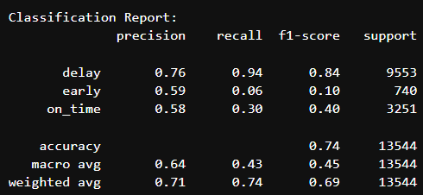
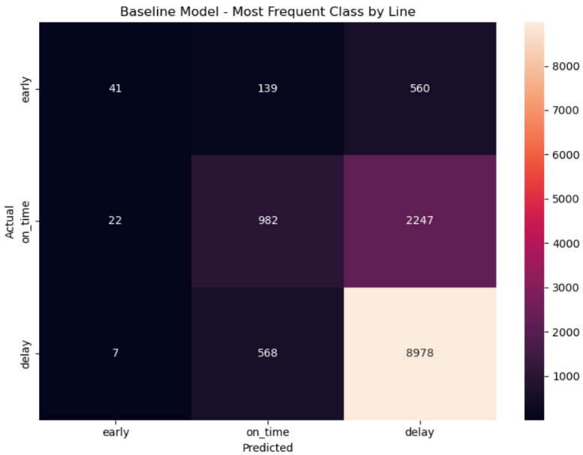
DS22 - Bar Ilan ML PROJECT
MAY 2026
MODELING · WORKFLOW
Baseline model – Rule based most frequent class by line
01
Agenda
02
Data & target
Built a baseline classification model using the most frequent operational class for each line group.
Grouped rides by agency_linenum_dir_alter_encoded.
Assigned the most common class (early, on_time, or delay) from the training dataset as the prediction.
Used the global most frequent class as a fallback for unseen groups.
Applied the baseline model to the validation dataset.
Evaluated performance using accuracy, classification report, and confusion matrix.
Used the baseline as a benchmark for comparison with the machine learning models.
03
EDA
04
Pipeline
05
Modeling
06
Conclusions
25 / 34
Notes:
Test set results. Out of 13,588 trips: accuracy 0.82, weighted F1 0.81, macro F1 0.68. Per-class: delay F1 of 0.90 with 94% recall — the model rarely misses a real delay. Early F1 of 0.51, recall 0.47 — the hardest class. On-time F1 of 0.64. The errors mostly live in on-time trips that get flagged as delay, which is the conservative kind of mistake from an operational point of view.

Slide 27
DS22 - Bar Ilan ML PROJECT
MAY 2026
MODELING · WORKFLOW
How we picked, tuned & validated.
01
Agenda
A four-stage funnel: cast a wide net first, then go deep on the winner. Each stage gates the next.
02
Data & target
03
EDA
METRICS WE OPTIMISE FOR
04
Pipeline
On-time is operationally cheap; what hurts passengers is missing an early or a late. So we track macro-F1 (which weighs the rare classes equally with the majority) and per-class recall on early & delay — accuracy alone would let a "predict delay always" model score 71%.
05
Modeling
06
Conclusions
STEP · 01
STEP · 02
STEP · 03
STEP · 04
Wide net.
Pick the winner.
Go deep.
Lock & compare.
Run every candidate model with default hyper-parameters on the same train/val split. No tuning, no class-imbalance work — a fair, cheap baseline for each family.
Compare on validation macro-F1 and per-class ROC-AUC. XGBoost wins on every class — it becomes the only model we tune from here on.
Three parallel experiments on XGBoost: hyper-parameter tuning (Optuna), threshold sweep 0.10 → 0.30, and an overfit check on train-vs-val gaps.
Freeze the best configuration — XGBoost + class weights + threshold = 0.20 — and benchmark it head-to-head against the LogReg baseline on the held-out test set.
LOGREG · RF · XGB · LGBM
★ XGBOOST SELECTED
OPTUNA · THRESHOLD · OVERFIT
F1 · 0.55 → 0.68
26 / 34
The next four slides walk through the funnel: ROC comparison, XGBoost tuning details, final test results, and baseline vs. tuned.
Notes:
Test set results. Out of 13,588 trips: accuracy 0.82, weighted F1 0.81, macro F1 0.68. Per-class: delay F1 of 0.90 with 94% recall — the model rarely misses a real delay. Early F1 of 0.51, recall 0.47 — the hardest class. On-time F1 of 0.64. The errors mostly live in on-time trips that get flagged as delay, which is the conservative kind of mistake from an operational point of view.

Slide 28
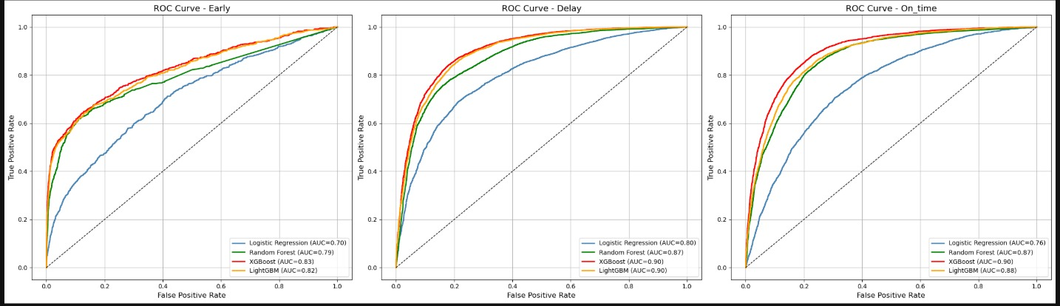
DS22 - Bar Ilan ML PROJECT
MAY 2026
MODELING · ROC COMPARISON
Four models, one winner.
01
Agenda
02
Data & target
FIG · ROC CURVES · EARLY / DELAY / ON-TIME
ONE-VS-REST
03
EDA
04
Pipeline
05
Modeling
06
Conclusions
LOGISTIC REGRESSION
RANDOM FOREST
LIGHTGBM
XGBOOST · WINNER
Linear baseline.
Bagging.
Histogram boosting.
Gradient boosting.
27 / 34
AUC: 0.70 / 0.80 / 0.76
AUC: 0.79 / 0.87 / 0.87
AUC: 0.82 / 0.90 / 0.88
AUC: 0.83 / 0.90 / 0.90
Notes:
SHAP feature importance, one plot per class. For delay: agency_linenum_dir_alter — route identity — dominates. Some lines are systemically late. For early: our engineered hour-by-route-length probability dominates. For on-time: average passengers per bus is the top driver. Read together: route identity drives delay, conditional probabilities drive early, and crowding drives on-time. Three different stories from one model.

Slide 29
DS22 - Bar Ilan ML PROJECT
MAY 2026
XGBOOST · FOUR FOLLOW-UP EXPERIMENTS
Tuning the winner.
01
Agenda
02
Data & target
EXPERIMENT · 01 · OVERFIT CHECK
EXPERIMENT · 03 · THRESHOLD TUNING ★
03
EDA
No significant overfit.
The lever that worked.
04
Pipeline
Sweeping the decision threshold from 0.10 to 0.30, optimizing F1_{delay+early}.
05
Modeling
TRAIN
VAL
GAP
06
Conclusions
Accuracy
0.858
0.823
+0.035
THRESHOLD
ACC
F1_{EARLY}
F1_{DELAY}
F1_{DE+EA}
F1_{macro}
0.737
0.663
+0.075
0.10
0.803
0.452
0.893
0.672
0.15
0.816
0.493
0.895
0.694
EXPERIMENT · 02 · SMOTE
0.20 ★
0.821
0.511
0.895
0.703
Synthetic minority oversampling — did not improve.
0.25
0.824
0.509
0.895
0.702
Targeted the early class. Synthetic samples introduced label noise that the model couldn't capitalize on.
0.30
0.823
0.485
0.895
0.690
Threshold 0.20 maximizes the recall-on-rare-classes metric while keeping accuracy near the peak — adopted in the final model.
DROPPED
EXPERIMENT · 04 · OPTUNA
Bayesian hyperparameter tuning.
Searched depth, learning rate, subsample, colsample, regularization. No further improvement on top of threshold tuning.
EVALUATED
28 / 34
Notes:
Closing comparison: baseline LogReg vs. our final tuned XGBoost. Macro F1 jumped from 0.55 to 0.68. The gain comes from three places: tree-based modeling, threshold tuning at 0.20, and the engineered features. Each was worth roughly five points of macro-F1.

Slide 30
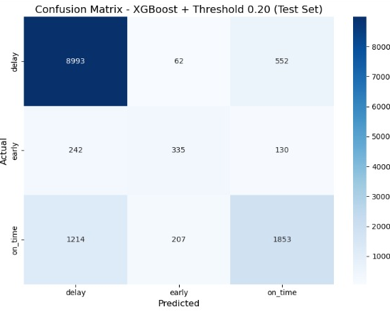
DS22 - Bar Ilan ML PROJECT
MAY 2026
FINAL MODEL · TEST SET · N = 13,588
Final XGBoost on the test set.
01
Agenda
02
Data & target
FIG · CONFUSION MATRIX · CLASSIFICATION REPORT
THR 0.20
ACCURACY
F1 · WEIGHTED
F1 · MACRO
03
EDA
82%
0.81
0.68
04
Pipeline
05
Modeling
06
Conclusions
PER-CLASS
CLASS
PREC
RECALL
F1
SUPPORT
DELAY
0.86
0.94
0.90
9,607
EARLY
0.55
0.47
0.51
707
ON-TIME
0.73
0.57
0.64
3,274
READING THE ERRORS
Conservative mistakes.
Delay recall is 94%. Most errors are on-time → delay — a useful failure mode if the operator is acting on the prediction.
29 / 34
Notes:
Section five — what we learned.

Slide 31
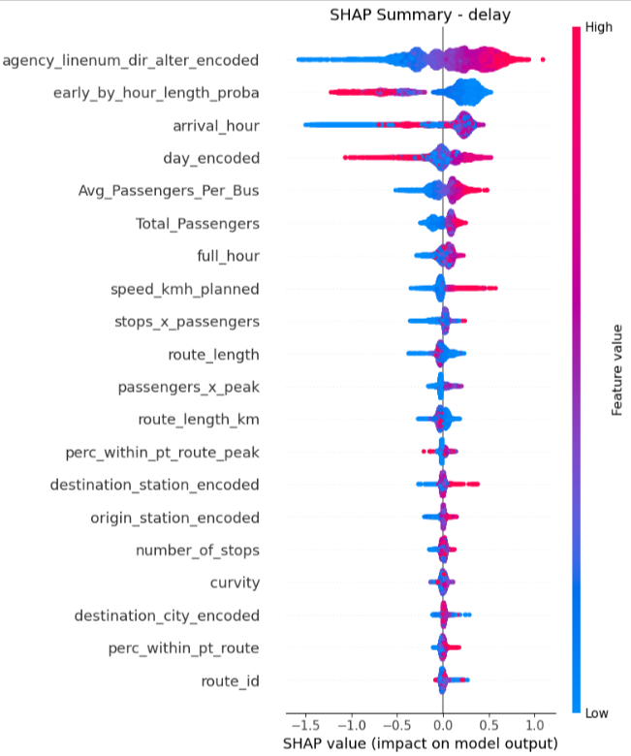
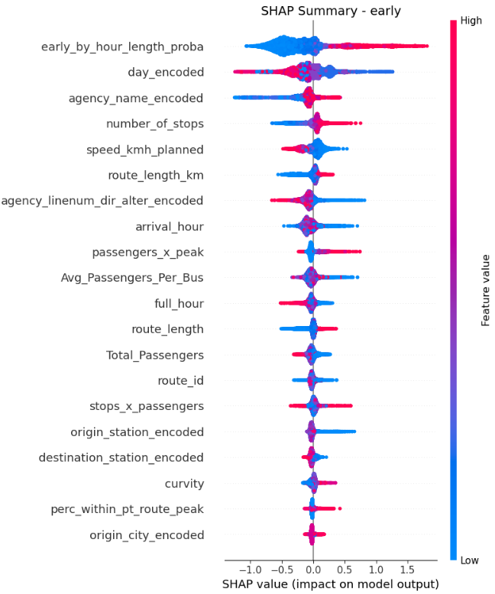
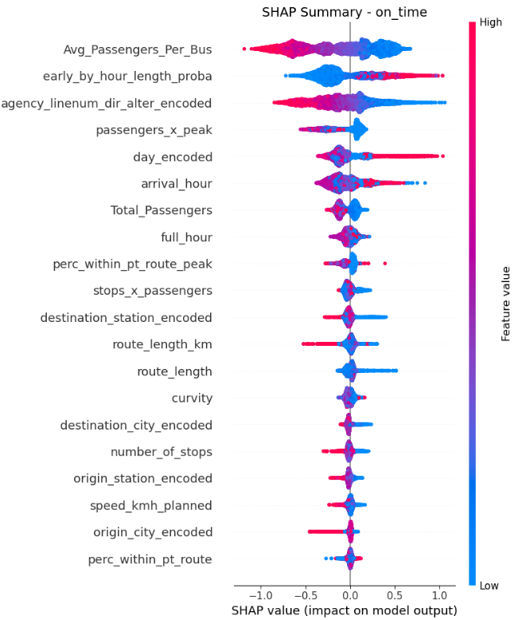
DS22 - Bar Ilan ML PROJECT
MAY 2026
SHAP · FEATURE IMPORTANCE PER CLASS
What the model actually learned.
01
Agenda
One SHAP summary per class. The top feature changes — three different stories from one model.
02
Data & target
03
EDA
TOP 20
TOP 20
TOP 20
04
Pipeline
DELAY
EARLY
ON-TIME
05
Modeling
06
Conclusions
DELAY · TOP DRIVER
EARLY · TOP DRIVER
ON-TIME · TOP DRIVER
agency_linenum_dir_alter
early_by_hour_length_proba
Avg_Passengers_Per_Bus
Route identity. Some lines are systemically late — independent of crowding or geometry.
Our engineered conditional probability lifted from EDA — the strongest signal for "running early".
Crowding drives the on-time class — the more loaded the bus, the less likely it stays in the on-time band.
30 / 34
Notes:
Three takeaways. Lateness is structural and predictable. Crowding beats geometry — passenger load is more important than any route shape feature. Long routes flip at night — same routes, opposite behavior. Three open questions: the early class is fundamentally harder, we have only one month of data so seasonality is invisible, and we have no driver-level data which we suspect explains residual variance.

Slide 32
DS22 - Bar Ilan ML PROJECT
MAY 2026
FROM BASELINE TO FINAL · WHAT EACH STEP BOUGHT US
Baseline → Final.
01
Agenda
02
Data & target
03
EDA
BASELINE
FINAL
04
Pipeline
Rule based – most frequent class by line
XGBoost · 20 features · thr 0.20.
05
Modeling
0.74
0.45
0.82
0.68
06
Conclusions
ACCURACY
F1 · MACRO
ACCURACY
F1 · MACRO
31 / 34
Notes:
Thank you. Happy to dig into any part of the pipeline.

Slide 33
DS22 - Bar Ilan ML PROJECT
MAY 2026
PART V · SECTION OPENER
01
Agenda
02
Data & target
03
EDA
04
Pipeline
05
Modeling
06
Conclusions
SECTION
Summary
05
32 / 34
Notes:
Thank you. To recap — bus lateness is structural and predictable: crowding is the dominant driver, route identity matters more than geometry, and long routes flip from late to early at night. Final model is XGBoost with class weights and threshold 0.20, reaching macro F1 of 0.68 on a held-out 15% test set. This work was done as the final project for the DS22 Machine Learning course at Bar-Ilan University. Happy to take any questions.

Slide 34
DS22 - Bar Ilan ML PROJECT
MAY 2026
FROM BASELINE TO FINAL · WHAT EACH STEP BOUGHT US
Summary
01
Agenda
02
Data & target
Conclusions
XGBoost achieved the best overall performance among the tested models.
The classification approach (early, on_time, delay) provided meaningful operational insights.
Feature engineering and tuning significantly improved model performance.
The model generalized well with no major overfitting.
The main challenge remained the early and on_time classes due to class imbalance.
03
EDA
04
Pipeline
05
Modeling
06
Conclusions
33 / 34
INSTITUTION
COURSE
AUTHORS
DATE
Bar-Ilan University
DS22 · 1125 · Machine Learning
Ofer Shahal · Tamir Edelstein
May 2026
Notes:
Thank you. Happy to dig into any part of the pipeline.

Slide 35
DS22 - Bar Ilan ML PROJECT
MAY 2026
FROM BASELINE TO FINAL · WHAT EACH STEP BOUGHT US
Summary
01
Agenda
02
Data & target
Next steps suggestions
Increase dataset size and seasonal coverage.
Further investigate the early class behavior.
Integrate additional external data (traffic, incidents, holidays).
Explore advanced imbalance-handling techniques.
03
EDA
04
Pipeline
05
Modeling
06
Conclusions
34 / 34
INSTITUTION
COURSE
AUTHORS
DATE
Bar-Ilan University
DS22 · 1125 · Machine Learning
Ofer Shahal · Tamir Edelstein
May 2026
Notes:
Thank you. Happy to dig into any part of the pipeline.

