Slide 1
Git Presentation TR Unconference 2022
Dan Jakob Ofer
@ofer987
https://github.com/ofer987
dan.ofer@thomsonreuters.com

Slide 2
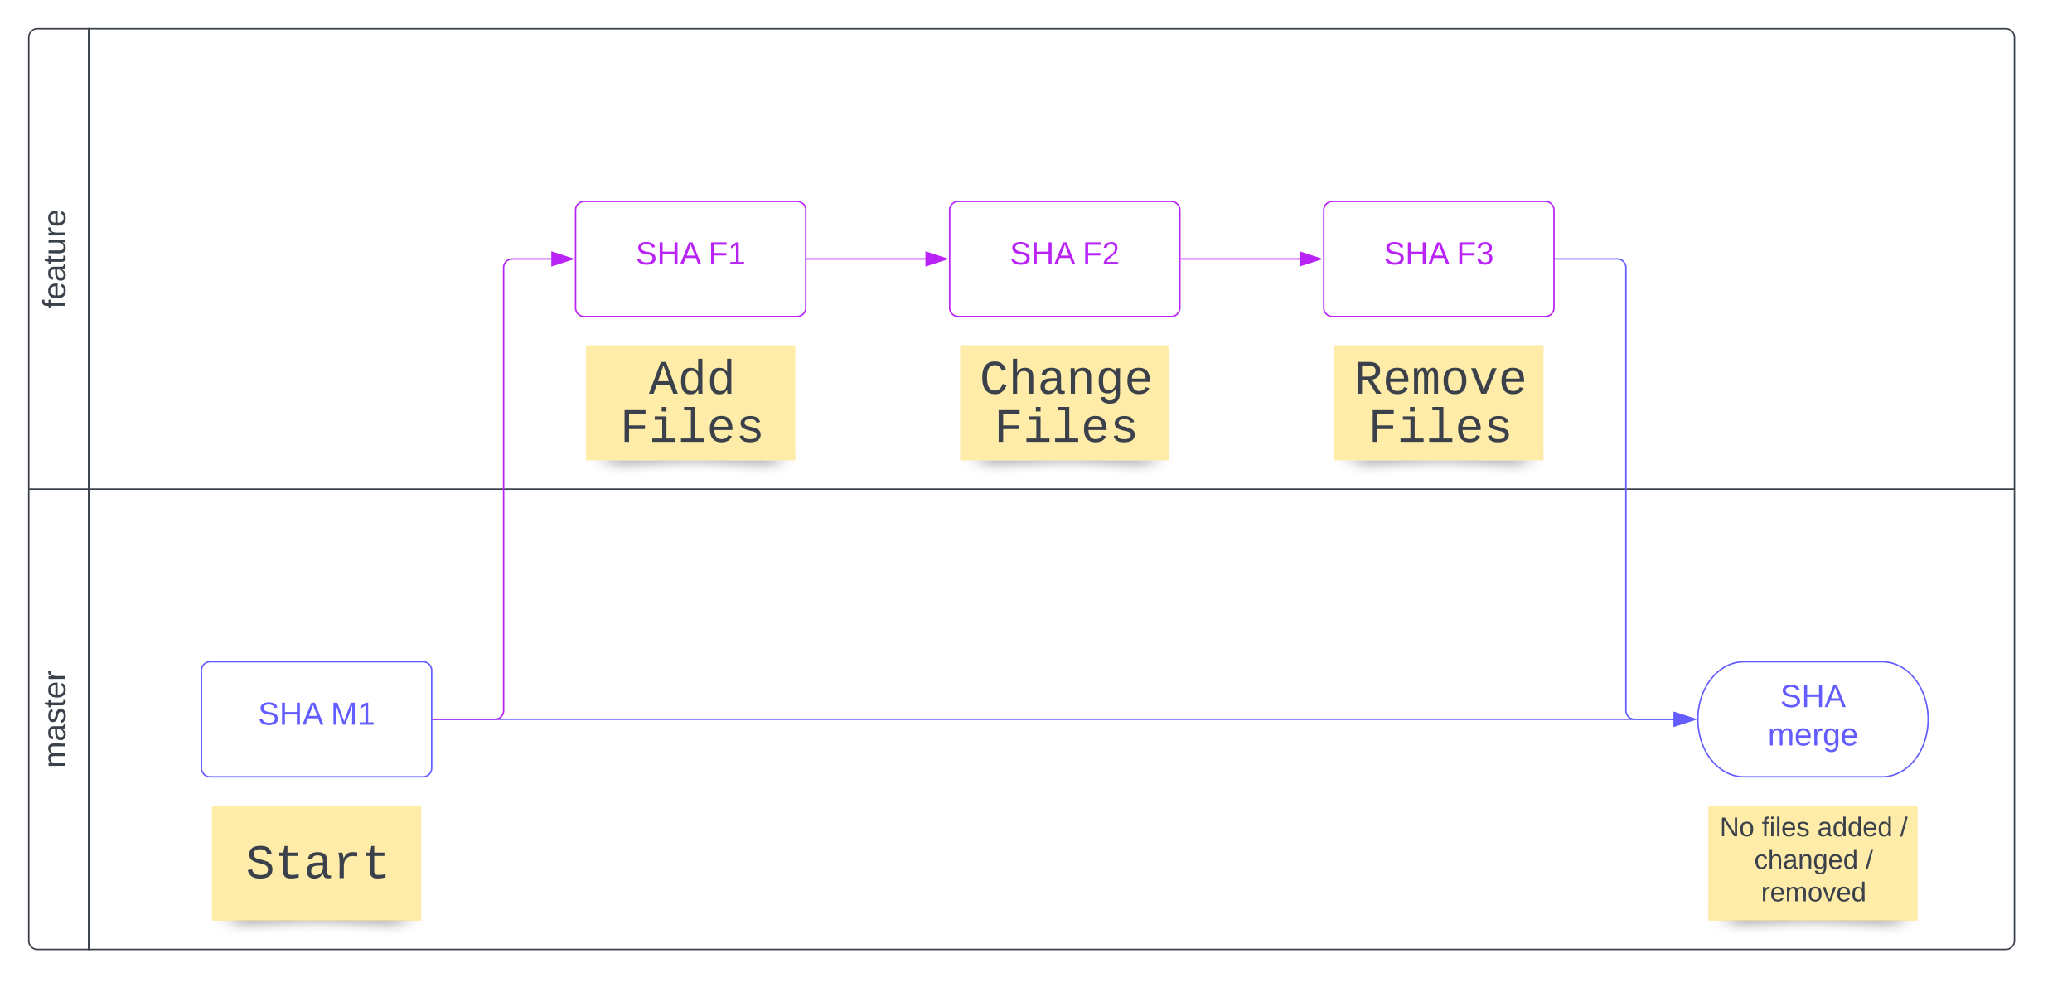
Overview

Slide 3
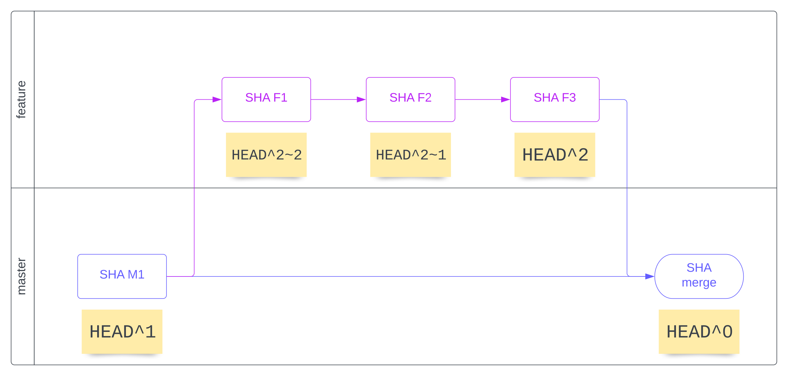
How to reference commits

Slide 4
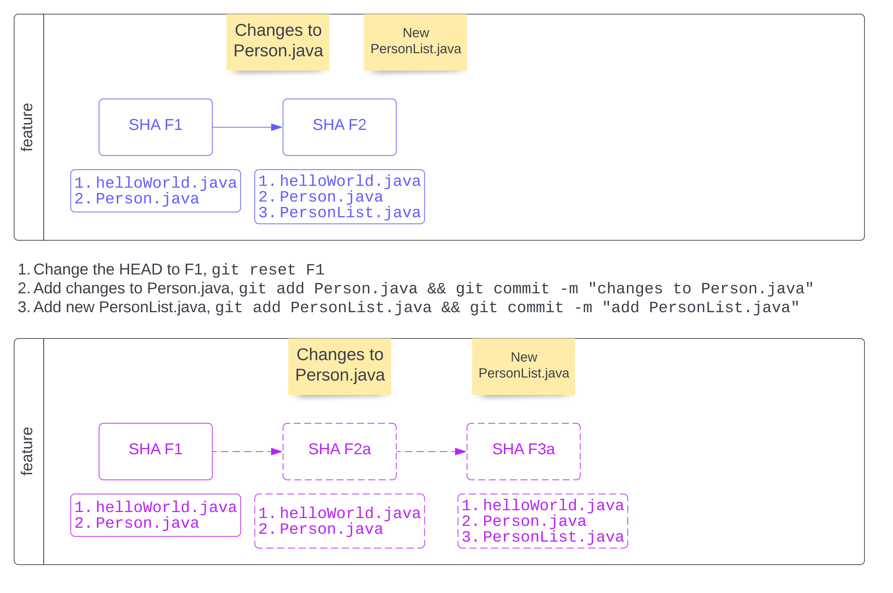
Fix commit history

Slide 5
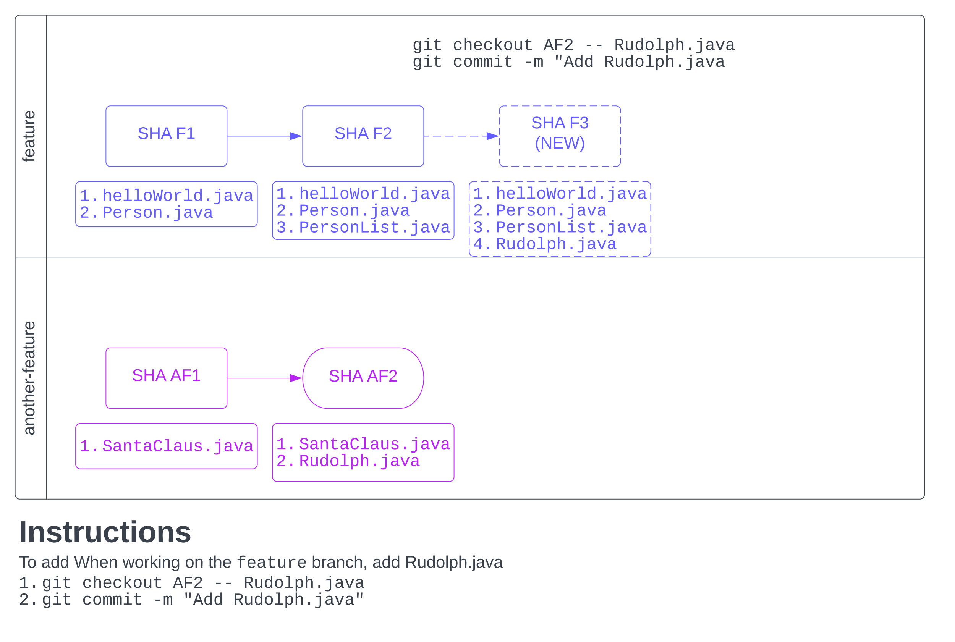
Checkout files from commit

Slide 6
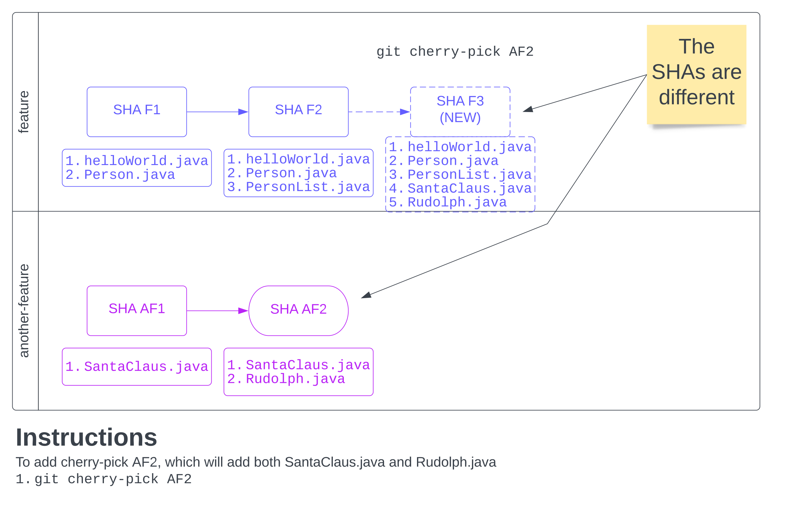
Cherry-pick commit from another branch

Slide 7
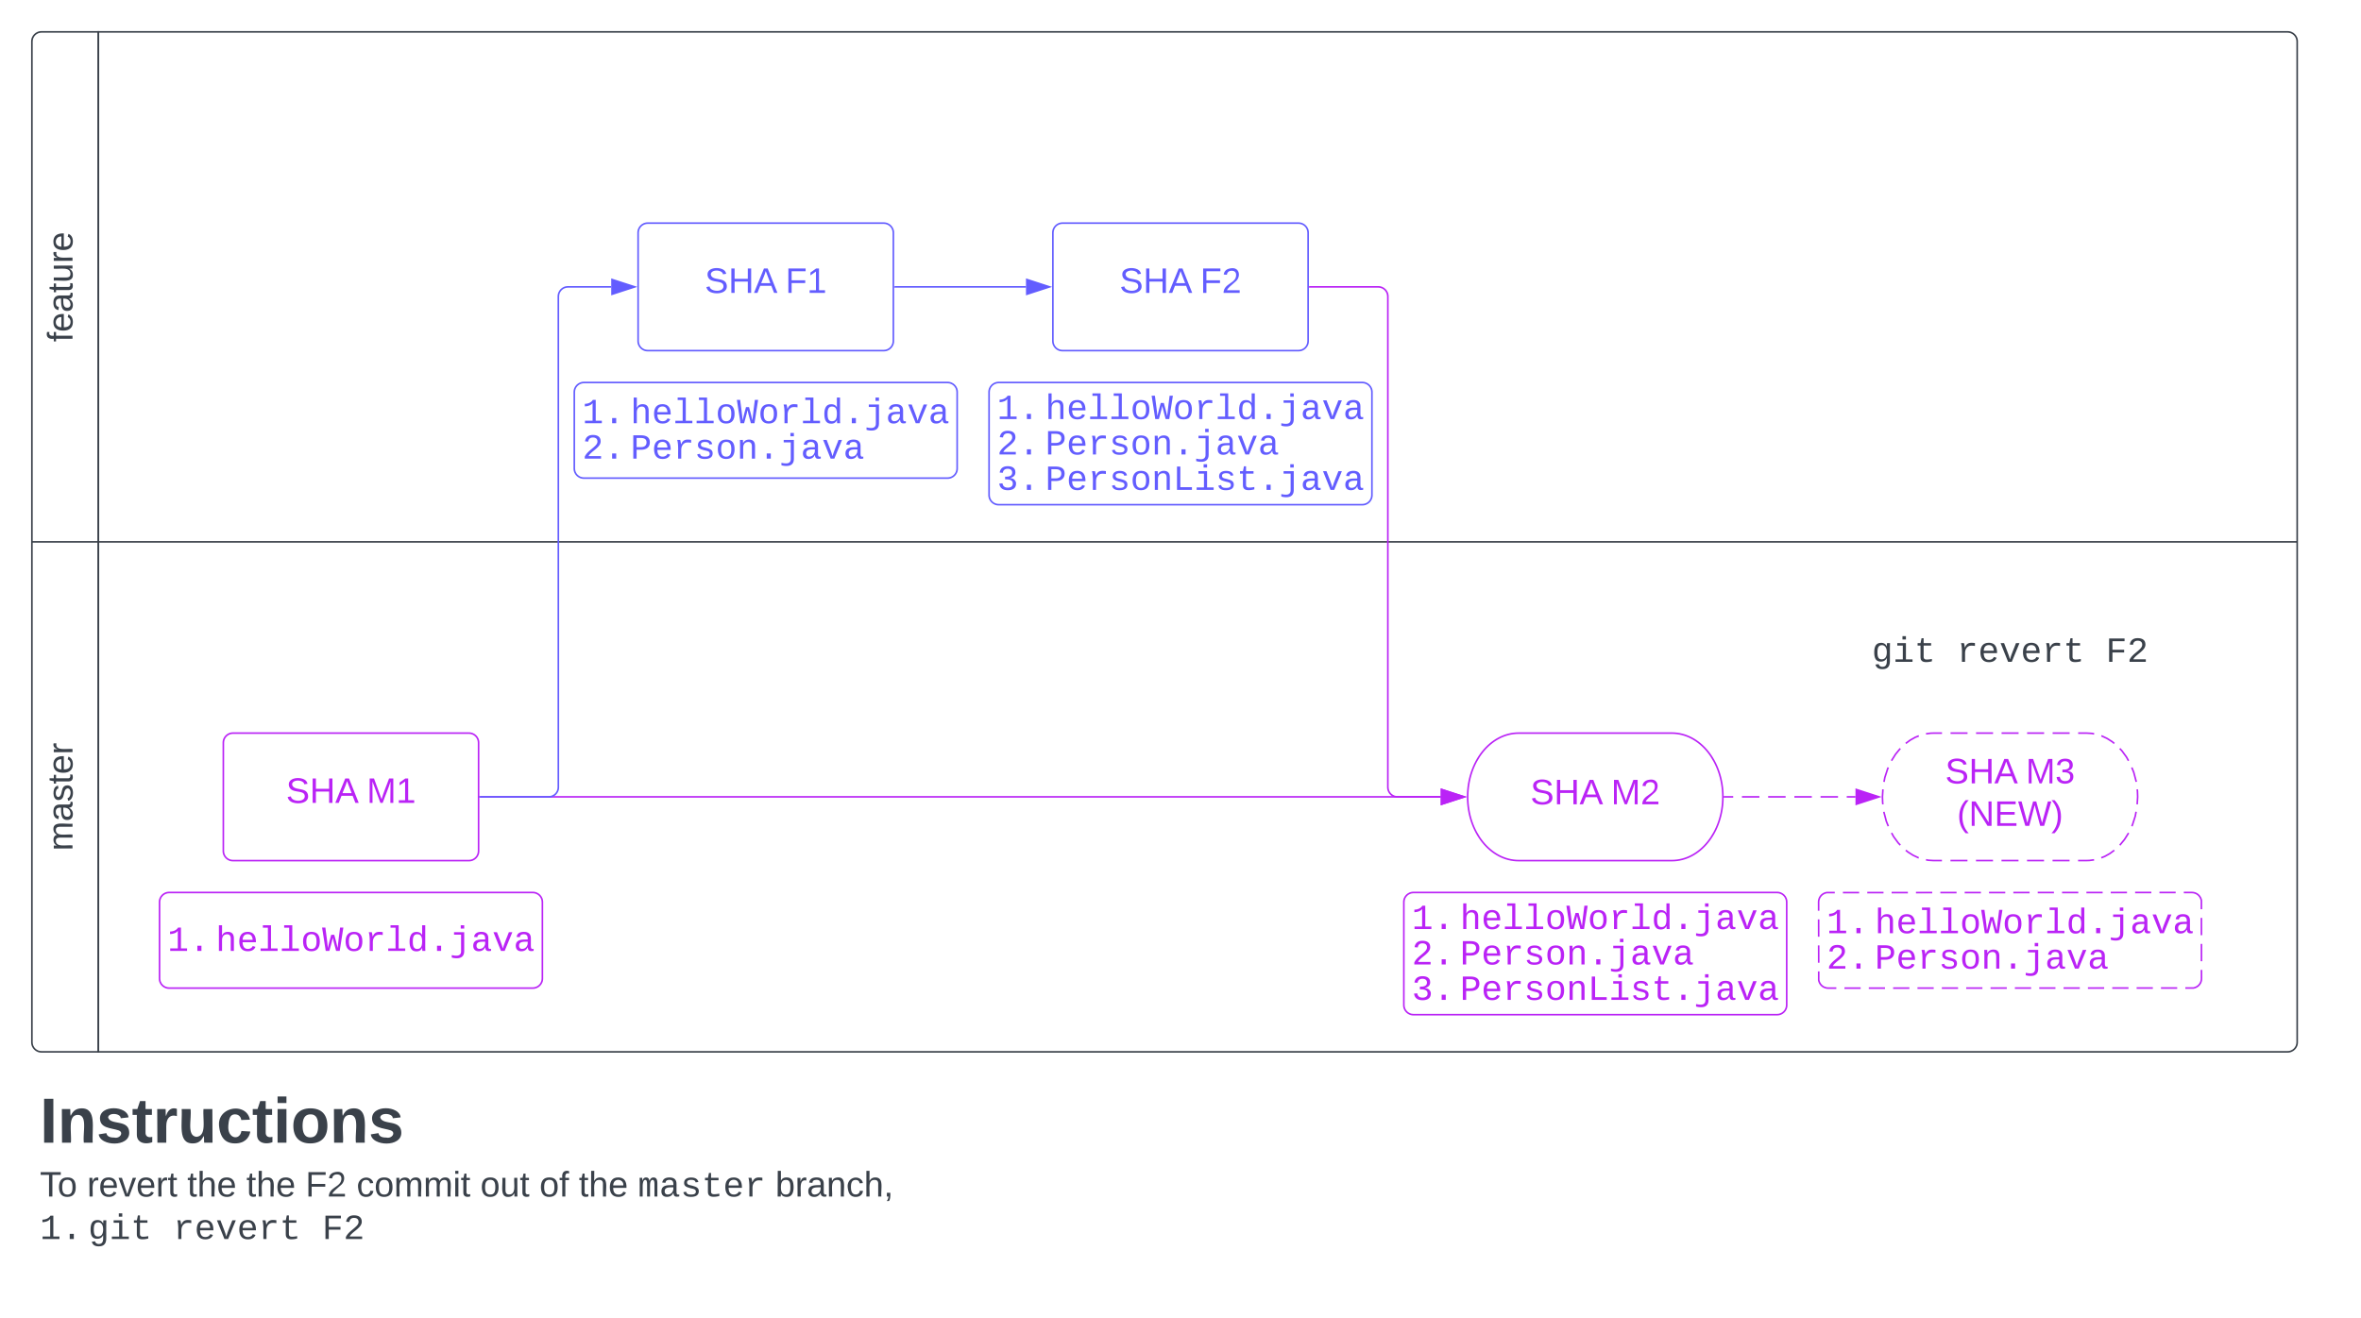
Revert a commit

Slide 8
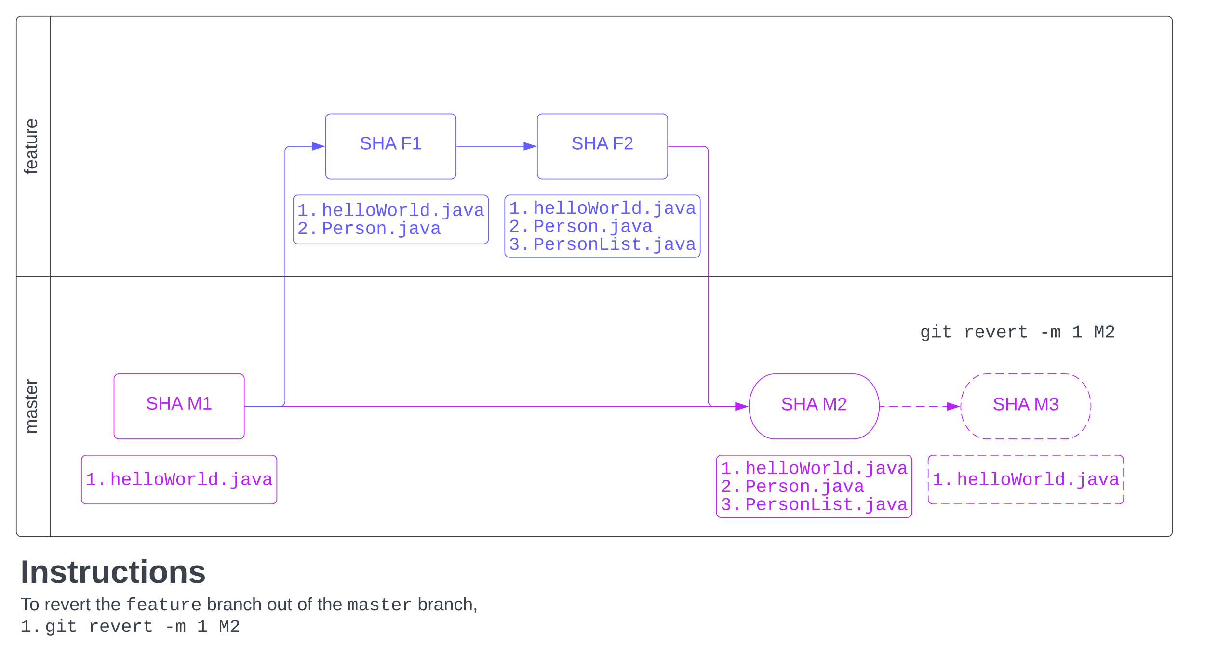
Revert a merge commit (e.g., a Pull Request)

Slide 9
Mission: Improve release process!
Who am I?
I work on the Digital Team
Responsible for improving our deployment processes
Problems we are facing
Several servers
Hundreds of developers
Two-week Sprints
Four weeks between End-of-sprint to Production Release

Slide 10
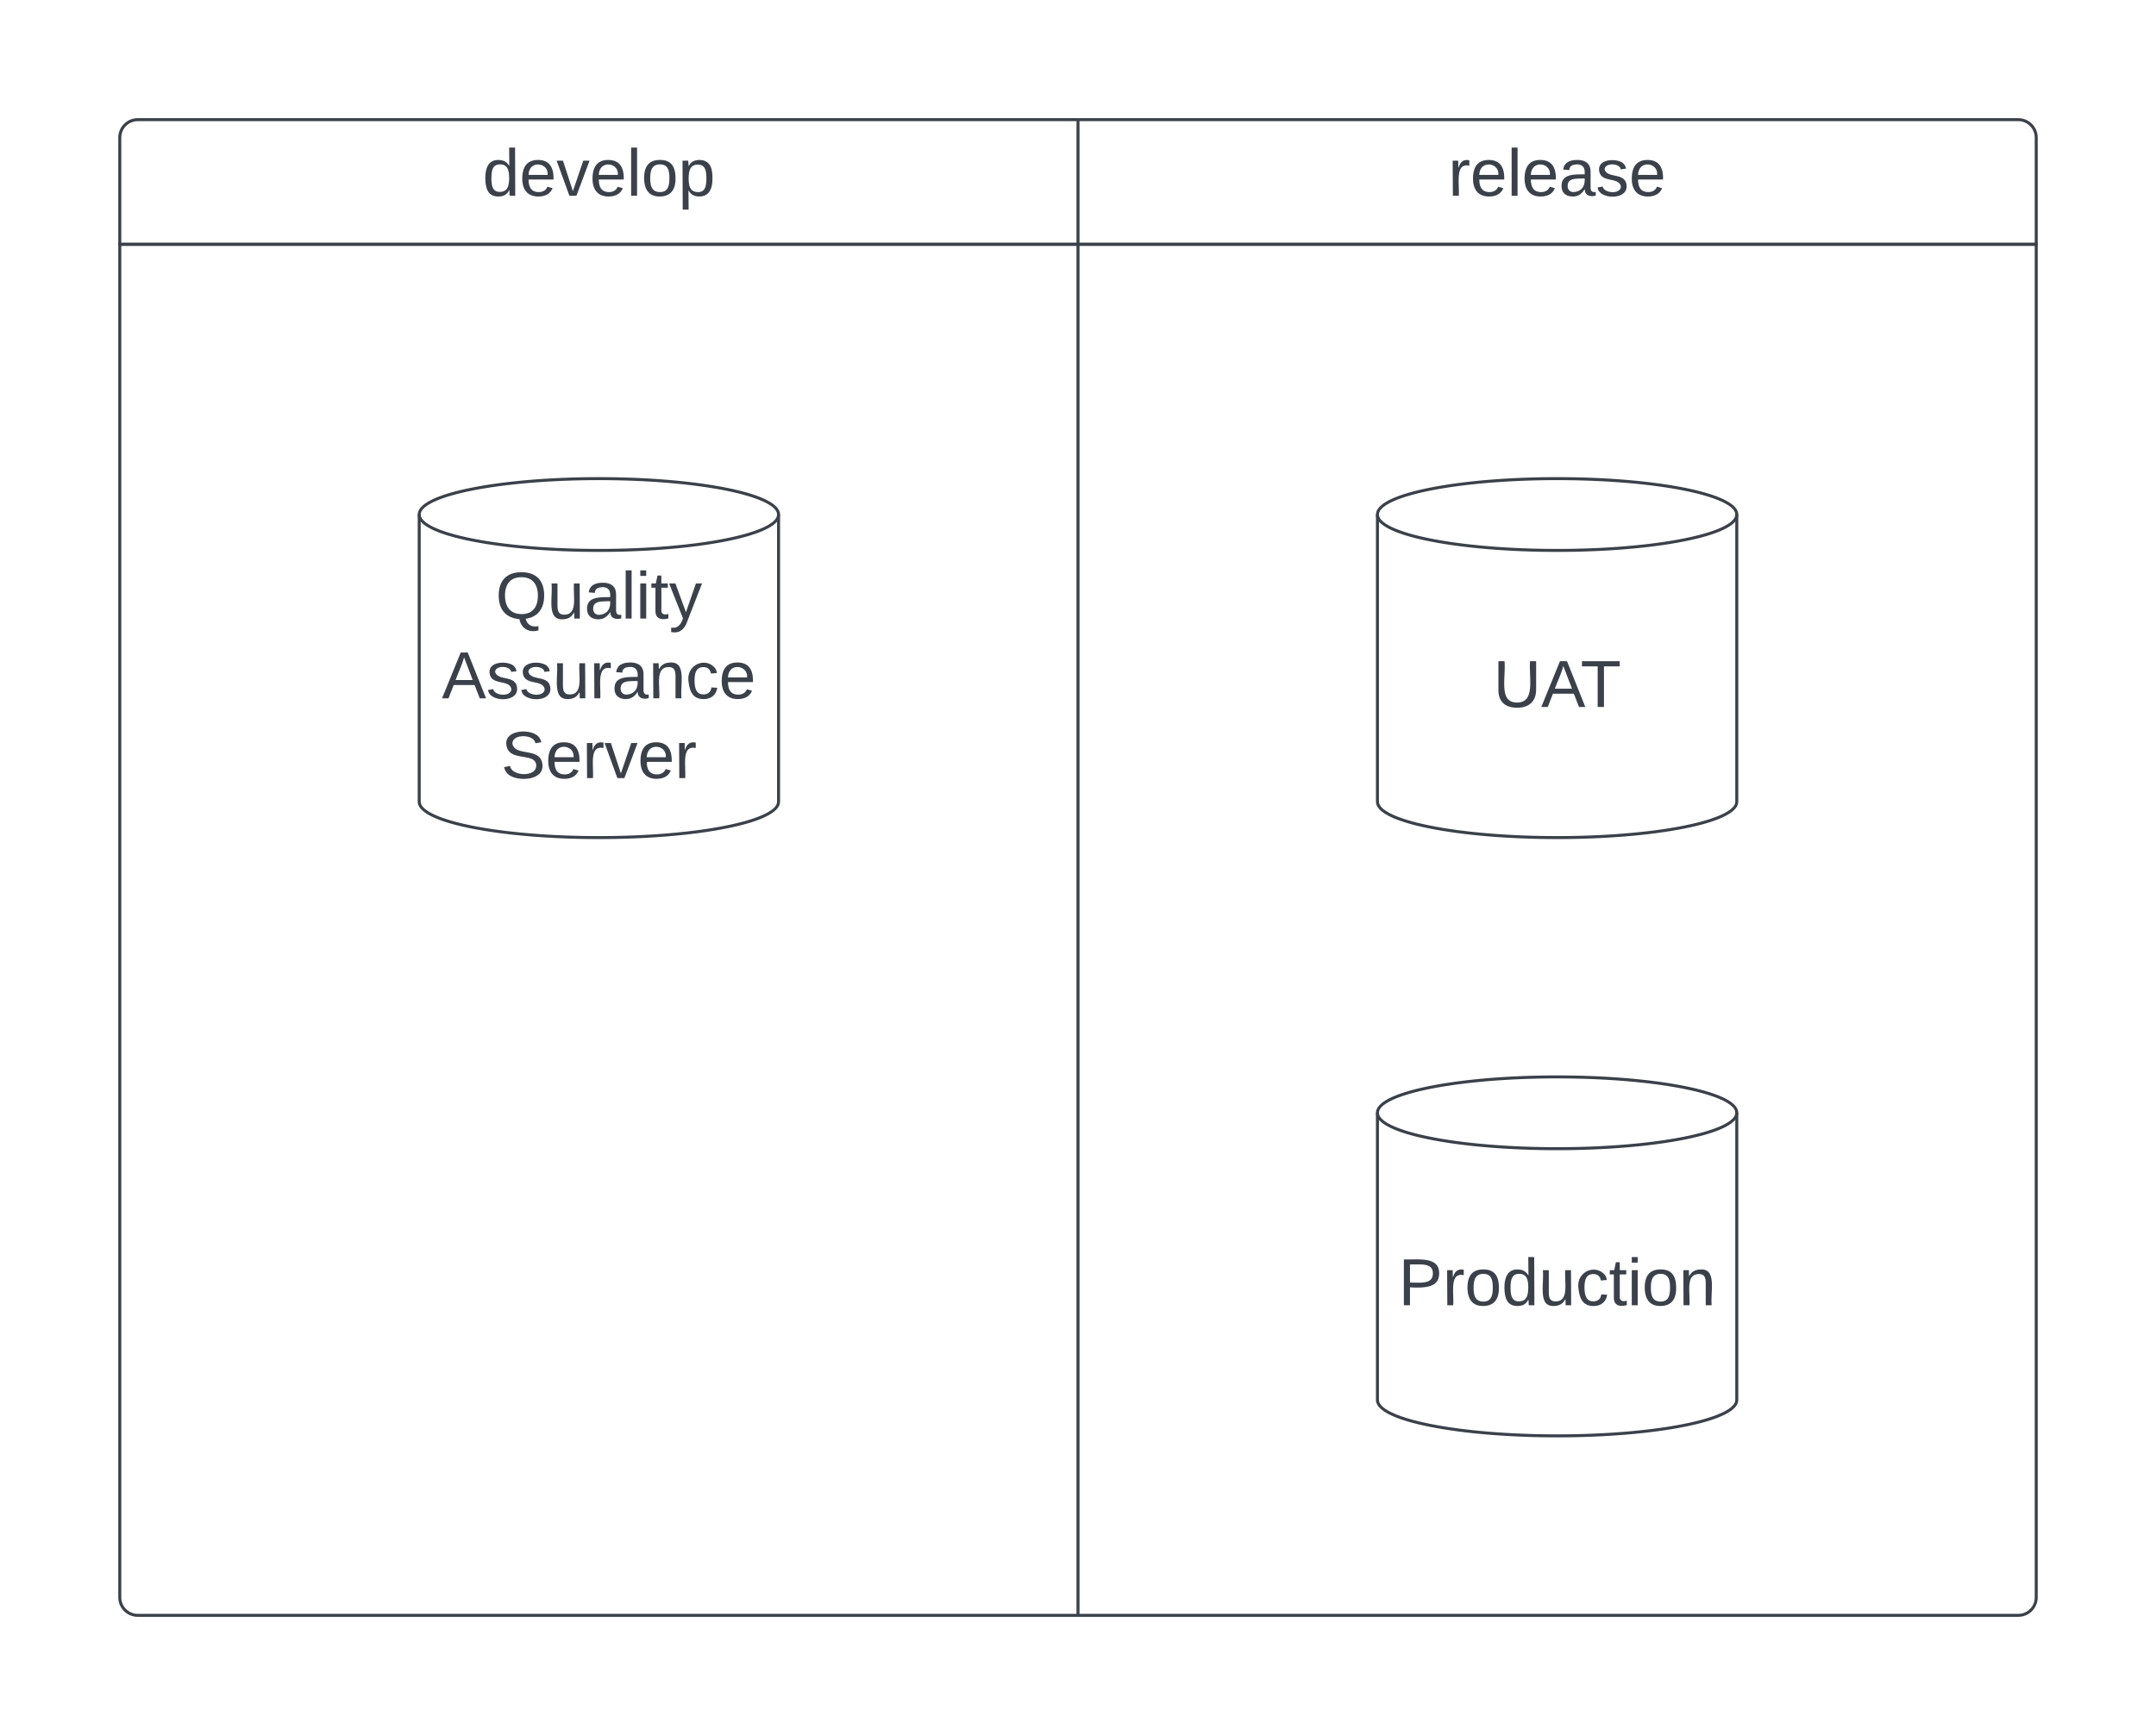
Servers

Slide 11
New release process
Year | Developers | Location | Release Process | Notes
2018 | 3 | All in London, UK | Legacy Process | Talk between developers
2019 | 10 | All in Toronto, Canada |  | Talk between developers
2020 | > 10, but < 100 | Worldwide, e.g., Toronto, United States, Eastern Europe, India |  | Problems arise!
2021 | > 100 | Worldwide, e.g., Toronto, United States, Eastern Europe, India | Develop Current Release Process | But it is confusing!
2022 | > 200 | Worldwide, e.g., Toronto, United States, Eastern Europe, India (more in India) | Develop New Release Process | 1. Simpler 2. Facilitates deployment 3. Easier to communicate

Slide 12
Current release process
Deploy everything in the develop branch
Revert unapproved Jira Issues
Sometimes we deploy work-in-progress code our code from next Sprint, and we find out in Production

Slide 13
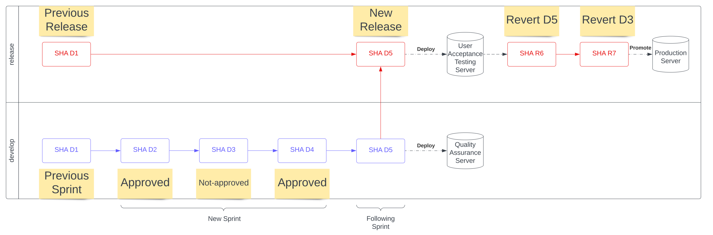
Current release process (Flow)

Slide 14
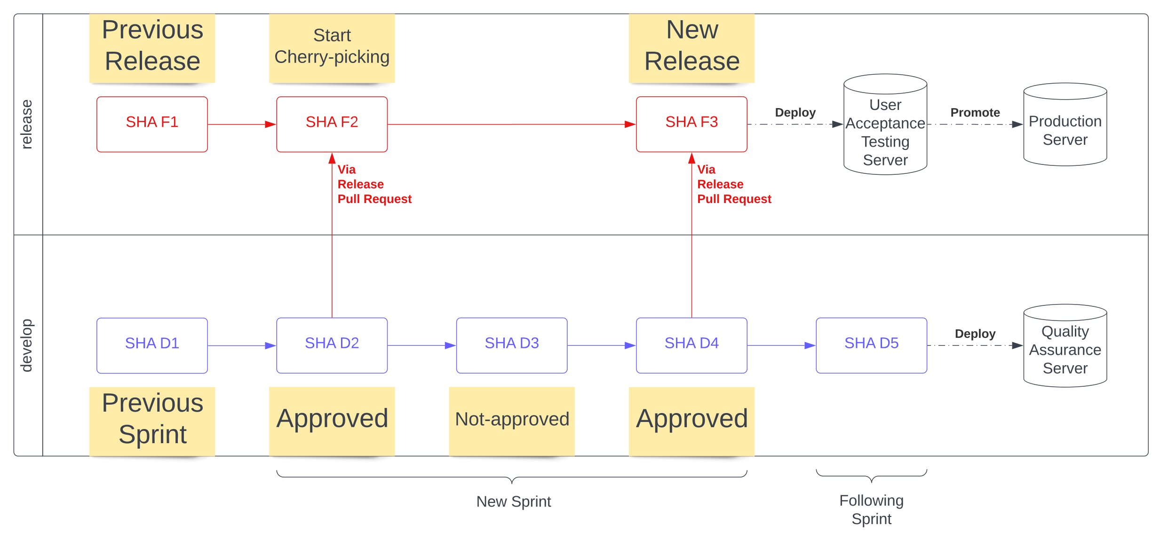
Our New Release Process

Slide 15
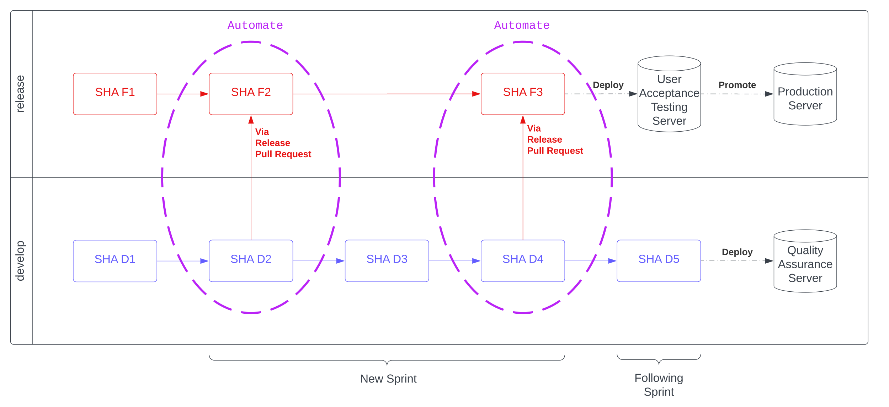
Automate the process!

Slide 16
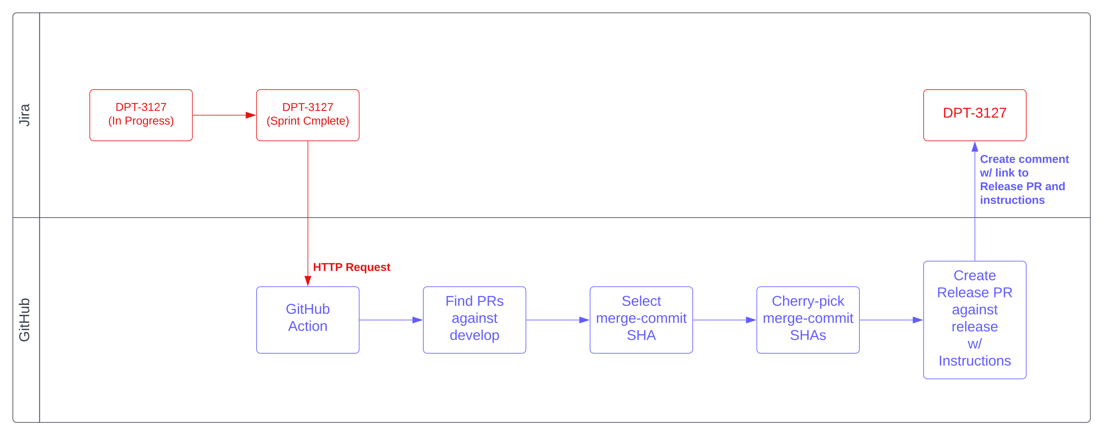
Flow between Jira and GitHub

Slide 17
What is a Release Pull Request?
A Release Pull Request is an Approved Jira Issue’s commits amalgamated into a new Pull Request against Production’s branch, release.
Release Pull Requests ensure that only approved code is delivered to the Production server.

Slide 18
Moving code from QA to Production
Jira Issue’s state is moved from Validated to Sprint Complete
Jira Server sends HTTP Request to GitHub Action
GitHub Action intelligently finds associated Pull Requests
Creates Release Pull Request to deliver to Production
All actions, including commands, printed to both the Jira Issue and Release Pull Request
In case of merge conflicts, the developer can repair the Pull Request, using the printed commands!

Slide 19
Automate a Cherry-picking Pull Request
Create local Cherry-pick branch, releases/<jira-key>
Checkout Cherry-pick branch, releases/<jira-key>
Add empty commit (to ensure that Pull Request can be created)
Cherry-pick merge commit SHAs of associated Pull Requests
Push branch to GitHub
Open Pull Request in GitHub
All actions (including git CLI commands) printed in,
Pull Request’s body
Jira Issue comment

