Slide 1
My Test Presentation
By Ofer Dekel
Notes:
Welcome to my test presentation, by Ofer Dekel.

Slide 2

Automatic videos from PPT files
Notes:
I created an app that takes any Powerpoint presentation and generates a video from it. On the next slide, I’ll show you how it works.

Slide 3
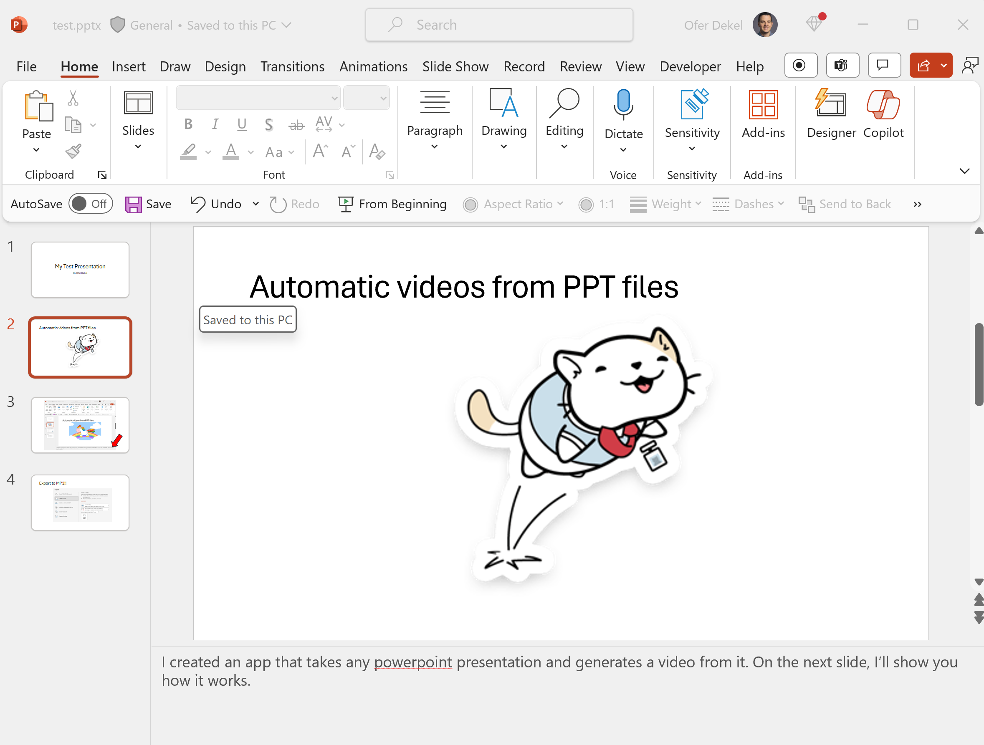
Notes:
All you have to do is type some text into the comments section for each slide. The app sends that text to Azure speech services and embeds the resulting audio into a new Powerpoint file.

Slide 4
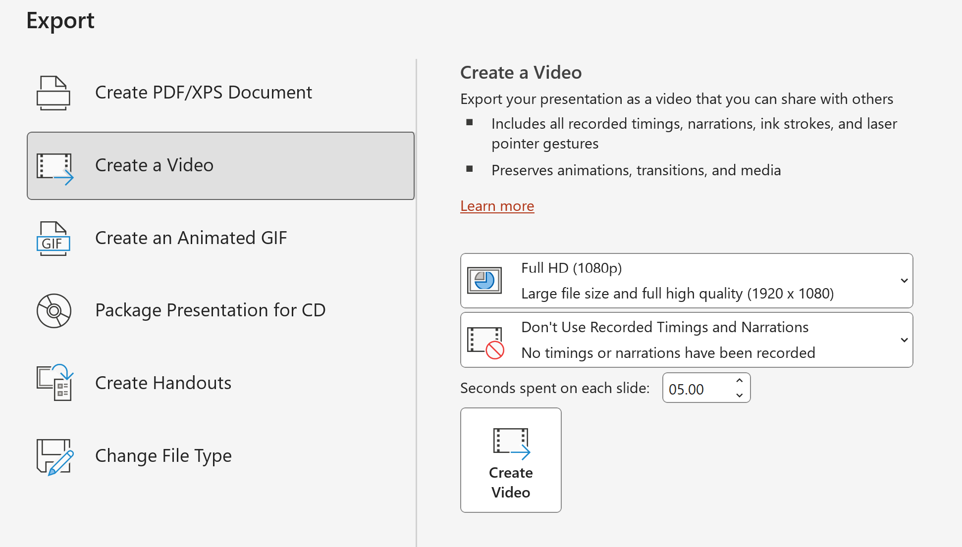
Export to MP3!!
Notes:
The last step needs to be performed manually. You open the new powerpoint file and select the option to create a video. That’s it.

Slide 5

This Photo by Unknown Author is licensed under CC BY-SA
Notes:
That’s all folks!

