Slide 1
Routers

Slide 2
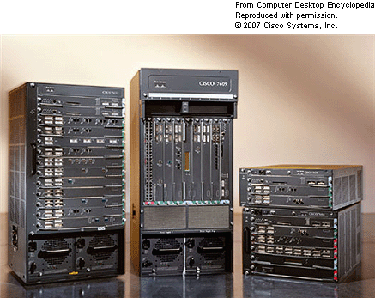
These high-end, carrier-grade 7600 models process up to 30 million packets per second (pps).

Slide 3
Lookup
The table is learnt manually or through routing protocols, such as BGP or OSPF.

Slide 4
TCAM
CAM: Content Addressable Memory.
CAM reads the data, and returns a list of addresses where the data is stored, if it finds any.
CAM searches the entire memory in one operation.
TCAM: three states, 0, 1, or don’t care

Slide 5
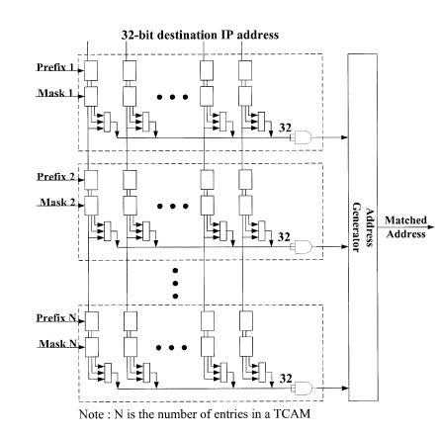
TCAM
A Priority TCAM IP-Routing Lookup Scheme, Po-Chou Lin and Chung-Ju Chang, Senior Member, IEEE

Slide 6
Switches
After figuring out the next hop, need to send the packet to the next hop.
The switches works in time slots. A large packet is divided into fixed length cells, cells are reassembled at the output.

Slide 7
N by N crossbar
Usually, the switch is a crossbar.
An input can send at most one cell per time slot, and an output can receive at most one cell per time slot.
Consider unicast packets.

Slide 8
Output contention
Consider an N by N switch. What if two input ports both have a cell to send to the same output port at the same time?

Slide 9
Buffers
So, buffers have to be added to the switch.
You may have buffer at the input port, or at the output port.
Which one is better?

Slide 10
Input Buffer Switch
Modern switches are input-buffered.
Cells arrive at the input port, if cannot be sent out, will be temporarily stored at the input buffer.
How would you organize the buffer? FIFO?

Slide 11
Head-of-Line Blocking
If simply using FIFO, you will have Head-of-line blocking.
Consider the case when at input port 0, you have 23334. If some other input port gets grant to send to output 2, while no one is sending to output port 3, input port 0 is forced to go idle – no good.
Throughput bounded 58%.
Any suggestions?

Slide 12
VOQ
Organize the cells into Virtual Output Queues (VOQ).
At each input port, you have N queues, one for each output.
Coming back to the example, at input port 0, you have 3 non-empty queues:
  2
  333
  4

Slide 13
Problem?
Now, every input port can potentially have cells to every output ports – How to schedule the transmission of cells?

Slide 14
Bipartite Matching
Draw a bipartite graph, let the left side vertices be the inputs, let the output side vertices be the outputs.
A left side vertex is adjacent to a right side vertex if this input port has a cell to send to the output port.
Now, recall the constraint that an input port can send at most one cell, and the output port can receive at most one cell.
Therefore, any schedule is a matching.

Slide 15
Maximum Matching
Maximum Matching in bipartite graphs can be found in O(n^2) time.
But the schedule must be computed really really fast, in the order of 10ns.

Slide 16
Maximal Matching
How about a really simple algorithm – just pick edges in any arbitrary order until no edges can be picked?
How bad can this be, compared to the maximum matching?

Slide 17
Maximal Matching
So, can we just run a maximal matching algorithm?

Slide 18
The algorithm being used
The materials in following slides are from “The iSLIP Scheduling Algorithm for Input-Queued Switches” by Nick McKeown published in IEEE/ACM Transactions on Networking.

Slide 19
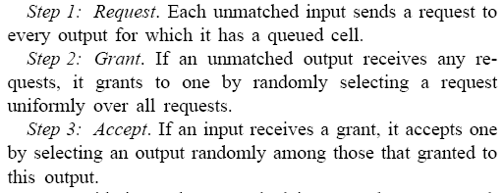
PIM
Notes:
Performance is bounded by 63%

Slide 20
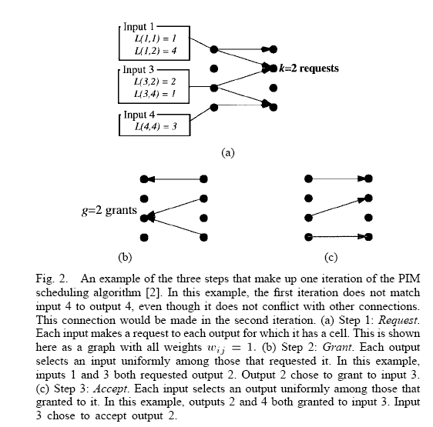
PIM

Slide 21
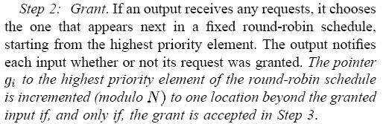
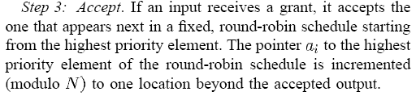
iSLIP Algorithm

Slide 22
The iSLIP Algorithm
Achieves 100% throughput for some simple type of traffic.

