Slide 1
HELLO WORLD
Here is where your presentation begins

Slide 2
WHOA!
It could be the part of the presentation where you can introduce yourself, write your email…

Slide 3
01
TABLE OF CONTENTS
02
03
04
THE COMPANY
Here you could describe the topic of the section
DATA ANALYTICS
Here you could describe the topic of the section
FUTURE PLANS
Here you could describe the topic of the section
SOCIAL MEDIA
Here you could describe the topic of the section

Slide 4
“This is a quote. Words full of wisdom that someone important said and can make the reader get inspired.”
—SOMEONE FAMOUS

Slide 5
01
THE COMPANY
This is the subtitle that makes it comprehensible

Slide 6
THE SLIDE TITLE GOES HERE!
Do you know what helps you make your point clear? Lists like this one:
Because they’re simple
You can organize your ideas clearly
And because you’ll never forget to buy milk!
And the most important thing: the audience won’t miss the point of your presentation

Slide 7
THIS IS A GREAT HEADLINE
And this is the subtitle that makes it comprehensible

Slide 8
MAYBE YOU NEED TO DIVIDE THE CONTENT
MERCURY
VENUS
Mercury is the closest planet to the Sun and the smallest one in the Solar System—it’s only a bit larger than our Moon. The planet’s name has nothing to do with the liquid metal since it was named after the Roman messenger god, Mercury
Venus has a beautiful name and is the second planet from the Sun. It’s terribly hot—even hotter than Mercury—and its atmosphere is extremely poisonous. It’s the second-brightest natural object in the night sky after the Moon

Slide 9
YOU COULD USE THREE COLUMNS, WHY NOT?
MARS
JUPITER
VENUS
Despite being red, Mars is a cold place, not hot. It’s full of iron oxide dust, giving the planet its reddish cast
It’s a gas giant and the biggest planet in our Solar System. Jupiter is the fourth-brightest object in the sky
Venus has a beautiful name and is the second planet from the Sun. It’s terribly hot, even hotter than Mercury

Slide 10

A PICTURE ALWAYS REINFORCES THE CONCEPT
Images reveal large amounts of data, so remember: use an image instead of long texts. Your audience will appreciate that

Slide 11

A PICTURE IS WORTH A THOUSAND WORDS

Slide 12
AWESOME WORDS
Because key words are great for catching your audience’s attention

Slide 13
02
DATA ANALYTICS
This is the subtitle that makes it comprehensible

Slide 14
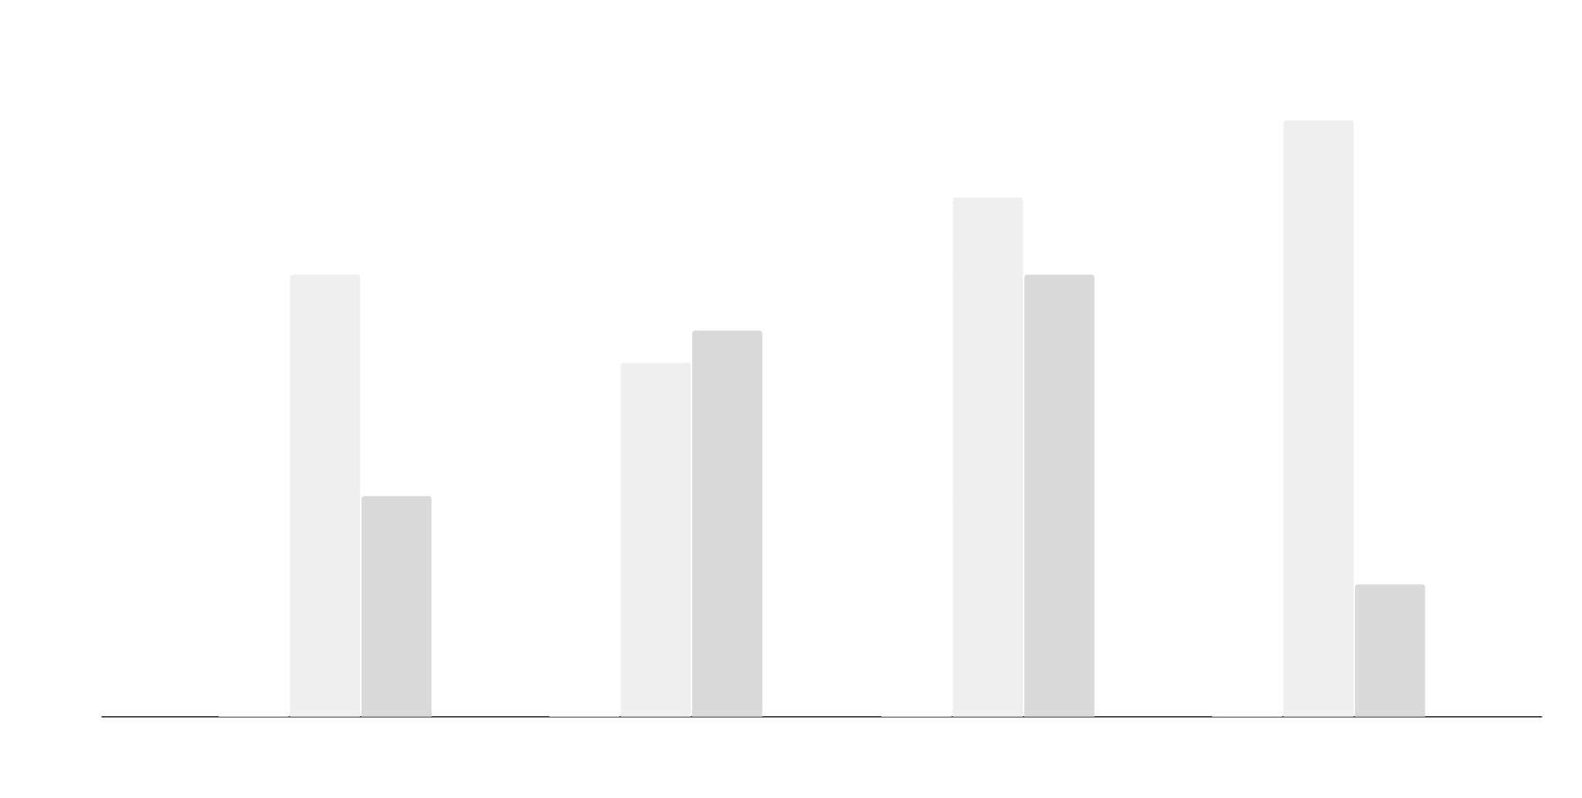
IF YOU WANT TO MODIFY THIS GRAPH, CLICK ON IT, FOLLOW THE LINK, CHANGE THE DATA AND REPLACE IT

Slide 15
SOMETIMES, REVIEWING CONCEPTS IS A GOOD IDEA
MERCURY
VENUS
MARS
Mercury is the closest planet to the Sun
Venus has a beautiful name, but it’s terribly hot
Despite being red, Mars is a cold place, not hot
SATURN
JUPITER
NEPTUNE
Yes, this is the ringed one. It’s a gas giant
It’s the biggest planet in our Solar System
Neptune is the farthest planet from the Sun

Slide 16
HOW ABOUT THE PERCENTAGES?
MERCURY
VENUS
Mercury is the closest planet to the Sun
Venus has a beautiful name, but it’s terribly hot
SATURN
JUPITER
Yes, this is the ringed one. It’s a gas giant
It’s a gas giant and the biggest planet in our Solar System

Slide 17
INFOGRAPHICS MAKE YOUR IDEA UNDERSTANDABLE…
VENUS
Venus has a beautiful name, but it’s terribly hot, even hotter than Mercury
NEPTUNE
Neptune is the farthest planet from the Sun
MERCURY
Mercury is the closest planet to the Sun
JUPITER
It’s a gas giant and the biggest planet in our Solar System
MARS
Despite being red, Mars is a cold place, not hot

Slide 18
…AND THE SAME GOES FOR TABLES
 | MASS (earths) | DIAMETER (earths) | SURFACE GRAVITY (earths)
MERCURY | 0,06 | 0,38 | 0,38
MARS | 0,11 | 0,53 | 0,38
SATURN | 95,2 | 9,4 | 1,16

Slide 19
THIS IS A MAP
NEPTUNE
Neptune is the farthest planet from the Sun
VENUS
Venus has a beautiful name, but it’s terribly hot, even hotter than Mercury
MARS
Despite being red, Mars is a cold place, not hot
JUPITER
It’s a gas giant and the biggest planet in our Solar System

Slide 20
A TIMELINE ALWAYS WORKS FINE
DAY 1
DAY 2
DAY 3
DAY 4
Mercury is the smallest planet in our Solar System and the closest to the Sun
Despite being red, Mars is a cold place, not hot. The planet is full of iron oxide dust
The Sun is the star at the center of the Solar System
Venus has a beautiful name, but it’s terribly hot

Slide 21
03
BUSINESS OBJECTIVES
03
This is the subtitle that makes it comprehensible

Slide 22
4,498,300,000
Big numbers catch your audience’s attention

Slide 23
333,000.00
24h 37m 23s
386,000 km
earths is the Sun’s mass
is Jupiter’s rotation period
is the distance between the Earth and the Moon

Slide 24
COMPANY SERVICES
MERCURY
MARS
VENUS
Mercury is the closest planet to the Sun and is only a bit larger than our Moon
Despite being red, Mars is a cold place, not hot. It’s full of iron oxide dust
Venus has a beautiful name and is the second planet from the Sun

Slide 25
04
SOCIAL MEDIA
This is the subtitle that makes it comprehensible

Slide 26
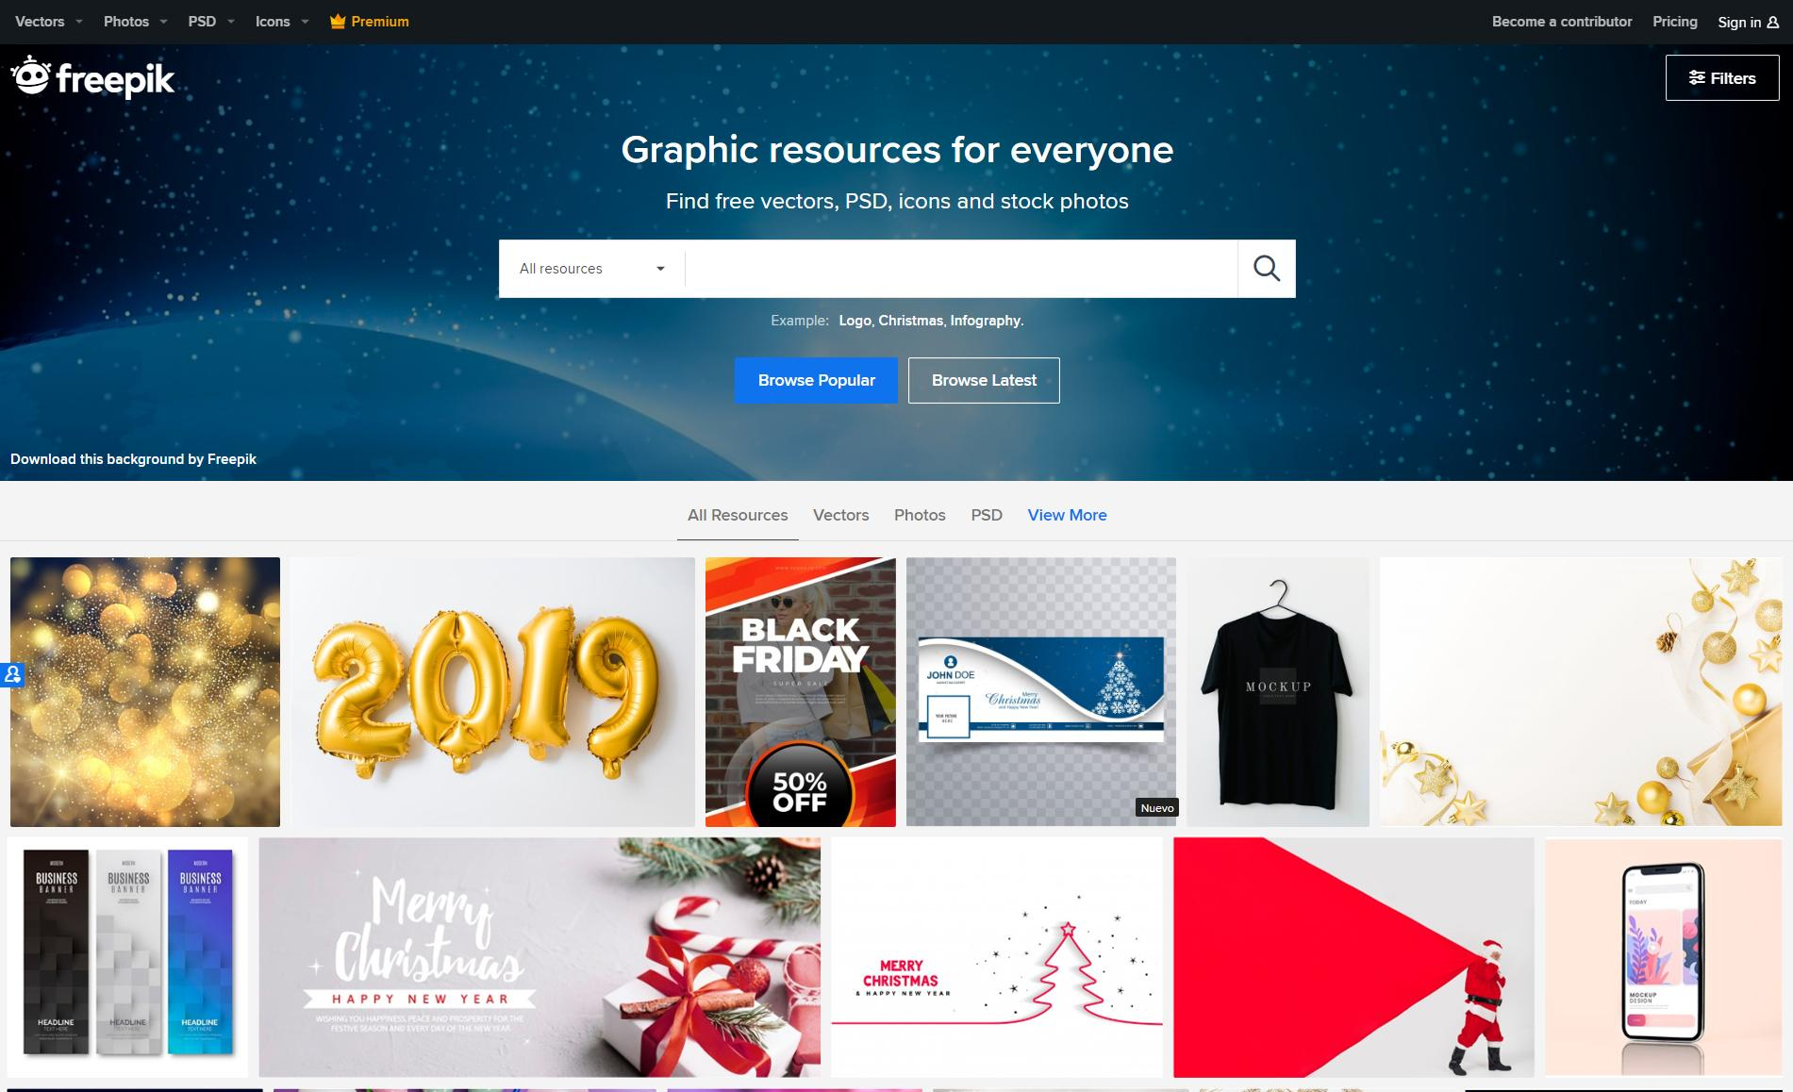
DESKTOP SOFTWARE
You can replace the image on the screen with your own work. Just delete this one, add yours and send it to the back

Slide 27
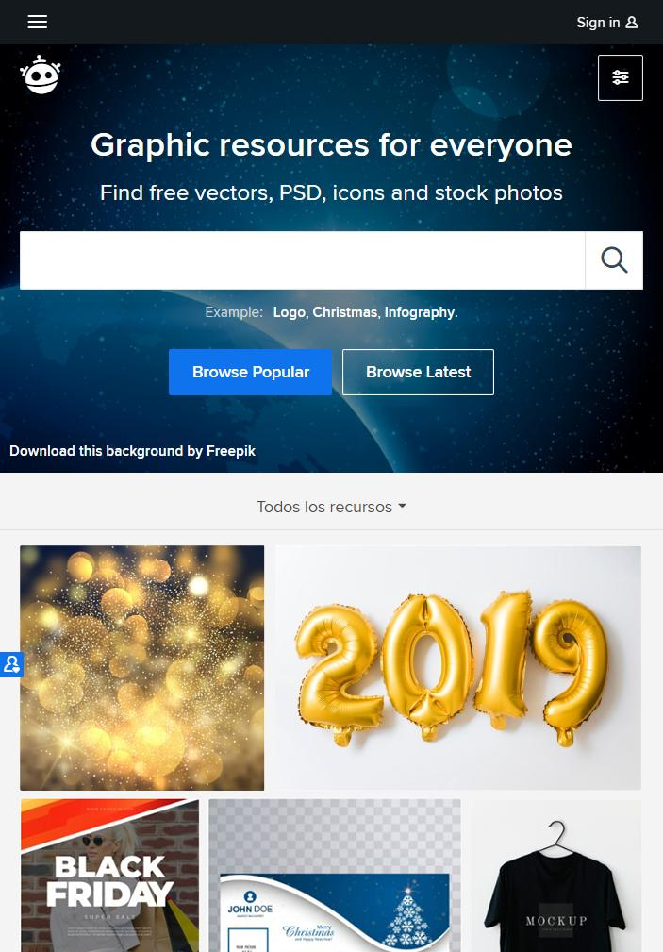
TABLET APP
You can replace the image on the screen with your own work. Just delete this one, add yours and send it to the back

Slide 28
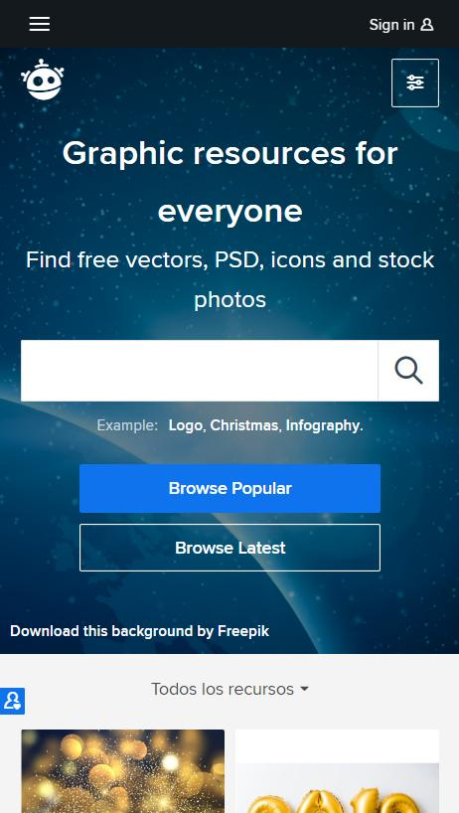
MOBILE WEB
You can replace the image on the screen with your own work. Just delete this one, add yours and send it to the back

Slide 29
OUR TEAM
JOHN DOE
HELENA JAMES
JAMES PATTERSON
You can replace the image on the screen with your own
You can replace the image on the screen with your own
You can replace the image on the screen with your own

Slide 30
THANKS!

Slide 32
Business Icons

Slide 33
Avatar Icons

Slide 34
Creative Process Icons

Slide 35
Educational Process Icons

Slide 36
Help & Support Icons

Slide 37
Medical Icons

Slide 38
Nature Icons

Slide 39
Performing Arts Icons

Slide 40
SEO & Marketing Icons

Slide 41
Teamwork Icons

