Slide 1
Linear Algebra

Slide 2
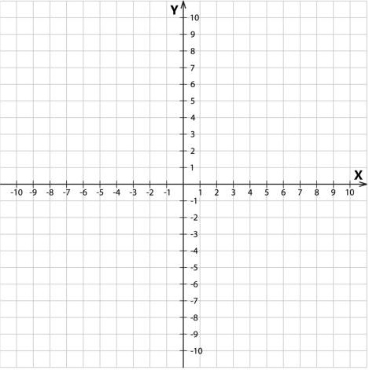

Linear Equation
$$a=\left(2, 3\right)$$
$$b=\left(−3, −2\right)$$
$$\frac{y−y1}{x−x1}= \frac{y2−y1}{x2−x1}$$
$$\frac{y−3}{x−2}= \frac{−2−3}{−3−2}$$

Slide 3

Linear Equation
$$\frac{y−3}{x−2}= \frac{−5}{−5}$$
$$\frac{y−3}{x−2}=1$$
$$y−3=x−2$$
$$y=x+1$$

Slide 4

Linear Equation
$$y=x+1$$
$$y=mX+c$$
x-coordinate
y-coordinate
Slope/Gradiant
y-intercept

Slide 5


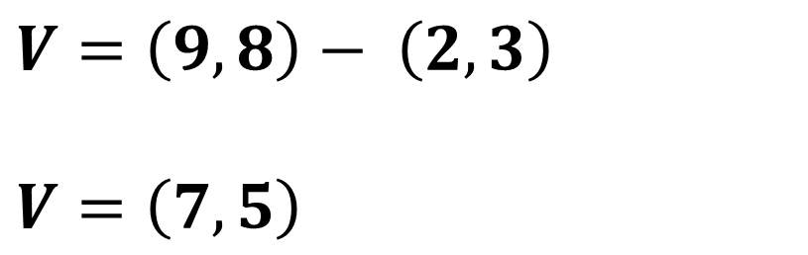
Vectors
$$V=\left(9, 8\right)− \left(2, 3\right)$$
$$V=\left(7, 5\right)$$
$$(9, 8)$$
$$(2, 3)$$

Slide 6
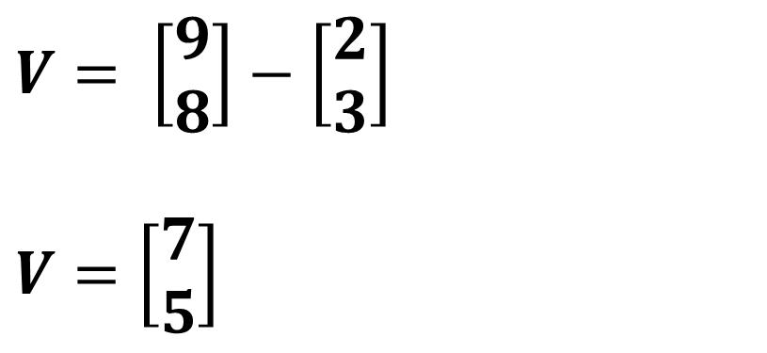
Vectors
$$V= \left[\begin{matrix}9 \\ 8\end{matrix}\right]−\left[\begin{matrix}2 \\ 3\end{matrix}\right]$$
$$V=\left[\begin{matrix}7 \\ 5\end{matrix}\right]$$
$$(9, 8)$$
$$(2, 3)$$

Slide 7
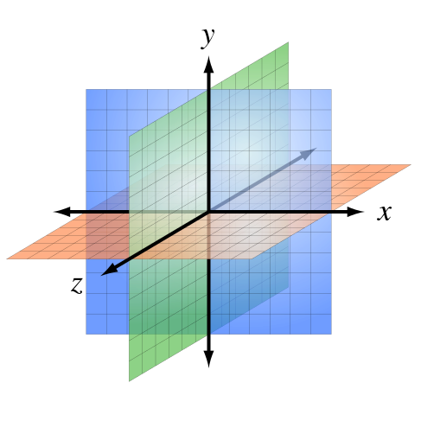


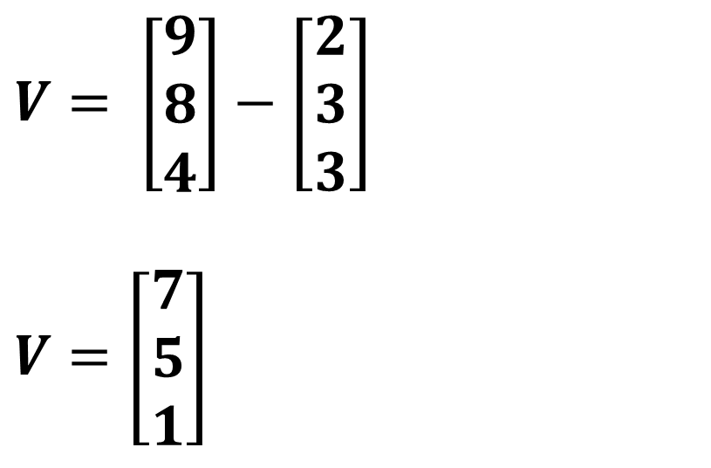
Vectors
$$V= \left[\begin{matrix}9 \\ 8 \\ 4\end{matrix}\right]−\left[\begin{matrix}2 \\ 3 \\ 3\end{matrix}\right]$$
$$V=\left[\begin{matrix}7 \\ 5 \\ 1\end{matrix}\right]$$
$$(9, 8, 4)$$
$$(2, 3, 3)$$

Slide 8
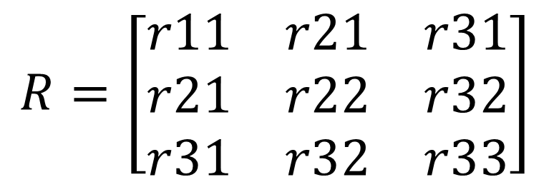
Matrices
$$R=\left[\begin{matrix}r11 & r21 & r31 \\ r21 & r22 & r32 \\ r31 & r32 & r33\end{matrix}\right]$$

Slide 9
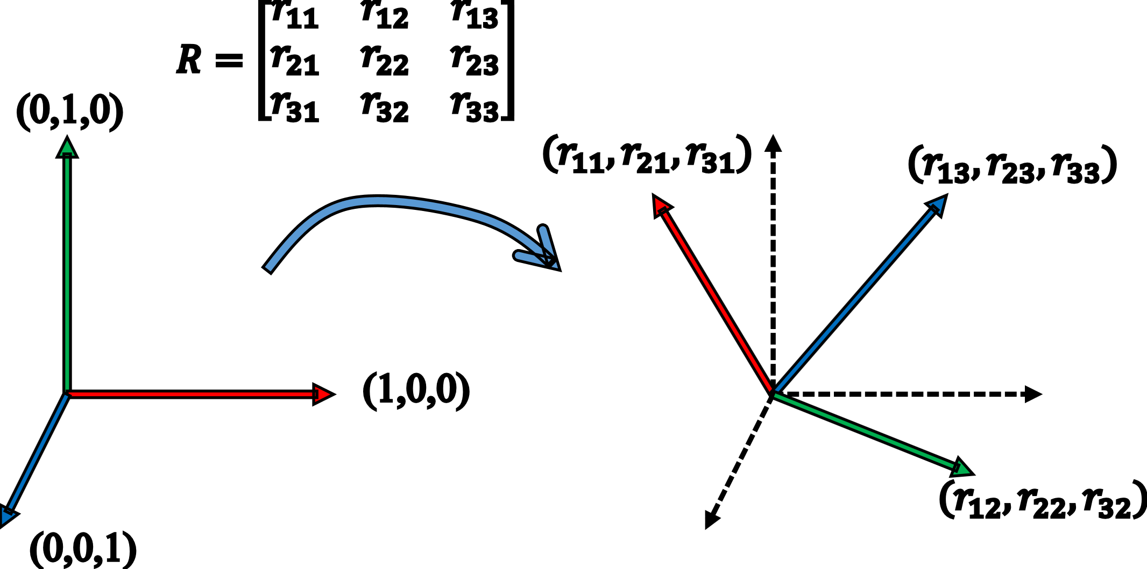
Matrices

Slide 10

Operations with Matrices
Addition
$\left[\begin{matrix}a & b \\ c & d\end{matrix}\right]+\left[\begin{matrix}e & f \\ g & h\end{matrix}\right]=\left[\begin{matrix}a+e & b+f \\ c+g & d+h\end{matrix}\right]$

Slide 11

Operations with Matrices
Multiplication by scaler
$k\left[\begin{matrix}a & b \\ c & d\end{matrix}\right]=\left[\begin{matrix}ka & kb \\ kc & kd\end{matrix}\right]$

Slide 12

Operations with Matrices
Multiply two matrices
$\left[\begin{matrix}a & b \\ c & d\end{matrix}\right]∗\left[\begin{matrix}e & f \\ g & h\end{matrix}\right]=\left[\begin{matrix}ae+bg & af+bh \\ ce+dg & cg+dh\end{matrix}\right]$

Slide 13
Operations with Matrices
Multiply two matrices
$\left[\begin{matrix}a & b \\ c & d\end{matrix}\right]∗\left[\begin{matrix}e & f \\ g & h\end{matrix}\right]=\left[\begin{matrix}ae+bg & af+bh \\ ce+dg & cg+dh\end{matrix}\right]$

Slide 14
Operations with Matrices
Multiply two matrices
$\left[\begin{matrix}a & b \\ c & d\end{matrix}\right]∗\left[\begin{matrix}e & f \\ g & h\end{matrix}\right]=\left[\begin{matrix}ae+bg & af+bh \\ ce+dg & cg+dh\end{matrix}\right]$

Slide 15
Operations with Matrices
Multiply two matrices
$\left[\begin{matrix}a & b \\ c & d\end{matrix}\right]∗\left[\begin{matrix}e & f \\ g & h\end{matrix}\right]=\left[\begin{matrix}ae+bg & af+bh \\ ce+dg & cg+dh\end{matrix}\right]$

Slide 16

Operations with Matrices
Multiply two matrices
$${\left[\begin{matrix}1 & 2 & 3 \\ 4 & 5 & 6\end{matrix}\right]}_{2x3}∗{\left[\begin{matrix}1 & 2 \\ 5 & 6 \\ 9 & 10\end{matrix} \begin{matrix}3 & 4 \\ 7 & 8 \\ 11 & 12\end{matrix}\right]}_{3x4}={\left[\begin{matrix}x & x \\ x & x\end{matrix} \begin{matrix}x & x \\ x & x\end{matrix}\right]}_{2x4}$$

Slide 17


System of Linear Equations
$a+b+3c=15$
$a+2b+4c=21$
$a+b+2c=13$
$$\left[\begin{matrix}1 & 1 & 3 \\ 1 & 2 & 4 \\ 1 & 1 & 2\end{matrix}\right]\left[\begin{matrix}a \\ b \\ c\end{matrix}\right]=\left[\begin{matrix}15 \\ 21 \\ 13\end{matrix}\right]$$

Slide 18

System of Linear Equations
$$1∗X=15$$
$$X=15$$

Slide 19


System of Linear Equations
$$\left[\begin{matrix}a \\ b \\ c\end{matrix}\right]=\left[\begin{matrix}∅ \\ ∅ \\ ∅\end{matrix}\right]$$
$$\left[\begin{matrix}1 & 0 & 0 \\ 0 & 1 & 0 \\ 0 & 0 & 1\end{matrix}\right]∗\left[\begin{matrix}a \\ b \\ c\end{matrix}\right]=\left[\begin{matrix}∅ \\ ∅ \\ ∅\end{matrix}\right]$$

Slide 20
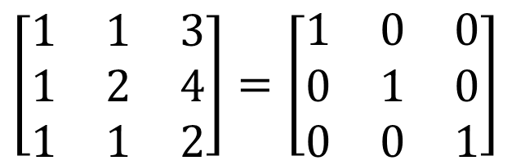
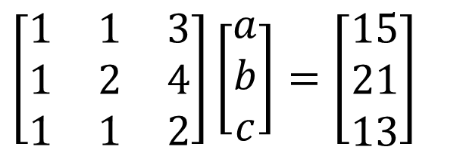
System of Linear Equations
$$\left[\begin{matrix}1 & 1 & 3 \\ 1 & 2 & 4 \\ 1 & 1 & 2\end{matrix}\right]\left[\begin{matrix}a \\ b \\ c\end{matrix}\right]=\left[\begin{matrix}15 \\ 21 \\ 13\end{matrix}\right]$$
$$\left[\begin{matrix}1 & 1 & 3 \\ 1 & 2 & 4 \\ 1 & 1 & 2\end{matrix}\right]=\left[\begin{matrix}1 & 0 & 0 \\ 0 & 1 & 0 \\ 0 & 0 & 1\end{matrix}\right]$$

Slide 21

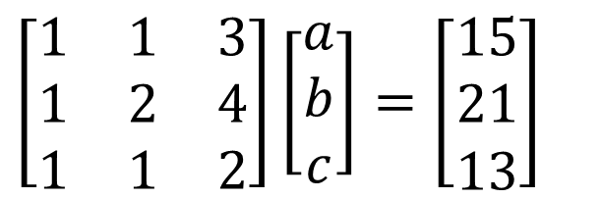

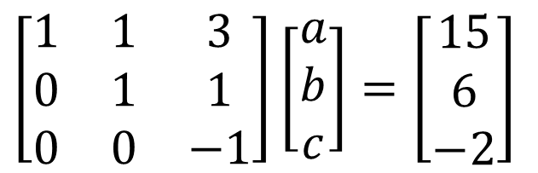

System of Linear Equations
$$\left[\begin{matrix}1 & 1 & 3 \\ 1 & 2 & 4 \\ 1 & 1 & 2\end{matrix}\right]\left[\begin{matrix}a \\ b \\ c\end{matrix}\right]=\left[\begin{matrix}15 \\ 21 \\ 13\end{matrix}\right]$$
$$r_{2}=−r_{1}+r_{2}$$
$$r_{3}=−r_{1}+r_{3}$$
$$\left[\begin{matrix}1 & 1 & 3 \\ 0 & 1 & 1 \\ 0 & 0 & −1\end{matrix}\right]\left[\begin{matrix}a \\ b \\ c\end{matrix}\right]=\left[\begin{matrix}15 \\ 6 \\ −2\end{matrix}\right]$$
$$r_{1}=−r_{2}+r_{1}$$

Slide 22

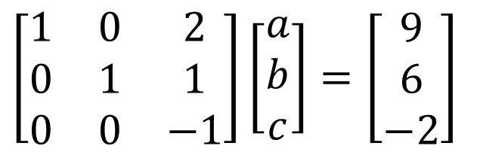

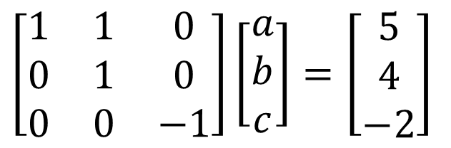

System of Linear Equations
$$\left[\begin{matrix}1 & 0 & 2 \\ 0 & 1 & 1 \\ 0 & 0 & −1\end{matrix}\right]\left[\begin{matrix}a \\ b \\ c\end{matrix}\right]=\left[\begin{matrix}9 \\ 6 \\ −2\end{matrix}\right]$$
$$r_{2}=r_{3}+r_{2}$$
$$r_{1}=2r_{3}+r_{1}$$
$$\left[\begin{matrix}1 & 1 & 0 \\ 0 & 1 & 0 \\ 0 & 0 & −1\end{matrix}\right]\left[\begin{matrix}a \\ b \\ c\end{matrix}\right]=\left[\begin{matrix}5 \\ 4 \\ −2\end{matrix}\right]$$
$$r_{3}=−r_{3}$$

Slide 23

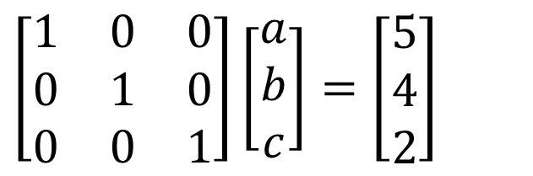
System of Linear Equations
$$\left[\begin{matrix}1 & 0 & 0 \\ 0 & 1 & 0 \\ 0 & 0 & 1\end{matrix}\right]\left[\begin{matrix}a \\ b \\ c\end{matrix}\right]=\left[\begin{matrix}5 \\ 4 \\ 2\end{matrix}\right]$$
$$\left[\begin{matrix}a \\ b \\ c\end{matrix}\right]=\left[\begin{matrix}5 \\ 4 \\ 2\end{matrix}\right]$$

Slide 24
System of Linear Equations
$a+b+3c=15$
$a+2b+4c=21$
$a+b+2c=13$
$$\left[\begin{matrix}1 & 1 & 3 \\ 1 & 2 & 4 \\ 1 & 1 & 2\end{matrix}\right]\left[\begin{matrix}a \\ b \\ c\end{matrix}\right]=\left[\begin{matrix}15 \\ 21 \\ 13\end{matrix}\right]$$

Slide 25

System of Linear Equations
$a+b+3c=15$
$a+2b+4c=21$
$a+b+2c=13$
$$\left[\begin{matrix}\begin{matrix}a \\ 1\end{matrix} & \begin{matrix}b \\ 1\end{matrix} & \begin{matrix}c \\ 3\end{matrix} \\ 1 & 2 & 4 \\ 1 & 1 & 2\end{matrix}\right]=\left[\begin{matrix}15 \\ 21 \\ 13\end{matrix}\right]$$

Slide 26
System of Linear Equations
area | bedrooms | age | price
2600 | 3 | 20 | 550000
3000 | 4 | 15 | 565000
3200 |  | 18 | 610000
3600 | 3 | 30 | 595000
4000 | 5 | 8 | 760000
4100 | 6 | 8 | 810000

