Slide 1




DATA ANALYTICS PORTFOLIO PROJECT
Airbnb Dynamic Pricing
Recommendation Engine
Benchmarking every NYC listing's price against comparable market
medians to guide data-driven pricing decisions.
Python
Excel
Power BI
48,895 NYC Listings | 5 Boroughs | Median-Benchmark Pricing Logic

Slide 2

WHY THIS PROJECT
Business Problem & Objective
The Problem
The Objective
Airbnb hosts frequently price listings by intuition rather than by comparing against similar, nearby listings — leaving money on the table or pricing themselves out of bookings.
Design a data-driven recommendation engine that benchmarks each listing's current price against the median price of comparable listings — same borough and same room type — and returns a clear pricing action.
41.1%
of listings priced below comparable market median
1
Compare Price
38.8%
priced above the median — a competitiveness risk
2
Benchmark vs. Median
3
Recommend Action
Source: engineered pricing_status field, 48,895 listings
02 / 10

Slide 3

FOUNDATIONS
Dataset & Tools
New York City Airbnb Listings Dataset
Analytics Workflow
48,895
16
5
Python
Data cleaning, EDA & feature logic — Pandas, NumPy, Matplotlib
Listings
Raw Columns
Boroughs
221
3
0
Excel
Neighborhoods
Room Types
Duplicate Rows
Engineered categories & the pricing recommendation columns
Data Quality
last_review / reviews_per_month: 20.6% missing (10,052 rows) — no review history yet
Power BI
name / host_name: < 0.1% missing (26 / 22 rows)
Interactive 3-page dashboard for stakeholder storytelling
Duplicate records: 0 — dataset verified clean
03 / 10

Slide 4
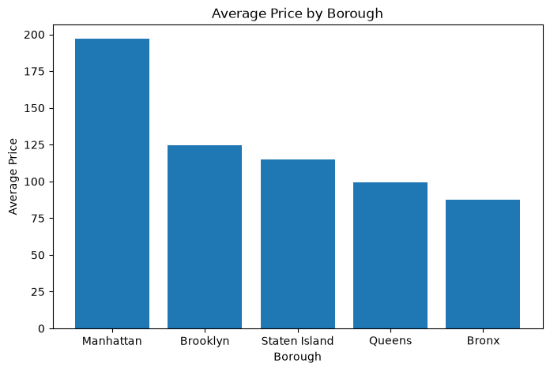
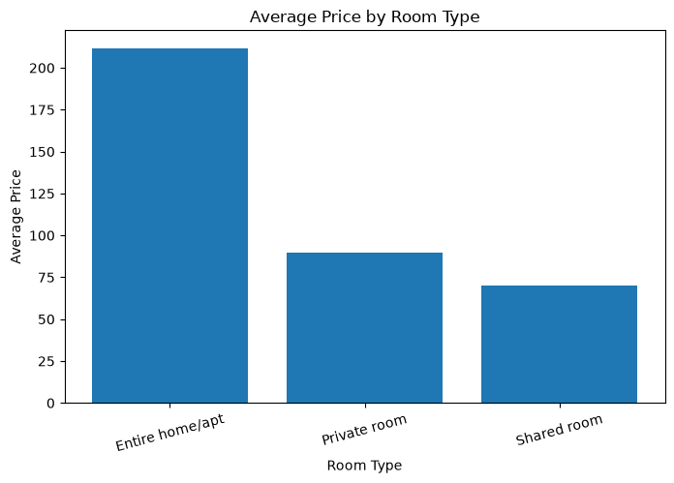
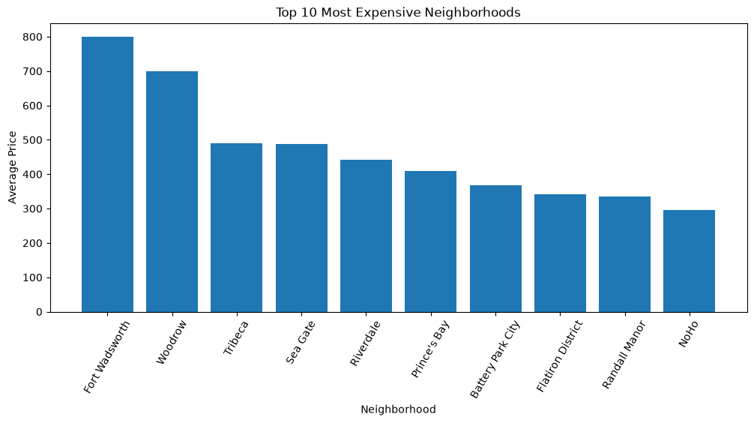

PYTHON EDA
Exploratory Data Analysis — Key Signals
What the Data Shows
Manhattan averages $196.88/night vs. $87.50 in the Bronx — a 2.25x price gap across boroughs.
Entire home/apt averages $211.79/night, nearly 3x a shared room's $70.13 — room type drives price more than any other factor.
The 10 priciest neighborhoods (e.g. Fort Wadsworth $800, Tribeca $490.64) sit well above the citywide median of $106.
04 / 10

Slide 5


EXCEL DATA ENGINEERING
Feature Creation for the Pricing Engine
price_category
availability_category
review_category
Budget / Standard / Premium / Luxury tiers from price
Not Available / Low / Medium / High from availability_365
Low / Medium / High / Very High from number_of_reviews
23,917 Budget · 16,583 Standard · 7,340 Premium · 1,044 Luxury
17,533 · 13,060 · 6,686 · 11,616 listings respectively
30,323 · 11,613 · 3,964 · 2,995 listings respectively
The Three Columns That Power the Recommendation Engine
recommended_price
price_difference
pricing_status
Median price of comparable listings (same borough + room type)
recommended_price minus the listing's current price
Increase / Maintain / Lower — the final recommendation label
05 / 10

Slide 6



METHODOLOGY
How the Recommendation Engine Works
Each listing is compared only to its true peer group — listings in the same borough (neighbourhood_group) and of the same room_type. The median price of that peer group becomes the fair-market benchmark.
Decision Logic
price < 90% of benchmark
recommended_price = median( price ) grouped by [neighbourhood_group, room_type]
→ Increase Price
within ±10% of benchmark
Peer-Group Median Price Benchmark ($)
→ Maintain Price
Borough | Entire home/apt | Private room | Shared room
Manhattan | $191 | $90 | $69
Brooklyn | $145 | $65 | $36
Queens | $120 | $60 | $37
Bronx | $100 | $53.5 | $40
Staten Island | $100 | $50 | $30
price > 110% of benchmark
→ Consider Lowering
Median chosen over mean to stay resistant to extreme outlier prices (e.g. the $10,000 max listing) within each peer group.
Real medians computed from the engineered dataset (airbnb_EDA_Engineered.xlsx)
06 / 10

Slide 7
THE OUTPUT
Recommendation Rules & Outcomes
Increase Price
Maintain Price
Consider Lowering
price < 90% of recommended_price
within ±10% of recommended_price
price > 110% of recommended_price
20,104
9,808
18,983
41.1% of listings
20.1% of listings
38.8% of listings
Distribution of Pricing Recommendations
Reading the Result
Nearly 4 in 5 listings sit outside the ±10% comfort zone — most hosts are leaving revenue on the table (underpriced) or risking lower booking rates (overpriced). Only 1 in 5 listings is already priced optimally against comparable inventory.
07 / 10

Slide 8
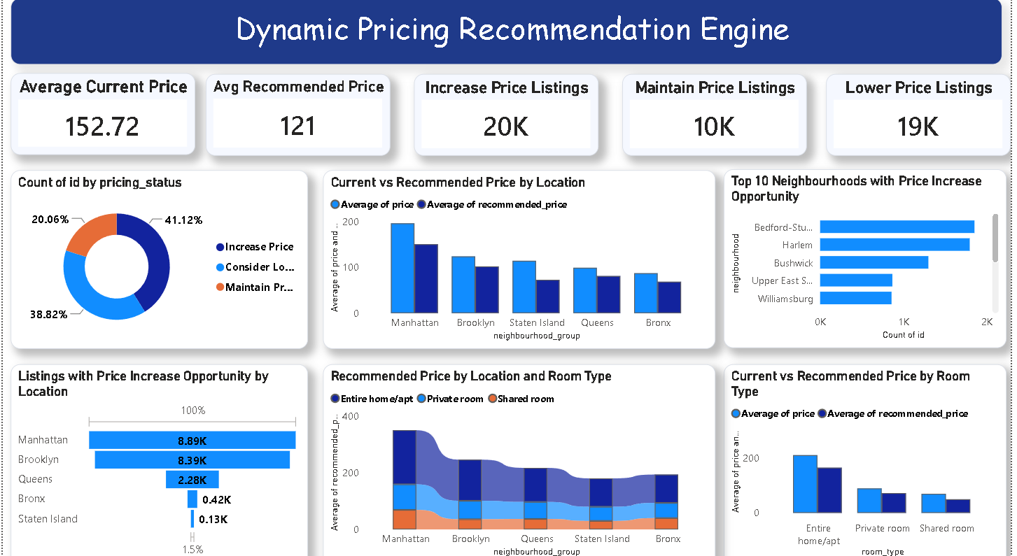
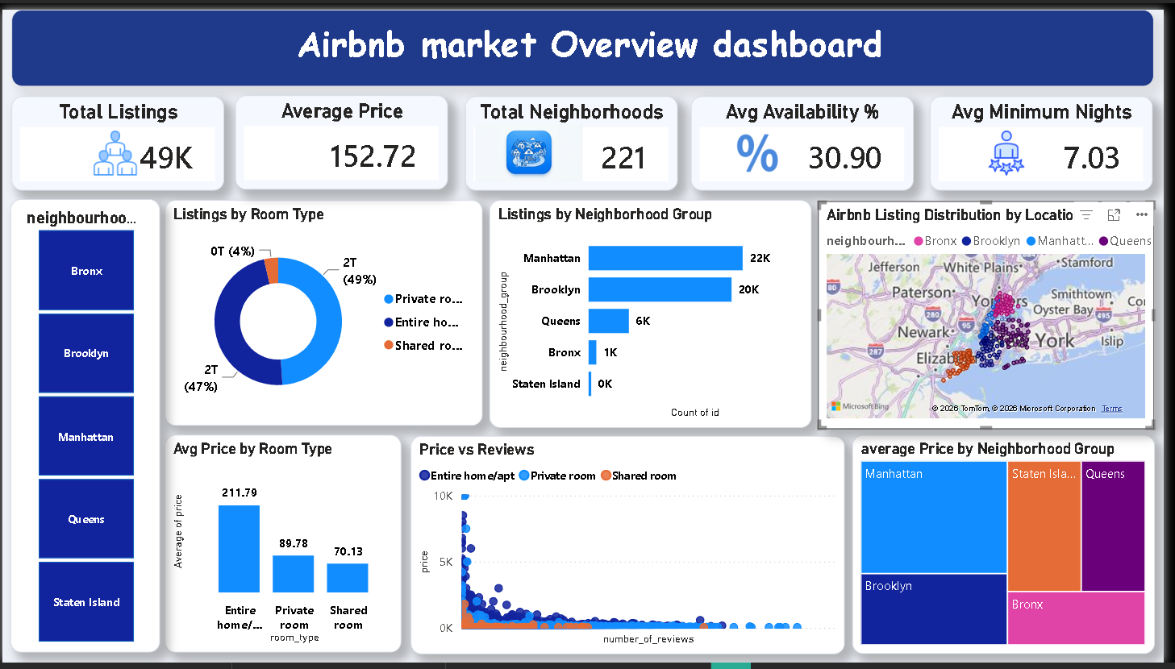
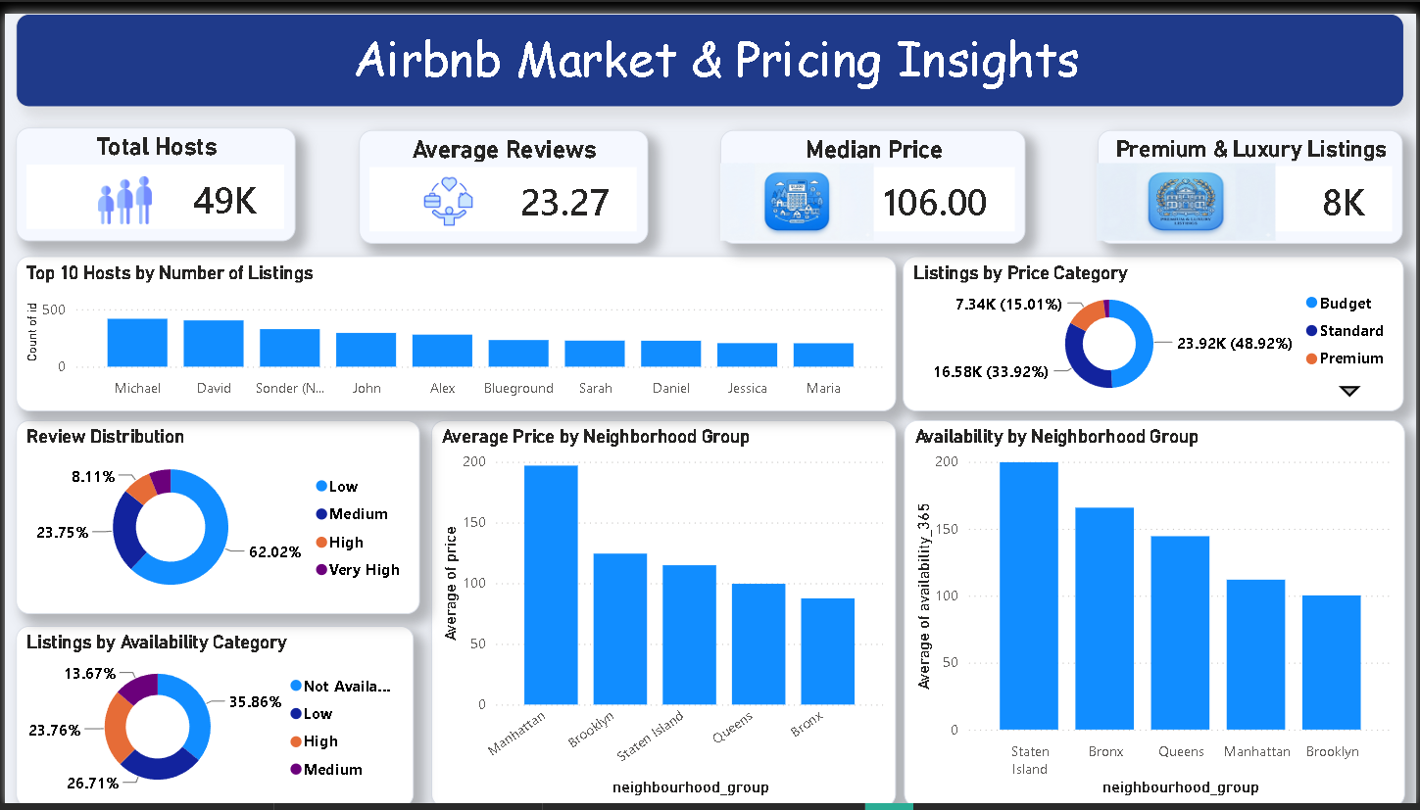
POWER BI DASHBOARD
Interactive Pricing Intelligence
Page 1 — Market Overview
Dynamic Pricing Recommendation Engine — page 3 of 3
Page 2 — Market & Pricing Insights
08 / 10

Slide 9

SO WHAT?
Business Insights
Borough price gap
Manhattan averages $196.88/night — 2.25x Bronx's $87.50 — the single biggest price driver in the market.
Demand vs. price
Brooklyn logs more total reviews (486,574) than pricier Manhattan (454,569), suggesting stronger booking turnover at lower price points.
Room type premium
Entire home/apt commands $211.79 on average — 2.4x a private room ($89.78) and 3x a shared room ($70.13).
Revenue opportunity
41.1% of listings (20,104) are priced below their peer-group median — the largest single group in the recommendation output.
Supply vs. turnover
Staten Island has the highest average availability (199.7 of 365 days) — a signal of lower demand relative to booking pace.
09 / 10

Slide 10


CLOSING THE LOOP
Limitations & Conclusion
Limitations
Conclusion
Peer group is defined only by borough + room type — amenities, review quality, and seasonality aren't factored in.
An end-to-end analytics pipeline — Python cleaning & EDA, Excel feature engineering, a transparent rule-based pricing engine, and a Power BI dashboard — turns 48,895 raw listings into a clear, explainable action for every host: increase, maintain, or lower price.
Raw data includes listings priced at $0, a likely data artifact not fully filtered before analysis.
Median can be less stable in small segments (e.g. Staten Island shared rooms, n < 40).
Single static snapshot — no time-series or seasonal demand adjustment.
✓
Data cleaning & EDA
Delivered as a transparent, rule-based benchmark rather than a predictive ML pricing model.
✓
Feature engineering
✓
Business rule design
✓
Dashboard storytelling
010 / 10

