Slide 1
SCHOOL INFRASTRUCTURE & LEARNING CONDITIONS
Identifying the educational resources most closely associated with student outcomes
Group 6

Slide 2
Background of the Study
INTRODUCTION
37
WAEC results are the main measure of secondary-school achievements and credits in five major subjects, including English and Maths, is one of the benchmarks used for entry into university. As a result of this, schools invest in teachers, classrooms, and other resources to improve said benchmark. This research project aims to find out which of these resources are closely associated with student outcomes.
states, including the FCT
6
years of data (2016–2021)
2
school sectors (public and private)

Slide 3
Problem Statement & Objectives
INTRODUCTION
Problem Statement
Objectives
Resource gaps exist between states and sectors, but it is not clear which of these resources (amount of teachers per student, teacher qualification, classroom condition, or toilet provision) are most closely linked to the desired outcomes (credits in core WAEC subjects). Without this knowledge, investment can be wasted on resources that don't matter.
Build a clean, comparable state-by-sector panel of educational resources and WAEC outcomes across a six-year period (2016 – 2021).
Use correlation to identify the resource(s) most closely associated with the outcome.
Use partial correlation to test which resource(s) remain associated with outcomes when other resources are accounted for.

Slide 4
Limitations
INTRODUCTION
1
2
State-level aggregates
Reused data
Findings show associations between states, not on individual students or schools.
Some data are reused from earlier years which hides real year-to-year change.
3
4
Coverage gaps
Lack of data
No classroom or toilet data was captured 2016–2018, and no private-teacher data for 2017.
Other relevant data such as school funding were not available.

Slide 5
Where Our Data Comes From
DATA
NEMIS
NBS
National Education Management Information System
National Bureau of Statistics
Source for educational resource data: student number, teacher number, teacher qualification, classroom condition, and toilet provision, reported separately for public and private schools in every state.
Source for student outcome data: WAEC candidate and credit counts, reported separately for public and private schools in every state.

Slide 6
Raw Files to Clean Panel Pipeline
METHODOLOGY
Data Gathering and Cleaning
Panel Structure
Resource data gathered as PDFs then converted to CSVs using Tabula.
Outcome data gathered as Excel spreadsheets then converted to CSVs using CloudConvert.
Resource data cleaned to handle conversion issues, such as columns filled with missing values.
Columns changed to easy-to-read Pythonic names.
State names standardized, such as removing footnote asterisks and state hyphens.
Missing values filled with the column median and totals recalculated as the sum of their parts. (Missing row was added and filled using the same method while data was ignored.)
Each observation comprises a state, sector, and year. For 37 states (including the FCT) in 2 sectors across a 6-year period, adding up to 444 total observations. They also comprise the following columns:
Column | Years
student_teacher_ratio | 2016–2021 (private 2017 missing)
qualified_teacher_pct | 2016–2021 (private 2017 missing)
students_per_qualified_teacher | 2016–2021 (private 2017 missing)
students_per_school | 2016–2017
students_per_good_classroom | 2019–2021
good_classroom_pct | 2019–2021
students_per_toilet | 2019–2021
pass_rate (outcome) | 2016–2021

Slide 7
Statistical Approaches
METHODOLOGY
Correlation Analysis
Partial Correlation
Pearson's r, which measures the strength of a linear relationship between two numerical variables.
Spearman's ρ, which measures the strength of a monotonic relationship between two numerical variables.
Computed on year-and-sector-demeaned values as well as on raw pooled values, since pooled values differ drastically.
Measures the correlation between each resource and the pass rate after removing the part explained by the other resources.
Year × sector held constant, so the 2018–2019 private shift cannot create a false link.
Pearson (log ratios) and Spearman (ranks) versions, with p-values and 95% confidence intervals.
Three feature sets: teachers 2016–2021, all resources 2019–2021, school size 2016–2017.

Slide 8
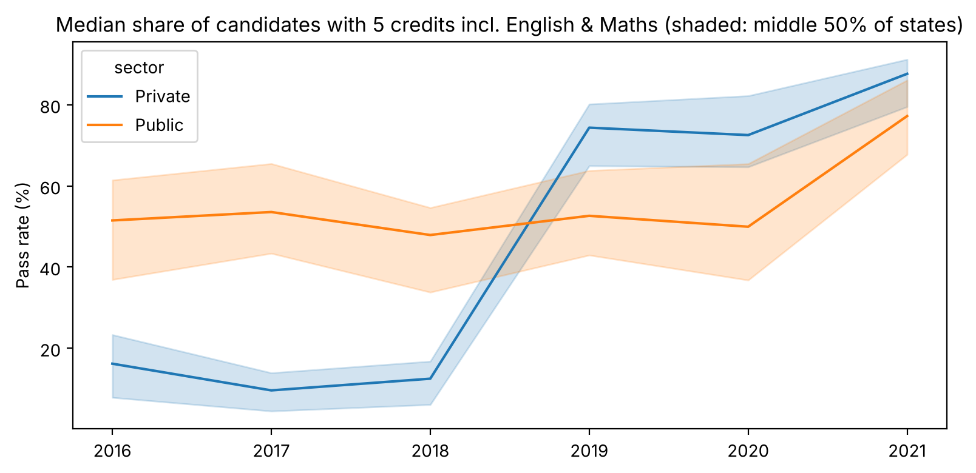
WAEC Pass Rates Over Time, by Sector
VISUALIZATION & ANALYSIS

Slide 9
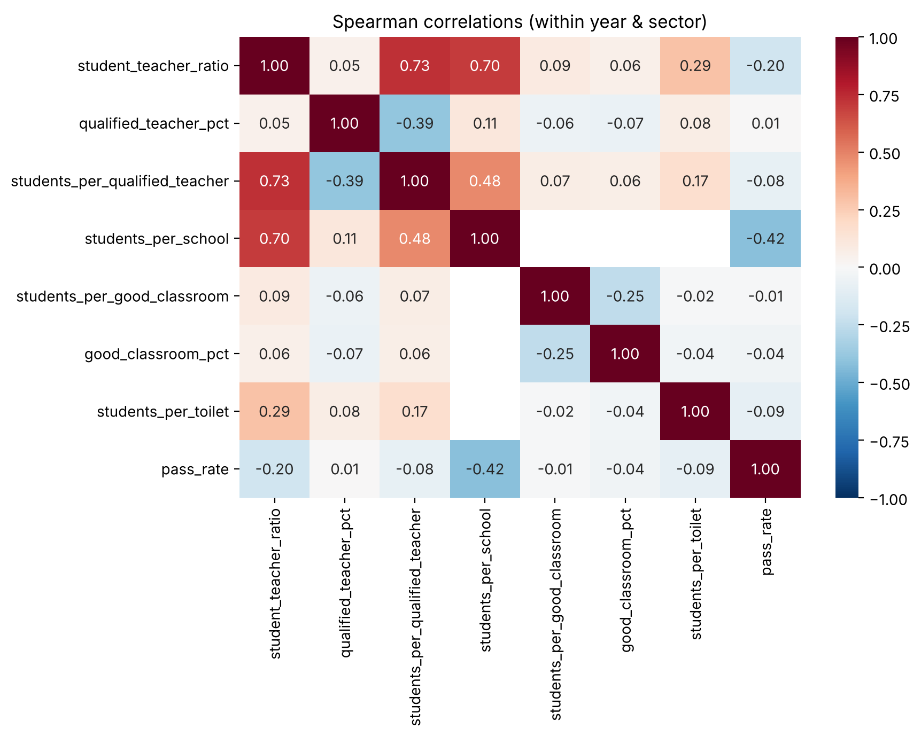
Within-Year, Within-Sector Correlations
VISUALIZATION & ANALYSIS

Slide 10
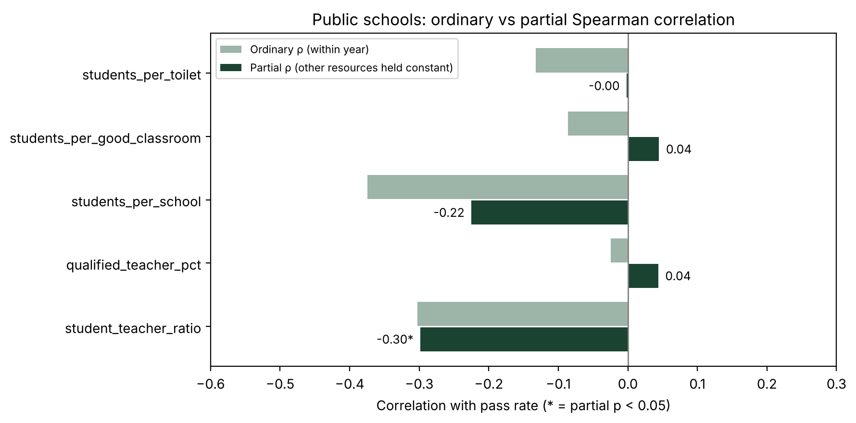
Partial vs Ordinary Correlation, Public Schools
VISUALIZATION & ANALYSIS
−0.30
Student-teacher ratio
Unchanged once qualified teachers and year are held constant (p < 0.001)
−0.23
Students per school
Weaker after controls (p = 0.059); 2016–2017 only
≈ 0
Classrooms & toilets
Partial ρ 0.05 and −0.00: no association

Slide 11
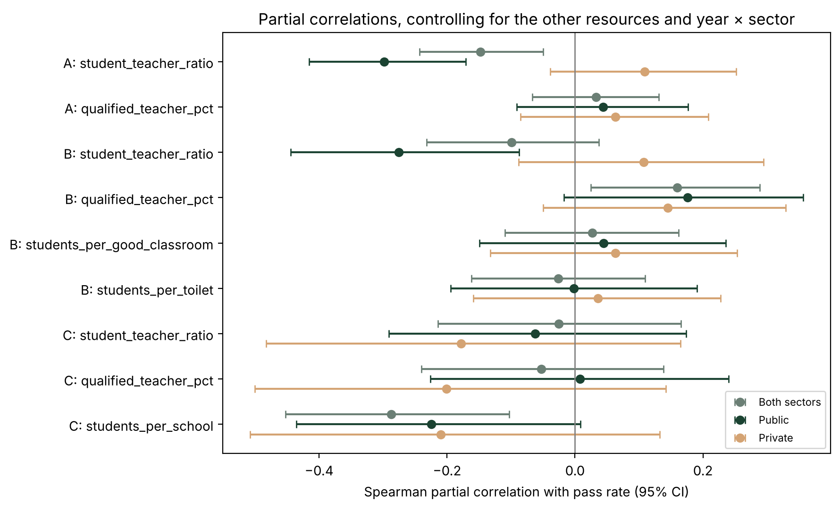
Partial Correlations by Sector
VISUALIZATION & ANALYSIS
How to read it
Each dot is a Spearman partial correlation; the line is its 95% confidence interval.
Lines crossing zero: no association once the other resources are held constant.
Public student-teacher ratio stays clearly negative in sets A and B (−0.30, −0.28).
Qualified teachers turn weakly positive in 2019–2021 (0.16–0.18).
Private schools: nothing significant (all p > 0.14).

Slide 12
Conclusion
CONCLUSION
1
Student-teacher ratio is most consistently linked to student outcomes, and stays linked when the other resources are held constant (partial ρ = −0.30 in public schools). Lower ratios yield higher results. Considering the available data, this should be the primary resource to improve on.
2
Qualified teacher percentage is also linked to student outcomes, but weakly (partial ρ = 0.16–0.18, 2019–2021 only). Higher percentages yield higher results. Considering the data, this should be a secondary resource to improve on.
3
Classroom conditions and toilet availability have no reliable association when the other resources, sector and year are controlled for.
4
School size had the highest correlation and stays linked after controls (partial ρ = −0.29), but only two years of data are available.
5
Private-sector results jump wasn't reliable. Likely driven by a reporting shift between 2018 and 2019.

Slide 13
Recommendations
RECOMMENDATIONS
1
Collect more extensive data on school size.
2
Understand and account for what factor caused the 2018-2019 private school result change.
3
Extend the panel to future years.
4
Handle the limitations mentioned.
5
Private-sector results jump wasn't reliable. Likely driven by a reporting shift between 2018 and 2019.

