Slide 1
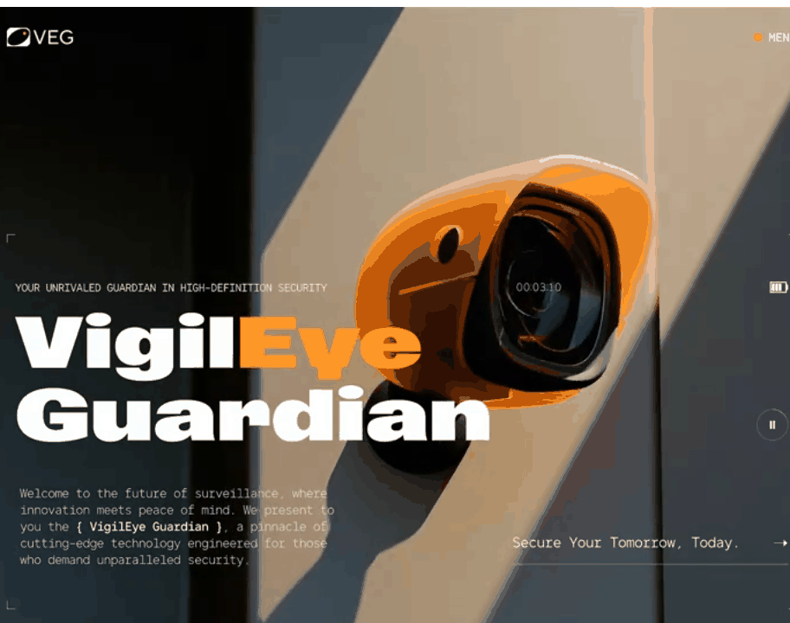
GROUP 4 / RESEARCH PROJECT
2026
Selective Smart
Surveillance System
Real-time restricted-zone monitoring
with face-based review
CAMERA • TRACKING • FACE REVIEW
TEAM
Joseph Ekuma
Amina Olagunju
Williams Emehel
Michael Iduma
Emmanuel John
Ugochukwu Okoroji
Banmen Akuso
Josiah Frank Achile
Abubakar Ahmed
GROUP 4 / PYTHON • STREAMLIT • LOCAL EVENT STORAGE
01
Notes:
Team names follow the supplied Group 4 proposal deck.
Cover animation: user-provided Pinterest pin, VEG Surveillance Camera Website — Bold Dark UI for Smart Security Camera System, https://pin.it/2NdyLXMFv. The source video is embedded to play on slide entry.

Slide 2
02 / PROBLEM STATEMENT
Motion does not tell us who entered
A camera can show movement without answering the security question: did someone cross this boundary, and does the enrolled gallery recognise them?
WHAT OPERATORS FACE
WHY IT MATTERS
Recorded footage requires manual review.
Motion-only alerts can fire outside the area of concern.
Repeated activity is difficult to tie to one visit.
An operator needs a visible, reviewable event linked to a defined zone, a tracked person and a cautious face-match result.
Unknown ≠ dangerous. It means no enrolled identity met the match rule.
GROUP 4 / SELECTIVE SMART SURVEILLANCE
02
Notes:
This is the problem framing from the supplied proposal, refined to avoid treating an unknown identity as proof of a threat.

Slide 3
03 / AIM, OBJECTIVES AND SCOPE
A local prototype for one marked area
AIM
Build and evaluate a local pipeline that detects entry into a dashboard-defined zone and shows a face-based decision.
01
Track people
Detect people and keep a stable track ID across frames.
02
Check zone entry
Use the saved polygon and trigger on a track crossing into it.
03
Review identity
Compare a usable face with consenting enrolled references.
04
Measure behaviour
Evaluate scenario outcomes, missed events, FPS and alert delay.
SCOPE / One camera view at a time • local dashboard and storage • no Telegram • no automated lock control
GROUP 4 / SELECTIVE SMART SURVEILLANCE
03
Notes:
The live camera and phone feed are intended to run into the laptop dashboard. The current project also supports local video replay for repeatable testing. No liveness detector or threat classifier is implemented.

Slide 4
04 / LITERATURE REVIEW AND GAP
Prior work covers the parts; local evidence is still missing
STUDY / METHOD
WHAT IT ADDS
ROLE HERE / LIMIT
YOLO
Redmon et al., 2016 [1]
Single-stage object detection from an image.
Provides the person boxes; the supplied custom weights lack a documented training set and have no local accuracy results.
ByteTrack
Zhang et al., 2022 [2]
Associates detections across frames, including lower-score boxes.
Supports person tracks; benchmark results from other datasets do not establish this camera's ID stability.
FaceNet
Schroff et al., 2015 [3]
Maps faces into an embedding space for similarity comparison.
Established the embedding approach; our implementation uses SFace, not FaceNet.
YuNet + SFace
Wu et al., 2023; Zhong et al., 2021 [4–5]
Lightweight face detection and face embeddings.
Used for face alignment and matching; local thresholds, lighting, twins and presentation attacks remain unmeasured.
GAP
Test the combined zone-entry and face-review workflow on consented local camera scenarios; report measured errors and timing.
GROUP 4 / SELECTIVE SMART SURVEILLANCE
04
Notes:
[1] Redmon, J., Divvala, S., Girshick, R., and Farhadi, A. (2016). You Only Look Once: Unified, Real-Time Object Detection. CVPR. https://openaccess.thecvf.com/content_cvpr_2016/html/Redmon_You_Only_Look_CVPR_2016_paper.html
[2] Zhang, Y. et al. (2022). ByteTrack: Multi-Object Tracking by Associating Every Detection Box. ECCV. https://arxiv.org/abs/2110.06864
[3] Schroff, F., Kalenichenko, D., and Philbin, J. (2015). FaceNet: A Unified Embedding for Face Recognition and Clustering. CVPR. https://openaccess.thecvf.com/content_cvpr_2015/html/Schroff_FaceNet_A_Unified_2015_CVPR_paper.html
[4] Wu, W., Peng, H., and Yu, S. (2023). YuNet: A Tiny Millisecond-level Face Detector. Machine Intelligence Research. https://doi.org/10.1007/s11633-023-1423-y
[5] Zhong, Y. et al. (2021). SFace: Sigmoid-Constrained Hypersphere Loss for Robust Face Recognition. IEEE Transactions on Image Processing, 30, 2587–2598. https://doi.org/10.1109/TIP.2020.3048632
The cited papers report their own benchmark experiments; none of those values are presented as results from this project.

Slide 5
05 / SYSTEM ARCHITECTURE
System architecture
The system checks zone entry first; face matching runs only after a person crosses the saved boundary.
01 CAMERA + OPERATOR
02 PERSON + ZONE
03 FACE REVIEW
04 LOCAL EVENT
VIDEO SOURCE
DETECT + TRACK
RESTRICTED ZONE
ONLY ON ZONE ENTRY
DECISION
DroidCam
Wi-Fi / USB
or local replay
YOLO
person boxes
ByteTrack IDs
Foot-point
inside saved
polygon?
YuNet
detect + align
Known
Unknown
Uncertain / unclear
SFace embedding → gallery score
STREAMLIT CAMERA VIEW
Operator draws and saves a polygon for this camera view
ENTRY RESULT
SQLite event + approved evidence
Known → log only • Unknown / unclear → dashboard review alert
No Telegram or external notification service
GROUP 4 / SELECTIVE SMART SURVEILLANCE
05
Notes:
System flow and module names are based on the cleaned project architecture. The live Streamlit dashboard receives frames and lets the operator draw/save a camera-specific polygon. YOLO and ByteTrack detect and track people; the foot-point transition into the polygon triggers face processing. YuNet detects/aligns a face, SFace creates an embedding, and a cosine similarity is compared with the local gallery. All entry decisions are stored in SQLite; Known entries are logged without an unknown-person alert, while Unknown or Uncertain outcomes are shown for review. There is no Telegram or external alert service.
DroidCam connection options documented in the project are Wi-Fi and USB; Bluetooth is not assumed. See docs/ARCHITECTURE.md and docs/PROJECT_AUDIT.md.

Slide 6
06 / DETECTION AND TRACKING
A zone event is a track crossing, not simple motion
01
02
03
04
YOLO
ByteTrack
Zone geometry
Entry transition
Find person boxes in each camera frame.
Link detections over time with track IDs.
Test each track's bottom-centre point against the saved region.
Create one event when a track moves from outside to inside.
WHAT THE OPERATOR SETS
The polygon is drawn in the camera view and saved for that view. If the camera moves, the boundary must be checked and saved again.
TRACK ID ≠ IDENTITY
Tracking follows a person in the video; face matching proposes a gallery identity separately.
GROUP 4 / SELECTIVE SMART SURVEILLANCE
06
Notes:
The current detector tests the person's bottom-centre point against the configured zone and emits entry/exit transitions. The tracker benchmark citation is listed on slide 13 and in the literature slide notes. Model provenance for best.pt is incomplete; no local detection accuracy is claimed.

Slide 7
07 / FACIAL RECOGNITION
Enrollment and matching use the same face pipeline
ENROLLMENT / CONSENTED PERSON
3+ captures
YuNet
SFace
Gallery
Separate face images
Detect and align
Create embeddings
Average template locally
ZONE ENTRY / VIDEO FACE
Entry crop
YuNet
SFace
Similarity
Decision
From tracked person
Detect + align
Embedding vector
Cosine match to gallery
Known / Unknown / Review
DECISION RULE
A cosine similarity is a score, not a probability. A usable face with no accepted match is Unknown; an unclear or missing face stays Uncertain / face unclear.
Augmentation previews help inspect enrollment inputs; they are not independent test samples and do not detect photo or screen attacks.
GROUP 4 / SELECTIVE SMART SURVEILLANCE
07
Notes:
The current Face Enrollment page requests at least three separate images and saves one averaged normalized SFace template locally. It previews four mild variations per image. The system has no liveness detector. References: Wu et al. YuNet (2023), https://doi.org/10.1007/s11633-023-1423-y ; Zhong et al. SFace (2021), https://doi.org/10.1109/TIP.2020.3048632 ; OpenCV Zoo model READMEs: https://github.com/opencv/opencv_zoo/tree/main/models/face_detection_yunet and https://github.com/opencv/opencv_zoo/tree/main/models/face_recognition_sface

Slide 8
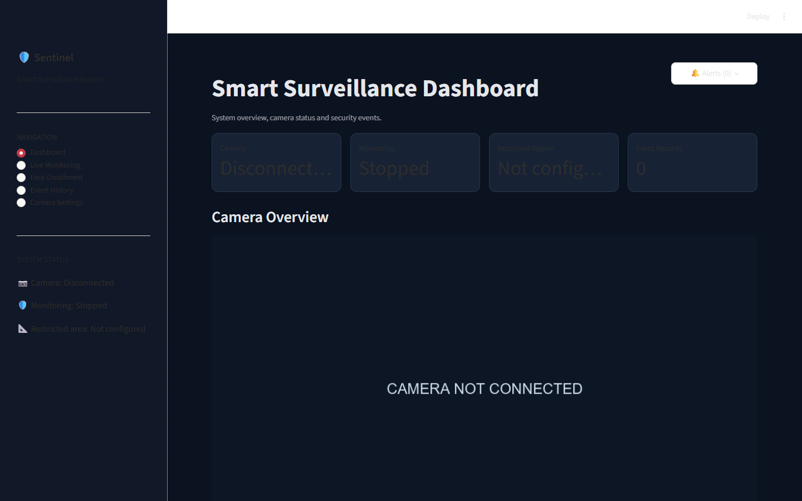
08 / DASHBOARD, ALERTS AND STORAGE
Dashboard, alerts and storage
VISIBLE EVENT RULES
KNOWN
Log entry; no unknown-person alert
UNKNOWN
Show an on-screen dashboard alert
UNCERTAIN
Show a needs-review notice
OUTSIDE ZONE
No selected entry event
LOCAL STORAGE
SQLite event history • saved evidence images • consented face templates in local private storage
CURRENT DASHBOARD • camera disconnected when captured
No Telegram or external alert service
GROUP 4 / SELECTIVE SMART SURVEILLANCE
08
Notes:
Screenshot was captured from the running local Streamlit dashboard at 127.0.0.1:8501 on 6 Nov 2026 while no camera was connected; it shows actual UI status, not a live surveillance event. The alert policy and storage statements reflect the cleaned project implementation and audit.

Slide 9
09 / DATA AND EXPERIMENTAL SETUP
The study plan is defined; participant trials are pending
CONTROLLED STUDY SETUP
PROPOSED VIDEO PLAN
01
Recruit consenting participants; assign private identity codes.
80
02
Keep enrollment images separate from threshold validation and final test.
short clips planned
in the earlier proposal
03
Group clips by recording session so adjacent frames do not leak across splits.
04
Record twins, caps, dim light, distance, side view, motion blur and outside-zone passes.
40 train / 20 validation / 20 final test
05
Test print, phone-screen and replay attacks as vulnerabilities; no liveness model exists.
PLAN ONLY — the cleaned repository contains no labelled 80-clip dataset or independent results.
06
Equipment plan: DroidCam phone by Wi-Fi or USB, Windows laptop, local Python app.
Model settings and thresholds must be frozen before final-test trials.
GROUP 4 / SELECTIVE SMART SURVEILLANCE
09
Notes:
The 80/40/20/20 clip count comes from the earlier supplied proposal and is explicitly presented as a plan only. The cleaned project audit found no such dataset or measured camera trials. The test split and scenario design follow docs/TEST_PLAN.md. Store participant labels and evidence privately; do not commit them to Git.

Slide 10
10 / RESULTS AND EVALUATION
Results and evaluation
SOFTWARE SMOKE TEST
20
3
3
frames processed
person tracks
zone-entry events
One sample clip • 464 × 832 • pipeline smoke test only
NOT RESEARCH RESULTS
No measured recognition rates, zone accuracy, false alerts, FPS or entry-to-alert response time are available yet. Eight automated checks passed, but they use synthetic code cases.
FPS
Not measured on DroidCam
ALERT DELAY
Not measured from zone entry to notice
Dashboard poll interval is 0.2 s (about 5 update requests/s); that is a target cadence, not measured FPS or response time.
GROUP 4 / SELECTIVE SMART SURVEILLANCE
10
Notes:
Smoke-test counts are reported in docs/PROJECT_AUDIT.md: 20 frames from one supplied sample video, three unique person tracks and three full-frame zone-entry events. This is not a participant study, accuracy result or live camera test. The UI requests updates every 0.2 seconds; actual end-to-end FPS and alert latency must be measured on the laptop. Report both FPS and entry-to-dashboard-notice response time, with hardware, resolution and test scenario.

Slide 11
11 / LIVE DEMONSTRATION
Live demonstration: connect, mark, verify
DEMO FLOW
01
Connect
Start the phone camera feed on the laptop; confirm the dashboard shows camera status.
02
Mark
Draw and save the restricted zone in the current camera view; then start monitoring.
03
Enrolled person enters
Show the Known event in history; confirm it does not raise an unknown-person alert.
04
Unknown person enters
Show the visible dashboard alert and its saved local event record.
Backup: replay a consented, labelled local clip if the phone connection or live camera is unavailable.
GROUP 4 / SELECTIVE SMART SURVEILLANCE
11
Notes:
This is the proposed demonstration sequence; it has not yet been performed with the team's DroidCam or real participants. Use only consented participants and private, locally stored evidence. The project supports local video replay as a backup.

Slide 12
12 / LIMITATIONS AND FUTURE WORK
The next work is measured field testing
CURRENT LIMITS
NEXT EXPERIMENTS
No live DroidCam trial or measured FPS / response time.
No independent recognition or zone-accuracy results.
No liveness detector; print, screen and replay attacks may pass.
Twin, cap, low-light and occlusion outcomes are unknown.
YOLO weight training data and class provenance are undocumented.
Connect DroidCam and log resolution, device and conditions.
Run held-out, consented trials for each scenario.
Measure false acceptance/rejection and unclear outcomes.
Record FPS and entry-to-alert delay with timestamps.
Evaluate presentation attacks; add liveness only as a separate tested component.
SAFE INTERPRETATION
An Unknown match is a review signal, not a claim that the person is an intruder. A face that cannot be assessed remains unclear.
GROUP 4 / SELECTIVE SMART SURVEILLANCE
12
Notes:
Limitations are drawn from docs/PROJECT_AUDIT.md, docs/ARCHITECTURE.md and docs/TEST_PLAN.md. The code detects zone entry and produces face-based review decisions; it is not a liveness or threat-detection system.

Slide 13
13 / CONCLUSION AND REFERENCES
Conclusion and references
CONCLUSION
The project connects video input, person tracking, a dashboard-defined zone, face comparison and local event review. Its contribution is the integrated workflow; accuracy, liveness and real-time performance still require measured trials.
KEY REFERENCES
[1] Redmon et al. (2016). You Only Look Once: Unified, Real-Time Object Detection. CVPR. openaccess.thecvf.com/content_cvpr_2016/html/Redmon_You_Only_Look_CVPR_2016_paper.html
[2] Zhang et al. (2022). ByteTrack: Multi-Object Tracking by Associating Every Detection Box. ECCV. doi:10.1007/978-3-031-20047-2_1
[3] Schroff, Kalenichenko & Philbin (2015). FaceNet: A Unified Embedding for Face Recognition and Clustering. CVPR. openaccess.thecvf.com/content_cvpr_2015/html/Schroff_FaceNet_A_Unified_2015_CVPR_paper.html
[4] Wu, Peng & Yu (2023). YuNet: A Tiny Millisecond-level Face Detector. Machine Intelligence Research. doi:10.1007/s11633-023-1423-y
[5] Zhong et al. (2021). SFace: Sigmoid-Constrained Hypersphere Loss for Robust Face Recognition. IEEE TIP 30, 2587–2598. doi:10.1109/TIP.2020.3048632
Model sources and checksums: OpenCV Zoo YuNet / SFace; project detector provenance is incomplete.
GROUP 4 / SELECTIVE SMART SURVEILLANCE
13
Notes:
[1] https://openaccess.thecvf.com/content_cvpr_2016/html/Redmon_You_Only_Look_CVPR_2016_paper.html
[2] https://doi.org/10.1007/978-3-031-20047-2_1 and https://arxiv.org/abs/2110.06864
[3] https://openaccess.thecvf.com/content_cvpr_2015/html/Schroff_FaceNet_A_Unified_2015_CVPR_paper.html
[4] https://doi.org/10.1007/s11633-023-1423-y
[5] https://doi.org/10.1109/TIP.2020.3048632
OpenCV Zoo model documentation: https://github.com/opencv/opencv_zoo/tree/main/models/face_detection_yunet and https://github.com/opencv/opencv_zoo/tree/main/models/face_recognition_sface. Model file hashes and limits are recorded in docs/MODEL_PROVENANCE.md.

