Slide 1
HACKATHON

Slide 2
What It Is ???
Automation of Paper Based Transactions
Ex : Demand Draft,Cheque

Slide 3
Value Added
Helps in fast processing with out human intervention

Slide 4
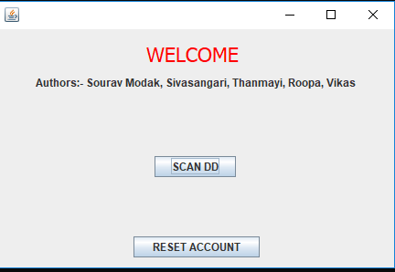
DEMO:

Slide 5
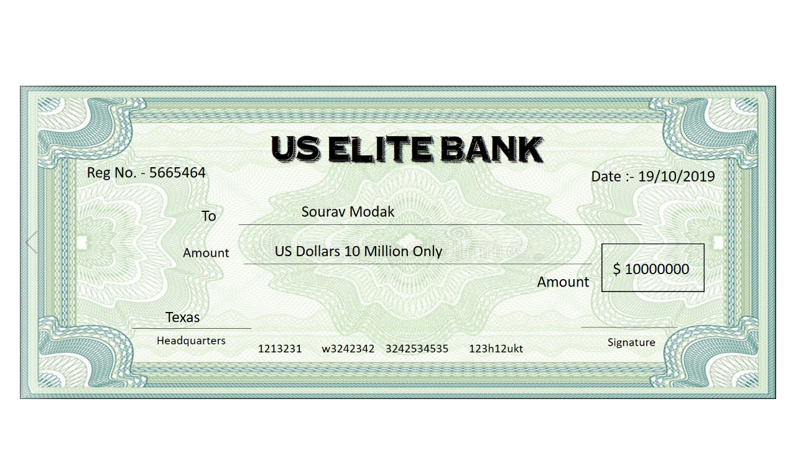
Scan DD:

Slide 6
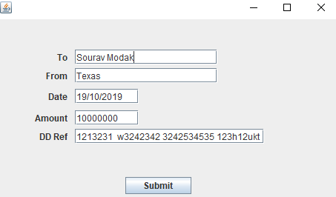
Image Processing:
After scanning the image, image processing is done and the details from the image is extracted.

Slide 7
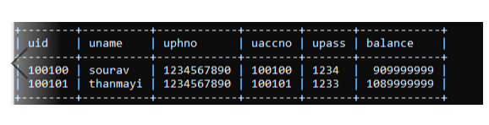
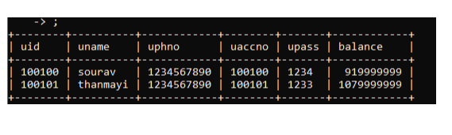
Output:
A sample SQL DB is used to check if transaction is successful.
Before Transaction: After Transaction:

Slide 8
Connect to T24:
These OFS messages have to be processed inorder to perform transaction in T24.
ENQUIRY.SELECT,,AUTHOR/123456//US0010001,%ACCOUNT,CUSTOMER.MNEMONIC:EQ=Texas
ENQUIRY.SELECT,,AUTHOR/123456//US0010001,%ACCOUNT,CUSTOMER.MNEMONIC:EQ=Sourav Modak
FUNDS.TRANSFER,/I/PROCESS,AUTHOR/123456,,TRANSACTION.TYPE=AC,DEBIT.ACCT.NO=Sourav Modak,DEBIT.CURRENCY=USD,DEBIT.AMOUNT=10000000,CREDIT.ACCT.NO=Sourav Modak,CREDIT.CURRENCY=USD

