Slide 1

Treecart
Presented by:-
ANIKET SARJINE (Roll no. = a 07)
Gaurav tilekar(roll no. = a 17)
Harshad borkar (roll no.=a 19

Slide 2
introduction
Treecart is the online nursery plant store is web based system that comfort and convenience of your homes. With this web based system customer can view the plants with details such as plants cost etc. carefully package and ship our plants to ensure they arrive at your doorstep in excellent condition. Treecart also provide ongoing customer support to answer any questions or concerns you may have, as we want your gardening experience to be enjoyable and successful.

Slide 3
Existing System
We analysis that many people’s want to buy plants and they have directly concern with nursery. Sometimes people do not know information about particular plant as well as sellers is not technically skilled. Also there is price comparison issue, because customers do not compare with different nurseries, and there are no online payment facilities are available only cash consumes. So in this case online nursery is a platform where solutions of this all problems are available.
In this existing system we need facilities like browse, research before buy and make online payments. Customer service is important, so there is advising, answering questions are important.
Also there is need to record information including customer’s name, address, and billing instructions for future reference or customer pleasant shopping experience.

Slide 4
Need For System
The need for an advanced nursery store system arises from various factors that can significantly enhance the customer experience and improve business operations. With the increasing popularity of online shopping, there is a growing demand for a nursery store system that allows customers to browse and purchase products conveniently from the comfort of their homes. An online nursery store system enables businesses to expand their customer base beyond their physical location. It allows customers from different geographical areas to access and purchase products, thereby increasing sales opportunities.: Unlike a physical store, an online system operates round the clock, providing customers with the flexibility to shop at any time that suits them. This convenience enhances customer satisfaction and encourages repeat purchases.

Slide 5
Scope of System
The scope of the Treecart Website encompasses a range of features and functionalities aimed at providing an exceptional online shopping experience for nursery products. The system focuses on the following aspects:
Product Management: The system allows administrators to add, edit, and remove nursery products. They can include details such as product descriptions, images, pricing, and inventory management. The system also supports categorization of products for easy navigation.
User Management: Users can create personal accounts to manage their profile information, view order history, and add to cart products. The system provides user registration and login functionality, ensuring a secure and personalized experience.

Slide 6
Modules / Functionalities
1) User Management Module:
Allows users to register, create accounts, and manage their profile information.
Enables user authentication and login functionality for secure access to personalized features.
Provides password reset and account recovery options.
2) Product Management Module:
Allows administrators to add, edit, and delete nursery products. It supports product categorization and management of product attributes such as descriptions, images, prices, and inventory.

Slide 7
3) Shopping Cart Module:
Allows users to add products to their virtual shopping cart.
Provides features for viewing and modifying the cart contents.
Calculates the total price and supports the ability to remove or update items.
4) Checkout and Payment Module:
Guides users through the secure checkout process.
Supports various payment methods, such as credit/debit cards, digital wallets, or cash on delivery.
Integrates with a payment gateway for secure transaction processing.

Slide 8
Operational Environment
Hardware Requirements:
Processor: Intel core i3 or above
RAM: 4GB
Hard Disk: 250GB
Software Requirements:
Front End: HTML, CSS & JavaScript
Operating System: Windows 10 and above.
Database: Xamp Server (SQL Server).
Back End : MYSQL

Slide 9
Proposed System
The proposed system aims to address the limitations of the existing system and provide an enhanced online shopping experience for customers.
Online Shopping Platform: The proposed system will be a comprehensive online platform where customers can browse, select, and purchase nursery products conveniently from anywhere, at any time.
User Accounts and Personalization: Customers will have the option to create personal accounts, enabling them to save their preferences, view order history, and receive personalized recommendations based on their browsing and purchasing patterns.

Slide 10
Shopping Cart and Secure Checkout: The system will feature a user-friendly shopping cart that allows customers to add products, review their selections, and proceed to a secure checkout process. Various payment options will be supported, ensuring a seamless and secure transaction experience.
Inventory Management: The system will incorporate real-time inventory management, ensuring accurate stock information. Customers will be informed promptly about product availability, minimizing the possibility of disappointment due to out-of-stock items.

Slide 11
Objectives of System
The objectives of the Treecart revolve around improving the customer experience, increasing operational efficiency, and driving business growth.
Enhance Customer Experience: The system aims to provide a seamless and convenient online shopping experience for customers, allowing them to browse and purchase nursery products with ease. Detailed product information, personalized recommendations, and user-friendly features will contribute to an enhanced customer experience.
Expand Customer Reach: By transitioning to an online platform, the system aims to expand the customer base beyond the limitations of a physical store. It will enable customers from different geographic locations to access and purchase nursery products, thereby increasing market reach and potential sales opportunities.

Slide 12
3) Enable Personalization: The system strives to personalize the shopping experience for customers by offering user accounts, saving preferences, and providing personalized recommendations. This objective aims to foster customer engagement, loyalty, and repeat purchases.
4) Improve Inventory Management: By implementing real-time inventory management, the system aims to maintain accurate stock information and minimize the occurrence of out-of-stock situations. This objective ensures customers have reliable information about product availability, reducing disappointment and improving overall satisfaction.
5) Achieve Business Growth: By offering an enhanced online shopping experience, expanding the customer base, and increasing customer satisfaction, the system seeks to drive business growth. This objective includes attracting new customers, increasing sales, and establishing the nursery store as a reputable and successful online retailer.

Slide 13
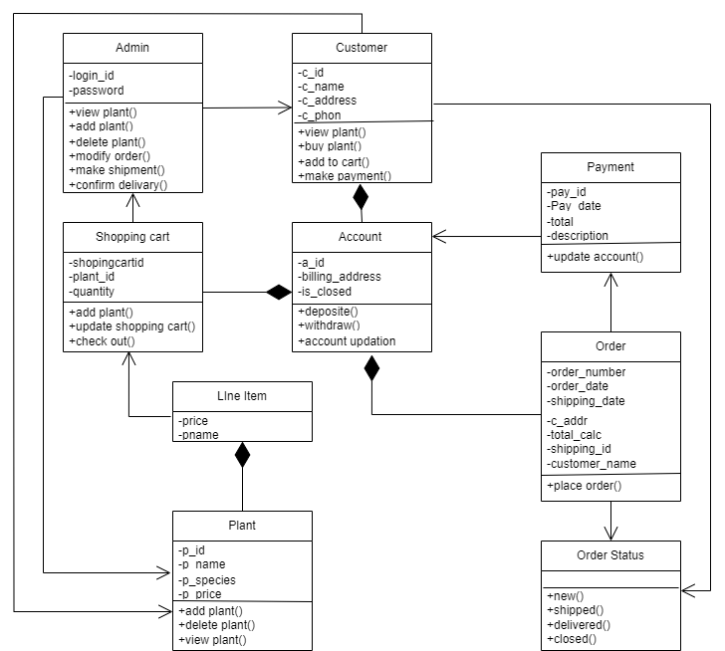
Class Diagram

Slide 14
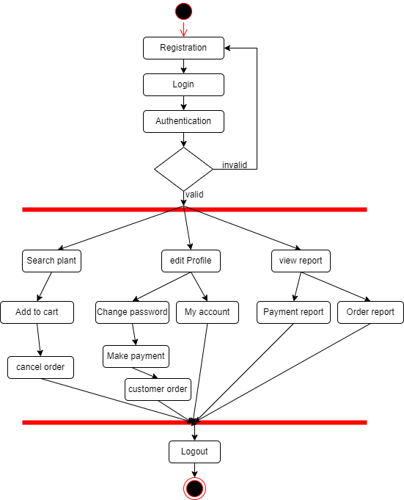
Activity diagram

Slide 15
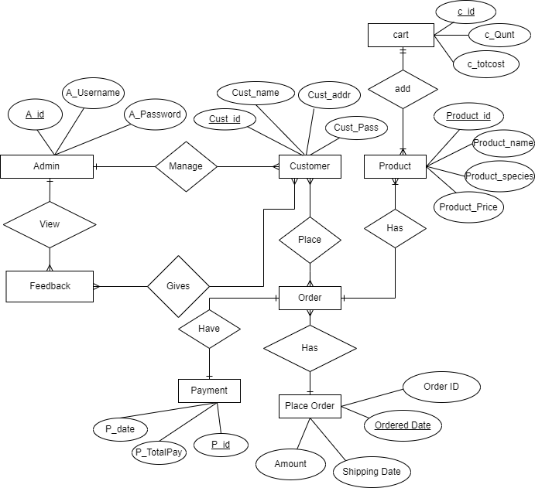
ER Diagram

Slide 16
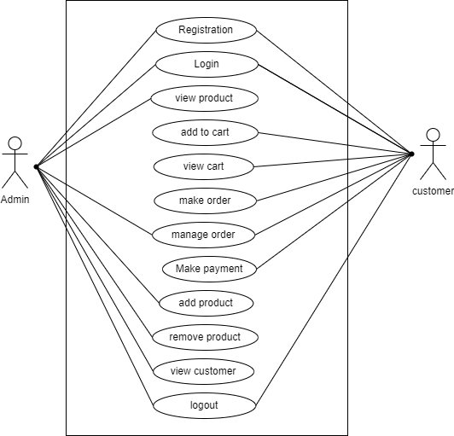
Use Case Diagram

Slide 17
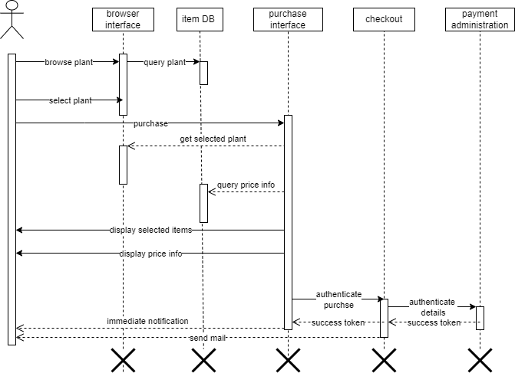
Sequence Diagrams

Slide 18
Conclusion
In conclusion, the proposed enhancement of the nursery store system aims to address the limitations of the existing system and provide an improved online shopping experience for customers. By leveraging technology and incorporating user-centric features, the enhanced system can overcome geographical constraints, expand the customer base, and stay competitive in the market.The introduction of an online storefront, mobile app, and real-time inventory management enhances customer accessibility and convenience. Personalized recommendations, streamlined checkout processes, and secure payment options contribute to a seamless and satisfying shopping experience. Additionally, the inclusion of plant care resources, customer reviews, and social media integration fosters engagement, education, and community-building among customers.
The proposed enhancements also consider the needs of administrators, offering tools for efficient product management, order processing, and data analytics. Integration with customer support channels ensures prompt assistance and issue resolution.

Slide 19
BIBLIOGRAPHY
Websites:
https://www.w3schools.com
https://www.javatpoint.com
https://www.codecademy.com
https://www.stackoverflow.com
YouTube video links:
https://youtu.be/5vzCjvUwMXg
https://youtu.be/dwVj_g3TpZ4
https://youtu.be/L5RpqspNAuc

Slide 20
THANK YOU …!

