Slide 1


K.RAMAKRISHNAN COLLEGE OF TECHNOLOGY
(AUTONOMOUS), TRICHY.
DEPARTMENT OF
COMPUTER SCIENCE AND ENGINEERING
20CS5501 DESIGN PROJECT-1
Batch No : 20
Date : 05.12.2024

Slide 2
Modernizing the Integrated Passport System: Enhancing Efficiency and Security with AI
Guided by Team
Ms. M. PAVITHRA.M.E., DHASHINESH K (811721104031)
HARIHARAN V M (811721104048)
BALAJI S (811721104302)

Slide 3
OBJECTIVE OF THE PROJECT
Streamline passport processing by automating and digitizing the application, verification, and issuance process.
Enhance security and data integrity by implementing secure data management practices and integrating with government databases.
Improve user experience with a user-friendly platform offering simplified applications, real-time updates, and minimized in-person visits.

Slide 4
ABSTRACT
This study explores modernizing integrated passport systems with AI to enhance efficiency and security. AI-driven solutions automate application processing, optimize workflows, and enable real-time biometric verification. Advanced fraud detection and cybersecurity tools mitigate risks, while seamless integration with border control systems facilitates secure traveler screening. AI provides actionable insights through data analytics, supporting informed policy-making. This leads to a more efficient, secure, and user-friendly passport system.

Slide 5
LITERATURE SURVEY
TITLE OF THE PAPER | AUTHOR (S) | PUBLISHER | PAPER GIST | TECHNOLOGY USED
The study of recent technologies used in E-passport system | Shivani Kundra; Aman Dureja; Riya Bhatnagar | 2014 IEEE Global Humanitarian Technology Conference - South Asia Satellite (GHTC-SAS) | The study examines recent technologies, including Artificial. | cryptographic security analysis of the epassport
Complexity in the delivery of product passports | Paul D Timms, Melanie R N King | 2023 18th Annual System of Systems Engineering Conference (SoSe) | The study explores the complexities and challenges in implementing product passports | idea of a digital product passport ‘ecosystem
The Electronic Passport | G. Matthew Ezovski; Steve E. Watkins | IEEE,Grapevine, TX, USA | The study examines the development, implementation, and benefits of electronic passports. | The selection of technologies remains questionable due to privacy and security concerns.
Operating System And Artificial Intelligence | Yifan Zhang,Xinkui Zhao,Jianwei Yin, Lufei Zhang,Zuoning Chen | IEEE Xplore, ACM Digital Library,ResearchGate,arXiv, Google Scholar | It explores the integration of AI into operating systems to enhance performance, security, and efficiency. | Machine Learning (ML), Deep Learning (DL), Natural Language Processing (NLP), Computer Vision,Reinforcement Learning

Slide 6
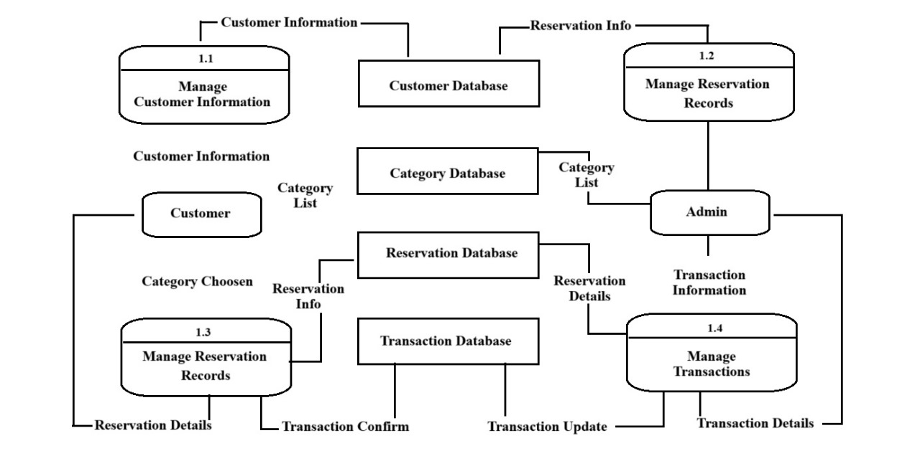
PROPOSED SYSTEM ARCHITECTURE

Slide 7
EXISTING SYSTEM ARCHITECTURE
1. Manual and Paper-Based Processes: The current passport application system in many countries relies heavily on manual, paper-based documentation, which leads to longer processing times, increased chances of human error, and delays in passport issuance.
2. Decentralized Systems: Different governmental agencies involved in passport issuance, such as immigration, police for background checks, and other verification bodies, often operate in isolation. This lack of integration slows down the overall process as data is transferred manually between systems.
3. Limited Automation: In most cases, passport issuance still requires significant manual intervention, including document verification and status updates. This lack of automation can lead to inefficiencies, delays, and the need for frequent in-person visits by applicants.
4. Security Concerns: The existing system often lacks robust security measures such as real-time identity verification, leading to vulnerabilities such as identity theft, document forgery, and unauthorized access to sensitive personal data.
5. User Experience Challenges: The existing systems are often not user-friendly, requiring multiple visits to passport offices and long waiting times. There is also limited transparency regarding the status of the application, leaving applicants uncertain about the progress of their requests.

Slide 8
SOFTWARE AND HARDWARE REQUIREMENTS
HARDWARE
SOFTWARE
Smart Card Readers
Networking Equipment
Data Center Requirements
Operating System
Database Management System(sql,php)
HTML5, CSS, JavaScript

Slide 9
MODULES
Applicant Management Module
Biometric Data Capture and Verification Module
Document Verification and Validation Module
Passport Issuance and Printing Module
Security and Identity Management Module

Slide 10
SUMMARY OF MODULE-1
Applicant Management Module
The Applicant Management Module oversees the passport application lifecycle, enabling online submission of details and required documents.
It provides features for form validation, document upload, real-time status tracking, and automated notifications via email or SMS.
The module ensures secure, role-based access control for administrative staff and provides a seamless user interface for end-to-end management of passport applications.

Slide 11
SUMMARY OF MODULE-2
Biometric Data Capture and Verification Module
The Biometric Data Module captures and verifies biometric data, such as fingerprints, facial recognition, and iris scans, to establish and verify an applicant's identity.
The system integrates with national and international biometric databases for real-time cross-checking and authentication of applicant data.
Biometric data is securely stored and transmitted, and embedded in the final passport document, ensuring compliance with international security standards.

Slide 12
SUMMARY OF MODULE-3
Document Verification and Validation Module
The Document Verification and Validation Module ensures authenticity of submitted documents using Optical Character Recognition (OCR) technology and fraud detection tools.
The module integrates with national and international databases for cross-verification of records and supports manual review by authorized personnel.
This ensures only verified and authentic applications proceed to the next stage, maintaining the integrity of the passport application process.

Slide 13
SUMMARY OF MODULE-4
Passport Issuance and Printing Module
The Passport Issuance and Printing Module oversees the secure generation of passport details, including biometric information, after applicant data verification.
The module incorporates multiple approval levels, security checks, and secure printing processes, including holograms and RFID chips, to ensure passport authenticity.
The module also manages passport delivery tracking, notifying applicants when their passport is ready, ensuring an efficient, secure, and traceable process.

Slide 14
SUMMARY OF MODULE-5
Security and Identity Management Module
The Security and Integrity Module ensures passport system security through multi-factor authentication, role-based access control, and advanced encryption protocols.
Sensitive data, including biometrics and personal information, is protected at rest and during transmission, with integration for external background checks and identity verification.
Real-time monitoring tools, intrusion detection systems, and audit trails track system activities, identifying and addressing suspicious behavior swiftly.

Slide 15
RESULTS AND DISCUSSION
Modernizing the integrated passport system with AI enhances efficiency, security, and user experience. AI-driven solutions automate application processing, reducing errors and wait times through tools like OCR. Advanced biometric verification strengthens identity authentication, while machine learning models detect fraudulent activities. AI integration with border control systems ensures seamless traveler screening and real-time risk assessment. AI supports data-driven insights for policy-making, analyzing trends in travel demand and regional passport issuance. Leveraging AI makes the passport system more secure, efficient, and future-ready.

Slide 16
CONCLUSION
An integrated passport system streamlines the passport issuance process, ensuring efficiency, security, and accessibility for applicants and authorities.
The system combines essential modules, including applicant management, biometric data capture, and document verification, to enhance accuracy and reliability.
Advanced technologies like biometric verification, OCR, and encryption ensure seamless and secure identity validation.
Automated workflows, real-time tracking, and secure communication optimize operational efficiency while maintaining stringent data protection standards.
The integrated passport system maintains authenticity and data protection standards, ensuring a secure and efficient passport issuance process.

Slide 17
THANK YOU

