Slide 1




ACADEMIC INSTITUTE MANAGEMENT SYSTEM

Slide 2



Features
Collaborate –
Faculty Student
Finance Management
Assessments
Inventory
Management
Student Registration
Administration
Transportation
Employee Parents
Profile
Library Management
Welcome Desk
Cloud Hosted
Mobile
Call Us
+91-888-333-1418
Visit Us
www.yashams.com
Mail us sales@yashams.com

Slide 3
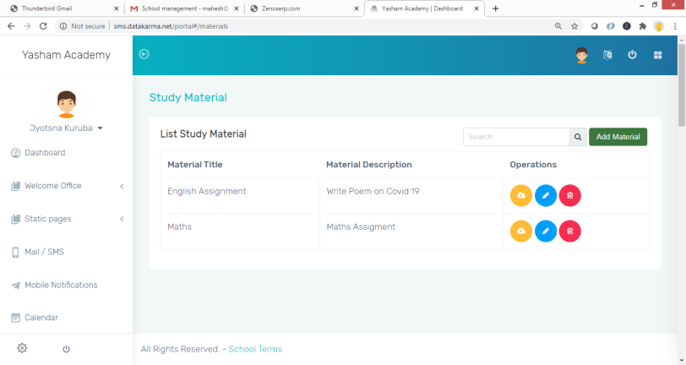
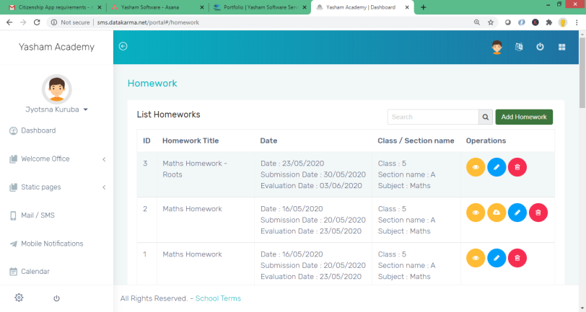
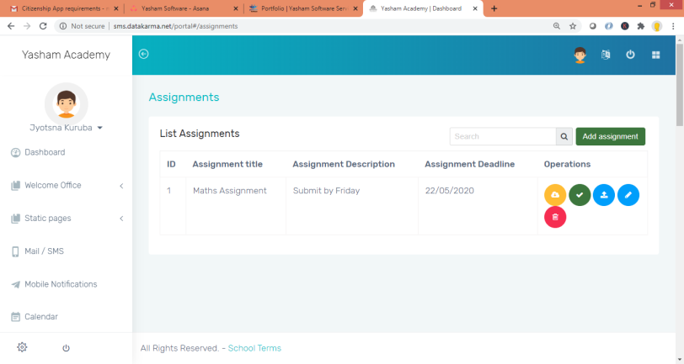
Collaborate – Faculty Student
Faculty can collaborate with students by sharing the Study material, Home work, Assignments and conducting Online Examinations through this System in this pandemic situation, so that your students don’t miss out on their academic year.
Study Material
Faculty can upload Study material to their students for their respective classes.
Students can download the material and read through their respective subjects.
Home Work
Faculty can upload homework for their students for their respective classes.
Students can complete their homework and share it with teacher.
Assignments
Faculty can provide assignments for their students for their respective classes.

Slide 4
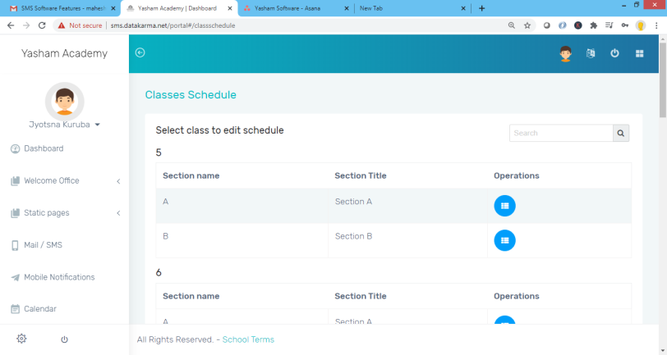
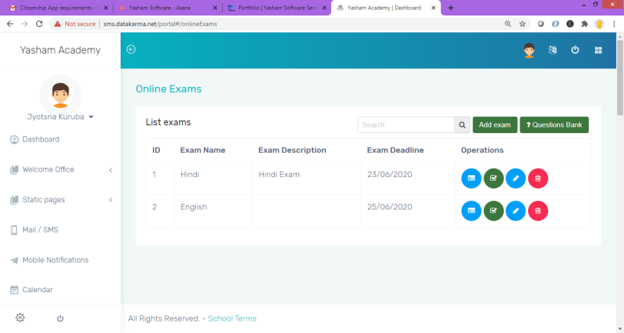
Assessments
Faculty can manage class and examination schedule; and Conduct Exams online.
Manage question papers by course and class.
Class Schedule
Manage class schedule across grades, courses and sections.
Exam Schedule
Faculty can manage the examination schedule by course and class.
Online Exams
Online examinations can be conducted through this portal. Students can login and take the exam.
It allows Faculty to upload questions for online exams. The questions can be objective and descriptive

Slide 5
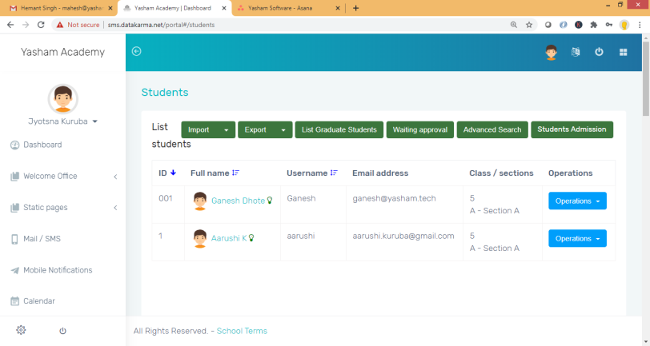
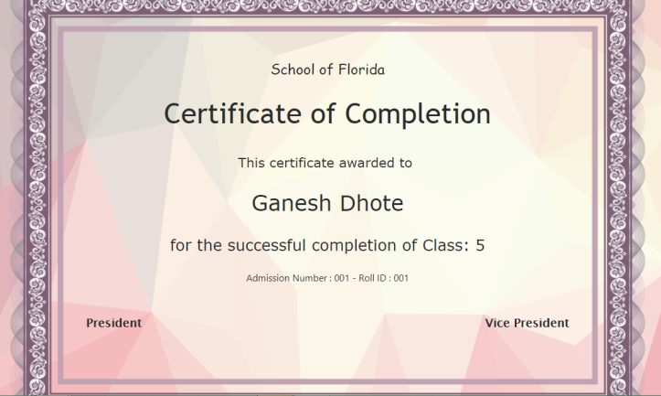
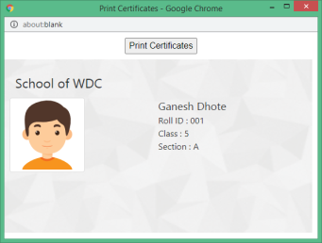
Student Registration Management
Manage your students profile and the services subscribed like Transport and Hostel.
Student Registration
Register your students and manage their profile like medical history and documents.
Manage services that student has subscribed for like Transport and Hostel.
Student Services
Administration can generate Course Completion Certificates, Mark Sheet of a student and their Identify cards for the campus.

Slide 6
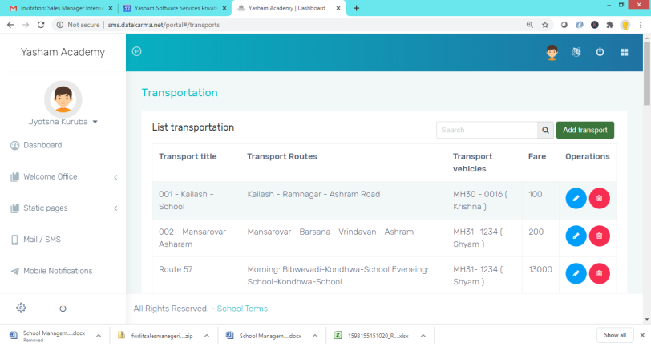
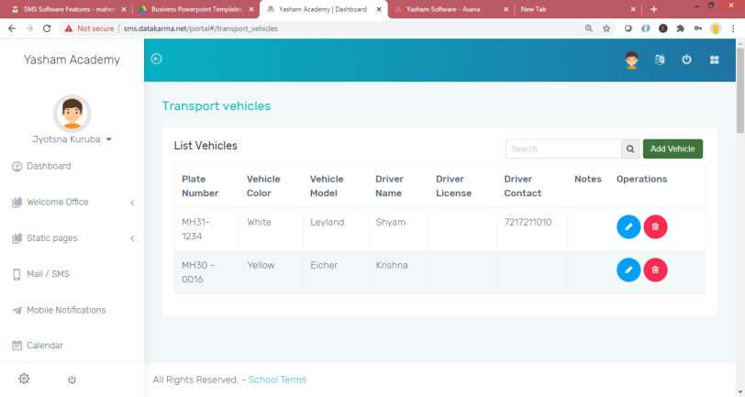
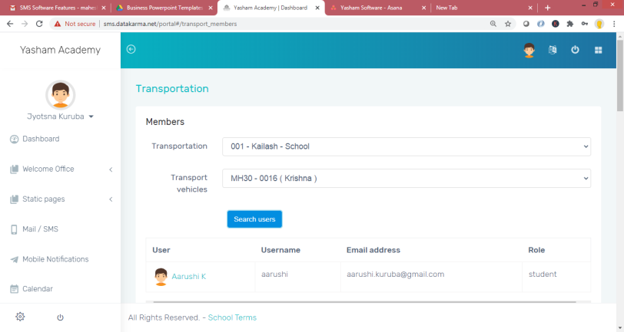
Transportation Management
Transport department can manage the schedules, routes, timings, vehicles using Transportation Module.
Transport Routes
Manage Transportation route details like vehicles that are assigned to the route and the fare for the route.
Manage the vehicle information and the driver information.
Vehicles
Manage vehicle and driver information including Driver Name and Contact number.
People on a Route
Manage faculty, staff and students subscription to transport facility for a specific route.

Slide 7
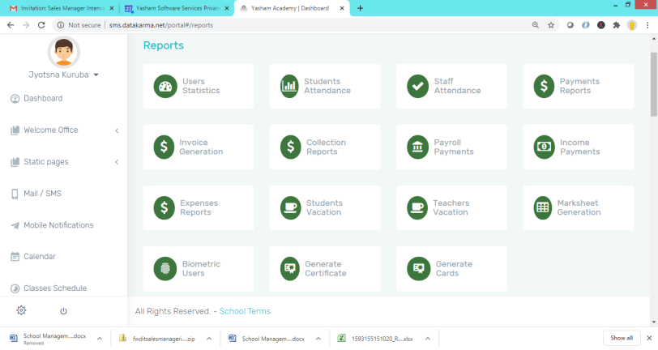
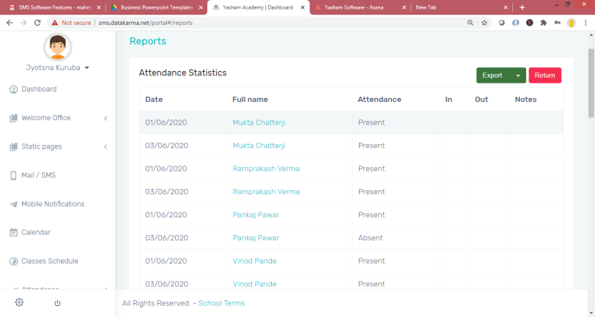
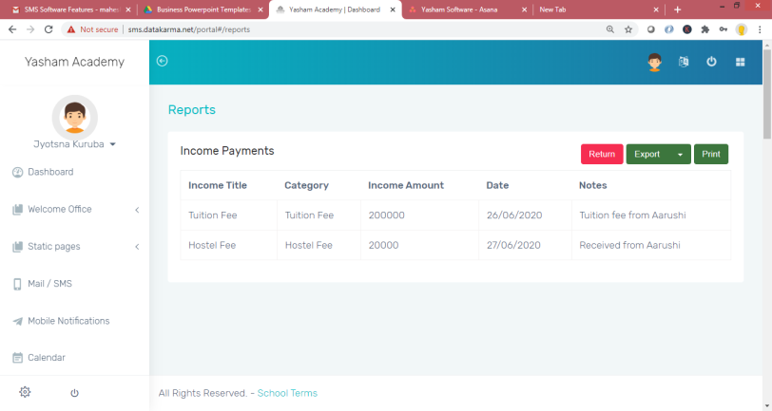
Administration
Generate various Administrative reports for Head of the Institute, Administration and Finance Department.
Reports
Generate reports related to Attendance and vacation of Students and teachers.
Generate Finance reports like Revenue, Expense, Payments, Invoice, Fee Collection Reports and Salary Slips.
Attendance and Leave Report
Generate Staff Attendance report for a specified duration.
Export the report in PDF and Excel formats.
Finance Reports
Generate Income Report, Collection Report, Expense Report etc. Also, generate pay slip of the faculty and staff.

Slide 8
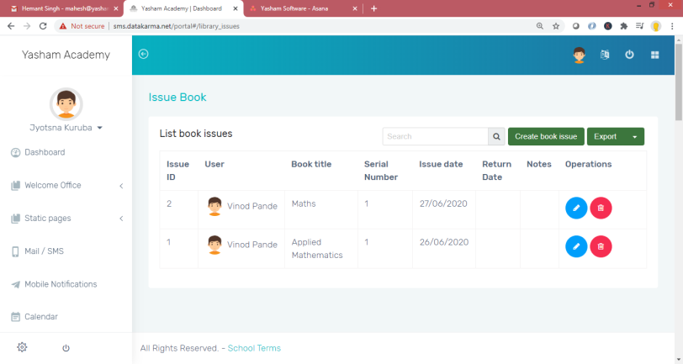
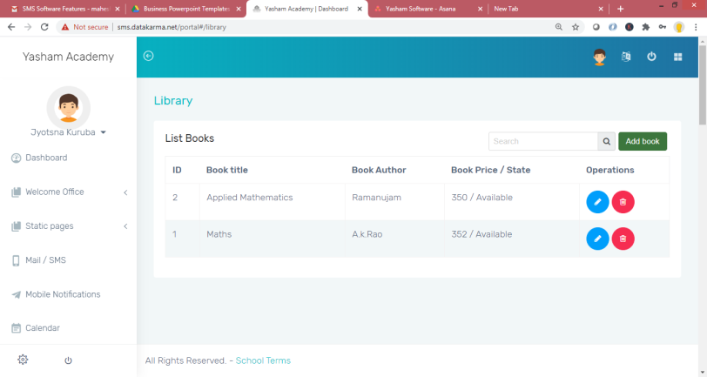
Library Management
Manage your library book issues and returns seamlessly
Book Issue and Return
Manage the list of books in library and Issue and return of books to faculty and students.
Book Information
Manage all books information available in library, with author, price and number of books available. Also, Manage shelf in which book is available.

Slide 9
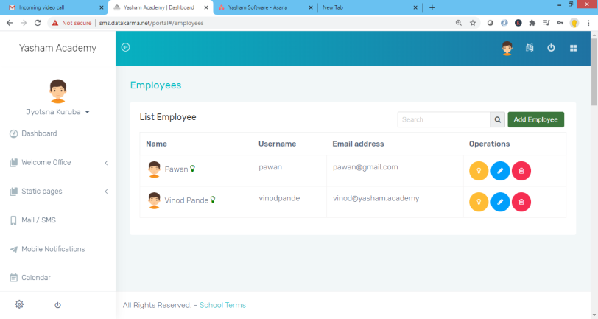
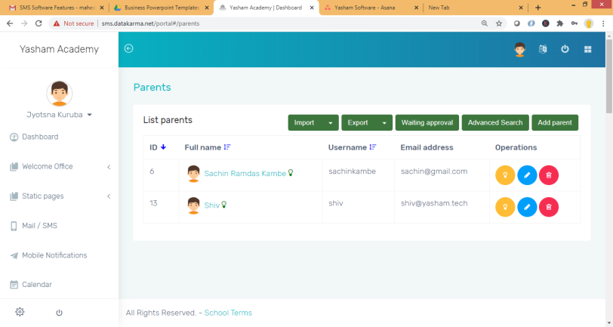
Profile Management
Manage your Faculty, Staff and Parents information.
Employees
Manage Faculty and Staff information with respective privileges.
Manage departments of the faculty and their designations.
Parents
Manage Parents information of your students to connect with them when required.

Slide 10
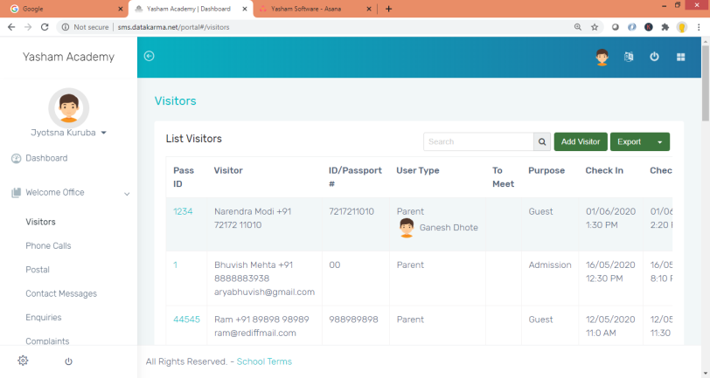
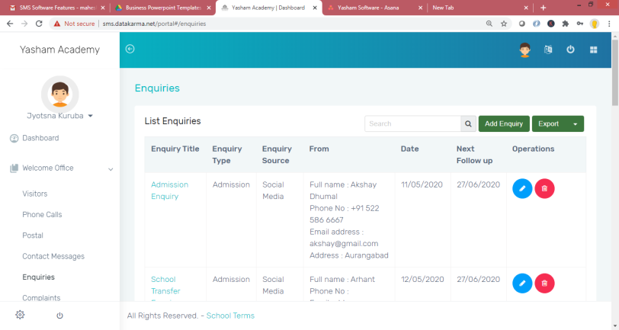
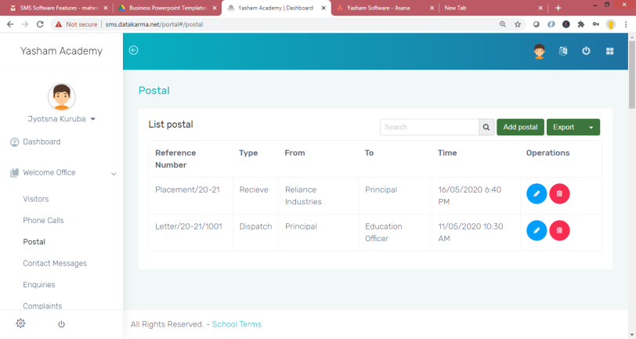
Welcome Desk
Manage all your front desk activities like visitor information, Phone calls, Posts/Couriers, Enquiries and Complaints, seamlessly.
Visitors
Manage visitor information to your institute for security purpose.
Enquiries
Manage all parent and student enquiries/complaints received at your front desk for admission, transfer etc., to track and close.
Postal
Manage all posts/couriers received and sent to parents, student and your suppliers.

Slide 11
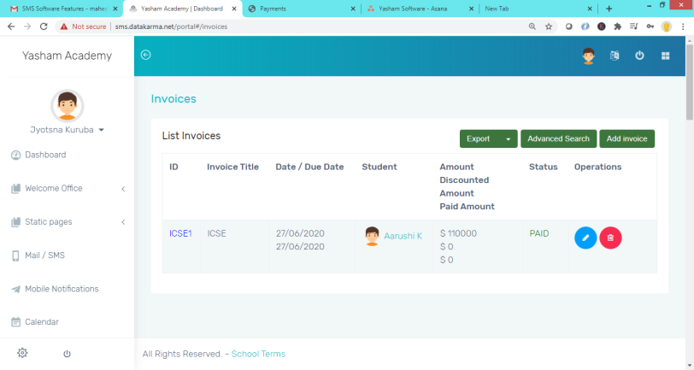
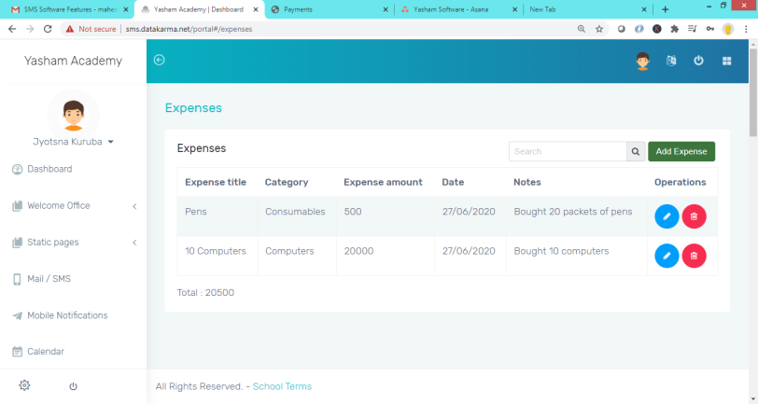
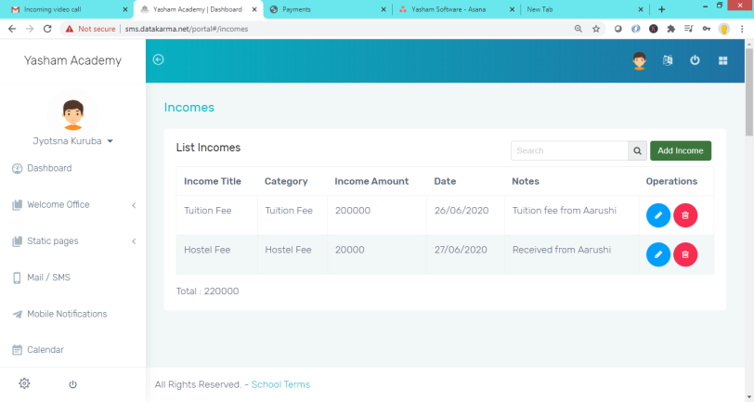
Finance Management
Manage all your Institute Accounts including fee collection, expenses and Income.
Invoices
Manage Fee invoices of students enrolled.
Manage your fee information and any discounts applicable for one-time payment or a policy for siblings.
Expenses
Manage your expenses related to capital expenditure or operational expenditure.
Income
Manage your Income from various sources like Tuition fee, Hostel fee and Transportation fee.

Slide 12
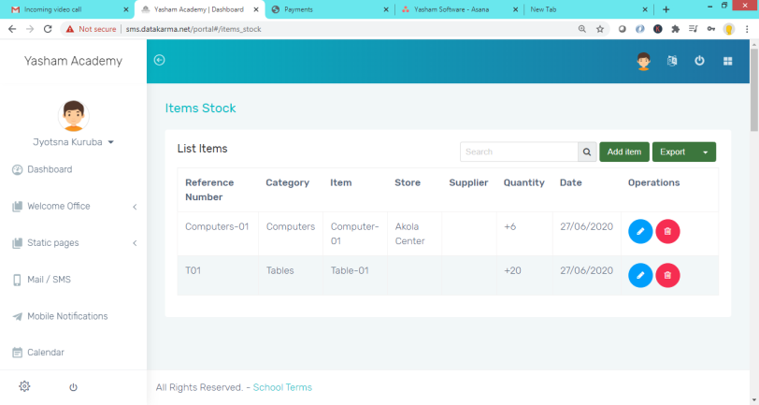
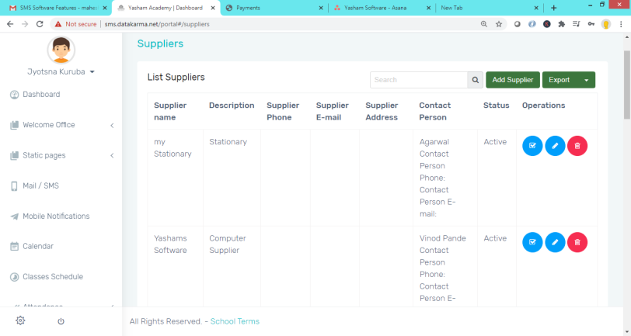
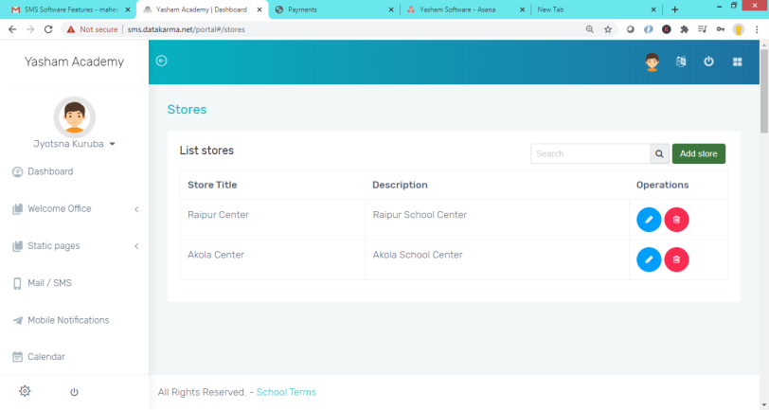
Inventory Management
Manage all your Institute Inventory of items like computers, tables, chairs, consumables and vendors.
Stock
Manage inventory of Computers, chairs, tables, consumables etc in one place.
Manage consumables issued to faculty or staff (or) track any items issued and received.
Suppliers
Manage your expenses related to capital expenditure or operational expenditure.
Stores
Manage stores across your schools at various cities or multiple centers.

Slide 13


Call Us
+91-888-333-1418
Visit Us
www.yashams.com
Mail us sales@yashams.com

