Slide 1
ComicSonic Pages to Audio, Awesomeness Unlocked
Sunny Raj Myson
Divyansh Gupta
Jaykumar Suthar
/
Devhacks X Strategy

Slide 2
Introduction
Experience comics like never before!

Slide 3
We have developed an LLM enabled application that converts comics and manhwa into narrated audio stories. This allows users to listen to their favorite comics instead of reading them, making the content more accessible and immersive. 🚀

Slide 4
Problem Statement
Comics Are Stuck in Silence!

Slide 5
Problem Statements
Manhwa takes years to be converted into anime and some of them just don't make it into animation. It is clear that the industry is ever growing and now has market share of $8B. We wish to provide a new means to enjoy these comics through audio books as there are growing number of users who wish to consume this type of entertainment over narrations.

Slide 6
Objectives
Tangible Results:
Create a seamless AI-driven comic narration experience.
Expand accessibility for non-readers and multitasking audiences.

Slide 7
Solution
Develop a user-friendly web application that leverages LLMs and Google Cloud Text To Speech to transform comics/manhwa into Narrations-audio File

Slide 8
Tech Stack
Front-end: Next.js
Back-end: Python
AI & APIs: Gemini API, Google Text-to-Speech API

Slide 9
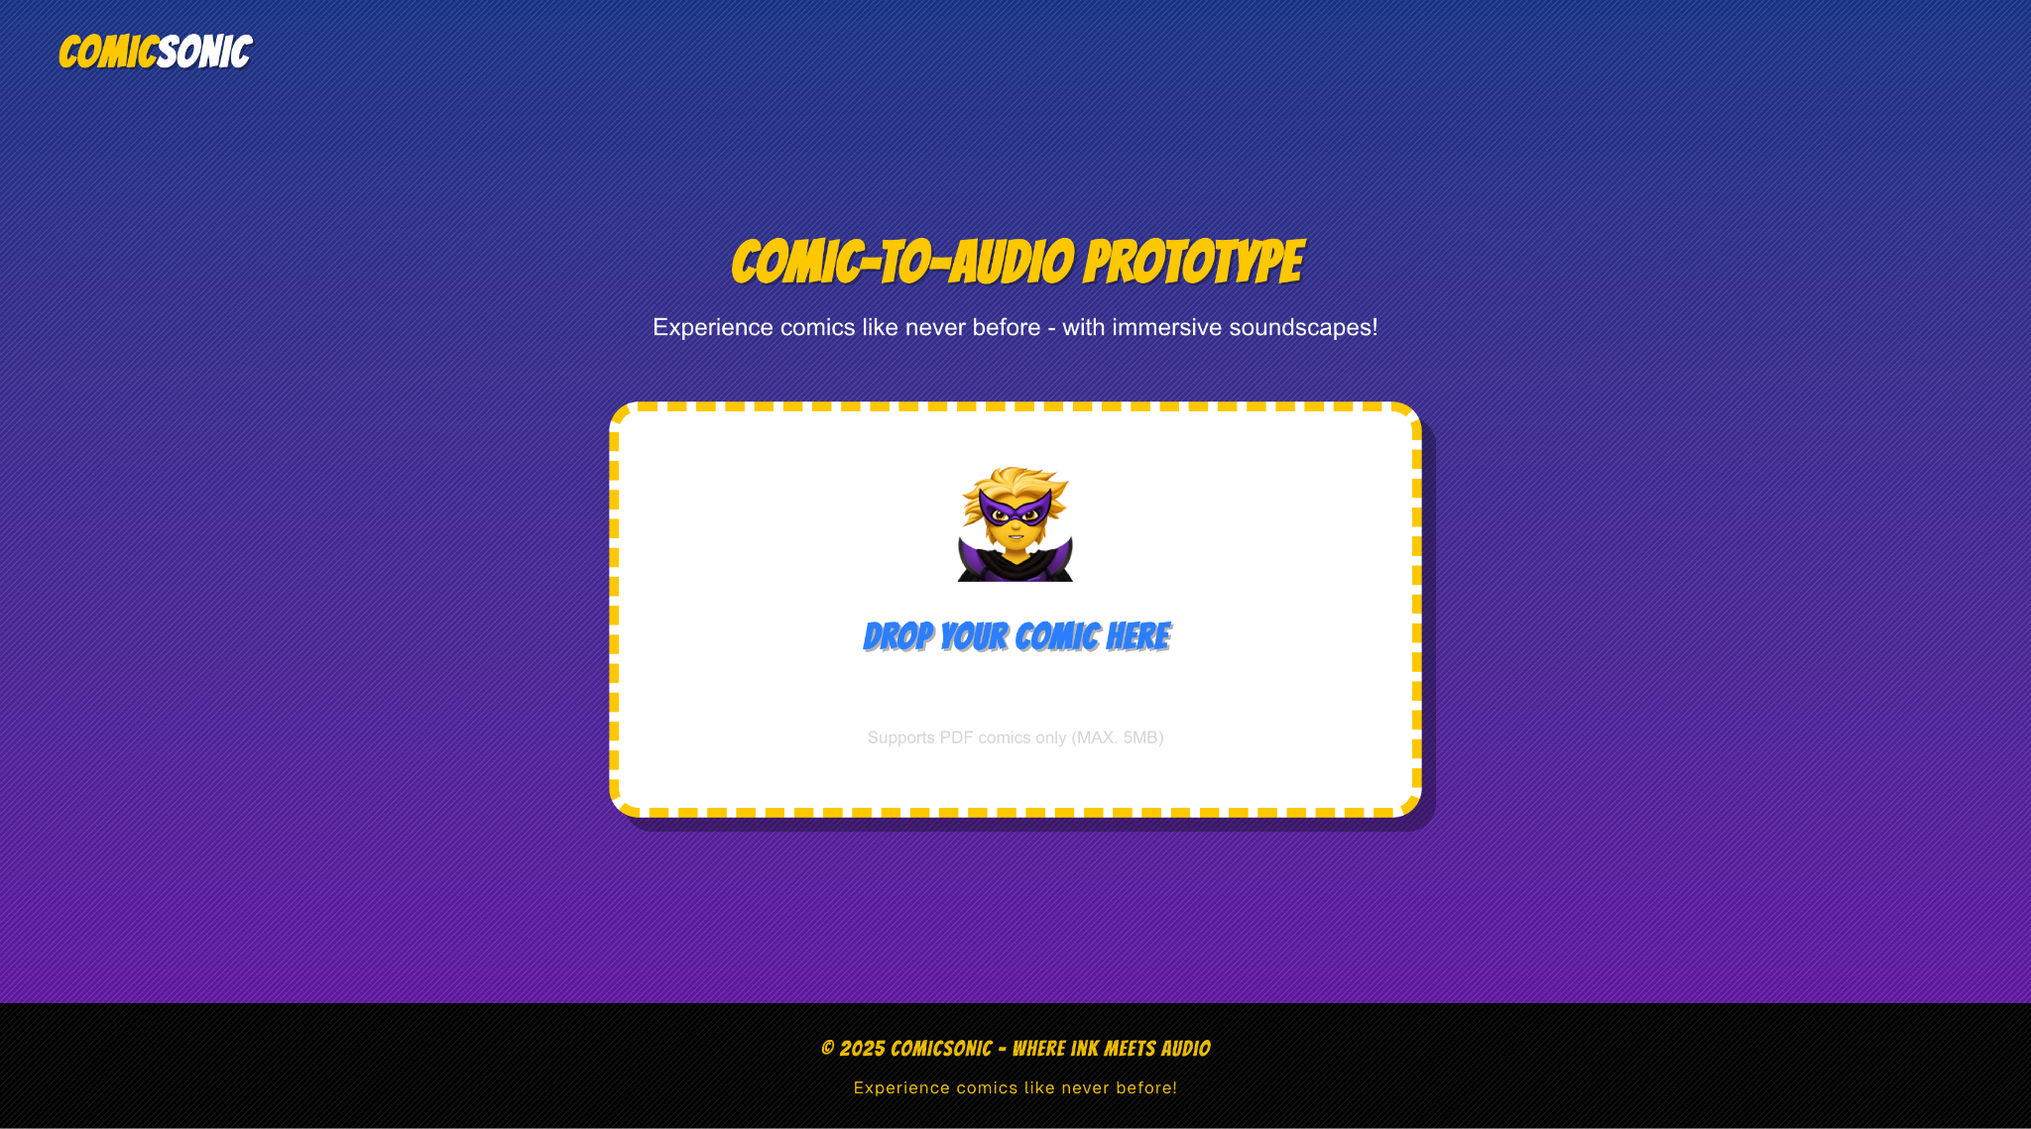
MY WEBSITE
Turn comic PDFs into immersive audio experiences with voices. Just drag, drop, and experience stories like never before!

Slide 10
Benefits
Converts static comic content into engaging audio experiences.
Encourages more users to consume digital comic content.
BOOM!!!!

Slide 11
ACCOMPLISHMENTS
Comics to audiobook Microservice – Powered by Gemini API + GCTTS (local processing)
Multi-Voice Narration – Male & female voices for dynamic storytelling
95% Accuracy – Consistent transcriptions via optimized prompt engineering

Slide 12
Whats Next?
Custom Voices - Assign unique tones to characters
Go Global - Support more languages
We are looking forward to deploy our backend on AWS EC2 and front end on vercel. To enable scalability.

Slide 13

THANK YOU

