Slide 1

Manish Kumar
Trained By - Durgesh Sir
Manager - Neeraj Sir

Slide 2
Spring Boot
● Create stand-alone Spring applications
● Inbuilt Embed Tomcat etc
● Provide opinionated 'starter' dependencies to simplify
your build configuration
● Automatically configure Spring and 3rd party libraries
whenever possible
● Absolutely no code generation and no requirement for
XML configuration

Slide 3
MyStore Application
An E-Commerce application with functionalities :-
create an account
add products to the cart
order items in a safe, secure and reliable way

Slide 4
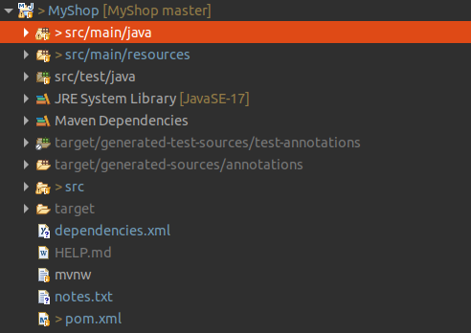
PROJECT DESIGN

Slide 5

What are Annotations?
Spring Annotations are a form of metadata that provides data about a program. Annotations are used to provide supplemental information about a program.

Slide 6
Annotations Used
@SpringBootApplication
@Configuration
@RestController
@RequestMapping
@Entity
@RestControllerAdvice
@Service

Slide 7
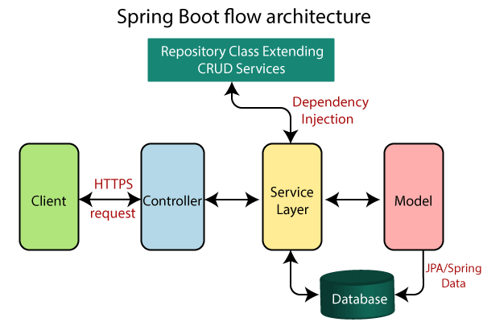

Slide 8
@Controller
In Spring Boot, the controller class is responsible for processing incoming REST API requests, preparing a model, and returning the view to be rendered as a response

Slide 9
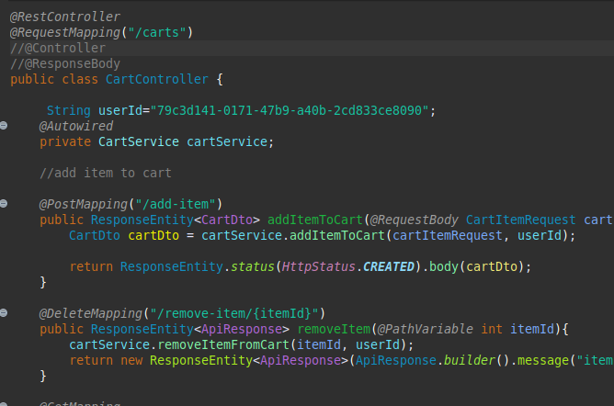

Slide 10
@Service
Spring boot service component is defined as a class file that includes the @Service annotation and allows developers to add business functionalities.

Slide 11
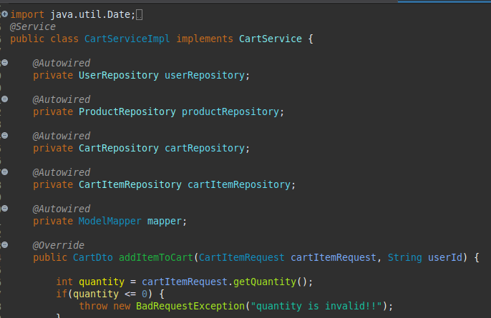

Slide 12
Repository
JPA Repository is mainly used for managing the data
in a Spring Boot Application.
public interface UserRepository extends JpaRepository<User, String> {
// custom ﬁnder methods
}

Slide 13
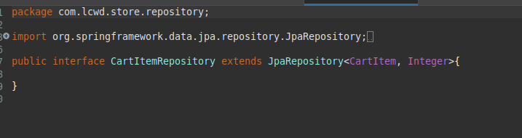

Slide 14
Global Exception Handling
In Java, exception handling is done by try, catch blocks
but spring boot also allows us to provide customized
global exception handling where we need not to add try
catch block everywhere, we can create a separate class
for handling exceptions and it also separates the
exception handling code from business logic code.

Slide 15
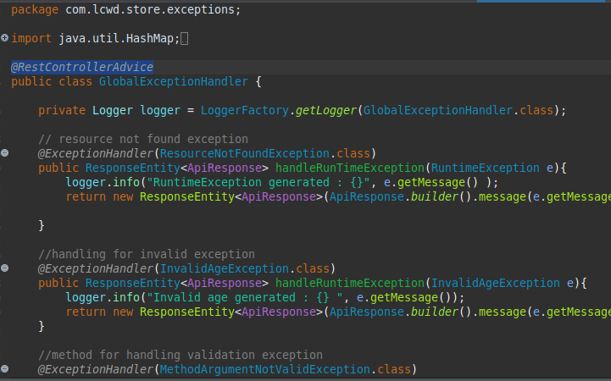

Slide 16
Java Persistence API (JPA)
It is a Java specification that gives some functionality
and standard to ORM tools. It is used to examine,
control, and persist data between Java objects and
relational databases. It is observed as a standard
technique for Object Relational Mapping.

Slide 17
Hibernate
The main feature of Hibernate is to map the Java classes to
database tables. Following are some key features of Hibernate :
● Hibernate is an implementation of JPA guidelines.
● It helps in mapping Java data types to SQL data types.
● It is the contributor of JPA.

Slide 18
JPA vs Hibernate
The major difference between Hibernate and JPA is that
Hibernate is a framework while JPA is API specifications.
Hibernate is the implementation of all the JPA guidelines.

Slide 19
Data Transfer Object (DTO)
In Spring Framework, Data Transfer Object (DTO) is an
object that carries data between processes.
When we’re
working with a remote interface, each call is expensive.
As a result, we need to reduce the number of calls. The
solution is to create a Data Transfer Object that can hold
all the data for the call.

Slide 20
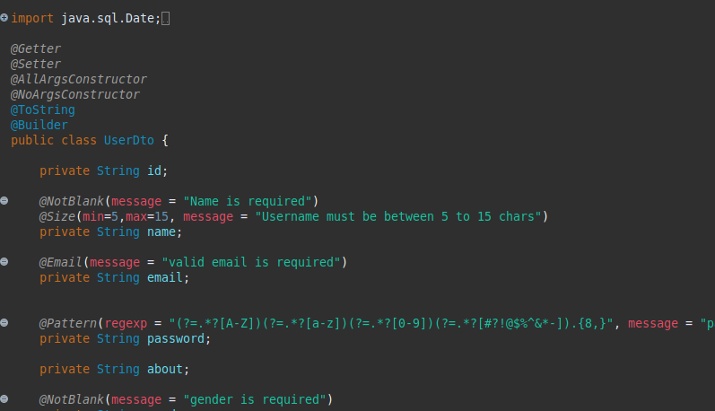

Slide 21
Spring Security and JWT
JSON Web Token or JWT, as it is more commonly called
is an open Internet standard (RFC 7519) for securely
transmitting trusted information between parties in a
compact way. The tokens contain claims that are
encoded as a JSON object and are digitally signed using
a private secret or a public key/private key pair.

Slide 22
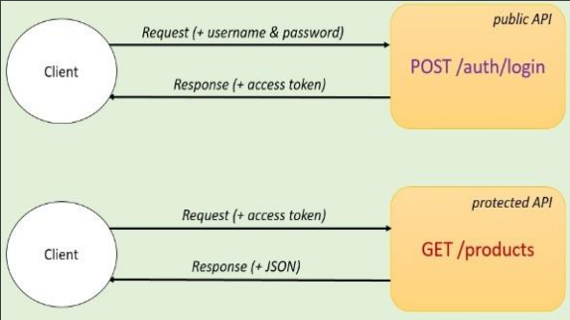

Slide 23
Swagger
Swagger is an open source project used to generate
the REST API documents for RESTful web services.
It provides a user interface to access our RESTful
web services via the web browser.

Slide 24
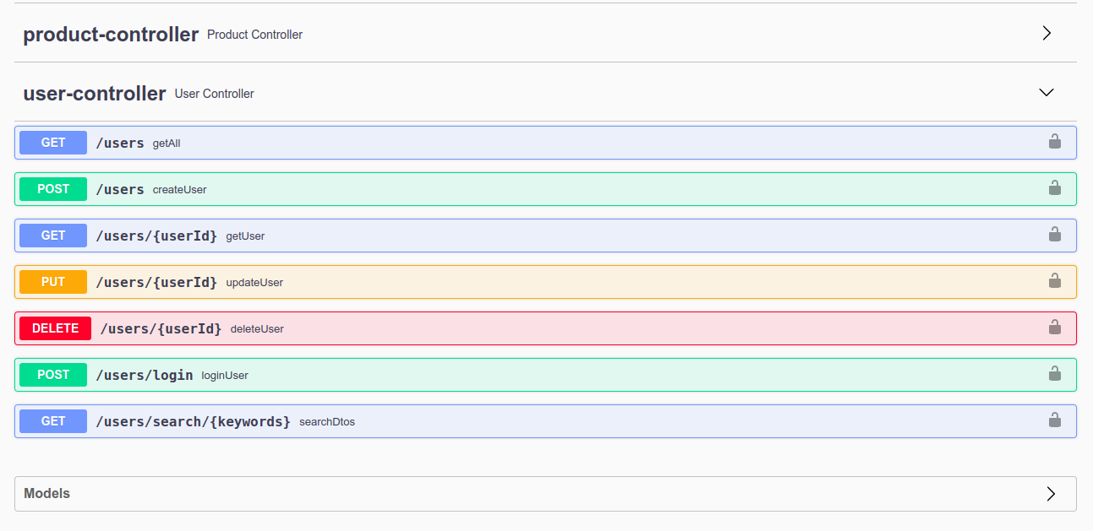

Slide 25


