Slide 1
Generative adversarial network
Presented by Deepak Rana Magar & Sachit Khadka Reviewed by Ananda Bhusal, Sibindra Timalsina, Bhargav Adhikari, Prajwal Joshi

Slide 2
AGENDA
Introduction
Components of GANs
Training a GAN
Application of GANs
Advantages & Future of GANs
Conclusion

Slide 3
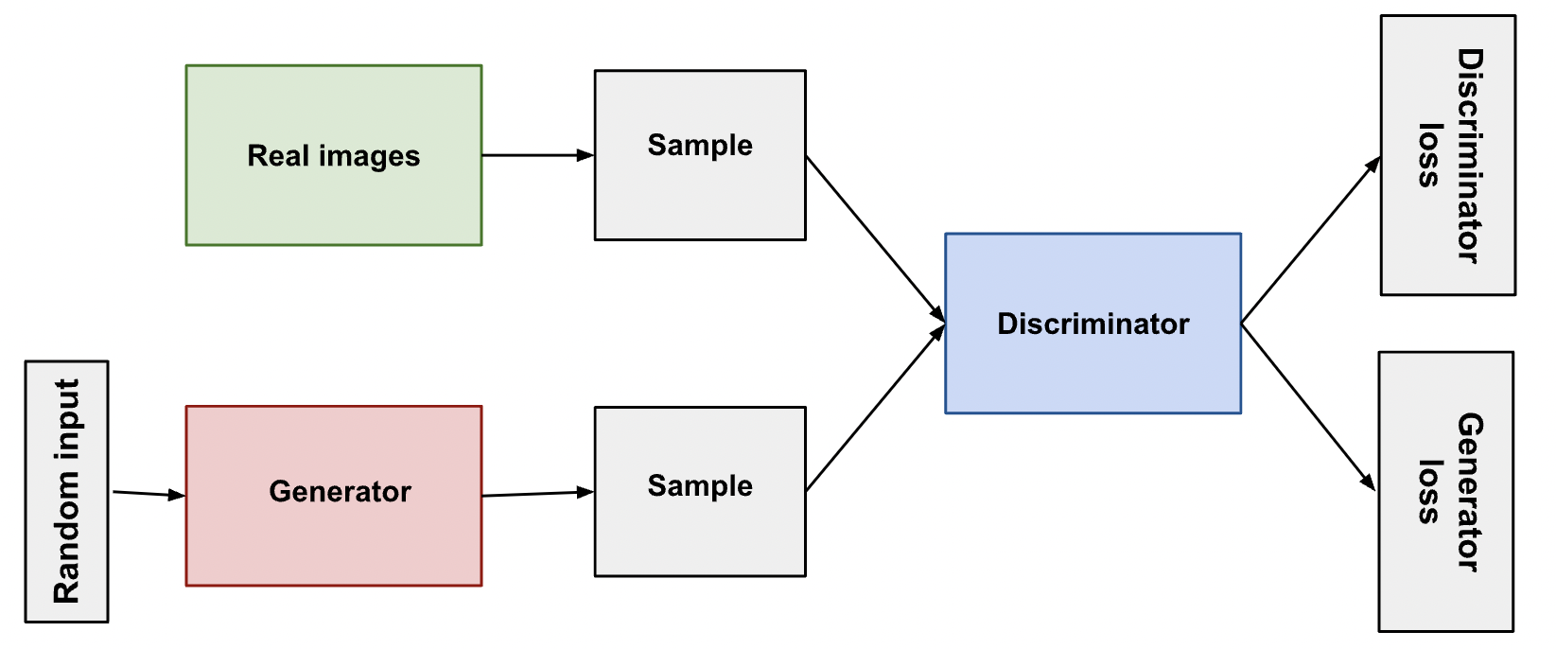
INTRODUCTION
The concept of GANs was first purposed by Ian Goodfellow & his team in 2014.
GANs is an approach for generative modelling using Deep Learning methods. (i.e., Convolutional Neural Network).
GAN is a type of artificial intelligence algorithm that is used to generate synthetic data that is like a training dataset.
GANs are composed of two neural networks: a generator network and a discriminator network.

Slide 4
PRIMARY GOALS
To Understand scope of Generative Adversarial Network

Slide 5
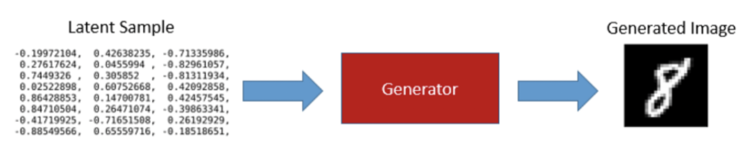
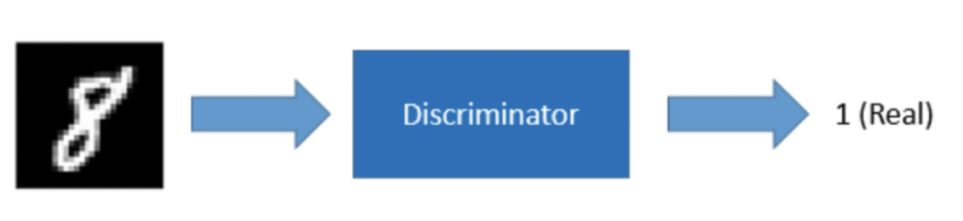
Components of gan
Generator
Discriminator
It is responsible for generating new, synthetic data samples, but do not necessarily exist in the real world.
​It tries to produces realistic data samples till the discriminator would not be able to distinguish from real samples.
It is responsible for determining whether a given data sample is fake or real.
It takes in a data samples as input and produces a probability score as output, indicating the likelihood that the input sample is real.

Slide 6
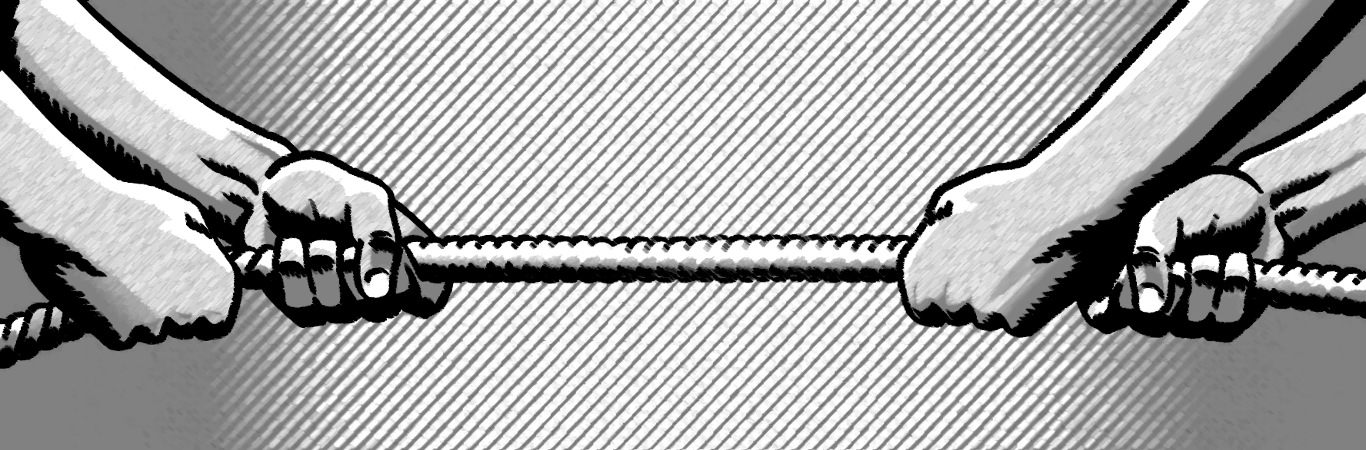
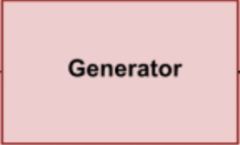
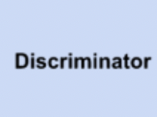
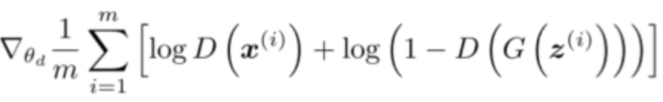
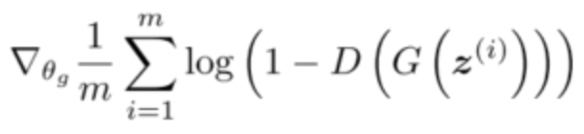
Training a gan
Adversarial Training
GENERATOR
DISCRIMINATOR

Slide 7
APPLICATION OF GAN
By the help of GANs, Distorted Images can be restored into HD quality.
Image to Image Translation
It allows us to use algorithms to convert day into night, summer into winter in the picture.
Text to Image Synthesis
It helps use to implement visualization of things that are being described.
Video Generation
Text to Video Synthesis
Image to Video Synthesis
Video To Video Synthesis
It can create very realistic looking images with the help of its algorithm.
Pixel Restoration
Photograph Generation

Slide 8
Advantages of gan
Q1
It can generate Generate Data.
Q2
It is unsupervised learning method.
Q3
It is more robust due to improved data diversity.
Q4
Fewer Data requirement.

Slide 9
Future of gan
Q1
It can improve to ease the training process avoiding mode collapse.
Q2
It can be better at image and video generation, natural language processing, etc.
Q3
It can also be used for 3D modeling.
Q4
GANs also can be combined with other forms of AI to generate new technologies.

Slide 10
conclusion
In this presentation, We were able to learn about:
GANs Network’s: Generator, and Discriminator
Their workings.
Applications, Advantages and Future of GANs
Implementation of GAN using Keras.

Slide 11
THANK YOU
FEEDBACKS

