Slide 1
Activation function
Presented by:
Anjeel Chaudhary 191736
Ishan Subedi 191710

Slide 2
Introduction
It is a type of machine learning algorithm
Design to recognize patterns.
Make predictions or decisions based on input data.
Main purpose is to perform tasks such as image or speech recognition, natural language processing, and decision making.

Slide 3
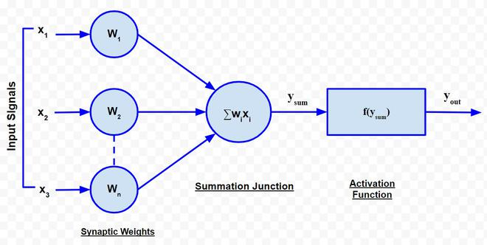
Introduction
It use hidden layer as well as output layer.
Decide whether a neuron should be activated or not.

Slide 4
Types of Activation Function
Identity Function:
Used as an activation function for the input layer.
It is the linear function having form:
As obvious, the output remains the same as the input.

Slide 5
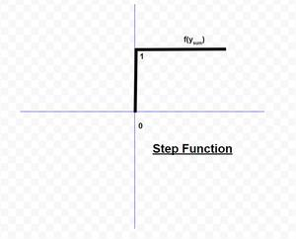

Types of Activation function
Step function:
It is a commonly used activation function.
From diagram;
It gives 1 output, when the input is
either 0 or positive.
It gives 0 output ,when the input is
negative.
Expressing it mathematically,

Slide 6
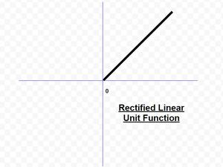

Types of Activation Function
ReLU(Rectified Linear Unit) Function :
It is the most popularly used activation function in the areas of convolutional neural networks and deep learning.
It is of the form:

Slide 7
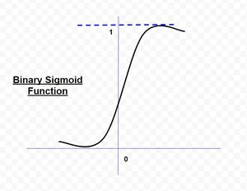
Types of Activation Function
Sigmoid function:
- A binary sigmoid function is of the form:
where k = steepness or slope parameter,
-The slope of origin is k/4.
-As the value of k becomes very large, the
sigmoid function becomes a threshold
function.

Slide 8
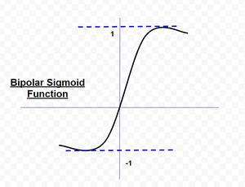
Types of Activation function
Hyperbolic Tangent Function:
-It is similar as Bipolar Sigmoid
Function.
-This function is a special type of neural
network known as Backpropagation
Network.
-This function is of the form

Slide 9
Example of real-world applications
1. Activation functions play a crucial role in the overall performance of
the network.
2. ReLU activation function is widely used in image recognition in CNNs.
3. Tanh in natural language processing.
4. Softmax activation function is used in speech recognition to convert
the output into a probability distribution.

