Slide 1
RECURRENT NEURAL NETWORK
A recurrent neural network is a type of artificial neural network commonly used in natural language processing. It recognize data’s sequential characteristics and use patterns to predict the next likely scenario . RNNs are used in deep learning and in the development of models that simulate neuron activity in the human brain .They are also powerful in use cases.

Slide 2
ADVANTAGES
It captures the sequential information present in the input data.
The output depends not only on the current word but also on the previous words.
It is the best example of long short term memory.

Slide 3
DISADVANTAGES
The computation of this neural network is slow.
Training can be difficult.
There is large complexity of network structure.

Slide 4
APPLICATIONS
Prediction problems
Machine Translation
Speech Recognition
Video Tagging
Face detection
Text summarization
Call center analysis
Image recognition

Slide 5
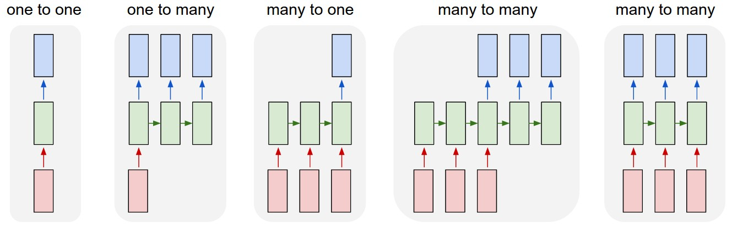
TYPES OF RNN

Slide 6
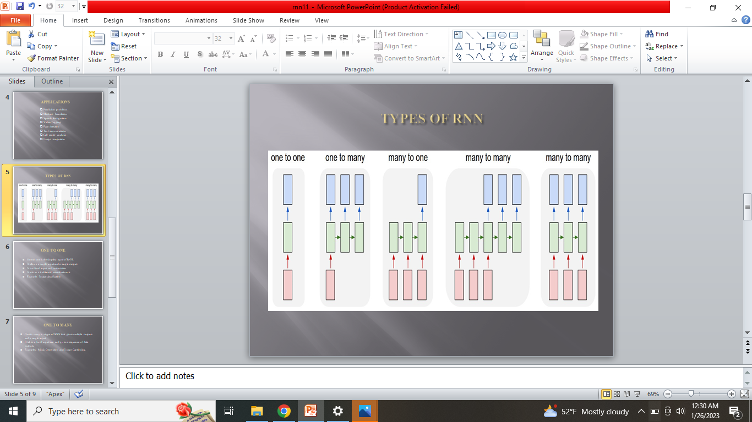
ONE TO ONE
One to one is the simplest type of RNN.
It allows a single input and a single output.
It has fixed input and output sizes.
It acts as a traditional neural network.
Example: Image classification

Slide 7
ONE TO MANY
One to many is a type of RNN that gives multiple outputs and a single input.
It takes a fixed input size and gives a sequence of data outputs.
Examples: Music Generation and Image Captioning.

Slide 8
MANY TO ONE
Many to one is a type of RNN that gives multiple inputs and a single output.
It takes a fixed input size and gives a sequence of data outputs.
Example: Sentiment analysis.

Slide 9
MANY TO MANY
Many to many is a type of RNN that gives multiple inputs and a multiple outputs.
It is used to generate a sequence of output data from a sequence of input units.
Example: Machine Translation

Slide 10
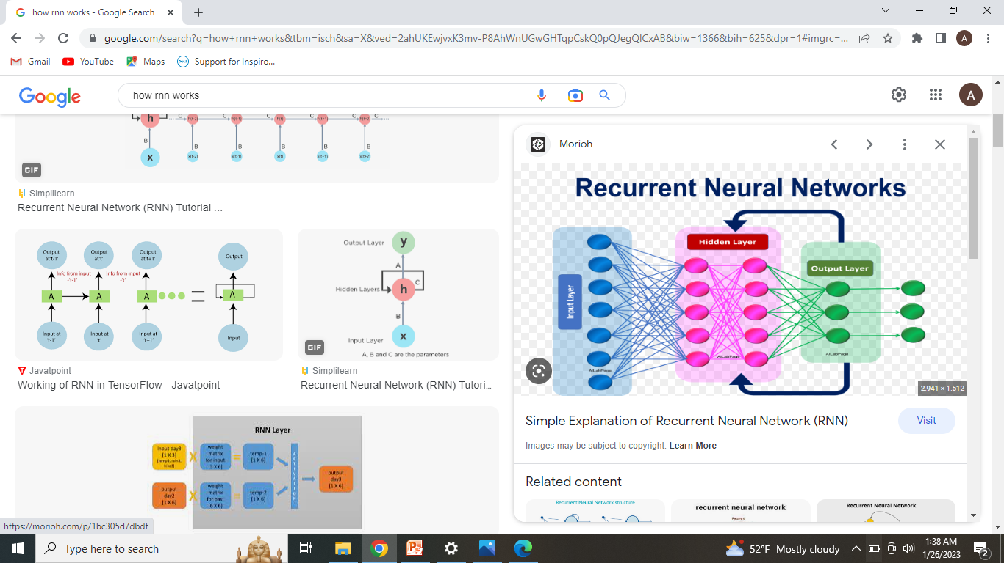
HOW RNN WORKS
RNN works on the principle of saving the output of a particular layer and feeding this back to the input in order to predict the output of the layer. It means output from the previous steps are fed as input to the current step.

Slide 11
CONCLUSION
RNNs are a powerful tools for processing sequential data and modeling dependencies over time . They have been applied to a wide range of tasks, including language translation, speech recognition. RNNs can be more difficult to train than other types of neural networks due to complexity of the loop structure.

