Slide 1
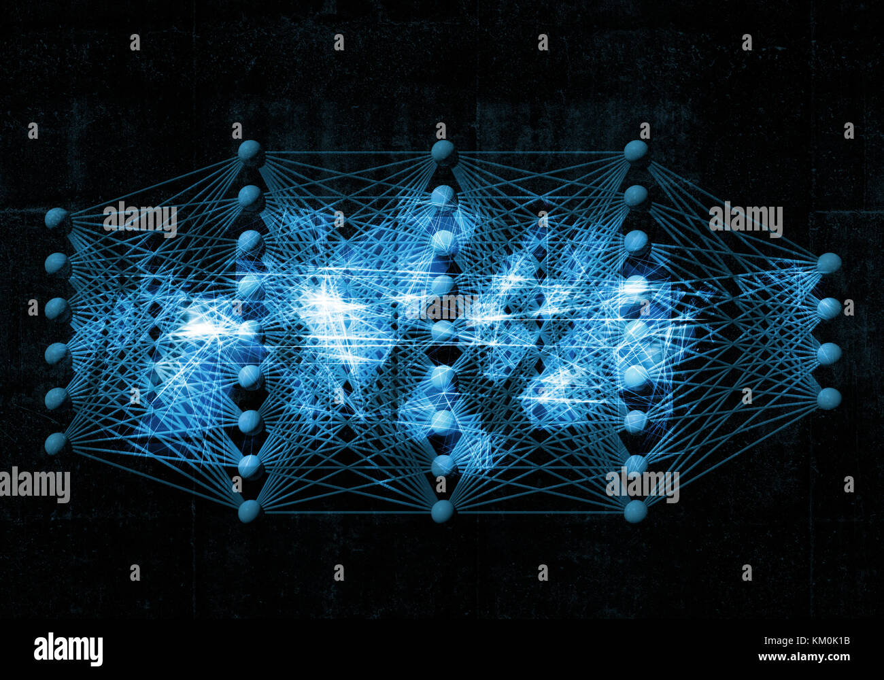
Back
                Propogation
Presented by : Arun Bikram Khatri
Reviewed By : Rikesh silwal Khatri

Slide 2
Contents
References
Neural Network
Backward
Propogation
Code
Feed Forward
Back Propogation
Loss Function
Gradient Descent

Slide 3
Neural Network
machine learning algorithm modeled after the human brain
composed of layers of interconnected "neurons" that process and transmit information.
consists 3 layers - Input , Hidden and Output

Slide 4
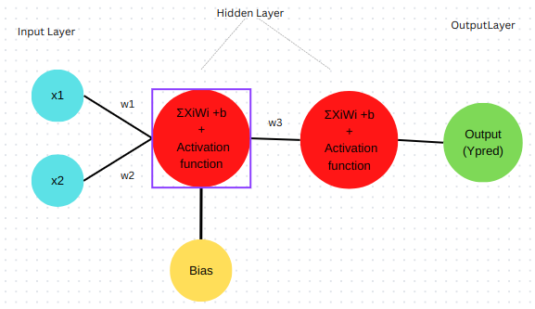
Neural Network
Activation function → Linear to non-linear
Bias → shift origin

Slide 5
How Does It Work ?
Feed-forward
Back propogation

Slide 6
Feed Forward Network
information flows through network in only one direction, from input to output.
input layer receives the input data.
output layer produces the final output
any layers in between are called hidden layers that process the input data.

Slide 7
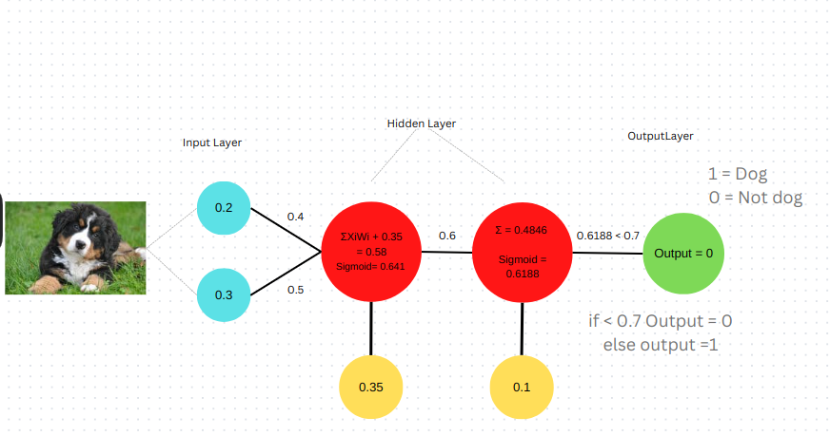
Feed Forward Network

Slide 8
Back Propogation
Algorithm used to train neural networks.
Algorithm
Forward propogation
Calculate the error (loss function)
propagates the error backward through the network(Gradient Descent)
Adjust weights to minimize error
Repeat steps 1 to 4 multiple times until network reaches a satisfactory level of accuracy.

Slide 9
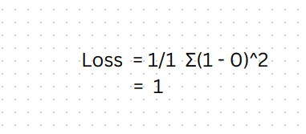
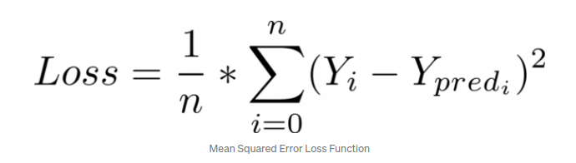
Loss function
function to calculate error between predicted and actual output.

Slide 10
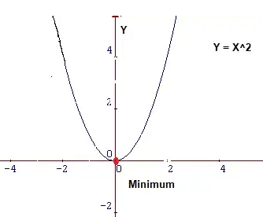
Minimize the loss function
find value of X that produces lowest of Y

Slide 11
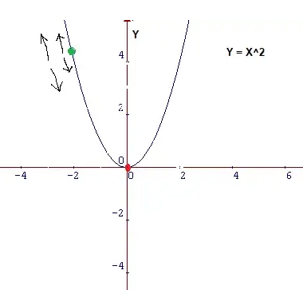
Gradient Descent
optimization algorithm used to update the weights of neural network during training
algorithm to find local minimum of a given function.
Two things to know to reach the minima
    which way to go --> Gradient( Derivative )
    how big a step to take. --> Learning rate

Slide 12
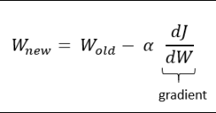
Gradient Descent Formula
here , dJ / dW = gradient of the loss function with respect to the weight w
α = Learning rate

Slide 13
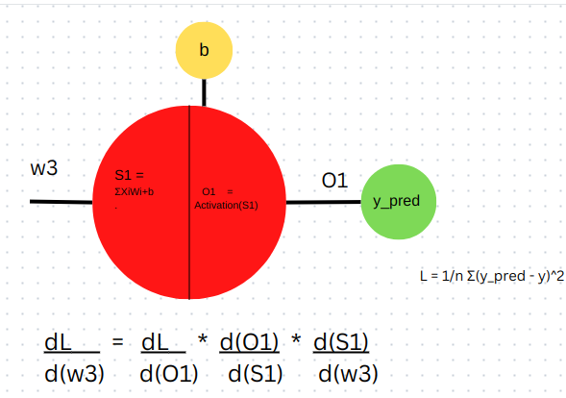
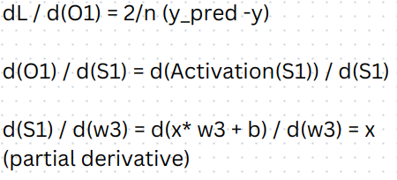
How is dL/dW calculated ?
Using chain rule

Slide 14
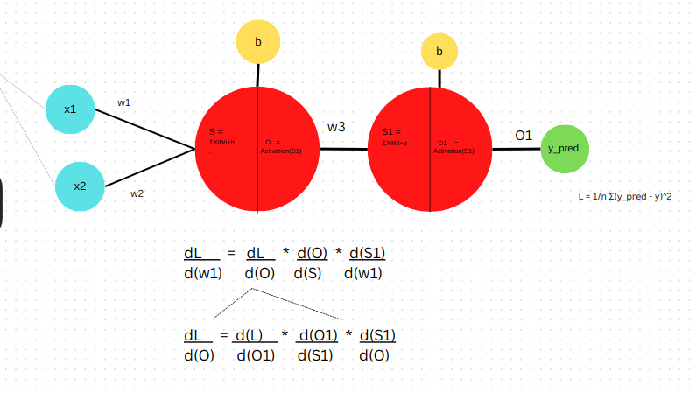
How dl/dw is calculated
Similarly

Slide 15
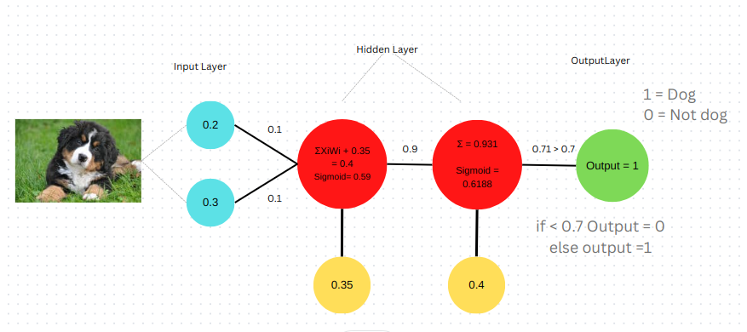
Update the weights

Slide 16
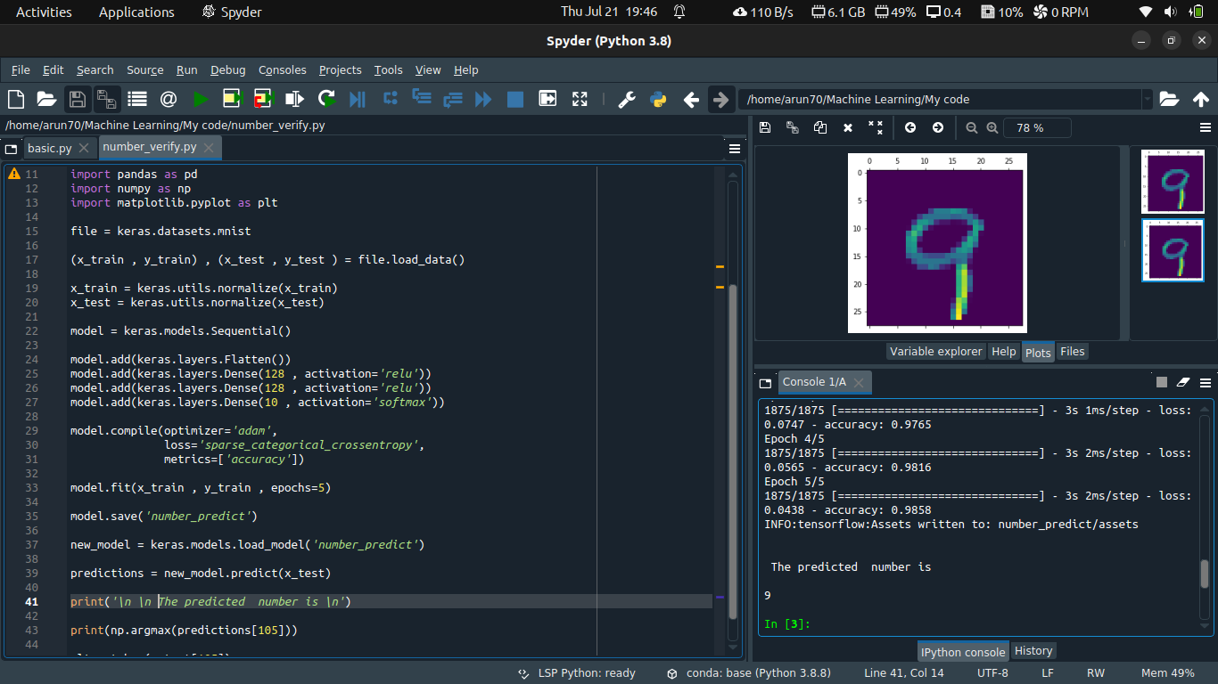
Code

Slide 17
References
Aurélien Géron.2022.Hands-On Machine Learning with ScikitLearn,Keras, and TensorFlow
Krish Naik https://www.youtube.com/@krishnaik06

