Slide 1

Building an Online Food Ordering System: A Summer Training Journey in PHP Web Development

Slide 2





Introduction to the Project
This presentation covers the journey of building an
using . We will
explore the , , and the overall learning experience during the summer training.
Join me as we dive into the world of
!

Slide 3




The first step involved gathering
We focused on user needs, including
for the system.
, order
placement, and payment processing. This phase was crucial for
defining the expectations.
of the project and ensuring we met user

Slide 4



Choosing the Tech Stack
For our project, we selected for server-side scripting, along with for database management. We also utilized , , and for the front end. This combination allowed us to create a robust and responsive application.

Slide 5

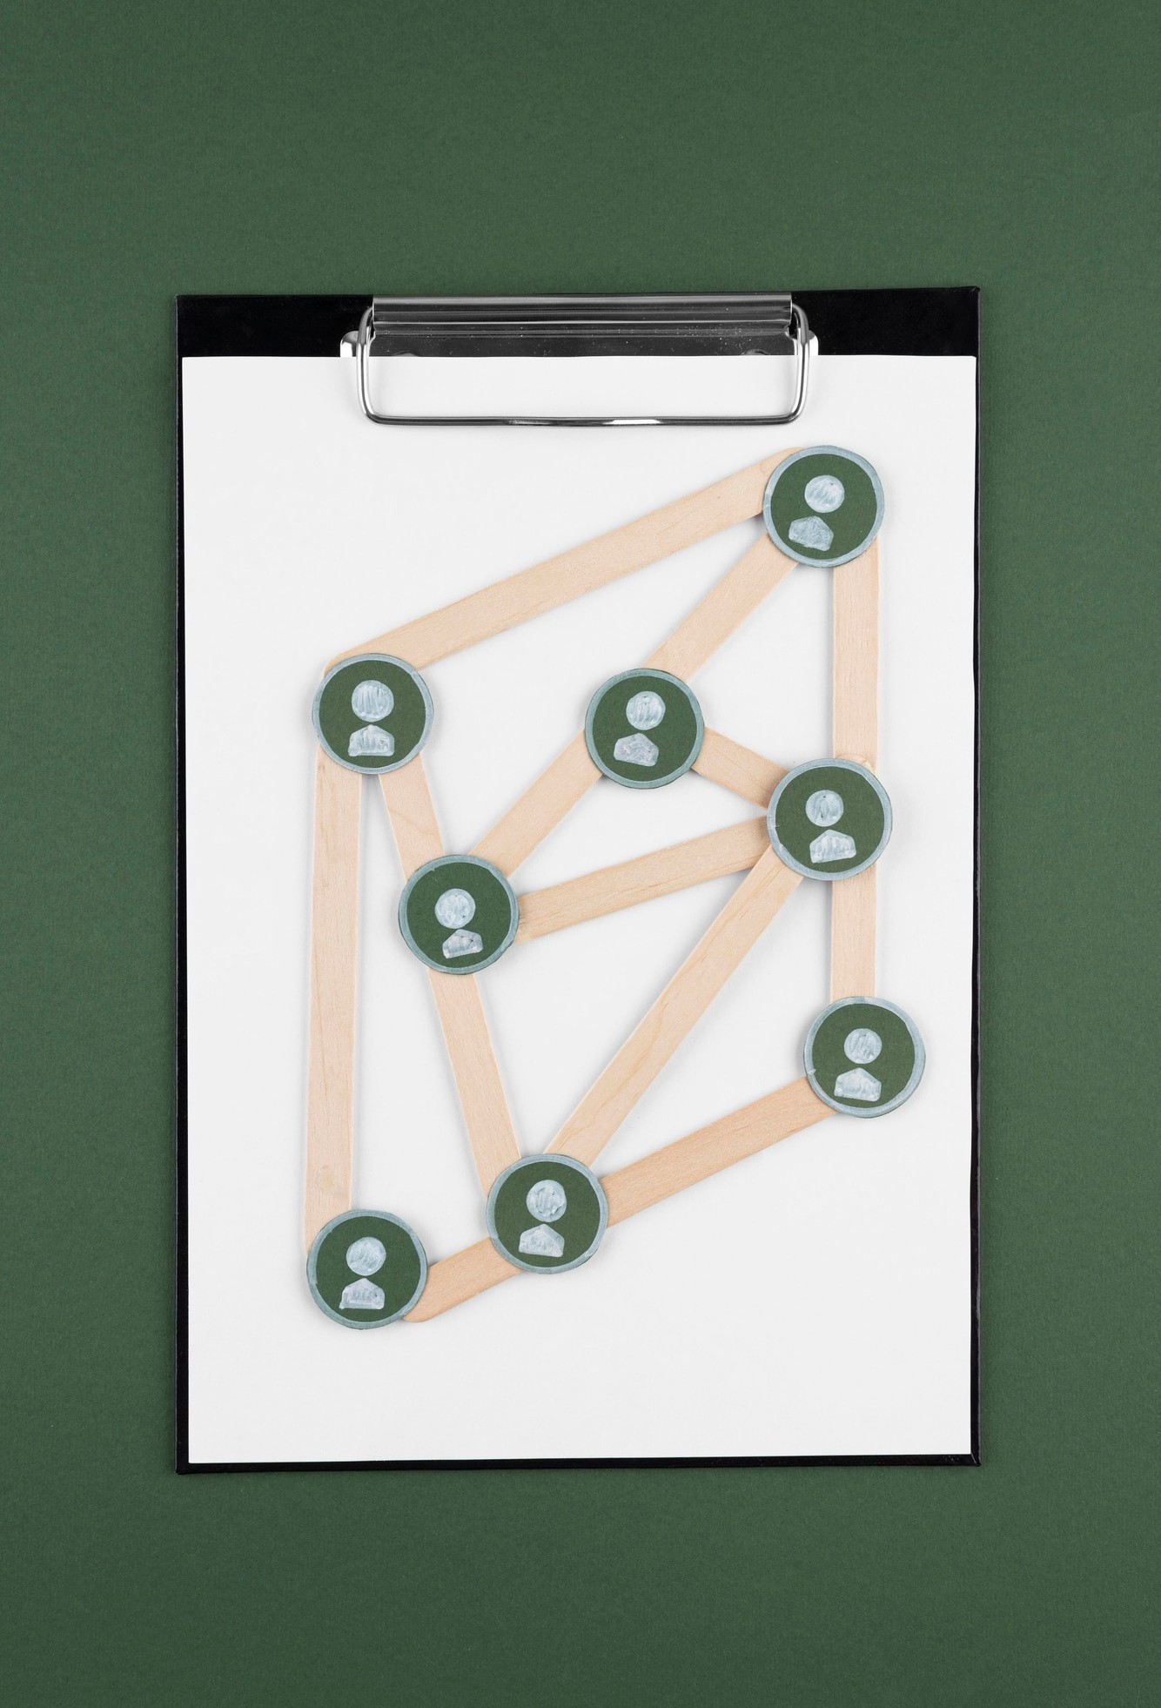



Database Design
Designing the
created tables for ,
was a critical step. We
, , and
. Proper normalization ensured data integrity and optimized performance, allowing for effcient data retrieval and management.

Slide 6
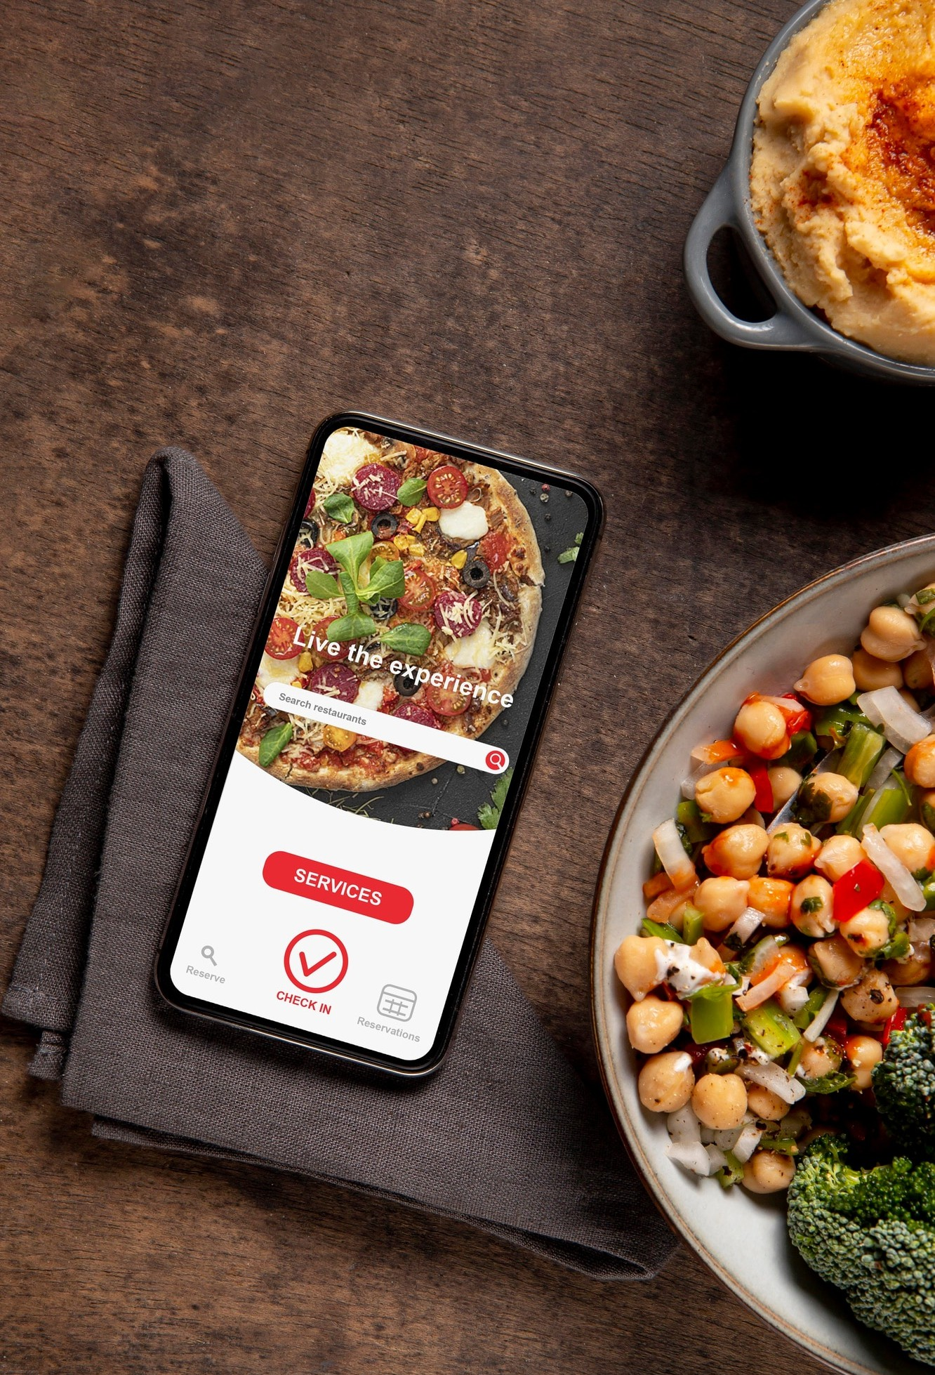

User Interface Development
Creating an intuitive was essential for user experience. We focused on a clean layout, easy navigation, and responsive design. The goal was to make the ordering process as seamless as possible for our users.

Slide 7

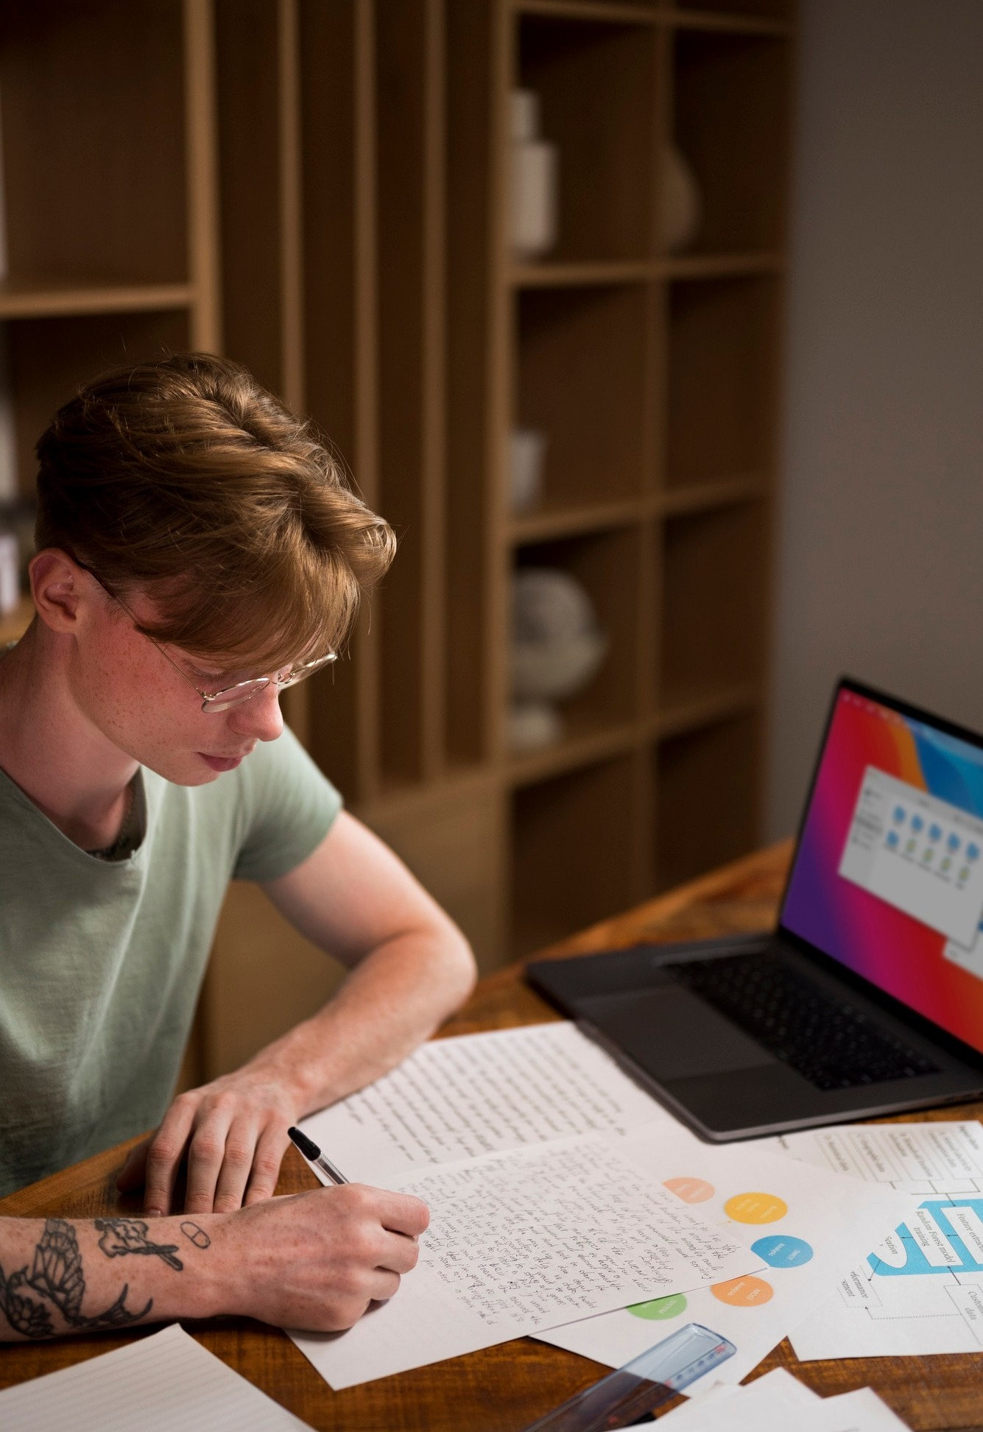

Implementing Features
Key features included , menu display, order management, and payment integration. We implemented these features using and ensured they worked smoothly, providing users with a reliable and enjoyable experience.

Slide 8


Testing was vital to ensure the system functioned correctly. We conducted and to identify and fix bugs. This process helped us improve the system's reliability and user satisfaction.

Slide 9
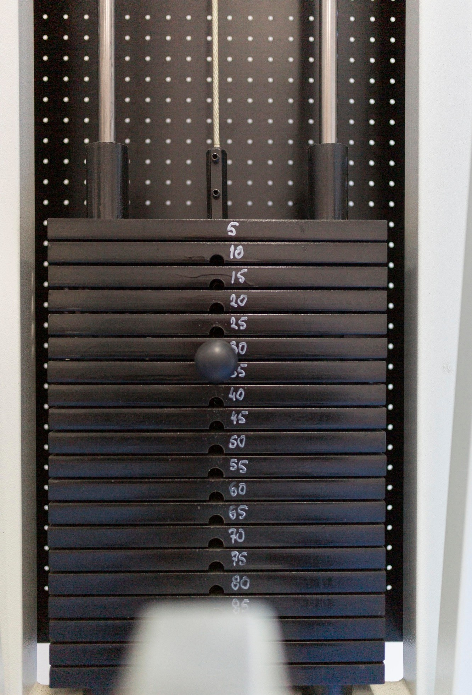

Deployment Process
After thorough testing, we prepared for
. We chose a reliable hosting service and configured the server environment. This step
was crucial for making the application accessible to users online.

Slide 10
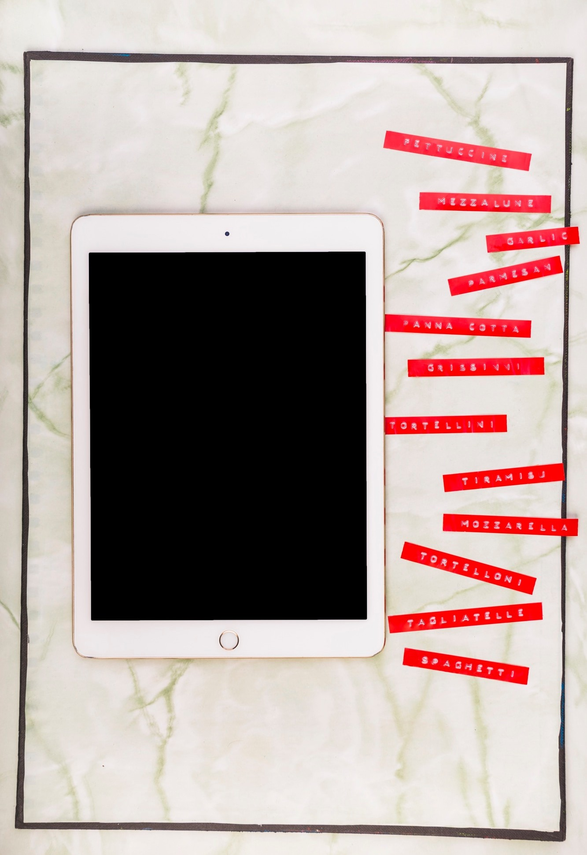

User Feedback and Improvements
Post-launch, we gathered to identify areas for improvement. This feedback loop allowed us to make necessary adjustments and enhance the overall user experience, ensuring the system met evolving user needs.

Slide 11



Building the
experience. We learned valuable skills in
was a rewarding
, project management, and user engagement.
This project not only enhanced our technical abilities but also prepared us for future challenges.

Slide 12




Do you have any questions? youremail@freepik.com
+34 654 321 432
yourwebsite.com

