Slide 1





Ambekeshwar Group Of Institution, Lucknow
PRESENTATION
ON
SUMMER TRAINING FROM UPPCL
33/11 KV SUB-STATION, PARASPUR GONDA (U.P.)
PRESENTED BY SUBMITTED TO:-
Nitish Kumar Mishra Mr. Viplov Diwakar Mr. Brijesh Kumar Dhore
Branch:- EE 3rd Year Co-Ordinator (HOD EE Dept.)

Slide 2
Topic
Step up and step down transformer
Isolator
Power Control Panel
Directional Relay
Power transformer
Lightning arrester
Single line diagram 11/33 KV

Slide 3
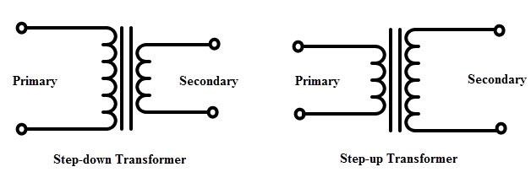
STEP DOWN TRANSFORMERS. STEP UP TRANSFORMER.
Low output voltage and high input voltage.
Primary winding are high input winding.
Secondary winding has a high current .
In a step-up transformer we have a larger secondary voltage compared to the original voltage .

Slide 4
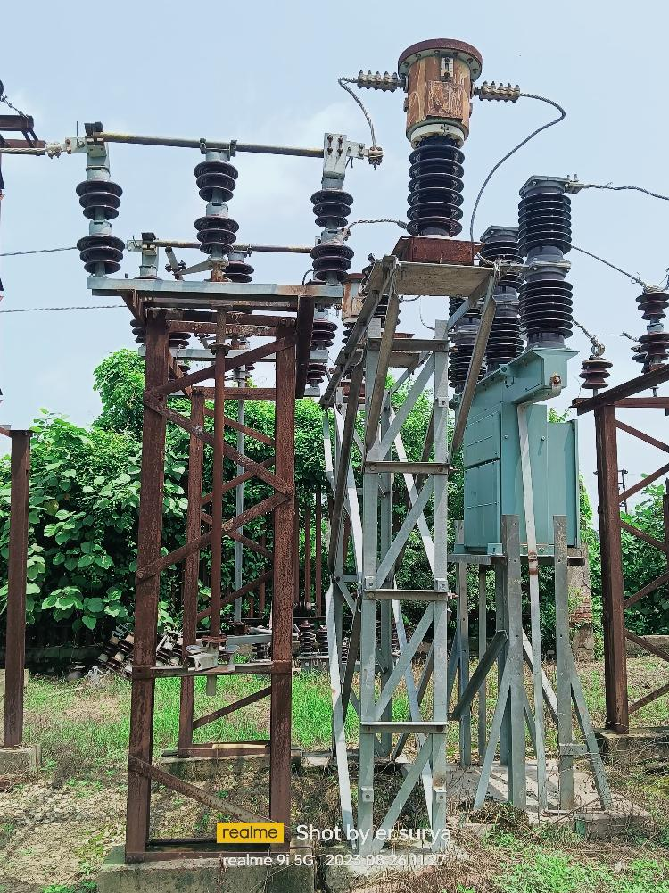
ISOLATOR
A Mechanical switching device that isolator a circuit or equipment from a power source.

Slide 5
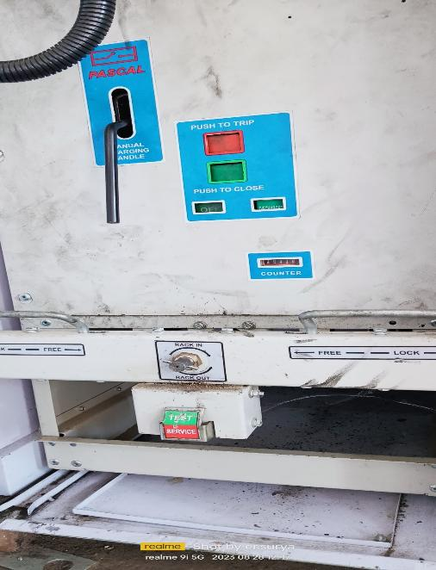
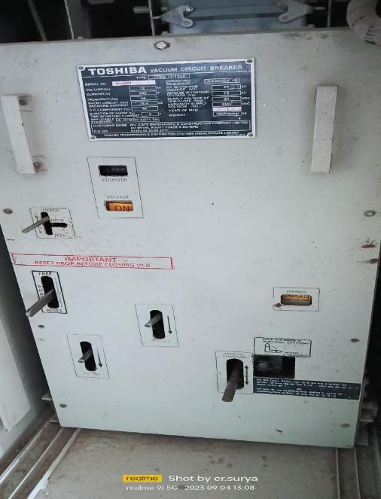
POWER CONTROL PANEL.
Monitor and control mechanical processes.

Slide 6
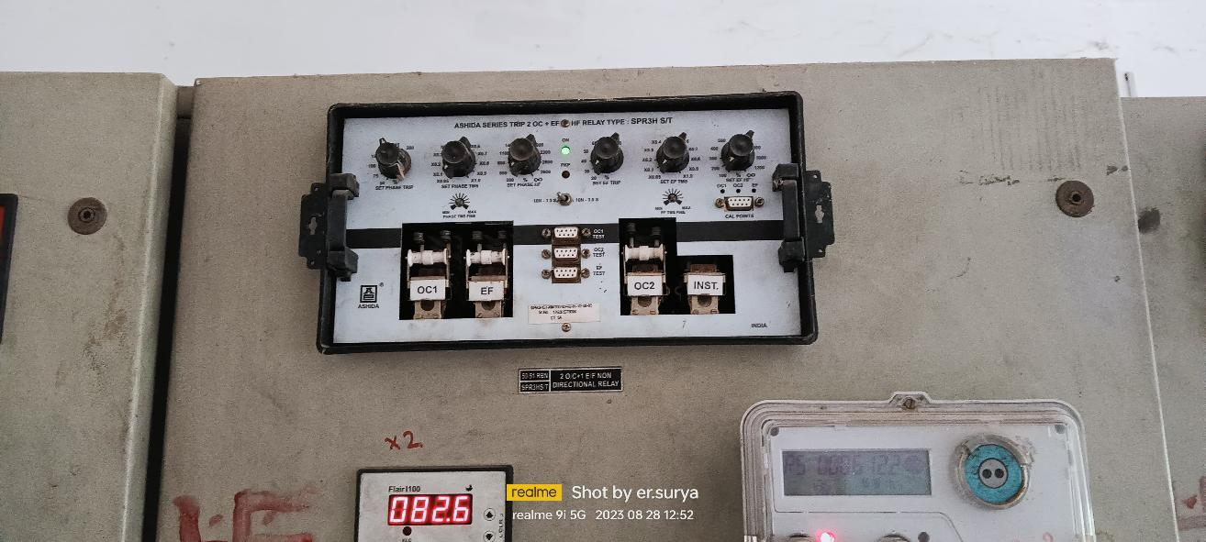
DIRECTIONAL RELAY.
A protective device that isolates faults in power systems and faults current systems.

Slide 7
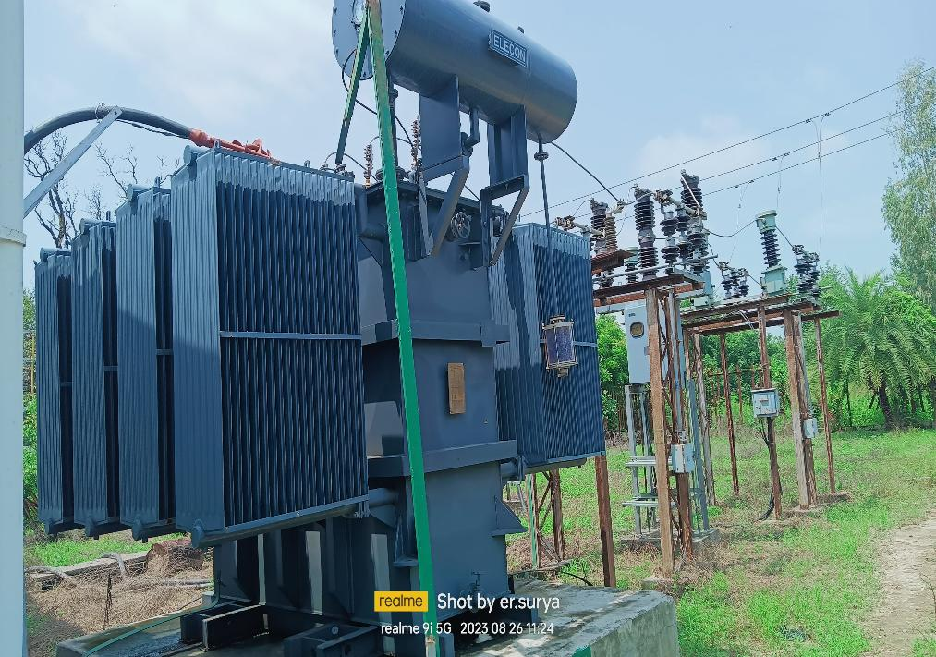
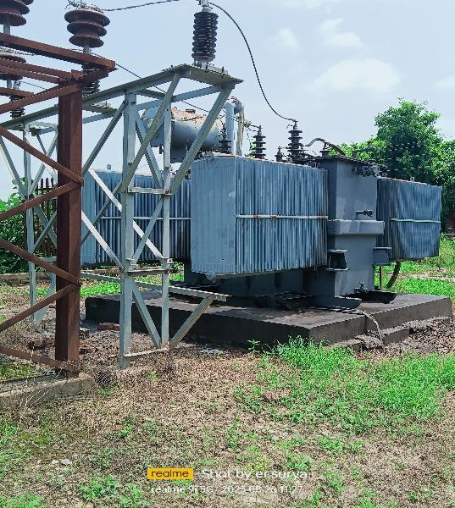
POWER TRANSFORMER.
A static device that transformer electrical energy from one circuit to another without changing frequency.

Slide 8
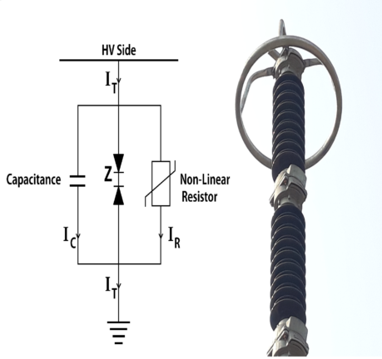
LIGHTNING ARRESTER
Protects electrical equipment from lightning damage
A device used on electrical power systems and telecommunications systems to protect the insulation and conductors of the system from the damaging effects of lightning.

Slide 9
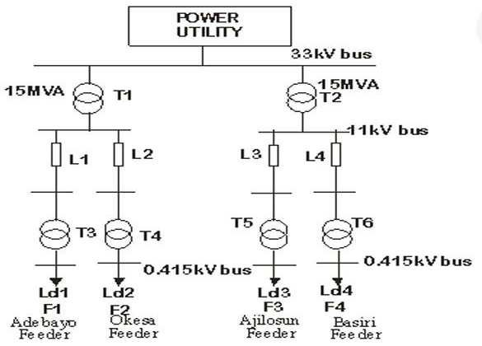
SINGLE LINE DIGRAM 11/33 KV

Slide 10
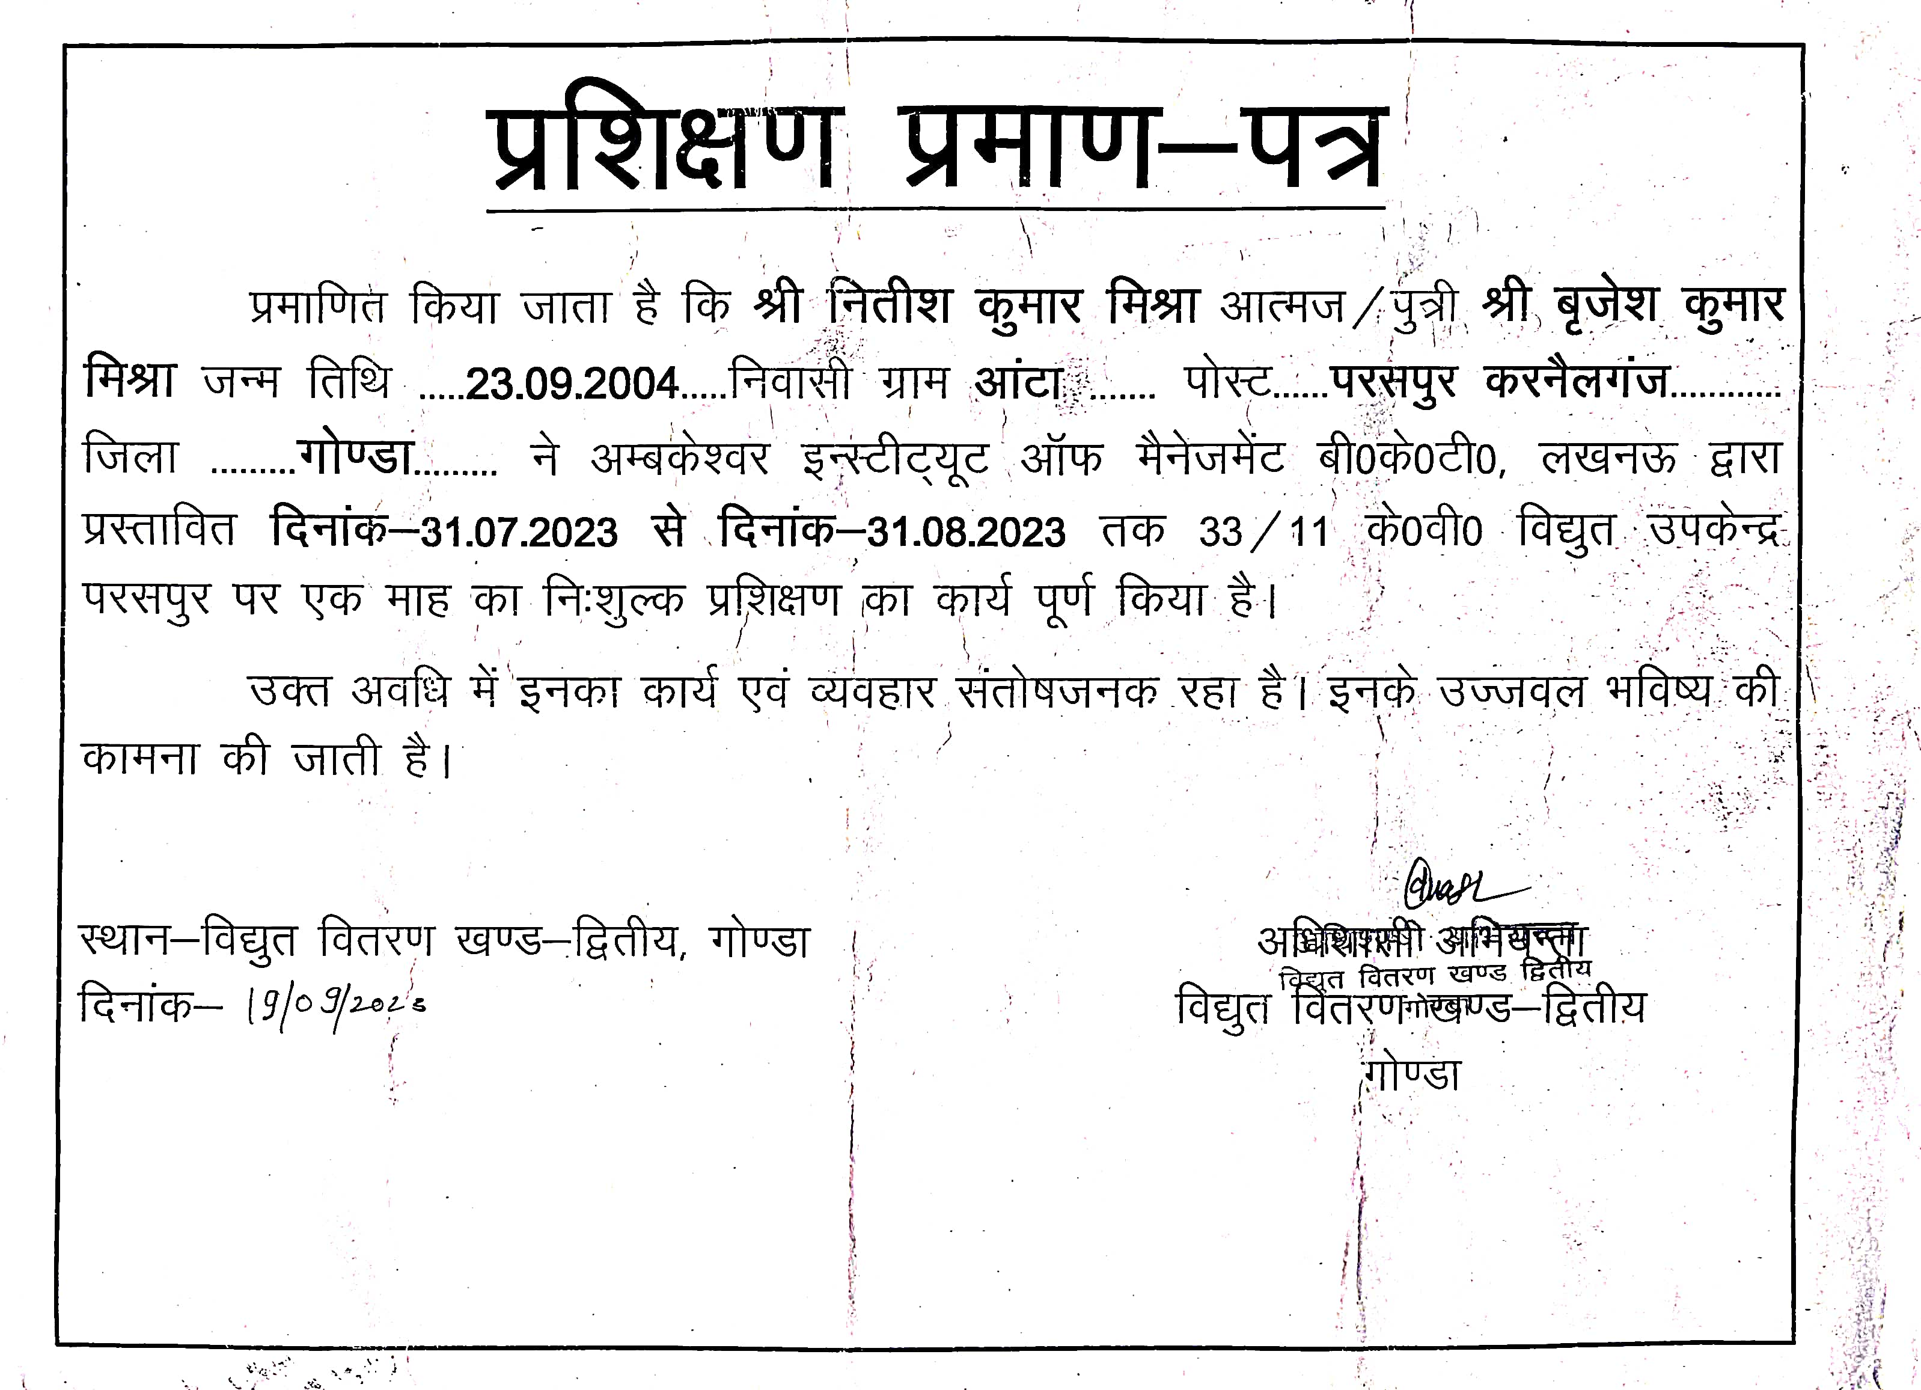

Slide 11


