Slide 1


AGI Welcome you
Fresher’s 2K26

Slide 2


Know Your Management

Slide 3


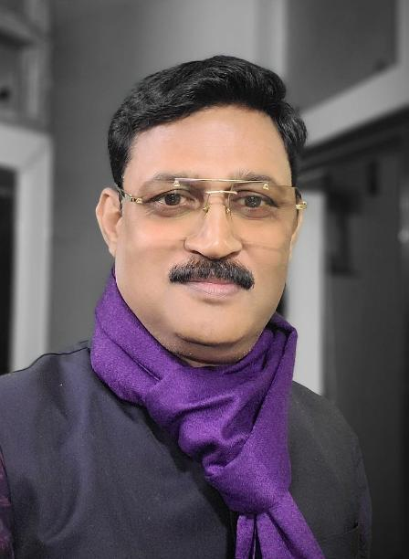
Dr. R.P. Panday
Founder & Chairman
(AGI)

Slide 4

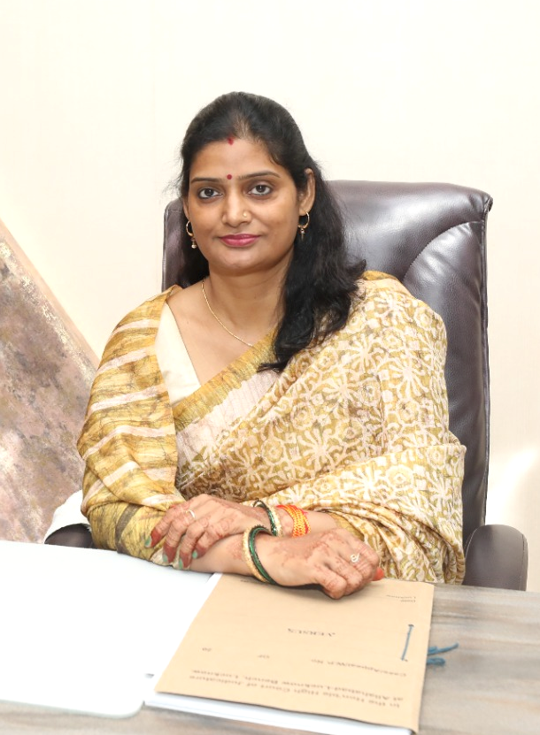
Mrs. Sarita Pandey
Vice Chairperson
(AGI)

Slide 5

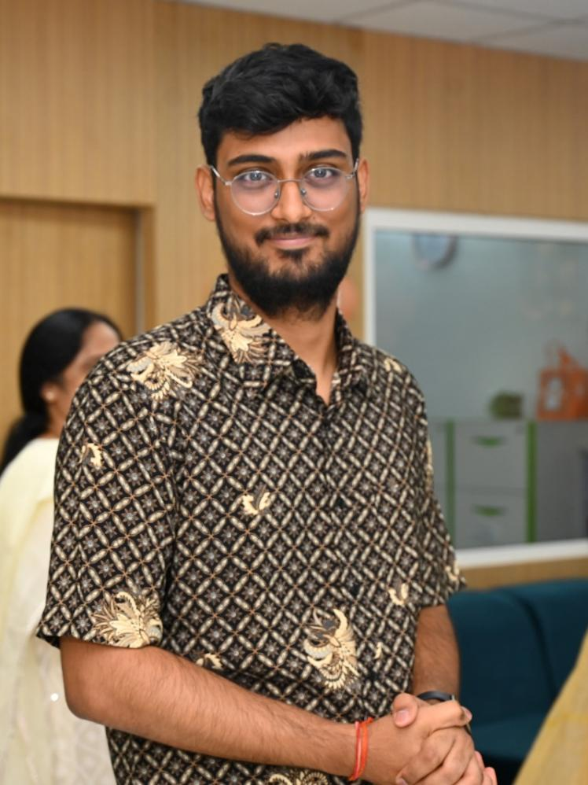
Mr. Naman Pandey
Manager
(AGI)

Slide 6

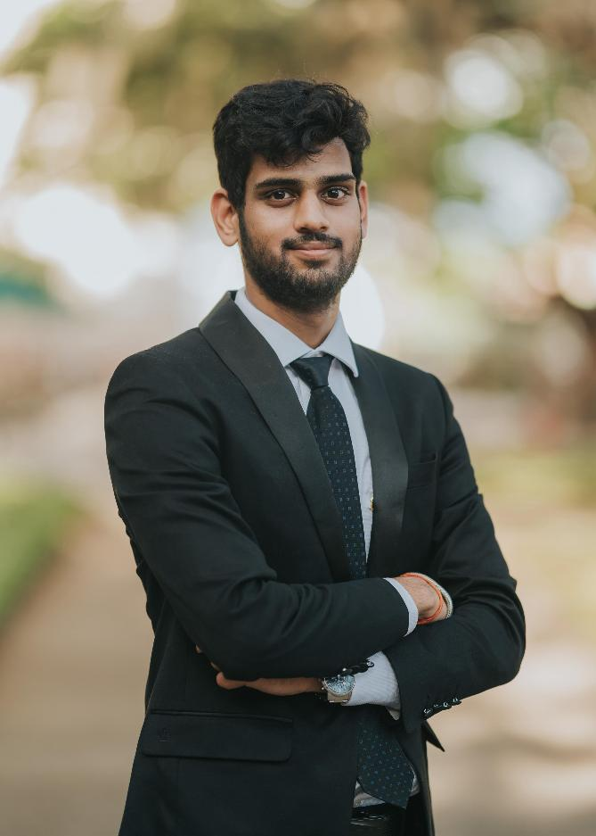
Mr. Mayank Pandey
Deputy Manager
(AGI)

Slide 7

Know Your
Administration

Slide 8

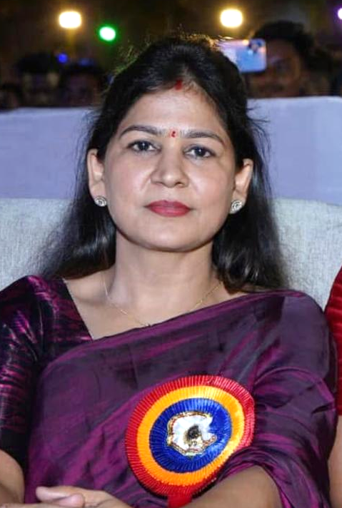
Ms. Sweeti Mishra
Director
(P&E)

Slide 9

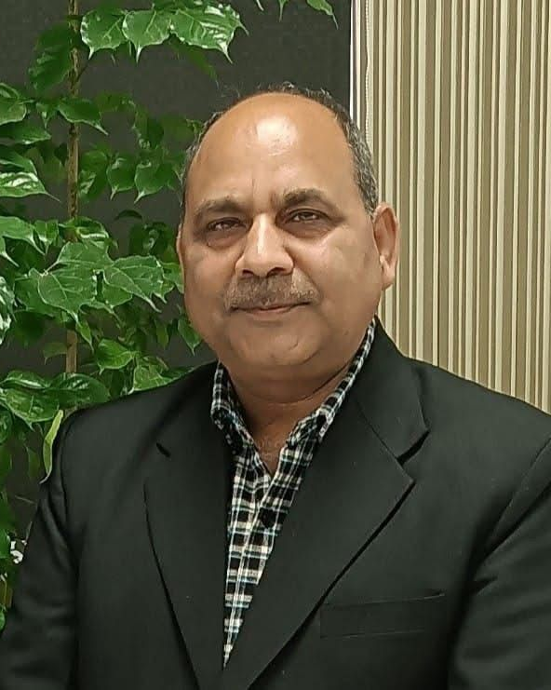
Mr. Jitendra Mishra
Manager
(Admin)

Slide 10


Ms. Anjali Pandey
HR (AGI)

Slide 11

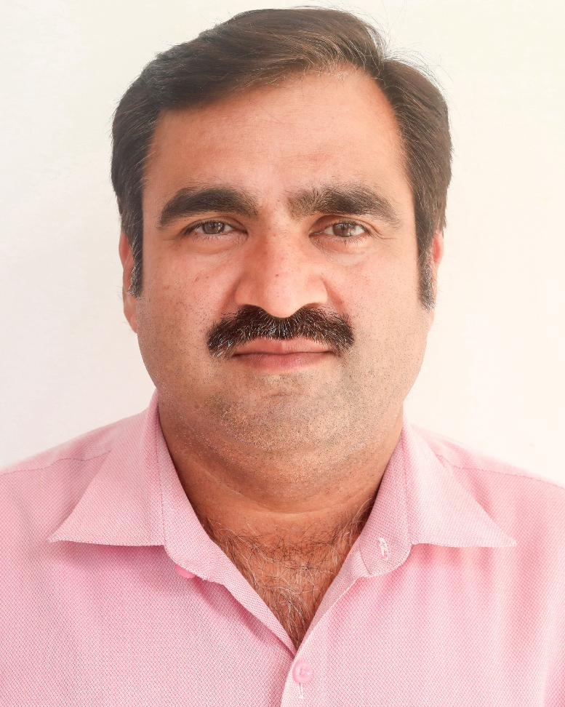
Mr. Karunesh Tiwari
Registrar
(AGI)

Slide 12

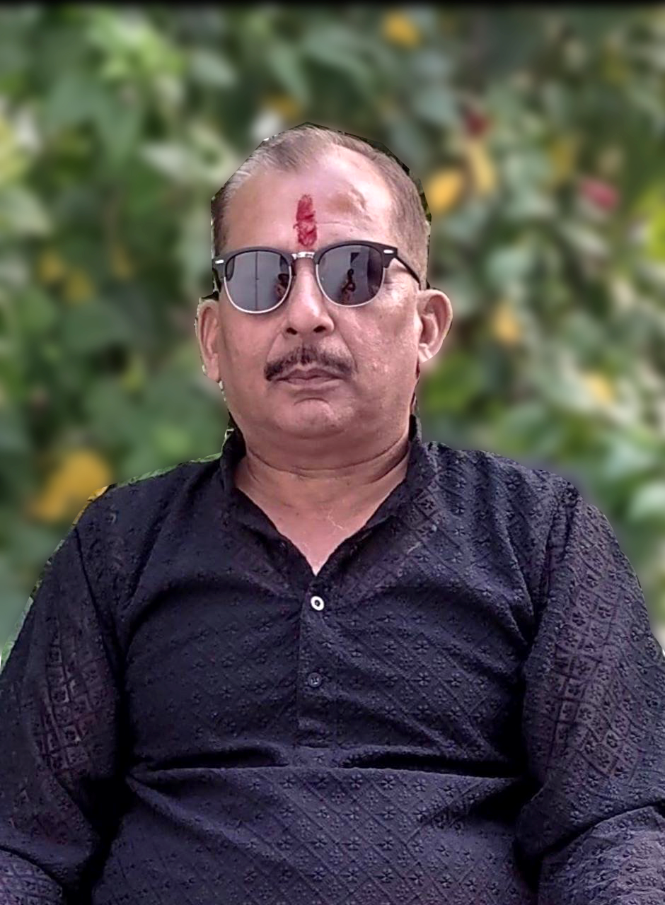
Mr. Anurag Dave
Accountant
(AGI)

Slide 13

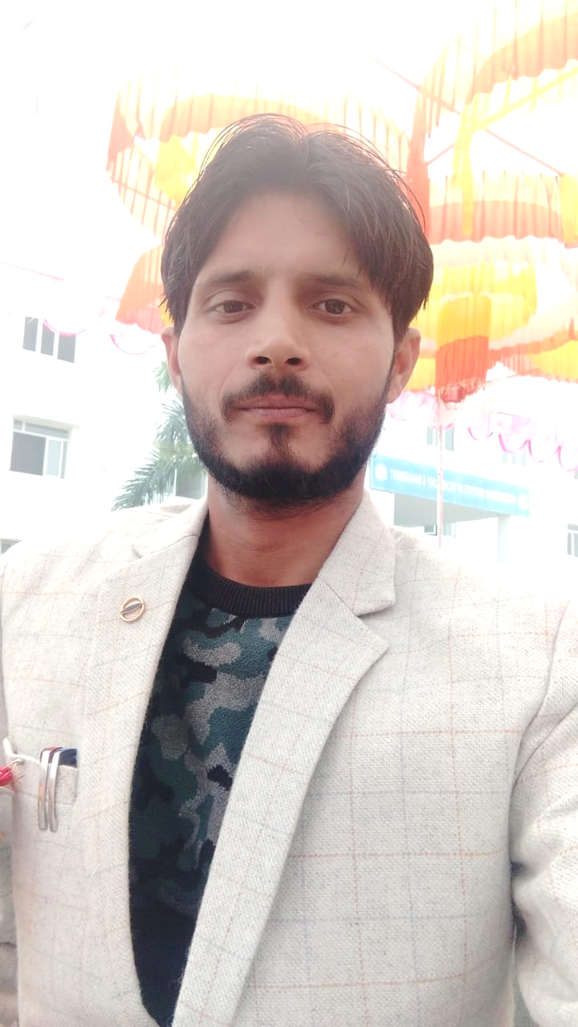
Mr. Madhukar Tripathi
Manager (Accounts)
(AGI)

Slide 14
Admission Cell`

Slide 15

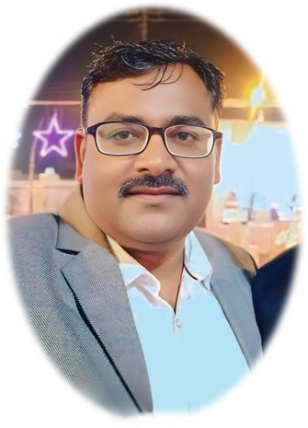
Mr. Ambrish Verma
Head marketing & Admission cell (AGI)

Slide 16

Training
And
Placement Cell`

Slide 17

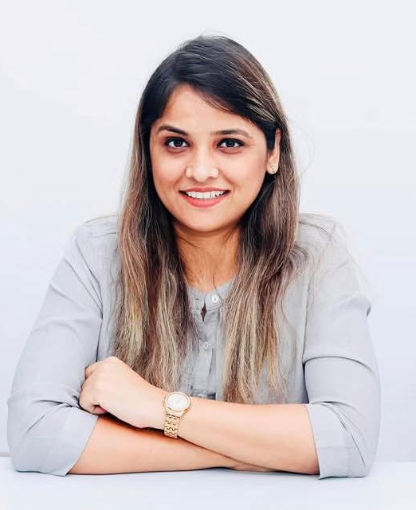
Ms. Anjali Pandey
Head T&P Cell
(AGI)

Slide 18

Academic Authorities (Pharmacy)

Slide 19

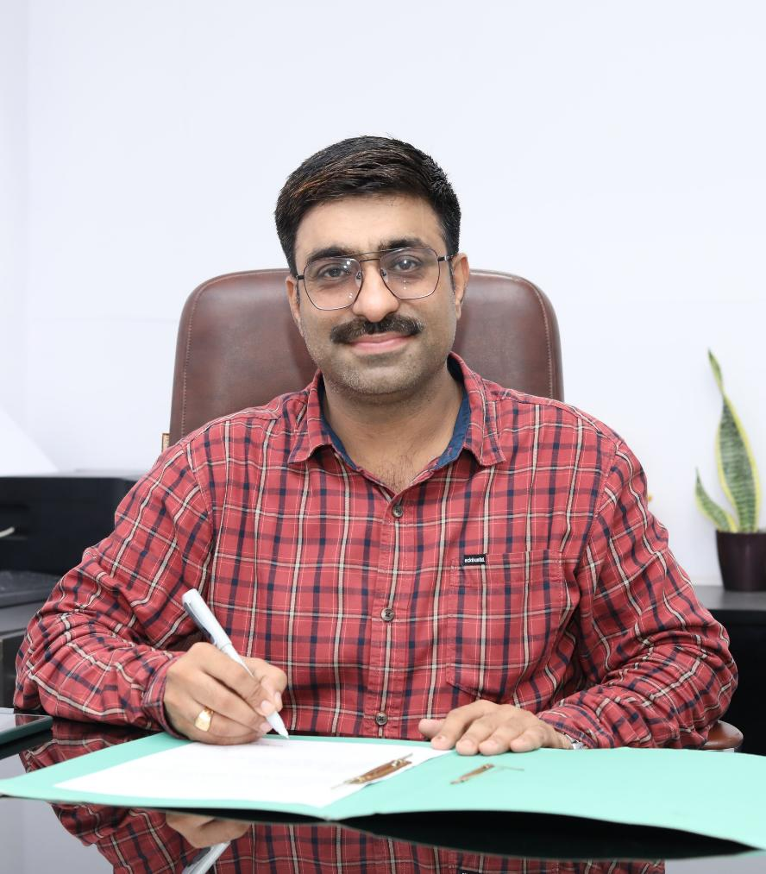
Prof. (Dr.) Dharamveer
Director (Pharmacy)

Slide 20
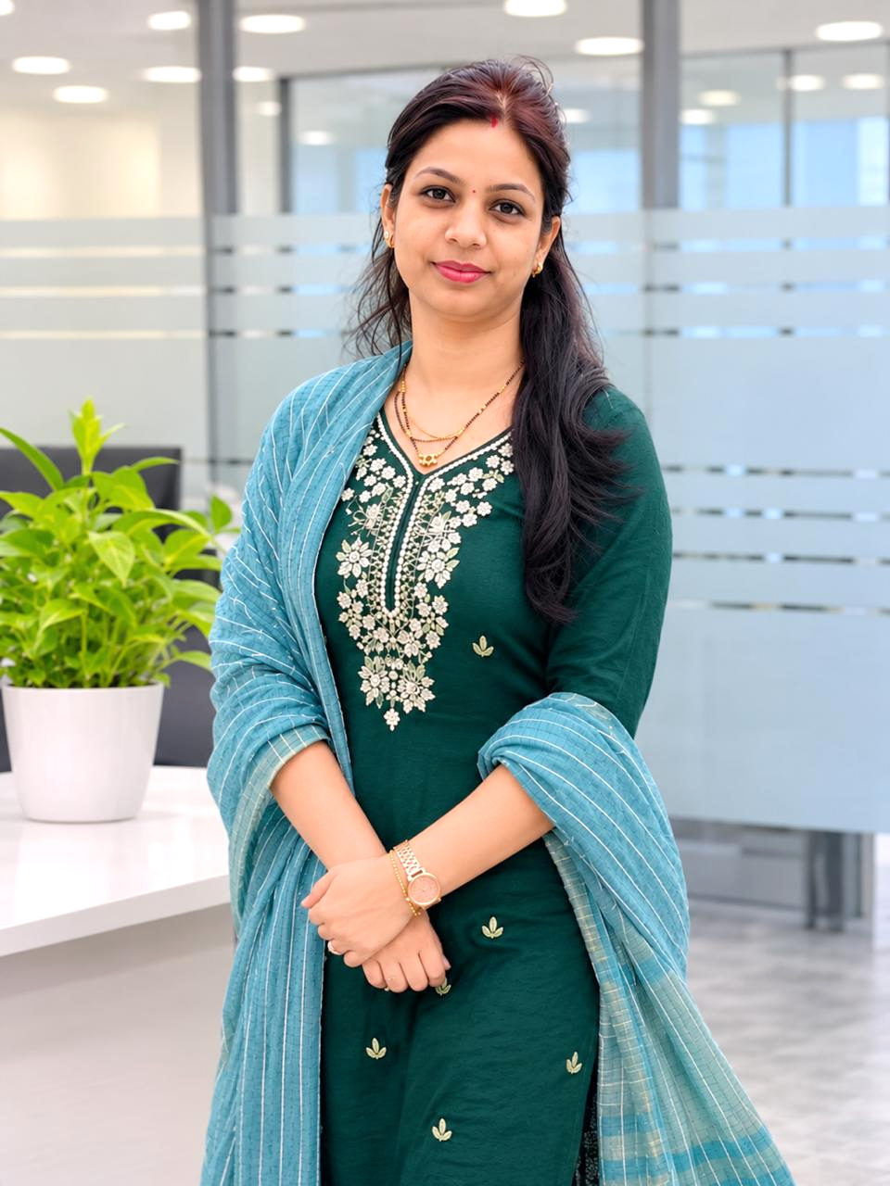
Mrs. Sarika Gupta
Principal
(Diploma in Pharmacy)

Slide 21

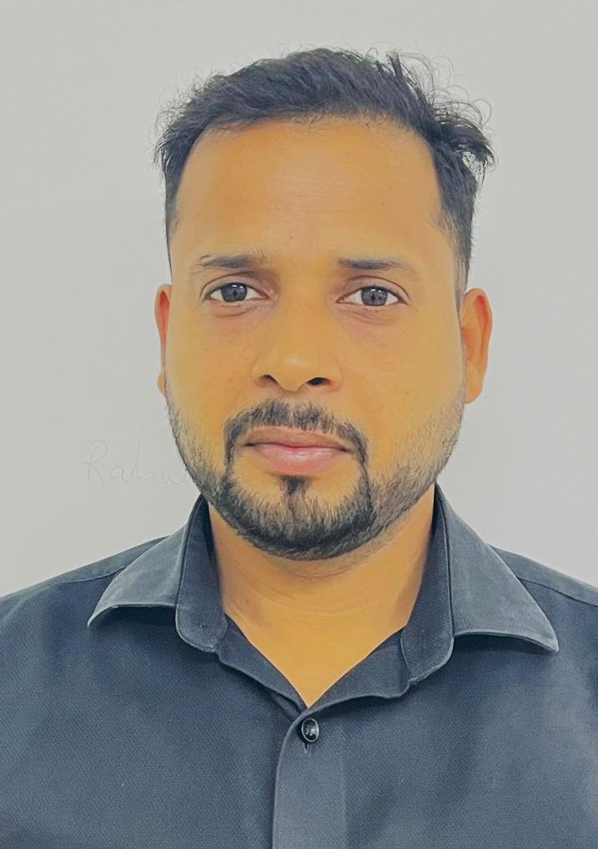
Mr. Rahul Kannaujiya
Academic Coordinator (B.Pharm.)

Slide 22

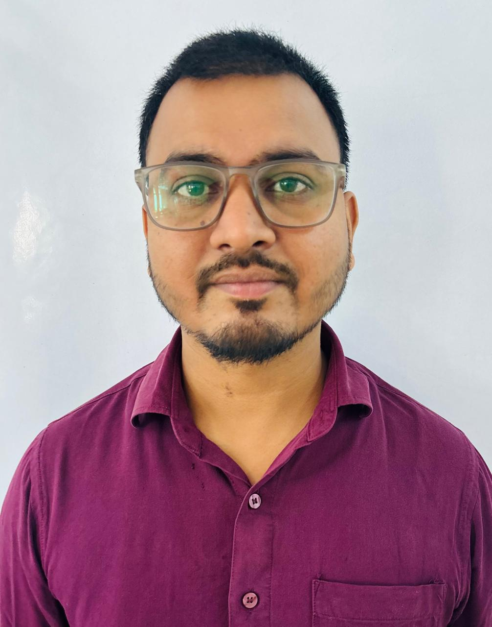
Mr. Vijay Bahadur
Academic Coordinator (D.Pharm.)

Slide 23
Academic Authorities (Polytechnic)

Slide 24
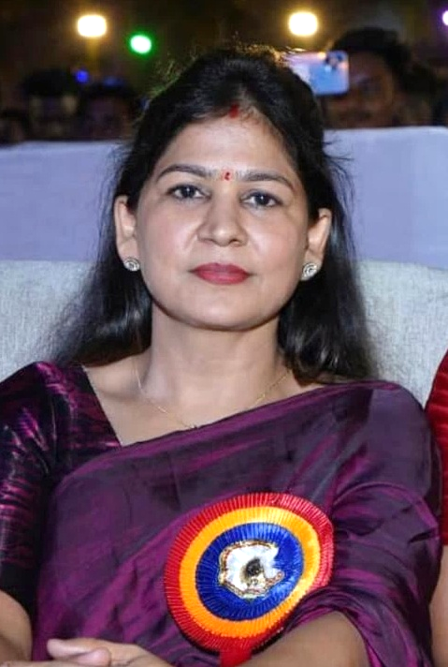
Ms. Sweeti Mishra
(Principal)

Slide 25
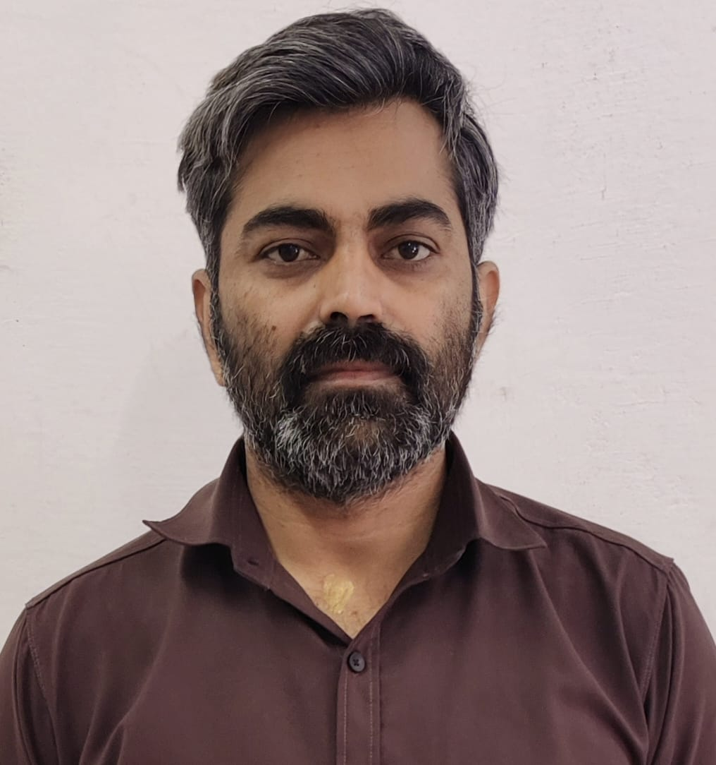
Dr. Ajay Sharma
Academic Coordinator

Slide 26

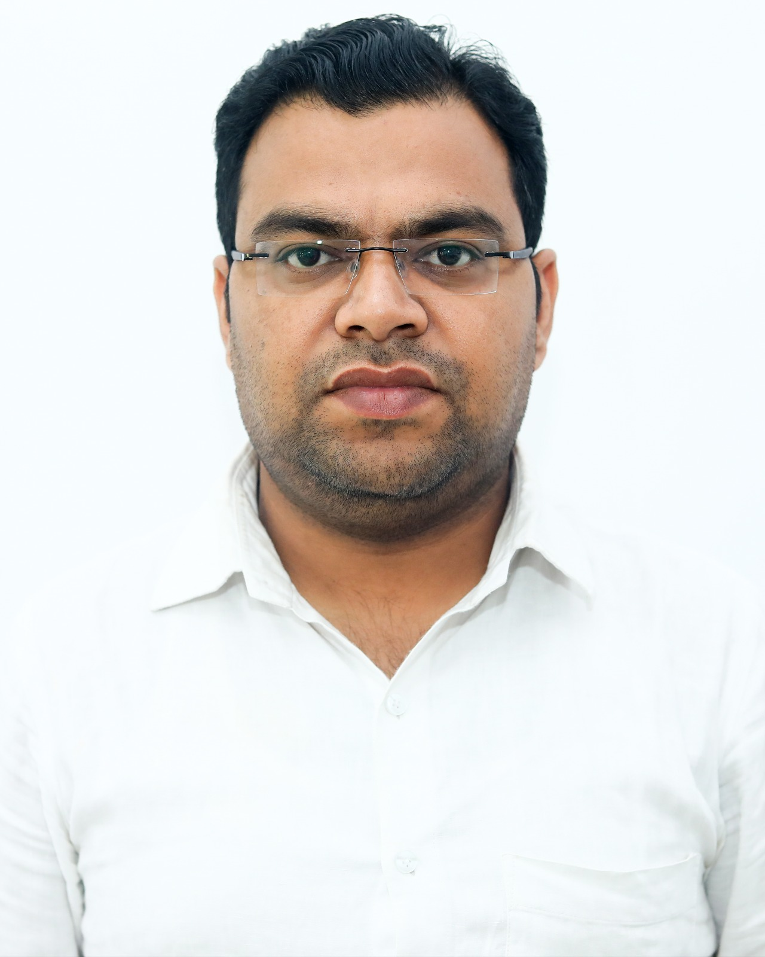
Mr. Himanshu Rastogi
Head of Department
(Mechnical Eng.)

Slide 27
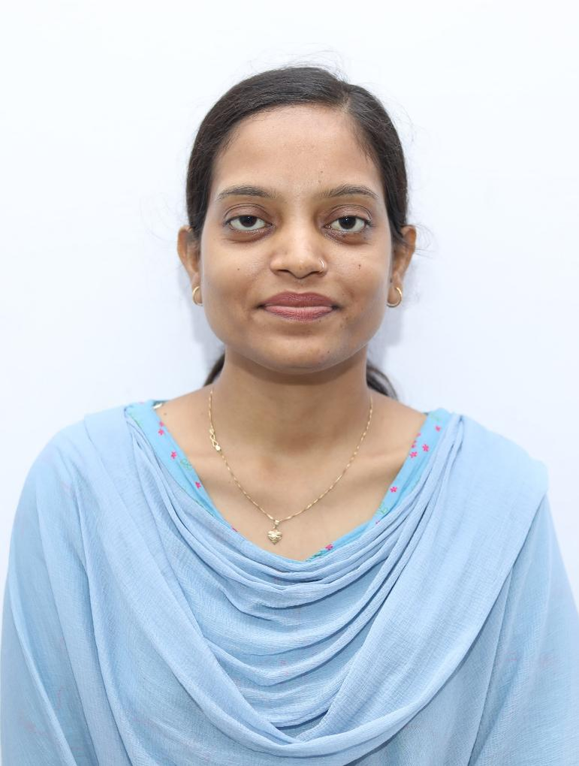
Ms. Fizza Hussain
Head of Department
(Computer Science Eng.)

Slide 28
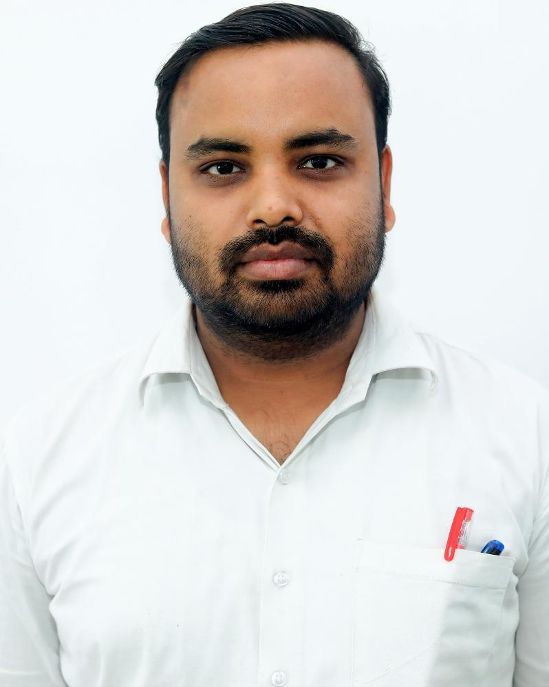
Mr. Anuj Rathor
Head of Department
(Civil Eng.)

Slide 29
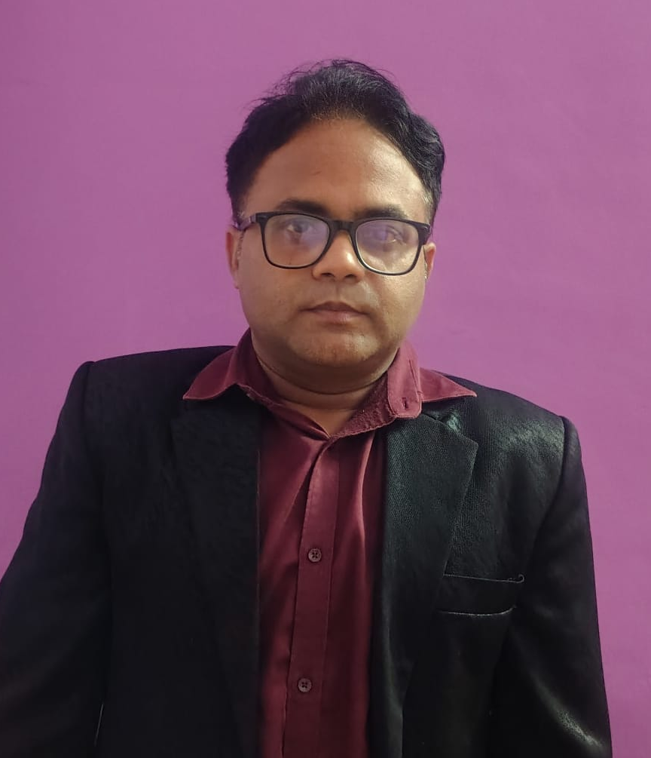
Mr. Yogesh Chaurasiya
Head of Department
(Electrical Eng.)

Slide 30
Welcome Freshers
Now You are also the member of AGI Family

