Slide 1

Day 4: Programming Fundamentals
PARIWARTAN COMPUTER TRAINING INSTITUTE
ISO Certified 9001-2015 | Authorized By: GCSA & DCE
Introduction to Programming, Logic Building & Hands-On Coding

Slide 2
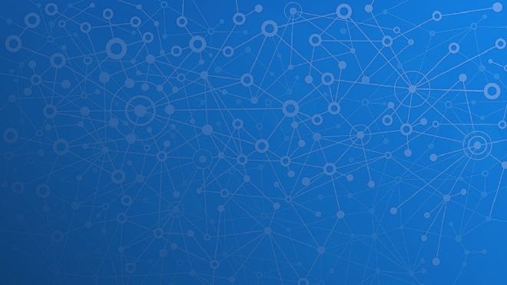
What is Programming?
- Giving instructions to a computer.
- Written in programming languages like C, Python.
- Used for solving problems, building apps, automating tasks.

Slide 3

How a Program Works
- Follows Input → Process → Output.
- Example: Input (2 numbers) → Process (Addition) → Output (Sum).
- Programs = Input + Logic + Output.

Slide 4

Basic Programming Terms
Variable – stores data (e.g., x = 5)
Data Types – int, float, string
Operators – +, -, *, /
Conditions – if, else
Loops – for, while
Functions – reusable code blocks

Slide 5

Programming Languages
- Low-Level: Machine Code, Assembly
- High-Level: C, Python, Java, JavaScript
- Python: easy syntax; C: structured programming

Slide 6

First Program: C & Python
C:
#include <stdio.h>
int main() {
printf("Hello, World!"); return 0; }
Python:
print("Hello, World!")

Slide 7

Logic Building Tips
- Break problem into steps (Algorithm)
- Example: Sum of two numbers = Input → Add → Output
- Use flowcharts or pseudocode first

Slide 8

Practical Tasks
✅ Add two numbers
✅ Check even or odd
✅ Print your name 5 times using loop

Slide 9

Activity & Homework
Class Activity:
1 Hello World program
2 Sum of numbers
3Even/Odd Checker
Homework:
1. Python: Square of number
2. C: Area of rectangle
3. List 5 languages
4. Flowchart: Positive/Negative
5. Why is logic important?

Slide 10


