Slide 1

PRESENTATION ON
HOSPITAL TRAINING -1st
(BP-509P)
SESSION 2023-24
Presented By-
Sarfraj Ansari 3rd Year
Roll no. 2109190500051
Co-ordinated By-
Mr. Shubham Yadav
BNCP, Lucknow
B. N. college of pharmacy, lucknow

Slide 2
Table of contents
ObjectiveS of training
Introduction
Departments in hospital
Work profile
Conclusion
References

Slide 3
Objectives of training
During hospital training , we get information about many diseases under the guidance of doctor.
To promote research in the field of health and hospital management in order to improve the efficiency of health care delivery system.
Hospital training provides practical knowledge to the student.
Training puts the students in real life situation.
Training removes the hesitation of the student regarding their working ski l and personally development.

Slide 4
Introduction
The hospitals are center of treatment. People from all corners of the society and all walks of life converge here to cure themselves of their disease.
A hospital is a health care institution providing patients treatment with specialized health science and auxiliary healthcare staff and medical equipment.
A health care center or health center is one of the network of clinical staffed by a group of general practitioner and nurses providing health care services to people in a certain area
I did my training in FSD Multi specialty hospital, Jankipuram, Lucknow.

Slide 5
Departments in hospital
Outpatient department (OPD)
General Ward
Intensive care unit (ICU)
Injection room
Emergency ward
Operation Theatre (OT)
Pharmacy
Pathology
Dres ing Department
Labor Room

Slide 6

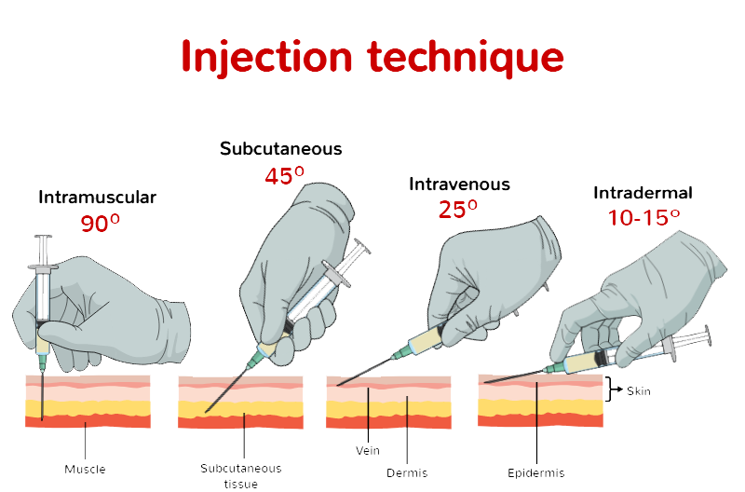
Injections
An injection is the act of putting a liquid, especially a drug into a persons body using a needle and syringe.
Injection is a technique for delivering drugs by parenteral administration that is administration via a route other than through the digestive tract.
Various method of injection
Intramuscular injection
Subcutaneous injection
Intravenous injection
Intradermal injection

Slide 7
Medicine :-
Cetirizine
Aspirin
Diclofenac
Ibuprofen
Solbutamol
dexamethasone
Metformin

Slide 8
Work profile
Always alert during my duty for attending emergency cases.
Worked as pharmacist in hospital's pharmacy during the training time experienced about many critical situations during the night duty.
During the traning, how to compound and dispense the medicament to the patient.
Served as working hand of our senior pharmacist.
Got guidance about the prescription , right way of reading, understanding and selection of medicaments
Came to know how to design dose on the basis of patients age, weight and experienced and learnt many things.

Slide 9
Prescription
A prescription is an order for medicine which a doctor writes, and which is given to a pharmacist to prepare and administer the medicine.
Parts of prescription
Date
Name, age ,sex , address of patient
Superscription
Inscription
Subscription
Signatura
Renewal
sign, license no. of prescriber

Slide 10
WASTE MANAGEMENT
Hospital waste management, also called medical waste management, is a system that handles the segregation, containment, and disposal of hazardous, hospital-generated, infectious waste.
Efficient waste management is critical for healthcare institutions because medical waste can be pathogenic and environmentally hazardous.
Non-compliance with proper hospital waste management can lead to serious health risks, fines, and damage to a healthcare institution’s reputation.

Slide 11
Work profile
Always alert during my duty for attending emergency cases.
Worked as pharmacist in hospital's pharmacy during the training time experienced about many critical situations during the night duty.
During the traning, how to compound and dispense the medicament to the patient.
Served as working hand of our senior pharmacist.
Got guidance about the prescription , right way of reading, understanding and selection of medicaments
Came to know how to design dose on the basis of patients age, weight and experienced and learnt many things.

Slide 12
Conclusion
During training procedures I have got lot of knowledge about following-
Sites of injection which includes knowledge of syringes, route of injections. Routes of injections such as intravenous, intramuscular, intradermal , subcutaneous.
the training in the hospital was rea ly necessary as it not only helped us to see how a hospital operates, but it also helped to learn basic functions of it like first aid care, how to give dispensing of drugs etc.
I also learn about patients observation chart and how to fi l, use it.
Hospital Management system (HMS) provides the facility of backup as per the requirement

Slide 13
REFERENCES
Reynard, Jonathan. “Corpus Curricula: Medical Education and the Voluntary Hospital Movement”.Retrieved17 December2012
Roderick E. McGrew, Encyclopedia of Medical History [Macmillan1985],page no.139
Michael Marks Davis; Andrew Robert Warner[1918]. Dispensaries, Their Management and Development; A Book for Administrator, public Health Workers, and All Interested in Better Medical Service for the People.
Mehta R.M”Pharmacist-1”IVth edition Vallabh Prakashan page no.274-278.

Slide 14
Thank you…

