Slide 1
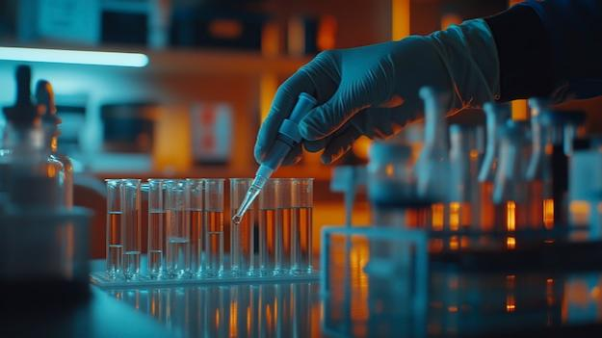

Title :- Microbiological assay
Subtitle :-
Assignment:- pharmaceutical microbiology
Topic :- Microbiological assay
Submitted by :- Vinay Kumar
Submitted to :- Apurva ma’am
College:- B.N college of pharmacy

Slide 2
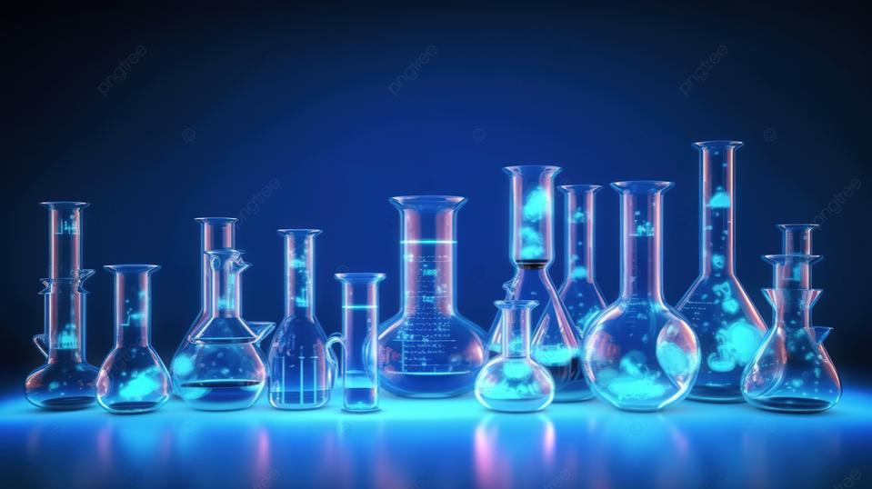
2: Table of Contents
Introduction to Microbiological Assays 2. Types of Microbiological Assays 3. Applications in Pharmaceuticals 4. Steps in Microbiological Assay 5. Advantages and Limitations.
6. Conclusion

Slide 3
Introduction to Microbiological Assays
Definition: A microbiological assay is a procedure that measures the concentration or potency of a substance using microorganisms as test organisms. Essential for determining the potency of antibiotics, vitamins, and amino acids. Ensures the quality and efficacy of pharmaceutical products. Examples: Assay of Penicillin, Vitamin B1

Slide 4
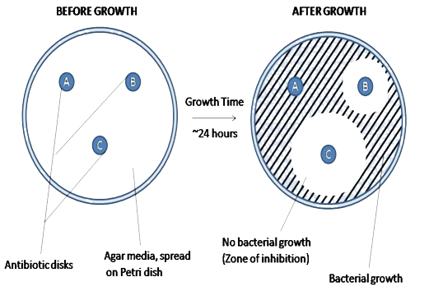
Types of Microbiological Assays
1. Turbidimetric Assay Measures growth as turbidity in a liquid medium. Suitable for water-soluble substances. 2. Agar Diffusion Assay Measures the zone of inhibition on an agar plate. Commonly used for antibiotics.

Slide 5
Applications in Pharmaceuticals
Quality control of antibiotics. Determination of vitamin levels in food and pharmaceuticals. Research and development of new drugs. Clinical diagnostics.

Slide 6
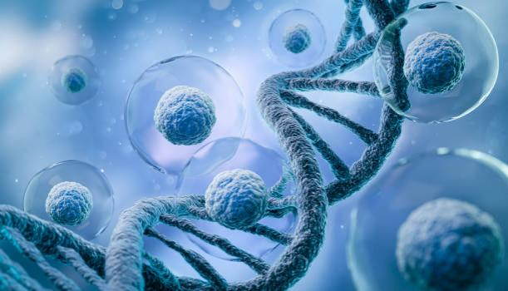
Steps in Microbiological Assay
1. Selection of test organism. 2. Preparation of standard solutions. 3. Inoculation and incubation. 4. Measurement of growth (e.g., turbidity,

Slide 7
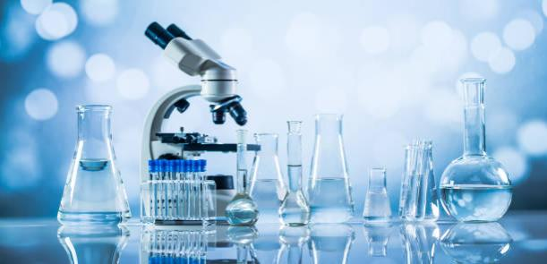
Advantages and Limitations
Advantages: High sensitivity to active substances. Economical and requires simple equipment. Limitations: Time-consuming process. Results can vary due to environmental factors.

Slide 8
Conclusion
Microbiological assays are integral to ensuring the efficacy of pharmaceutical products. They combine microbiology and analytical methods to maintain quality standards. Despite limitations, they remain a widely used tool in pharmaceuticals.

Slide 9
Reference

Slide 10


