Slide 1

AMBEKESHWAR Institute
of Technology & Management
Presentation
On
Industrial Training of E-Commerce
PRESENTED BY:-
Shivam
Diploma C.S.E.
3rd Year
SUBMITTED BY:-
Ms. Richa Mishra

Slide 2
Introduction to
Rapid Mart
We are living in the computer age during past some year. The computer has gaining popularity. Computer revolution found its way into almost every aspect of human life and living.
This Software is used mainly for stores to maintain the details of electronic device such as stock and account.
The Rapid Mart software is so designed as to ease the workload of Rapid Mart professionals.
The main feature includes Inventory, and stock control and customer management.
We cannot easily manage to store large number of data or information single handle.

Slide 3
Research Analysis
Why Rapid Mart ?
Manually managing store data is time-consuming and prone to errors. It often hinders efficient operations and accurate decision-making.
Solution
Making a system where employees can easily manage and control products, stock, and billing systems.
The Rapid Mart software is so designed as to ease the workload of Rapid Mart professionals. The main feature includes Inventory, and stock control and customer management.

Slide 4
Designing
Fronted Design:-
. Java Swing ,which is a Graphical User Interface toolkit ,
used to create a desktop application.
Backend Design:-
. Java is mainly used as backend.
. MySQL-connector-java library is used to connect MySQL database with Java.
. JDK 1.8 is used to run the project .

Slide 5
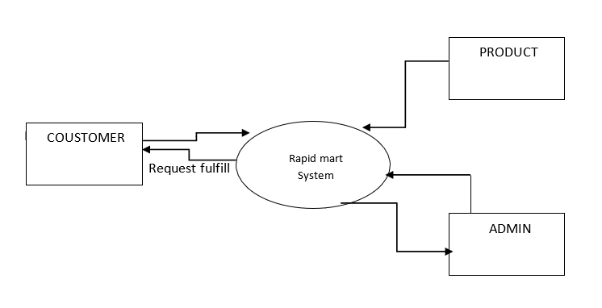
Data Flow Diagram
Zero level Diagram

Slide 6
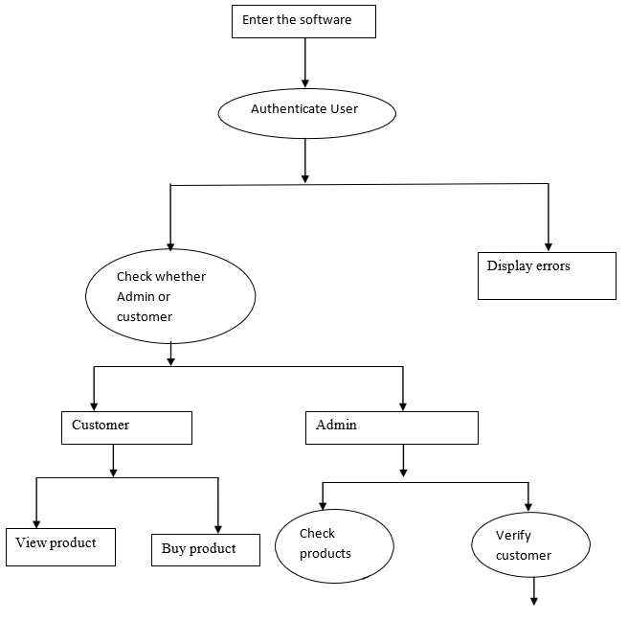
0 level Diagram

Slide 7
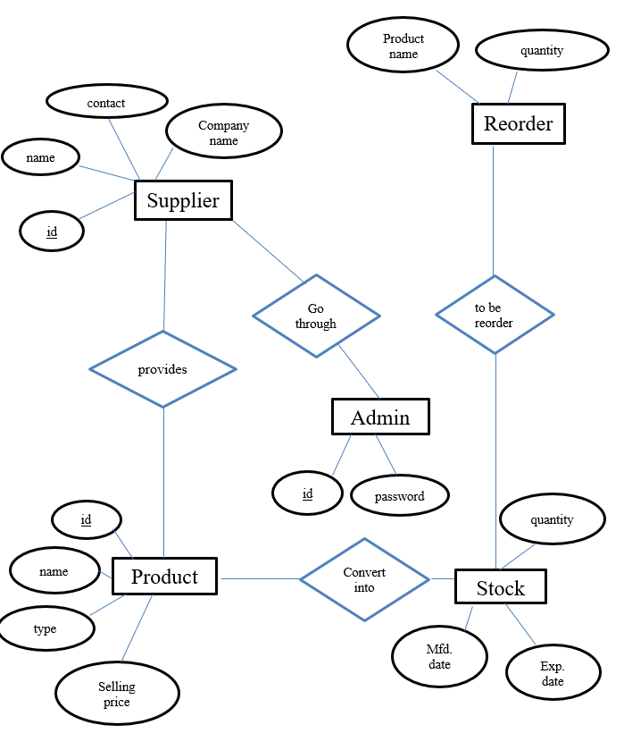
ER Diagram

Slide 8
Software and Hardware
Requirements
Software Used:-
. Java Swing ,which is a Graphical User Interface toolkit .
. JDK and NetBeans IDE for backend logic.
. MySQL and SQLYOG to store and manage data.
Hardware Required:-
. A computer with at least 8GB RAM .
. A dual-core processor.
. A reliable internet connection with sufficient bandwidth.

Slide 9
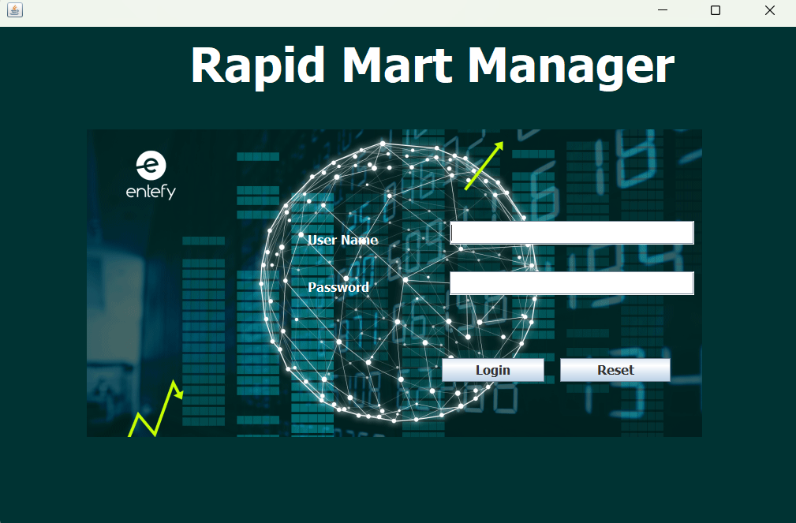
Login Window

Slide 10
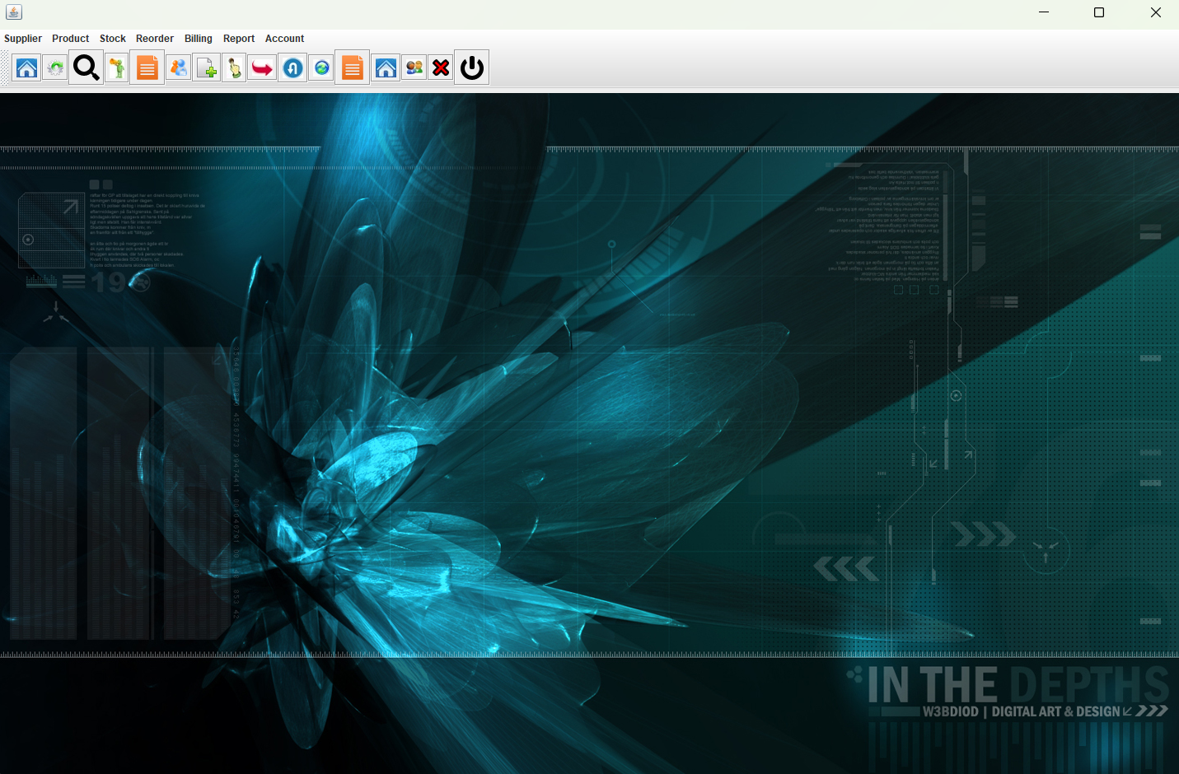
Main Window

Slide 11
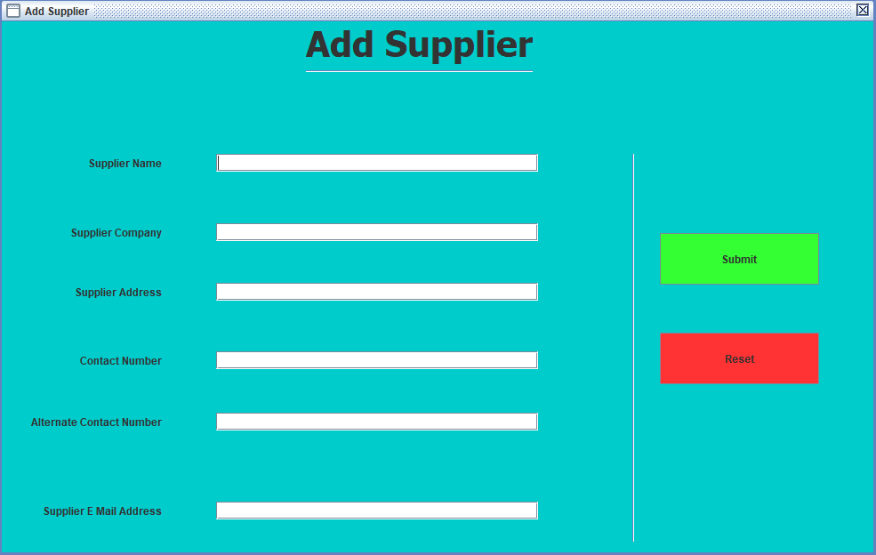
Here you can add new Supplier

Slide 12
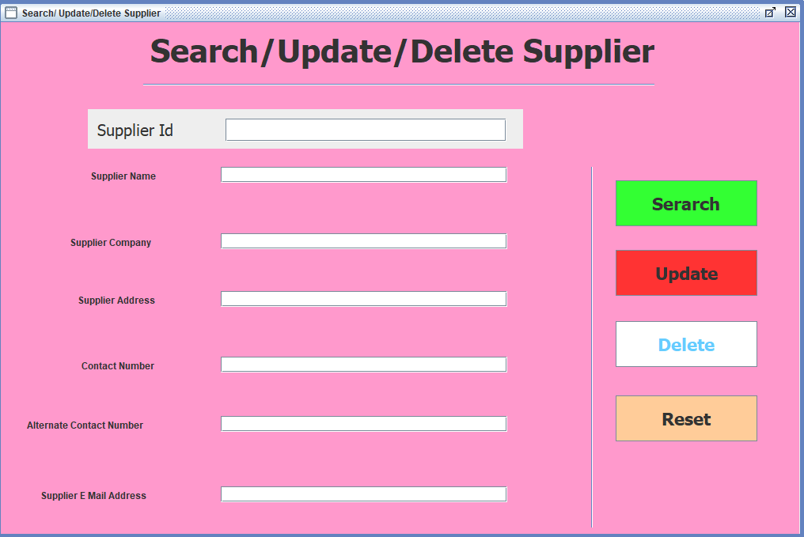
Here you can Update supplier

Slide 13
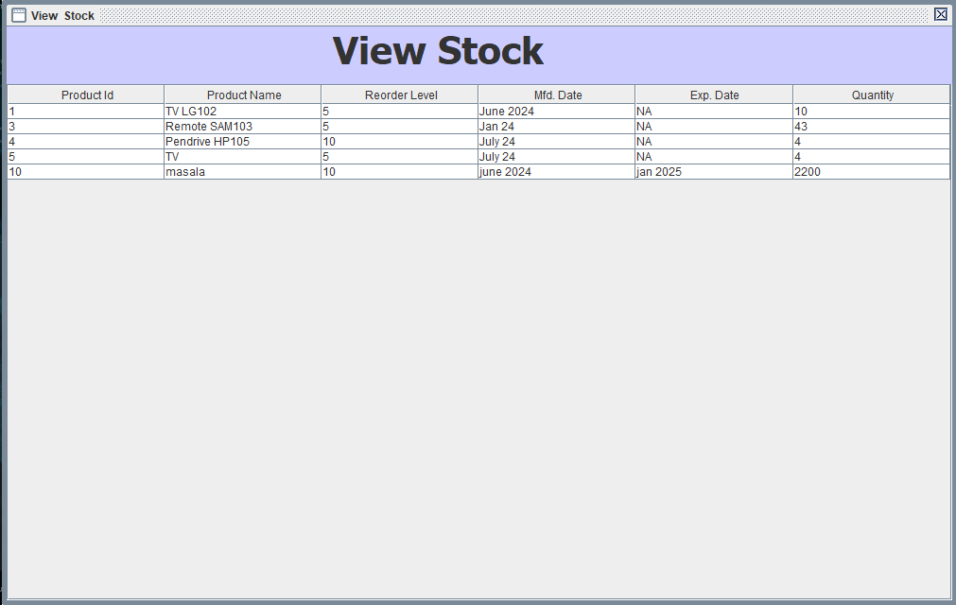
View Stock

Slide 14

Conclusion & Future Scope
Conclusion:-
The application is portable which ensure its adaptability for use on different computer terminals with different operating system and standards.
Future scope:-
Rapid Marts can grow by using technology and offering more services. They can use self-checkout and mobile payments to make their billing easier. By doing these things, Rapid Marts can attract it’s more users and become more successful.

Slide 15
References
Tutorials:-
. W3School for MySQL.
Tools Used :-
. JDK
. MySQL
. NetBeans IDE
Acknowledgment:-
Thanks to my trainer and the organization for their guidance.

