Slide 1




SMART INDIA HACKATHON 2026
TRINETRA OS - DELHI
“City-Wide Traffic Intelligence & Vehicle Trajectory Platform”
  Problem Statement ID – 26127
  Problem Statement Title- City-Wide AI Engine for Multi-Camera ANPR Trajectory Tracking and Urban Traffic Analytics
  Theme- Smart Automation
  PS Category- Software
  Team ID-
  Team Name- Baazigars

Slide 2











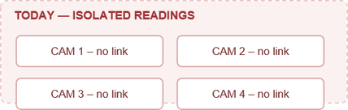

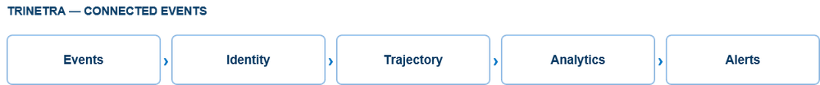
TRINETRA OS
Baazigars
one event driven platform turning city ANPR cameras into live vehicle tracking, traffic analytics & instant alerts.
"From isolated camera detections to connected city-wide intelligence."
CAPTURE → CONVERT TO EVENTS
ONE VEHICLE, ONE IDENTITY
FROM SIGHTINGS TO JOURNEY
INDIVIDUAL VEHICLES → CITY-LEVEL INSIGHTS
DETECT → ALERT → INVESTIGATE
ONE OPERATIONAL VIEW
  Instead of sending continuous video to the central server, each camera generates a lightweight event containing plate, timestamp, camera ID, location and confidence.
  Our Delhi demonstration uses ~60 virtual ANPR camera/gate locations placed on real Delhi junctions such as CP, India Gate, Lodi Road and South Ex.
  Standardized ingestion: Every source follows the same POST /ingest/v1/events contract, so replacing simulated feeds with real camera feeds does not require redesigning the downstream system.
  Raw plate readings are canonicalized into a consistent format before processing.
  The system compares OCR variants instead of blindly trusting every reading.
  Plates with up to one-character difference can be associated when they occur within a 10-minute temporal window.
  DL51AB1234 → DL51AB123I → DL51AB1234 can still be treated as the same vehicle observation sequence.
  Missed detections create gaps rather than automatically breaking the vehicle's identity, improving trajectory robustness under imperfect ANPR.
  Cross-camera trajectory reconstruction: Connects detections of the same vehicle across multiple ANPR cameras
  Each detection contributes camera location + timestamp + confidence to the vehicle's journey.
  The reconstructed route is drawn directly on the Delhi road network.
  Journey intelligence: The system derives inter-camera travel information such as hop timing and speed where data supports it.
  Authorities can search a plate and view its route, detection sequence and timeline.
  Real-time traffic density: Aggregates camera observations into traffic-volume rollups and map-based heatmaps.
  Congestion detection: Compares observed travel time against a free-flow reference to identify heavy/congested corridors.
  Origin–Destination analysis: Determines aggregated movement between camera regions — essentially “Where are vehicles coming from and where are they going?”
  Peak-hour analysis: Tracks traffic trends across time windows to identify changing traffic patterns.
  Camera health analytics: Monitors expected vs observed detections to identify healthy, degraded or down cameras.
  Blacklisted vehicle
Authority adds a vehicle plate to the blacklist.
A matching detection automatically generates a blacklist alert.
Alert is published to the dashboard for operator acknowledgement/investigation.
  Impossible travel
The system compares detections of the same plate across cameras.
If the vehicle appears at another location faster than physically possible, it generates an impossible-travel alert.
  Camera anomalies
Monitors camera observation patterns against expected activity.
  Centralized command interface: Combines the city map, vehicle trajectories, traffic analytics, camera health and alerts.
  Live GIS map: Displays cameras, traffic heatmaps and active vehicle movement.
  Alert management: View, acknowledge and investigate blacklist/impossible-travel/anomaly alerts.
  Analytics view: Provides congestion, traffic volume, OD patterns and camera-health information.
  Operator-focused design: Information is organized for quick investigation rather than requiring authorities to switch between multiple systems.
Existing problem
Our solution
We don't just detect vehicles—we connect their movement to understand the city.
City-Wide Traffic Intelligence
Lack of Macro-Level Traffic Insights
Isolated Data Silos
Unified Event-Based Network
Generates congestion heatmaps and identifies congested corridors.and Calculates traffic density/volume trends from camera observations.
Camera infrastructure only performs localized detection (e.g., spot-checking a single lane).
Existing CCTV and ANPR cameras operate independently without communication between nodes.
Connects multiple ANPR camera sources through a common event-ingestion layer and standardizes event containing plate, timestamp, camera ID/location and confidence for each camera sighting.
Generates Origin–Destination (OD) patterns from vehicle movement between camera regions.and Calculates travel-time/congestion indicators for monitored corridors.
It fails to extract aggregated trends like overall city traffic density, origin-destination patterns, or system-wide bottleneck locations.
Data is captured locally, preventing central visibility across different sectors or jurisdiction boundaries.
Redis-based real-time event processing and Stores events centrally in PostgreSQL + PostGIS + TimescaleDB, creating a common source of truth.
Provides camera health/coverage analytics to indicate where data may be unreliable.
Compatible with future RTSP/edge camera feeds
Robust ANPR Pipeline
Environmental & Real-World Accuracy Drop
Inability to Track Vehicle Trajectories
City-Wide Trajectory Reconstruction
designed to accept imperfect ANPR results rather than assuming every plate read is correct and Uses confidence-aware normalization and fuzzy matching to tolerate OCR variations.
Lack of spatial-temporal data linking makes it impossible to trace a vehicle's continuous journey across the city.
Links vehicle detections from different cameras using plate normalization + fuzzy matching and Handles minor OCR errors so one incorrect character does not immediately break the vehicle's journey.
Missed detections create trajectory gaps instead of automatically terminating vehicle identity.
Standard OCR systems degrade under real-world conditions like motion blur, extreme angles, bad weather, poor lighting, or damaged license plates.
Security agencies cannot efficiently recreate historical routes of high-interest or blacklisted vehicles.
Uses timestamp + camera location + matching confidence to reconstruct the vehicle's movement.
Planned YOLO + PP-OCRv4 production pipeline and Target: >90% accuracy across conditions
Displays the reconstructed journey on a GIS map and provides trajectory search so authorities can investigate a vehicle using its plate.
Team: Baazigars SIH26127
2
Missed detections create trajectory gaps instead of automatically terminating vehicle identity.
Notes:
2

Slide 3
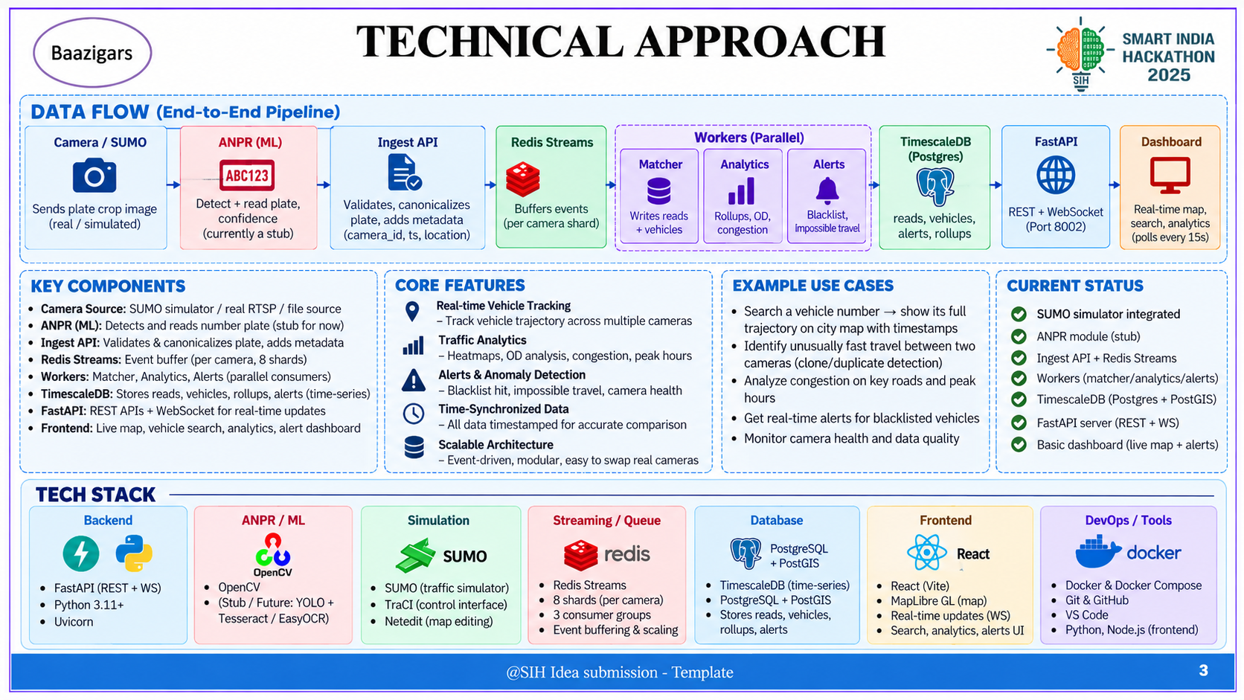
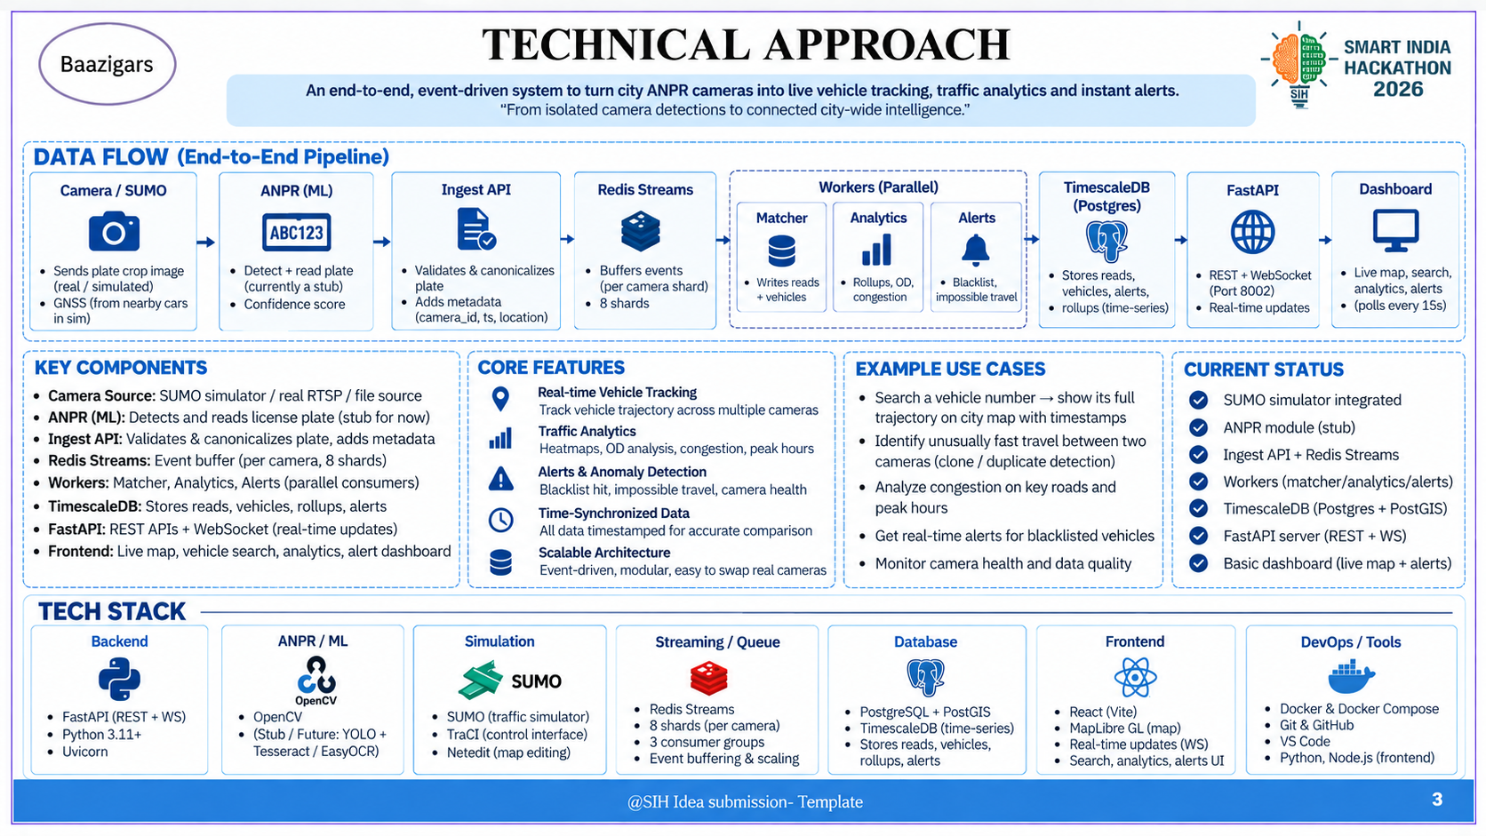
@SIH Idea submission- Template
3
Team: Baazigars SIH26127
3
Notes:
3

Slide 4

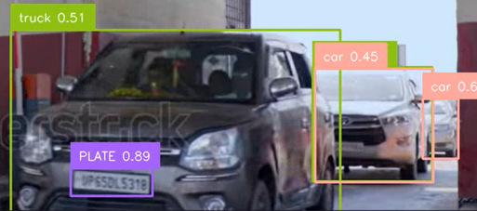
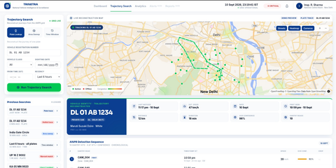
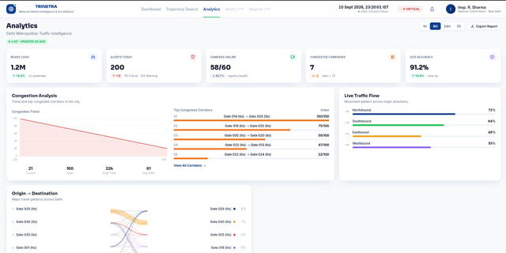
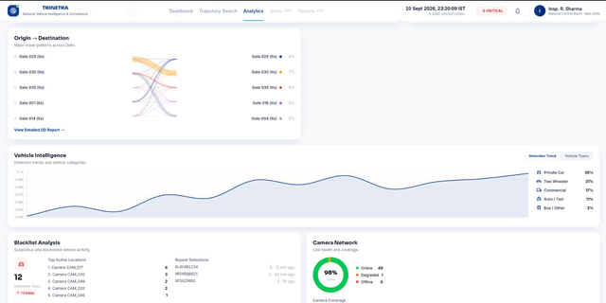
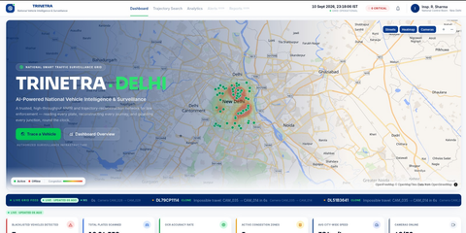

FEASIBILITY AND VIABILITY
Baazigars
Built as a modular event-driven system, validated on a realistic Delhi traffic simulation and designed for real camera integration.
REAL-TIME OPERATIONAL FEASIBILITY
SCALABILITY & DEPLOYMENT FEASIBILITY
REAL-WORLD VALIDATION FEASIBILITY
RISK-RESILIENT SYSTEM DESIGN
Can it respond fast enough?
Can it grow city-wide?
Has it been tested against realistic conditions?
Can it handle imperfect conditions?
Trinetra processes lightweight vehicle events instead of continuously sending video through the entire system, allowing alerts to be generated quickly as vehicles are detected.
The system is designed so that additional cameras and processing capacity can be added without redesigning the complete application.
Instead of validating the system on a small artificial map, Trinetra is tested on a realistic Delhi road network with simulated traffic movement and virtual ANPR checkpoints.
The system is designed to continue producing reliable intelligence even when camera data is incomplete or ANPR recognition is imperfect.
Architecture targets 1000+ cameras and 10K+ events/sec, with processing workers that can scale horizontally.
~13 × 12 km network
11,955 nodes • 30,510 road edges • 75 signals
~60 virtual ANPR gates
ANPR Errors → Confidence + fuzzy matching
Camera Failure → Health monitoring + alerts
High Event Load → Sharding + scalable workers
False Clone Flag → Physics-based validation
Real Deployment → Common camera contract
8 Redis shards distribute incoming events across processing workers, with a <2 sec target for alert visibility.
{
"camera_id": "CAM_017",
"ts": "2026-08-26T09:14:32+05:30",
"plate_raw": "DL 8C AB 1234",
"canonical": "DL8CAB1234",
"confidence": 0.93,
"vehicle_class": "private",
"crop_b64": "...",
"ground_truth": "DL8CAB1234"
}
An event for a vehicle
↑ SAFE DEPLOYMENT
↑ RELIABILITY
TRADITIONAL APPROACH
1000 Cameras
▼ ~3 Gbps VIDEO
▼ CENTRAL SYSTEM
Digital-city validation
Real Delhi road geometry enables repeatable testing before real deployment.
One event → multiple intelligence
The same recorded detection powers trajectory, traffic analytics and alerts.
Why Trinetra is practical ?
TRINETRA APPROACH
1000 Cameras
▼ ~2 MB/s
EVENTS plate • time • camera
▼ CENTRAL SYSTEM
↓ INFRASTRUCTURE CHANGE
↓ DATA BURDEN
Event-based architecture
Only lightweight detection events are centralized.
Event-based architecture
Only lightweight detection events are centralized.
Team: Baazigars SIH26127
4
Notes:
4

Slide 5
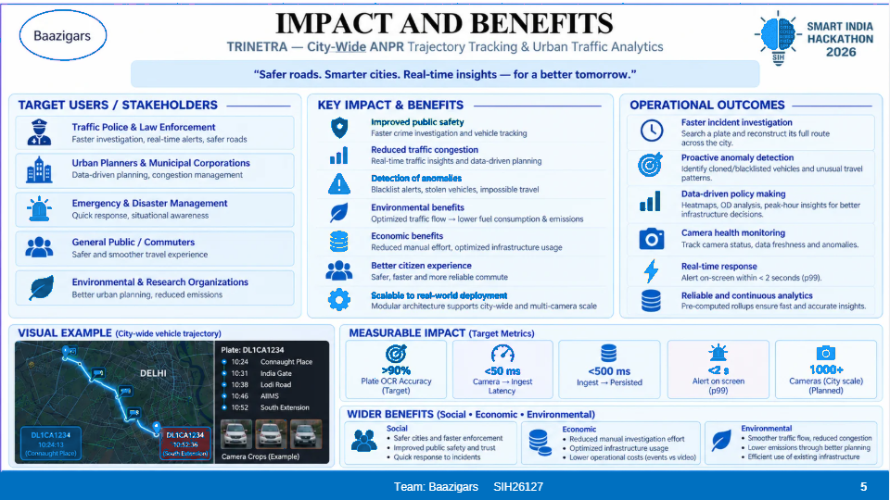
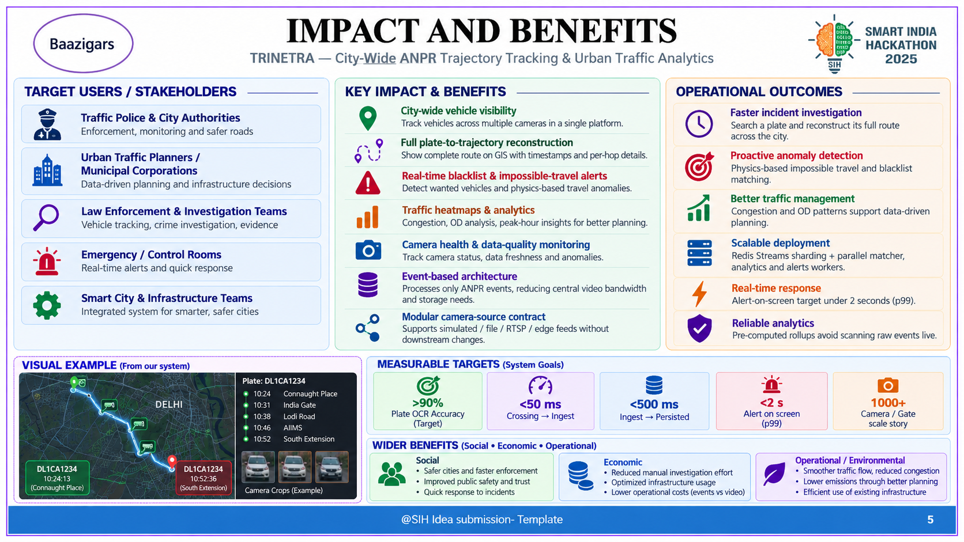
@SIH Idea submission- Template
5
Team: Baazigars SIH26127
5
Notes:
5

Slide 6
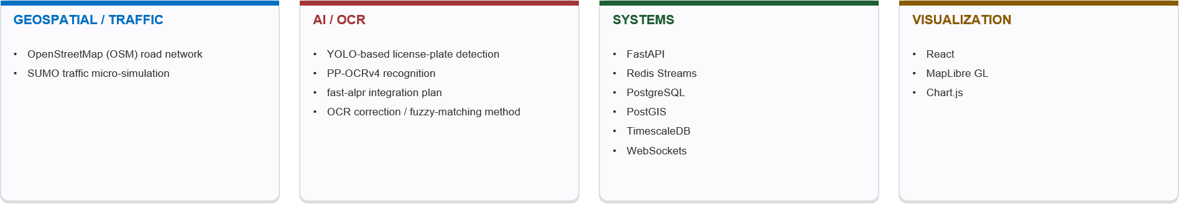
RESEARCH AND REFERENCES
Baazigars
Trinetra combines established research in ANPR, OCR, vehicle re-identification and traffic simulation with scalable event-driven systems to build a unified city-wide intelligence platform
SIH26127 — City-Wide AI Engine for Multi-Camera ANPR Trajectory Tracking and Urban Traffic Analytics
https://www.cv-foundation.org/openaccess/content_cvpr_2016/papers/Redmon_You_Only_Look_CVPR_2016_paper.pdf
Source: IIIT Blog https://share.google/FnpUiPvKHbfVt4ulp
https://www.cv-foundation.org/openaccess/content_cvpr_2016/papers/Redmon_You_Only_Look_CVPR_2016_paper.pdf
Team: Baazigars SIH261127
6
Notes:
6

