Slide 1




SMART INDIA HACKATHON 2026
TRINETRA OS - DELHI
“City-Wide Traffic Intelligence & Vehicle Trajectory Platform”
  Problem Statement ID – 26127
  Problem Statement Title- City-Wide AI Engine for Multi-Camera ANPR Trajectory Tracking and Urban Traffic Analytics
  Theme- Smart Automation
  PS Category- Software
  Team ID-
  Team Name- Baazigars

Slide 2
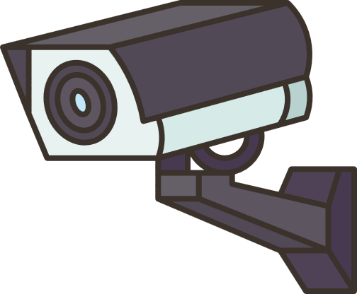







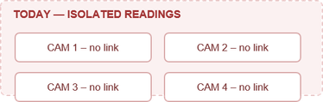
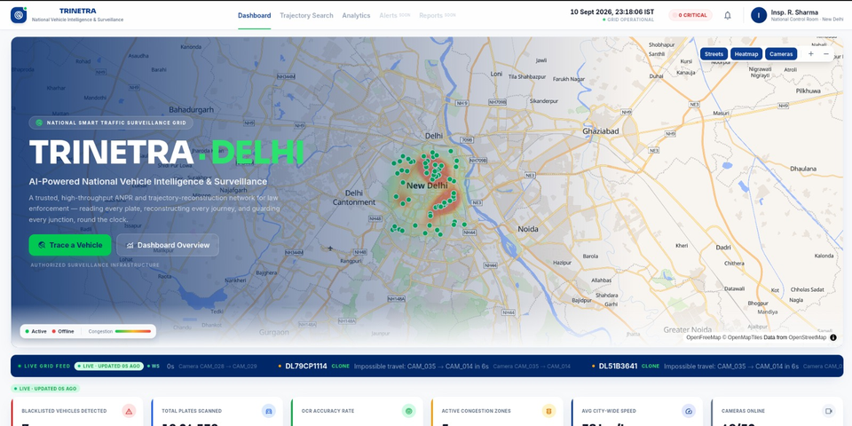

TRINETRA OS
Baazigars
one event driven platform turning city ANPR cameras into live vehicle tracking, traffic analytics & instant alerts.
CAPTURE → CONVERT TO EVENTS
ONE VEHICLE, ONE IDENTITY
FROM SIGHTINGS TO JOURNEY
INDIVIDUAL VEHICLES → CITY-LEVEL INSIGHTS
DETECT → ALERT → INVESTIGATE
ONE OPERATIONAL VIEW
  Instead of sending continuous video to the central server, each camera generates a lightweight event containing plate, timestamp, camera ID, location and confidence.
  Delhi uses ~60 virtual ANPR camera/gate locations on real junctions such as CP, India Gate, Lodi Road etc
  Standardized ingestion: Every source follows the same POST /ingest/v1/events contract, so replacing simulated feeds with real camera feeds does not require redesigning the downstream system.
  Raw plate readings are canonicalized into a consistent format before processing.
  The system compares OCR variants instead of blindly trusting every reading.
  Plates with up to one-character difference can be associated when they occur within a 10-minute temporal window.
  DL51AB1234 → DL51AB123I → DL51AB1234 can still be treated as the same vehicle observation sequence.
  Missed detections create gaps rather than automatically breaking the vehicle's identity, improving trajectory robustness under imperfect ANPR.
  Cross-camera trajectory reconstruction: Connects detections of the same vehicle across multiple ANPR cameras
  Each detection contributes camera location + timestamp + confidence to the vehicle's journey.
  The reconstructed route is drawn directly on the Delhi road network.
  Journey intelligence: The system derives inter-camera travel information such as hop timing and speed where data supports it.
  Authorities can search a plate and view its route, detection sequence and timeline.
  Real-time traffic density: Aggregates camera observations into traffic-volume rollups and map-based heatmaps.
  Congestion detection: Compares observed travel time against a free-flow reference to identify heavy/congested corridors.
  Origin–Destination analysis: Determines aggregated movement between camera regions — essentially “Where are vehicles coming from and where are they going?”
  Peak-hour analysis: Tracks traffic trends across time windows to identify changing traffic patterns.
  Camera health analytics: Monitors expected vs observed detections to identify healthy, degraded or down cameras.
  Blacklisted vehicle
Authority adds a vehicle plate to the blacklist.
A matching detection automatically generates a blacklist alert.
Alert is published to the dashboard for operator acknowledgement/investigation.
  Impossible travel
The system compares detections of the same plate across cameras.
If the vehicle appears at another location faster than physically possible, it generates an impossible-travel alert.
  Camera anomalies
Monitors camera observation patterns against expected activity.
  Centralized command interface: Combines the city map, vehicle trajectories, traffic analytics, camera health and alerts.
  Live GIS map: Displays cameras, traffic heatmaps and active vehicle movement.
  Alert management: View, acknowledge and investigate blacklist/impossible-travel/anomaly alerts.
  Analytics view: Provides congestion, traffic volume, OD patterns and camera-health information.
  Operator-focused design: Information is organized for quick investigation rather than requiring authorities to switch between multiple systems.
Isolated Data Silos
Unified Event-Based Network
We don't just detect vehicles, we connect their movement to understand the city.
CCTV/ANPR cameras operate independently, no inter-node communication
Common event-ingestion layer standardizing plate, timestamp, camera ID/location, confidence
Local data capture → no central visibility across sectors/jurisdictions
Redis real-time processing; central storage in PostgreSQL + PostGIS + TimescaleDB
Future-ready for RTSP/edge camera feeds
Lack of Macro-Level Traffic Insights
City-Wide Traffic Intelligence
Only localized detection (e.g., single-lane checks)
Congestion heatmaps, density/volume trends
Our solution
Origin-Destination patterns, travel-time/congestion indicators
Can't extract city-wide trends: density, OD patterns, bottlenecks
Existing problem
Camera health/coverage analytics for data reliability
EVENTS
Inability to Track Vehicle Trajectories
City-Wide Trajectory Reconstruction
No spatial-temporal linking → can't trace continuous vehicle movement
Links detections via plate normalization + fuzzy matching (tolerant to OCR errors)
IDENTITY
Hard to recreate routes of blacklisted/high-interest vehicles
Reconstructs movement using timestamp + location + confidence
GIS map visualization + plate-based trajectory search
TRAJECTORY
Environmental & Real-World Accuracy Drop
Robust ANPR Pipeline
ANALYTICS
OCR degrades under motion blur, bad angles, weather, poor lighting, damaged plates
Confidence-aware normalization handles OCR variations
Missed detections → gaps, not broken identity
Planned YOLO + PP-OCRv4 pipeline, targeting >90% accuracy
ALERTS
Team: Baazigars | SIH26127
2
Notes:
2

Slide 3








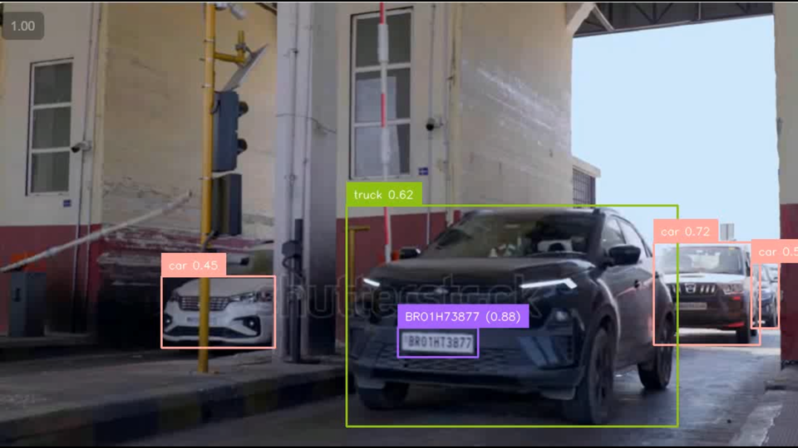
TECHNICAL APPROACH
Baazigars
An end-to-end, event-driven system turning city ANPR cameras into live tracking, analytics and instant alerts.
"From isolated detections to connected city-wide intelligence."
60 cameras · 296 detector loops · 13×12 km Delhi OSM (11,955 nodes / 30,510 edges) · ~300 events/sec · alert on screen <2s p99 · ANPR avg >90%
Data Flow (From Camera to Dashboard)
CAMERA / SUMO
INGEST API
REDIS STREAMS
WORKERS (PARALLEL)
TIMESCALEDB (POSTGRES)
FASTAPI
DASHBOARD
CORE FEATURES
MATCHER
ANALYTICS
ALERTS
ABC123
  Real + Simulated Feeds
  Gate triggers + speed
Validates and canonicalizes plate
Adds metadata (camera_id, ts, location)
The Waiting Line :
So that nothing is lost at rush hour
Optimized for chronological and time-series data indexing
  REST
  Websocket
  Pushes Live Updates within seconds
Live map, search, analytics, alerts (polls every 150ms)
Reads the Plate
Find + Straighten + OCR + Correct Mismatches
Fuzzy edits plates
Rollups, travel time graph,
OD matrix,
Blacklist, impossible travel, camera health
KEY COMPONENTS
CORE FEATURES
ANPR ENGINE
ACCURACY
SCORECARD
CORRECTOR
  Camera source: SUMO sim / RTSP / file (one swap layer)
  ANPR service: plate brain of the system (see →)
  Ingest + Redis: ordered, buffered event backbone
  Workers: parallel fuzzy-match, analytics, alerting
  TimescaleDB + API + dashboard: store once, serve fast
PIPELINE
  Real-time Vehicle Tracking — full trajectory + timestamps
  Traffic Analytics — heatmap, OD, congestion, peak hours
  Alerts & Anomaly Detection — blacklist, clone/impossible travel, camera health
  Scalable Architecture — event-driven, swap real cameras in
find the plate → straighten the photo → read characters → fix letter/digit mix-ups → confidence score
Indian plates follow rules. We use them:-
0↔O, 1↔I, 8↔B only where a digit or letter must be. Measured on our test model: exact-match 89.2% → 91.7%
CLEAN
97%
BLUR
93%
NIGHT
88%
RAIN
86%
average ~91%
TECH STACK
Backend
ANPR / ML
Simulation
Streaming /Queue
Database
Frontend
  FastAPI (REST + WS)
  Python 3.11+
  Unicam
  OpenCV
  (Stub / Future: YOLO + Tesserate / EasyOCR)
  SUMO (Traffic simulator)
  TraCI (control interface)
  Netedit (map editing)
  Redis Streams
  8 shards
  3 consumer groups
  Event buffering & scaling
  PostgreSQL (time-series)
  TimescaleDB (time-series)
  Stores reads, vehicles, rolls, alerts
  React (Vite)
  MapLibre GL
  Realtime updates WebSocket
  Search, analytics, alerts UI
@SIH Idea submission- Template
3
Team: Baazigars | SIH26127
3
Notes:
3

Slide 4


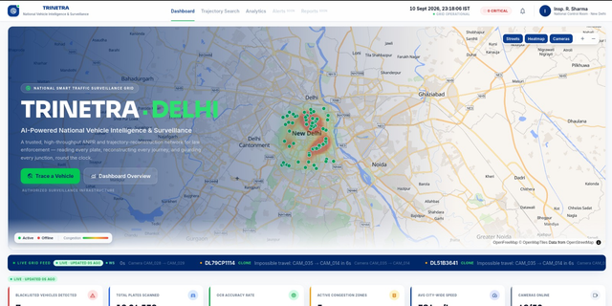
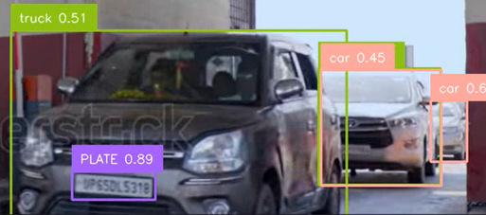
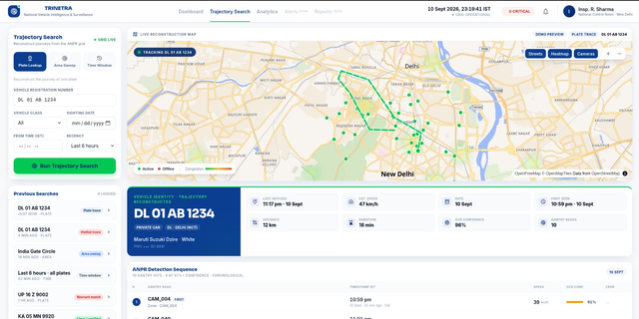
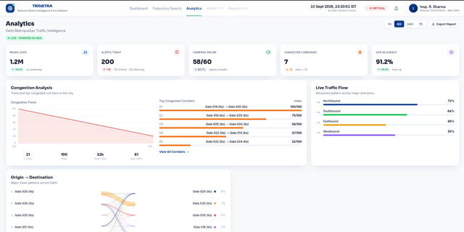
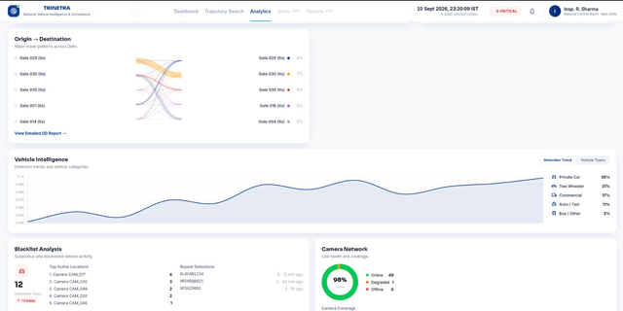

FEASIBILITY AND VIABILITY
Baazigars
Built as a modular event-driven system, validated on a realistic Delhi traffic simulation and designed for real camera integration.
REAL-TIME OPERATIONAL FEASIBILITY
SCALABILITY & DEPLOYMENT FEASIBILITY
REAL-WORLD VALIDATION FEASIBILITY
RISK-RESILIENT SYSTEM DESIGN
Can it respond fast enough?
Can it grow city-wide?
Has it been tested against realistic conditions?
Can it handle imperfect conditions?
  Trinetra processes lightweight vehicle events instead of streaming full video, enabling fast alert generation as vehicles are detected
  Designed so additional cameras and processing capacity can be added without redesigning the full application.
  Tested on a realistic Delhi road network with simulated traffic and virtual ANPR checkpoints, instead of a small artificial map
  Built to keep producing reliable intelligence even with incomplete camera data or imperfect ANPR recognition
  Architecture targets 1000+ cameras and 10K+ events/sec, with processing workers that scale horizontally
  ~13×12 km network: 11,955 nodes
  30,510 road edges
  75 signals
  ~60 virtual ANPR gates
  ANPR Errors → Confidence + fuzzy matching
  Camera Failure → Health monitoring + alerts
  High Event Load → Sharding + scalable workers
  False Clone Flag → Physics-based validation
  Real Deployment → Common camera contract
  8 Redis shards distribute incoming events across processing workers, targeting <2 sec alert visibility
{
"camera_id": "CAM_017",
"ts": "2026-08-26T09:14:32+05:30",
"plate_raw": "DL 8C AB 1234",
"canonical": "DL8CAB1234",
"confidence": 0.93,
"vehicle_class": "private",
"crop_b64": "...",
"ground_truth": "DL8CAB1234"
}
An event for a vehicle
↑ SAFE DEPLOYMENT
↑RELIABILITY
TRADITIONAL APPROACH
1000 Cameras
▼ ~3 Gbps VIDEO
▼ CENTRAL SYSTEM
  Digital-city validation
  Real Delhi road geometry enables repeatable testing before real deployment.
  One event → multiple intelligence
The same recorded detection powers trajectory, traffic analytics and alerts.
Why TRINETRA is practical ?
↓ DATA BURDEN
TRINETRA APPROACH
1000 Cameras
▼ ~2 MB/s
EVENTS plate • time • camera
▼ CENTRAL SYSTEM
↓ INFRASTRUCTURE CHANGE
  Sends only lightweight text events (plate, time, location) instead of streaming raw video, keeping bandwidth and storage needs minimal
  Works with existing ANPR/CCTV cameras;
  no need to replace hardware, just plug into the common event-ingestion layer.
Team: Baazigars | SIH26127
4
Notes:
4

Slide 5




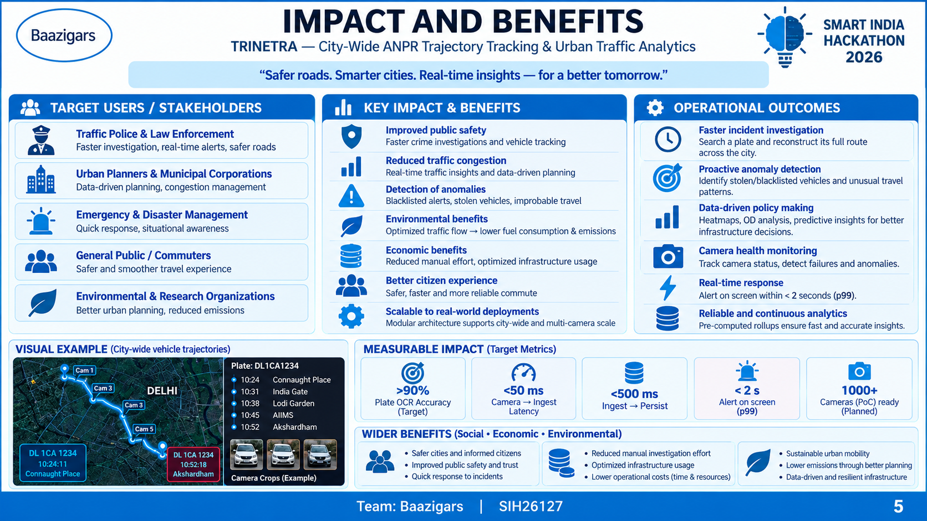


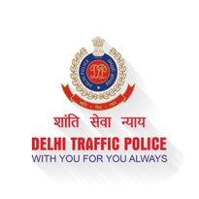
IMPACT AND BENEFITS
Baazigars
TRINETRA CRAETES VALUE FOR AUTHORITIES , CITIZENS AND THE CITY BY TURNING INTO ACTIONABLE INTELLIGENCE - FASTER, SMARTER AND AT SCALE
FASTER LAW ENFORCEMENT
SMARTER TRAFFIC MANAGEMENT
ANOMOLY DETECTION
BETTER CAMERA UTILISATION
  Search a vehicle and reconstruct its city-wide movement history.
  Receive alerts for blacklisted vehicles and suspicious travel patterns.
  Reduce time spent manually correlating multiple camera records.
  Identify congested corridors and traffic hotspots in real time.
  Analyse origin–destination patterns to understand how traffic moves across the city.
  Support better decisions on traffic diversion, infrastructure and peak-hour management.
Less time in traffic → Faster mobility → Better city-wide traffic flow
  Detect blacklisted/wanted vehicles as they appear at monitored locations.
  Flag impossible travel / potential cloned plates when the same identity appears at physically incompatible locations.
  Detect unusual traffic or camera behaviour through continuous monitoring.
  Convert individual camera detections into city-wide intelligence.
  Monitor camera health, data freshness and inactive nodes.
  Existing cameras can feed the platform through a common event interface instead of requiring a completely new system.
REAL-TIME SITUATIONAL AWARENESS
ECONOMIC BENEFITS
  Live map combines vehicles, cameras, congestion and alerts in one operational view.
  Alerts are designed to reach the authority dashboard within a <2 sec p99 target.
  Authorities can move from detection → investigation → action from the same platform.
  Reduced manual investigation effort → less time and manpower spent correlating CCTV/ANPR records.
  Better use of existing infrastructure → extracts more intelligence from deployed cameras without requiring an entirely new surveillance network.
  Lower operational costs → event-based processing reduces the need to centrally move and store continuous video.
Ministry of Road Transport and Highways
Delhi Traffic Police
MEASURABLE IMPACTS
@SIH Idea submission- Template
5
Team: Baazigars | SIH26127
5
Team: Baazigars SIH26127
5
Notes:
5

Slide 6
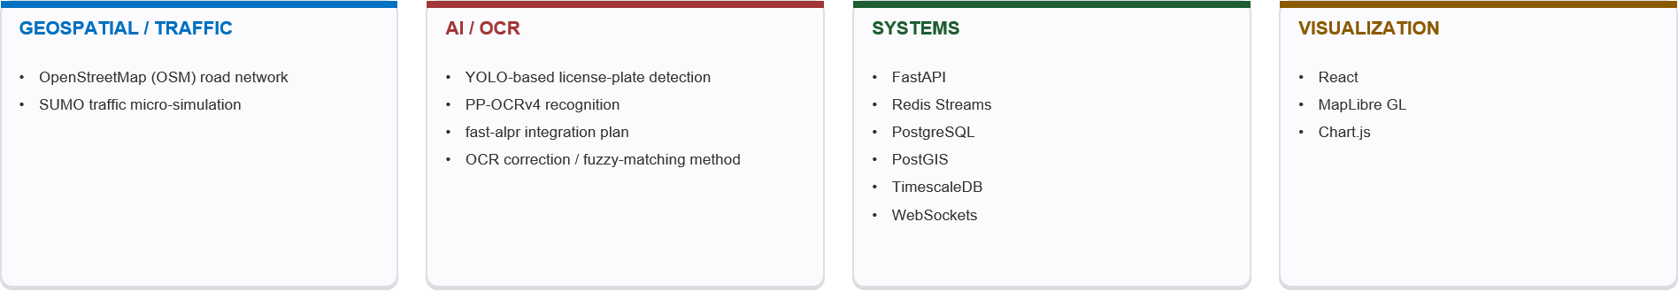

RESEARCH AND REFERENCES
Baazigars
TriNetra combines established research in ANPR, OCR, vehicle re-identification and traffic simulation with scalable event-driven systems to build a unified city-wide intelligence platform
SIH26127 — City-Wide AI Engine for Multi-Camera ANPR Trajectory Tracking and Urban Traffic Analytics
https://www.researchgate.net/publication/377677383_Traffic_Management_System_Using_YOLO_Algorithm
https://www.cv-foundation.org/openaccess/content_cvpr_2016/papers/Redmon_You_Only_Look_CVPR_2016_paper.pdf
Adaptive Traffic Signals :
Real-Time Detection :
Indian Traffic Dataset:
https://arxiv.org/html/2507.19912v1
ANPR for Trucks :
https://share.google/FnpUiPvKHbfVt4ulp
Traffic Simulation :
https://www.researchgate.net/publication/224793504_SUMO_Simulation_of_Urban_MObility_An_open-source_traffic_simulation
License Plate Recognition :
https://pubmed.ncbi.nlm.nih.gov/41846120/
Team: Baazigars | SIH26127
6
Notes:
6

