Slide 1
Military Equipment Distribution to Law Enforcement Agency
Dashboard Analysis Report
Generated on 14 May 2026

Slide 2
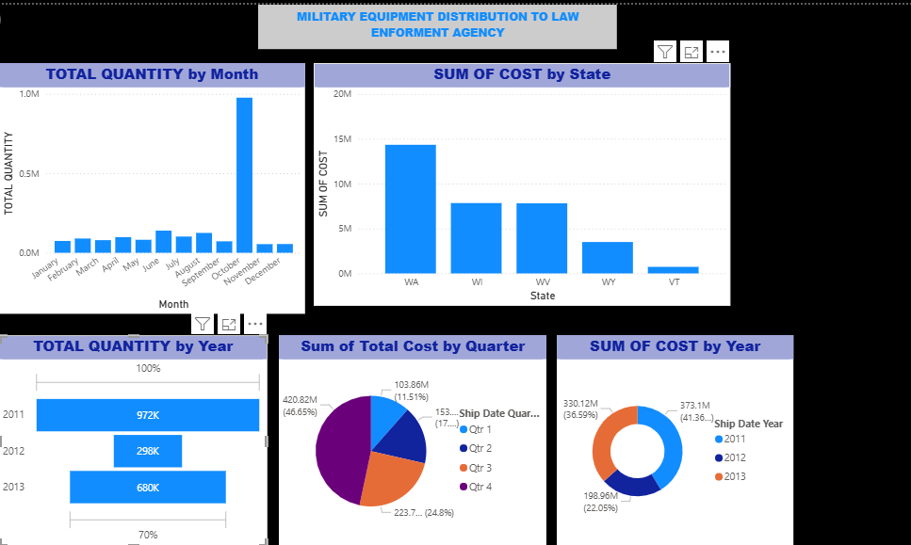
Dashboard Overview
This dashboard provides insights into the distribution of military equipment to law enforcement agencies across different states, months, quarters, and years.

Slide 3
Monthly Quantity Distribution Analysis
Key Insights:
October recorded the highest quantity distributed, approaching 1 million units.
Distribution levels were relatively low between January and September.
A sharp increase in October may indicate large procurement or strategic deployment.
November and December experienced a decline compared to October.

Slide 4
State Cost Distribution Analysis
Observations:
Washington (WA) recorded the highest total equipment cost.
Wisconsin (WI) and West Virginia (WV) showed similar expenditure levels.
Wyoming (WY) and Vermont (VT) had the lowest equipment cost allocations.
The distribution suggests uneven allocation of resources across states.

Slide 5
Yearly Quantity Analysis
Summary:
2011 had the highest quantity distribution at approximately 972K units.
2012 experienced a significant reduction in quantity.
2013 showed recovery with distribution increasing to approximately 680K units.
The fluctuations indicate changes in procurement policy or operational demand.

Slide 6
Quarterly Cost Analysis
Quarterly Breakdown:
Q4 represented the largest share of total costs at approximately 46.65%.
Q3 accounted for nearly 25% of the total expenditure.
Q1 had the lowest contribution at about 11.51%.
Spending appears concentrated toward the end of the fiscal year.

Slide 7
Yearly Cost Analysis
Findings:
2011 recorded the highest total cost contribution at over 41%.
2013 contributed approximately 36.59% of total costs.
2012 represented the smallest share at around 22.05%.
The data indicates that spending levels varied considerably across the years.

Slide 8
Recommendations
Strategic Recommendations:
Investigate the reason behind the October distribution spike.
Review states with low allocation to ensure operational adequacy.
Implement balanced quarterly spending to avoid year-end concentration.
Monitor annual procurement trends for improved forecasting and budgeting.

Slide 9
Conclusion
The dashboard highlights significant variations in military equipment distribution by time period and geographic region. The analysis suggests strong year-end spending patterns and unequal state-level allocation, providing useful insights for strategic planning and resource management.

