Slide 1

Report – Hyperspectral imaging
23.10.2024
Moritz Limbacher

Slide 2
HSI Program in Igor
Explenation and current features
features to implement in the future

Slide 3
Load the files
Remove the cosmic rays

Slide 4
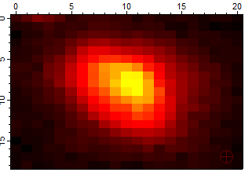
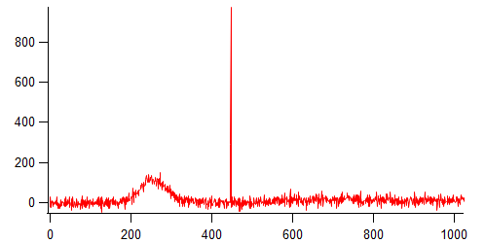
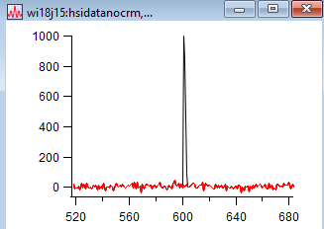
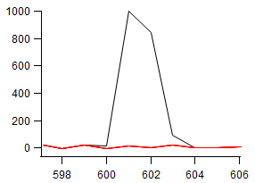
Cosmic ray removal
Calculate derivative of cosmic
Look for cosmic start and end („pairs“) within cosmic width
Interpolate the cosmics by surrounding pixels
Axis: Counts / spectrometer pixel

Slide 5
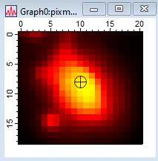
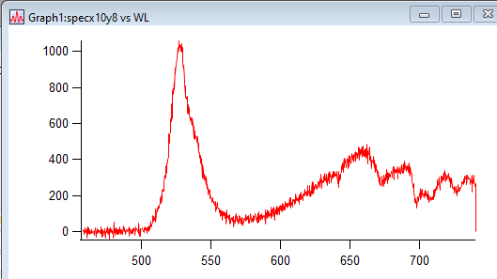
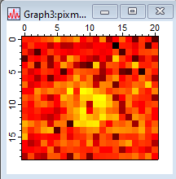
Process Data

Slide 6
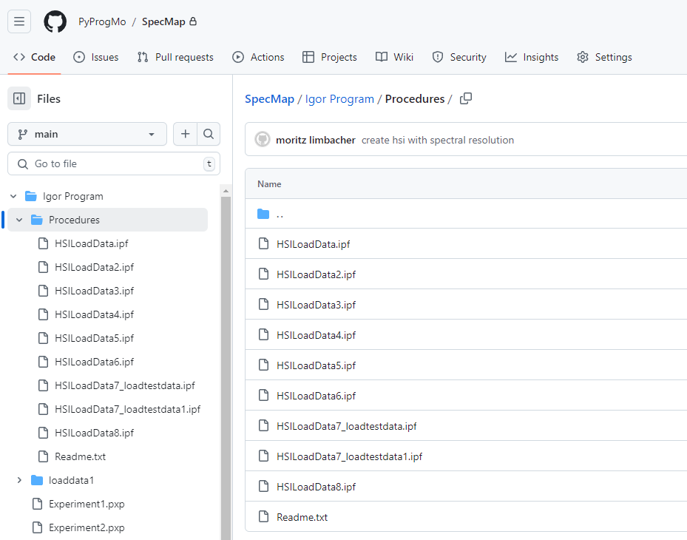
Access on github
1. Register and login
2. Write me your name
3. I add u as cooperation partner
4. now you can always access the newest version

Slide 7
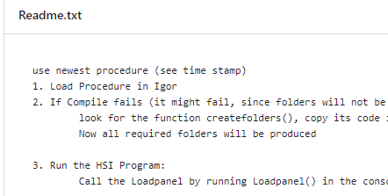
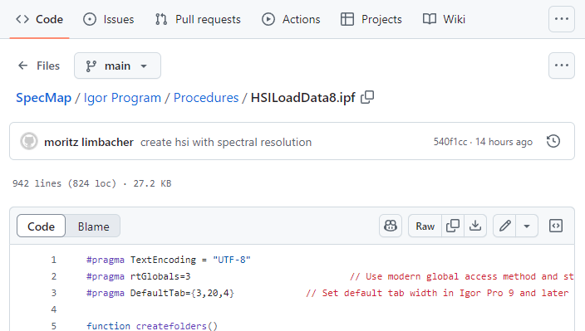
Instruktionen
Download the procedure

Slide 8
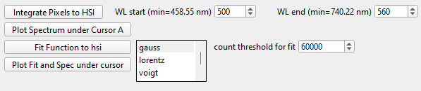
Further steps
Fit to data to obtain further information about the peaks:
- maximum (gaussian) => peak picking
- A, B exciton (double voigt) => peaks, broughdening, ect.
Fitparamters are saved in a 3D wave according to the HSI spec

Slide 9
Further questions?

