Slide 1
Historical VM and Compose Prototype
HISTORICAL CONCEPTUAL VIEW
The original deployment proved the workflow and exposed tightly coupled operational responsibilities.
Mutable VM + Docker Compose boundary
API Gateway
RabbitMQ
Workers + Listener
Legacy adapter
+ OSC-API
Researcher
WebApp
PostgreSQL
External Fabric VM
Peers + ordering + chaincode
Fast learning
Implicit responsibilities
Historical source: original OSC-IS Draw.io architecture and repository history. Not a production topology.
Notes:
Historical conceptual view derived from the original OSC-IS Draw.io diagrams and current-state review. The historical deployment connected the WebApp, API Gateway, PostgreSQL, RabbitMQ, workers, a compatibility adapter/OSC-API path, and an externally managed Fabric VM.

Slide 2
Authorization and Ledger Invariants
EXPERIMENTALLY DEMONSTRATED
Policy lives at the portal boundary; organization and ownership invariants remain enforceable at the ledger boundary.
API Gateway
Fabric provenance contract
Authenticated request
JWT + active organization
PORTAL AUTHORIZATION
LEDGER INVARIANTS
Authentication and active membership
Submitting MSP checks
Portal roles and administration
Organization and ownership rules
Caller tenancy and audit metadata
Stable keys and valid transitions
Organization-scoped routing
Ledger history and idempotency
Cross-organization request denied
Direct Fabric identity misuse denied
NSG
Citizen Science
Fabric used organization service identities; individual attribution remained in trusted Gateway audit metadata.
Notes:
Evidence: C01, C02, and C15 in the US-RSE 2026 claim-evidence matrix. Six authorization controls were recorded in each of two separate disposable AWS runs. Claims apply to tested scenarios only.

Slide 3
Disposable AWS Experiment
EXPERIMENTALLY DEMONSTRATED
GitOps reconciled a two-organization provenance stack on three private EKS nodes.
Git repository
Declared state
Argo CD
Healthy + Synced
Private EKS runtime
3 Ready nodes
Browser
CloudFront + S3
WebApp
NSG Ledger
Gateway
API Gateway
Private Amazon MQ
RabbitMQ
Fabric
2 orgs + ordering
provenance chaincode
PostgreSQL
+ outbox
Submission worker
+ listener
Citizen Science
Ledger Gateway
Secrets Manager + workload identity
Disposable experiment, not a production topology. Workloads and images were deployed by immutable revision/digest.
Notes:
Source: OSC-IS-Infra AWS evidence commits d5975ce and 25aefb8. The EKS path excluded OSC-API and the historical compatibility adapter. OIDC is documented as workflow configuration; the retained evidence does not prove a remote GitHub Actions execution.

Slide 4
Three Evidence Layers
EVIDENCE MODEL
Each layer answers a different question; together they avoid an inflated browser-to-ledger claim.
1 Browser edge
CloudFront, catalogs, navigation, mobile layout, session presentation, axe checks
3/3 browser smoke
2 AWS API-to-ledger
Authorization, asynchronous submission, ledger revisions, recovery, rollout and rollback
Two separate AWS runs
3 Local correlated trace
One request across outbox, RabbitMQ, worker, Ledger Gateway, Fabric, completion and final API state
5 direct + 2 inferred links
No full browser-to-ledger E2E claim
Retained evidence package
Notes:
Evidence boundary: live browser edge smoke plus a separately validated API-to-ledger integration path. The local trace contains five direct records and two bounded inferences.

Slide 5
Controlled Recovery Observations
EXPERIMENTALLY DEMONSTRATED
Elapsed seconds from controlled dependency interruption to observed recovery.
Run 1
Run 2
One ledger revision observed in each retained recovery case
Measured observations from two disposable AWS runs. These are not SLO, HA, or disaster-recovery claims.
Notes:
Sources: run 1 resilience/summary.json at OSC-IS-Infra d5975ce and run 2 aws-recovery/summary.json at 25aefb8. Values: Gateway 46/46 seconds; RabbitMQ-worker 223/226 seconds; alternate peer 6/6 seconds.

Slide 6
GitOps Reconciliation Observations
EXPERIMENTALLY DEMONSTRATED
Argo CD restored declared state and immutable revisions in both disposable runs.
Declared state
Drift detected
Known-good restored
Measured observations, not a production deployment-frequency or reliability target.
Notes:
Sources: run 1 gitops/summary.json at OSC-IS-Infra d5975ce and run 2 aws-gitops/summary.json plus aws-post-rollback/summary.json at 25aefb8.

Slide 7
Observed Kubernetes Workload Topology
EXPERIMENTALLY DEMONSTRATED
A retained snapshot showed 54 Running pods across three Ready EKS nodes.
Argo CD
Healthy + Synced
34 platform pods
6 application pods
14 Fabric pods
All Running
Node A Shared / ordering
Node B NSG
Node C Citizen Science
zone 2a | m7i.large | Ready
zone 2b | m7i.large | Ready
zone 2b | m7i.large | Ready
APPLICATION
APPLICATION
APPLICATION
PostgreSQL
API Gateway
NSG Ledger Gateway
Citizen Science Gateway
Submission worker
Submission listener
FABRIC
FABRIC
FABRIC
Ordering service
NSG CA
Citizen Science CA
Org CA
NSG peers
Citizen Science peers
Chaincode pods
Chaincode pod
Observed scheduling snapshot, not an intended high-availability topology. Node names and private addresses are intentionally omitted.
Notes:
Source: kubernetes-nodes.json, kubernetes-pods.json, and argocd-application.json at OSC-IS-Infra 25aefb8. Counts: 8 Argo CD, 6 Secrets Manager CSI, 3 cert-manager, 1 ingress, 16 kube-system, 6 osc-apps, and 14 osc-fabric pods.

Slide 8
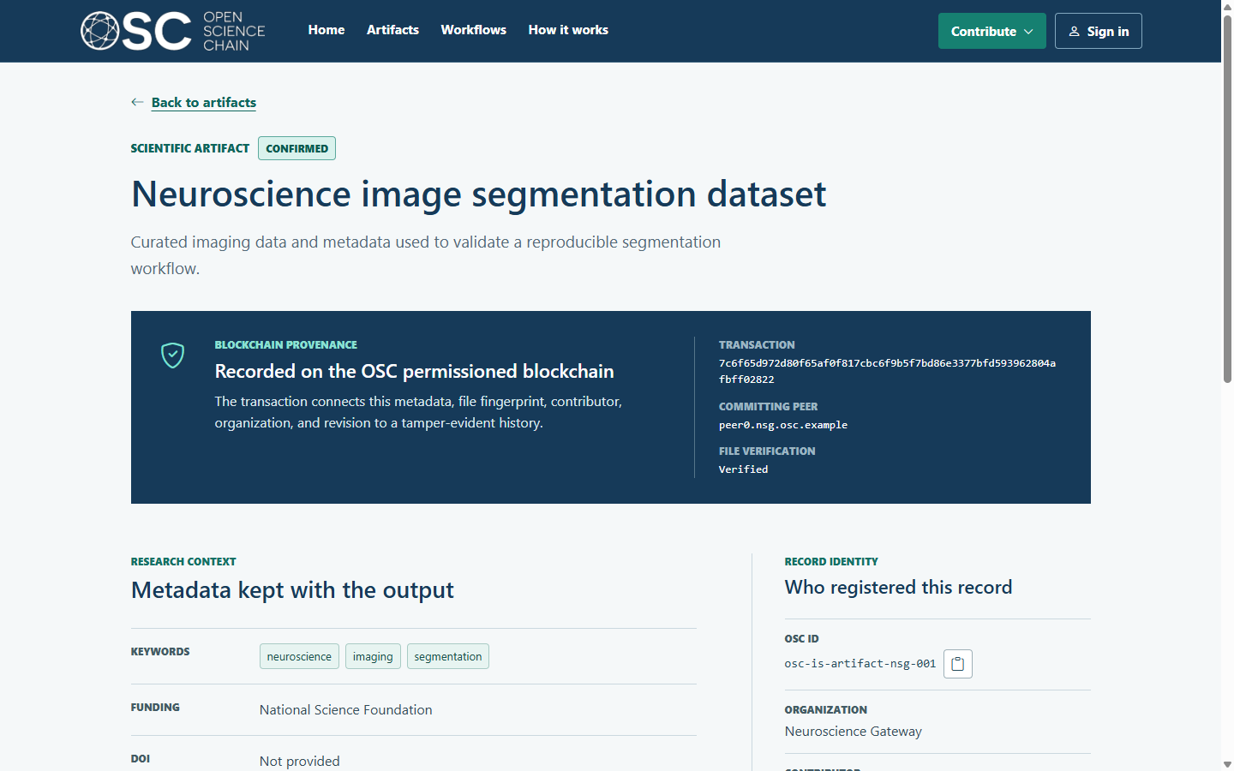
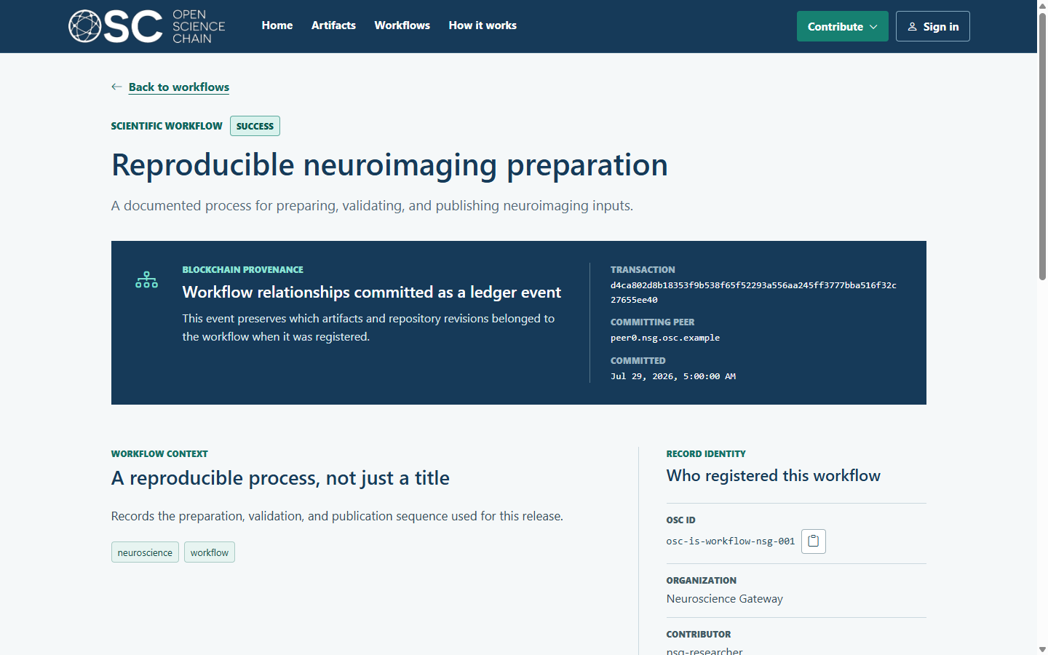
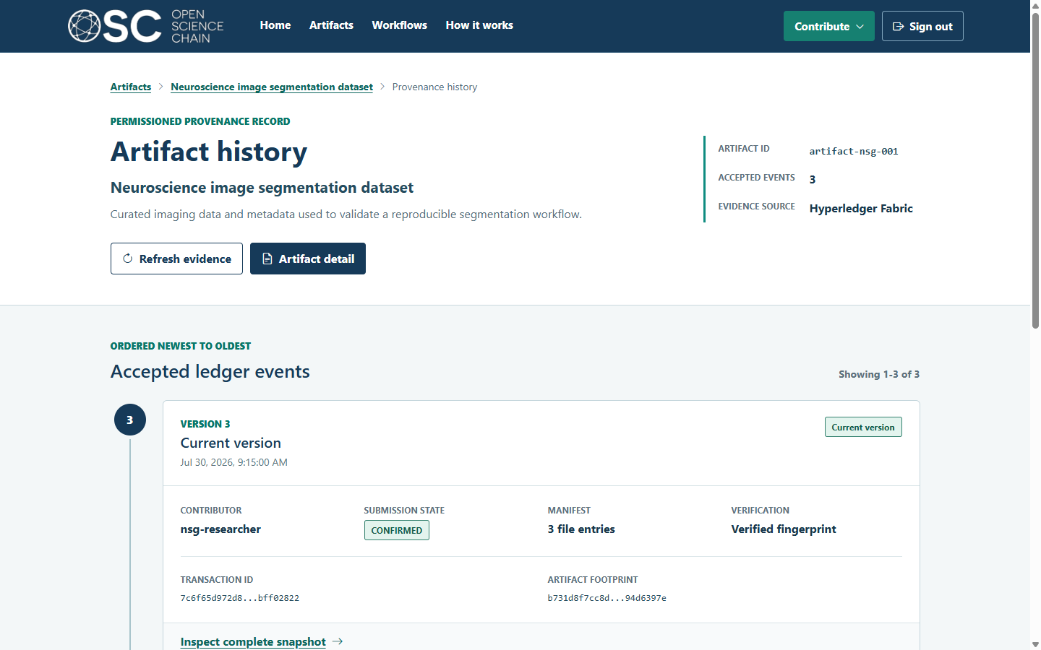
Artifact, Workflow, and Provenance History
CURRENTLY IMPLEMENTED
Deterministic fixtures make the product states repeatable; they are not live-ledger screenshots.
Artifact record
Workflow record
Accepted history
Artifact metadata, organization, fingerprint, and transaction context
Workflow relationships and committed ledger-event context
Version timeline, transaction evidence, and verification state
Three views of the same provenance-centered product model
Source revision: OSC-WebApp 07e2a0f. Demonstration records are synthetic and representative.
Notes:
All three screenshots come from the canonical deterministic UX evidence package at OSC-WebApp 07e2a0f. They support current product-state and visual-design claims, not a live Fabric transaction.

Slide 9
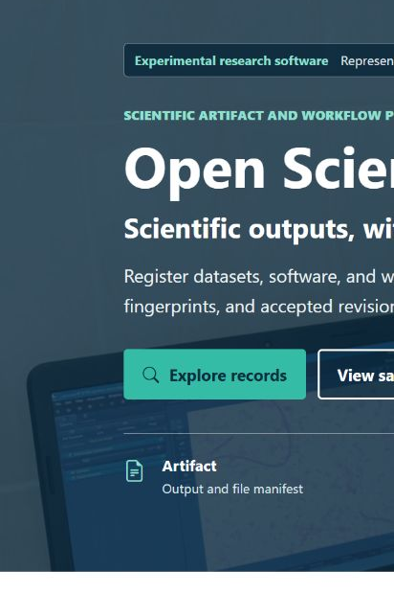
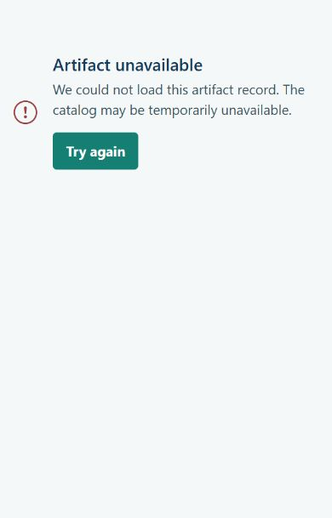
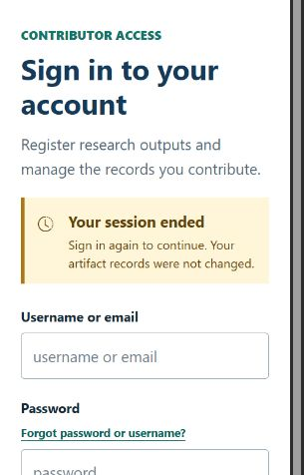
Accessibility Regression Evidence
CURRENTLY IMPLEMENTED
Automated and manual checks target WCAG 2.2 AA; this is not certification.
18
focused unit tests
9/9
Cypress/axe journeys
No screen-reader or native-zoom claim
Keyboard focus
Error and retry
Expired session reflow
Source revision: OSC-WebApp 16b18d3. Report-level 222/222 execution history is not raw-transcript-backed.
Notes:
Evidence includes 18 focused unit tests and 9/9 Cypress/axe journeys, plus manual keyboard, focus, semantics, headings, errors, responsive layout, contrast, non-color cue, and reduced-motion checks. No accessibility certification or legal opinion.

Slide 10
Trust Surfaces Beyond the Ledger
EVIDENCE SUMMARY
Usability, deployability, reviewability, and cleanup were treated as product behavior.
9/9
6
$1.41
0
Cypress/axe journeys
deployed image roles
nearest-cent run estimate
live experiment resources
Accessibility regression
8 retained scan records
$1.42 conservative ceiling
after authoritative teardown
Current release boundary: WebApp governance reports 15 High production dependency findings.
Image-scan findings do not describe the full dependency estate. Cost is an estimate, not an invoice.
Notes:
Evidence summary for slide assembly. Six deployed image roles and eight retained scan records, including two replacements, reported zero High/Critical image-scan findings. Do not generalize this result to all product dependencies or comprehensive security.

