Slide 1


Slide 2


whoami
Joshua
Student @ WMU
Systems Analyst / Developer @ a college
If u want to know more, have a qr code

Slide 3




air who?
Maintained by Open Source Contributors and the Apache Software Foundation
For my big data friends you may recognize apache Hadoop, Cassandra and CouchDB.
The honorable, but not database software, Gaucamole RMS

Slide 4
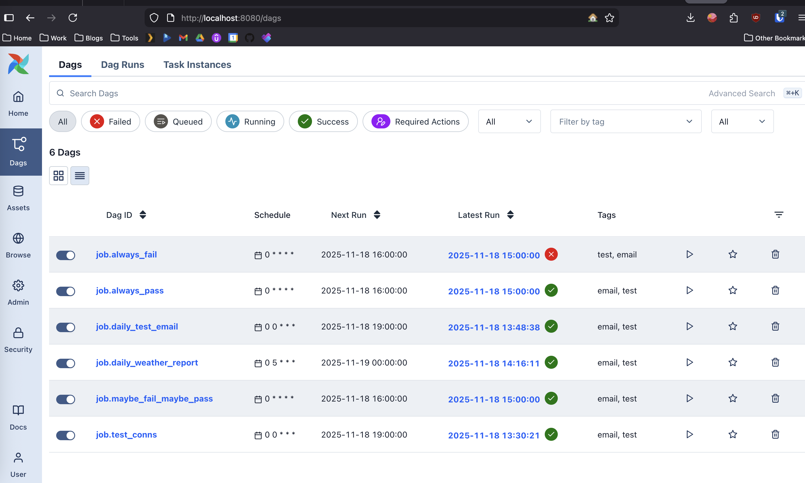
air what?

Slide 5

air why?

Slide 6

a world without airflow

Slide 7
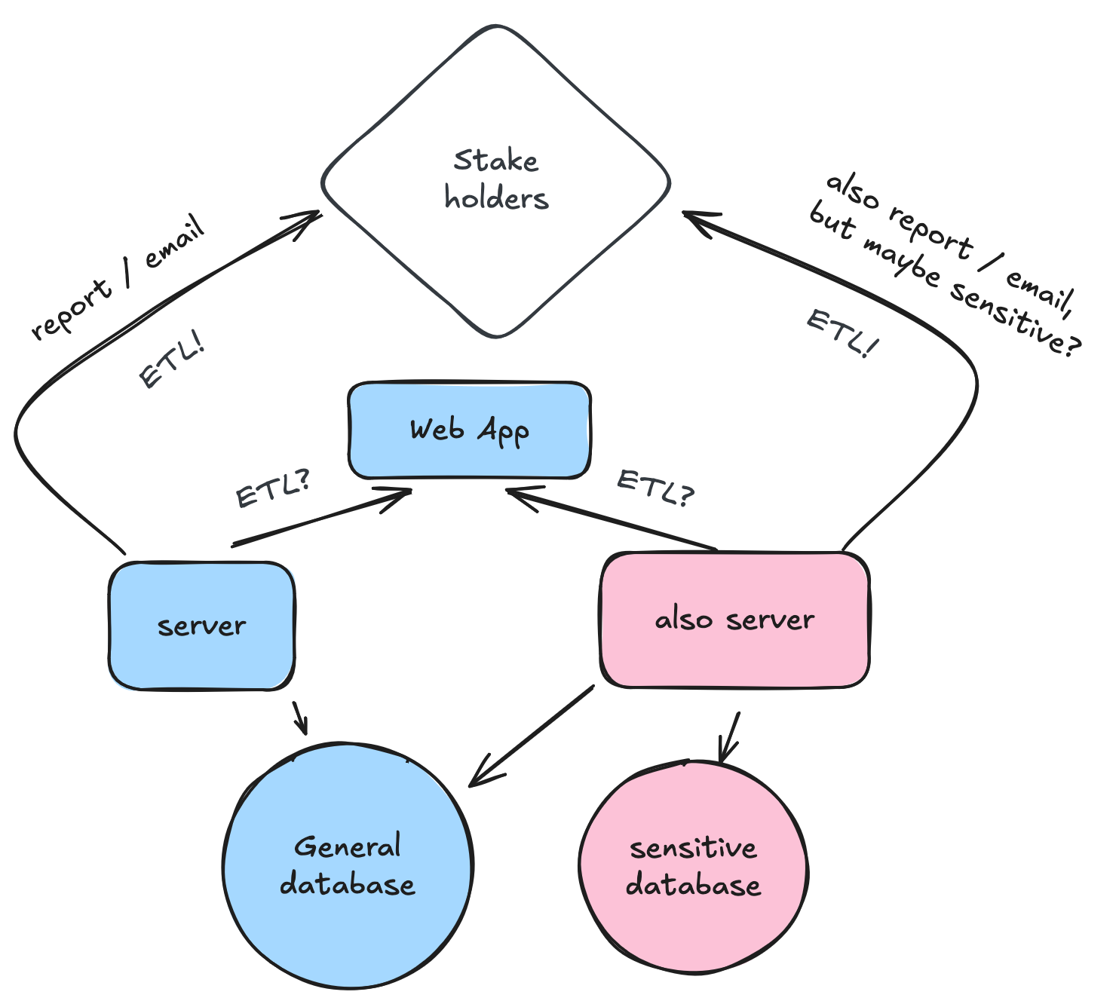
air why?
Two servers is pretty simple, but what are some reasons you may add a server into this mix? (hint: something to do with the programming language you use)
how many linux servers can you guess a medium to large size company has? (for all of my services, I have roughly 8… these are all just for me!!)

Slide 8
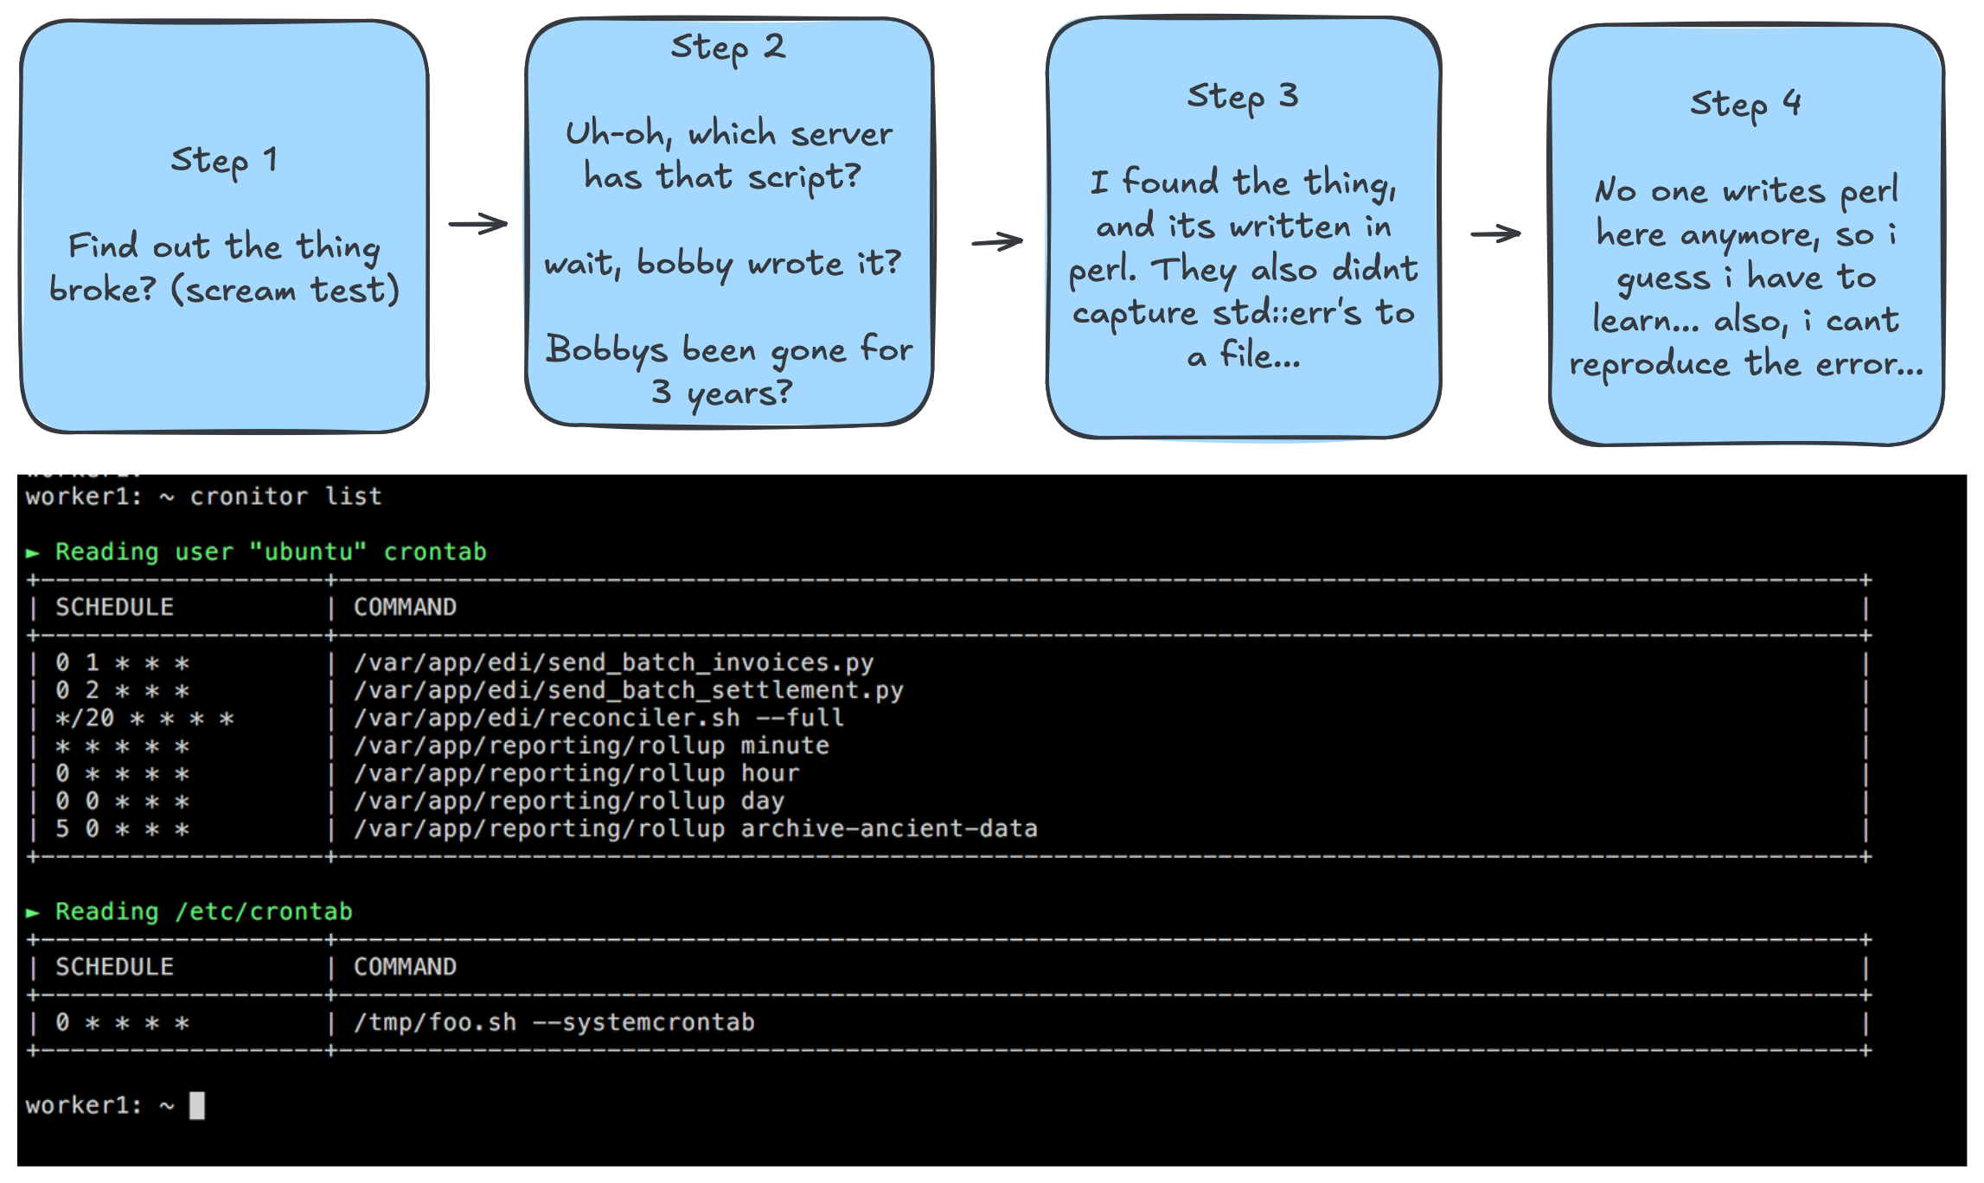
air why?

Slide 9
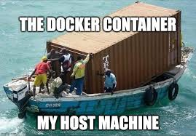
air how

Slide 10

air how

Slide 11
If I havent actually shown you the configuration and dashboard by now, I should do that now… :)

Slide 12
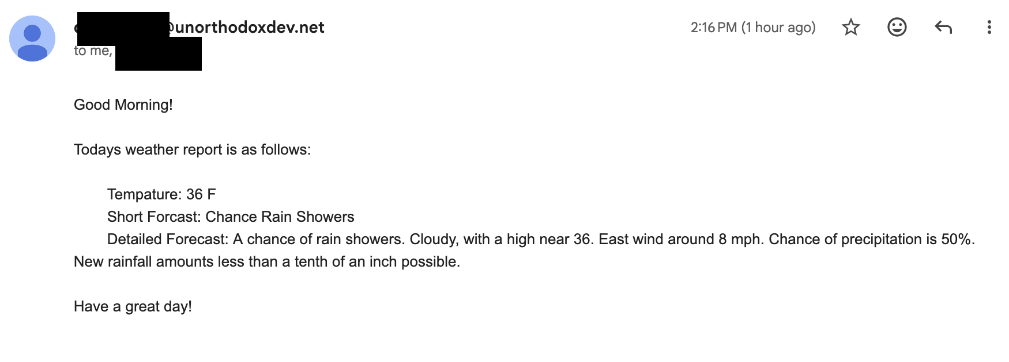

Slide 13
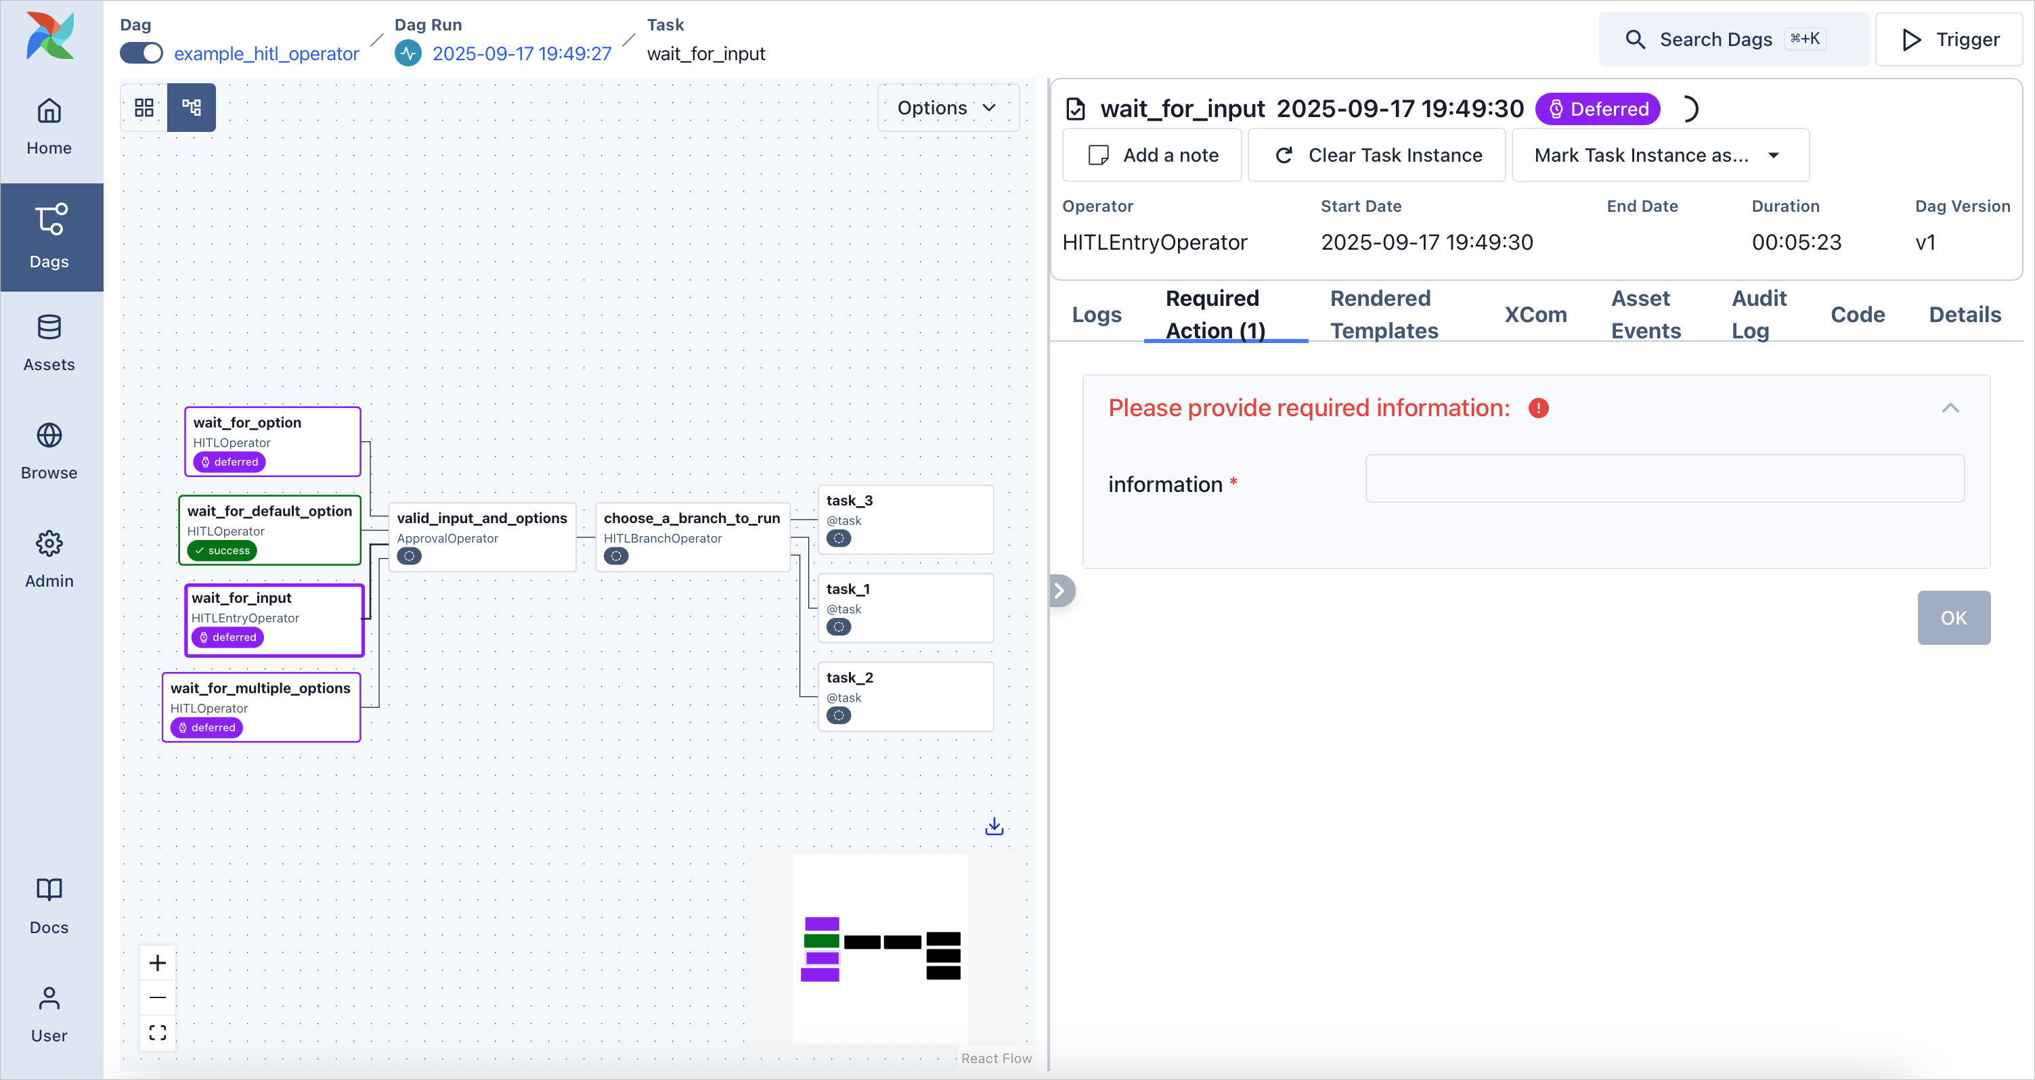
HITL

Slide 14
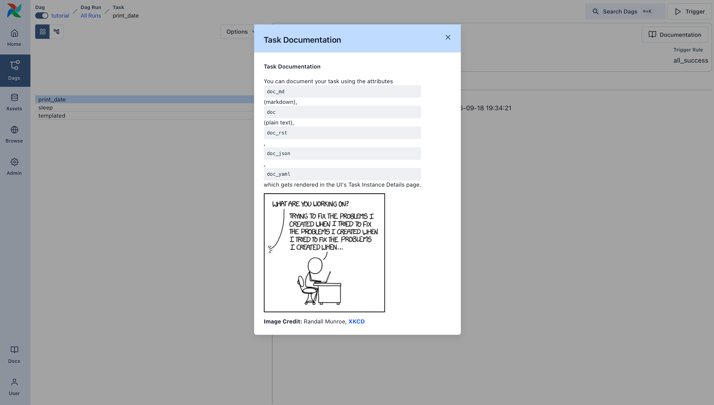
HITL

Slide 15
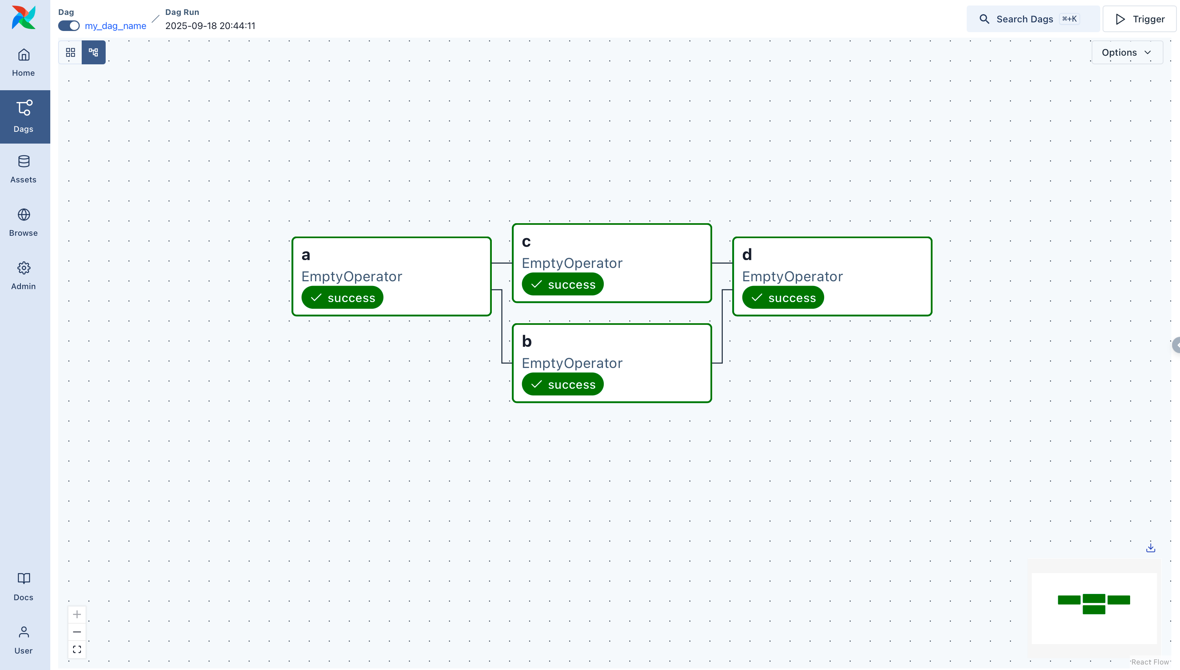

Slide 16
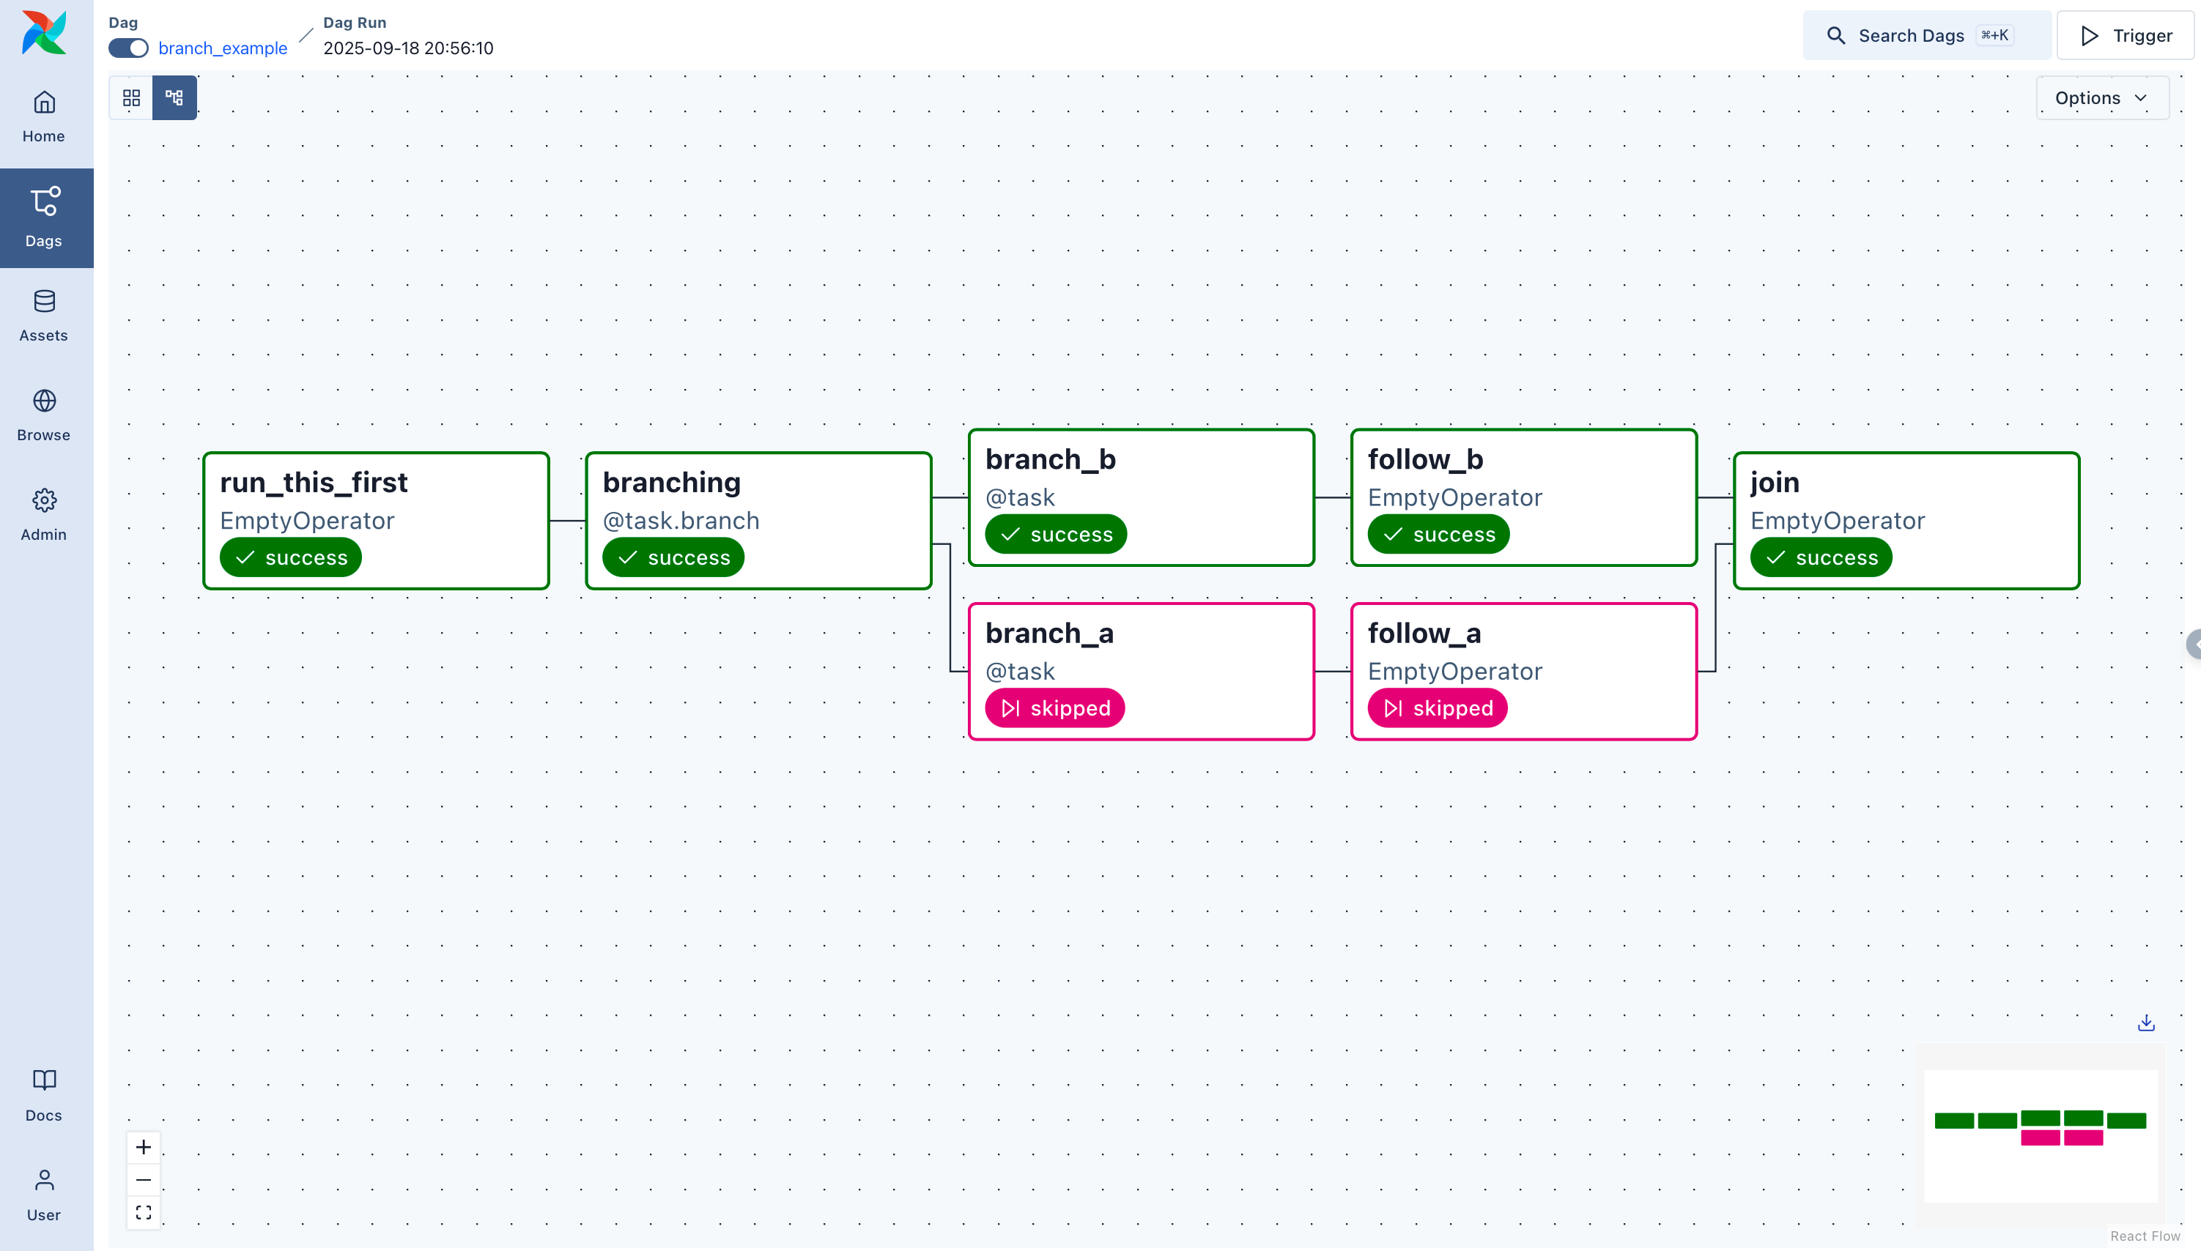

Slide 17


Questions?
Write Up
Repo

