Slide 1
YOLO Tumour Segmentation — Pipeline Overview
BraTS whole-tumour segmentation on axial MRI slices, fine-tuned YOLO11n-seg
1. Patient split
1,621 labeled patients -> train 60% / val 20% / test 20%, by patient (seed=42)
2. RGB frame per slice
R = T1C-T1 (uptake) G = T2 B = FLAIR -> 512x512 image
3. Labels from expert mask
seg>0 -> connected components -> polygons -> YOLO-seg .txt
4. Train yolo11n-seg
Ultralytics fine-tune on train/val, 25 epochs, imgsz 512
5. Evaluate on held-out test
Dice = 2|pred (cap) gt| / (|pred|+|gt|) -> mean Dice per patient
6. Web UI
Flask /yolo blueprint renders GT vs. prediction overlay + Dice tables
Code: YOLO/pipeline.py, train.py, evaluate.py, render.py, routes.py

Slide 2
Dataset & Patient Split
All patients are labeled (expert -seg mask) — split by patient, never by slice
1,621
Total labeled patients
973
Train (60%)
324
Validation (20%)
324
Test (20%, held out)
Source pools (config.yaml -> paths.extract_to):
• training_data1_v2 — 1,350 patients
• training_data_additional — 271 patients
Split logic (pipeline.split_patients):
• Deterministic shuffle, seed = 42 — reproducible across runs
• Split by patient (all slices of one patient stay in one split) — avoids data leakage
• Train + val used for fine-tuning yolo11n-seg; test is never trained on
• Test split = the web UI's patient list; every Dice shown there is on unseen patients

Slide 3
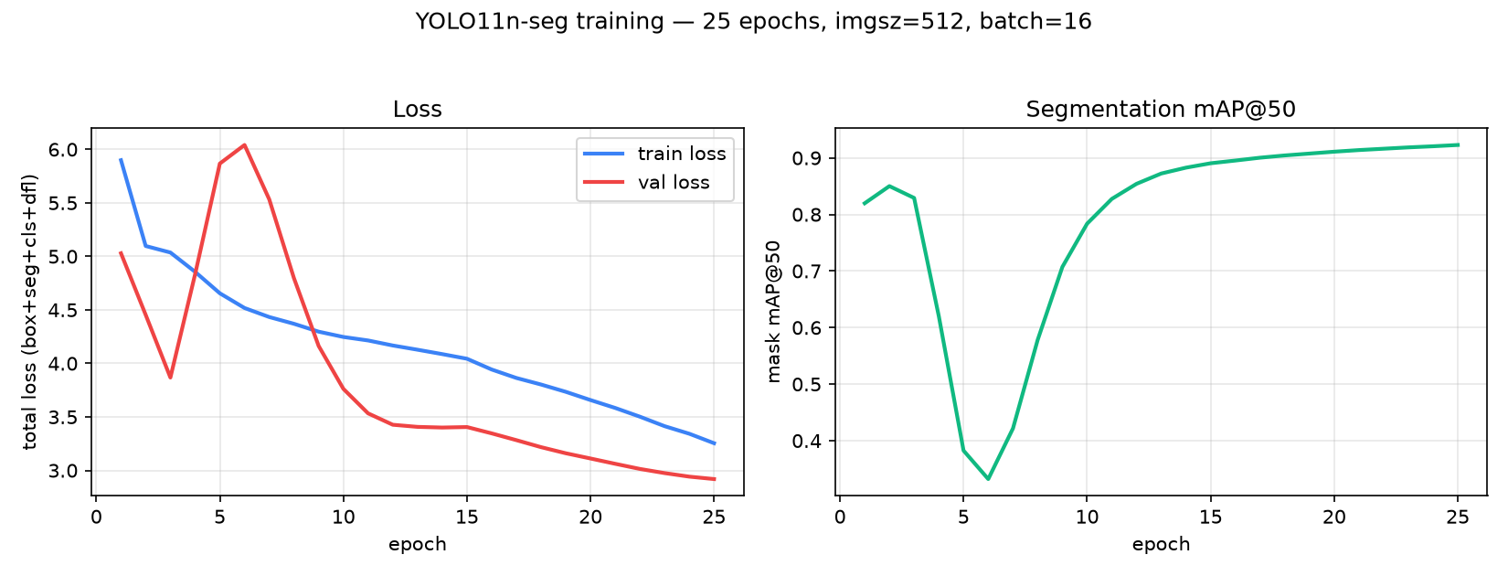
Training Results — Current Best Checkpoint
best_20260821-013417_valloss2p9192_testdice0p8662.pt
0.866
Mean test Dice
2.919
Best val loss (total)
324
Test patients evaluated
Epochs: 25
Image size: 512
Batch size: 16
Base model: yolo11n-seg.pt (COCO pretrained)
Loss = box + seg + cls + dfl (Ultralytics results.csv). mAP@50 computed on the validation split.

Slide 4
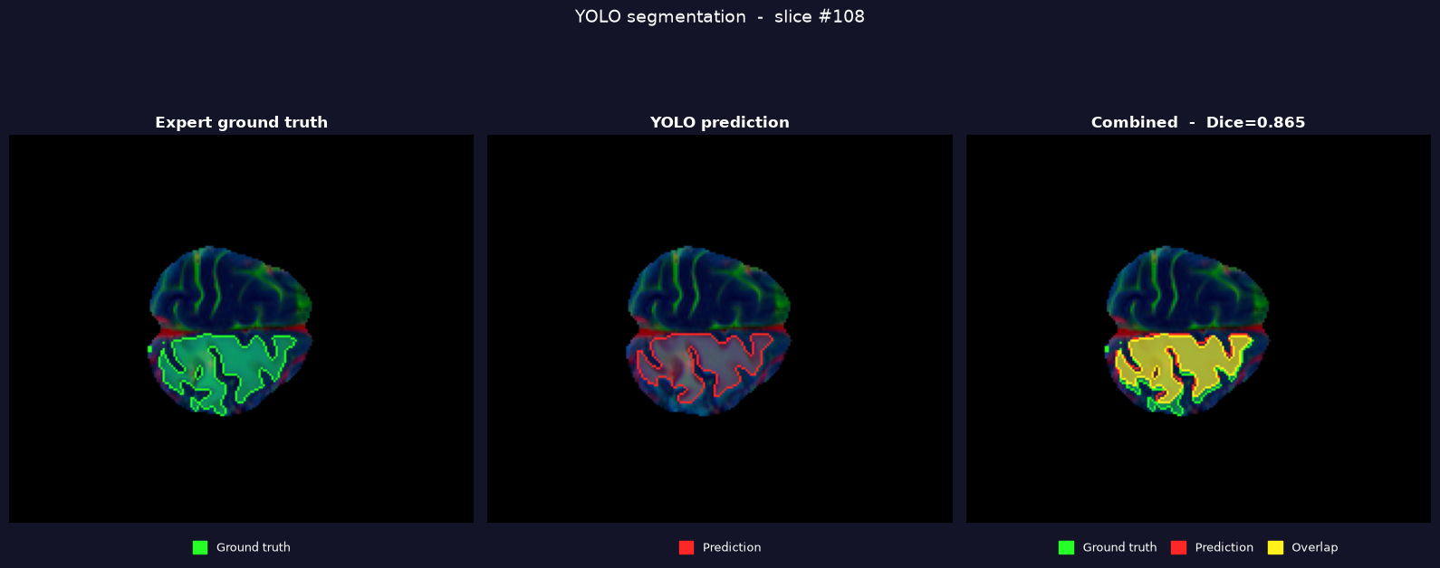
Segmentation Result — Ground Truth vs. Prediction
Rendered by render.py using the checkpoint above, on a held-out test-split patient
Patient BraTS-GLI-02141-101 (test split, unseen during training) — patient mean Dice 0.867, close to the overall test mean of 0.866 across 324 patients.
Green = expert ground truth • Red = YOLO prediction • Yellow = overlap

