Slide 1
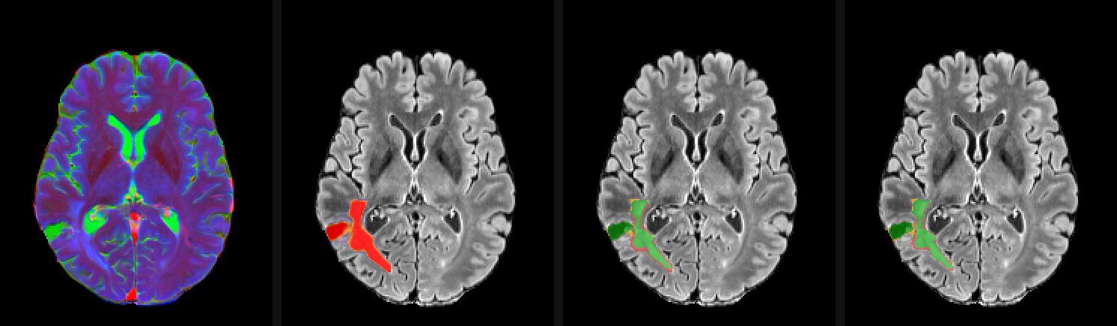
CLASS PROJECT · OCTOBER 2026
Brain Tumour Segmentation on MRI with YOLO + MedSAM2
A fast 2D detector finds the tumour; a promptable video model refines it in 3D. BraTS 2024 adult glioma, 1,621 MRI scans.
One slice: the MRI picture · YOLO's hint · YOLO's own mask · MedSAM2's answer (green = found, red = extra)
Presented by: ______________
Notes:
SUMMARY: Introduces the project: segmenting brain tumours on MRI by combining YOLO and MedSAM2.
KEY TAKEAWAY: We combine a fast 2D detector with a 3D-aware promptable model to outline brain tumours.
- The picture shows the whole pipeline on one slice, left to right.

Slide 2
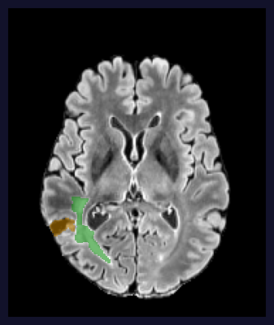
BACKGROUND
Why segment brain tumours automatically?
• Gliomas are the most common malignant primary brain tumours in adults.
• Doctors outline the tumour on MRI to plan surgery and radiotherapy and to track change between scans.
• Outlining by hand is slow: a scan has well over a hundred slices, each drawn separately.
• Experts don't agree perfectly with each other, so outlines vary between readers.
• Automation goal: a fast, consistent 3D outline a doctor only needs to check.
An expert outline on FLAIR (green = swelling, yellow = surgery cavity)
Key takeaway: Automatic 3D segmentation saves expert time and makes tumour measurements consistent.
2 / 15
Notes:
SUMMARY: Explains the clinical need for automatic tumour outlining.
KEY TAKEAWAY: Automatic 3D segmentation saves expert time and makes tumour measurements consistent.
- Manual contouring is the bottleneck; variability between experts limits how 'perfect' any model can look.

Slide 3
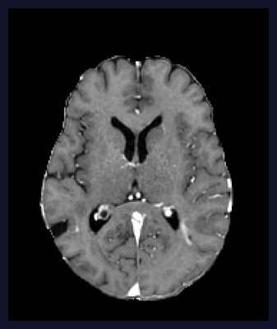
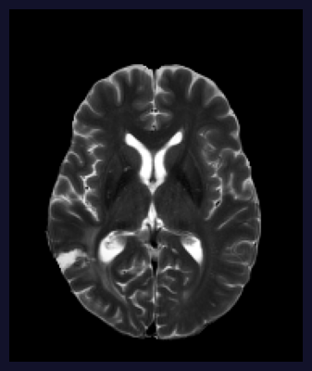
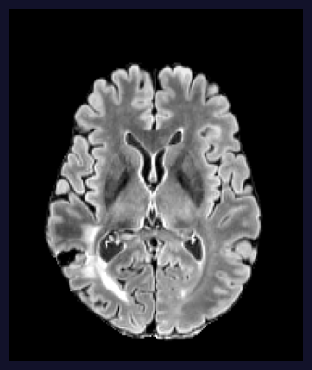
BACKGROUND
MRI sequences and the BraTS 2024 data
How we score: 3D Dice
Dice = 2 × overlap ÷ (model + expert)
0 = no overlap, 1 = perfect
Computed per patient over the whole 3D volume, then averaged.
Each sequence shows the tumour differently, so we feed three of them (T1C, T2, FLAIR) as one colour picture.
T1C (with contrast)
T2
FLAIR
FLAIR + expert labels
• Each scan: 4 MRI sequences, 182 × 218 × 182 voxels of 1 mm³ (1,000 voxels = 1 mL).
• Experts label 4 parts: NETC dead core, SNFH swelling, ET enhancing tumour, RC surgery cavity.
• Our target: the whole tumour = all labelled parts together.
Key takeaway: Different MRI sequences show different tumour parts; we score the whole-tumour outline with 3D Dice.
3 / 15
Notes:
SUMMARY: Shows the MRI sequences, the four labelled tumour parts and how results are scored.
KEY TAKEAWAY: Different MRI sequences show different tumour parts; we score the whole-tumour outline with 3D Dice.
- 85% of the scans are post-operative (they contain a surgery cavity).

Slide 4
BACKGROUND
Two models with different strengths
YOLO11-seg (Ultralytics)
SAM2 → MedSAM2
• Fast object detector that also draws a mask for each shape it finds.
• Works on one 2D slice at a time, no knowledge of neighbouring slices.
• Gives a confidence for every shape (0–1).
• We use the medium model (yolo11m-seg), pretrained on everyday photos.
• Segment Anything 2 (Meta): outlines an object from a prompt (point, box or mask).
• Treats a 3D scan like a video: remembers the slices it already did.
• MedSAM2 = SAM2 further trained on medical images and scans.
• 39 M weights: image encoder 70%, memory 19%, mask decoder 11%, prompt encoder <0.1%.
Key takeaway: YOLO is good at finding the tumour on a slice; MedSAM2 can refine it using the slices around it.
4 / 15
Notes:
SUMMARY: Introduces the two models and why they complement each other.
KEY TAKEAWAY: YOLO is good at finding the tumour on a slice; MedSAM2 can refine it using the slices around it.
- Weight counts measured on the actual checkpoint: 38,962,498 in total.

Slide 5
THE PROJECT
Research question and ground rules
Can MedSAM2, prompted by YOLO on every slice, outline the whole tumour better than YOLO alone (3D Dice)?
Ground rules
  The expert mask is never shown to a model when it predicts.
  Settings are chosen on validation pools; test is scored once.
  Patients are split by person, never by scan.
  We compare against YOLO's own best setup, not a weak baseline.
What we built
  A fine-tuned YOLO (stage 1).
  A fine-tuned MedSAM2 that reads YOLO's hints (stage 2).
  An interactive web app to explore the data and every result.
Key takeaway: A fair two-stage test: does adding MedSAM2 beat the best YOLO we could build?
5 / 15
Notes:
SUMMARY: States the research question and the rules that keep the comparison fair.
KEY TAKEAWAY: A fair two-stage test: does adding MedSAM2 beat the best YOLO we could build?

Slide 6
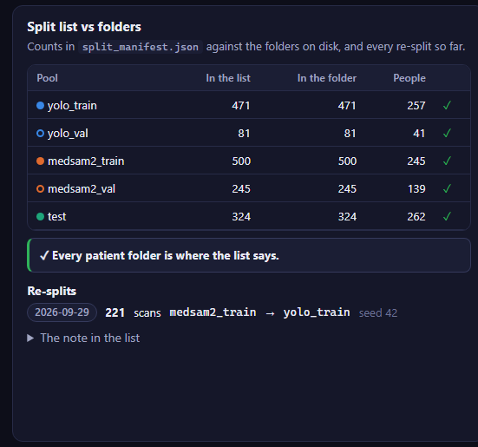
DATA
Data: 1,621 scans from 731 people, split by person
• Five pools: YOLO train 471 · YOLO val 81 · MedSAM2 train 500 · MedSAM2 val 245 · test 324 scans.
• No person is in both a YOLO pool and a MedSAM2 pool, so MedSAM2 trains on hints YOLO made for people it never saw, like real use.
• Pool sizes set by learning curves: MedSAM2 barely improved past 500 patients (250 → 500 → 721: 0.884 → 0.886 → 0.886), while YOLO still gained from more data.
• Caveat: test shares some people (other scans) with training pools, from the original split; kept so all test scores stay comparable.
Key takeaway: Keeping the two models' people apart makes MedSAM2's training hints realistic.
6 / 15
Notes:
SUMMARY: Shows how the data was split into five pools and why.
KEY TAKEAWAY: Keeping the two models' people apart makes MedSAM2's training hints realistic.
- 221 scans were moved from MedSAM2 train to YOLO train on 2026-09-29 after the learning curves.

Slide 7
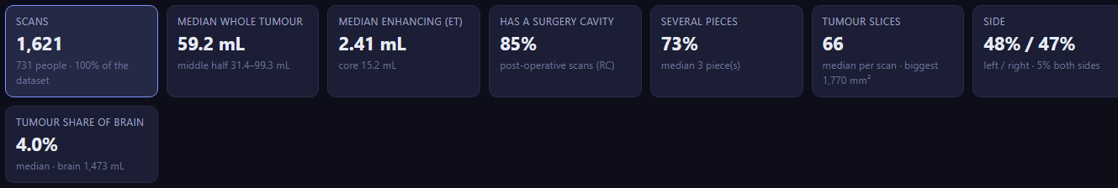
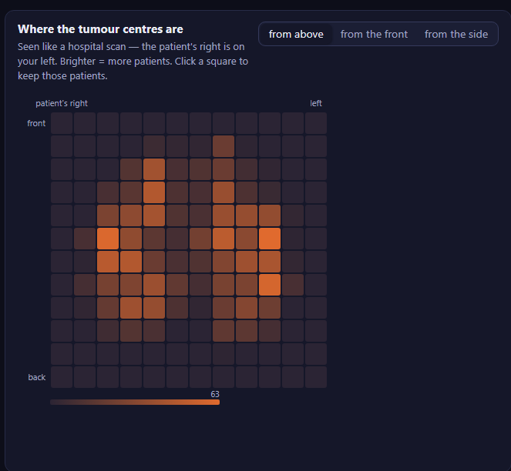
DATA
Knowing the data: an interactive analytics app
• 4 pages: Analytics, Results, YOLO, MedSAM2; every chart filters the others.
• Median tumour 59 mL; 85% of scans are after surgery; 73% have several separate pieces.
• Tumours split evenly between the left (48%) and right (47%) brain.
• Used to check the split, find unusual patients and see where each model fails.
Key takeaway: Understanding sizes, sides and pieces explained where the models struggle.
7 / 15
Notes:
SUMMARY: Presents the web app built to explore the dataset and the results.
KEY TAKEAWAY: Understanding sizes, sides and pieces explained where the models struggle.
- Heat map: where tumour centres are, seen from above (patient's right on the viewer's left).

Slide 8
METHOD
The pipeline: YOLO finds, MedSAM2 refines
MRI slices
YOLO11-seg
Hint map
MedSAM2
Mirror check
Final 3D mask
T1C · T2 · FLAIR
as one colour picture
every slice, shapes
with confidence ≥ 0.05
probability → logit × 8
empty / outside head = 'no'
start slice, then up & down
memory: start + last 6
run on the mirrored patient
and average
> 50% = tumour
drop pieces < 100 voxels
• Stage 1 (YOLO) runs once per patient; its hint maps are saved.
• Stage 2 (MedSAM2) gets the picture and YOLO's hint on every slice, plus its memory of the slices it just did.
• Only at the very end is the 3D mask compared with the expert's (3D Dice).
Key takeaway: MedSAM2 doesn't search from scratch; it corrects YOLO's guess using the neighbouring slices.
8 / 15
Notes:
SUMMARY: Walks through the full inference pipeline from MRI slices to the final 3D mask.
KEY TAKEAWAY: MedSAM2 doesn't search from scratch; it corrects YOLO's guess using the neighbouring slices.
- Start slice = the slice where YOLO is most confident (area × score).
- Mirror check: the mirrored copy runs in the same batch, so it costs almost nothing.

Slide 9
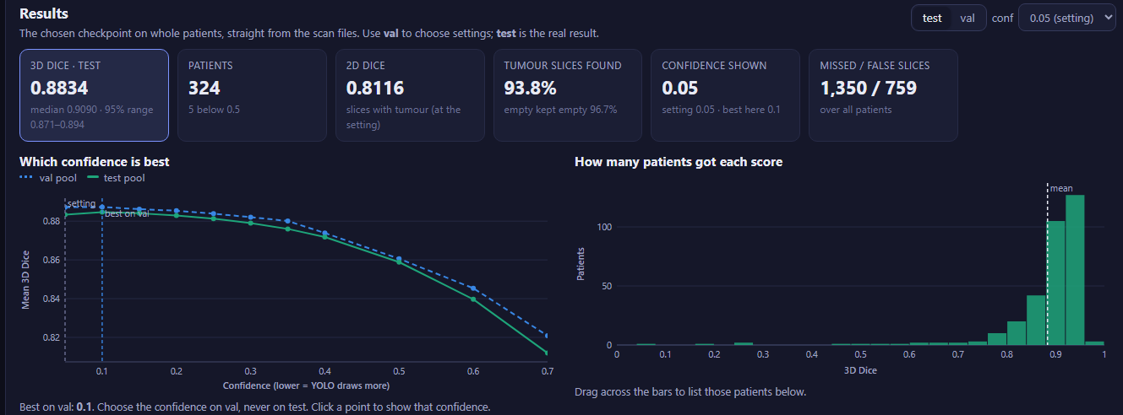
METHOD · RESULTS
Stage 1: fine-tuning YOLO
• yolo11m-seg at 512 px, trained on the slices of 471 scans, including empty ones (teaches when to draw nothing).
• Best round picked on YOLO val; stopped early at round 32 of 60.
• Extras when predicting: confidence 0.05, mirror averaging, remove pieces < 200 voxels (+0.006 on val).
• Test 3D Dice 0.8834 (median 0.909); found 93.8% of tumour slices.
Key takeaway: A strong 2D baseline: 0.883 3D Dice on 324 unseen test patients.
9 / 15
Notes:
SUMMARY: Describes how YOLO was fine-tuned and how well it does on its own.
KEY TAKEAWAY: A strong 2D baseline: 0.883 3D Dice on 324 unseen test patients.
- The confidence chart shows lower confidence = more drawn = better 3D Dice, up to 0.05–0.1.

Slide 10
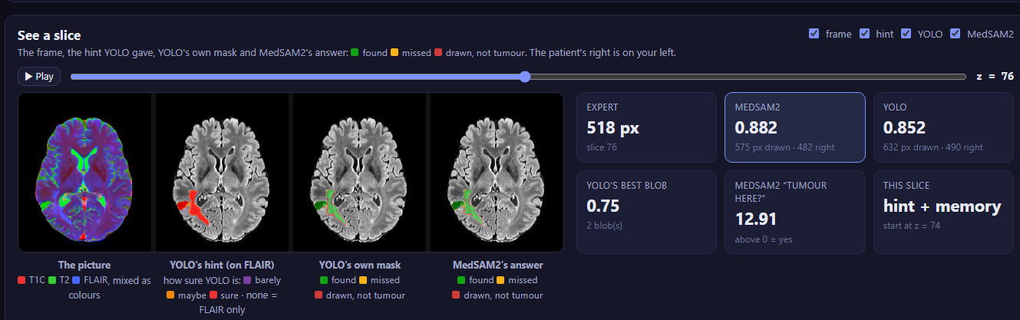
METHOD
Stage 2: turning YOLO's output into a MedSAM2 hint
• Hint = YOLO's probability per pixel from every shape at confidence ≥ 0.05.
• Turned into a logit × 8 (−44 … +44): MedSAM2's own scale, where 0 = 50%.
• Empty slices and outside the head get a firm 'nothing here' (−20).
• Every slice is hinted; memory carries the start slice + the last 6 slices.
Key takeaway: YOLO's soft guess plus 3D memory lets MedSAM2 fix single-slice mistakes.
10 / 15
Notes:
SUMMARY: Explains how YOLO's output becomes the prompt MedSAM2 reads on every slice.
KEY TAKEAWAY: YOLO's soft guess plus 3D memory lets MedSAM2 fix single-slice mistakes.
- Picture (left to right): input picture, YOLO's hint, YOLO's own mask, MedSAM2's answer.
- YOLO's own mask uses only shapes ≥ 0.25 and pixels > 50%; it is only for comparison.

Slide 11
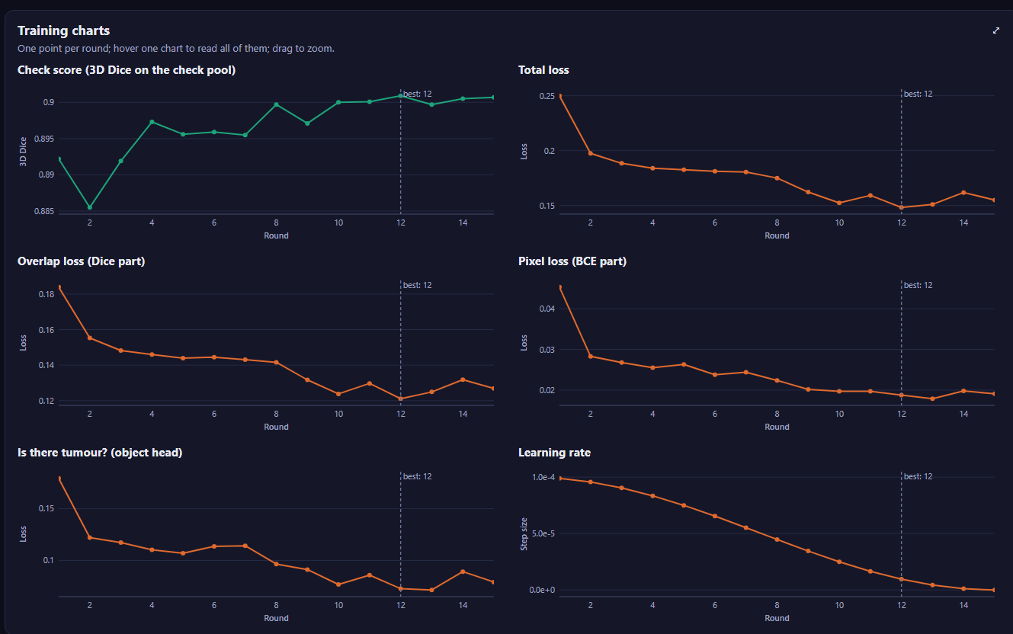
METHOD
Training MedSAM2 to fix, not copy
• 500 training scans, clips of 8 slices, 15 rounds; best round checked on 80 val scans.
• Trained: mask decoder + prompt encoder (lr 1e-4) and memory (1e-5) = 11.7 M weights (30%).
• Frozen: the image encoder (70% of weights); training it too gave no gain.
• 30% of training hints damaged on purpose (dropped, shifted, grown, shrunk) while the answer stays the expert's.
• Loss: Dice + cross-entropy (+ small IoU and object terms).
Key takeaway: Train only the small parts that read the hint and carry memory; keep the big image encoder frozen.
11 / 15
Notes:
SUMMARY: Explains what parts of MedSAM2 are trained and how training teaches correction.
KEY TAKEAWAY: Train only the small parts that read the hint and carry memory; keep the big image encoder frozen.
- Check score levels off around round 10 at about 0.90.

Slide 12
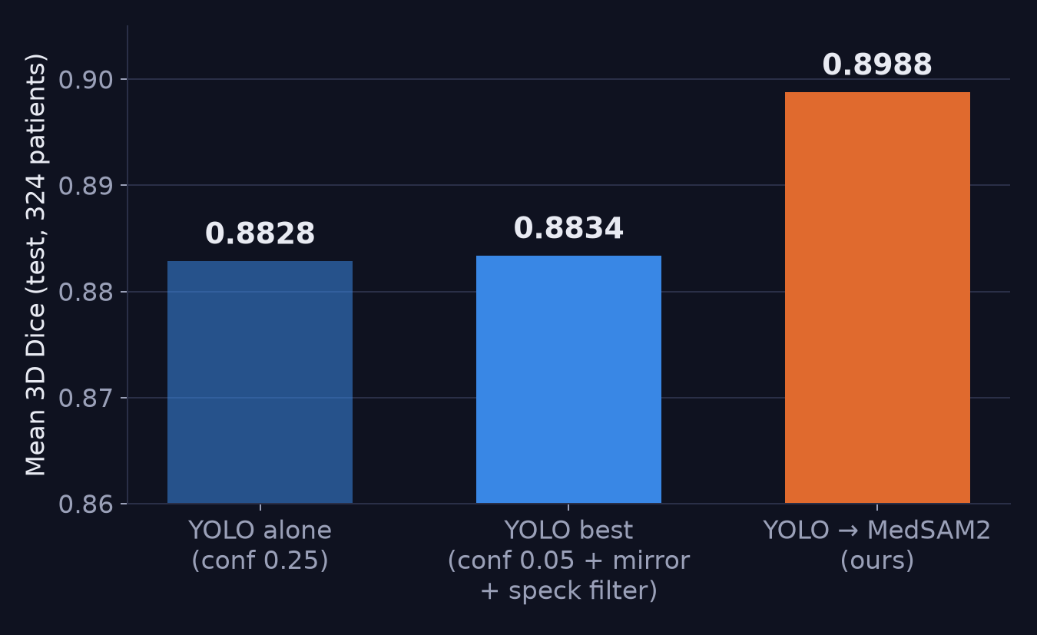
RESULTS
Results: MedSAM2 beats YOLO's best on test
• 0.8988 vs 0.8834 mean 3D Dice on the same 324 test patients.
• Gain +0.0154 (95% CI +0.012 … +0.019); Wilcoxon p < 10⁻³³.
• 185 patients better, 18 worse (by more than 0.01); the rest about the same.
• Found 96.9% of tumour slices and kept 96.4% of empty slices empty.
• Settings were picked on val; test was scored once.
Key takeaway: Adding MedSAM2 gives a consistent, statistically clear gain over the best YOLO.
12 / 15
Notes:
SUMMARY: Presents the final test results against YOLO's best setup.
KEY TAKEAWAY: Adding MedSAM2 gives a consistent, statistically clear gain over the best YOLO.
- The fair comparison is against 'YOLO best' (0.8834), not 'YOLO alone' (0.8828).

Slide 13
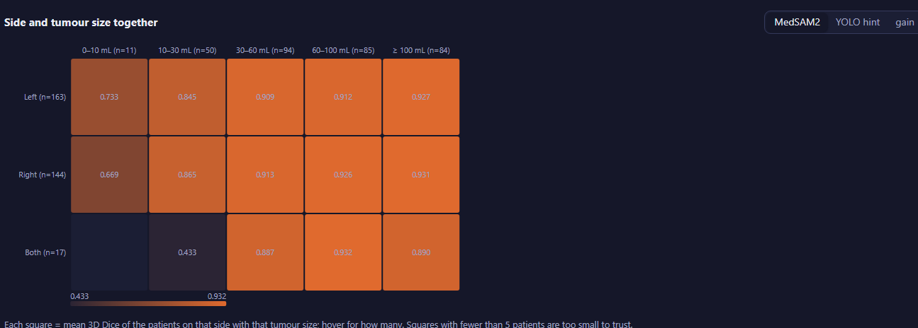
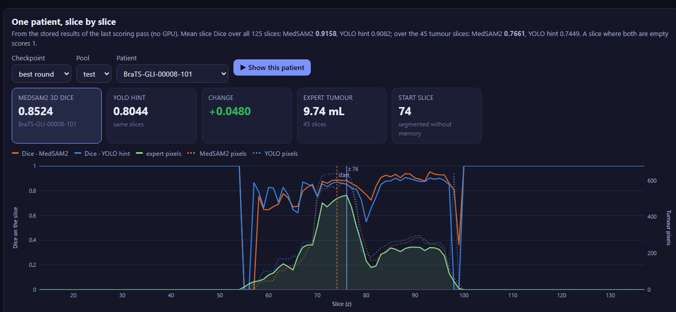
RESULTS
Where it works, and where it struggles
• Size matters, side doesn't: about 0.67–0.73 for tumours under 10 mL vs about 0.93 for 100 mL and up; left ≈ right.
• The biggest gains over YOLO are on small tumours.
• Slice by slice (bottom): MedSAM2 follows the tumour through memory and rejects YOLO's isolated false alarms.
• Few patients in some groups (e.g. 'both sides': 17), so those squares are noisy.
Mean MedSAM2 3D Dice by side (rows) and tumour size (columns), test
Key takeaway: Tiny tumours remain the weak spot, and they are where MedSAM2 helps most.
13 / 15
Notes:
SUMMARY: Breaks results down by tumour size and side and shows one patient slice by slice.
KEY TAKEAWAY: Tiny tumours remain the weak spot, and they are where MedSAM2 helps most.

Slide 14
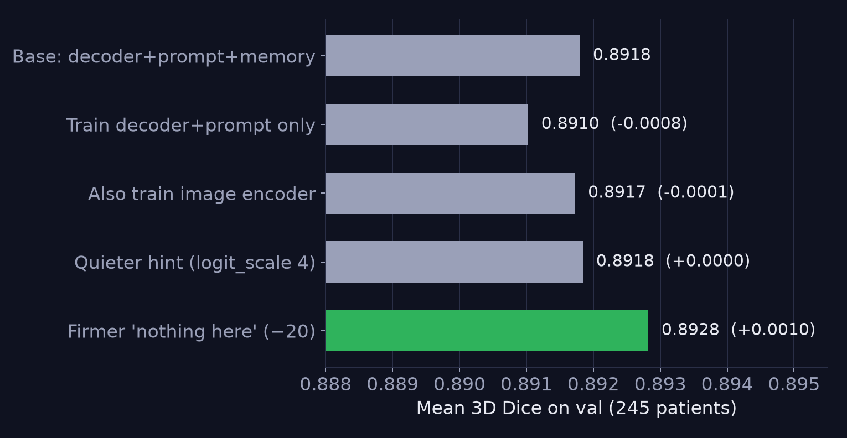
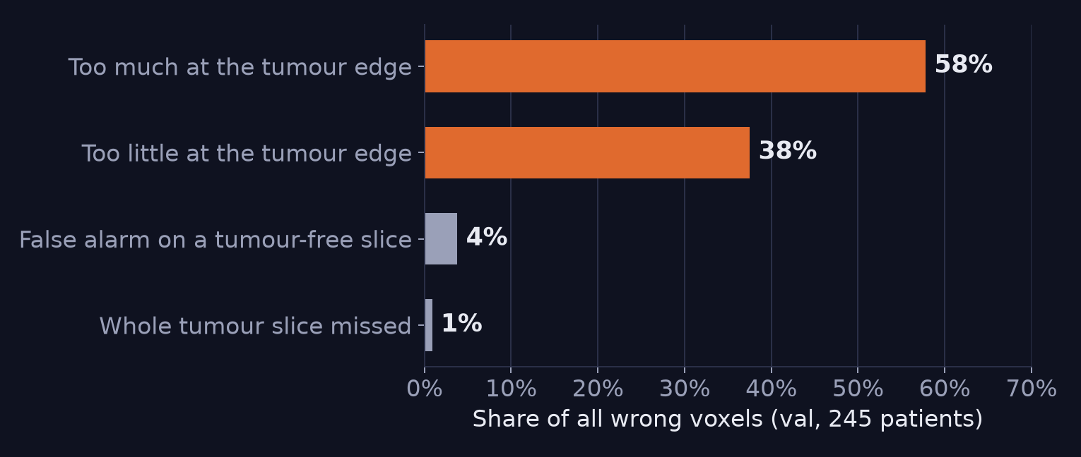
EXPERIMENTS
What we tried and what we learned
Where the remaining wrong voxels are (val)
Settings experiments (val): only the green change was statistically real
• First design (only the start slice prompted, plus extra correction rounds) made things worse than YOLO (0.856 vs 0.864, val); hinting every slice fixed it.
• Most settings changes moved Dice by ≤ 0.001: 96% of the remaining error is at the tumour edge, not in finding the tumour.
Key takeaway: Design mattered more than tuning; what's left to win is edge precision.
14 / 15
Notes:
SUMMARY: Summarises the experiments: the redesign that worked, tuning results, and where errors remain.
KEY TAKEAWAY: Design mattered more than tuning; what's left to win is edge precision.
- The old-design numbers were on the earlier pools, so they are compared within that setup only.

Slide 15
NEXT STEPS
Future work
Sharper edges
Better hints & small tumours
Beyond this project
• Average several trained MedSAM2 runs (an ensemble), with no new training.
• Edge-focused training loss; finer output resolution.
• Weigh hint pixels by shape confidence ('max_weighted').
• Give YOLO 3D context; focus on tumours under 10 mL.
• Predict the tumour parts (ET, NETC, SNFH), not only the whole tumour.
• Test on other hospitals' scans; remove the test/train people overlap; measure speed.
Key takeaway: Next gains come from sharper edges and small tumours, then proving it on outside data.
15 / 15
Notes:
SUMMARY: Lists the most promising next steps and the wider follow-ups.
KEY TAKEAWAY: Next gains come from sharper edges and small tumours, then proving it on outside data.
- Experts themselves don't agree perfectly, so expect small gains from here.

