Slide 1
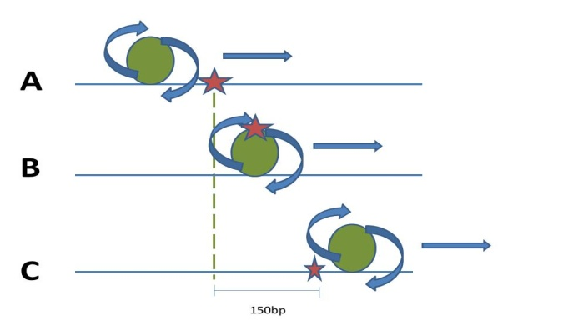
A.
UV-C
C.
A0
A0
Nucleus
expansion
B.
D.
A(u)
1
2
3
Nucleus
UV lesion
Repair protein
DNA
nucleosome

