Slide 1
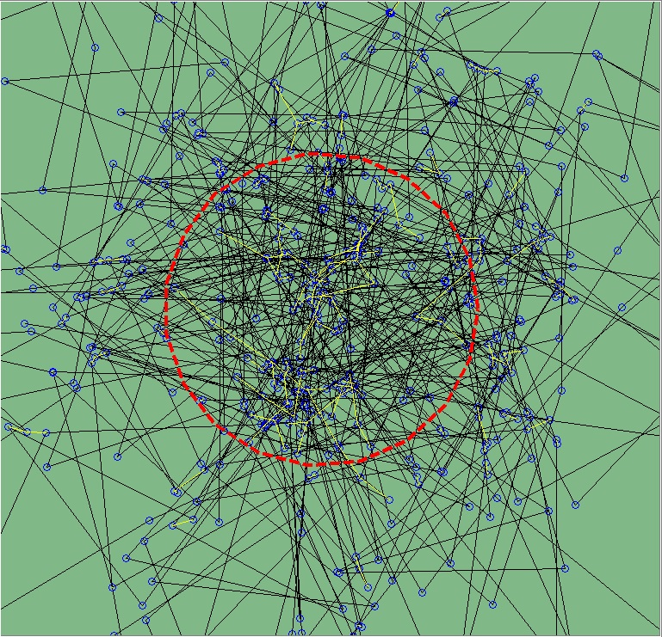
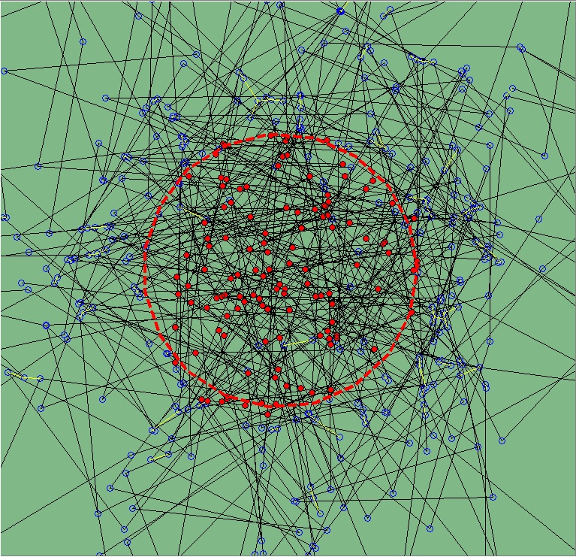
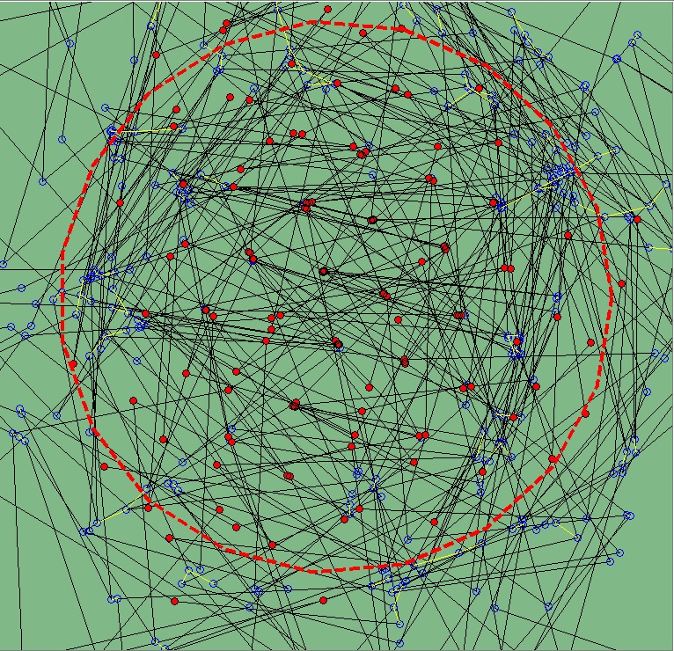
A.
B.
C.
Figure 1: Stages in the Simulation of chromatin spatial organization post UV-C irradiation. A. a Rouse chain of 500 monomers (circles) connected by harmonic spring (black lines) with a minimal length L0 is crossed-linked by harmonic springs (dashed lines in box) is simulated up to relaxation time, at which point a UV-C beam is vertically shot through a circular damage region (red dashed circle) around the polymer’s center-of-mass. B. damaged monomers (red circles) are set to be distributed uniformly for each UV dose. Following UV-C irradiation, cross-links (dashed lines in box) to and from damaged monomers are removed. C. crowding of repair proteins is simulated by regions of exclusion centered around each damaged monomer. An elastic pushing force is applied to surrounding monomers with a maximal affect radius of rp. As a result, the damage region expands until reaching its maximal size 15 minutes post UV-C. The Region of Interest (ROI) is then determined as the circles containing 90% of the damaged monomers (dashed red circle).

